Slide 2

ESR 06 WP2: Integrated Time-based Signal Processing Circuits for Harsh Radiation Environments
RADSAGA Training Workshop – March 2018
Presented by Arijit Karmakar
Doctoral Student
KU Leuven, ADVISE Group

Slide 3
ESR 06 WP2: Integrated Time-based Signal Processing Circuits for Harsh Radiation Environments
Supervisor: Prof. Paul Leroux (KU Leuven), Co-supervisor: Prof. Valentijn De Smedt (KU Leuven)
Project Deliverable & Milestones Lists:
Report on technology selection and architecture definition.
Report on the design and measurement of a radiation tolerant Time-to-Digital Converter.
Report on the design and measurement of a radiation tolerant time based sensor readout circuit.
Completed development of a radiation tolerant time based sensor readout circuit.
Planned Secondments [total: 8 months]:
Magic Instruments (Dr. Y. Cao)[2m] For support in design and manufacturing of component.
SCK•CEN (Dr W. de Cock): [2m] For neutron and gamma irradiation testing.
CERN (Dr S. Danzeca): [2m] For mixed field radiation testing at CHARM.
University of Montpellier (Dr V. Pouget): [2m] For SEE laser testing and hardening techniques.

Slide 4

Which One?
Ionizing Radiation!!
Ionizing
Thermal
Electromagnetic

Slide 5
Radiation Affected Areas
Transpor-tation
Medical
Accelera-tors
Aviation
Space
Industrial

Slide 6
General Sensing Interface
Physical Information
Electrical Information
SENSOR
INTERFACE
Temperature
Humidity
Pressure
Acceleration
etc.
SENSOR
Voltage
Current
Capacitance
Resistance
etc.
DIGITAL
CONDITIONING CIRCUITRY
INFORMATION
-to-
DIGITAL
Ref: Time-Based Energy-Efficient Sensor Interface Circuits, PhD Thesis, J Van Rethy, 2014

Slide 7
General Sensing Interface
SENSOR
INTERFACE
SENSOR
DIGITAL
CONDITIONING CIRCUITRY
INFORMATION
-to-
DIGITAL
Sensor
-to-
Amplitude
Amplitude
-to-
Digital
Digital
Processing
Sensor
-to-
Time
Time
-to-
Digital
Ref: Time-Based Energy-Efficient Sensor Interface Circuits, PhD Thesis, J Van Rethy, 2014

Slide 8




Amplitude vs Time-based Conditioning Circuits
Analog-to-Digital
Convertor
Time-to-Digital
Convertor
As Technology Scales…
A
D
D
Voltage Resolution $↓$
Timing Resolution $↑$
A
D
D
TDCs provides Low-power , Area-efficient and Better Dynamic Range compared to ADCs.
Ref: Time-Based Energy-Efficient Sensor Interface Circuits, PhD Thesis, J Van Rethy, 2014

Slide 9
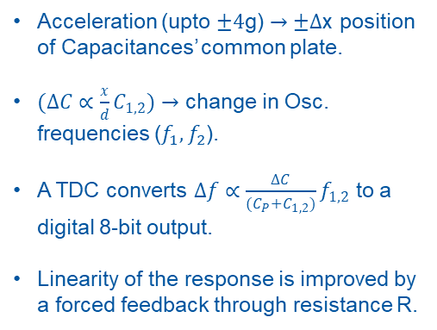
Rad-hard MEMS Accelerometer Readout Interface
HPF
Acceleration (upto $±4$g) $→±Δ$x position of Capacitances’ common plate.
$(ΔC∝\frac{x}{d}C_{1,2})→$ change in Osc. frequencies ($f_{1},f_{2}$).
A TDC converts $Δf∝\frac{ΔC}{(C_{P}+C_{1,2})}f_{1,2}$ to a digital 8-bit output.
Linearity of the response is improved by a forced feedback through resistance R.
Ref. Clk.
Cp
L
0
8-bit
TDC
Digital O/P
C1
90
LPF
16
Quadrature Osc.
Mixer
2-bit
Frequency Change
Detector
Cp
L
0
LPF
2
C2
90
Mixer
Accelerometer
Quadrature Osc.
+K
R
-K

Slide 10
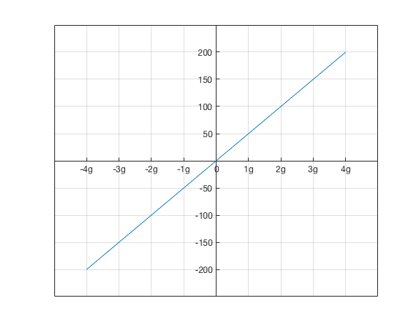
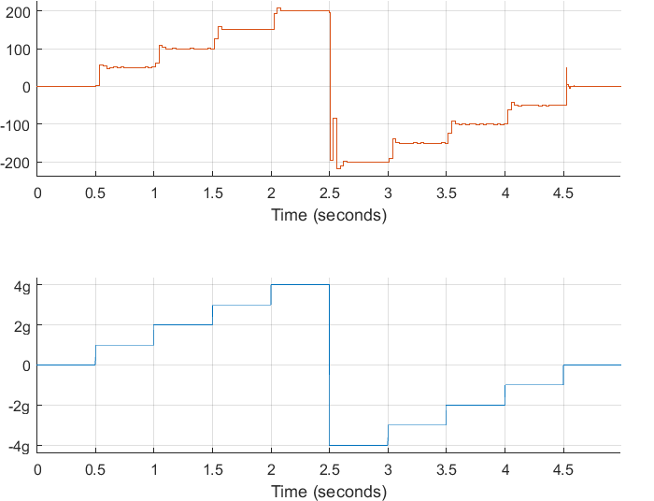
Rad-hard MEMS Accelerometer Readout Interface
Transfer Characteristics
Transient Response
Digital O/P
Digital O/P
Acceleration
Acceleration

Slide 11
Thank you
Questions?
Contact me
arijit.karmakar@kuleuven.be

