Slide 2
ESR 15
Andrea Coronetti
Prospective activities for year 2018
RADSAGA Training Workshop – March 2018

Slide 3
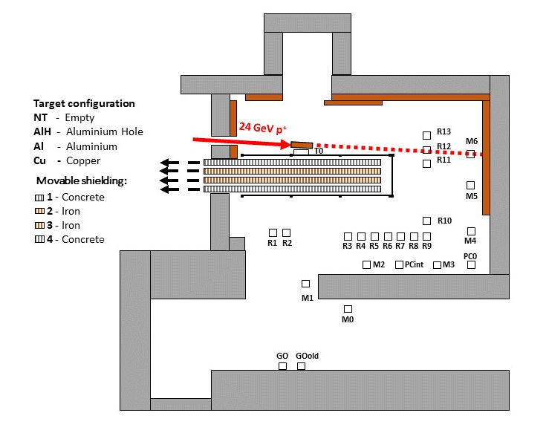
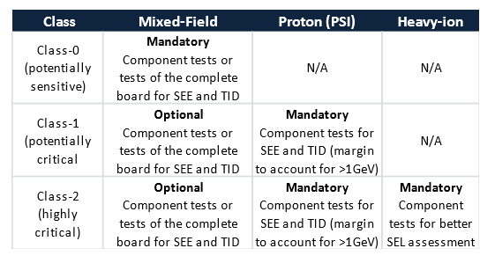
CHARM
Cern High-Energy AcceleRated Mixed-field facility
Mixed field:
  Pions
  Protons
  Neutrons
Energy spectra (meV-GeV)
Not in guidelines!
  But in the current RHA at CERN
ESR 15 – Andrea Coronetti

Slide 4
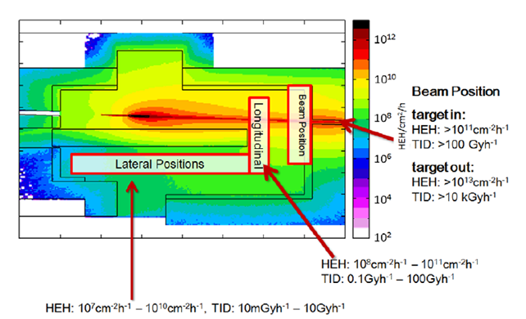
CHARM
Cern High Energy AcceleRated Mixed-field facility
No radiation-free haven:
  Care about what you put in irradiation areas
1 full week irradiation
  CHARM week wed to wed
  Target and shielding can be changed
Typical TID 100-400 Gy
Dry-Run
  Need to come one week before
Post Irradiation Tests
  No immediate measurements
  Shorter annealing time if components separable from boards
ESR 15 – Andrea Coronetti

Slide 5
CHARM
RADSAGA campaign coordination
Constraints
  CHARM available till October 2018
  Scaling of equipment
  Timing incompatibilities
  Further upgrading of systems
  Setup not well known
  Availability of supporting components
  Incompatibility with existing CHARM HW
  Measurements at other facilities are valuable
  Special requests
  Skype illegal in France
  …
Applications
  Only 7 ESRs will test
  2 RADSAGA partners to test
  No RADSAGA week
  Need to come multiple times (ESR12 – ESR14)
  Need further iteration with the facility
  Better to bring your own
  Optical fibers (ESR2)
  Determine best position (ESR4)
  Water cooling (ESR14)
  Infringe the law or Vidyo
  …
ESR 15 – Andrea Coronetti

Slide 6



CNES Secondment
Standards for Space Radiation Testing
  Interpretation and application from a space agency POV
Testing of COTS devices at UCL
Integration of NINANO with 3DPlus camera
  Preparation for testing at CHARM
Preparation for testing of Xilinx UltraScale+ FPGA
RADSAGA partner
ESR 15 – Andrea Coronetti

Slide 7
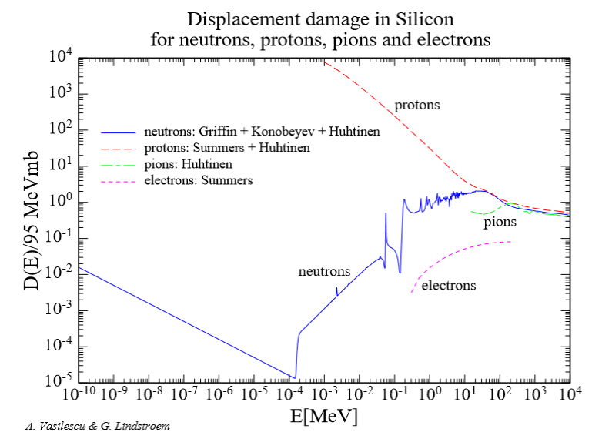
Displacement Damage
VESPER
  New use of the facility at CERN
60-200 MeV electron beam
Two beam modes
  Dark current
  Laser driven
Hardness factor ~ 8%
VESPER = Very energetic Electron facility for Space Planetary Exploration missions in harsh Radiative environments
ESR 15 – Andrea Coronetti

Slide 8
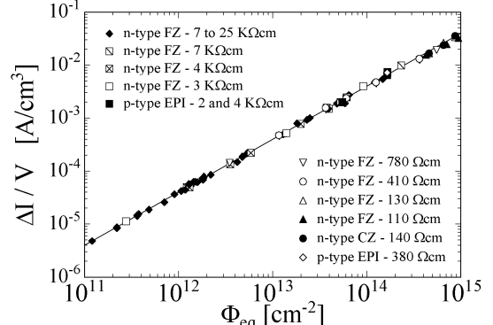
Displacement Damage
PIN Diodes
  Multiple fluence steps
Objectives
  Calibrate facility for two modes of use
  Find an alternative to DD Neutron testing
Michael Moll
ESR 15 – Andrea Coronetti

Slide 9

GANIL
Heavy ions with higher energy than UCL, RADEF
Planning as of today
  Lead beam 29 MeV/n
  July 3rd-5th
ESR1, ESR4, ESR7, ESR15
ESR 15 – Andrea Coronetti

Slide 10
ESR 15
Andrea Coronetti
Prospective activities for year 2018
RADSAGA Training Workshop – March 2018

