Slide 2
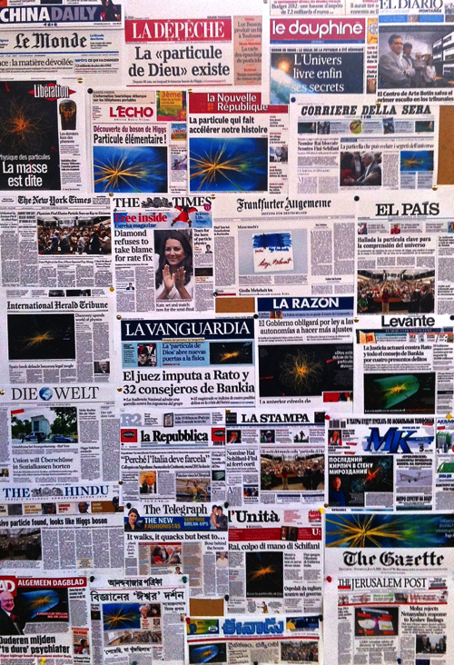
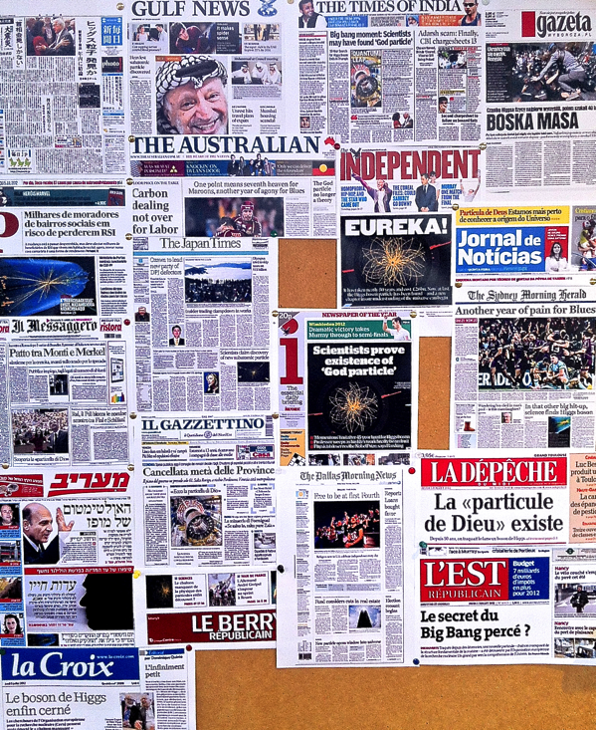

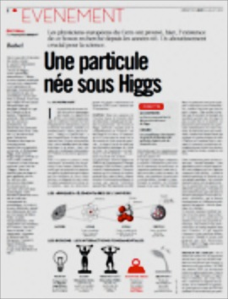

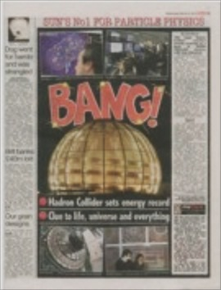

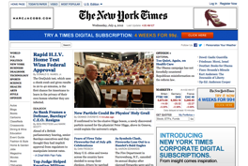
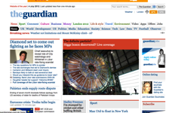
How Did the Higgs Boson
Become a Rock Star?

Slide 3












Press office in 2015 - Key numbers and activities
367 media visits
22 PRs and 24 Media tips
4 press conferences
(at CERN and abroad)
Thousands of resources
(photos, videos, agenda, backgrounders, bios, etc.)
1K emails per month
4,1K followers
1M page visits
558K new visitors
150 press cuttings per day w/ 2 billion visitors
≈180K for the year
Deals with © requests
(Co-)organises events
Is active in scientific networks
(EPPCN, Interactions)
Organises media training sessions and participates in crisis management

Slide 4
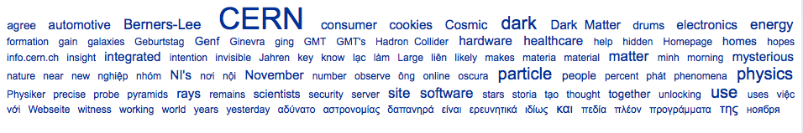
LHC Restart
Start run2
ATLAS & CMS 2015 results
LHC HighLumi + collider in China
LHC Restart briefing
Nobel Prize in Physics
Short circuit
13 TeV first collisions
AAAS briefing
450 GeV collisions
Ion Run
Media coverage – Press cuttings (CERN or LHC)
2015

Slide 5
The year after the Higgs boson
Media coverage – keywords: “CERN & LHC”

Slide 6
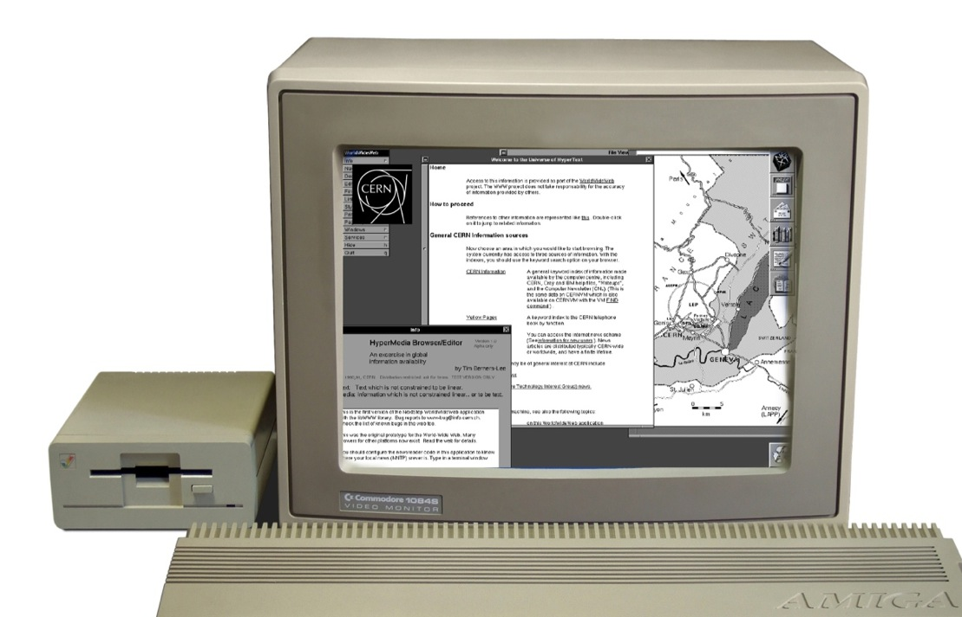
What is the story with
best impact in the year
just after the Higgs
in your opinion?
1. Celebrating WWW’s 25th?
Notes:
Fundamental research has always been a driving force for innovation : 2014 = 25 years of the WWW

Slide 7
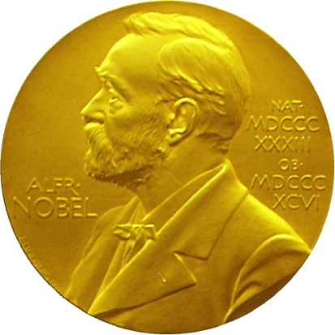
2. Prizes?

Slide 8

3. Big Bang theory story?

Slide 9
Let’s see…
ALPHA, gravity & antimatter
+ 20 years of www
Big Bang theory story + Higgs and Cern sharing science medal
Principe de Asturias Prize

Slide 10
Need to zoom in…
Principe de Asturias Prize
www: 20 years
Englert: “many cosmic mysteries remain”
CERN searches for 1st Web page + ILC report
Isolde exotic atoms
NeXT first webpage…
Key words: “CERN” & “LHC”- Fermilab

Slide 11
First!...
But web and big bang theory very high:
What does-it tell us?
Science is important to the public
Geeks are our best friends
It can be fun!
Not every story is driven by
press releases (and not even by us!)
Notes:
First: prizes (even more if we include Nobel of course)
2nd: www (huge impact… on the web itself)
3rd: Big Bang theory… (well, we are for nothing in there!)

Slide 12
Media coverage – Press cuttings 2016
(CERN, LHC and related keywords)
Weasel story
Retreat 2016

Slide 13
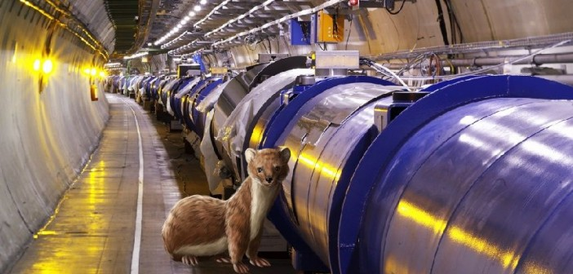
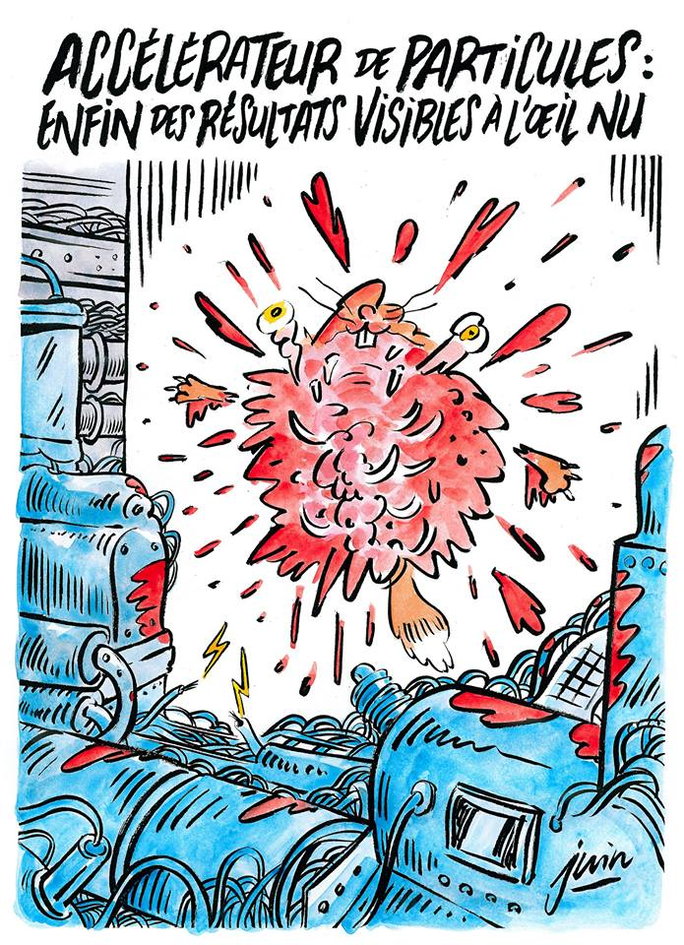

‘Weaselgate’: First time we have results one can see with naked eyes…

Slide 14
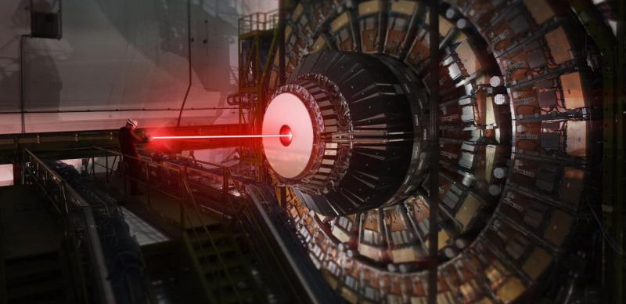
Our top story ever on the web and social media…
…was our 2015 April fools’ s

Slide 15

Media – who are they?
  > TV/Radio: easily reach out to million people depending the profile
  > Daily newspapers: often a few hundred thousand copies
  > Local press – a thousand copies often – but important!
  > But traditional media are dying: free newspapers (not always good quality), online media and social media more and more taking over.
  > At CERN we deal with different profiles: science journalists, generalists and press agencies, local press
  > Constraints: media are in competition (scoop is important), embargo is a common
  practice for science stories, Time is important!... Think DEADLINE
Notes:
15

Slide 16
The journalist: who is he and what does she/he want?
  > Works mostly alone – is very independant
  > Curious, interested in learning new things and meet people
  > Always in a hurry (and will receive 50 press releases a day…)
  > Often knows more about littereature and politics than science!
  > Thinks he/she knows everything – does not easily accept his/her mistakes ;)
  > More end more a freelancer – and not particularly well paid
  > A press release is first of all here to HELP the journalist (must be to the point then he/she can understand and be fast)
  > The news value must be obvious (because he/she will need to ‘sell’ the story to the editor)
Notes:
16

Slide 17

What are the readers interested in?
Distance
  . That is easy:
  A good story is first of all close
  to the reader
  Example: sthg in my city more important
  than sthg in a remote part of the world
  Today is more important than last year
  It touches people if the story is about
  them or their close friends
Social
Time
Emotional
Notes:
17

Slide 18
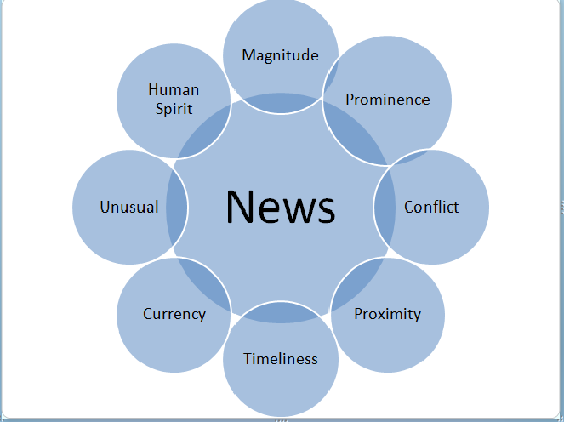
Powerful angles! (or why would we do a press release after all?...)
  > It is new – very first time – noone ever achieved this before
  > It completely changes the ladscape of a certain area - not compatible with theory
  > We’ve been looking for this for ages
  > It explains something that was so far not understood
  > We want to clarify something that is wrong in the media – so we react
  > Because of the scale: smallest, biggest, most important etc.
  > It is an important milestone of a project: start, end, result etc.
  > It is a huge technical challenge
  > It can have a huge impact on society (think about the web invented at CERN!)
  > We have really nice images to share…!
  > It’s official (may be not powerful – but can be a reason for a press release)
Notes:
18

Slide 19
Some key questions journalists will ask
  > What is it useful for?
  > Why is it important?
  > How does it work?
  > Why is it new?
  > What does it change for the audience?
  > How much does it cost?
  > Why? Why? Why?
  > Who? When? Where?
  > Who is the winner / the looser?
Notes:
19

Slide 20
Preparing a press release
Some key questions
?
  « Strategy »:
  > Who is my target audience for this story?
  > What is the main message I would like to convey? My angle?
  « Technical questions »
  > How do I do that?
  . How can I use the journalistic tricks to my advantage?
  . What are the best channels to be used for my story?
Notes:
20
J’ai mélangé des éléments de cours d’écriture et de media training – car les ressorts sont les mêmes…

Slide 21
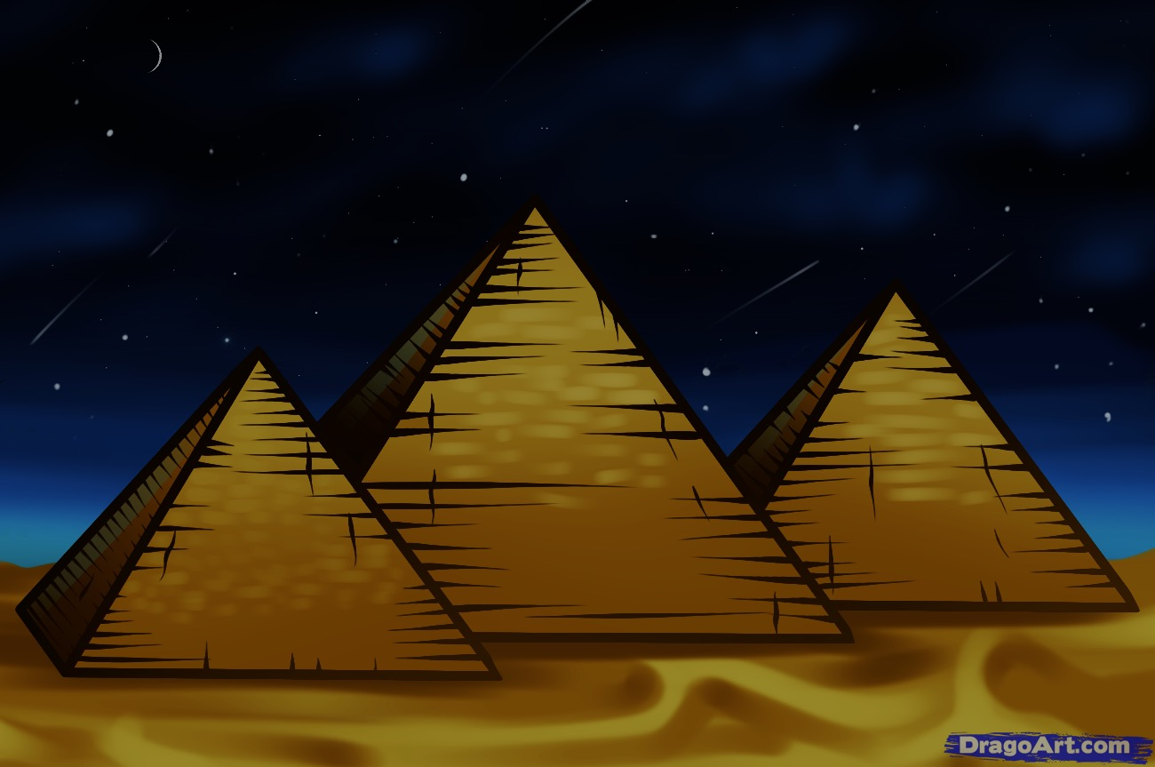
The great pyramid of audiences
Your
analysis
Your experiment
The LHC community
The HEP community
The physics community
“I majored in physics” general public
Science journalists; professional staffers
Reporters, politicians, congress persons, ambassadors
“Cats are funny and Taylor Swift is my hero” general public
© Sarah Charley
Notes:
Remember your audience. You’ve seen this slide earlier today.
In this session we’ll focus on reporters as the main audience, but we’ll give you tools that will be useful for you in writing for a range of audiences below the “”I majored in physics” general public”
Even if you never have to write a press release yourself, learning to write a press release/news story is good practice for learning to write for a non-scientific audience.

Slide 22
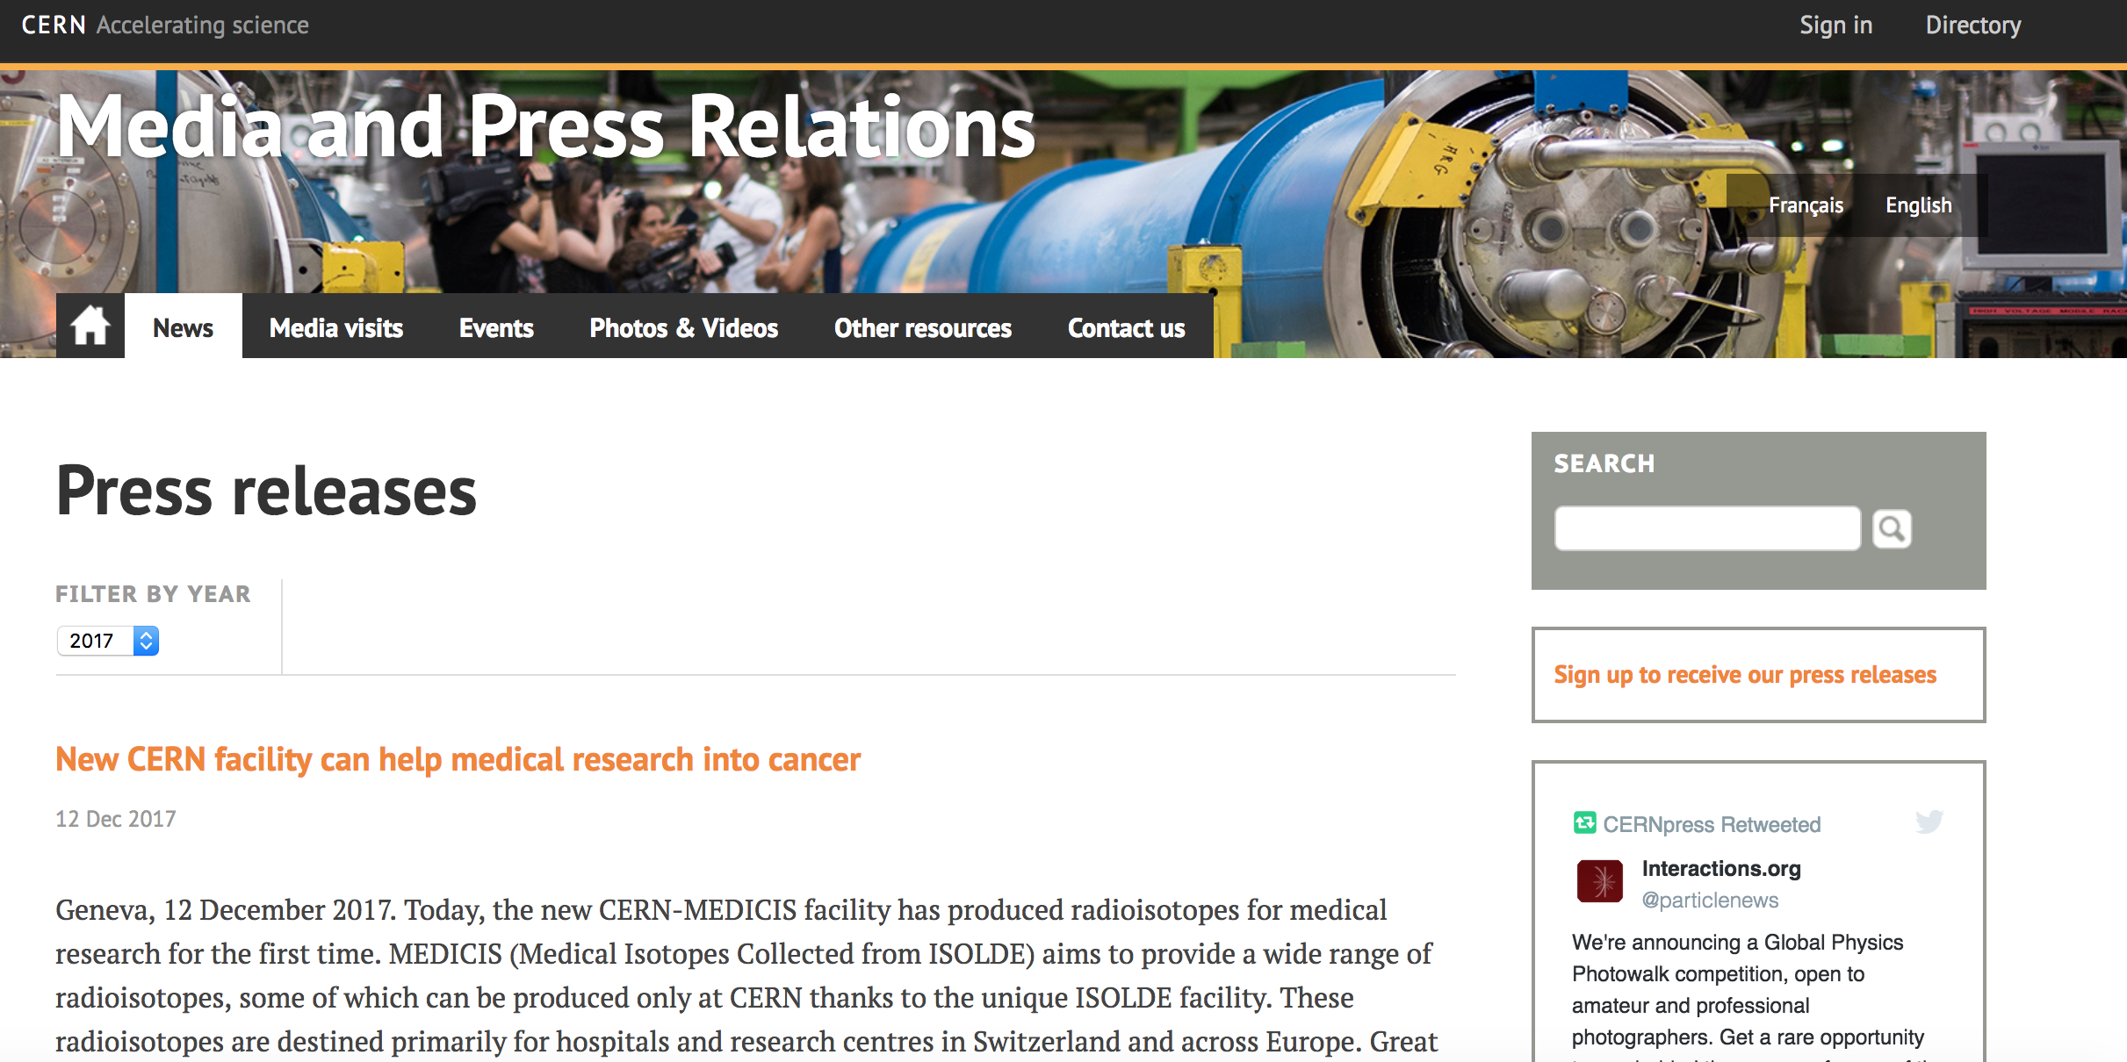
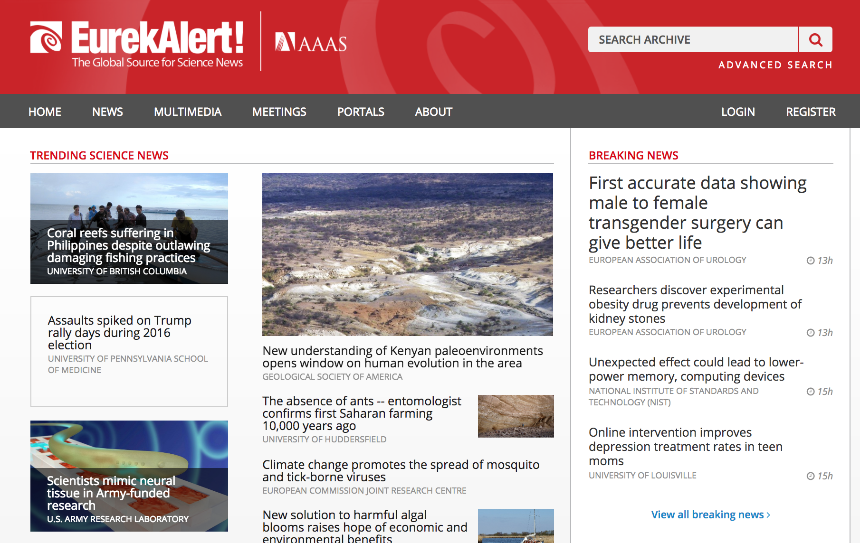
Where do journalists go for news?
Peer-reviewed journals and magazines
Wire services and News agencies
Newspapers, radio and television
Social media
Scientific conferences
Press conferences (rare)
Personal contacts
Press releases

Slide 23
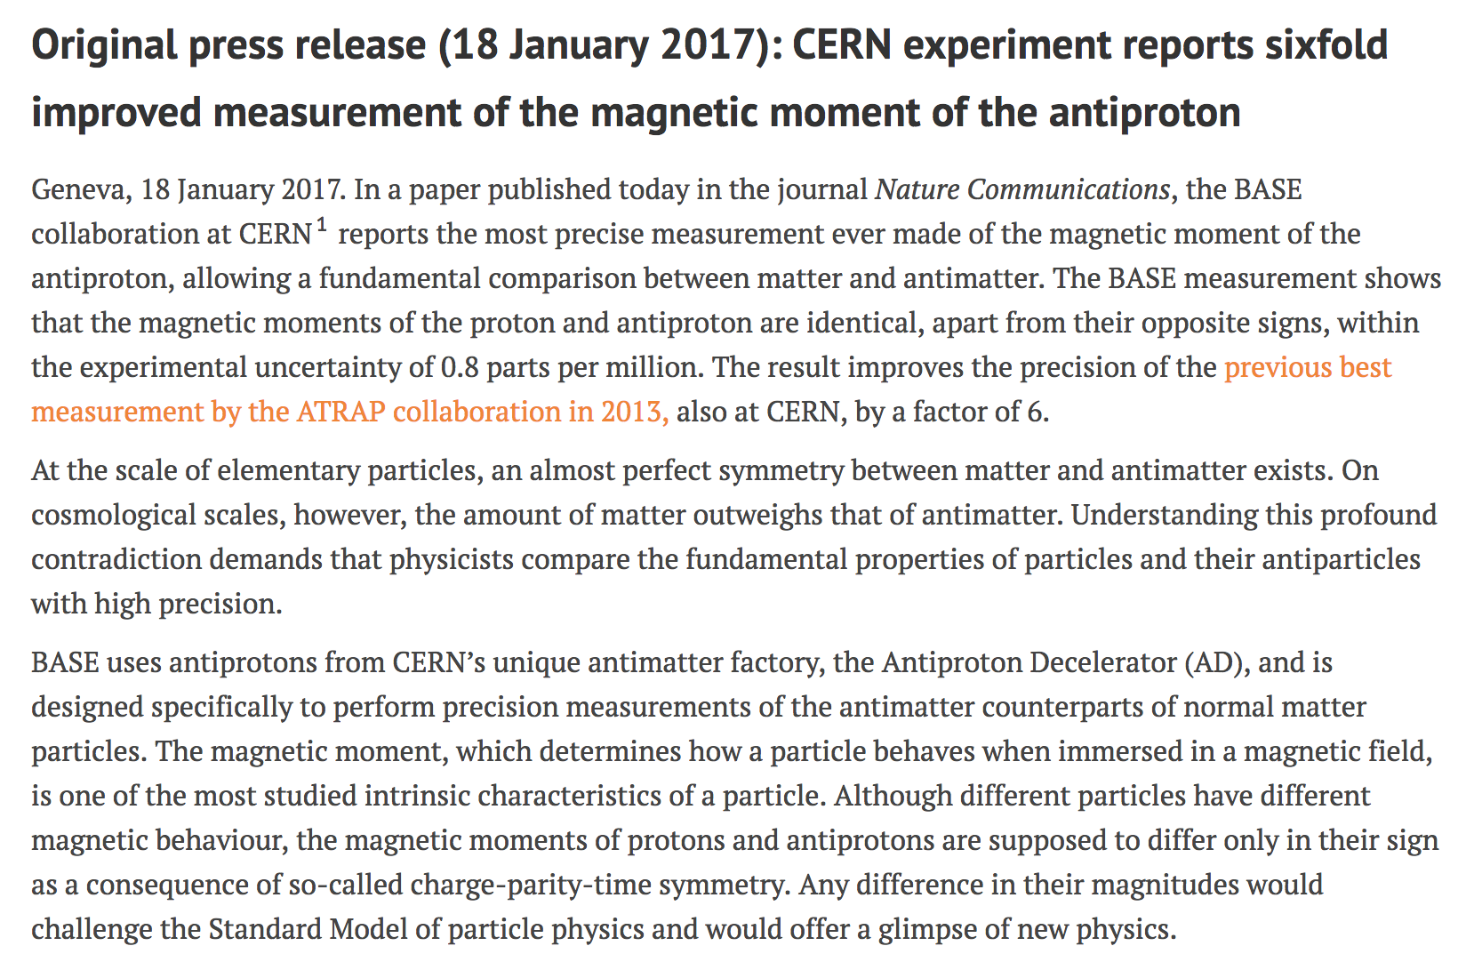
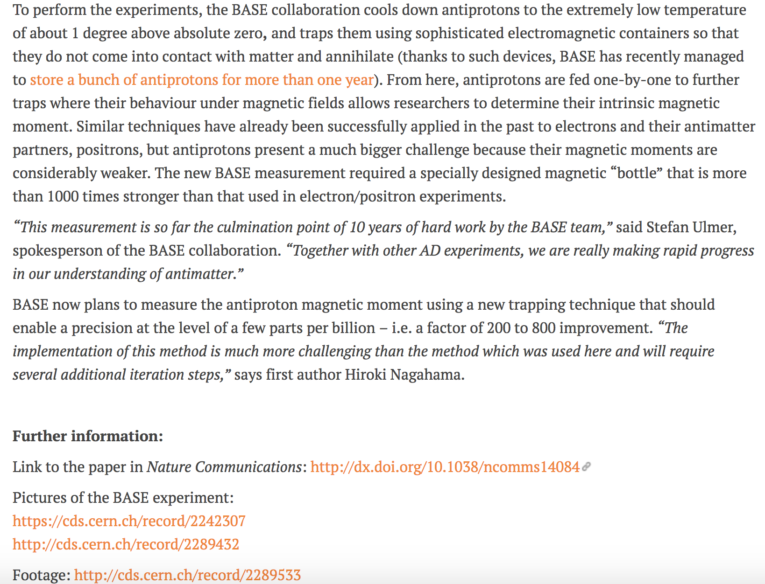
What is a Press Release?
Short news article (around 500 words)
Should communicate essence of a story and why it is news to journalists

Slide 24
Structure of a research paper
Abstract
Introduction
Methods
Results
Discussion

Slide 25
The press release – I
Results
Introduction

Slide 26
The press release – II
Methods

Slide 27
The research paper “vs” the press release (or news story)
Science
  Abstract
  Introduction
  Methods (experiment)
  Results
  Discussion & conclusion
Science news
  Results
  Discussion & conclusion
  Introduction
  Theory
  Methods (experiment)
A news article is an academic paper turned on it’s head

Slide 28
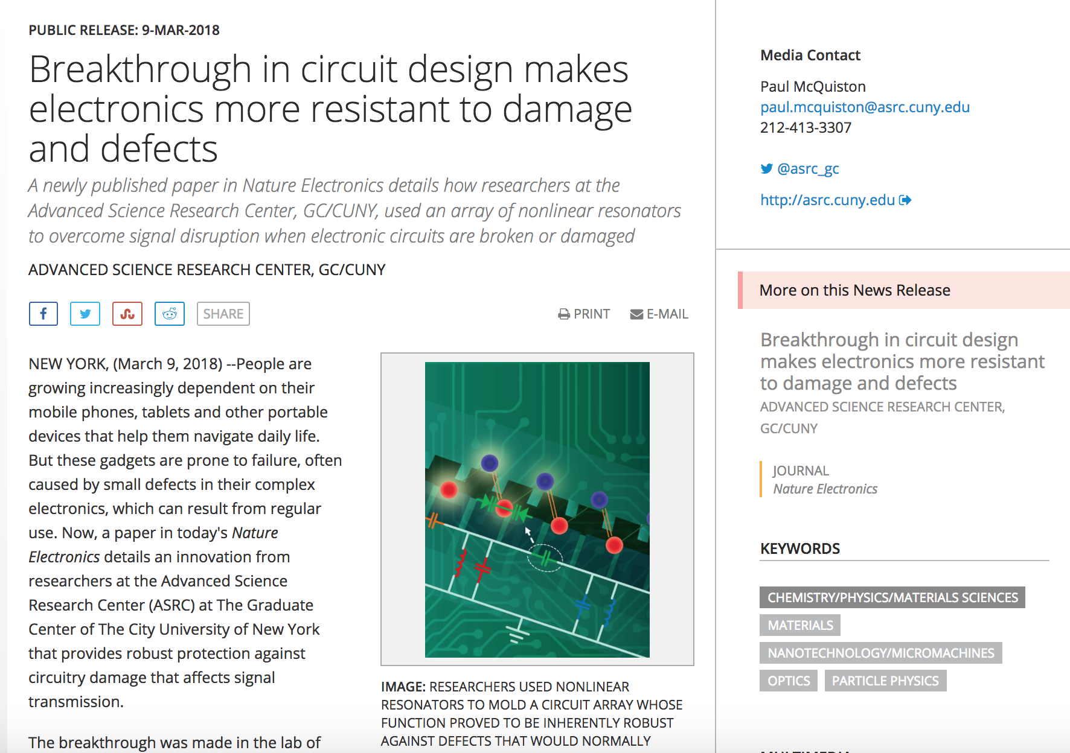
The components of a press release
Date
Heading & sub-heading
Correct and functioning contact details
Lead: the results (i.e. what is the news)
Inverted pyramid writing
Images with captions and credits
Institutional details

Slide 29
The heading
Should be short, high-impact, jargon-free
Should highlight the main news point
PR: Breakthrough in circuit design makes electronics more resistant to damage and defects
Paper: Self-induced topological protection in nonlinear circuit arrays
PR: The LHCb experiment is charmed to announce observation of a new particle with two heavy quarks
Paper: Observation of the doubly charmed baryon Ξ++

Slide 30
A closer look at the first paragraph
Who (made it news)
What (is the story about)
When (did the story happen)
Where (did the story happen)
Why (did it make the news)
How (did it happen)

Slide 31
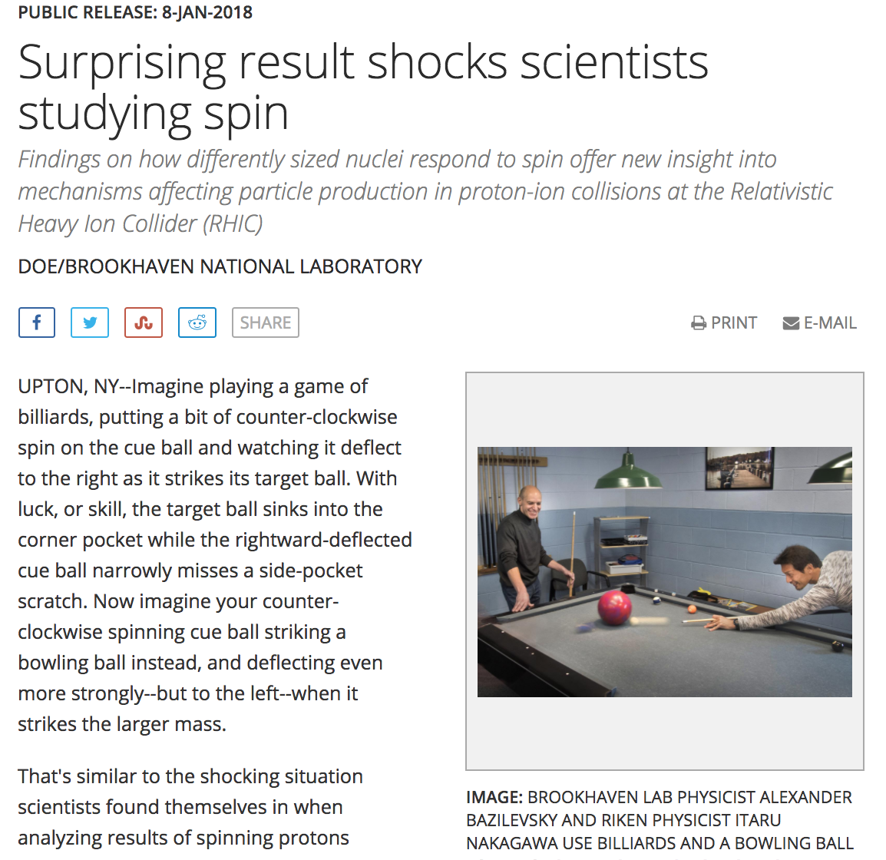
The 5W may not
be in the first paragraph
Nuclear dependence of the transverse-single-spin asymmetry for forward neutron production in polarized p+A collisions at √sNN = 200 GeV (Physical Review Letters)

Slide 32
The body of the press release - The inverted pyramid
What is the story?
How did it happen?
Amplification
Tie up loose ends

Slide 33
Writing style
short sentences
one idea per sentence
active not passive voice
use direct quotations, if appropriate (give opinion, analysis, interpretation)
avoid scientific jargon – make it “human”
avoid technical and historical explanations – go in Notes to Editors

Slide 34

Preparing a press release
Some key questions
Why should journalists read my press release?
Why should they read it NOW?
Who is my target audience for this story?
What is the main message I would like to convey? My angle?
Notes:
34

Slide 35

Exercise
Work in pairs to produce a press release
Identify which of the articles provided to write a press release on.
Each person writes a press release on the news peg identified above

Slide 36
Remember to ask yourself these questions
Why should journalists read your press release?
Why should they read it NOW?
What is the story?
The lead
Who (made it into the news)
What (is the story about)
When (did the story happen)
Where (did the story happen)
Why (did it make the news)
How did it happen?
Amplification
Tie up loose
ends

Slide 37
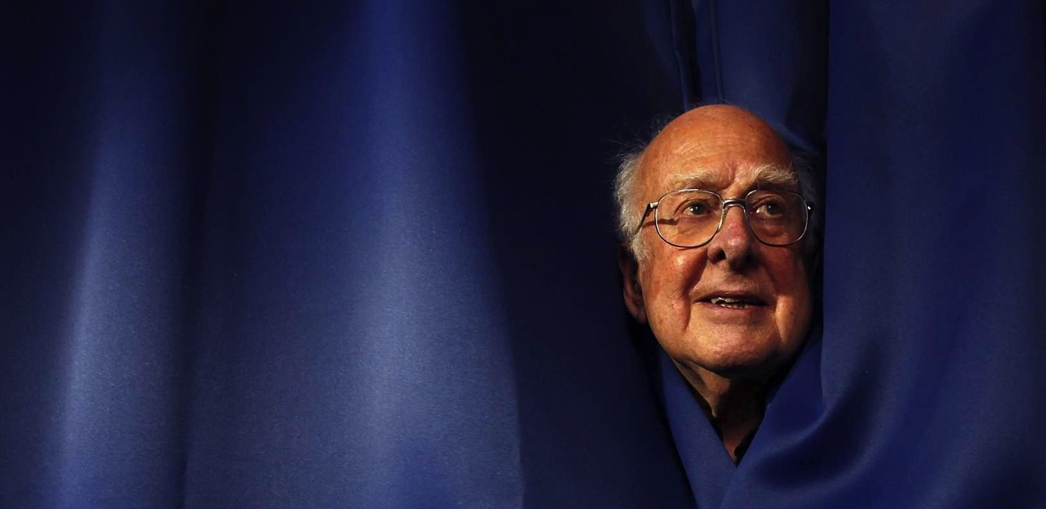
REUTERS/David Moir
Ana Godinho – Head of Education, Communication and Outreach
Arnaud Marsollier – Head of Media Relations – RADSAGA - March 2018

