Slide 2
CROC Competition-
Ideas Selection over a coffee
ESR 01 – Sascha Lüdeke
ESR 04 - Vanessa Wyrwoll
RADSAGA Training Workshop – March 2018

Slide 3
Why Outreach?
engaging large audience
bringing knowledge to general public
showing very simple what happens to tax money in RADSAGA

Slide 4
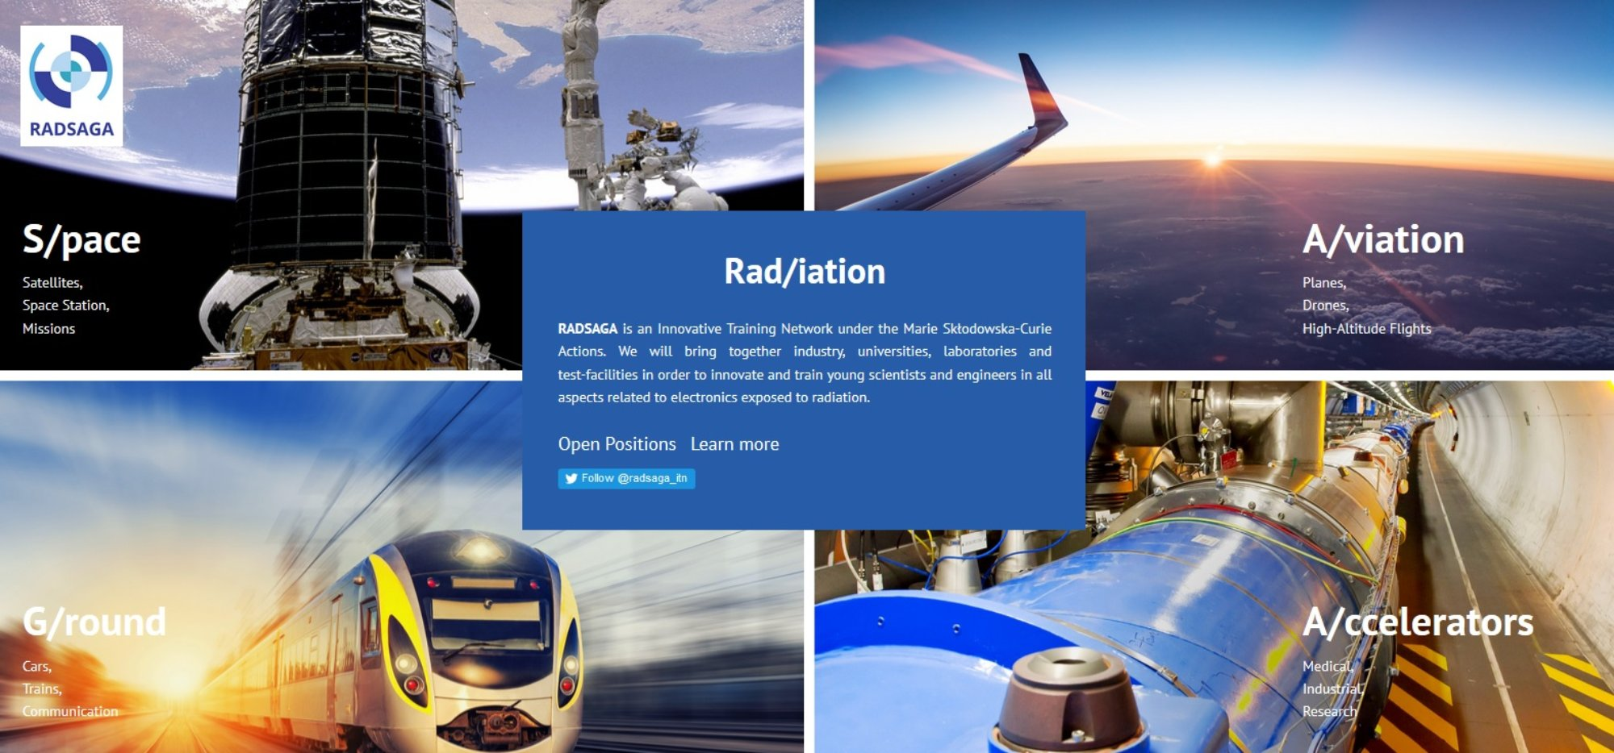
What to transfer?

Slide 5
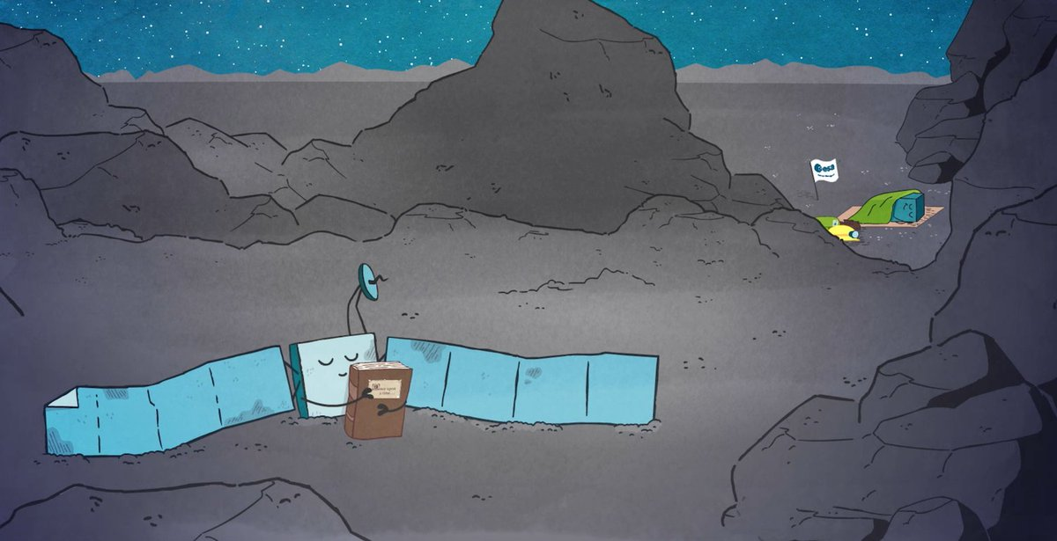
Main Question and Idea
What can RADSAGA contribute to the daily life of everyone?
Short cartoon movie
Three scences
keep it simple
Copyright ESA

Slide 6
Description
man gets into his car (singing a song) and enters a destination into his GPS and starts to drive -> continues driving
a girl gets into a plane and starts using her laptop during the flight and listens to music with headphones
astronaut in space e.g. on the ISS
  All three scenes recognizing a problem

Slide 7
Description
Transition to explanation scene using voice over: Explanation that the solar event caused all three incidents
Astronaut sees the effects
Girl in the plane
Man in the car
  To show how the impact on the different levels (space, avionics and ground)
  Simultaneously explaining the novel effects

Slide 8
Thank you for your attention!

