Slide 1


Slide 2
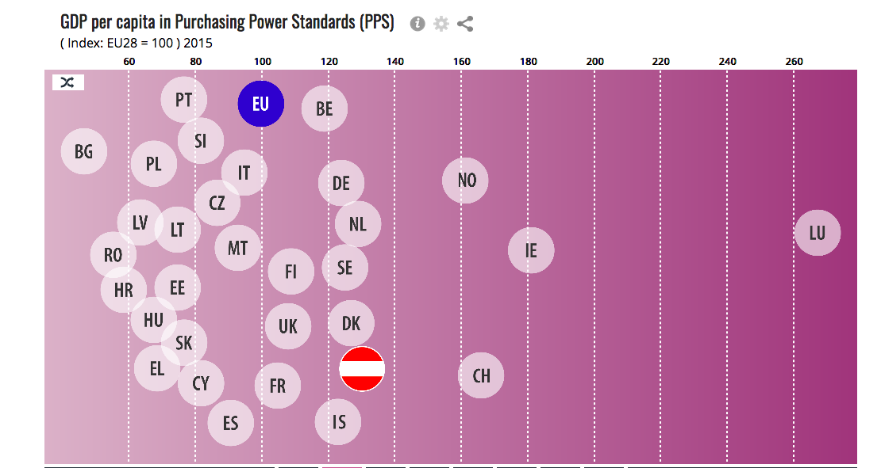
Basic information about Austria
http://ec.europa.eu/eurostat/tgm/refreshTableAction.do?tab=table&plugin=1&pcode=tec00001&language=en
Population: 8.8 million
GDP at market prices per capita (2017): 42 000 € (EU average 29 900 €)

Slide 3
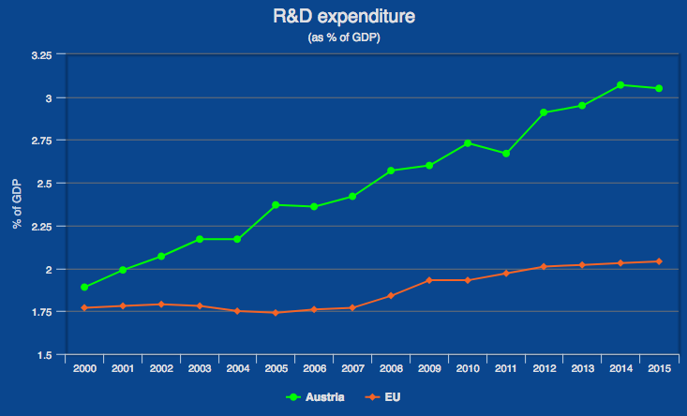
R&D expenditure over time
http://ec.europa.eu/eurostat/web/science-technology-innovation
Total expenditure for R&D in % of GDP: 3.05% (2015) - 10.5 G€
EU average: 2.04% (2015)
Austria
EU

Slide 4
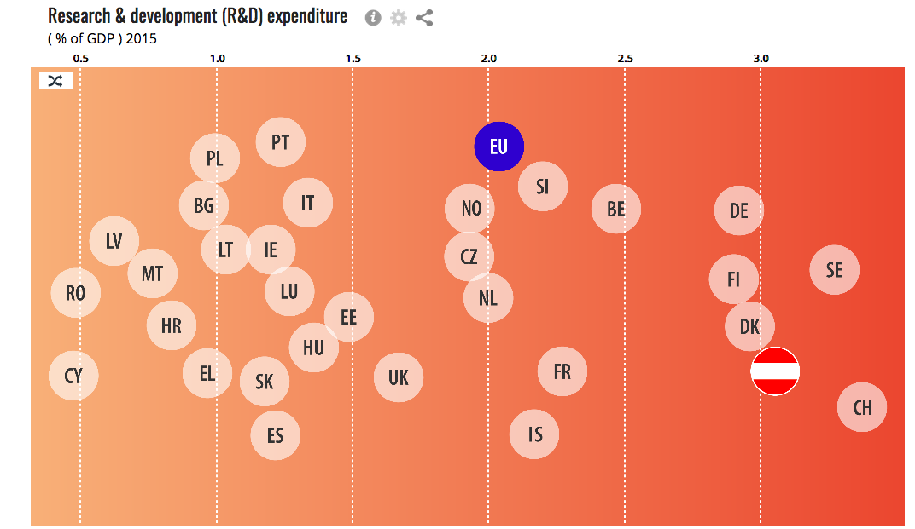
R&D expenditure country comparison
Problem: In spite of excellent ranking basic research is underfunded. Most of the expenditure goes to applied research and does not come from governmental sources.
Notes:
Only 35% from governmental sources.

Slide 5
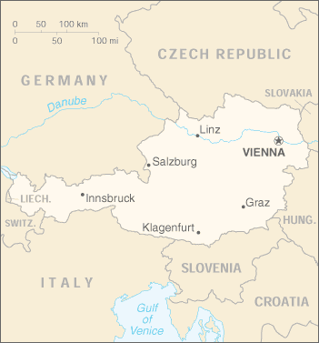
Universities, non-university institutions
22 public and 12 private universities
    7 public universities offer physics education (University of Vienna*, TU Vienna*, University of Graz*, TU Graz, University of Innsbruck*, University of Linz, University of Salzburg; *particle physics activities)
21 universities of applied sciences (Fachhochschulen, FH)
    FH Wiener Neustadt: medAustron, was in ATLAS
Austrian Academy of Sciences
    2 institutions in particle and nuclear physics: HEPHY, SMI

Slide 6








Research groups
Institute of High Energy Physics Vienna (HEPHY)
    experimental particle and dark matter physics, theory/phenomenology
Stefan Meyer Institute for Subatomic Physics Vienna (SMI)
    experimental particle and nuclear physics
University of Vienna
    theory/phenomenology, nuclear physics, environmental physics
TU Wien, Institute of Theoretical Physics
    theory/phenomenology
TU Wien, Institute of Atomic and Subatomic Physics (Atominstitut)
    quantum and nuclear physics, gravitational physics,
    experimental particle and dark matter physics (personnel), theory
University of Graz
    theory/phenomenology
University of Innsbruck
    experimental particle physics, astroparticle physics,
    environmental physics
Johannes Kepler University Linz
    quantum materials, nuclear physics
Notes:
Uni Wien: nTOF, CLOUD, AsaCusa. Linz: ISOLDE

Slide 7

Particle physics group
Current activities and framework
ATLAS is main activity
operates in university environment
operates part of federated Austrian Tier-2
  transformation to storageless cloud computing based on OpenStack ongoing
  supported by dedicated staff of the university computing centre
strong involvement in outreach activities
Group size
1 staff
2 master students
2 bachelor students
2 PhD students at CERN (FCC, AEGIS)
2 non-permanent scientific associates (Tier-2, administration)
Past
3 PhD students funded by Austrian CERN doctoral students program
successful FWF project on B physics with 1 postdoc and 1 PhD student 2011-2014
Future
3 more years of ATLAS participation funded, optional extension
activities beyond 2020 to be defined
Notes:
FCC: Track reconstruction for the hadronic Future Circular Collider (Valentin Völkl)
AEGIS: Construction of an efficient protonium source (Emanual Oswald)

Slide 8
Research projects
Accelerator-based physics
CERN LHC: ATLAS, CMS, ALICE
CERN AD: ASACUSA, AEgIS
CERN PS: CLOUD, nTOF
CERN ISOLDE: IS576, IS611, IS612, IS630
KEKB, SuperKEKB: BELLE, BELLE-II
J-PARC: E15/E31 (kaon-nucleon interaction), E57/E62 (kaonic atoms)
GSI FAIR / FLAIR: PANDA (Barrel TOF detector, TDR prepared at SMI)
LNF DAFNE-2: SIDDHARTA-2, AMADEUS
Non-accelerator-based physics
LNGS: VIP, CRESST, COSINUS
ILL Grenoble: NoMoS, PERKEO III, aSPECT, qBOUNCE
Atominstitut Vienna: Experiments in neutron and quantum physics
FRM-II Munich: PERC
Astroparticle physics
Space, Namibia FERMI, HESS
Chile / Canary Islands CTA
Italy / US VIRGO/LIGO
Particle physics theory and phenomenology
SUSY, dark matter, QGP, QCD, QFT, chiral perturbation theory, neutrino physics, quantum mechanics, gravitational physics
Notes:
J-PARC: Japan proton accelerator centre at Tokai. AMADEUS: Antikaonic Matter at DAFNE. qBounce: spectroscopy of gravity.
SIlicon Drift Detector for Hadronic Atom Research by Timing Applications. PERC, aspect: neutron beta decay. NoMoS (Neutron decay prOducts MOmentum Spectrometer)

Slide 9

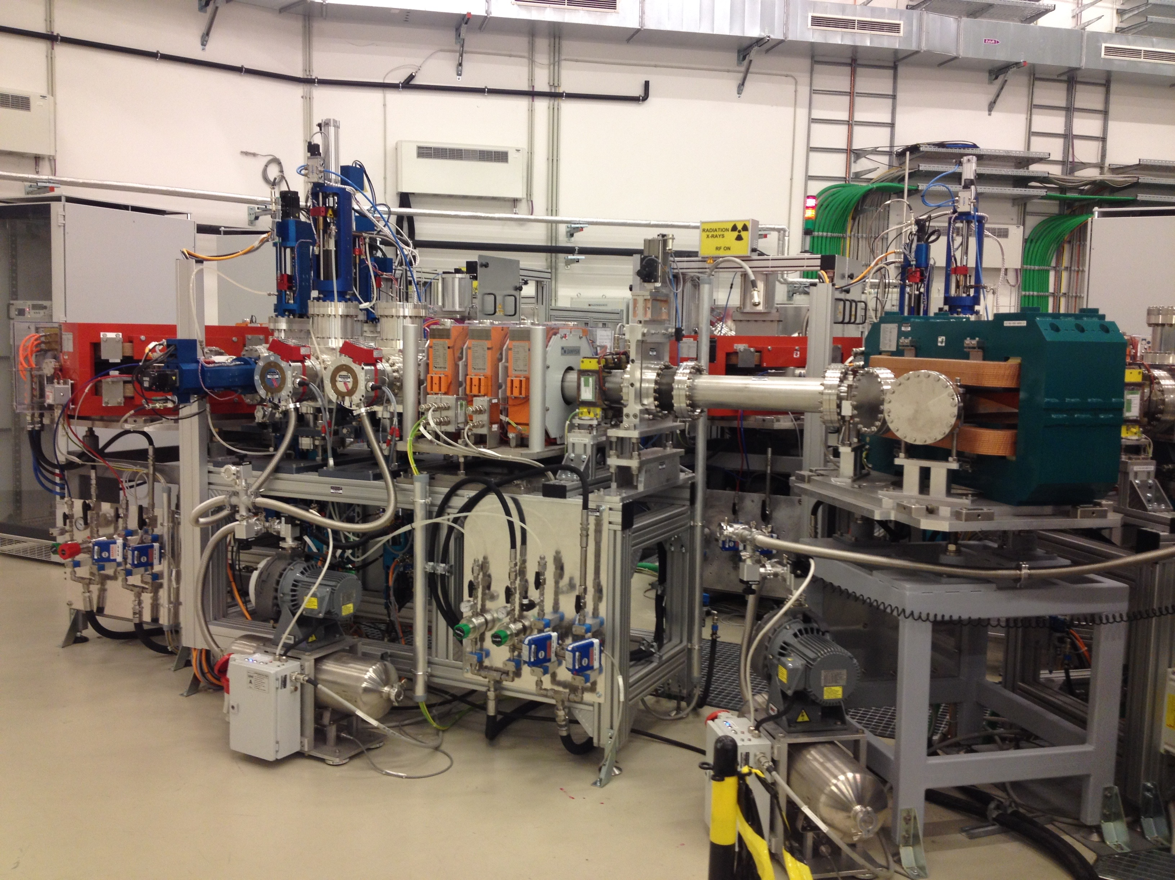

R&D for detectors, accelerators, medical physics
CERN: Phase II LHC upgrades (CMS, ALICE Fast Interaction Trigger)
RD18 (Crystal Clear)
RD50 (Radiation hard Si devices for very high luminosity colliders)
EU projects: AIDA
ILC: ILD
FCC: studies
Atominstitut: detector tests at nuclear reactor TRIGA Mark-II
MedAustron: physics-related projects at new ion therapy centre
Medical: TOF-PET
Industry: Silicon sensors, HV/HR sensors, …
Notes:
EU project terminated in 2017: PALADIN (Positron Annihilation Detection Beyond the Limits)

Slide 10


Principal funding resources
Principal Austrian funding resources
Ministry of Education, Science and Research
  Universities
  Academy of Sciences (HEPHY, SMI, New Frontiers research groups, special funding, prizes and stipends, bilateral exchanges)
  FWF - Science Fund, for basic research (but not “big science”)
    Individual projects (postdocs, PhD students)
    Graduate schools (Particles and Interactions, Hadrons in Vacuum, Nuclei and Stars)
    SFB (priority research programs)
    International programs, habilitation grants, prizes
  OeAD – Austrian Exchange Service (Erasmus+, Marietta Blau fellowships, bilateral programs, ...)
  Additional funds on a case-to-case basis (in the past, e.g. CMS construction)
  CERN and ESO membership contributions, CERN Austrian doctoral students
Ministry for Transport, Innovation and Technology and Ministry for Economic and Digital Affairs
  FFG - Research Promotion Agency (applied research)
    cooperation with industry
    internships
  ESA membership contribution
Notes:
Austria is not member of FAIR.

Slide 11

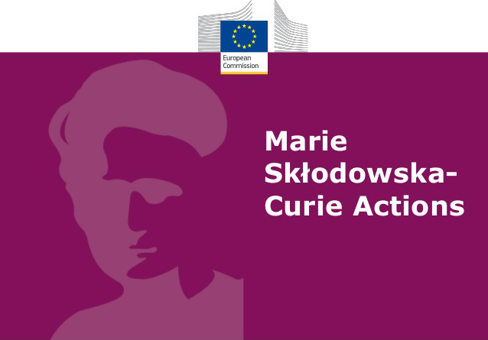


Other funding resources
Other Austrian funding resources
National bank (Österreichische Nationalbank)
Regional organizations (Länder, …)
Principal foreign funding resources
European Research Council and European Commission
  ERC starting, consolidator and advanced grants
  Marie Sklodowska-Curie actions
    ITN (Innovative Training Networks)
    RISE (Research and Innovation actions (e.g. AIDA-2020)
    Individual fellowships
  COST actions (cooperation in science and technology)
Non-Austrian Academies of Sciences
  mainly for short-term exchange programs
Notes:
Advanced grant: Hyperfine Structure of Antihydrogen

Slide 12
Resources summary
SUSET - TO BE UPDATED AS SOON AS POSSIBLE
Experiment name | Particle physics experiments at CERN | Heavy ion experiments at CERN | Nuclear physics experiments at CERN | Experiments elsewhere: particle physics exp. at accelerators (incl. neutrino) | Experiments elsewhere: astroparticle exps, GW exps, other neutrinos | Detector R&D | Computing R&D and operations | Accelerators R&D and operations | Theory | SUM
Physicists permanent [FRA] | 10,25 |  | 2,75 | 1,30 | 0,75 | 0,70 | 1,00 |  | 6,00 | 22,75
Physicists fixed term [FRA] | 4,25 |  | 1,00 | 1,00 | 4,00 | 0,10 | 0,00 |  | 7,50 | 17,85
PhD students [FRA] | 12,60 |  | 2,00 | 3,00 | 2,00 | 0,40 | 0,00 |  | 12,00 | 32,00
Engineers [FRA] | 2,80 |  | 1,00 | 2,00 | 0,00 | 0,00 | 0,00 |  | 0,00 | 5,80
Technicians [FRA] | 4,60 |  | 0,25 | 3,90 | 1,35 | 1,35 | 1,50 |  | 0,00 | 12,95
TOTAL | 34,50 | 0,00 | 7,00 | 11,20 | 8,10 | 2,55 | 2,50 | 0,00 | 25,50 | 91,35
TOTAL/Population [1/million inhab.] | 3,93 | 0,00 | 0,80 | 1,28 | 0,92 | 0,29 | 0,28 | 0,00 | 2,91 | 10,41
TOTAL/GDP [1/G€] | 0,09 | 0,00 | 0,02 | 0,03 | 0,02 | 0,01 | 0,01 | 0,00 | 0,07 | 0,25
“project”-kind of funding: travels, stay at CERN/abroad (€ per year 2017) | 31405 |  | 70000 |  |  |  |  |  | 49000 | 150405
“project”-kind of funding: fixed-term salaries or PhD grants (€ per year 2017) | 670000 |  |  |  | 10000 |  |  |  | 748000 | 1428000
“project”-kind of funding: M&O costs (€ per year 2017) | 217333 |  |  |  |  |  |  |  |  | 217333
investments for construction or upgrades (€ per year 2017) | 201080 |  |  |  |  |  |  |  |  | 201080
R&D funding (€ per year 2017) |  |  |  |  |  |  |  |  |  | 0
computing (€ per year 2017) |  |  |  |  |  |  |  |  |  | 0
Total (€ per year 2017) | 1119818 | 0 | 70000 | 0 | 10000 | 0 | 0 | 0 | 797000 | 1996818

Slide 13

Physics education
Following the 1999 Bologna recommendations, studies have gradually been reorganized since 2003/2004. Bachelor and Master degrees were introduced.
Normal duration of studies:
Bachelor 6 semesters, Master: 4 semesters, PhD: 6 semesters.
 | TOTAL | FEMALE | MALE | % FEMALE | % MALE
Students per subject of study | 381.079 | 205.965 | 175.114 | 54,0 | 46,0 | 2015-2016
Students overall | 332.688 | 175.941 | 156.747 | 52,9 | 47,1 | 2015-2016
- Bachelor / Master students | 307.092 | 164.254 | 142.838 | 53,5 | 46,5 | 2015-2016
- PhD students | 25.596 | 11.687 | 13.909 | 45,7 | 54,3 | 2015-2016
Nat. Science & Technology students | 99.118 | 40.621 | 58.497 | 41,0 | 59,0 | 2015-2016
- Natural Science students (BSc/MSc) | 51.128 | 28.687 | 22.441 | 56,1 | 43,9 | 2015-2016
- Technology students (BSc/MSc) | 47.990 | 11.934 | 36.056 | 24,9 | 75,1 | 2015-2016
- Natural Science students (PhD) | 2.447 | 1.119 | 1.328 | 45,7 | 54,3 | 2015-2016
- Technology students (PhD) | 4.445 | 941 | 3.504 | 21,2 | 78,8 | 2015-2016
BSc physics students | 4.037 | 809 | 3.228 | 20,0 | 80,0 | 2015-2016
MSc physics students | 907 | 169 | 736 | 18,6 | 81,1 | 2015-2016
PhD physics students | N/A | N/A | N/A | N/A | N/A | 2015-2016
Teaching physics students | 518 | 151 | 367 | 29,2 | 70,8 | 2015-2016
Obtained BSc degrees in physics | 336 | 63 | 273 | 18,8 | 81,3 | 2014-2015
Obtained MSc degrees in physics | 242 | 51 | 191 | 21,1 | 78,9 | 2014-2015
Obtained teaching degrees in physics | 27 | 8 | 19 | 29,6 | 70,4 | 2014-2015
Obtained PhD degrees in physics | N/A | N/A | N/A | N/A | N/A | 2014-2015
Obtained PhD in Nat. Science & Technology | 789 | 225 | 564 | 28,5 | 71,5 | 2014-2015
Note: “Physics” does not include astronomy, meteorology or geophysics.

Slide 14
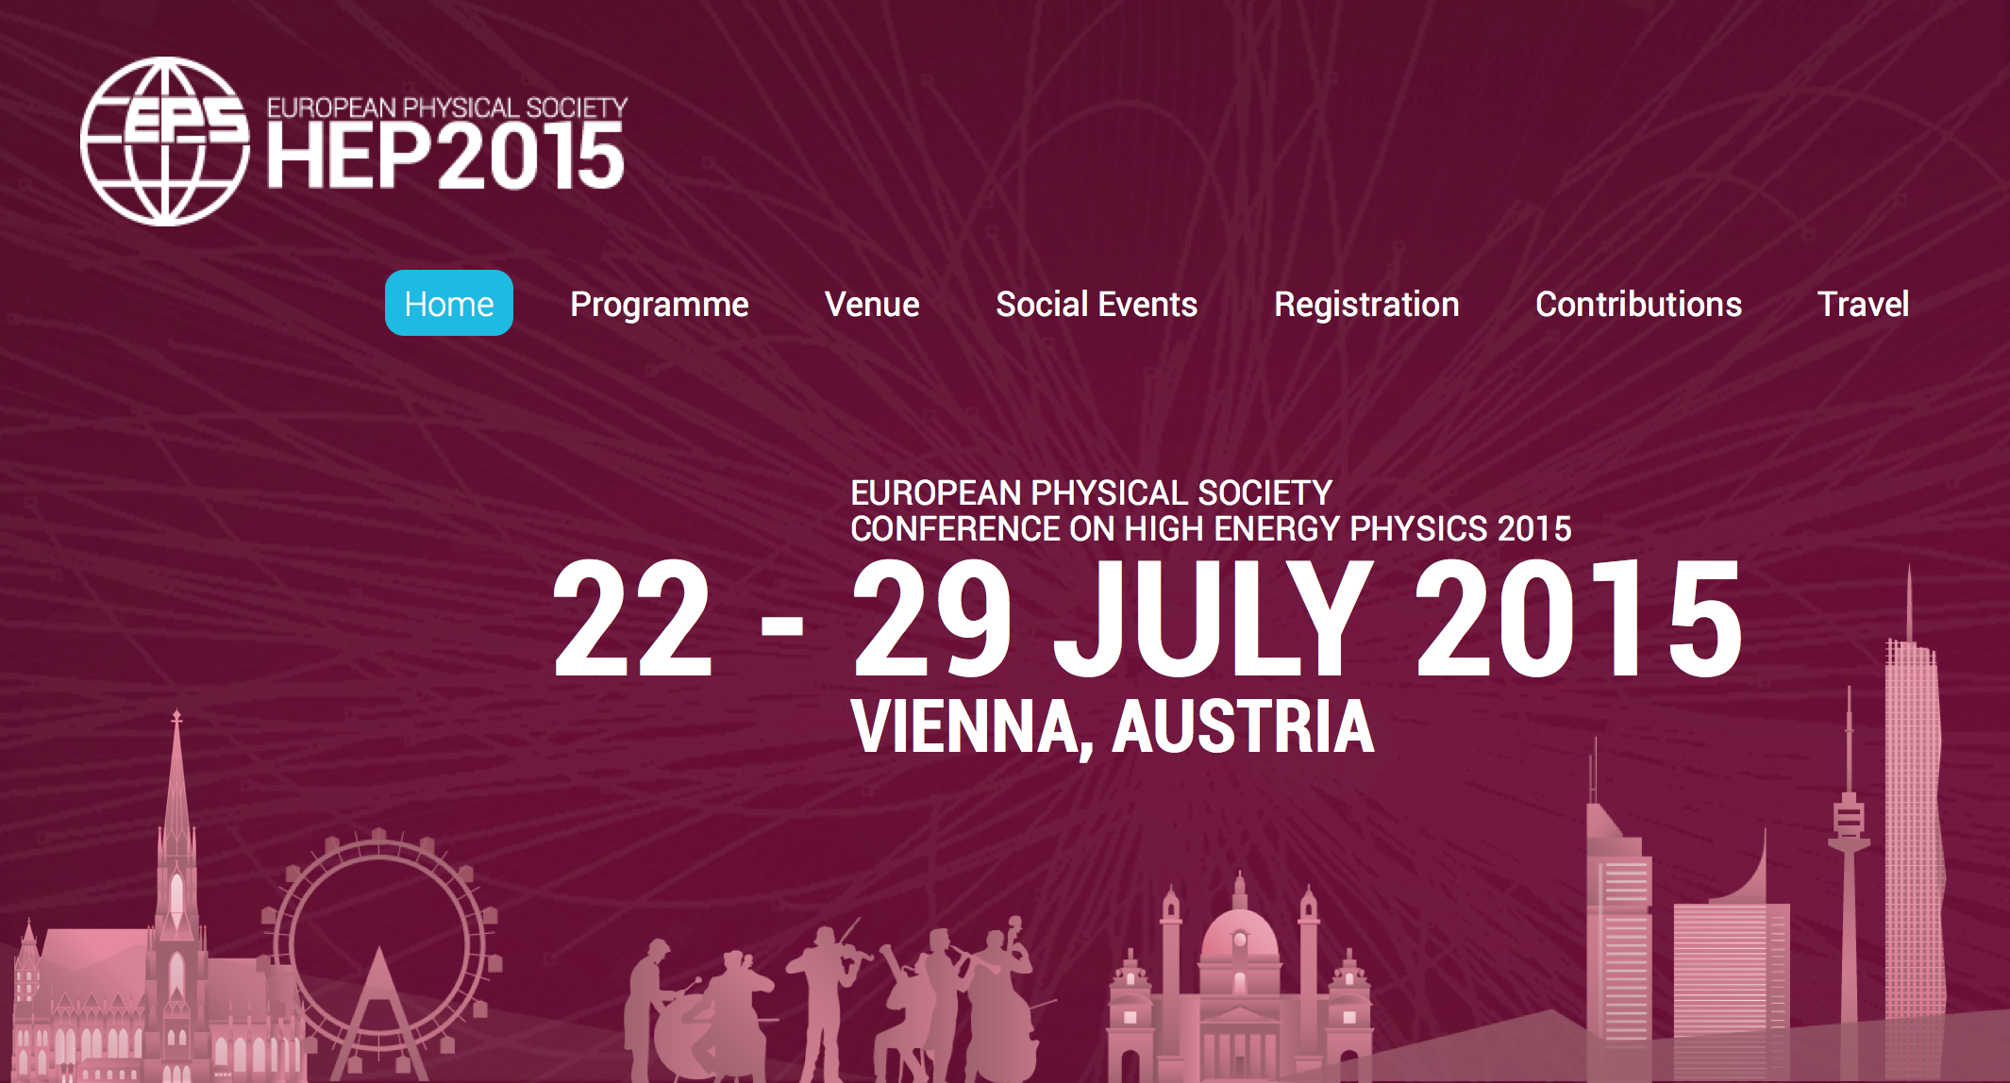
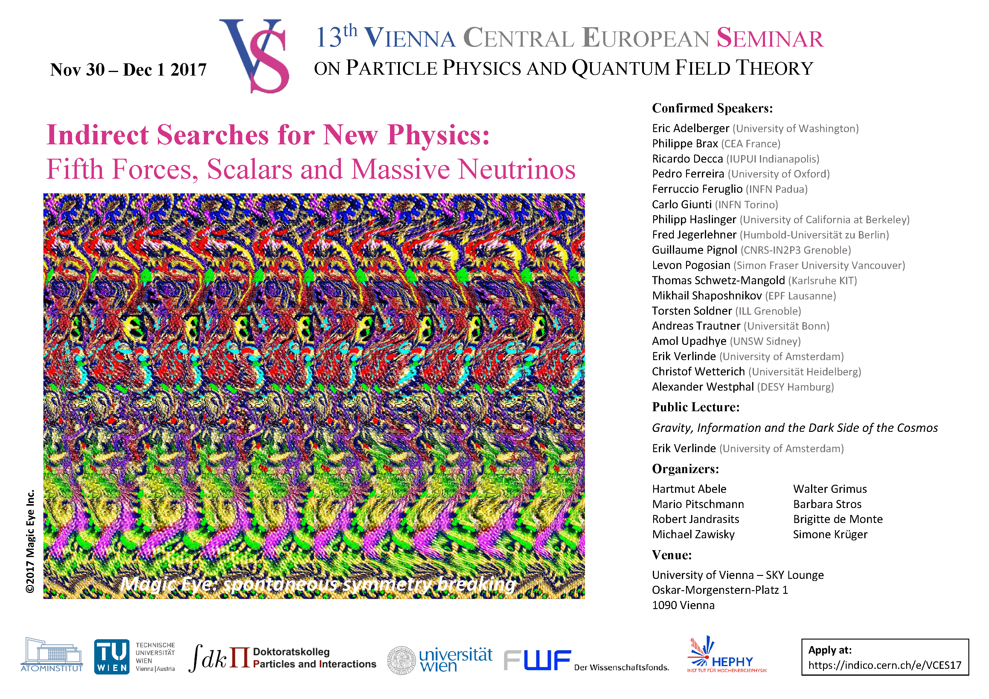
Conferences and schools
Regular conferences and schools
Vienna Conference on Instrumentation
  every third year, organised by HEPHY and TU Wien
Vienna Central European Seminar
  every year, organised by University of Vienna
EXA – Exotic Atoms and Related Topics
  every third year, organised by SMI
ALPS / LHCSki
  every year, organised by HEPHY and University of Graz
Recent other conferences and schools
EPS-HEP 2015
ISOTDAQ 2018 (International School for Trigger and Data Acquisition)

Slide 15
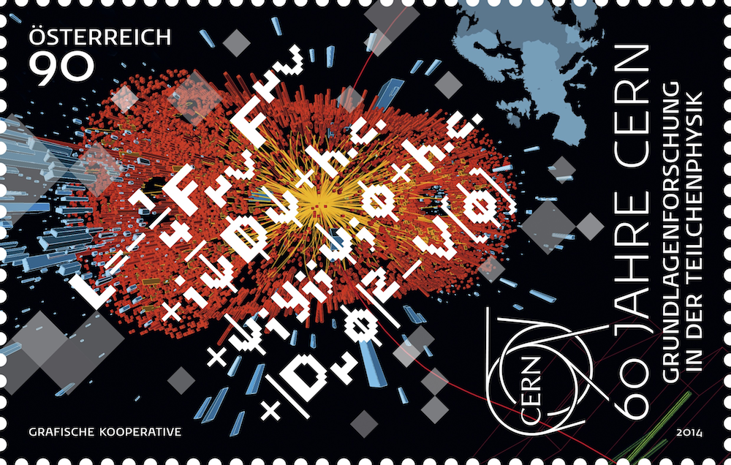
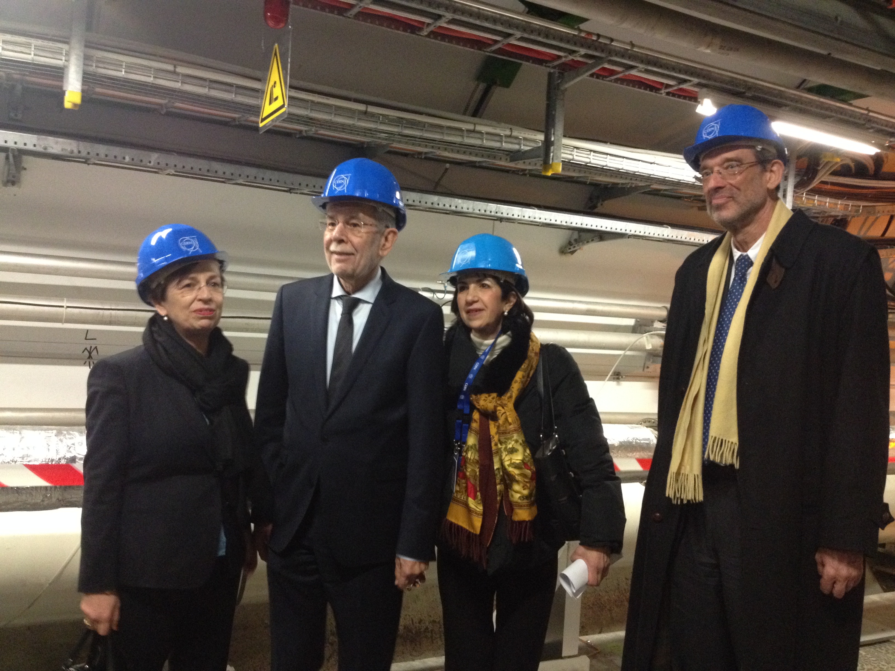
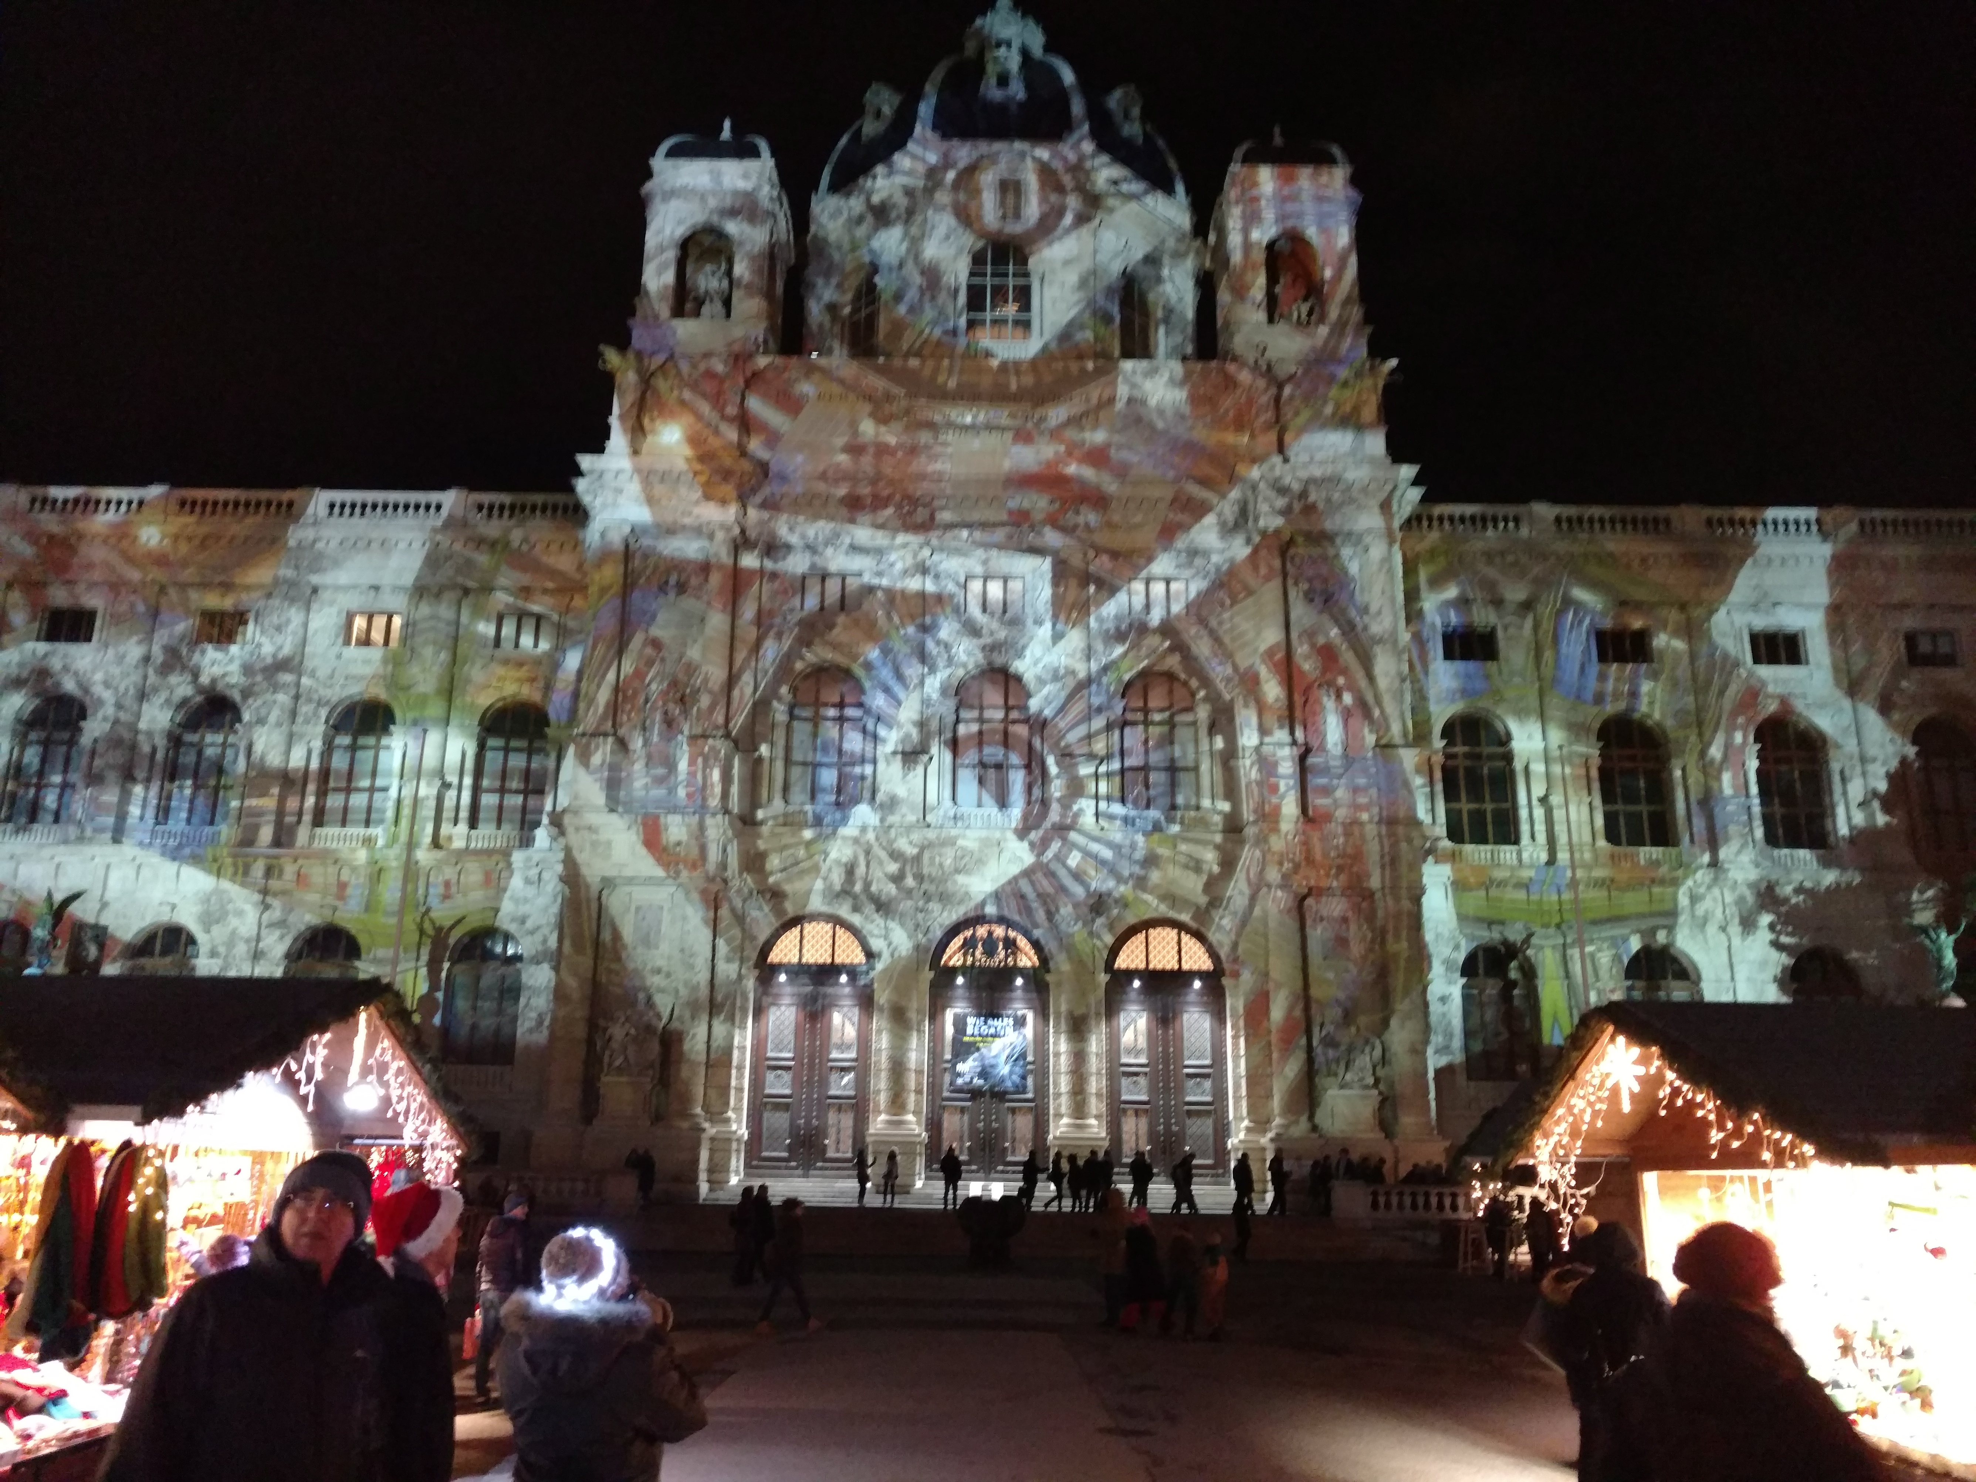
Outreach
Recent high-profile events
CERN visit of Austrian president and science minister
Exhibition at Museum of National History Vienna
Many excellent activities throughout Austria
General public
Teachers and students
Children
Events for persons without specific interest in science (art events, bars etc.)
Large media presence
Press, TV and film, radio, social media

Slide 16

Future
Update of the European Strategy for Particle Physics
Work out road map for Austria
Consider new activities (e.g. experimental neutrino physics)
Consolidation
New dark matter activities
LHC experiment upgrade

