Slide 1
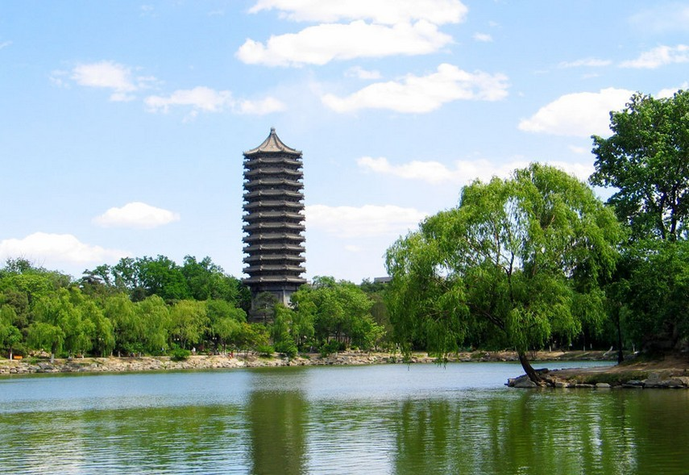
Applications of Deep Learning in Relativistic Hydrodynamics
Huichao Song
宋慧超
Peking University
Second international workshop on Collectivity in Small Collision Systems (CSCS 2018)
Hengfeng Huang, Bowen Xiao, Huixin Xiong, Zeming Wu, Yadong Mu and Huichao Song,arXiv:1801.03334
June. 15, 2018

Slide 2
What is deep learning?
AI ：the broadest term, applying to any technique that enables computers to mimic human intelligence.
ML：A subset of AI aiming at optimizing a performance criterion using example data or past experience, but without explicit instruction.
DL：A subset of ML aiming at understanding high-level representations of data using a deeper structure of multiple processing layers

Slide 3
Broad Applications of Deep Learning
AlphaGo (by Google DeepMind) beat human champion, March, 2016
Google DeepMind, London Nature 529, 484-489 (2016)

Slide 4
Broad Applications of Deep Learning
Language processing
-Machine translation
-Chinese poetry generation
-Speech recognition

Slide 5
Broad Applications of Deep Learning
Computer vision
-Image style transition:
-Image generation:
… … … …

Slide 6
Broad Applications of Deep Learning
-Playing Games:
-Autonomous Driving

Slide 7
Categories of deep learning
-Supervised learning
-Unsupervised learning
-Reinforcement learning
… … … …
Ian Goodfellow, Yoshua Bengio, and Aaron Courville, http://www.deeplearningbook.
org MIT Press, 2016

Slide 8
An example of Supervised Learning
-Identify cats and dogs
Supervised learning:
Training on a dataset contains many features and associated with a label or target.

Slide 9
An example of Unsupervised Learning
-Classify cats and dogs
Unsupervised learning
-experience a dataset contains many features but without labels, and learn useful properties of the structure of this dataset.

Slide 10
An example of Reinforcement Learning
-play games
Reinforcement learning
concern with how software agents ought to take actions in an environment so as to maximize some notion of cumulative reward

Slide 11
Deep Neural Network
-- more details

Slide 12
Deep learning tutorial for non-experts
Somewhat similar to look for a super complex function
-Define a set of functions
-Evaluate each function
-Pick up the best

Slide 13
Neural Network / Deep Neural Network
-In fact, there is not a “function” but to build up a (deep) neural network with huge tunable parameters to connect the inputs and outputs.

Slide 14
Neuron

Slide 15
Deep Neural network-loss fuction
Loss function：
-To evaluate the difference between the network’s outputs and learning targets.

Slide 16
Deep Neural network-back propagation & gradient decent
Back propagation and gradient decent
-Deep neural network can reduce fitting error by updating model parameters through back propagation and gradient decent.

Slide 17
Common Network Structures
Fully Connected Network
-recognize handwrite digits
… … … …
Convolutional Neural network
-image recognition
-image classification
… … … …
Recurrent Neural Network
-speech recognition
… … … …

Slide 18
Applications of Deep Learning in Physics

Slide 19
Why Deep Learning in Physics?
“Unlike earlier attempts … Deep Learning systems can see patterns and spot anomalies in data sets far larger and messier than human beings can cope with.”
Can “Black-box” models learn patterns and models solely from data without relying on scientific knowledge?

Slide 20
Applications of Deep Learning in Physics

Slide 21
Searching for Exotic Particles in High-Energy Physics
Motivation:
-Finding the rare particles in high-energy particle colliders requires a successful distinguish of the signal from the huge & messy background
-Traditional ‘shallow’ machine learning models that have a limited capacity for such task
P.Baldi,P.Sadowski,& D.Whiteson Nature Commun. 5, 4308 (2014)

Slide 22
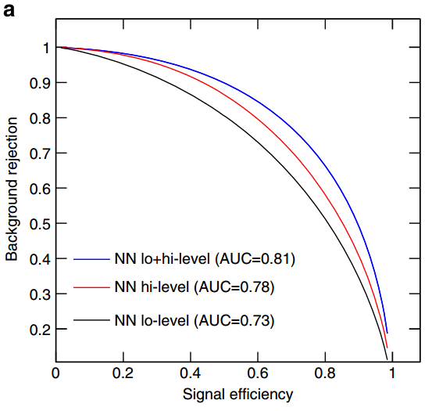
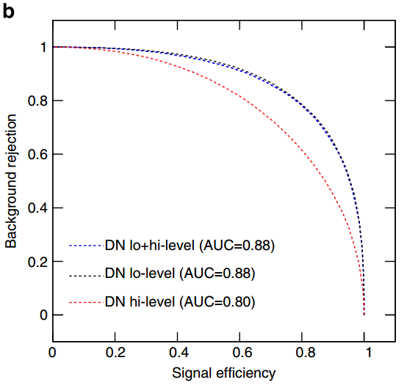
Searching for Exotic Particles in High-Energy Physics
A) Generating training/testing data
MadGraph (collisions) +PYTHIA (showering & hadronization) +DELPHES (detector response)
B) Training DNN/NN: supervised learning with 11 million data (low level / high level)
C) Testing DNN/NN
-DNN improves AUC by 8% compared to NN
Deep learning can improve the power for the collider search of exotic particles
P.Baldi,P.Sadowski,& D.Whiteson Nature Commun.5, 4308 (2014)

Slide 23
Classifying the Phase of Ising Model
Motivation:
-Traditionally, the study of phases transition of condense matter systems is to calculate the associated order parameter, measure specific heat, ect
-Can deep learning identify phases and phase transitions?
J. Carrasquilla and R. G. Melko. Nature Physics 13, 431–434 (2017)

Slide 24
Classifying the Phase of Ising Model
A）Generating training/testing data:
traditional MC method from the Boltzmann distribution
C) testing the trained net work
B) training fully connected network: with these raw configurations of square-lattice Ising-model
-The trained fully connected network also past the test of triangular-lattice
Ising model, showing its abilities of generalize to task beyond their original design
J. Carrasquilla and R. G. Melko. Nature Physics 13, 431–434 (2017)

Slide 25
Classifying the Phase of Ising Model
A）Training/testing data:
traditional MC method from the Boltzmann distribution
Further test- Ising gauge theory
B) training fully connected network: with these raw configurations of square-lattice Ising-model
Fully connected network fails (50% accuracy)
-equal to simply guessing
J. Carrasquilla and R. G. Melko. Nature Physics 13, 431–434 (2017)

Slide 26

Classifying the Phase of Ising Model
A）Training/testing data:
traditional MC method from the Boltzmann distribution
Further test- Ising gauge theory
No free lunch theorem^{[1]}
No machine learning algorithm is consistently better than another. In other words, there is no silver bullet, deep learning and neural networks not exempted. In fact, the most universal feedforward neural network does worse than tree based methods or SVM on many problems. Therefore, when adapting a model to new problems, one should be aware of model assumptions and ensures that they still holds.
[1] Wolpert, D. H. (1996). The lack of a priori distinctions between learning algorithms. Neural computation, 8(7), 1341-1390.
B) training fully connected network: with these raw configurations of square-lattice Ising-model
Fully connected network fails (50% accuracy)
-equal to simply guessing
J. Carrasquilla and R. G. Melko. Nature Physics 13, 431–434 (2017)

Slide 27
Classifying the Phase of Ising Model
For the case of Ising gauge theory
J. Carrasquilla and R. G. Melko. Nature Physics 13, 431–434 (2017)
The trained CNN discriminates high-temperature from ground States with very high accuracy in spite of the lack of an order Parameter or qualitative differences in the spin-spin correlations
Neutral network can be used to encode phases of matter and discriminate phase transitions in correlated many-body systems.

Slide 28
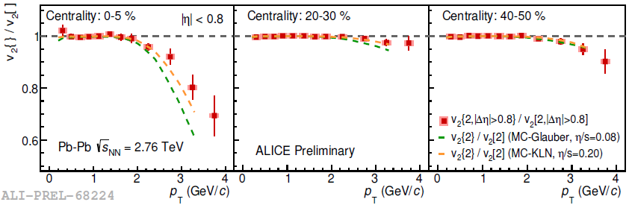
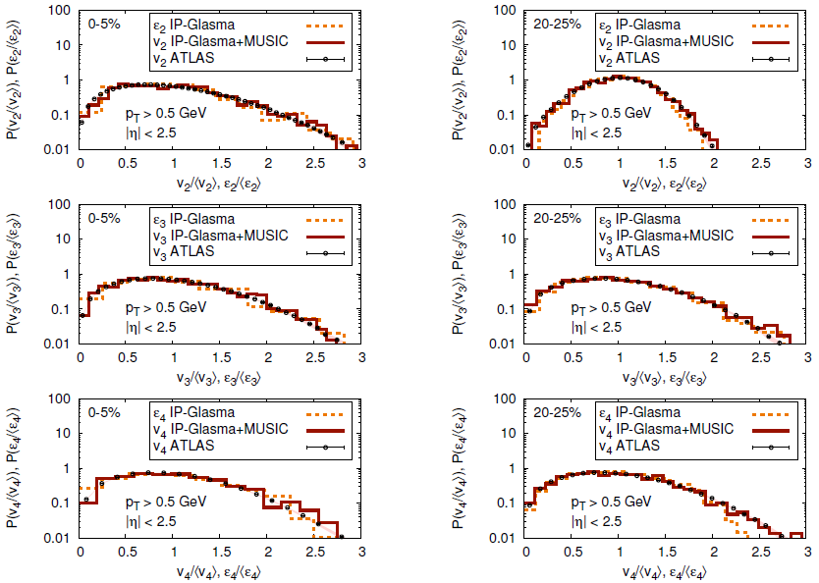
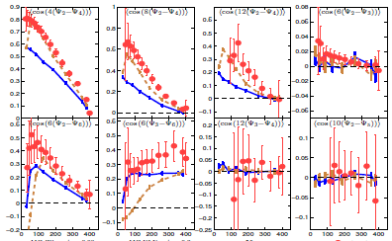
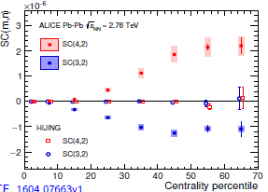
Identify QCD Phase Transition with Deep Learning
Motivation:
-Traditionally, the properties of the QCD matter are extracted from the event averaged observables
-Can deep learning identify different EoS from the raw data of heavy ion collisions?
LG. Pang, K.Zhou, N.Su, H.Petersen, H. Stoecker, XN. Wang. Nature Commun.9 (2018) no.1, 210

Slide 29
Identify QCD Phase Transition with Deep Learning
A）Generating training/testing data:
C) testing the trained net work
-Run Hydro with EOS L and EOS Q
-particle spectra - image (15*48 pixels)
B）Training CNN
Hydro CLVis (AMPT)
One can efficiently decode the EOS information from the complex final particle info event by event using deep learning
LG. Pang, K.Zhou, N.Su, H.Petersen, H. Stoecker, XN. Wang. Nature Commun.9 (2018) no.1, 210

Slide 30
More Comments
on several examples of supervised learning
Image classification
Dog or Cat ?
Yes or No ?
Higgs signal or background?
P.Baldi,et al,Nature Commun.(2014)
High temperature or low temperature phase?
Carrasquilla & Melko. Nature Physics (2017)
EoS L or EOSQ ?
Pang,et al Nature Commun.(2018)

Slide 31
Deep learning can do more … …
Image classification
Dog or Cat ?
Image generation

Slide 32
Image generation
For hydrodynamics can we use deep learning to learn/predict the pattern transform between initial and final profiles?
Initial energy density profiles
-------- > final energy density velocity profiles
Initial energy density profiles
-------- > final particle profiles
Final particle profiles
-------- > Initial energy density profiles
For the non-linear hydro system, can the “Black-box” network could learn patterns solely from data without relying on scientific knowledge? ( conservation laws)

Slide 33
Applications of deep learning to relativistic hydrodynamics
H.Huang, B.Xiao, H.Xiong, Z.Wu, Y. Mu and H.Song arXiv: 1801.03334

Slide 34
Traditional hydrodynamics
Deep Learning
-Such deep learning systems do not need to be programmed with the hydro
equation Instead, they learn on their own

Slide 35
Deep Learning
Step1）Generate the training/testing data sets from hydro (VISH2+1)
Initial & final energy momentum tensor profiles ----> initial & final image sets
Step2）Design & train the deep neural network
Training sets: initial & final profiles from hydro with MC-Glauber initial conditions
Step3）Test the deep neural network
Compare DNN predictions with hydro results for different testing initial conditions
（MC-Glauber, MC-KLN, AMPT Trento）

Slide 36
Deep Learning for 1+1-hydro
1) Generate the training/testing data sets from 1+1-d hydro
EoS: p=e/3, MC-Glauber/MC-KLN initial condtions
2) Design / train neural network (CNN)
Huang & Song unpublished notes

Slide 37
Deep Learning for 1+1-hydro
3）Testing the neural network
-CNN predictions vs. hydro simulation: CNN works for 1+1-d hydrodynamics
-A first hint that a well designed network could capture the non-linear
evolution of hydrodynamics
Huang & Song unpublished notes

Slide 38


Deep Learning (CNN): an extension to 2+1-hydro
Initial condition
Hydro results
CNN prediction
$τ$0 =0.6 fm/c
$τ=2$.6 fm/c
$τ=2$.6 fm/c
-For 2+1-d hydro, CNN does not work, so does not other common network, such as local connected layer
-From 1+1-d hydro to 2+1-d hydro, the pixel of the imagine sets increased from 200 to 40000 (200*200)

Slide 39
Deep Learning (CNN): an extension to 2+1-hydro
Initial condition
Hydro results
CNN prediction
No free lunch theorem^{[1]}
No machine learning algorithm is consistently better than another. In other words, there is no silver bullet, deep learning and neural networks not exempted. In fact, the most universal feedforward neural network does worse than tree based methods or SVM on many problems. Therefore, when adapting a model to new problems, one should be aware of model assumptions and ensures that they still holds.
[1] Wolpert, D. H. (1996). The lack of a priori distinctions between learning algorithms. Neural computation, 8(7), 1341-1390.
$τ$0 =0.6 fm/c
$τ=2$.6 fm/c
$τ=2$.6 fm/c
-For 2+1-d hydro, CNN does not work, so does not other common network, such as local connected layer
-From 1+1-d hydro to 2+1-d hydro, the pixel of the imagine sets increased from 200 to 40000 (200*200)

Slide 40
Stacked U-net for 2+1-d hydro
The activation function:
The loss function:
normalized MAE loss
H.Huang, B.Xiao, H.Xiong, Z.Wu, Y. Mu and H.Song arXiv: 1801.03334

Slide 41
Training / Testing data sets from 2+1-d hydro
Initial conditions: MC-Glauber, MC-KLN, AMPT, Trento
EoS: p=e/3,
hydro evolution time:
The Training Data Sets
2+1-d hydro VISH2+1 | MC-Glauber
 | 10000 events
The Testing Data Sets
2+1-d hydro VISH 2+1 | MC-Glauber | MC-KLN | AMPT | Trento
 | 10000 events | 10000 events | 10000 events | 10000 events
H.Huang, B.Xiao, H.Xiong, Z.Wu, Y. Mu and H.Song arXiv: 1801.03334

Slide 42






Predictions: Stacked U-net vs. CNN
Initial condition
Hydro results
CNN prediction
$τ$0 =0.6 fm/c
$τ=2$.6 fm/c
$τ=2$.6 fm/c
Initial condition
Hydro results
sUnet predictions
$τ$0 =0.6 fm/c
$τ=2$.6 fm/c
$τ=2$.6 fm/c
-sUnet is the proper directions that works

Slide 43


Single sUnet for longer time evolution
Hydro results
sUnet predictions
Hydro results
sUnet predictions
$τ=2$.6 fm/c
$τ=4$.6 fm/c
Combined sUnet for long time evolution

Slide 44
sUnet prediction vs. hydro simulations

Slide 45
sUnet prediction vs. hydro simulations
-for a closer look

Slide 46
sUnet prediction vs. hydro simulations

Slide 47
sUnet prediction vs. hydro simulations
-for a closer look

Slide 48
sUnet prediction vs. hydro simulations

Slide 49
sUnet prediction vs. hydro simulations
-for a closer look

Slide 50
sUnet prediction vs. hydro simulations
Eccentricity distributions:

Slide 51
sUnet prediction vs. hydro simulations

Slide 52
Summary & outlook

Slide 53
Traditional hydrodynamics
Deep Learning

Slide 54
For hydrodynamics can we use deep learning to learn/predict the pattern transform between initial and final profiles?
Initial energy density profiles
-------- > final energy density velocity profiles
Summary
-Using 10000 initial and final profiles generated from VISH2+1 with
MC-Glauber initial condition, we train the network called sU-net.
-We use the well-train network to predict the final profiles from with different
initial conditions, including MC-Glauber, TRENTo, AMPT and MC-KLN.
-Out results show that deep learning can predict the magnitude and inhomogeneous structures of the final energy density and flow velocity, which can also describe the related eccentricity distribution P("n).
-Deep learning can capture the main features of the non-linear evolution of hydrodynamics.

Slide 55
Outlook
For hydrodynamics can we use deep learning to learn/predict the pattern transform between initial and final profiles?
Initial energy density profiles
-------- > final energy density velocity profiles
Initial energy density profiles
-------- > final particle profiles
Final particle profiles
-------- > Initial energy density profiles
For flow in large and small systems
open for discussions

Slide 56
Thank You

Slide 58
Unet & Stacked Unet
-Inspiration from biomedical image segmentation

