Slide 1
ReSharper
Improve your coding experience

Slide 2
What is ReSharper?
Visual Studio Extension
by JetBrains s.r.o., registered in Prague, Czech Republic
Supports latest languages and standards of .NET and C++
Full integration with Visual Studio
Powerful coding tools
  Advocates best development and design practices
  Code quality and solution-wide analysis
  Provides multiple automated quick-fixes
  Solution-wide automated refactoring
  Code generation and templates
  Navigation and search
Notes:
ReSharper
Primarily intended for the C# language
Launched 2004
ReSharper C++
Launched 2013

Slide 3
Key Features for C# and C++
Analyze and improve code quality
Eliminate errors and code smells
Refactor and transform code
Generate common code
Consistent code style
Comply with coding standards
Find usages and navigate code
Run and manage unit tests
C# 7.0 support
C++11 and C++17 features

Slide 4
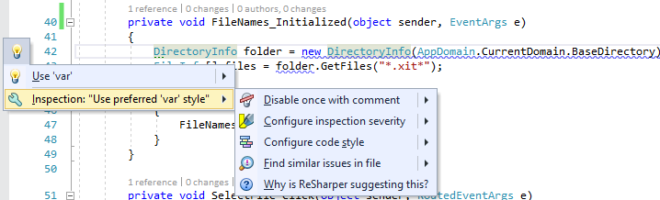
Code analysis example: use 'var' style
Code analysis suggest me to use the var keyword:
    var folder = new DirectoryInfo();
But I like explicit types:
    DirectoryInfo folder = new DirectoryInfo();
Notes:
I don’t like using the var keyword and prefer the explicit types.
So I can adjust the Code Style options to use the explicit types.

Slide 5
Improve code development in C# and C++
Quality analysis
  Quick-fixes for code issues
  Solution-wide inspections
Context sensitive coding assistance
  Smart completion, importing namespaces
  Live and Surround templates
Consistent code style
  Code formatting and cleanup
  Removing code redundancies
Refactoring
  Change Signature
  Extract classes, interfaces or methods
  Introduce field or variable
Generation
  Constructors, Properties, Methods
  Formatting and Equality Members
  Implement/Override Methods
Navigation and Inspection
  Go to classes, methods or last edit location
  Find usages and references
  Type hierarchy, stack trace explorer, bookmarks
Unit test runner
  Running and debugging unit tests
  Analysing code coverage
  Profiling and Monitoring memory usage
Internationalization
  Highlighting localizable strings
  Moving strings to resource files
  Refactor, Inspect, Navigate resource files
Additional support
  Customizable Templates
  XAML editing tools
  ASP.NET, JavaScript and TypeScript

Slide 6
ReSharper Ultimate
A set of .NET tools and ReSharper C++ in one license
ReSharper | for .NET developers
ReSharper C++ | for C++ developers
dotTrace | .NET performance profiler
dotCover | .NET unit test runner and code coverage tool
dotMemory | .NET memory profiler
dotPeek | .NET decompiler & assembly browser
Notes:
dotTrace helps you detect performance bottlenecks
dotCover is a .NET unit test runner and code coverage tool
dotMemory allows you to analyse memory usage
dotPeek is a free-of-charge standalone tool based on ReSharper's bundled decompiler. It can reliably decompile any .NET assembly into equivalent C# or IL code

Slide 7
License Subscriptions
Commercial yearly licenses per user
ReSharper C++ € 199.00 in 1st year
ReSharper € 299.00 in 1st year
ReSharper Ultimate € 399.00 in 1st year
  ReSharper, ReSharper C++, dotTrace, dotMemory, dotCover
Discounts for academic institutions and non-commercial open source software projects
  https://www.jetbrains.com/resharper/buy/#edition=discounts

Slide 8
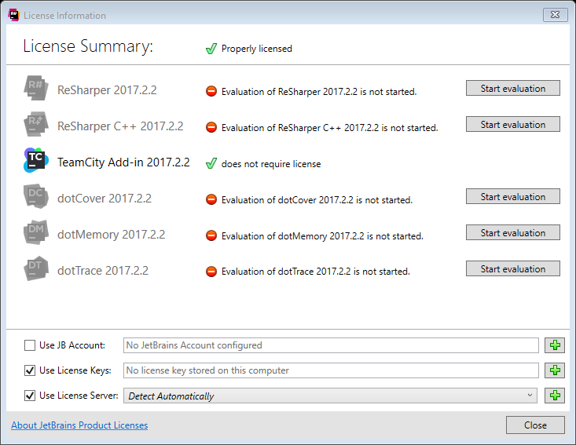
Evaluation license
Notes:
Started evaluation on 14th November and paused on 17th November.
Evaluation times of
dotCover 30 days
dotMemory 5 days
dotTrace 10 days
TeamCity = Build management server with continuous integration (merging the development branches)

Slide 9
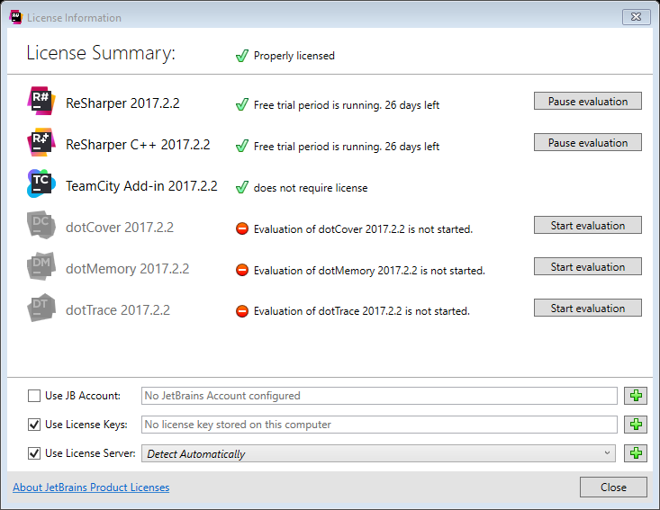
Evaluation license
Notes:
Started evaluation on 14th November and paused on 17th November. Continued today.
Remember to pause it during vacation or weekends.

Slide 10
Live Presentation
ChabaCore
  Unused variables
  Not implemented private functions
  Hiding local declaration
  Incomplete switch statements or unhandled default case
SpatialAnalyzerSDK
  Configure naming conventions
  Correct spelling mistakes
  Unused includes
  Develop an algorithm

Slide 11
Why I like it?
Makes Microsoft Visual Studio a much better IDE.
Improves your Code Quality and supports the latest language features.
Be more productive with Code Analysis, Refactoring, Code Style and Code Generation.
And if you getting annoyed about several code analysis messages, while you develop an algorithm and examine its behaviour, then just pause and check for improvements later.
Extensible with ReSharper Plugins like spell checking.
Various customizable settings for shortcuts, code style and code analysis.
Not required for the other team members and supports team wide configuration settings.
Detailed documentation and tutorials with introduction about first steps in ReSharper.
Using annotations to refine Code Analysis (requires JetBrains.Annotations Package).
More ReSharper Benefits:
C# | C++
ReSharper Data Sheet | ReSharper C++ Data Sheet
ReSharper 2017.2 vs. Visual Studio 2017 | ReSharper C++ 2016.3 vs. Visual Studio 2015
 | ReSharper C++ vs. Visual Assist

Slide 12
What’s next?
Have a deeper look on ReSharper Ultimate
  https://www.jetbrains.com/dotnet/
Try out what effort you have using this software
  The 30-days trial period can be paused and resumed later.
Take some time to learn more about ReSharper
  Understand why it suggests improvements for your code.
  Visit the Features and Documentations for C# and C++.
  See some video tutorials of JetBrains .NET Tools.
  Use it in your daily coding project for some time, then pause the license evaluation and check if you miss some features.
Get in contact with Hiba Gerster or Chafik El Chazouani from CERN procurement, to get an offer and be able to make a DAI.

Slide 13
Enjoy a new coding experience!

