Slide 1
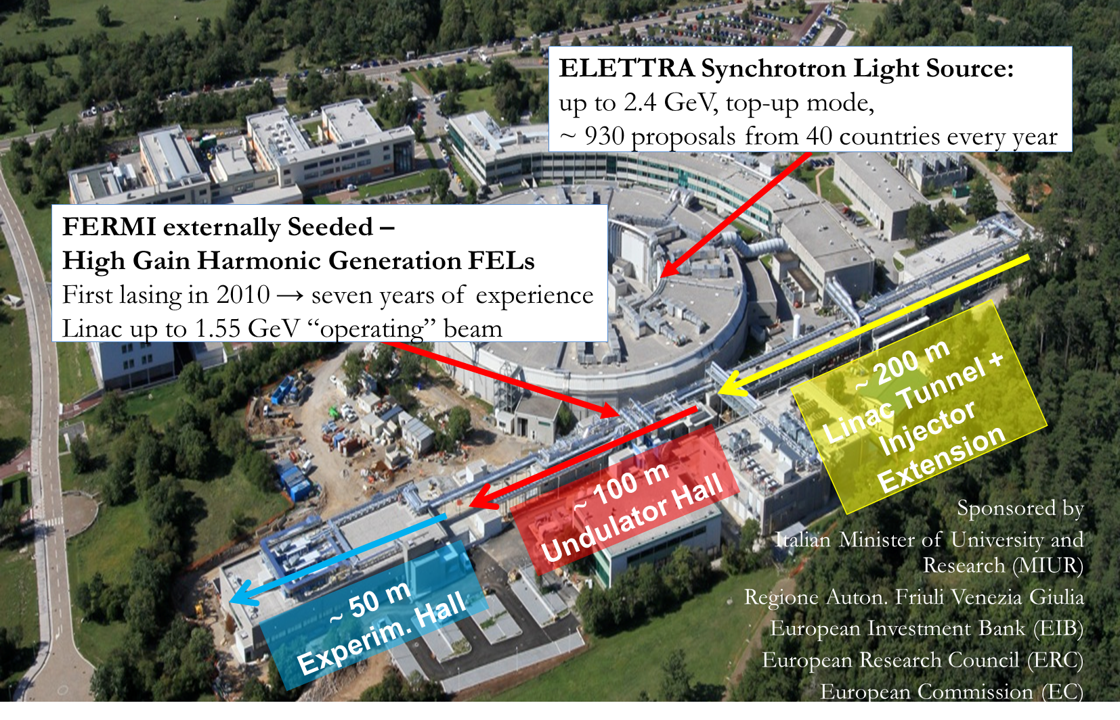
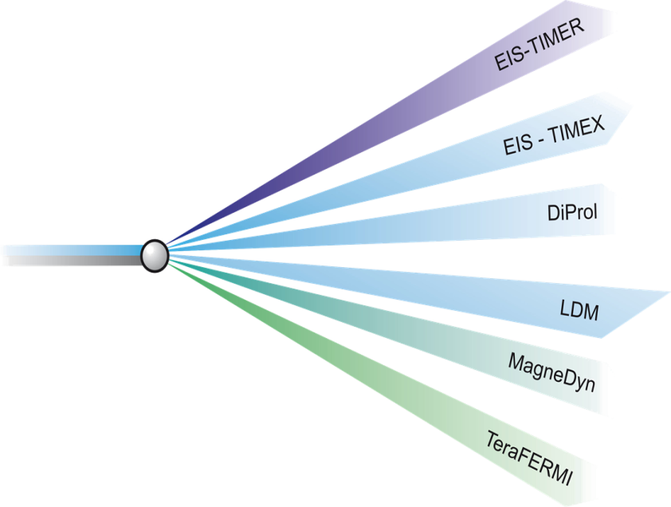
Elettra Sincrotrone Trieste
Science Beamlines at FERMI:
Project started in 2004
CDR (Intern. Collab.): +3 years
Construction: +2 years
Commissioning: +9 months
First Users: +5 months (2010)

Slide 2
E-ST for WP6
Institute’s expertise:
Design, construction and management of Light Sources
  Synchrotron, Linac-FEL, Conventional Lasers, HHG
Areas of contribution to WP6:
Definition of layout
  electron beam delivery system, undulator line, diagnostic lines, dumps…
  collective effects (analytical and numerical)
Contribution to S2E simulations
Level of resources:
S. Di Mitri, senior accelerator scientist
  Efforts to be shared over WP2, WP3 and WP6

