Slide 1
CERN Participation in
XLS :: WP6
A. Latina, D. Schulte
for the CLIC Beam Physics Team

Slide 2
Our Expertise and Interest
CLIC Study
Code Development and Benchmark
  PLACET: Linear Accelerators & Colliders
  RF-Track: Injectors
  Adapt to FEL case, start-to-end
  Pursue benchmarks and experimental verifications
Cost-Evaluation and Cost-Optimization Tools
  Improve our tools
  Adapt to FELs and adjust to existing FELs
  Use it for CompactLight integration studies and optimization

Slide 3
PLACE Tracking code
PLACET is a tracking code originally developed by Daniel Schulte to evaluate the performance of CLIC. Since then it has been used for e.g. ILC, FACET, ATF2, FERMI, EU-SPARC, …
4D and 6D tracking ; single- / multi- bunch ; using 2 beam models, macroparticles / slices
Implements the standard element types: QUADS, SBENDS, ACC CAVITY, BPMs, CORRECTORS, …
Implements the Power Extraction and Transfer Structures (PETS), key elements of CLIC, including beam loading
It provides beam-based alignment (BBA) routines including Dispersion-Free Steering, Wakefield-Free Steering for dynamical simulations, these are necessary to derive tolerances
Collective effects:
Resistive-wall wakefields in collimators
Single-bunch Short-range wakefields: optimized implementation in accelerator structures and collimators; wakefields can be attached to any elements using splines
Multi-bunch long-range wakefields in accelerator structures, time-domain/frequency-domain models
Incoherent synchrotron radiation in all magnets and in kickers
Coherent synchrotron radiation (w/ and w/o shielding) in sector bends
It can simulate dynamics effects, such as vibrations, ground motion (ATL law or measured on site), magnetic stray fields ; halo formation
It is programmable using Tcl/Tk, Octave and Python.

Slide 4
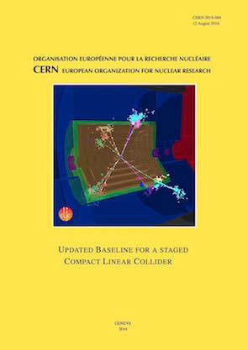
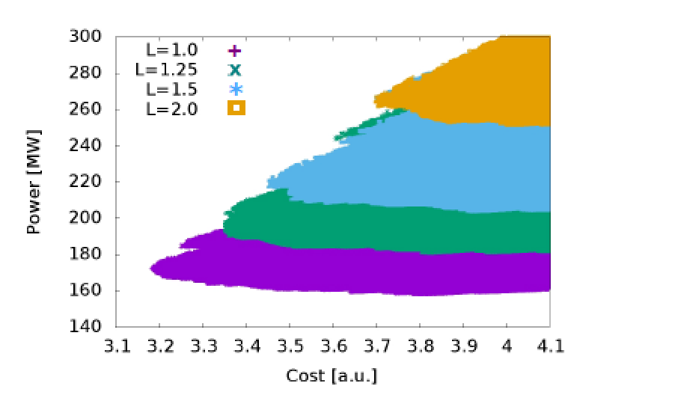
Costing tools:
Design Parameters of CLIC @ 380 GeV
Optimisation for performance, cost and power, but considering further energy stages
Luminosity goal 1.5x10³⁴cm⁻²s^{-1,} 60% of luminosity in the peak
Using already demonstrated structure performance
Includes all our knowledge on system design limits (RF structures, beam-beam, damping ring, beam delivery system, stabilisation, magnets, …)
CERN-2016-004
CompactLight - WP6 Pre-Kick Off Meeting

