Slide 1
Tracker summary:

Slide 2
Contents:
Tracker paper: status and plans
Tracker jobs list and preparation of schedule
Conclusions

Slide 3
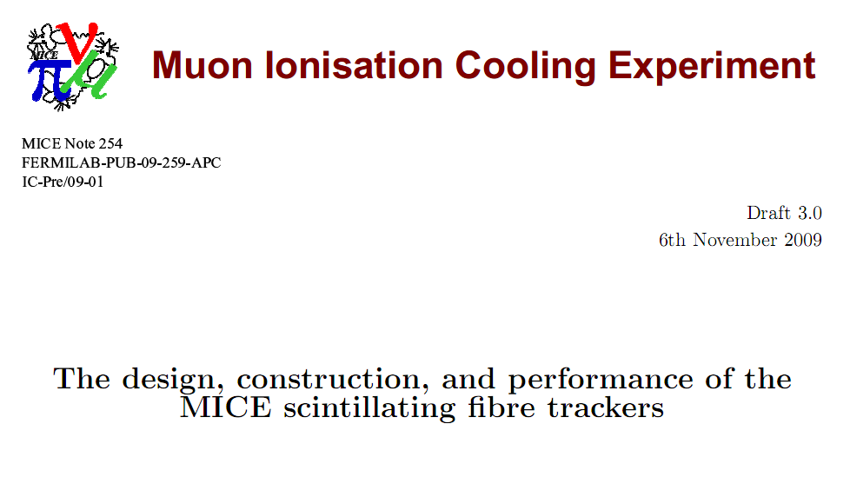
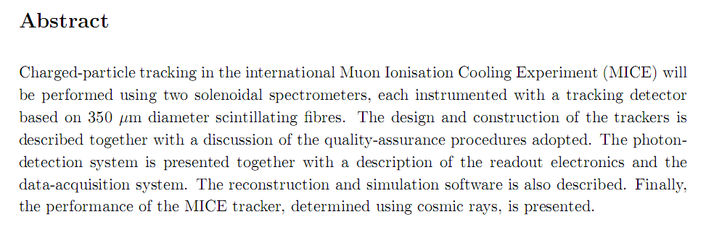

Slide 4
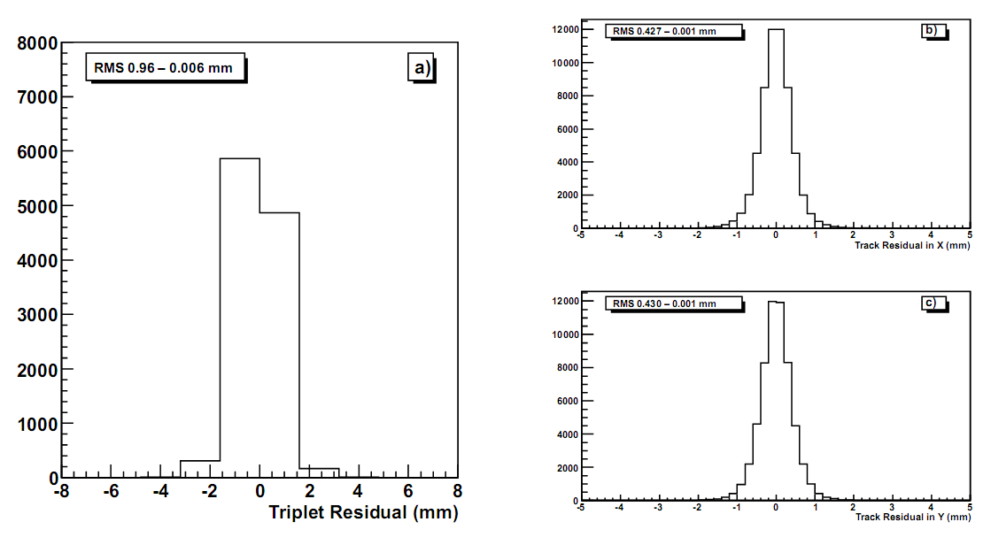
Resolution:
D.Adey

Slide 5
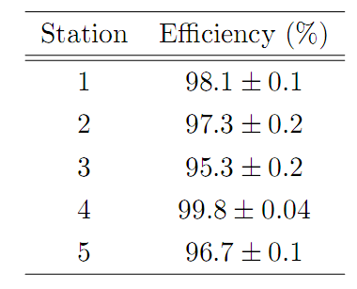
Efficiency:
Bug or feature in G4MICE being addressed to get correct efficiency v#1lues for tracker 1

Slide 6
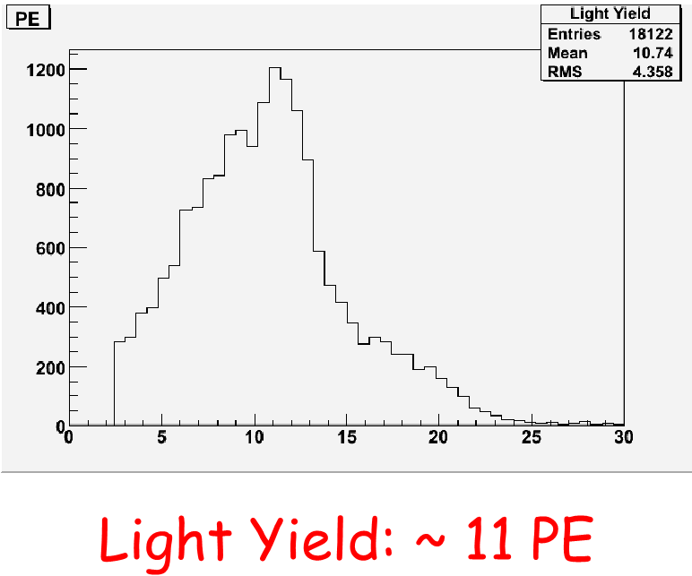
Light yield:
Plot to be made [D.Adey] to be added to paper

Slide 7
Tracker Status
Both tracker systems are complete and tested and currently in Lab 7
  We will retest tracker 2 before moving into MICE Hall
  Will do a full DATE readout test before moving into the Hall
Outstanding issues
  Cryocoolers and compressors:
    Cold heads and compressors need to be serviced before installation in Hall
  Must replace VLPC cryostat vacuum pump systems*
    Turbos may be OK.
    Controllers need replacing – not reliable
  Integration with slow control/online monitoring system*
    All parameters to be logged have been identified
    Some hooks into the hardware need to be pinned down
  Radiation Shields
    Out for Fabrication in US
  Installation of Hall probes*
    Still need input from NIKEF
  Finalize design of He window and fabricate
*Needed for Step III.1

Slide 8
Preparation of schedule:
Preconditions:
  Finish paper;
    Submit to NIM [or Jinst?]
  Begin update of TRD;
  Spectrometer solenoid schedule following review 18—19Nov09
Prepare schedule based on task list, working back from solenoid installation date at RAL

Slide 9
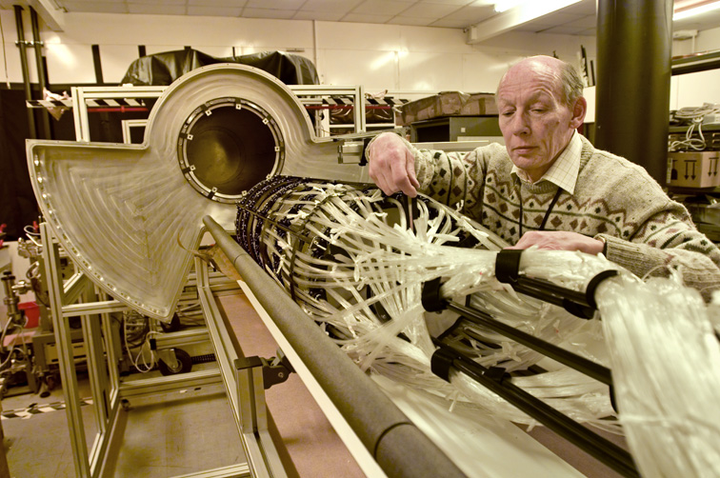
Conclusions:

