Slide 1

PID status report
M. Bonesini
Sezione INFN Milano Bicocca

Slide 2
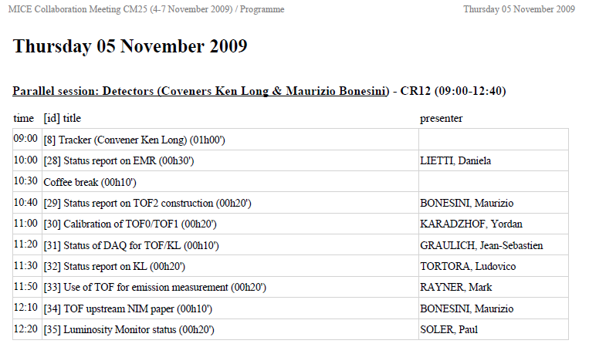

A crowded agenda in CM25 for PID

Slide 3
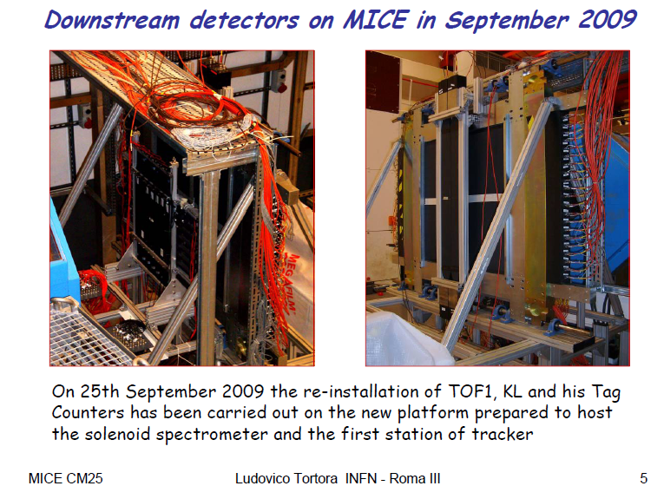
The usual workhorses : CKVOV/TOF0/TOF1 +KL

Slide 4
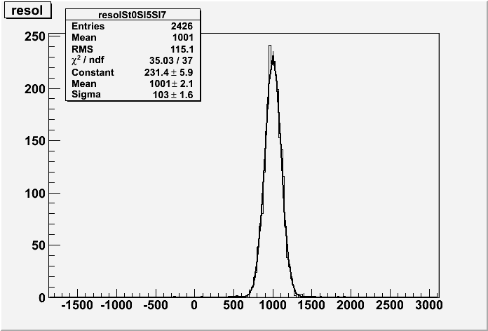
TOF0 calibration
The resolution in a given pixel can be measured before the absolute time calibration (see the plot)
The expected total resolution of the detector can be calculated by the formula , where σ_{i} is the resolution in pixel I N_{i} is the number of events in pixel i and N_{tot} is the total number of event.

Slide 5
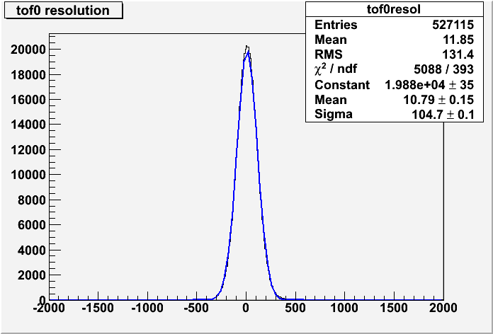
TOF0 calibration
Measured total resolution – 52.3ps

Slide 6
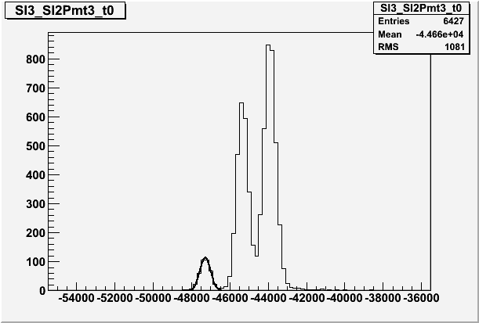
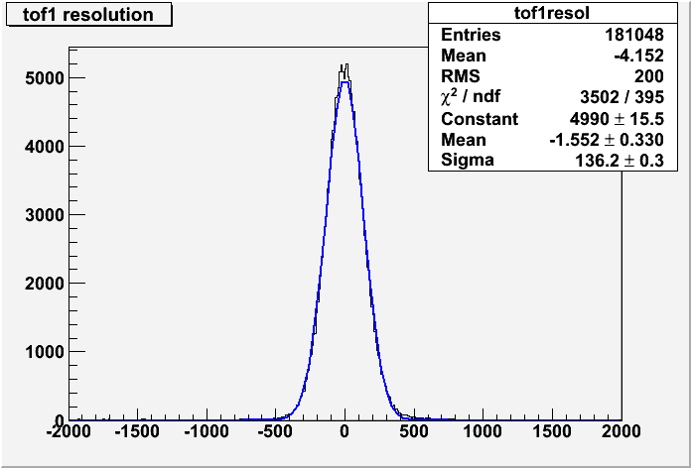
TOF1calibration
Positron peak in the TOF spectrum is used to calibrate TOF1
Expected resolution – 64.2ps
Measured resolution – 68.1 ps
Absolute time calibration in TOF1 is not so precise.

Slide 7
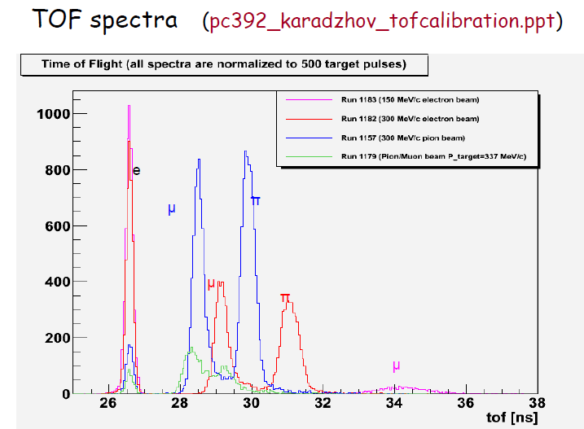
Time of flight

Slide 8
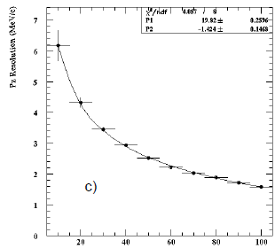
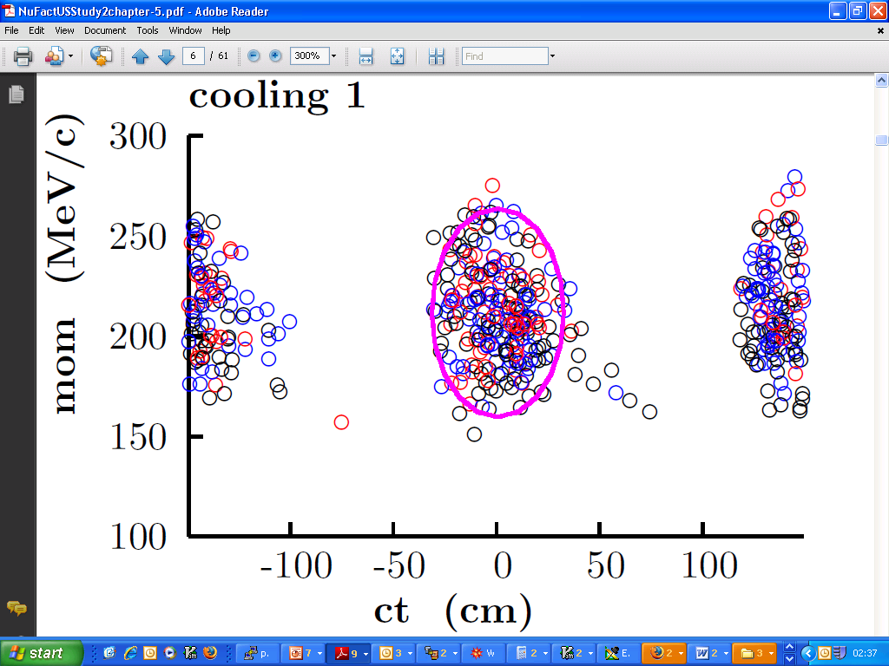
TOFs make important physics measurements beyond PID
Stages II - VI
I_{D}
I₇
I₈
I₉
TRP
Absorber
RF
Q7
Q8
Q9
Diffuser
D2
?
t₁
x₁, y₁
x, y, z
p_{x}, p_{y}, p_{z}
t
7
?
?
t₀
x₀, y₀
σ_{x}, σ_{y}
α, β, γ, ε
t
Pz Resolution (MeV/c)
note suppressed zero
0
20
True Pt (MeV/c)
100

Slide 9
Conclusion
Stage I
  Difficult to predict emittance
  Scraping: difficult to design optics
  Emittance-momentum matrix?
Stages II – VI
  RF phase of individual muons?
  Longitudinal emittance?
  Longitudinal-transverse coupling?
  Amplitude-Pz correlation?
TOF capabilities
  Individually calculated and independent measurements of all phase space variables
  Essential for timing
  Important momentum measurement upstream of thick diffuser plates, particularly at low amplitudes
ADC
TDC
Digits
Calibration,
Complete
detector
measurements
Slab hits
Space points
PID,
Phase space
distributions
at all z
Tracks

Slide 10
A good news : DAQ synchr. problem solved
TOF and KL FEE in different VME Crates
  Each crate receives separate DAQ trigger at the end of the spill
Perfect Synchronization needed for correlation between TOF and KL
Synchronization can be lost because of
  Unstable electronics in DAQ trigger distribution
  Unstable behavior of the VME/Pci Interface
The DAQ software release the busy and enables the DAQ trigger receiver channel after readout
  Must go through the VME/Pci Interface
  It happens that one of the two commands is not executed properly…
  Unpredictable
  Cured only by a power cycle
Has to be monitored

Slide 11
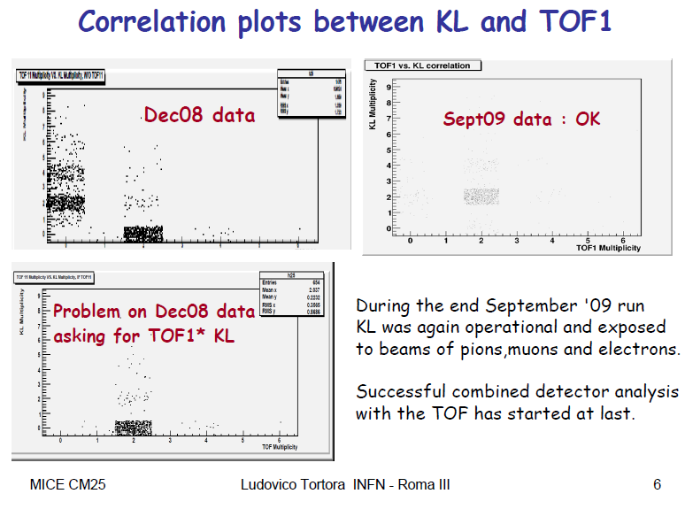

Slide 12
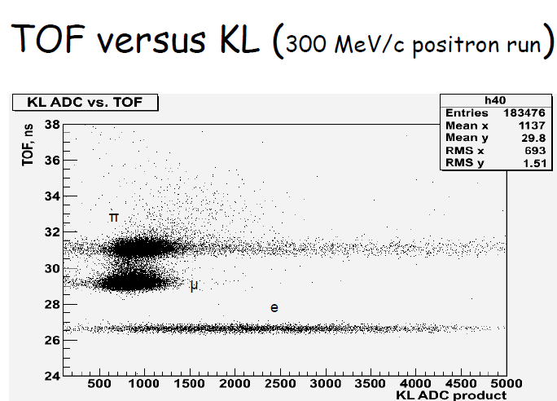

Slide 13
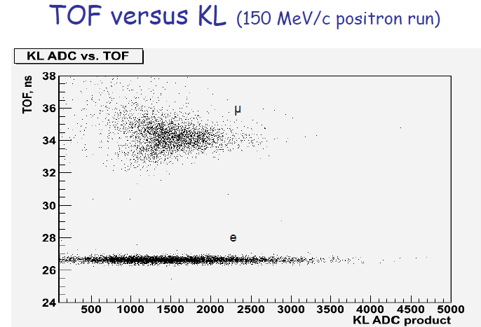

Slide 14
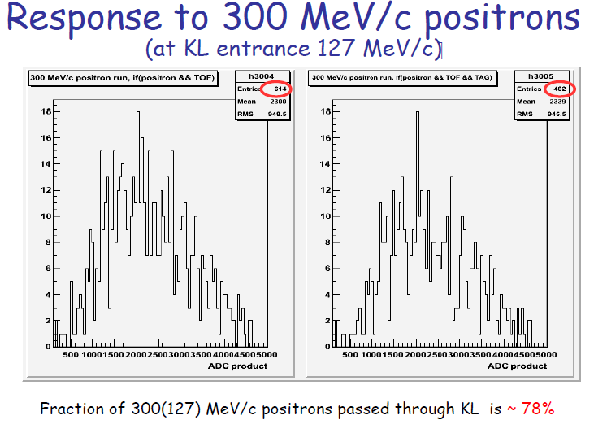

Slide 15
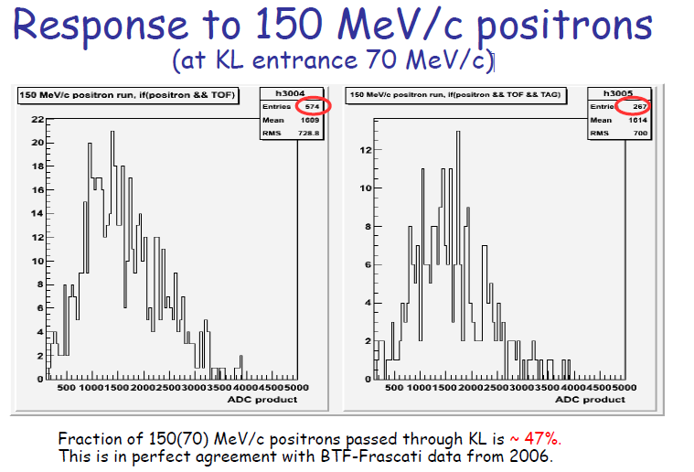

Slide 16
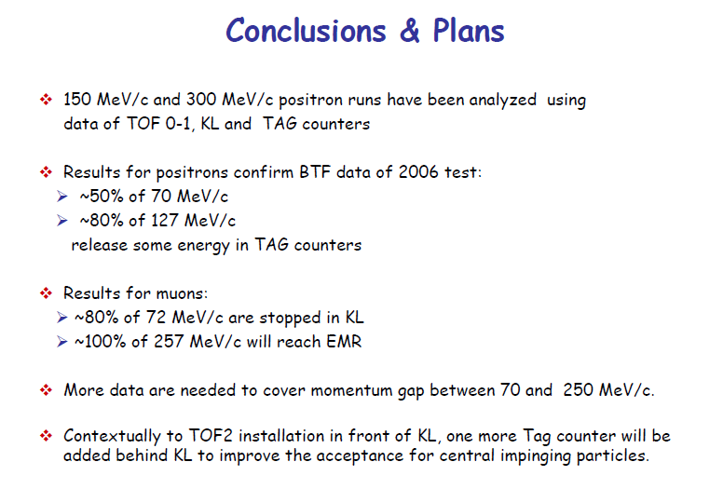

Slide 17
TOF2 construction status (MIB+PV)
TOF2 counters assembled in MIB
last faulty H6533MOD assemblies under repair at Hamamatsu have been delivered around 20 October .
All PMTs have been tested after some days of burning up
final platform for KL+TOF2+SW from Rm3 ready
TOF2 mechanics + local shielding ready
Final assemby of TOF2 will start soon (some problems due to the weight of the detector ~200 kg with shieldings)
Expected transport at RAL 23/11
Installation/cabling foreseen for 24/11 – 28/11

Slide 18
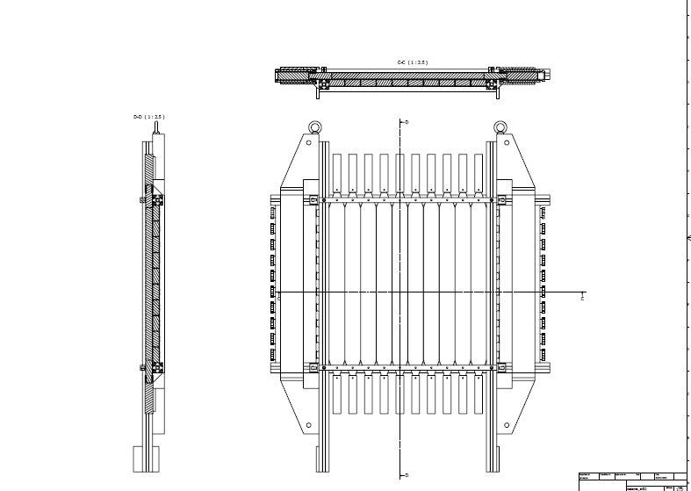
Details of construction for TOF2

Slide 19
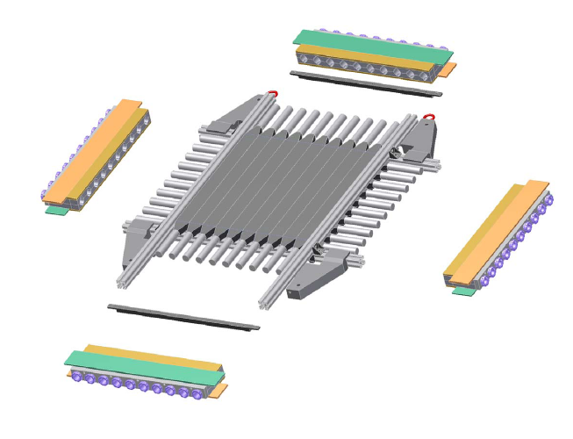
Details of TOF2 local shielding
Joints to close magnetic circuit
Local shielding (in addition to Virostek plate)

Slide 20
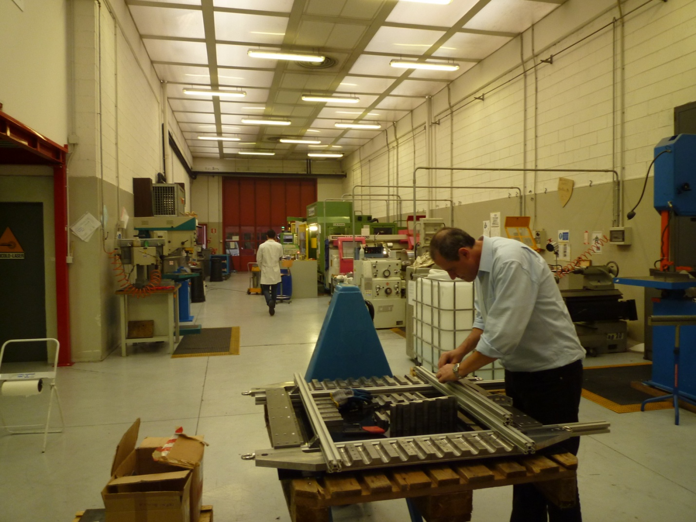
Pre-test of assembly in MIB mechanics workshop

Slide 21
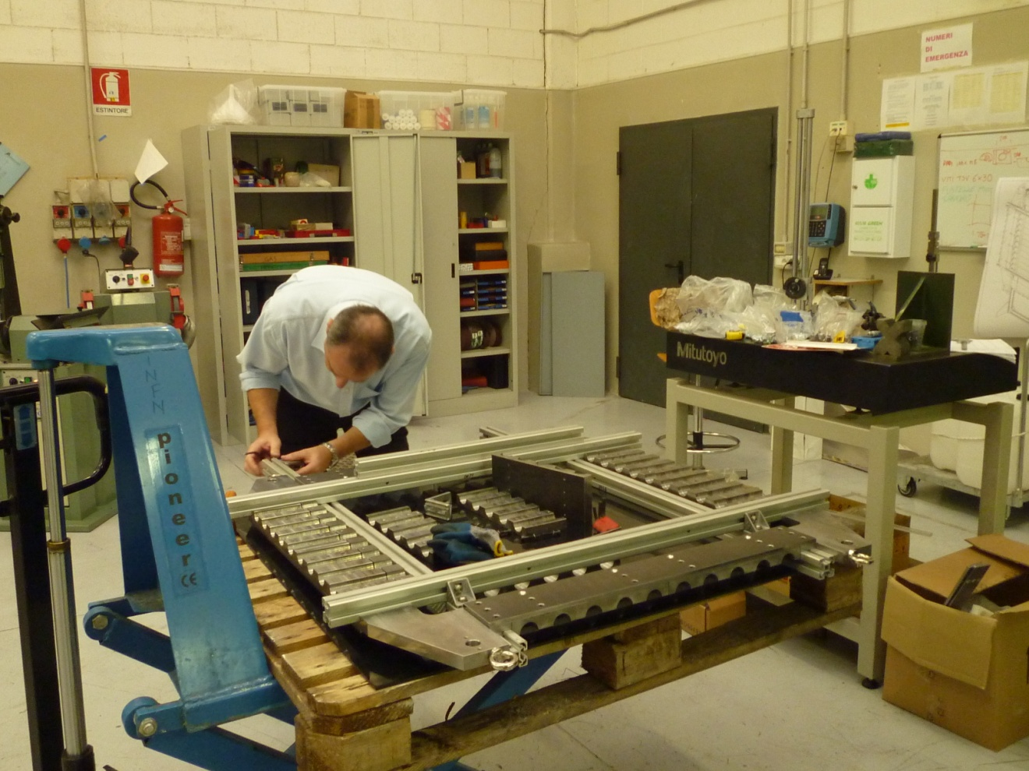
A closer look

Slide 22
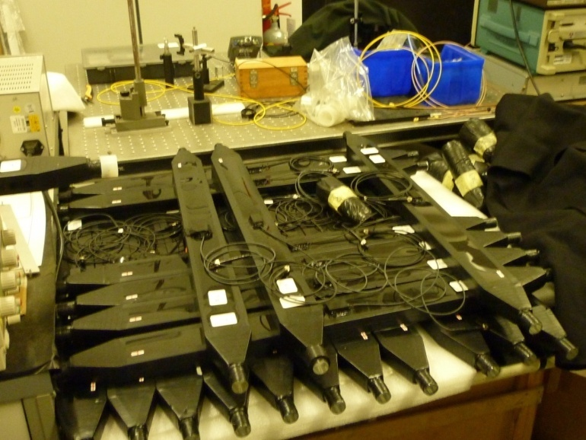
Tests foreseen for counters
Tests on single PMTs
  Dark current/spikes tests for some days
  Pre-calibration with YAP-CE source
Tests on single counters (after assembly)
  Tests for light tightness
  Tests with laser light injection (changing HV)
  Tests with cosmics (changing HV)

Slide 23
Cables for TOF2
signal cables: 20 old RG213 cables 40 m long (~169.6 ns delay) + in addition other 20 RG213 cables (30 m long) from NOVACAVI Milano giving the same delay
ready
    All individually measured for delay
HV cables: 40 new 31 m long cables to allow all STEPS done in MIB instead of 2m long cables ready
no length problem

Slide 24
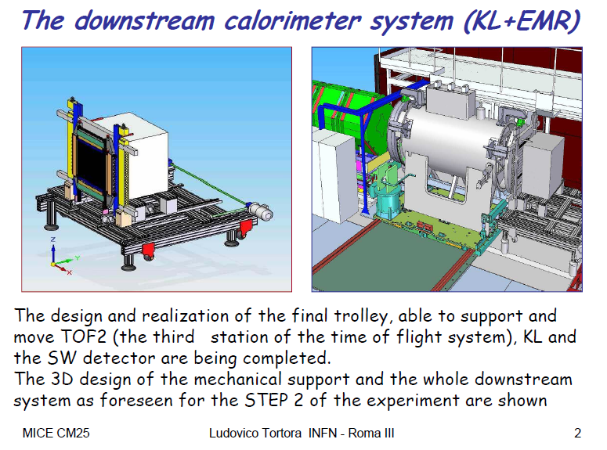

Slide 25
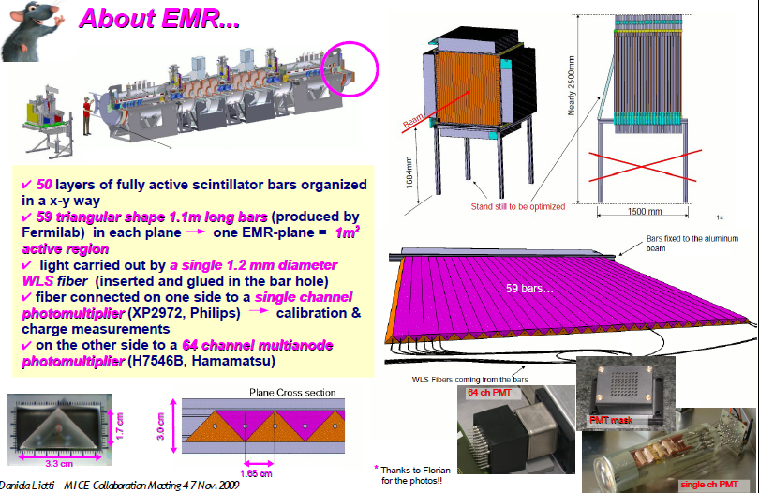
New developments: EMR

Slide 26
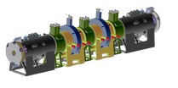

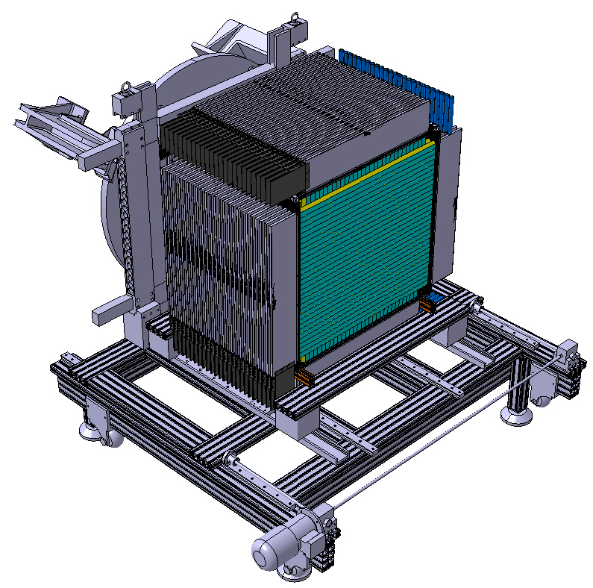
EMR design & Module M0 prototype
KL
EMR
EMR features:
25 modules
1 module is made of X&Y planes
2950 triangular bars
nearly 11 km of WLS fibers
(1.2mm diam.)
50 multianode PMT
50 single pixel PMT
28 Kg per plane (1,5 Ton totally)
Movable platform
(existing part to be
delivered soon?)

Slide 27
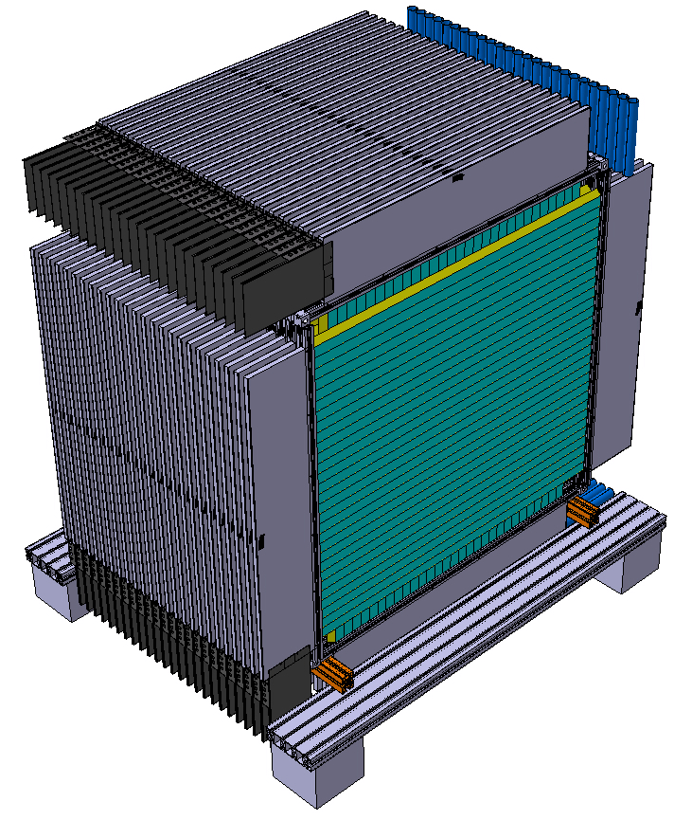
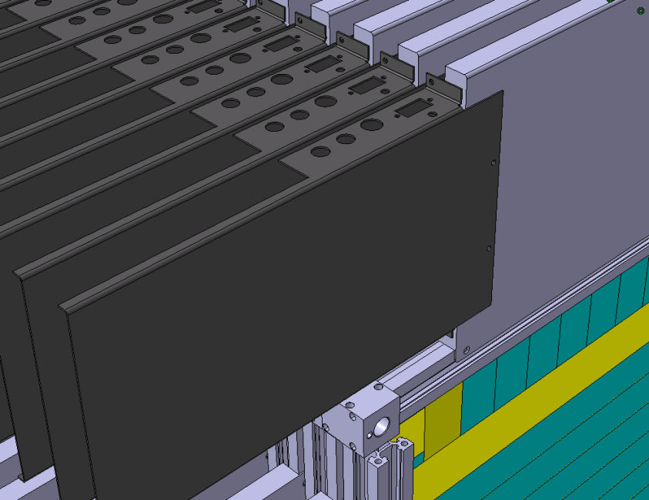
EMR design & Module M0 prototype
Outer Box
Single pixel
PMT
Fiber
enclosure
4mm gap between
Electronics boxes
FEE & Multianode
PMT
Supporting
frame (interface)…still under investigation

Slide 28
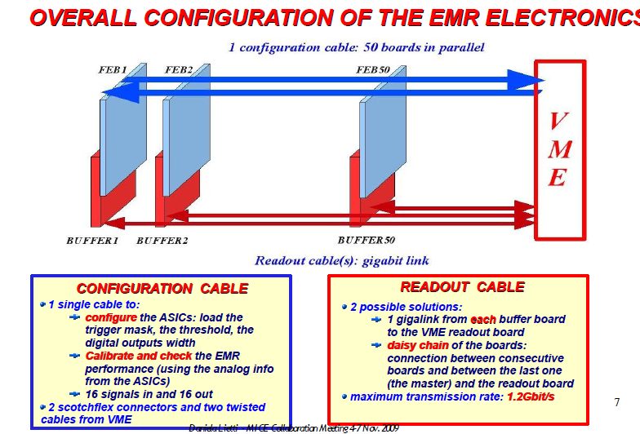

Slide 29
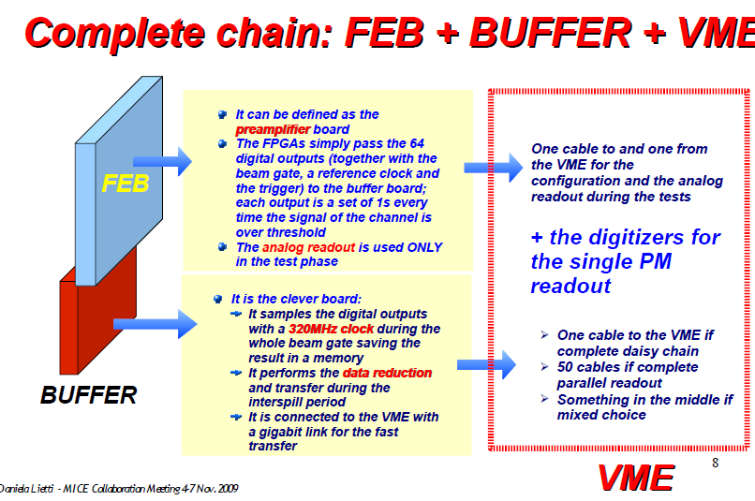

Slide 30
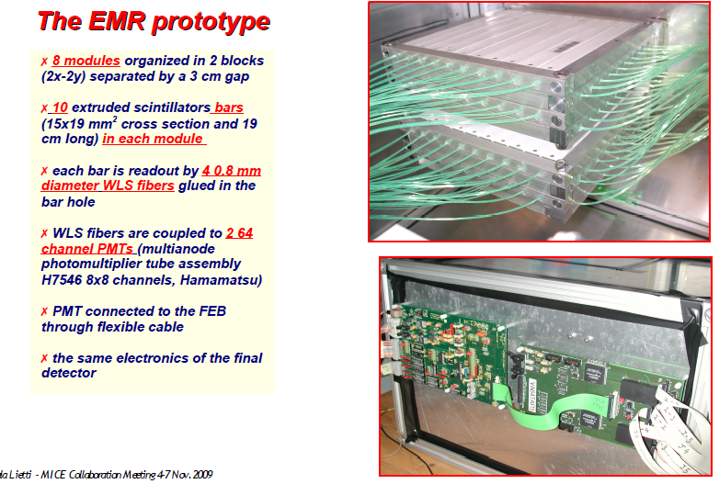

Slide 31
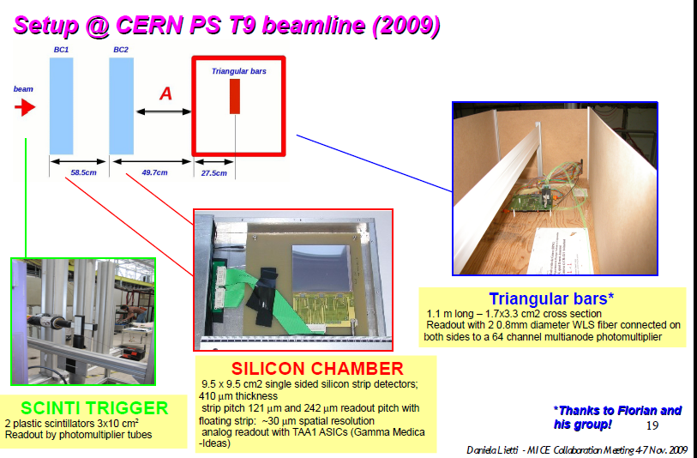

Slide 32
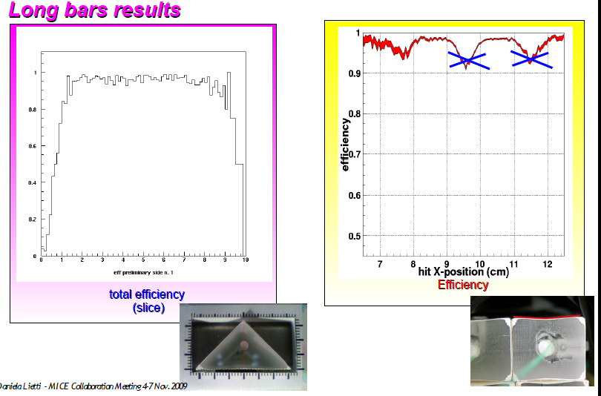

Slide 33
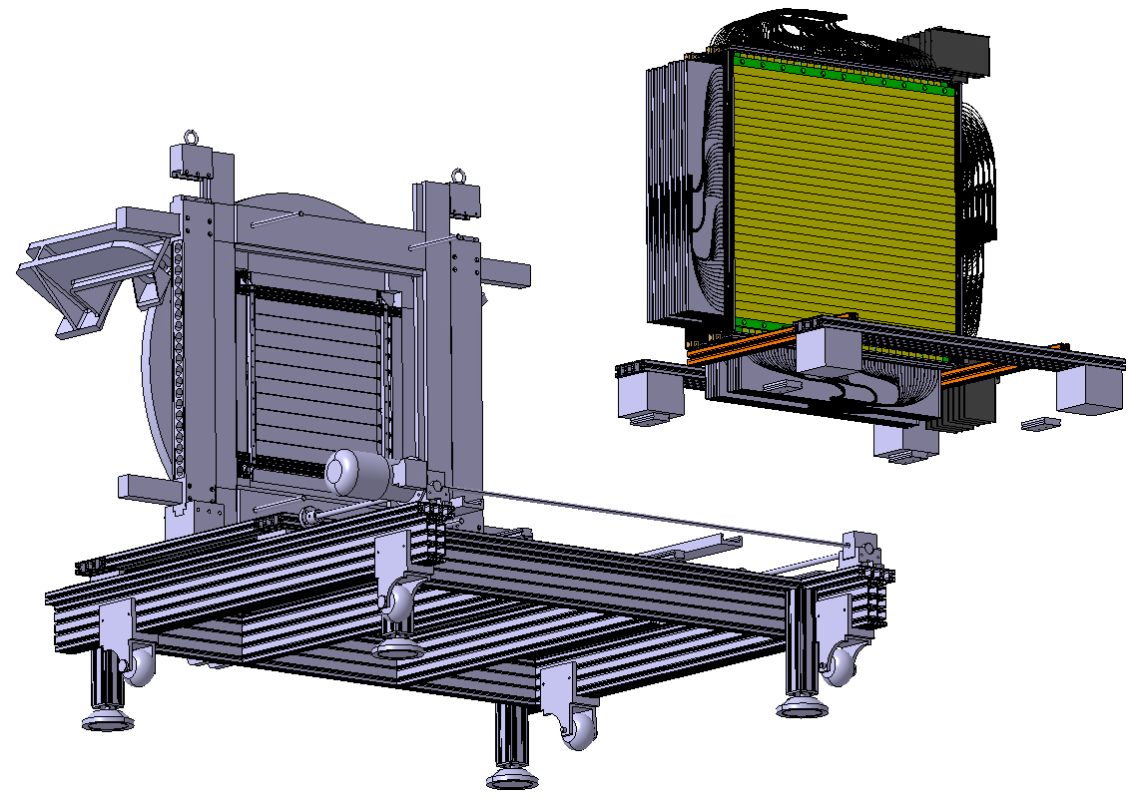
EMR Integration issues @ RAL
Crane access
with the slings!!
Interfere / upper platform
Upper platform
80 cm
Patch panel
location
Jack screws
for vertical tuning
FEA’s will be performed on EMR
to validate the design

Slide 34
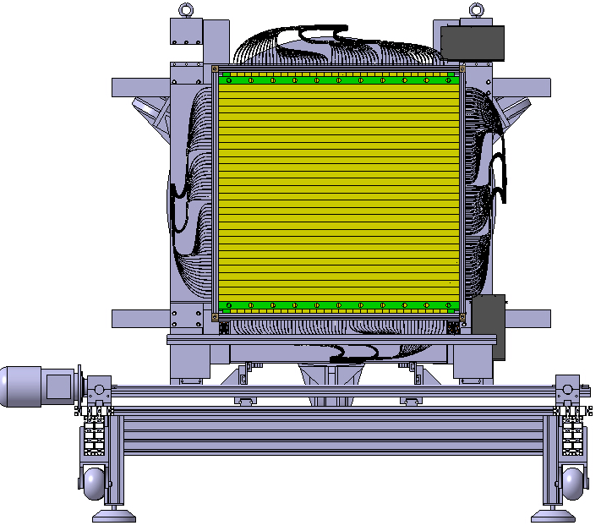
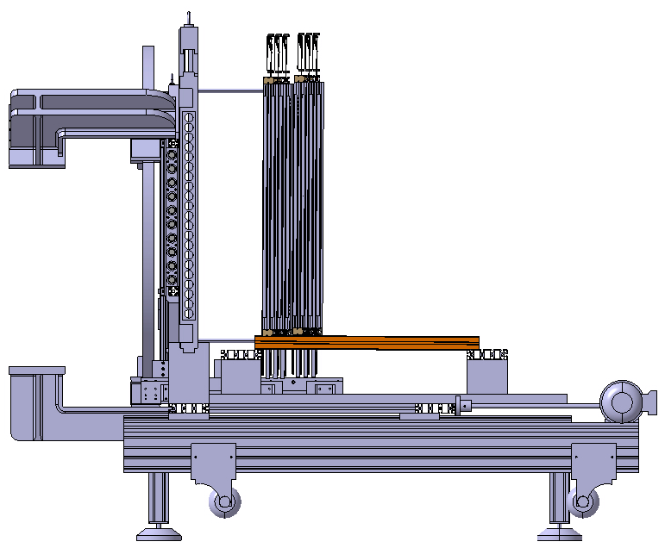
EMR Integration issues @ RAL
KL
EMR first modules

Slide 35
Purpose of Luminosity Monitors
Luminosity monitor to determine particle rate close to target and extract protons on target as function of depth – independent of beam loss monitors.
Luminosity monitor will record the number of particles crossing 4 scintillators for every spill – can build up high statistics to validate particle production in target.
By having a small plastic filter we can also reduce low energy protons – some sensitivity to proton energy.
Can be used to compare particle rates close to target (luminosity monitor measures mainly protons and pions) with other counters along beamline (GVA1, TOF0, CKOV, TOF1 and FBPM counters which measure pions, muons, electrons) – validate beamline simulations
For this reason, the luminosity monitor will be very useful for beam commissioning

Slide 36
Proposed design of Luminosity Monitors
Final design of luminosity monitor:
Rate: for beam loss monitors running 50 times higher level (ie. beam loss ~2.5 V) would mean around 2000 particles/cm² in final 2 ms of spill (ie ~4 MHz proton rate in 4 cm²)
Cuts off: protons ~500 MeV/c pions ~150 MeV/c
Beam

Slide 37
Photomultipliers
PMTs: Hamamatsu H5783P
  0.8 ns rise time
  ~1x10⁶ gain
  Only need to provide 15V to power PMT
Cost: £632/PMT. Had two already, only needed to buy two extra (~£1300)
Readout: use NIM coincidence units and count three channels using VME scalers already in DAQ
50 mm
High rate capability with
10 ns coincidence gate
If rate still an issue, can
make more shielding

Slide 38
Conclusions
TOF0,TOF1,KL, CKOV work horses working well
Soon delivery of TOF2 + final downstream platform
EMR expected for mid 2010
Luminosity monitors soon available
A lot of activities around; PID is in good shape

