Slide 1

TOF2 status
M. Bonesini
Sezione INFN Milano Bicocca

Slide 2
TOFes status
TOF0, TOF1 installed at RAL since 2008
  For TOF0,TOF1 construction see MICE note # 241 (R. Bertoni et al.)
  TOF0,TOF1 calibration/performances see MICE note # 251 (Y.Kharadzov et al.)
  A paper to be send to NIM is ready for the upstream TOF system
TOF2 in construction in MIB (scheduled delivery end November 2009) + final PID downstream platform in Rm3

Slide 3
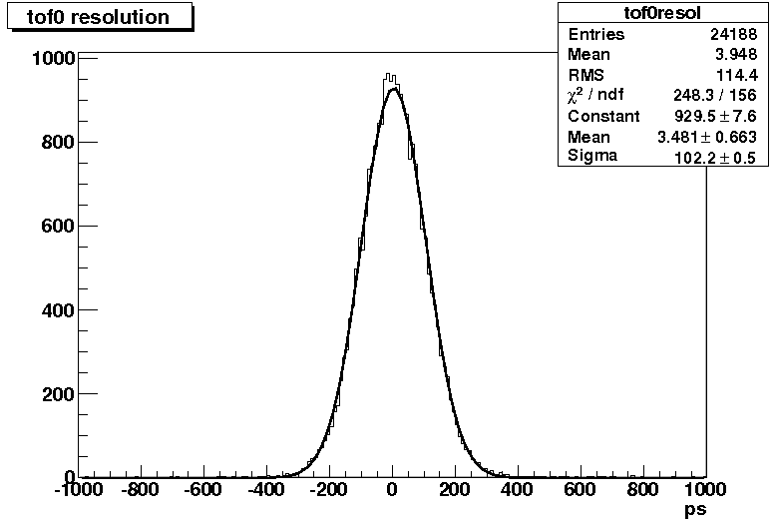
TOF0 time resolution
The time difference between the vertical and horizontal slabs in the same station can be used also to measure the time resolution obtained after the calibration. The resolution on the difference in the calibrated pixels in TOF0 is ~ 102 ps. This translates into ~ 51 ps resolution for the full detector with crossed horizontal and vertical planes.

Slide 4
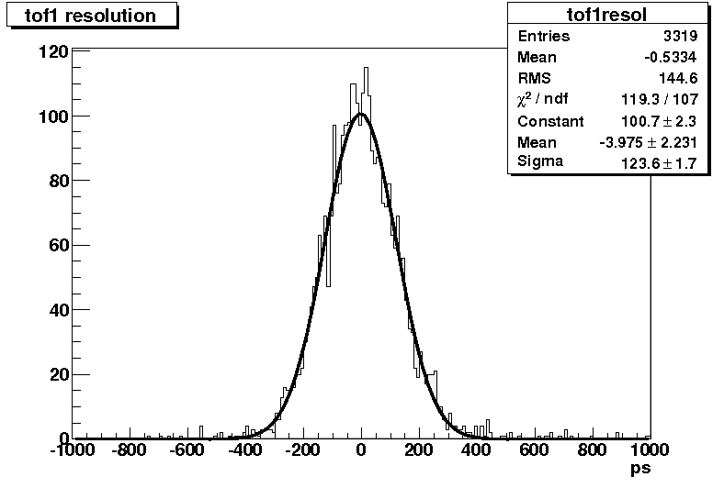
TOF1 time resolution
The resolution on the difference in the calibrated pixels in TOF1 is ~ 124ps. This translates into ~ 62ps resolution for the full detector with crossed horizontal and vertical planes.

Slide 5
TOF2 construction status (MIB+PV)
TOF2 counters assembled in MIB
last faulty H6533MOD assemblies under repair at Hamamatsu have been delivered around 20 October .
All PMTs have been tested after some days of burning up
final platform for KL+TOF2+SW from Rm3 ready
TOF2 mechanics + local shielding ready
Final assemby of TOF2 will start soon (some problems due to the weight of the detector ~200 kg with shieldings)
Expected transport at RAL 23/11
Installation/cabling foreseen for 24/11 – 28/11

Slide 6
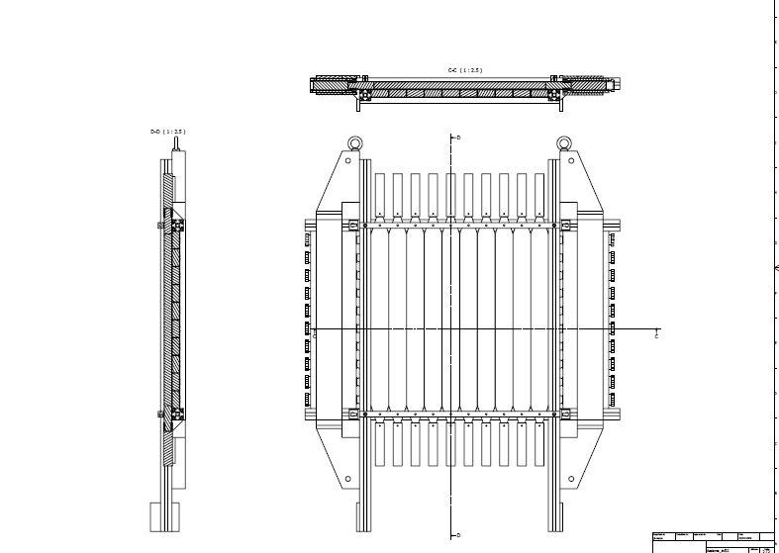
Details of construction for TOF2

Slide 7
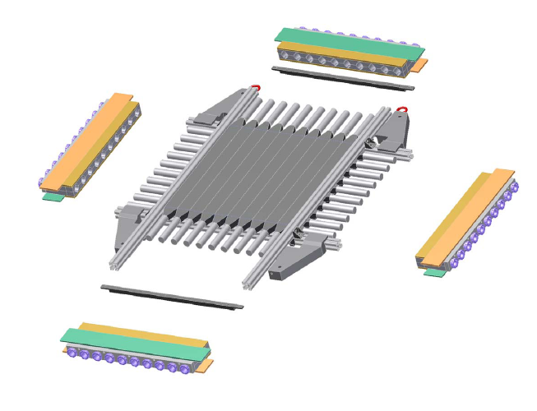
Details of TOF2 local shielding
Joints to close magnetic circuit
Local shielding (in addition to Virostek plate)

Slide 8
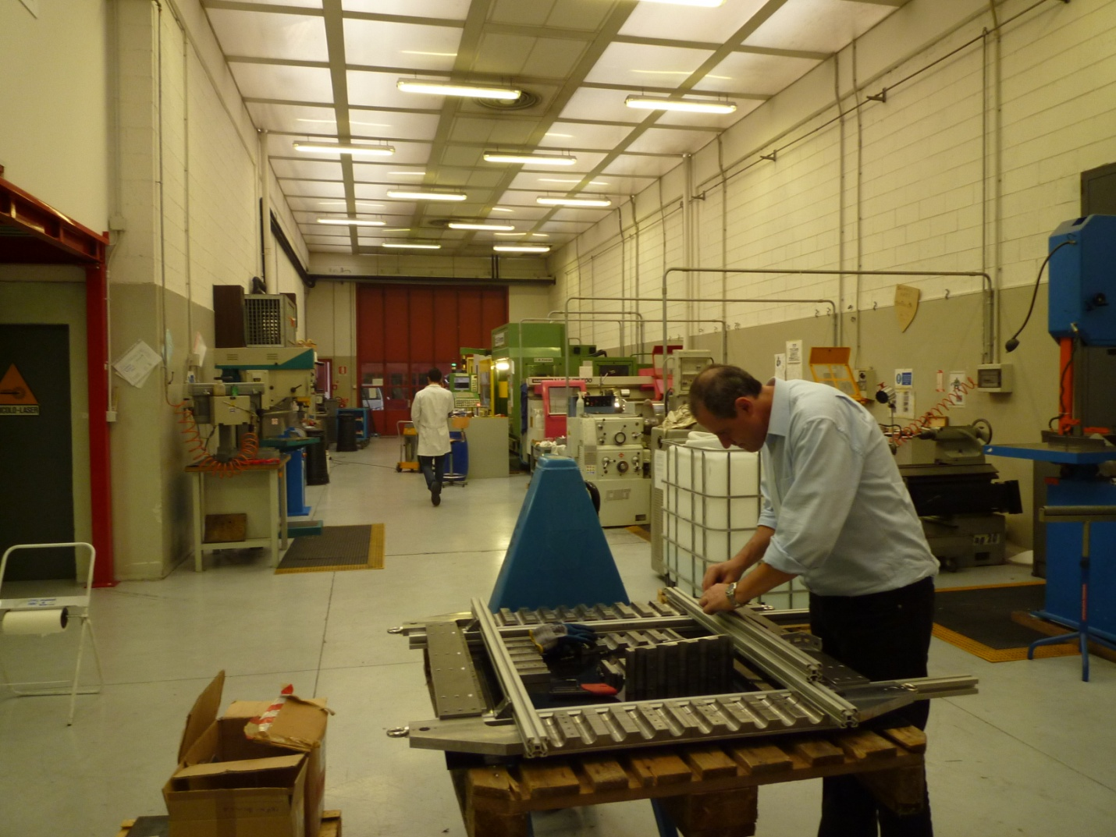
Pre-test of assembly in MIB mechanics workshop

Slide 9
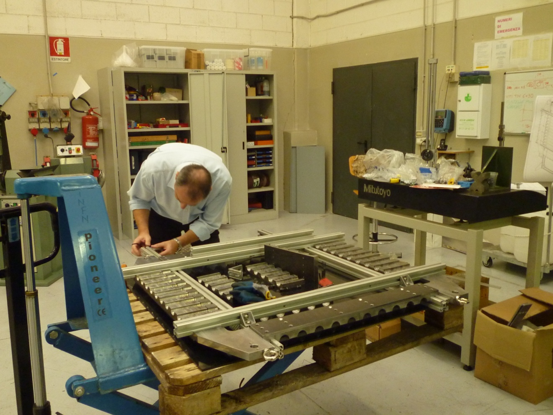
A closer look

Slide 10
Tests foreseen for counters
Tests on single PMTs
  Dark current/spikes tests for some days
  Pre-calibration with YAP-CE source
Tests on single counters (after assembly)
  Tests for light tightness
  Tests with laser light injection (changing HV)
  Tests with cosmics (changing HV)

Slide 11
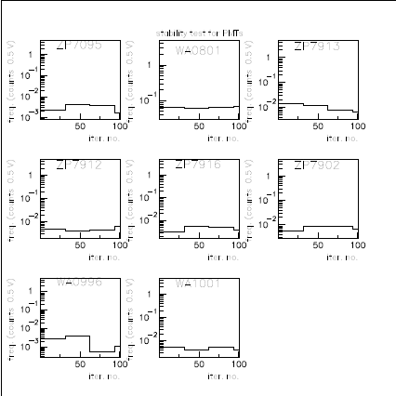
Dark current measurements
Dark currents rates have been measured with a discriminator thr. at 0.5 V in 30 min runs
acquisition via VME system for 2-3 days run
Old PMT for comparison: now noise at least a factor 10 lower

Slide 12
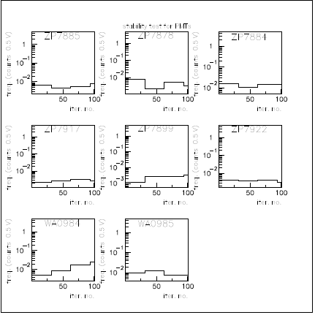
Second set of PMTs
refurbished assemblies have much lower dark currents
and spikes rates

Slide 13
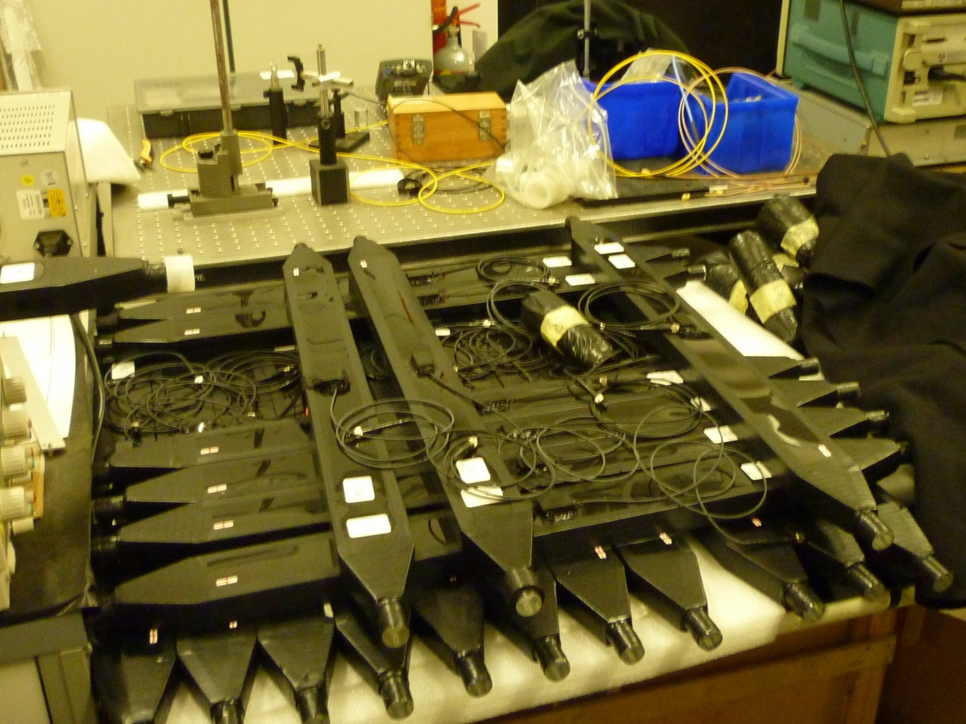
Scintillation counters ready to be equipped with PMTs

Slide 14
Cables for TOF2
signal cables: 20 old RG213 cables 40 m long (~169.6 ns delay) + in addition other 20 RG213 cables (30 m long) from NOVACAVI Milano giving the same delay
ready
    All individually measured for delay
HV cables: 40 new 31 m long cables to allow all STEPS done in MIB instead of 2m long cables ready
no length problem

Slide 15
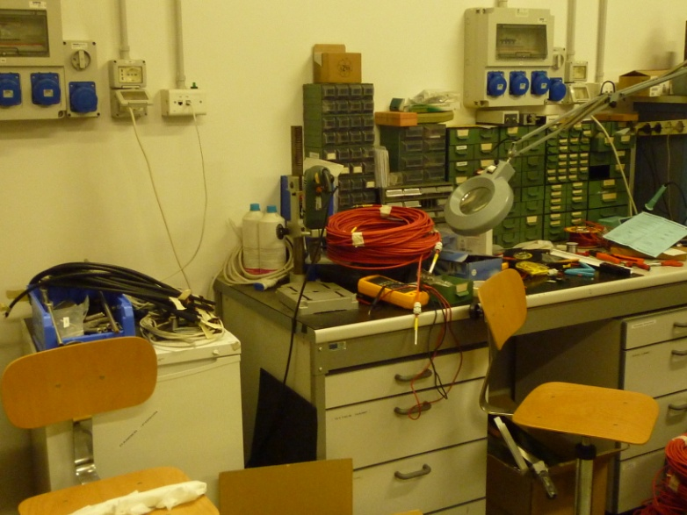
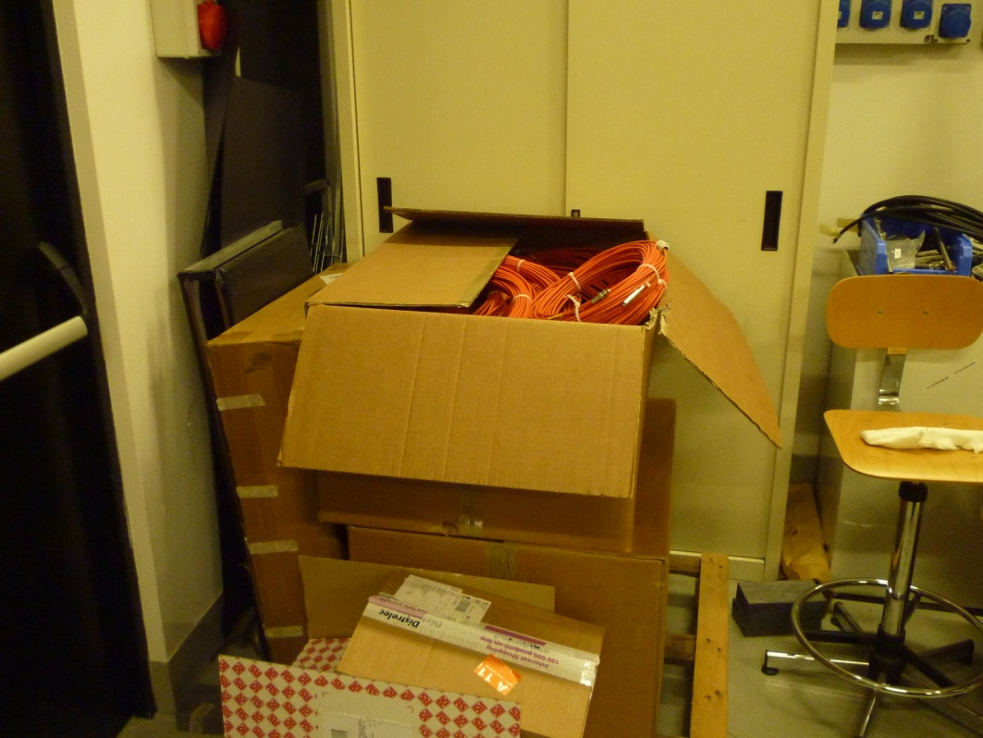
Some cables ready or less ready for shipping to RAL

Slide 16
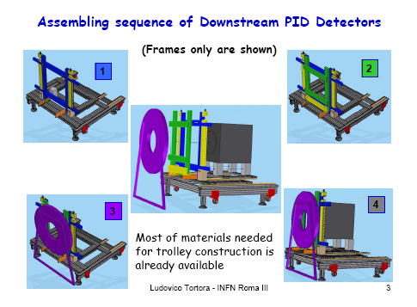

Slide 17
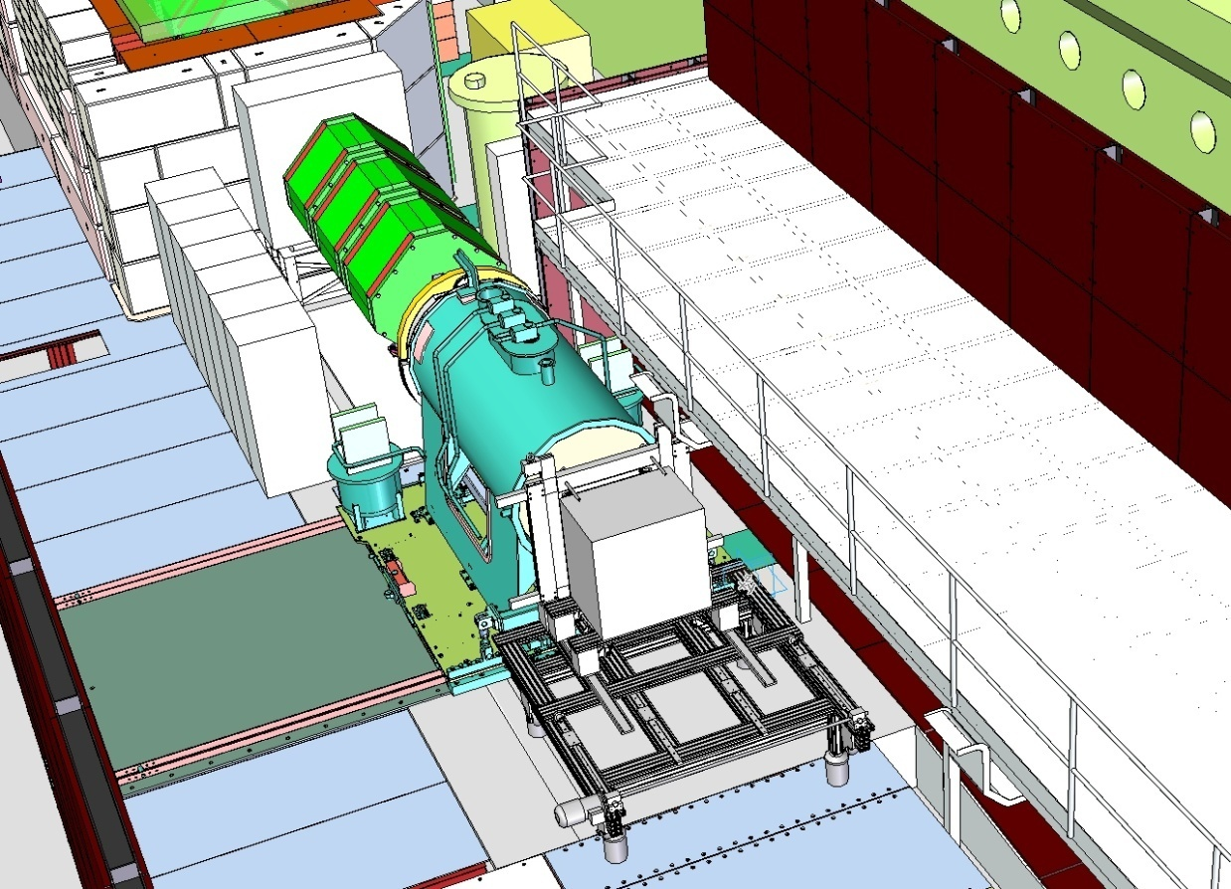
Downstream layout for STEP II

Slide 18
Conclusions
TOF2 assembly in MIB to be finalized
TOF2 delivery/installation at RAL expected with final platform from Rm3 for end November 2009 at RAL

