Slide 1


Upstream TOF NIM paper
M. Bonesini
Sezione INFN Milano Bicocca

Slide 2
mainly based on some MICE notes:
  Tests in magnetic fields of R4998 PMTs: MICE note # 201 (R. Bertoni et al.)
  TOF0,TOF1 construction : MICE note # 241 (R. Bertoni et al.)
  BTF testbeam performances : MICE note # 163 (M. Bonesini et al.)
  TOF0,TOF1 calibration/performances : MICE note # 251 (Y.Kharadzov et al.)
and 2008 data analysis

Slide 3
Aims
Document work done
Needed for PhD thesis discussion (Yordan, …) -> need to be quick
Helpful for funding discussion

Slide 4
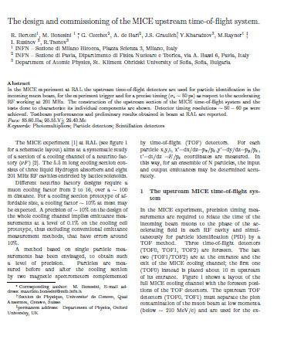

Slide 5
Main items
Design of TOF0/TOF1
Tests on PMTs in MIB: B field, rate-capability, …
Criteria for PMTs selection
BTF performances
Preliminary performances at RAL (calibration)

