Slide 1
Step VI:
UK deliverables and timescales

Slide 2
MICE at Step VI:
UK deliverables:
  3rd focus coil module
  3rd LH2 system
  Second pair of 2 MW amplifiers and distribution system
  Infrastructure

Slide 3
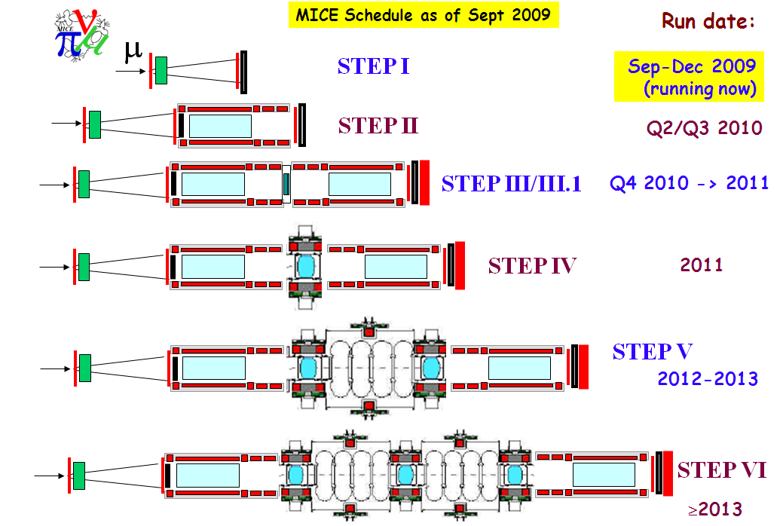

Slide 4
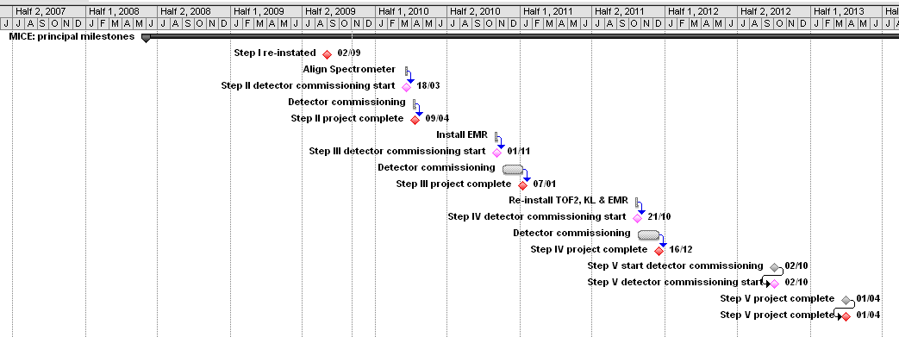
Schedule:
Issues:
  Match to CERN Council 2012 decision point
  Cost to the UK of MICE to Step VI:
    Require to take up option on focus-coil #3 in 1st (latest, perhaps 2nd) quarter of calendar 2010
    To exploit economies of scale in the implementation of the RF power system require to be able to negotiate supply of full system
      RF system implementation scheduled to begin 2010 to meet Step V milestone
Implies approval for Step VI required in 1st (latest, perhaps 2nd) quarter of calendar 2010

Slide 5
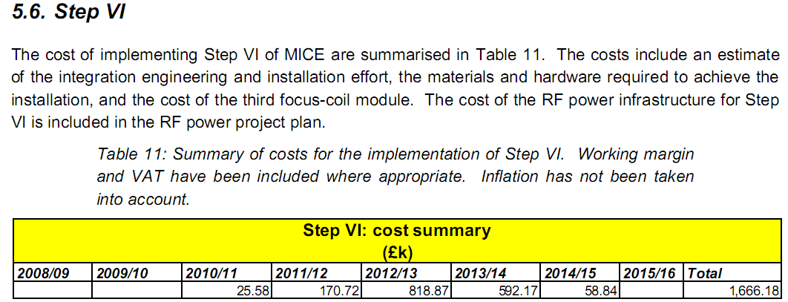
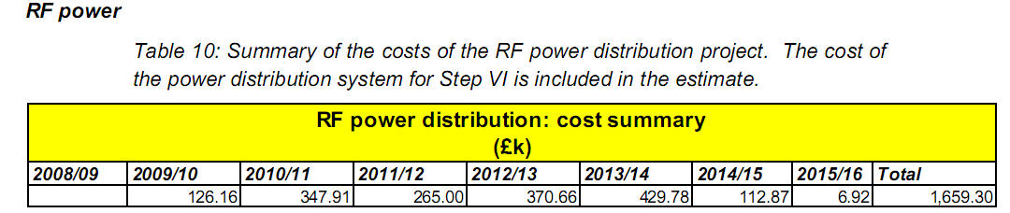
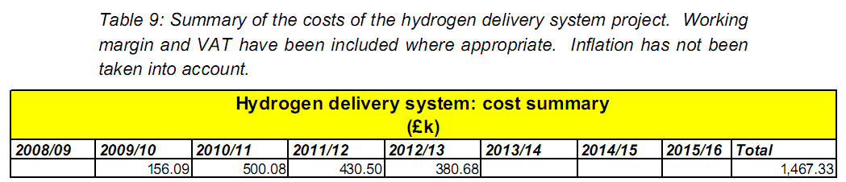
Cost:
As presented to C&S review:

Slide 6
TIARA:
EC FP7 Preparatory Phase proposal
WP8: Ionisation Cooling Test Facility
  Proposal provides for resources to support:
    Personnel at DL, CERN, and RAL to collaborate on the design, specification, and oversight of the RF power system
    [Note to CB: need to raise this at CB meeting, issue is associate institutes]

