Slide 1
The Design of the 704 MHz Cryomodule
Luca Dassa

Slide 2
Outline
History: from SPL cryomodule to HG cryomodule
HG cryomodule: few hints
Design status
Cost evaluation
Documentation
Compliance with standards
Towards PERLE

Slide 3
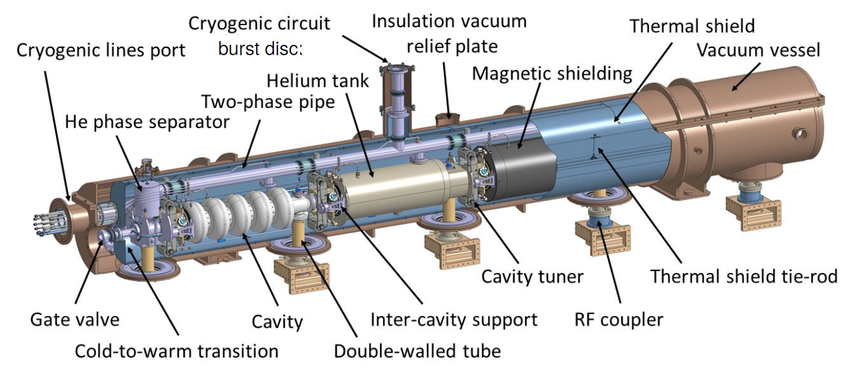
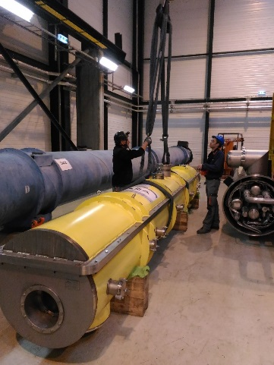
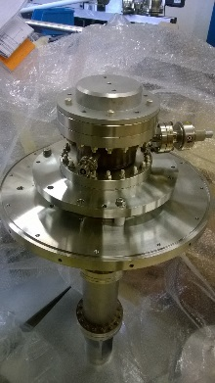
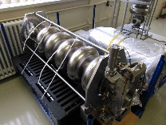
SPL (Superconducting Proton Linac) Short Cryomodule
foreseen as a low power injector into PS2 (that would have replaced PS)
HG cryomodule: goal & motivations
CEA – Saclay (F)
Design of β=1 cavities
Design & construction of 4 helium vessels for β=1 cavities
Supply of 4 tuners
Testing of RF couplers
CNRS – IPN – Orsay (F)
Design of prototype cryo-module cryostat
Construction of the vacuum vessel
Design of cryostat assembly tools
CERN
4 β=1 cavities in industry + 1 in-house
4 RF couplers
Test bench for studying the support strategy

Slide 4
HG cryomodule: goal & motivations
SPL team (CERN, CEA – Saclay, CNRS – IPN – Orsay )
SPL (Superconducting Proton Linac) Short Cryomodule
Superconducting Proton Linac is cancelled
HG (High Gradient) Cryomodule
HG team (new CERN team)

Slide 5
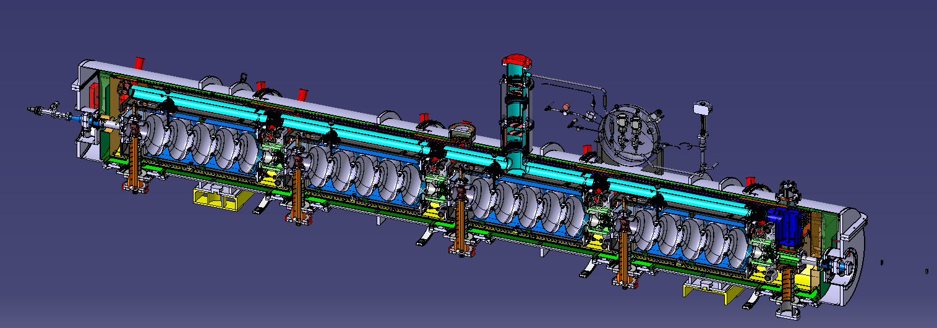
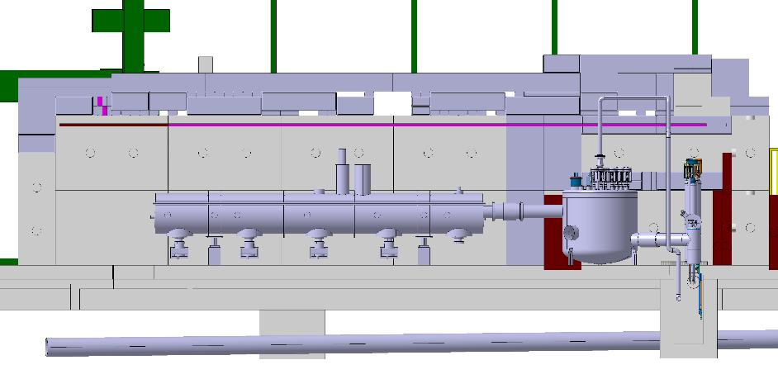
HG cryomodule: goal & motivations
HG (High Gradient) Cryomodule
RF-related goals :
RF tests on a multi-cavity assembly driven by a single RF source.
Demonstration of reachable accelerating gradients and Q-values for 704 MHz, multi-cell, β=1 cavities. Establishment of state of the art bulk-Nb technology at CERN.
RF testing of cavities in horizontal position, housed in their helium tanks, tuned, and powered by machine-type RF couplers
Test critical components like RF couplers, tuners, HOM couplers in their real operating environment
Cryomodule-related goals :
Validation of design for innovative supporting of cavities via the RF couplers
Learning of the critical assembly phases:
  handling of long string of cavities with complete RF coupler
  alignment/assembly in the cryostat
  Validation through operational experience:
  Cool-down/warm-up transients and thermal mechanics
  Gas-cooled RF coupler double-wall tube (active cooling effect on cavity alignment)
  Alignment/position stability of cavities
  Cryogenic operation (He filling, level control, etc.)
CERN
Finalization of drawings
Clean room tools
Procurement of remaining components
…
Test on RF bunker (lateral view)

Slide 6
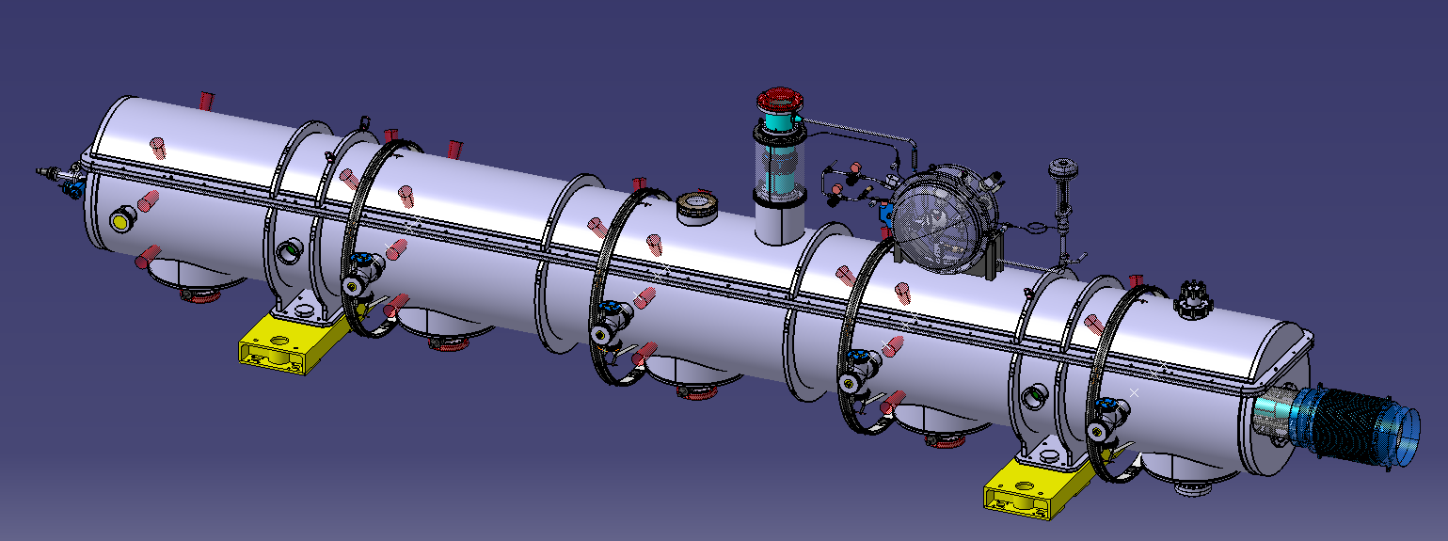
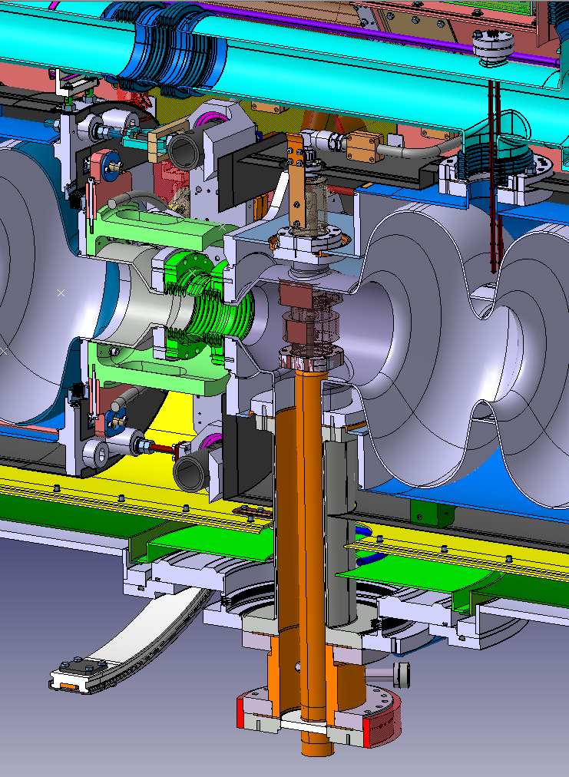
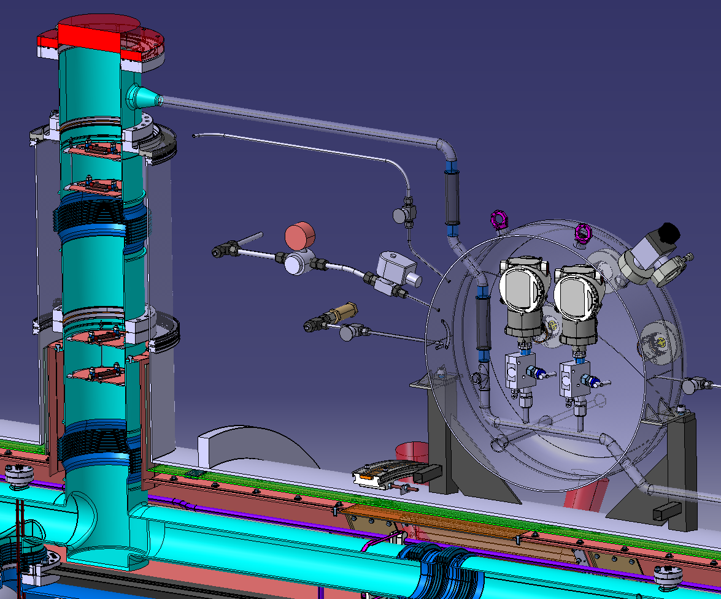
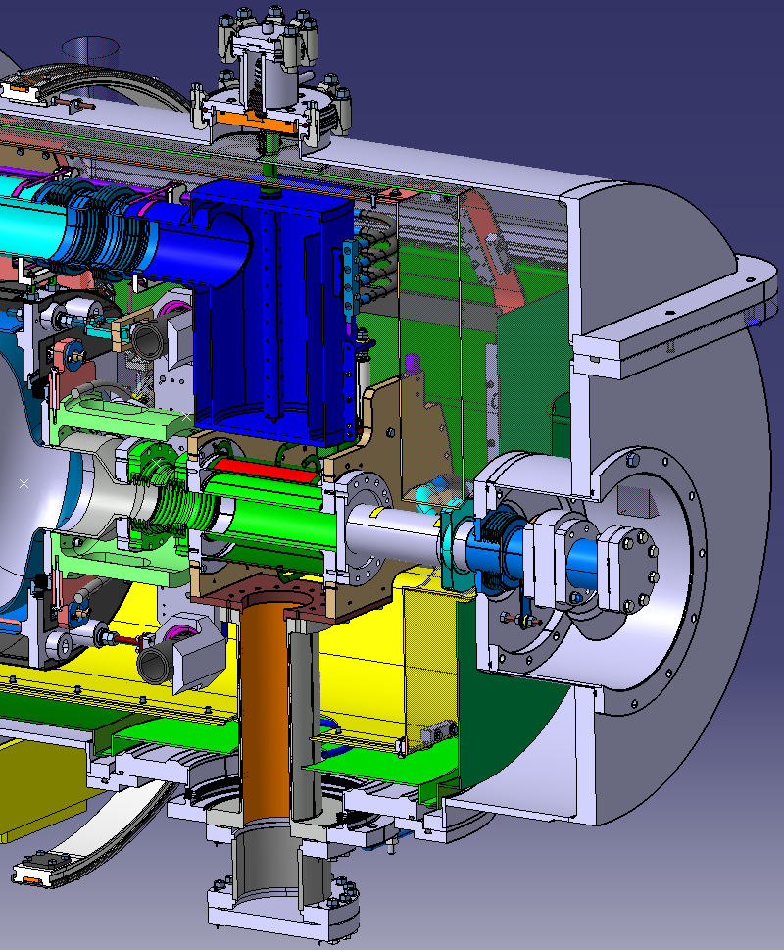
HG cryomodule

Slide 7
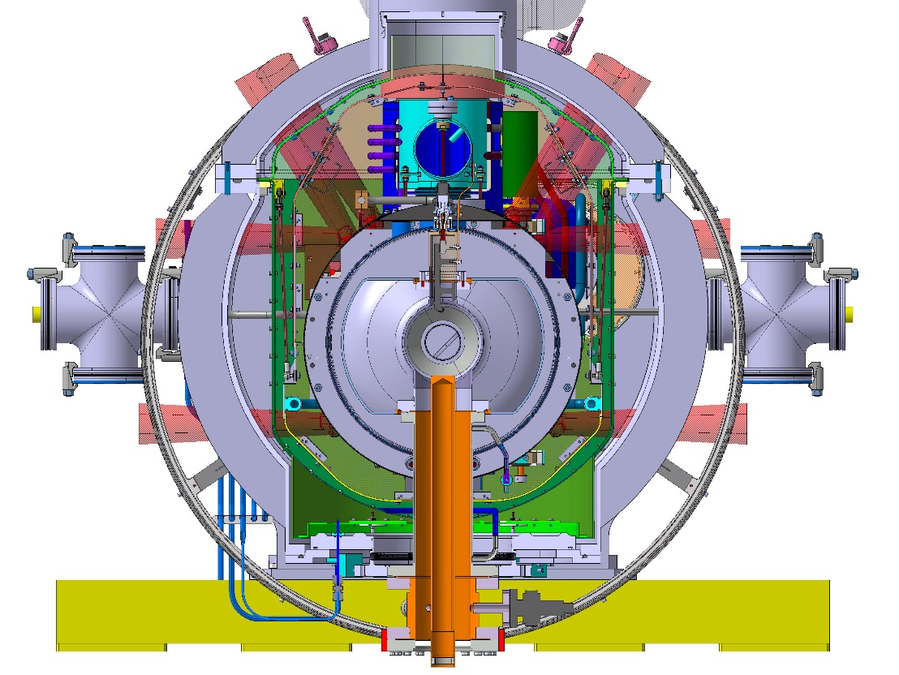
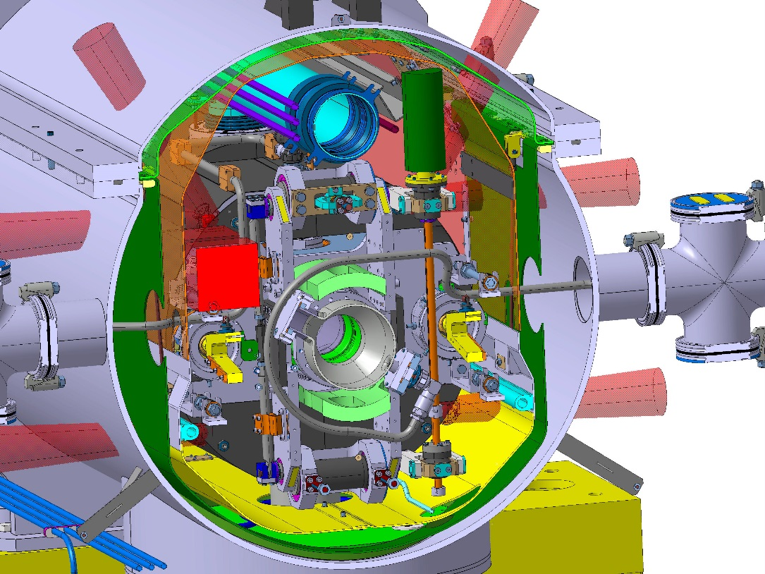
HG cryomodule
Cross section on the coupler axis
Cross section in the intercavity region

Slide 8
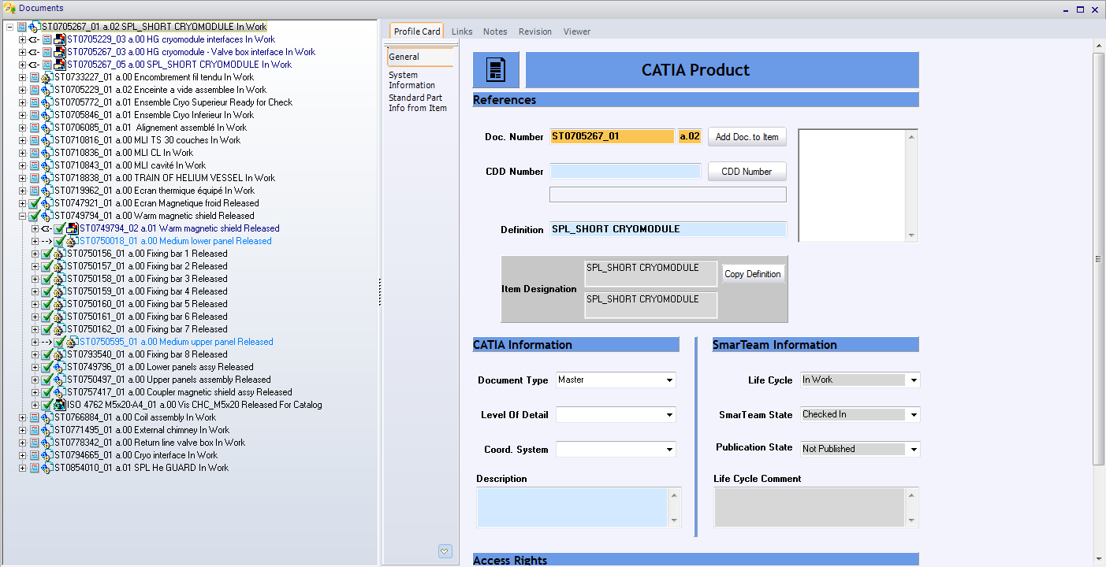
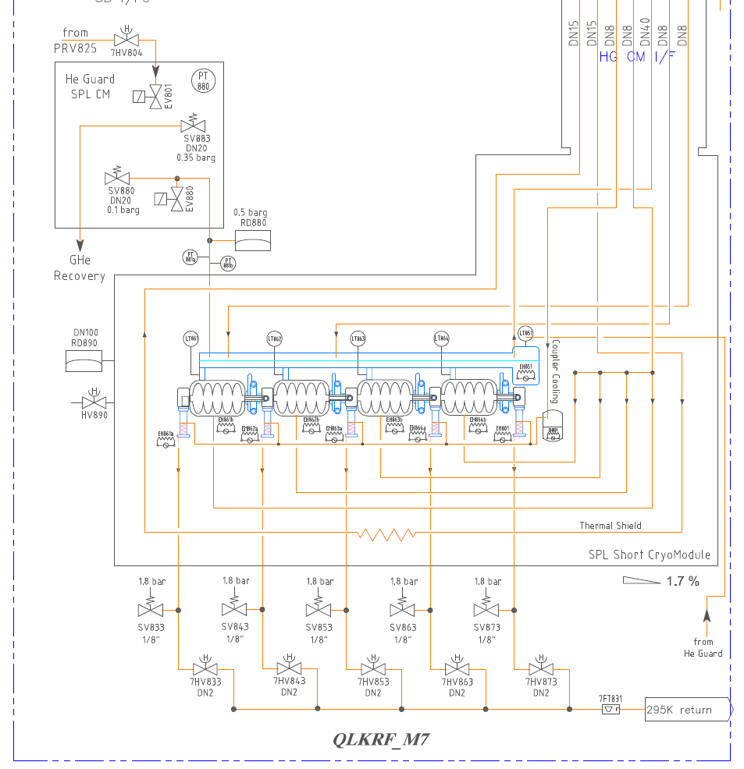
Design activities completed
For the cryomodule: 3D + 2D in Catia V5, stored in SmarTeam are available.
Not all the 2D are valid for execution (intercavity bars, mod on tuners, ext cryog components)
Design activities partially completed
Cryostating tools
Design activities to do
Tools for clean room assembly
Desing status
Engineering activities: collection of documentation related to calculation, schemas, procedures, …
Engineering activities to do
Safety devices finalization of sizing (linked to the pressure for the cavity (0.5 barg max today))
Alignment of cavities (procedure)
Clean room and cryostating procedures (to finalize)
Follow-up of cavity displacement during transitory: wire system not studied / possibility to integrate laser system

Slide 9
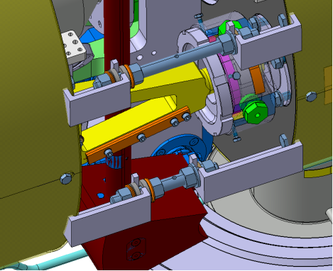
Desing status
Assembly in clean room
Low lateral flexibility for the coupler bellows
Torsion to be avoided on intercavity bellows
Limited space for assembly in the intercavity region
Modification on the tuner frame validated
Preliminary procedure available but not validated
Coupler assembly direction to validate
Tools for clean room assembly to design

Slide 10
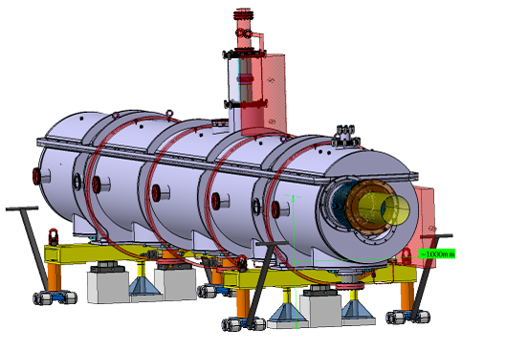
Design of tools for cryostating is available (CNRS - IPN – Orsay)
Desing status
Cryostating
Transport
Tools to be modified (modification on cryo lines, on thermal shield, on intercavity supports)
Cryostating procedure to update with the new shielding (and, in addition, door knobs assembly from bottom, as close as possible to the test bunker)
Tools for transport have been designed

Slide 11
For the 1st cryomodule, R&D included
Cost evaluation (1)
 | CAVITIES
 | total | achieved | to be planned
 | [kChF] | [kChF] | [kChF]
R&D + tools for manufacturing and testing | 1194 | 1194 | 0
material (Nb) | 420 | 420 | 0
4 cavities produced by RI + 1 mono-cell | 375 | 375 | 0
1 CERN cavity | 175 | 175 | 0
cavities | 2164 | 2164 | 0
 | CRYOMODULE
 | total | achieved | to be planned
 | [kChF] | [kChF] | [kChF]
Couplers + pick-ups | 360 | 360 | 0
HOM (proto, material, 8 HOMs, design office) | 561 | 40 | 521
in kind contribution for cryomodule (SPL design, vacuum vessel, tuners) | 320 | 320 | 0
Design office (cryomodule revision + tools for clean room + tools for cryostating) | 190 | 100 | 90
Cryogenic system | 220 | 180 | 40
Cold magnetic shielding, Warm magnetic shield, Thermal shield | 325 | 0 | 325
Management support (fellow) + Quality Assurance | 274 | 274 | 0
Various | 640 | 250 | 390
Tooling for Clean Room assembly and cryostating + manpower | 560 | 60 | 500
total without cavities | 3450 | 1584 | 1866
 | TOTAL
 | total | achieved | to be planned
 | [kChF] | [kChF] | [kChF]
cavities | 2164 | 2164 | 0
total without cavities | 3450 | 1584 | 1866
total with cavities | 5614 | 3748 | 1866

Slide 12
For the 2nd cryomodule, R&D excluded
Cost evaluation (2)
 | CAVITIES
 | [kChF]
material (Nb) | 420
4 cavities produced by RI + 1 mono-cell | 375
cavities | 795
 | CRYOMODULE
 | [kChF]
Couplers + pick-ups | 260
HOM (8 HOMs) | 432
vacuum vessel, tuners | 240
Design office | 50
Cryogenic system | 220
Cold magnetic shielding, Warm magnetic shield, Thermal shield | 325
Management support (fellow) + Quality Assurance | 141
Various | 640
Clean Room assembly and cryostating: manpower | 100
total without cavities | 2408
 | TOTAL
 | [kChF]
cavities | 795
total without cavities | 2408
total with cavities | 3203
Cost 1st cryomodule – cost 2nd cryomodule = 2411 kChF

Slide 13
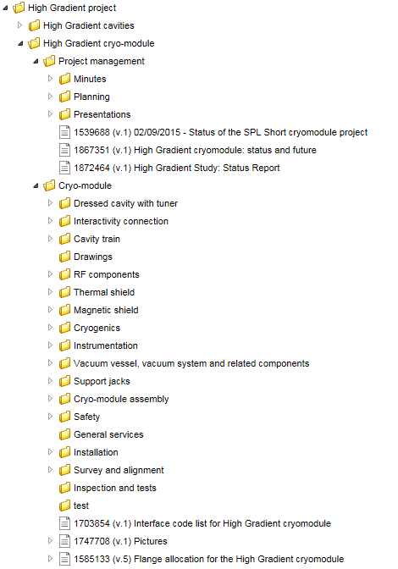
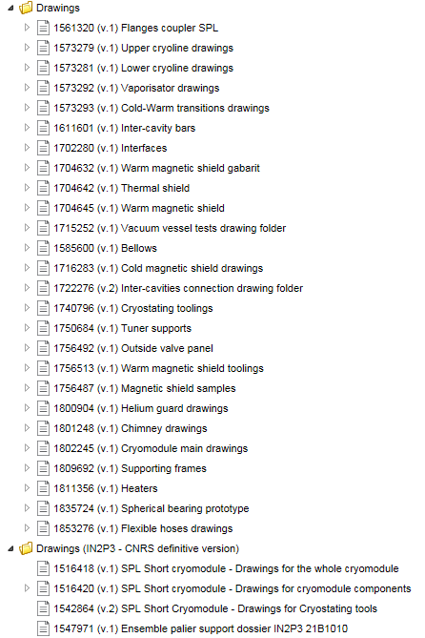
Documentation
Documentation is available in EDMS (CERN storage system for document)

Slide 14
Compliance with standards
Main assumption for SPL and HG cryomodules: Maximum Allowable Pressure to be out of the scope of the Directive 68/2014 (PED)
PS ≤0.5barg => out of the scope of the Directive 68/2014 (PED)
V ≈ 340 l
Cryogenic lines can accept higher Maximum Allowable Pressure but there is no calculation of the maximum.
Manufacturing follow-up: welding book is included (NDT considered, based on reasonable assumptions, i.e.10% on butt welded joints), no Notified Body involved
Only one burst disc (set pressure 0.5 barg) is installed : preliminary sizing is not compliant with standards but acceptable from a safety point of view

Slide 15
Towards PERLE
Main assumptions: new cavities, new HOMs (2 x cavity) actively cooled, beam presence, power couplers to be reused
New cavities, smaller than the actual ones => positive impacts
Higher heat loads (250 W for Perle / 200 W for HG) => seems not to be a problem
2 HOMS per cavity => modification to thermal shields, cold magnetic shields, cryogenic lines (minor) / volume reserved for wire system could be not anymore available
Advantages of re-using the SPL/HG design:
Well-advanced development
Detailed 3D environment available
Available components (≈600 kChF)
Possibility to test some interesting technical solution (i.e. supporting via main coupler)
Disadvantages of re-using the SPL/HG design:
Constraints from old technical choices (vertical cryostating, …)
Existing components (i.e. tuner, main power couplers)
Actively cooled HOMs require some compromise and modifications to cryo lines, being now manufactured

Slide 16
Thank you…

Slide 17
Back-up slides

Slide 18
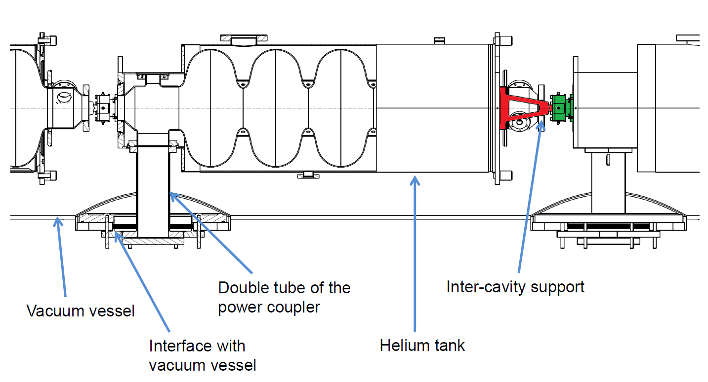
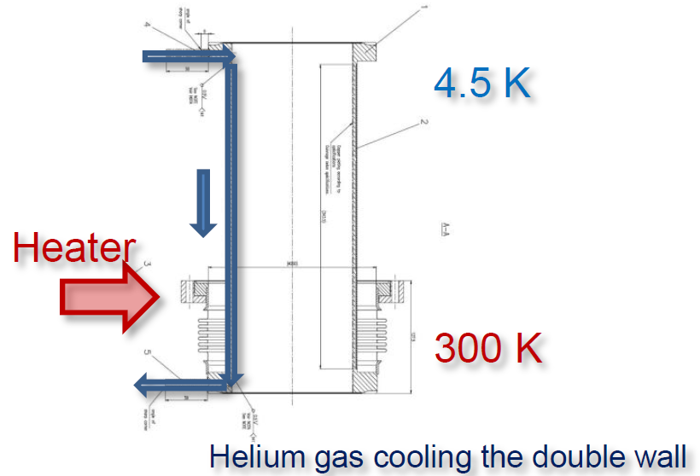
HG cryomodule:
few hints
Requirement | Value
β | 1
Frequency | 704.4 MHz
Qo | >5 x 10⁹
Gradient | 25 MV/m
Operat. T | 2 K
Innovative supporting condition (coupler)
Innovative coupler cooling (double walled tube)
Vertical cryostating

Slide 19
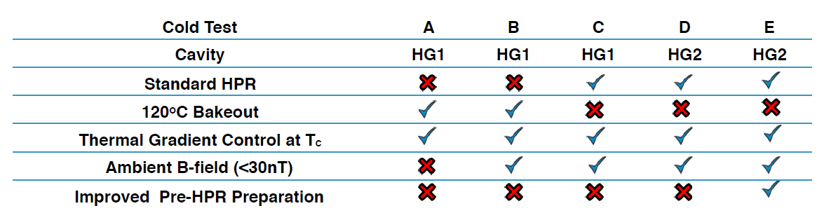
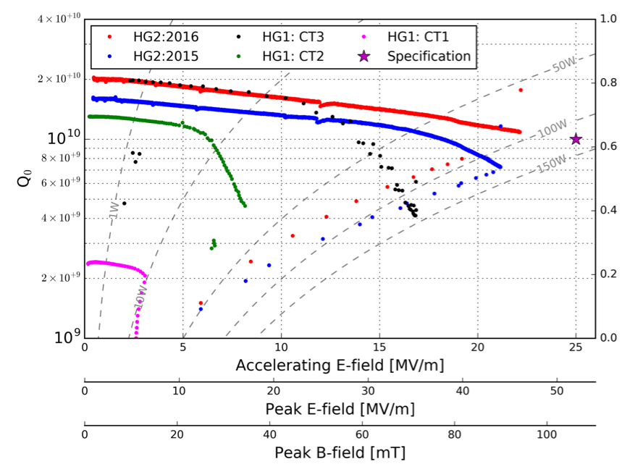
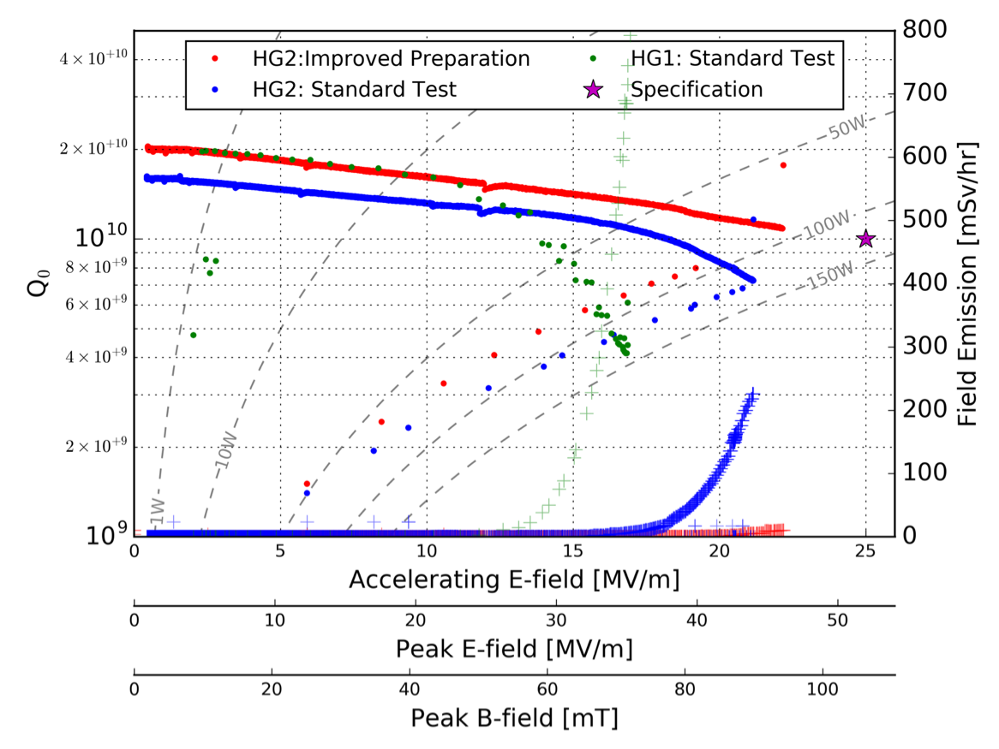
Cavity test results
06/07/2016
Evolution of Cavity Performance
Comparison of HG 1 & HG2
E
D
B
C
A

Slide 20
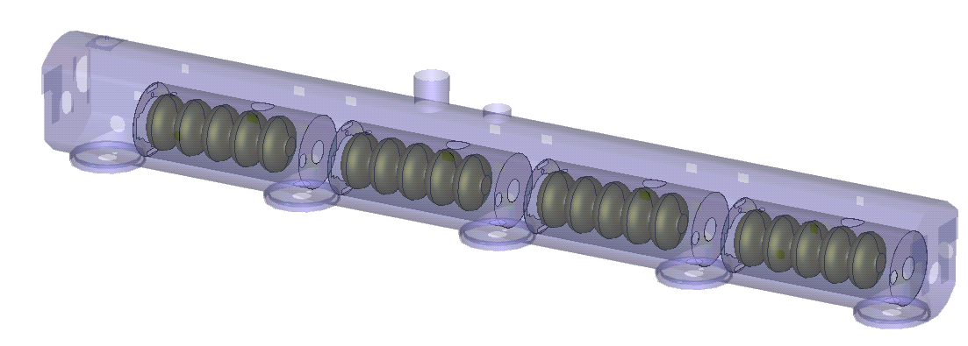
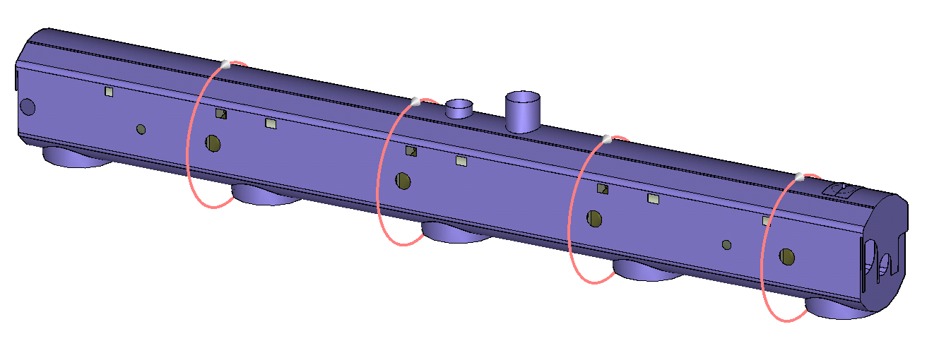
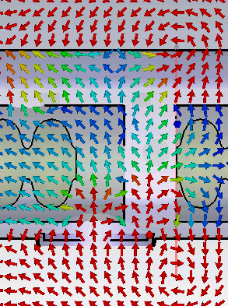
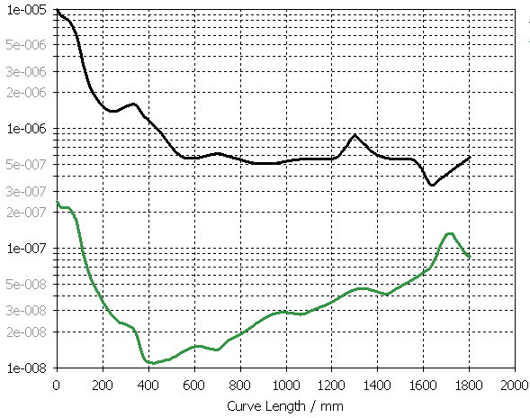
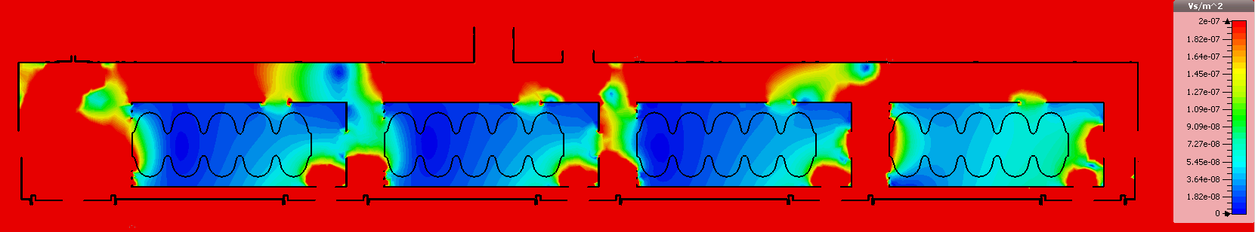
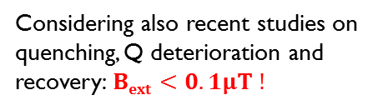
Warm + cold magnetic shield + compensating coils
New warm magnetic shield: simulation
Coil
Warm + cold magnetic shield + compensating coils
Warm+cold
Warm+cold+coils
IBI on cavity surface
along axis - worst case [Τ]
Considering also recent studies on quenching, Q deterioration and recovery:$Bext<0.1μT !$
Early results further investigation needed.
3D Simulation results (CST)
2D plot – axial side view
B=50μΤ
I
0.2 μT
|B|

Slide 21
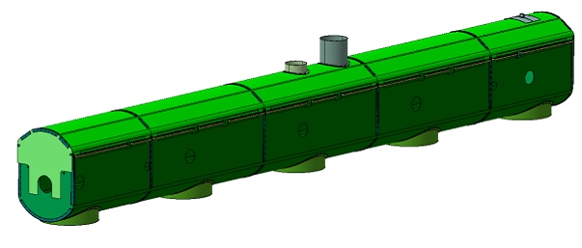
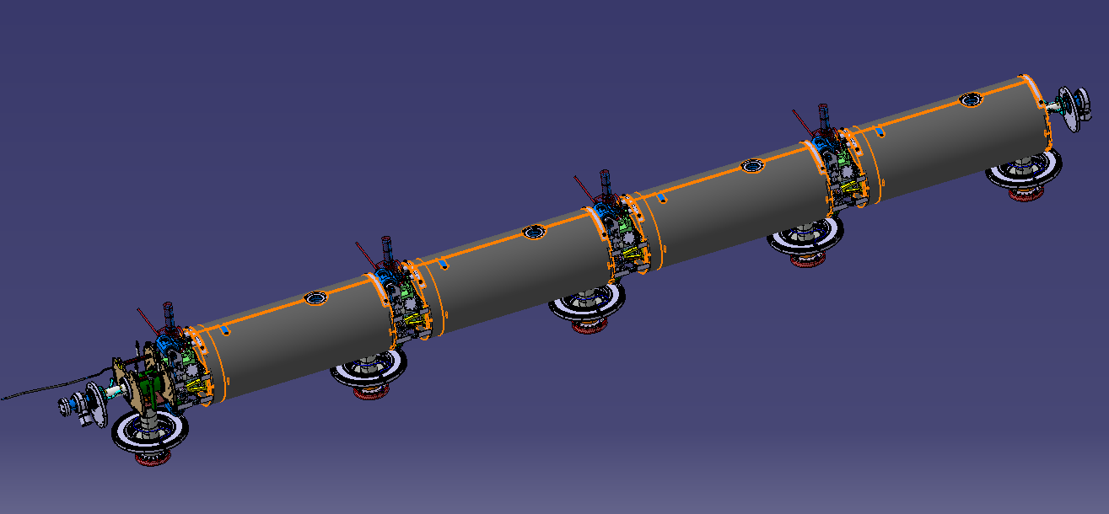
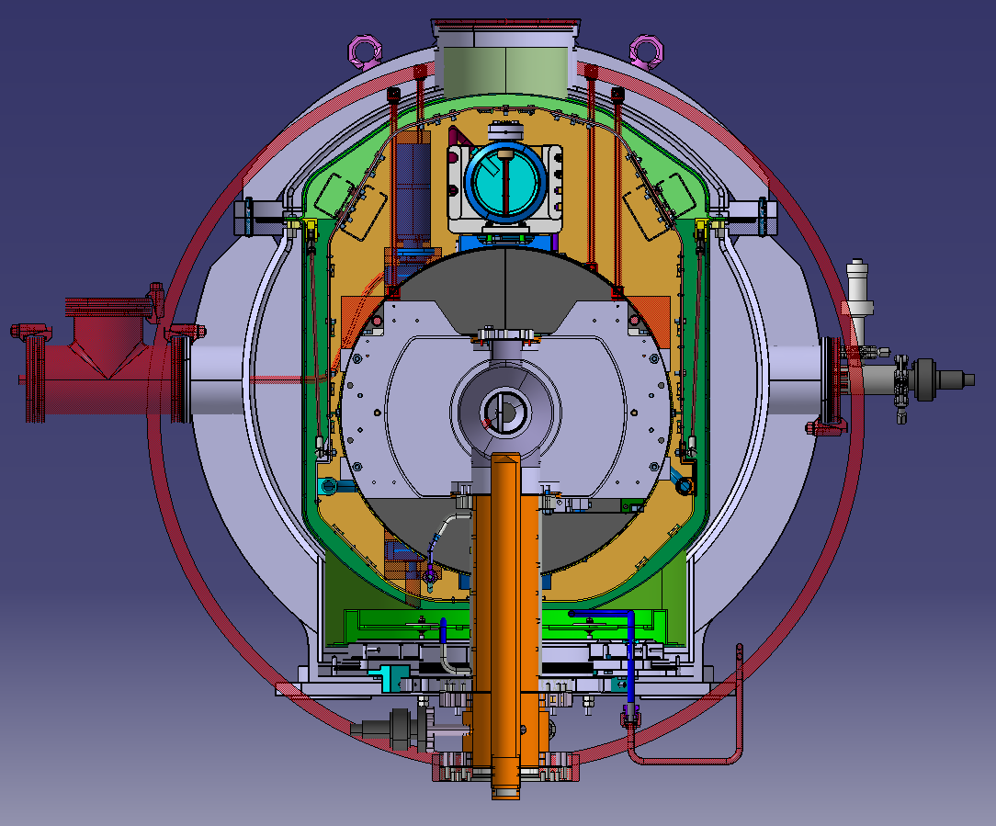
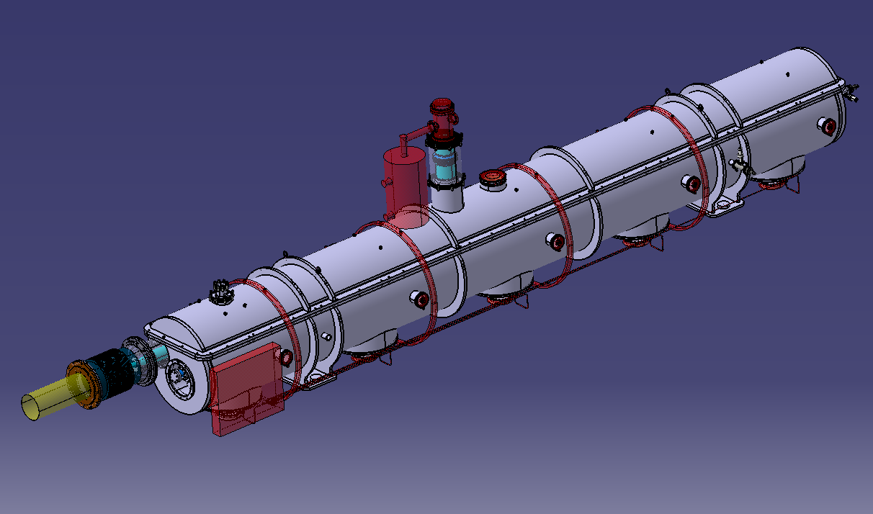
Simulations showed need of warm magnetic shield
Magnetic shielding: 3 levels of shielding strategy resumed -> need to introduce a warm magnetic shield in coupler region
magnetic shielding
Warm shield
Cold shields
Correction coils

Slide 22
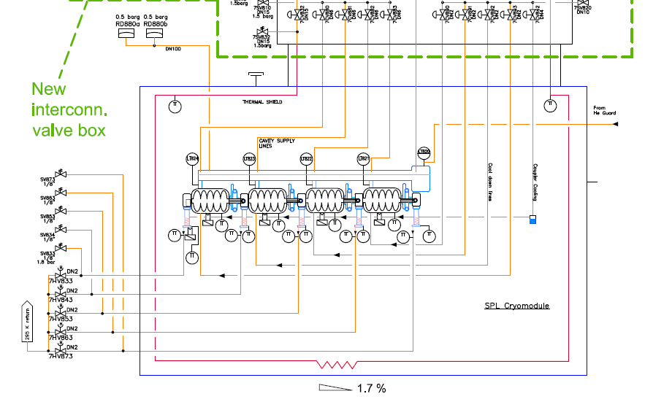
PID review and update
Operating condition: p<0.5 bar gauge
Box with valves to reduce peaks during transient
Redundant cryogenic reduced (but not eliminated)
Circuit | Temp. in K | Pressure in bar | Heat load in W | Flow rate in g/s
Thermal radiation shield | 50 – 75 | 1.4 - 1.15 | 240 | 1.85
Liquid supply (two cavity circuits) | 2.2 | 1.2 | 200 dynamic | 10 in total
Helium return | 2 | 0.0031 | - | 10
Power couplers 4x | 4.5 – 300 | 1.25 – 1.05 | - | 0.1

Slide 23
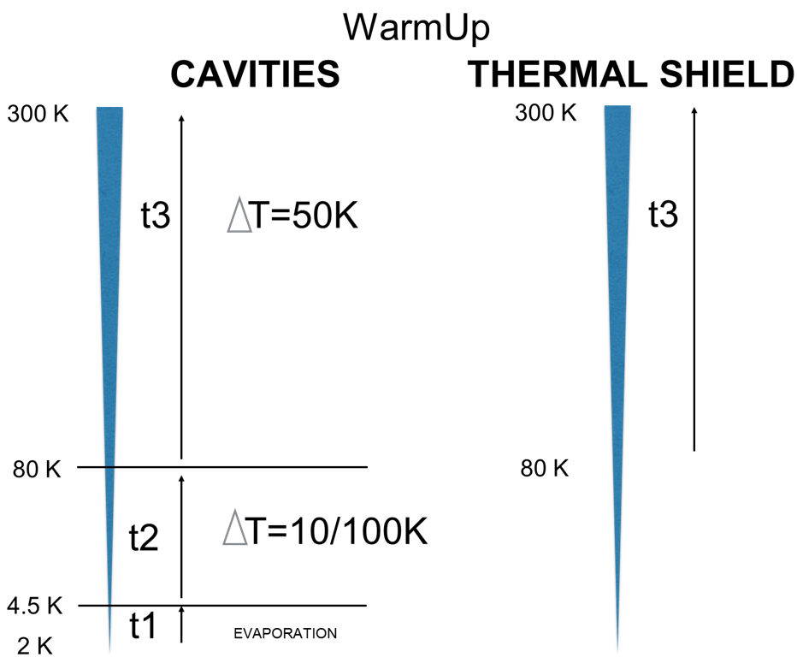
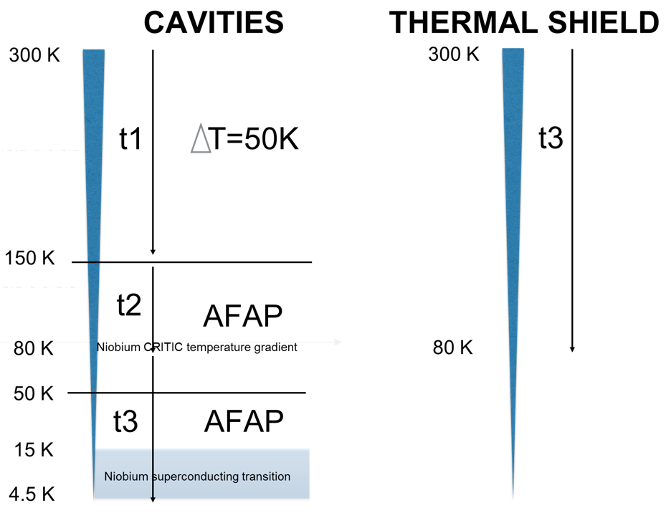
Proposal to adopt the same operating procedures for CRAB test cryomodule
Cryo operation
CoolDown
Between top and bottom of the cavity
T of the injected fluid, variable
T1 - Cavities 300 K → 150 K (control of ΔT ~ 50 K)
T2 - Cavities 150 K → 80 K (AFAP)
T3 - Cavities 80 K → 4.5 K (AFAP)
T3 - Thermal Shield 300 K → 80 K
T4 – Cavities 4.5 K → 2 K
T1 - Cavities 2 K → 4.5 K (Evaporation by heaters)
T2 - Cavities 4.5 K → 80 K (control of T ~ 10-100 K )
T3 - Cavities 80 K → 300 K (control of ΔT ~ 50 K )
T3 - Thermal Shield 80 K → 300 K
OPTION:
T3 - Cavities 80 K → 15 K (AFAP)
+ stop at 15 K for thermalization
+ cavities 15 K → 4.5 K

Slide 24
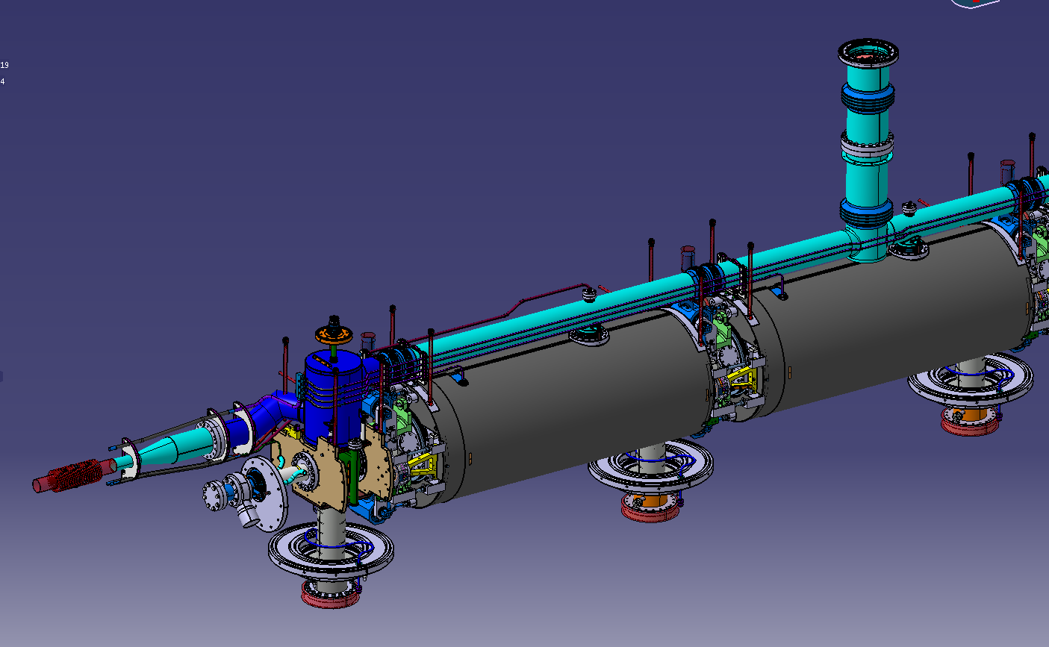
Cryo lines
New chimney with intermediate shields to reduce heat transfer on the biphase tube
materials : 1.4429 (316LN) is the best but not always possible
Safety devices under dimensioning (past calculations are available but not definitive)
Welded details compliant with European Standards

Slide 25
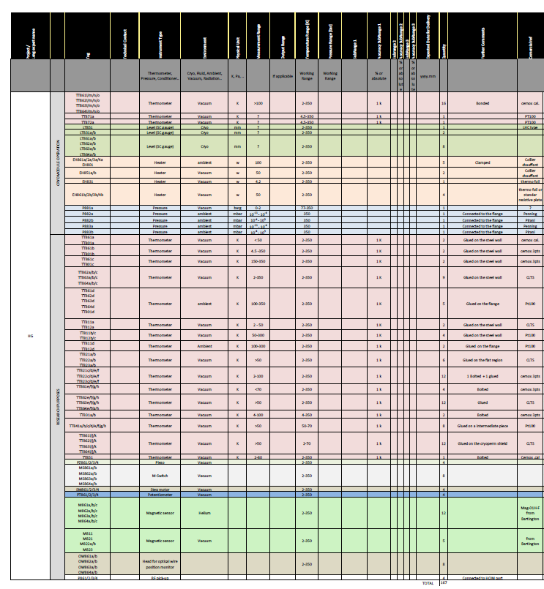
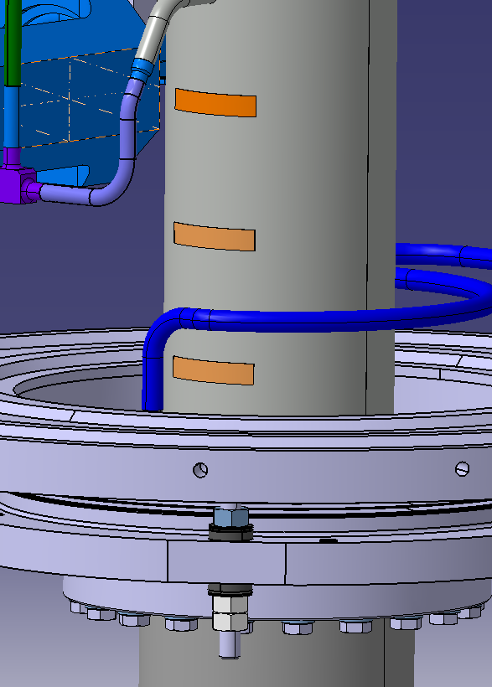
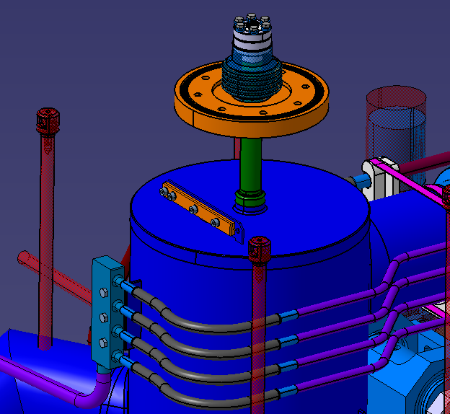
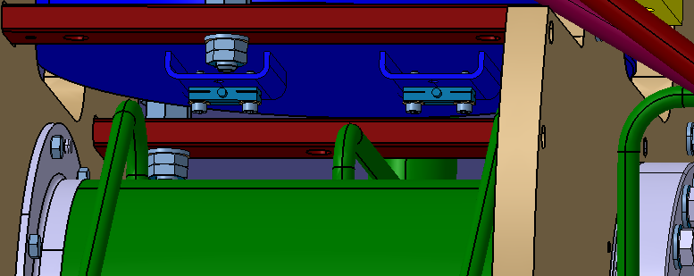
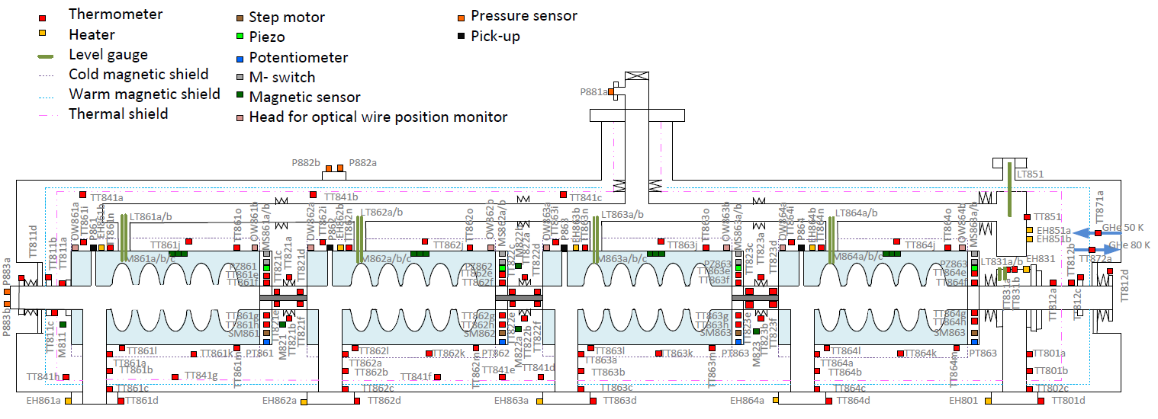
Instrumentation
integration in drawings
new magnetic sensors in the intercavity region and inside the He vessel (TBC)
flow meter installed in the valve box

