Slide 1
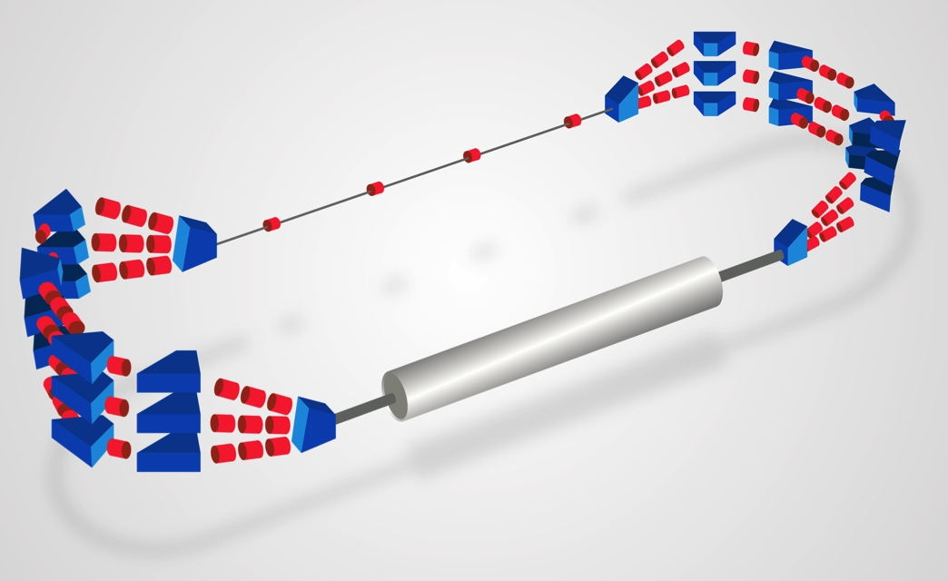
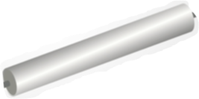



Towards the first PERLE cryomodule
(material for discussion)
PERLE Workshop, Daresbury, 15th January 2018

Slide 2
What development plan for the first Perle Cryomodule ?
Main goal: to have a complete cryomodule assembled and ready for test in 3 years (Jan2018 – Dec2020)
Taking into account:
  What we have for the moment
  What has been recently developed and that could be the basis for several systems design
  A realistic funding plan
  A staged approach including design time, prototype and series production

Slide 3
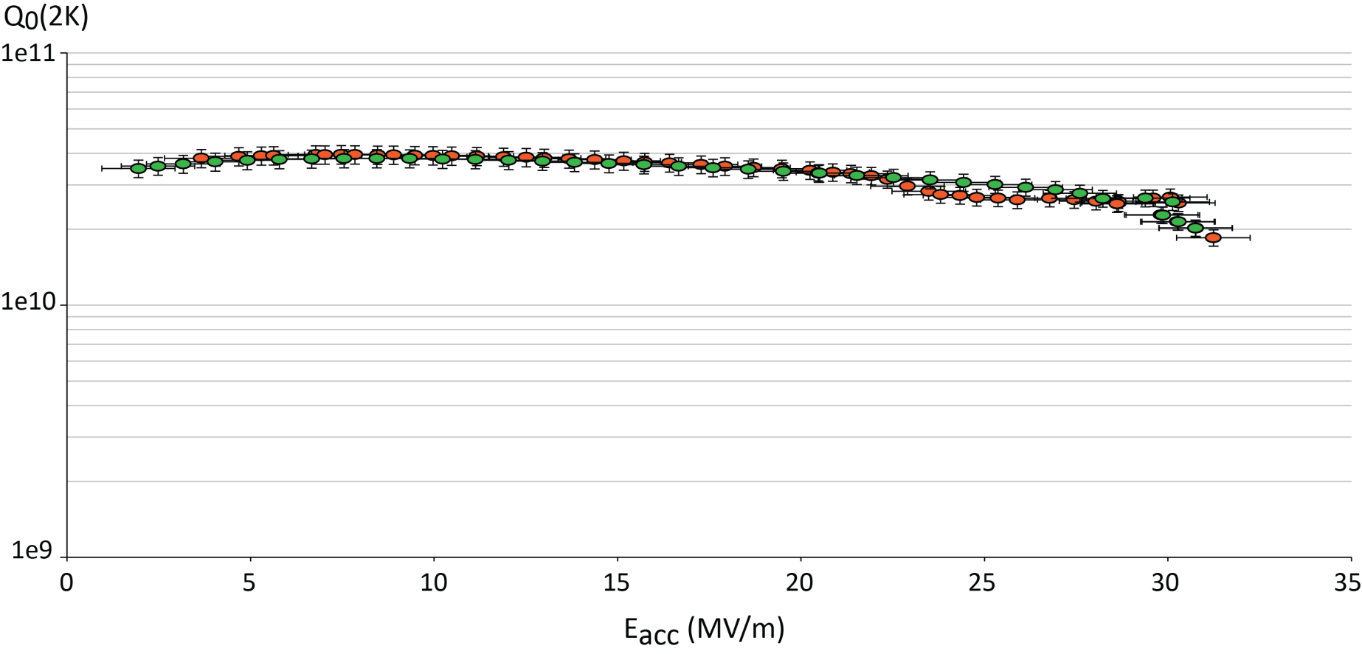
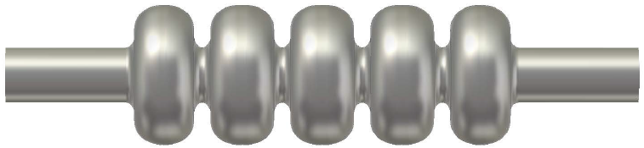
Present situation: what we have
Linac cavities
Ongoing development at Jlab – First very good results on a “bare” cavity
=> Validate the RF shape and preparation procedures
JLAb results on the 5 cell prototype (F. Marhauser)

Slide 4
Present situation: what we have
Cryomodule design
The PERLE at Orsay layout is integrating 2 cryomodules, each of them containing 4 superconducting 801.58 MHz 5-cells elliptical cavities. Recently, several projects worldwide have designed cryomodules for elliptical cavities with a cavity configuration (number, length and diameter) which is very close to the one required by PERLE
2 potentially good candidates as a reference basis for the Perle cryomodule:
SPL: the cryomodule is designed to integrate 4 elliptical 5-cells 704 MHz cavities of β = 1
ESS: two cryomodules of the same length can host either 4 elliptical 6-cells 704 MHz cavities of β = 0.67 or 4 elliptical 5-cells 704 MHz cavities of β=0.85.

Slide 5
Present situation: what we have
Cryomodule design option 1: SPL
the cavity string directly supported by the power coupler and with dedicated inter-cavity support features.
integrates a full length demountable top lid, enabling the cavity string assembly from the cryomodule top
CERN proposed to re-use the existing SPL short cryomodule prototype either as it is or replacing the 704 MHz cavities by the perle referenced 802 MHz cavities

Slide 6
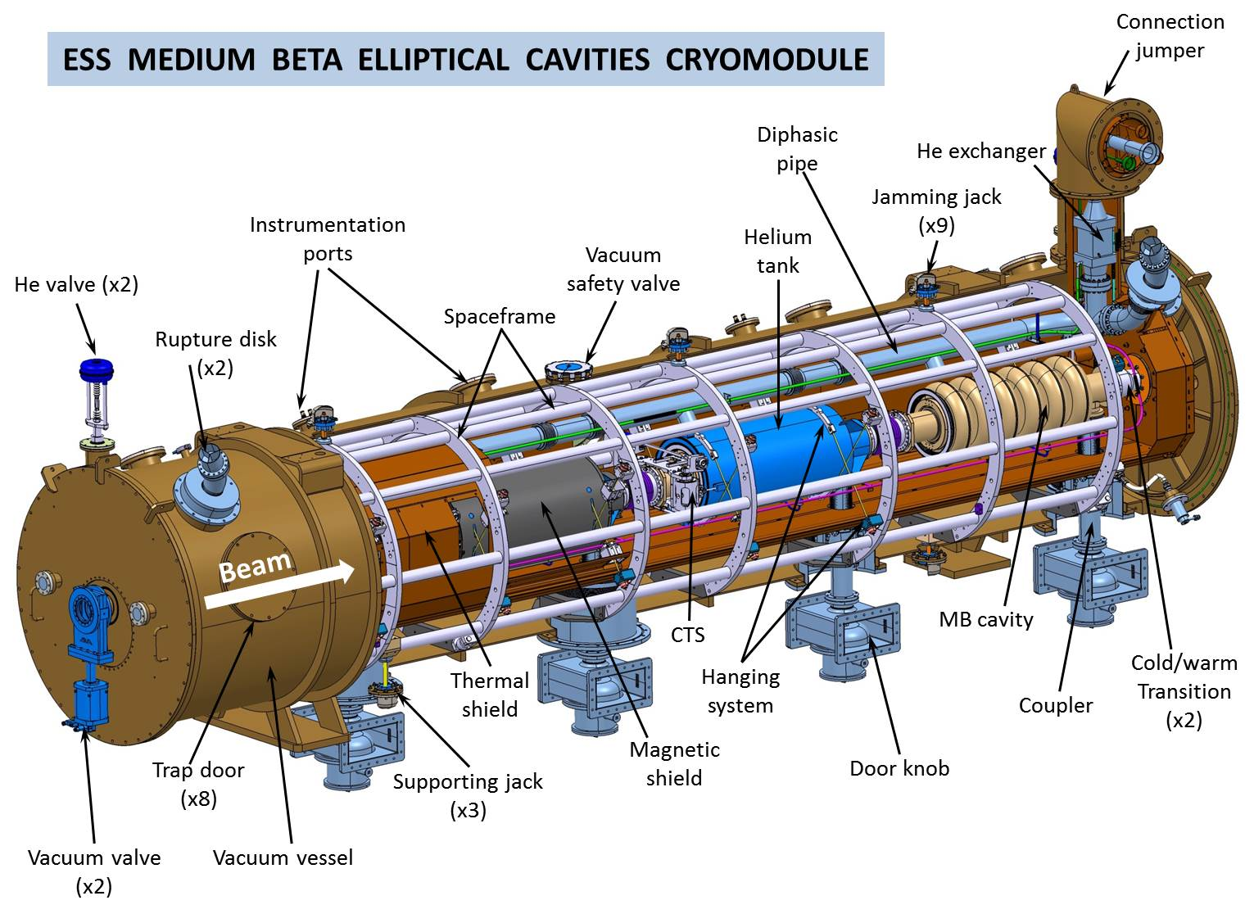
Present situation: what we have
Cryomodule design option 1: ESS (SNS)
based on an intermediate support system, called the spaceframe, which is horizontally translated inside the cryomodule vacuum vessel
All the hanging and alignment operations of the cavities string and shielding are implemented outside the vacuum tank, using the spaceframe

Slide 7
2 stages to go to the complete cryomodule
Prototype / TDR Phase
Cavity: ongoing work on the “bare” 5-cells
Perform HOM analysis and HOM coupler design
Produce and test a complete cavity (FPC & HOM ports, He tank) : cav#1
Power couplers: design, produce and test 2 couplers (RF conditioning)
Cryomodule: analyze the possibility to adapt the SPL cryomodule to the 802 MHz PERLE cavity – chose between the 2 options (SPL / ESS)
Design and build a prototype cold tuning system
Series Phase
3 more cavities to be produced and tested
Detailed design and fabrication of the cryomodule
2 additional power couplers to be fabricated and tested
Production of all HOM couplers
3 additional cold tuning systems produced
Then SRF is the technology of choice to take benefit from the very low surface resistance and allow efficient and cost-effective CW operation

Slide 8
Possible cryomodule development plan
CAVITIES
Prototype/TDR Phase
  RF design validation with the test on the “bare” 5-cells: Dec17 - Jan18, JLab DONE!
  Integration of the power coupler ports, HOM ports: Jan18 – May 18, JLab+Orsay,
  Purchase niobium for cav#1: Mar18, Orsay, 60 k€
  Adapt naked 5-cells to have coupler & HOM ports: May18 – Sept18, JLab, 40 k€
  Fabrication of cav#1: Sep18- Apr19, JLab, 140 k€
  Prepare and test cav#1 : May19 – July19, CERN/Orsay/JLab ???, 50 k€
Series Phase
  Purchase niobium for cav#2, cav#3, cav#4 July19
  Produce cav#2, cav#3, cav#4, July19 – April20
  Prepare and test cav#2, cav#3, cav#4, May20 – July20

Slide 9
Possible cryomodule development plan
2. POWER COUPLERS
Prototype/TDR Phase
Power coupler design: Jan18 - Nov18, Orsay+CERN
Power coupler test bench (conditioning) design: May18 - Dec18, Orsay+CERN
Fabrication of FPC#1 and FPC#2: Nov18 – June 19, Orsay+CERN, 80 k€
Fabrication of power coupler test bench: Jan19 – May19, Orsay+CERN, 60 k€
Power coupler test (RF conditioning @ nominal power, ~ 60 kW): June19 – Oct19, Orsay+CERN, ? k€ (RF source available at CERN ?)
Series Phase
Produce FPC#3, FPC#4, Oct19 – April20, Orsay+CERN, ??? k€
Preparation and RF conditioning of FPC#3, FPC#4, May20 – June20 Orsay+CERN, ??? k€

Slide 10
Possible cryomodule development plan
3. HOM COUPLERS
Prototype/TDR Phase
HOM Power coupler design: Feb18 - Sept18, Orsay+JLab+CERN
Study of HOM integration in cryomodule: May18 - Dec18, Orsay+JLab+CERN
Fabrication of HOM#1 to #3: Feb19 – June19, Orsay+CERN, ?? k€
Test of HOM#1 to #3: June19 – July 19, Orsay+CERN+ JLab, ?? k€
Series Phase
Fabrication of HOM#4 to #12: Sept19 – April20, ?????, ?? k€

Slide 11
Possible cryomodule development plan
4. COLD TUNING SYSTEM (CTS)
Prototype/TDR Phase
CTS design: Feb18 - Jan18, Who ???
Fabrication of CTS#1: Feb19 – June19, who ???, 35 k€
Test of CTS#1 (RT and cryo ?): June19 – July 19, who ???, ?? k€
Series Phase
Fabrication of CTS#2 to #4: Sept19 – March20, ?????, ?? k€

Slide 12
Possible cryomodule development plan
5. CRYOMODULE
Prototype/TDR Phase
Analyze the possibility to adapt the SPL cryomodule to the 802 MHz PERLE cavity: Dec17 - Apr18, Orsay+JLab+CERN
Decision to go to SPL cryomodule adaptation or dedicated design: June18, All partners
Series Phase
Detailed design of PERLE cryomodule: June18 – June19, Orsay+CERN
Fabrication of PERLE cryomodule parts (w/o cavity package): June19 – Apr20, Orsay+CERN, 650 k€
Assembly of PERLE cryomodule: June20 – Dec20, Orsay+CERN, ??? k€

Slide 13
Possible cryomodule development plan
Prototype/TDR phase
Total cost (hardware only) about 500 k€…
Open for discussion !

