Slide 1



Preliminary studies :
Arc bending magnets and quadrupoles
P.A THONET (CERN) - C. VALLERAND (LAL)
16th January 2018

Slide 2
Overview
Summary of magnet inventory
Arc bending magnets :
  Requirements and constraints
  2D preliminary design
  3D preliminary design
Quadrupole magnets :
  Requirements and constraints
  3D preliminary design
Points to be highligthed

Slide 3
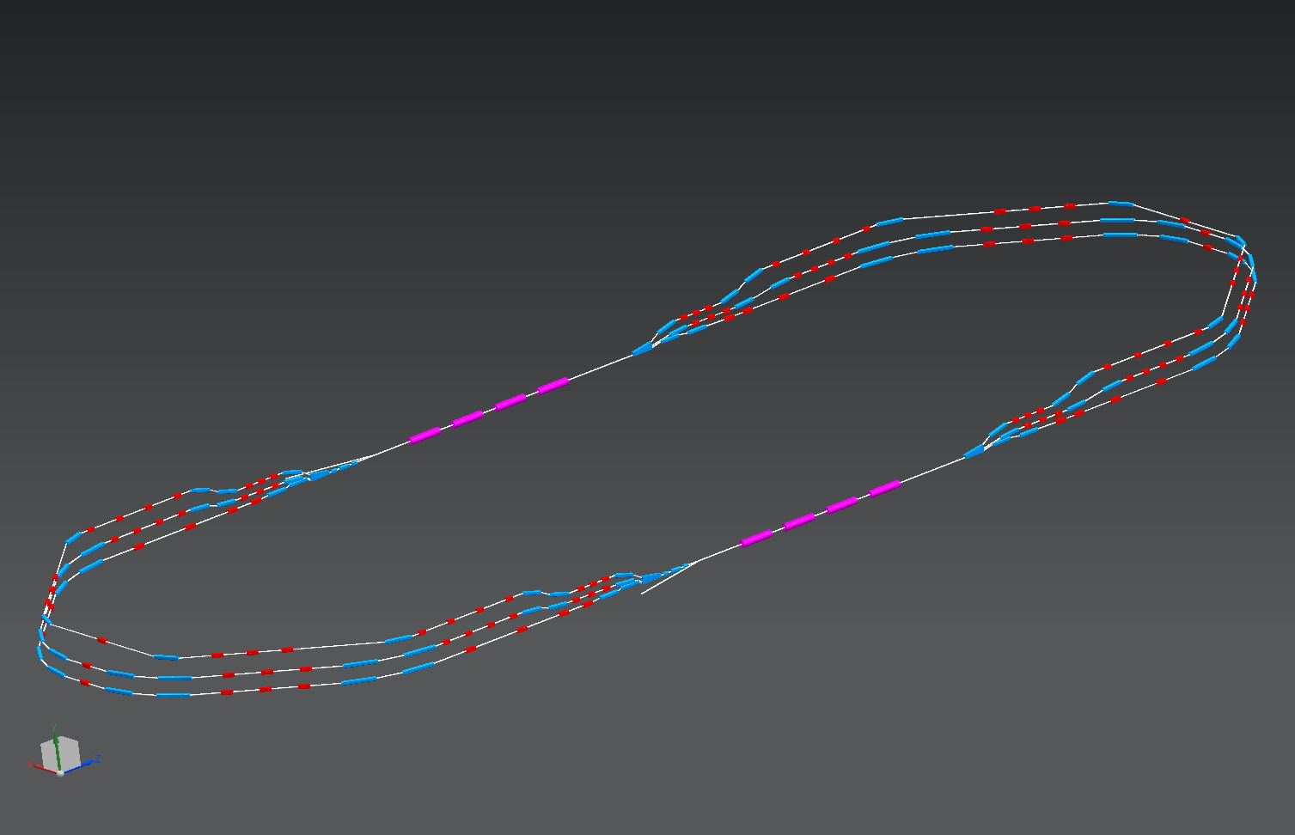
Summary of magnet inventory
There are 6 arcs, one each for 80, 155, 230, 305, 380, 455 MeV beams.
Each arc contains : 4 dipoles, powered in series within that arc
114 quadrupoles, which are powered individually
Number of sextupoles, correctors included and octupoles to be defined
46 spreader/combiner dipoles, which are powered individually
184 magnets without including sextupoles and octupoles
=> Need to optimize design of magnets by considering cost as a key parameter
1 : 3 : 5
400 MeV
ΔE = 65.5 MeV
5.5 m
0.8 m
injector
5 MeV
24 m
ΔE = 65.5 MeV
2 : 4 : 6
5 MeV
dump
ΔC = λ_{RF}/2

Slide 4
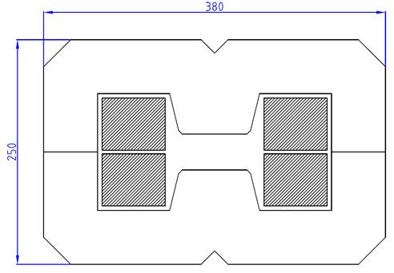
Arc bending magnets : Requirements & constraints
Iron-dominated resistive magnets preferred for improving tunability
Engineering current density of 7-8 A/mm²
H design to reduce the height of magnet for stacking
Homogeneous field as low as possible due to the use of one power supply by arc
Cost minimization with a design of the arc magnets coupled to studies of the power converters, the vacuum system and cooling as well as only one magnet per bend with a 45° deflection
Features of arc bending magnets
Quantity | 12 + 1 (pre-serie) | 12 + 1 (pre-serie)
Rotation angle | 45° | 45°
Radius of curvature | 1192 mm | 596 mm
Main field B₀ | 1.25 - 1.3 T | 1.25 - 1.3 T
Gap | 40 mm | 40 mm
Good field region | +/- 20mm | +/- 20mm
Mechanical length | 936 mm | 468 mm
Current max. | Not defined | Not defined
Beam energy | From 305 to 455 MeV | From 80 MeV to 230 MeV
Challenge to highlight : Very compact bending magnets while keeping a reasonable current
density for 6 arcs and using the same structure for Arc 1 up to 3 and for Arc 4 up to 6.

Slide 5
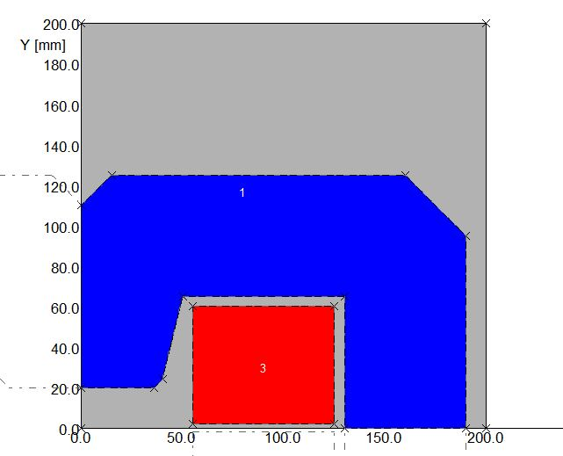
Preliminary design V1 for R = 1192 mm
All simulations have been done by OPERA/TOSCA software based on finite element for 2D and 3D electromagnetic design analysis.
2D Simulation results
Expected field value = 1.25 – 1.3 T and simulated field value = 1.25 T
2D simulations confirmed a good agreement with expected results
=> Preliminary 3D simulations will rely on this model

Slide 6
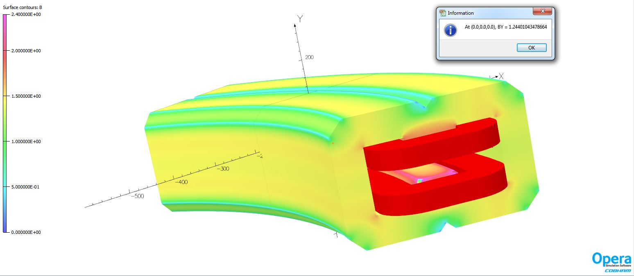
Preliminary design V1 for R = 1192 mm
3D Simulation results from 2D design with racetrack coils (simplest and cheapest coils).
Value of vertical field at the center fulfills requirements but the simulated current density is too high (7.8A/mm²).
=> Simulation of the same model with bedstead coil instead of racetrack coil

Slide 7
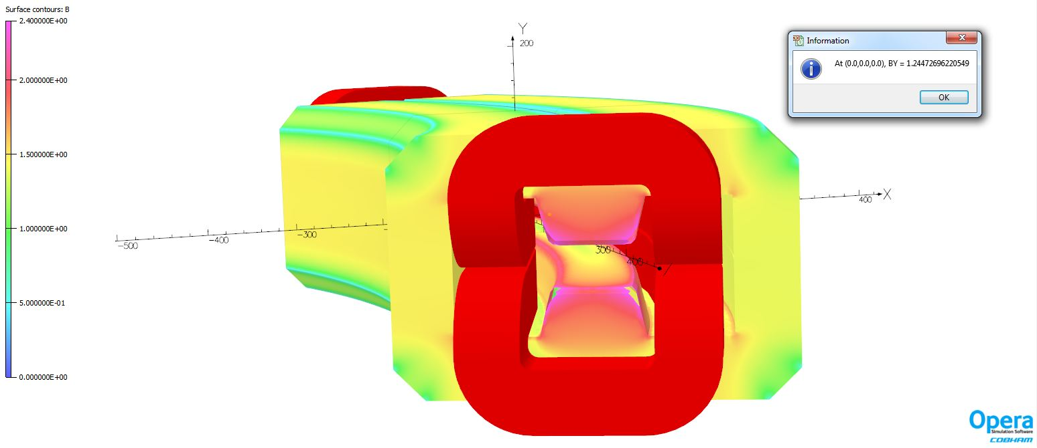
Preliminary design V2 for R = 1192 mm
3D Simulation results from 2D design with bedstead coils
Value of vertical field at the center fulfill too requirements. We obtained with the same number of turns the same value but with a current density much lower than model with racetrack coil : 5.5A/mm2 instead of 7.8 A/mm2
=> Investigation of this model

Slide 8
Preliminary design V2 for R = 1192 mm
Vertical field in a transverse horizontal plan and field homogeneity in the median plan
Good field value but low field homogeneity (1.4%) and height of coils not allowing the superposition of arc bending magnets

Slide 9
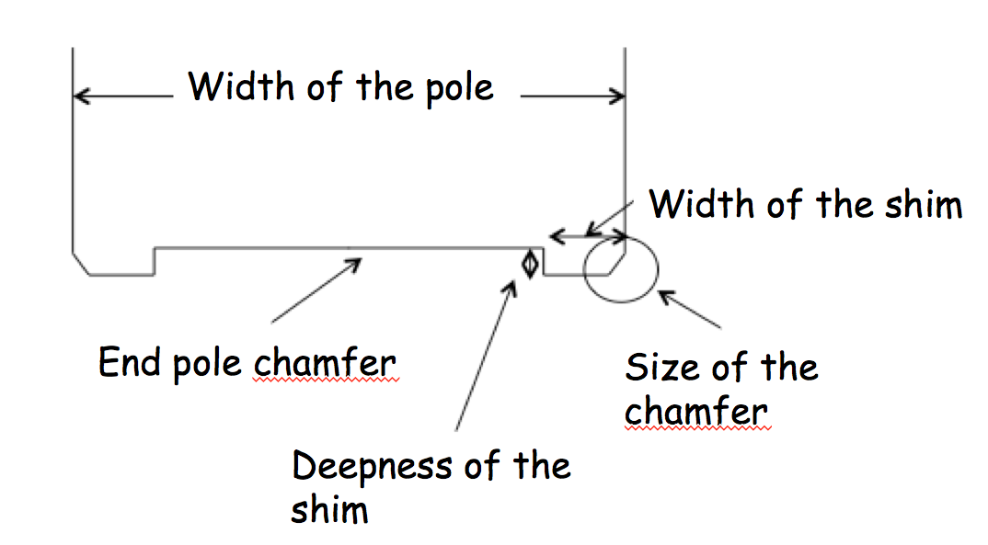
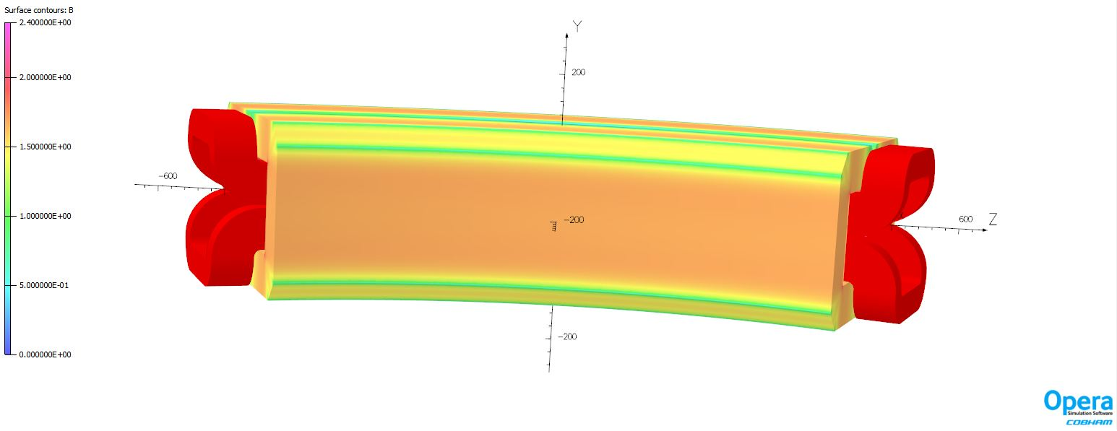
Preliminary design V2 for R = 1192 mm
Optimization of the model :
  enlargement of the pole base width (50mm instead of 40mm) to desaturate iron
  add-on of shims (10mm) to improve the homogeneity of field
  Diminution of coil height for stacking

Slide 10
Preliminary design V3 for R = 1192 mm
Results of the first optimization : pole width = 60 mm and shims = 10mm
Results show a low field homogeneity with a value of vertical field at the center for 455 MeV lower than expected with this model
=> Need to go ahead field homogeneity optimization BUT feasibility of design is done

Slide 11
Homogeneity study
Simulation results with 4 thickness of shims to obtain a field homogeneity of 5.10⁻⁴ expected
=> Thickness of 0.888mm
The field homogeneity with the optimized shim is 8.8 10⁻⁵ at ± 20 mm (GFR), better than expected (5 10⁻⁴).

Slide 12
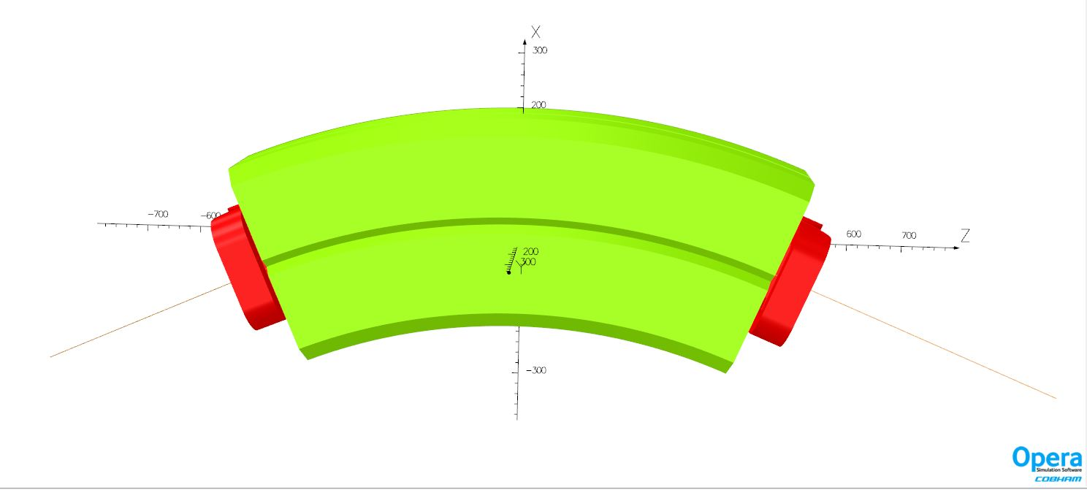
Preliminary design V3 for R = 1192 mm optimized with shims
Int By (x) and Lmag (x) at 455 MeV
Magnetic length is 51 mm longer than mechanical length
=> Need to optimize a chamfer at the entrance
/exit for matching Lmag with Lmec

Slide 13
Magnetic length study
With a chamfer of 45 mm
Magnetic length = mechanical length along the central trajectory
=> 1st model optimized for long radius

Slide 14
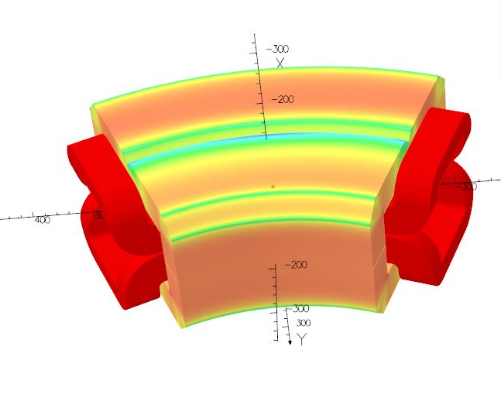
Preliminary design for R = 596 mm
Same way of design for R=1192 mm-V3 model.
Use of shims optimized for 455MeV (0.88 mm) and studies to optimize chamfer
With a chamfer of 51.1 mm :
Magnetic length = mechanical length along the central trajectory
=> 1st model optimized for short radius

Slide 15
Conclusion for arc bending magnets
Feasibility is done for short and long radius with the same structure :
  Diminution of cost, specially if laminated dipole used
Optimization of short and long radius is done for the arc 3 and 6 :
  Magnetic field value of 1.26 T
  By Homogeneity of 8.8 10⁻⁴
  Magnetic length = Mechanical length
First results about homogeneity showed that shims have to be optimized to keep an homogeneity lower than 5 10⁻⁴ for all energies.
  Optimization of shims has to be go ahead. We propose to optimize the width of the pole to increase the height of shims and then to optimize shims for keeping the same for all arcs.
Design of the coil has to be done.

Slide 16
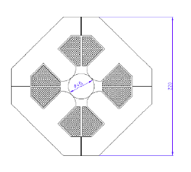
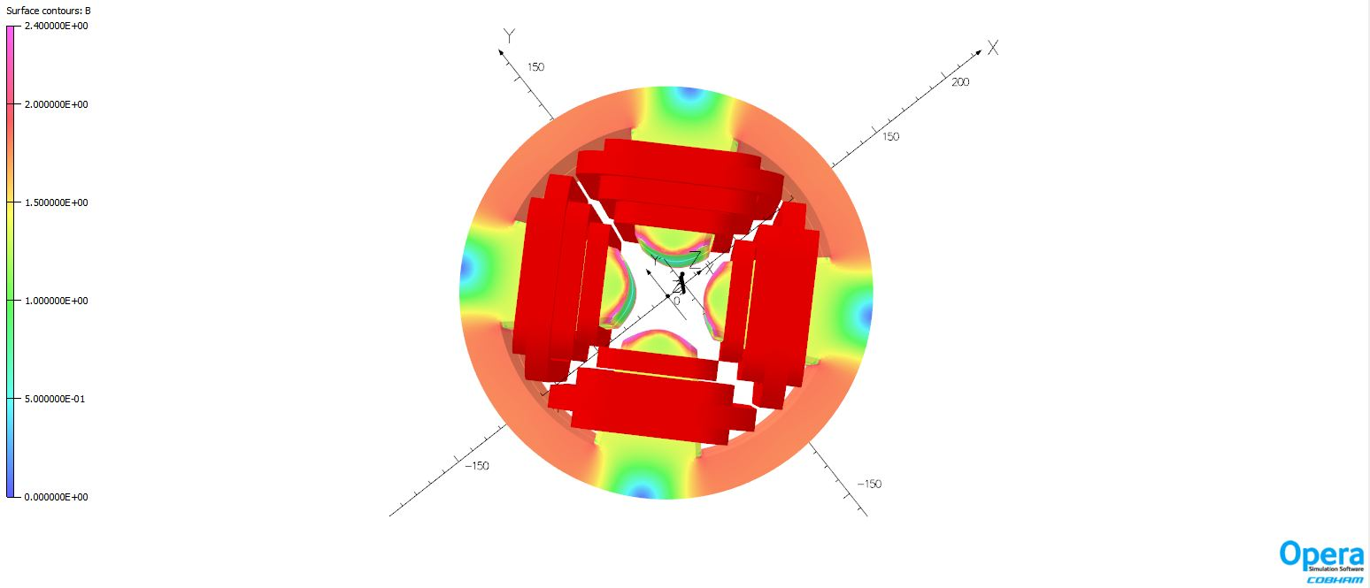
Quadrupoles of arc : features and requirements
Features of quadrupoles magnets
Quantity | 114 + 1 (pre-serie)
Magnetic length | 100 - 200 mm
Main gradient G₀ | 30T/m
Gap | 40 mm
Good field region | +/- 20mm
Beam energy | From 50 to 400 MeV

Slide 17
Preliminary design V1 L = 150 mm
3D Results with straight coil
Integrated gradient is 4.81 T.
As the gradient is 29.92 T.m then the magnetic length is 161 mm.
=> Need to optimize magnetic length of quadrupoles

Slide 18
Preliminary design V1 L = 150 mm
Harmonic analysis @ R = 13mm (2/3 of GFR). Multipoles are given in 10⁻⁴ and normalized by b₂.
Sextupolar component is too high => Need to tune the chamfer at the entrance of the pole
Regarding the DG/G curve, we observe that the gradient decreases of 0.4% at +/-20mm

Slide 19
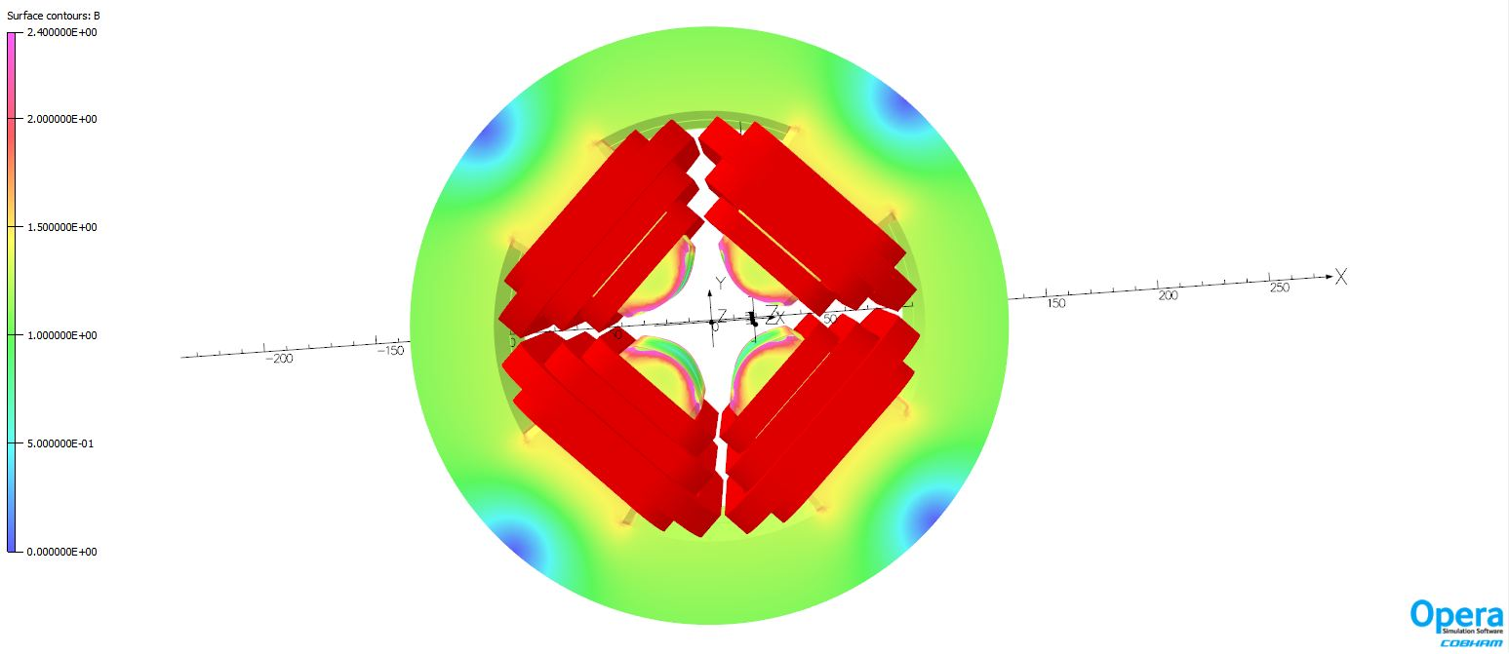
Preliminary design V2 L = 150 mm
As the iron is saturated, we decided to use the same height of bending magnet for quadrupole design (h = 250 mm).
Integrated gradient is 32.54 T/m. As the iron is desaturated, the gradient is higher than the previous model (32.54 T.m)
=> Need to have confirmation about the possibility to use this height.

Slide 20
Conclusion
Feasibility of arc bending magnets as well as quadrupoles is done
1st model optimized for short and long radius arc bending magnets
What remains to do
Finalization of arc bending optimization (magnetic design) : 4 weeks
Finalization of quadrupole optimization : 4 weeks
Simulation of the cross-talk between arc magnets : 4 days
Design of spreader and combiner magnets : 4 months
Need sextupoles with integrated correctors ? Design of these sextupoles : 8 weeks

Slide 21
Thank you for your attention

Slide 22
Preliminary design V3 for R = 1192 mm optimized with shims
Homogeneity of By_x for 3 last arcs with the shim optimized for 455 MeV but without chamfer
Shim optimized for 455 MeV doesn’t match for others energies with this design of magnet.
=> Need to adjust shims for each beam energy or change the design to use a same shim.

