Slide 1
Frequency Hunting Application for Beam Noise Detection
DEELS’18
D. Yépez, A. Olmos
ALBA Synchrotron

Slide 2
Content
The Problem
Frequencies tracking app
Tracked events
What’s next?

Slide 3
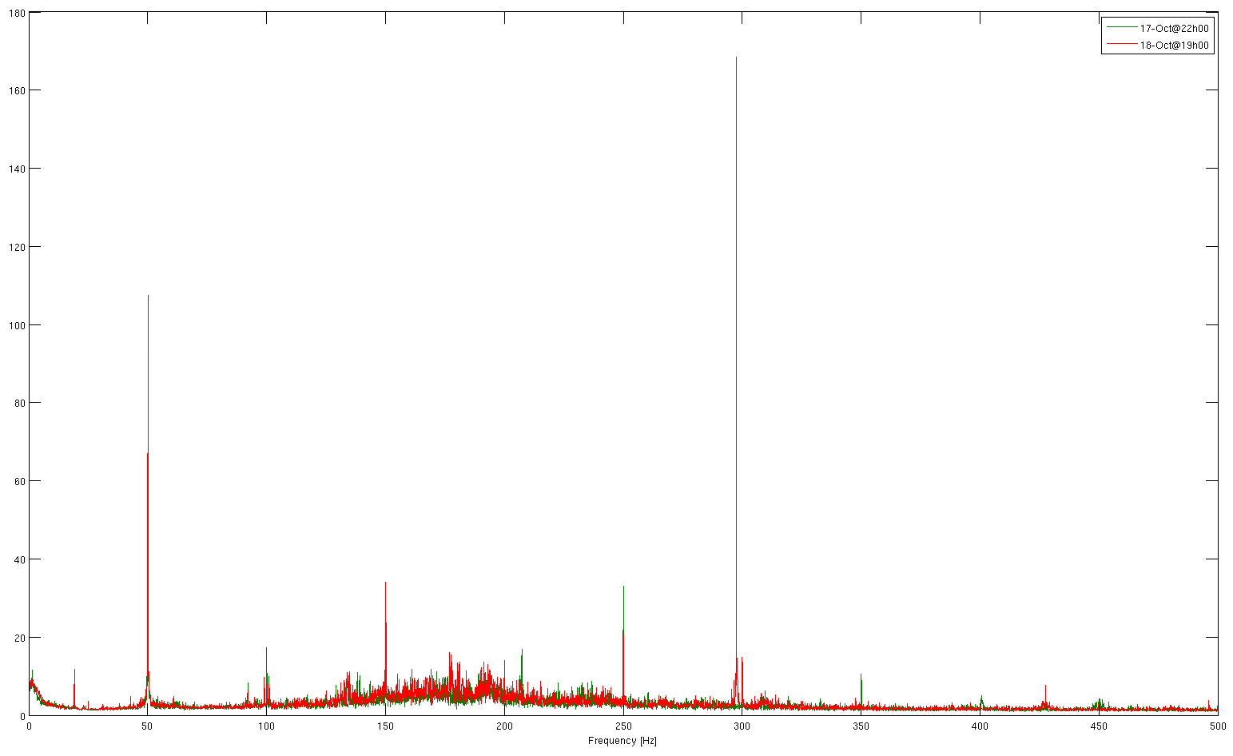
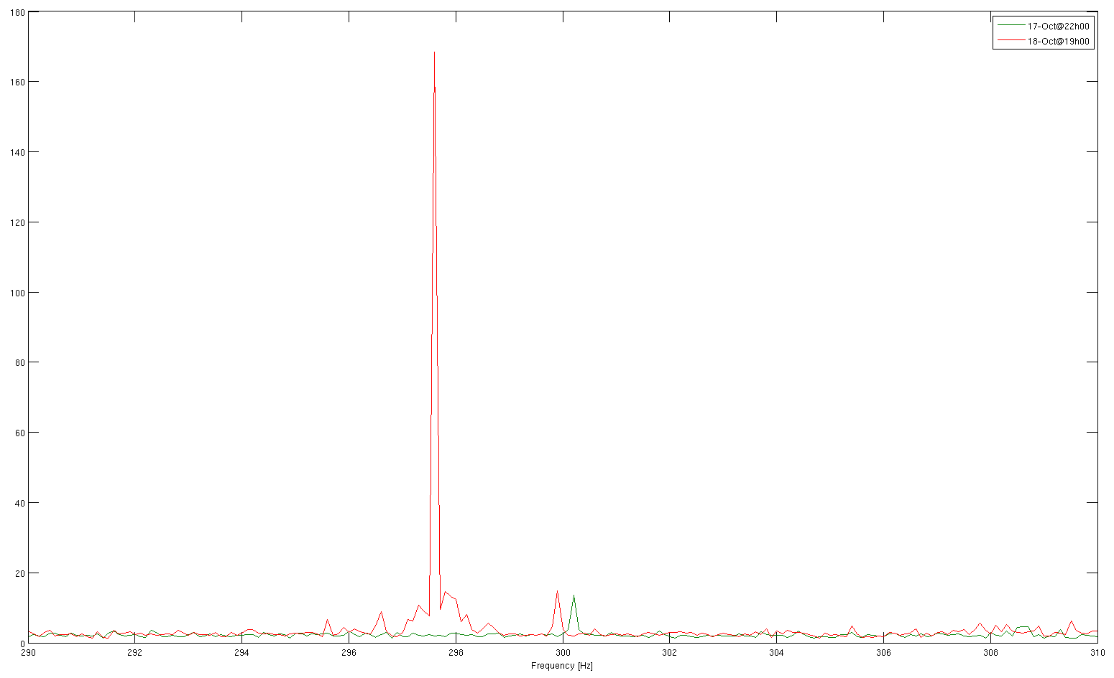
The Problem
Weird orbit distortions showing up and vanishing
We ca not correlate these perturbations directly with its source, because they appear at random times
17-Oct
18-Oct
17-Oct
18-Oct
297.5Hz
VERTICAL Spectrum Amplitude
0
50
100
150
Freq (Hz)
300
350
400
450

Slide 4
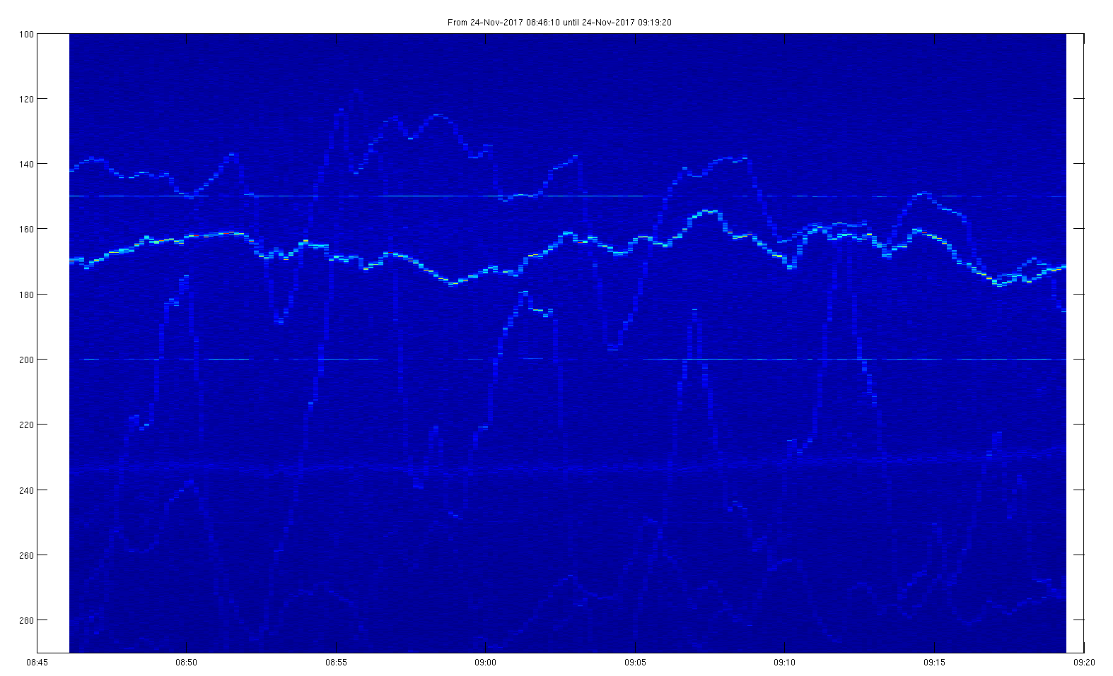
The Problem
They do not have frequencies easily identifiable with a subsystem
We need a reliable way to keep track of this unusual frequencies
24-November
100
120
140
160
180
Freq (Hz)
200
220
240
10sec beam spectrum slices
260
280
~35min

Slide 5
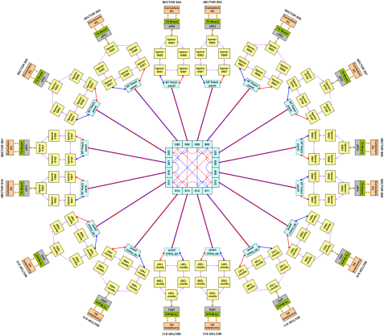
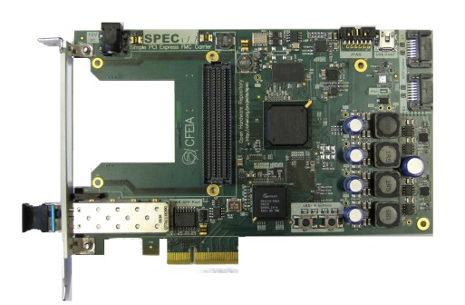
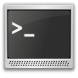


Frequencies tracking app
Based on the analysis of BPM data from the Fast Archiving System
120 BPMs position data (10kHz) stored during ~13days
12Tb

Slide 6
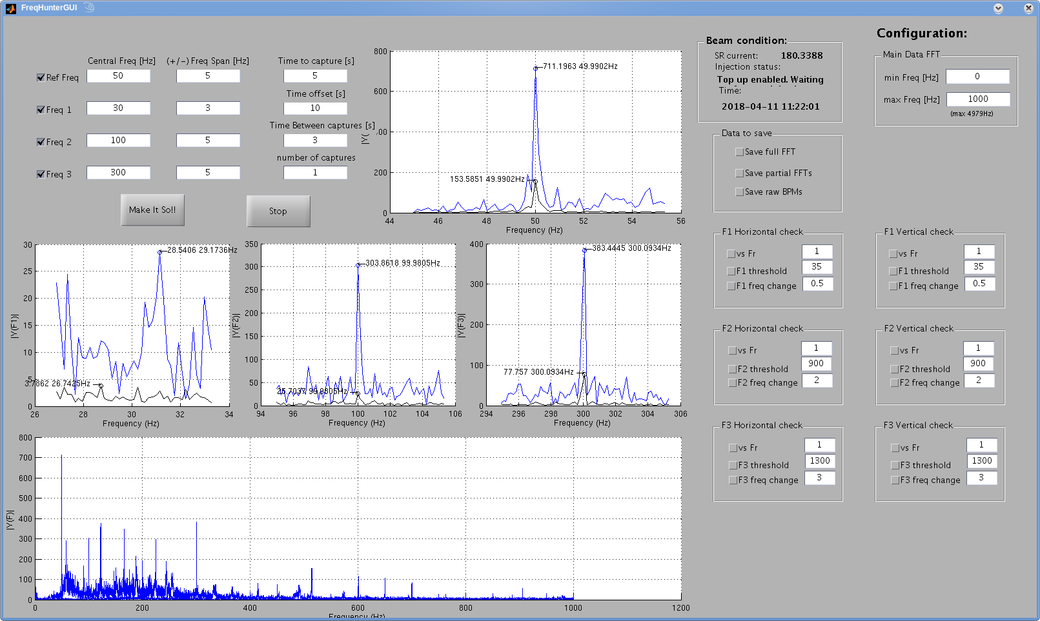
Frequencies tracking app
1st attempt
Matlab GUI to keep track of up to 3 frequencies using the data from the Fast Archiver
Not very reliable, uses a lot of computing power and needs a dedicated Matlab license (quite coveted at ALBA)

Slide 7
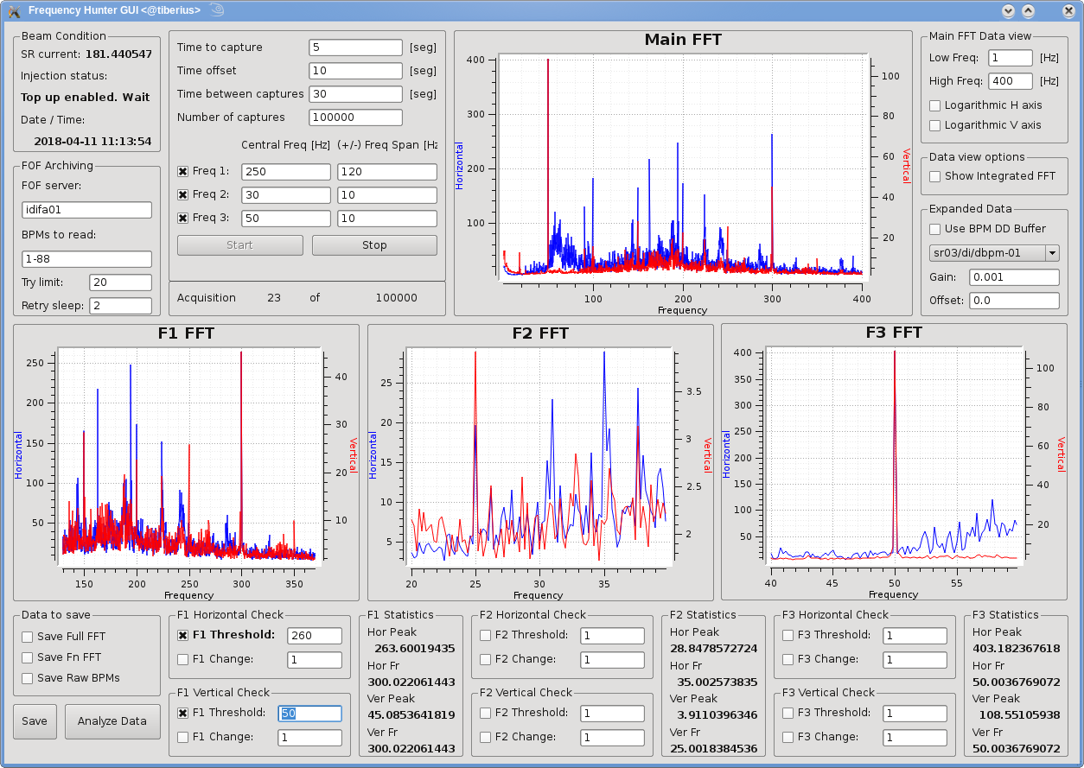
Frequencies tracking app
2nd attempt: “Frequencies Hunter”
Made in python → free
Memory handling under control
Stable → more that 3 months working without any problem
Keep track of 3 frequencies at the same time, together with many machine parameters (beam current, FOFB status, Injector status, …)

Slide 8
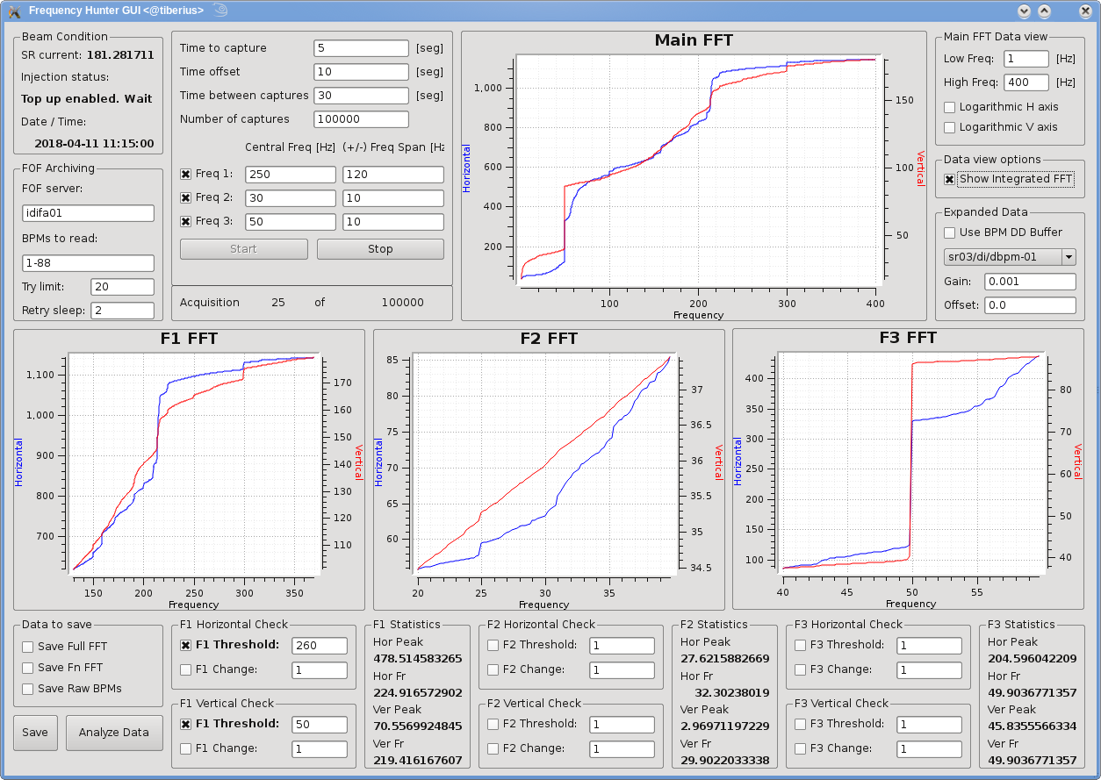
Frequencies tracking app
2nd attempt: “Frequencies Hunter”
Machine Status:
SR current
Working mode
Date - Time
Data view options
BPMs to check
Number of tries before error
Sleep time between retries
Time span to analyze
Time between captures
Number of captures
Central frequency and side bands to monitor
Tracked frequencies Stats
Data to save:
Full FFT
Partial FFT
Full BPMs raw data
Save data conditions:
Frequency peak value
Absolute frequency movement

Slide 9
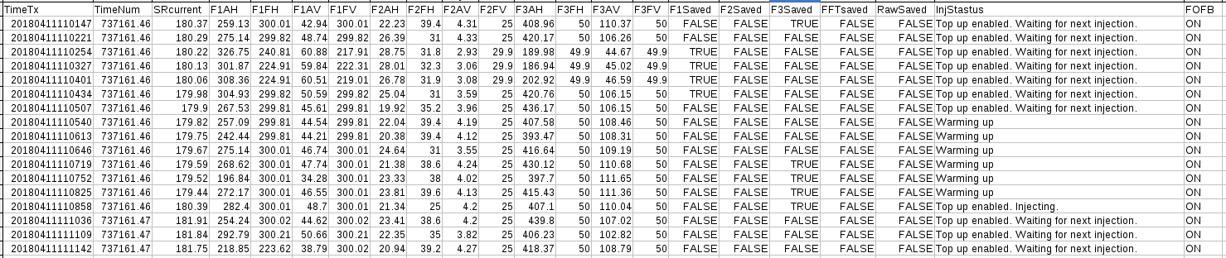
Frequencies tracking app
Log File
FFT values of the tracked frequencies saved in a log file
Log is updated on every acquisition loop, even if the save data conditions are not met
Off-line analysis of the file allow us to identify freq peaks vs. time and machine status

Slide 10
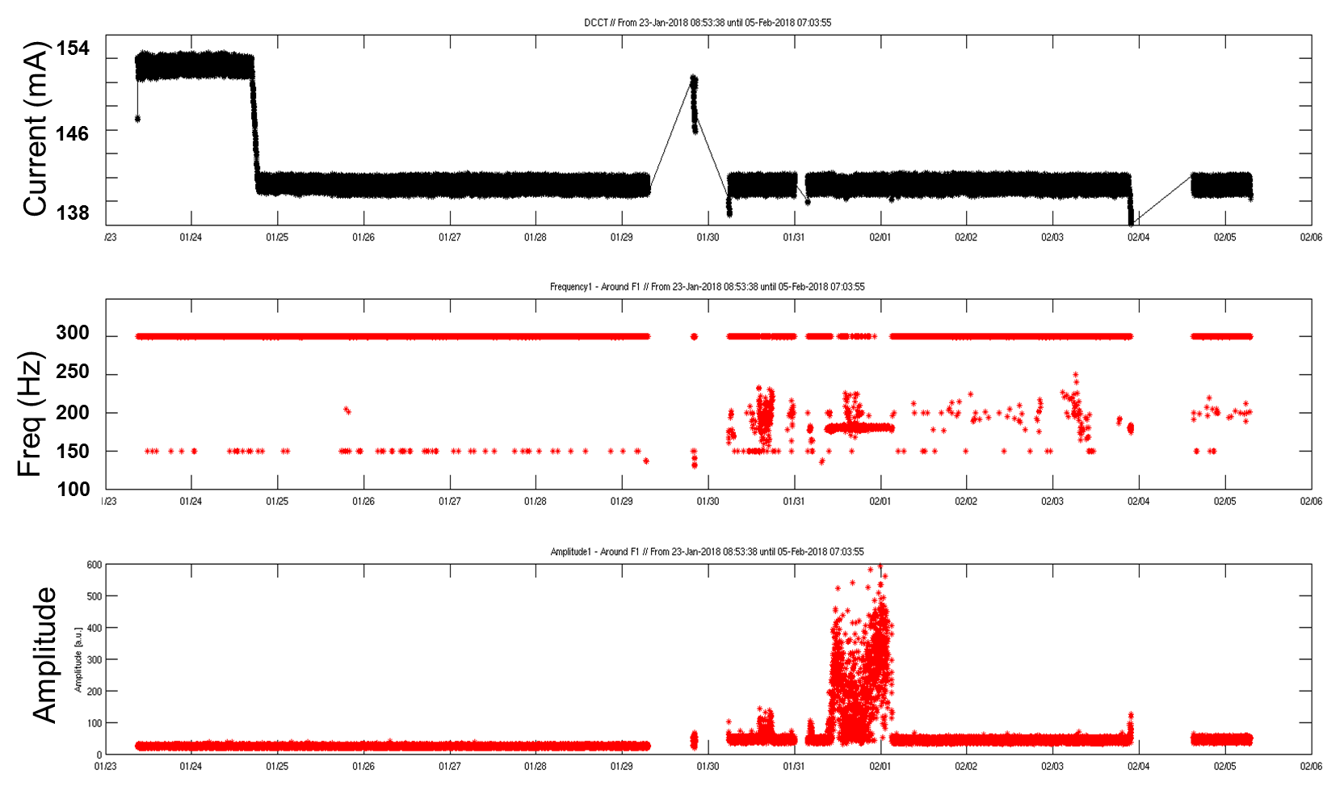
Tracked events – Case1
Swinging 150-250Hz
23-Jan until 05-Feb
Beam Current
Broad freq
swing (~100Hz)
Max Freq peak
Peak Amplitude
Huge noise
“The Calm”
~14 days

Slide 11
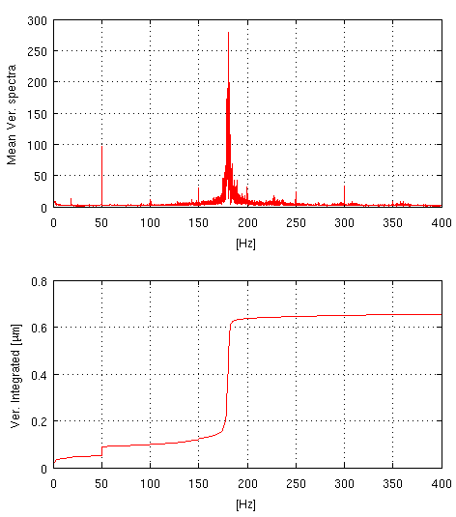
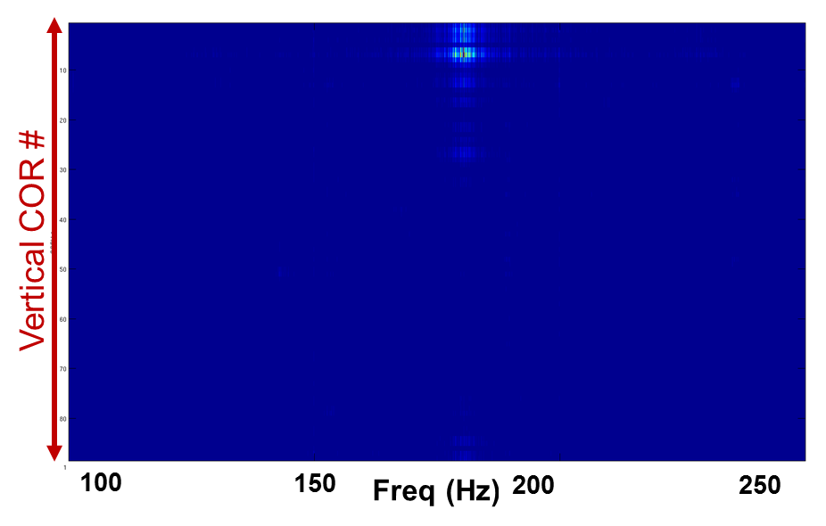
Tracked events – Case1
Swinging 150-250Hz
Retrieved data from the “noisy day”
CORV0202
From 180 to 600nm
CORV0202 replaced on the 5th of February → Swinging peak gone since then

Slide 12
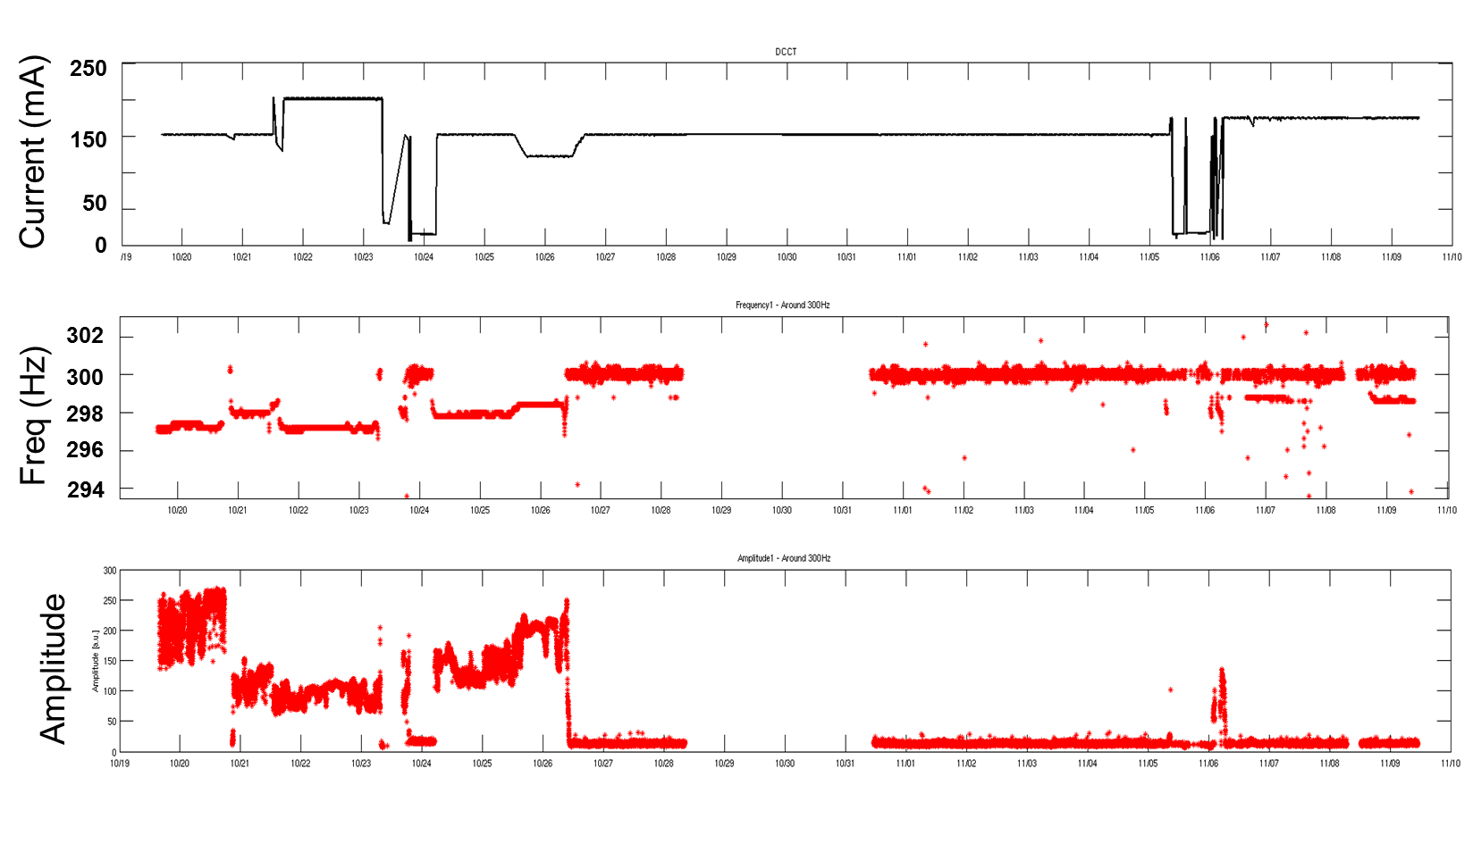
Tracked events – Case2
297Hz vertical noise
19-Oct until 11-Nov
Beam Current
Tiny freq drift (3Hz)
Max Freq peak
Huge noise
“The Calm”
???
Peak Amplitude
~20 days

Slide 13
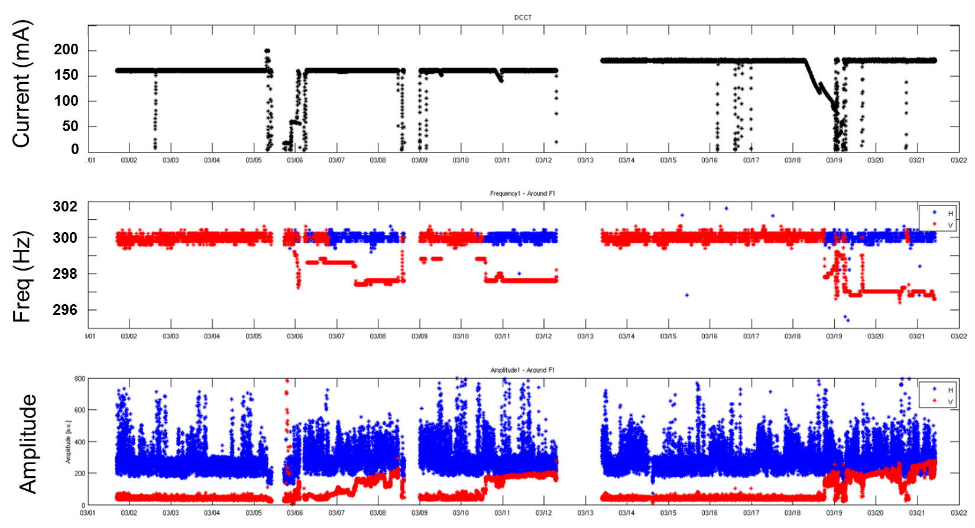
Tracked events – Case2
297Hz vertical noise
01-Mar until 21-Mar
~ 297Hz vertical noise showing up again from time to time
Beam Current
Max Freq peak
Tiny freq drift (3Hz)
Peak Amplitude
19 days

Slide 14
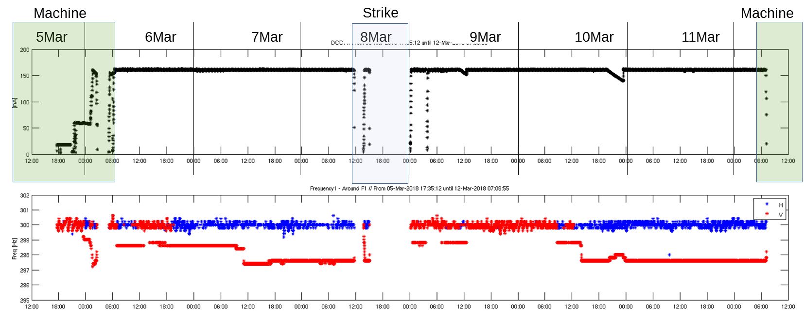
Tracked events – Case2
297Hz vertical noise
~ 297Hz vertical noise showing up again from time to time
200
150
Current (mA)
100
50
0
302
300
Freq (Hz)
298
296
Back to all OK
after reinjection
???
08:43:30 ???
Beam noise
starts to show up
14:07:04 ???

Slide 15
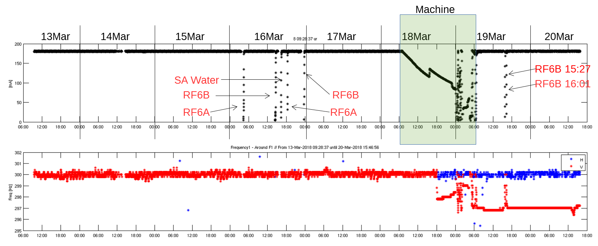
Tracked events – Case2
297Hz vertical noise
~ 297Hz vertical noise showing up again from time to time
200
150
Current (mA)
100
50
0
302
300
Freq (Hz)
298
All OK
296
18:06:42
Noise again during
decay @ 120mA
No noise during reinjection …
but again there when >90mA

Slide 16
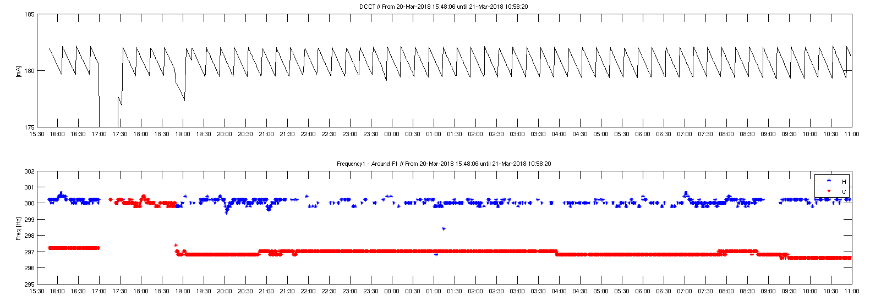
Tracked events – Case2
297Hz vertical noise
SCW quench +
beam down
SCW quench +
1mA loss
185
Current (mA)
180
175
302
300
Freq (Hz)
298
296
Noise
present
Noise
back
All OK

Slide 17
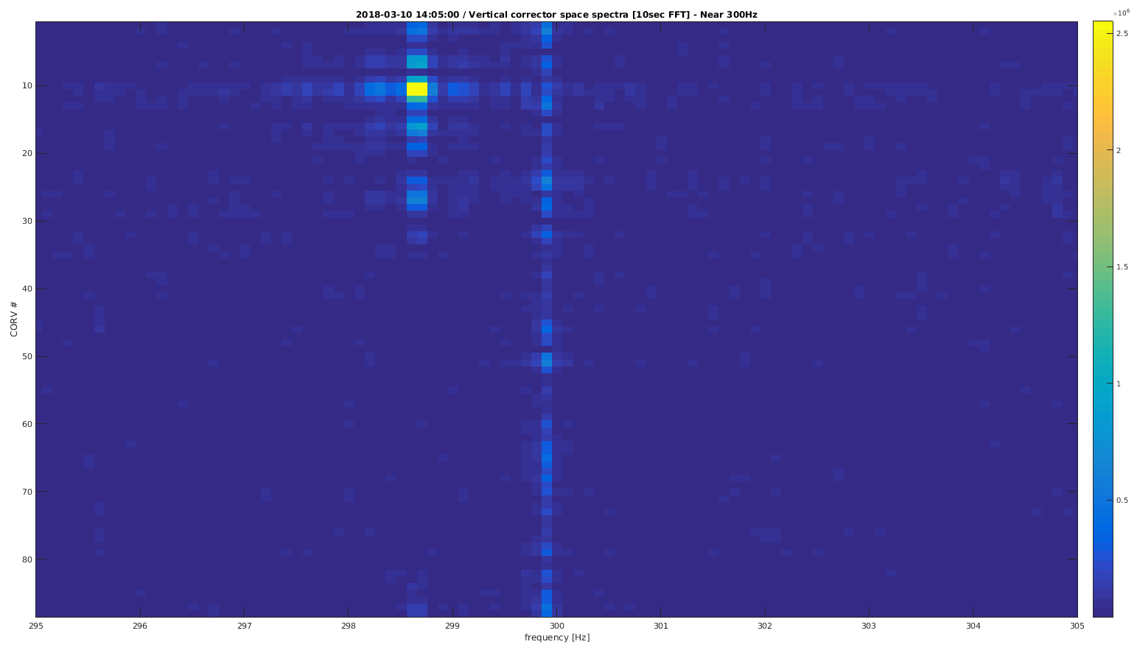
Tracked events – Case2
297Hz vertical noise
CORV0303
VER COR#
296
298
Freq(Hz)
301
303
CORV0303 replaced on the 5th of April → Noise gone since then
But why related with beam reinjections, decaying beams, SCW quenches, RF cavities trips … and also when none of these happens?

Slide 18
What’s next?
Multiple (infinite) frequencies tracking
Frequencies self-detection and tracking
Save not only mean FFT data but all BPMs FFT info
Create a TANGO Device Server to integrate it into Control System
Save data into ALBA archiving instead of logfile for easier events correlation
…
Thanks for your attention!!!

