Slide 1
Diagnostics X-ray Beamline at Diamond Light Source
Lorraine Bobb

Slide 2


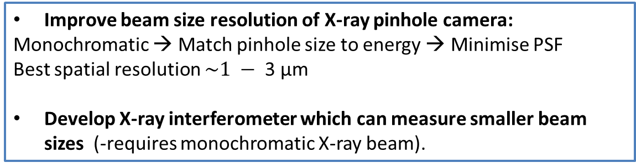
Small-scale X-ray beamline
Improve beam size resolution of X-ray pinhole camera:
Monochromatic → Match pinhole size to energy → Minimise PSF
Best spatial resolution $\sim 1 − \text{3 }\text{μ}\text{m}$
Develop X-ray interferometer which can measure smaller beam sizes (-requires monochromatic X-ray beam).
Camera
X-rays (white)
Measured beam size
+
Lattice param.
X-rays (mono)
Emittance
Visible light
Lens
Source
Pinhole / Interferometer
Scintillator
Mirror
Monochromator
$$d_{o}$$
$$d_{i}$$

Slide 3
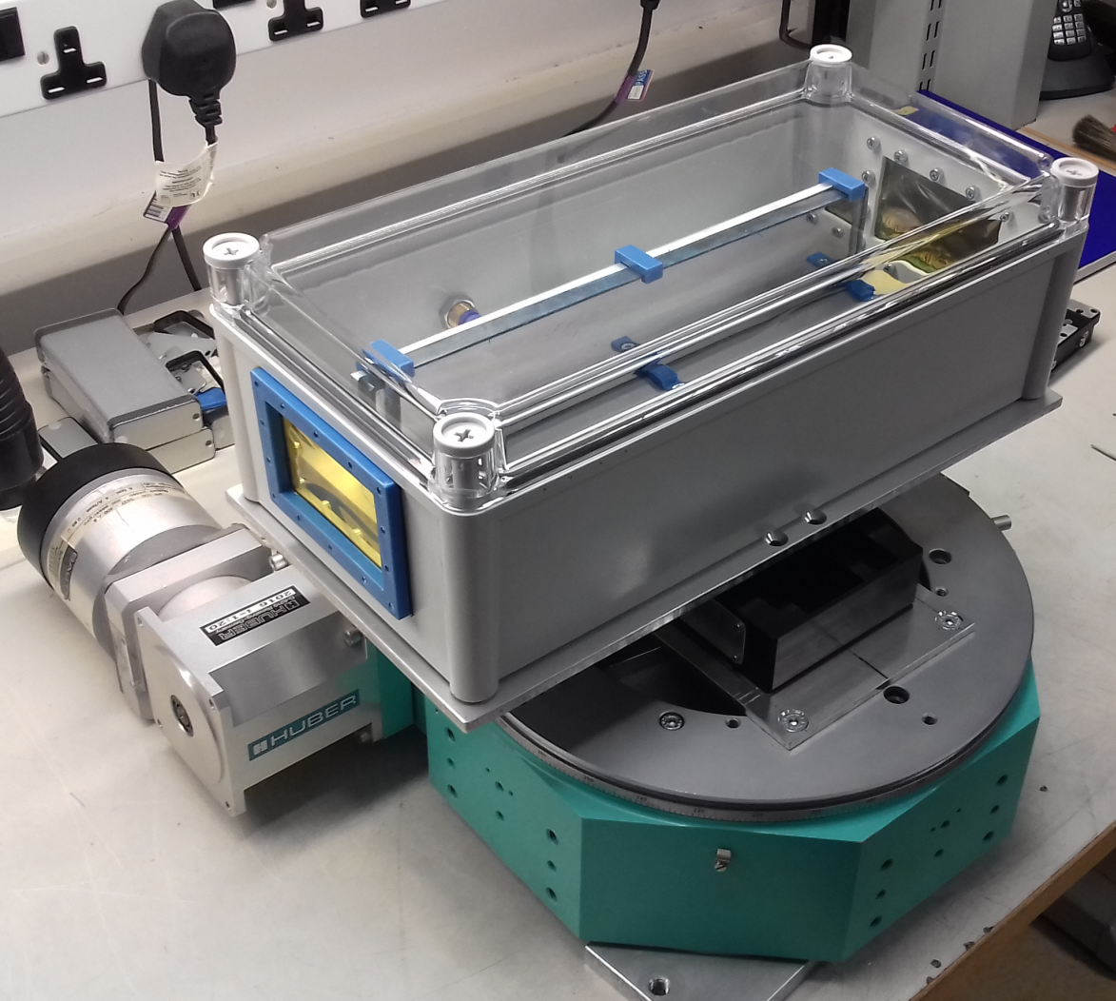
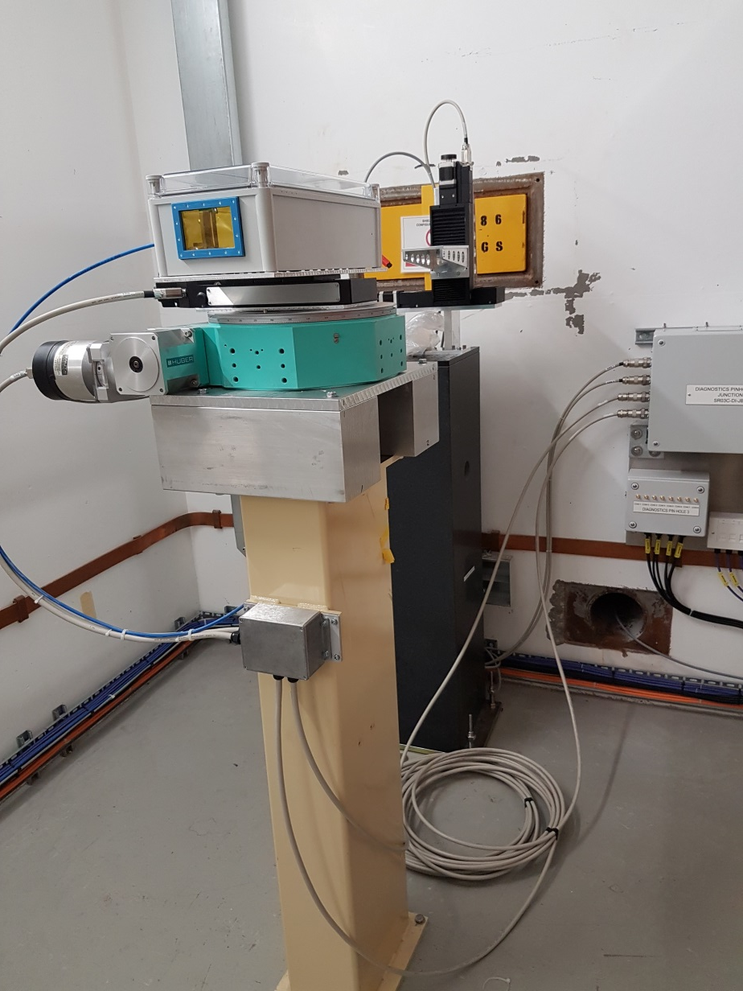
Photos of Monochromator

Slide 4
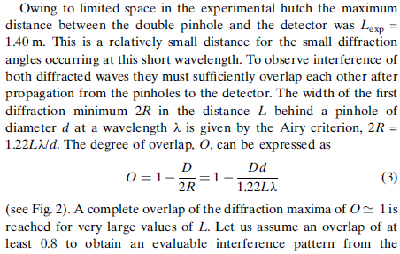
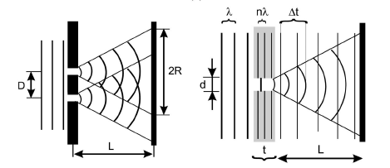
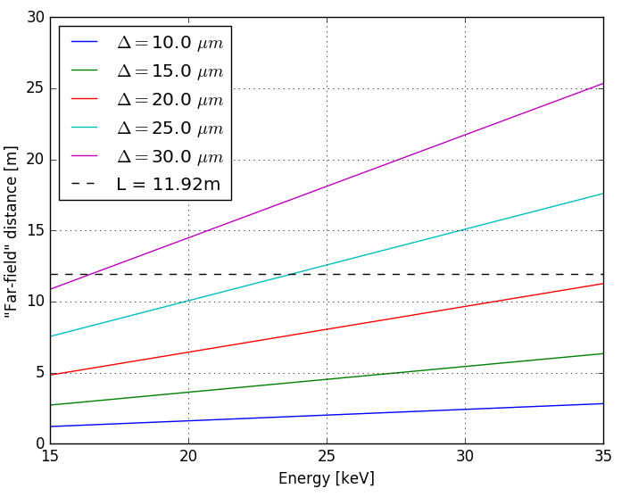
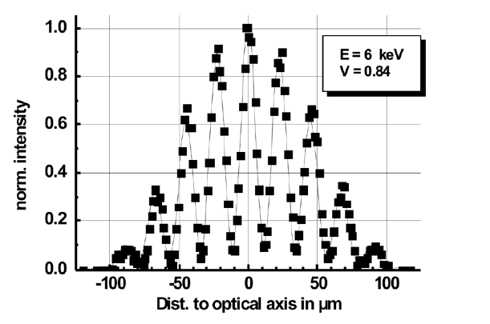
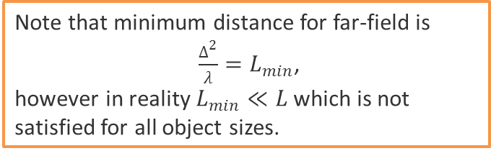
X-ray Interferometer
Overlap @ 15 keV ≈ 0.79
Overlap @ 25 keV ≈ 0.66
Note that minimum distance for far-field is
$\frac{∆^{2}}{λ}=L_{min}$,
however in reality $L_{min}≪L$ which is not satisfied for all object sizes.
Example interferogram
[1] Pinhole interferometry with coherent hard X-rays- Wolfram Leitenberger, Horst Wendrock, Lothar Bischoff and Timm Weitkamp

Slide 5
Multilayer Mono Parameters
 | Borrowed from Optics group | Incoatec
Dimensions | 300 mm x 50 mm | Approx 40mm x 100mm
D-spacing | 4.8 nm | 4 nm
Multilayers | Mo/Si with N=100 layer-pairs deposited on float glass | Tungsten/Boron Carbide (B4C) with 200 pairs
Comment | At 12 keV, it will have a Bragg angle of ~0.67 deg, giving a beam-deflection of ~23mm at 1m

Slide 6
Extra Slides

Slide 7
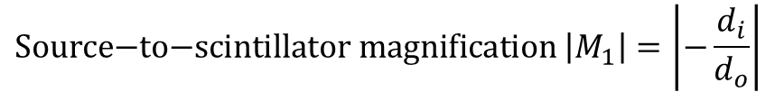
Principle of Operation
Camera
Synchrotron radiation is emitted from the source point.
Intermediate image is formed at the scintillator screen via a pinhole.
Image is relayed to the camera by a lens.
X-rays
$$\text{Source}\text{−}\text{to}\text{−}\text{scintillator} \text{magnification} \left|M_{1}\right|=\left|−\frac{d_{i}}{d_{o}}\right|$$
Visible light
$$\text{Scintillator}\text{−}\text{to}\text{−}\text{camera} \text{magnification} \left|M_{2}\right|\sim 1$$
Lens
Source
Pinhole
Mirror
Scintillator
$$d_{o}$$
$$d_{i}$$

Slide 8
Emittance Calculation
X-ray pinhole cameras measure the transverse profile of the beam, from which the emittance may be calculated.
Example image from Diamond Light Source in 2010, from which the emittance can be calculated [4, 5].

Slide 9
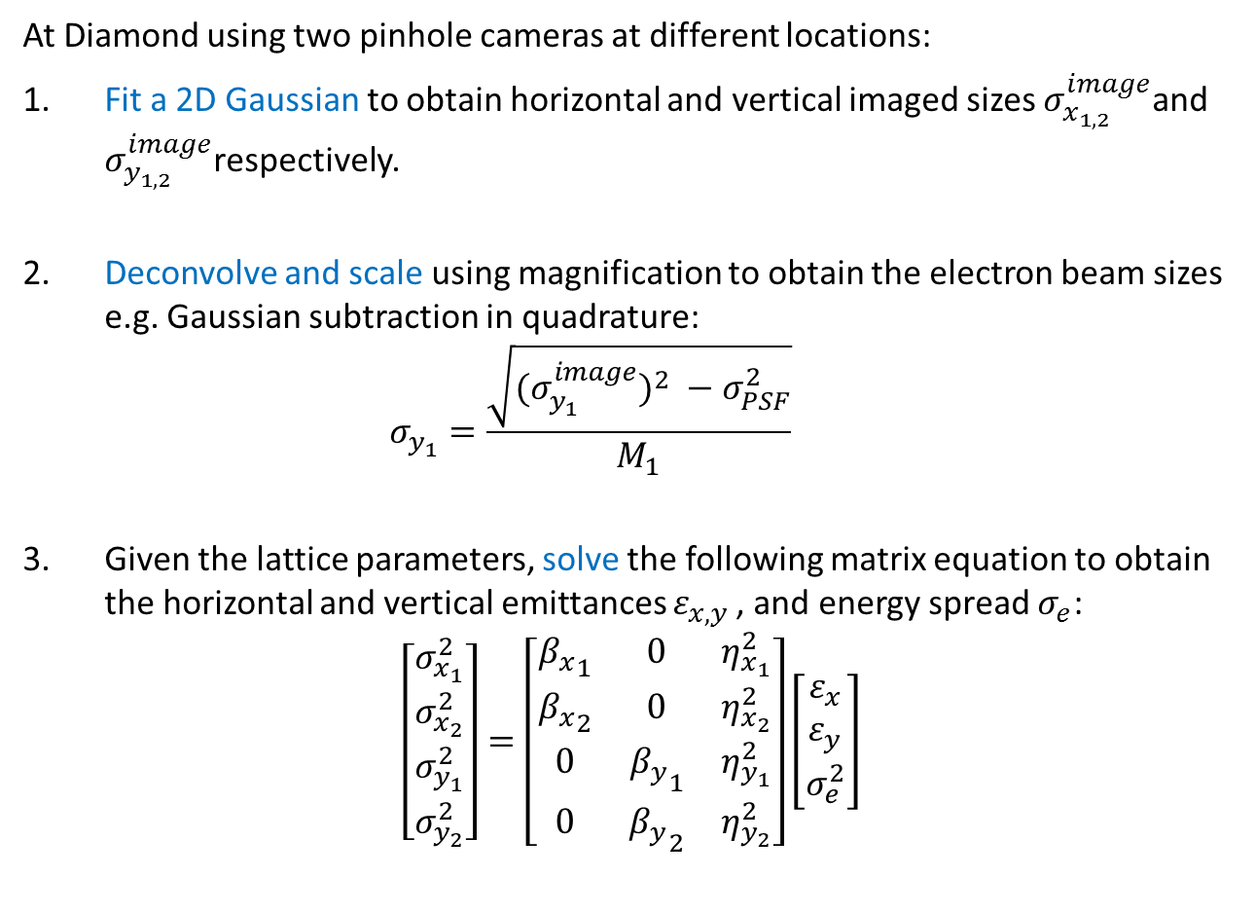
Emittance Calculation
At Diamond using two pinhole cameras at different locations:
Fit a 2D Gaussian to obtain horizontal and vertical imaged sizes $σ_{x_{1,2}}^{image}$and $σ_{y_{1,2}}^{image}$respectively.
Deconvolve and scale using magnification to obtain the electron beam sizes e.g. Gaussian subtraction in quadrature:
$σ_{y_{1}}=\frac{\sqrt{{{(σ}_{y_{1}}^{image})}^{2} −σ_{PSF}^{2}}}{M_{1}}$
Given the lattice parameters, solve the following matrix equation to obtain the horizontal and vertical emittances $ε_{x,y }$, and energy spread $σ_{e}$:
$$\left[\begin{matrix}\begin{matrix}σ_{x_{1}}^{2} \\ σ_{x_{2}}^{2}\end{matrix} \\ \begin{matrix}σ_{y_{1}}^{2} \\ σ_{y_{2}}^{2}\end{matrix}\end{matrix}\right]=\left[\begin{matrix}{β_{x}}_{1} & 0 & η_{x_{1}}^{2} \\ {β_{x}}_{2} & 0 & η_{x_{2}}^{2} \\ 0 & {β_{y}}_{1} & η_{y_{1}}^{2} \\ 0 & {β_{y}}_{2} & η_{y_{2}}^{2}\end{matrix}\right]\left[\begin{matrix}ε_{x} \\ ε_{y} \\ σ_{e}^{2}\end{matrix}\right]$$

Slide 10
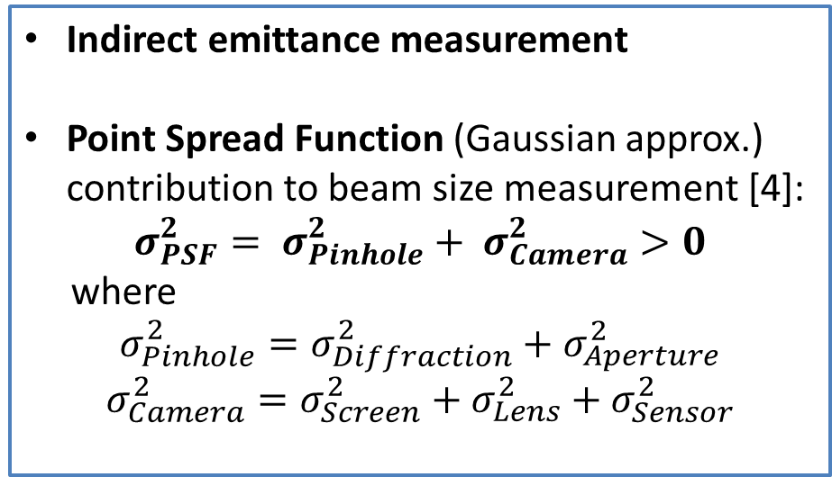
Fundamental Limitations
Indirect emittance measurement
Point Spread Function (Gaussian approx.) contribution to beam size measurement [4]:
$$σ_{PSF}^{2}= σ_{Pinhole}^{2}+ σ_{Camera}^{2}>0$$
where
$$σ_{Pinhole}^{2}=σ_{Diffraction}^{2}+σ_{Aperture}^{2}$$
$$σ_{Camera}^{2}=σ_{Screen}^{2}+σ_{Lens}^{2}+σ_{Sensor}^{2}$$
Camera
Lens
Source
Pinhole
Mirror
Scintillator
$$d_{o}$$
$$d_{i}$$

Slide 11
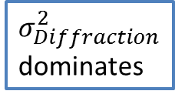
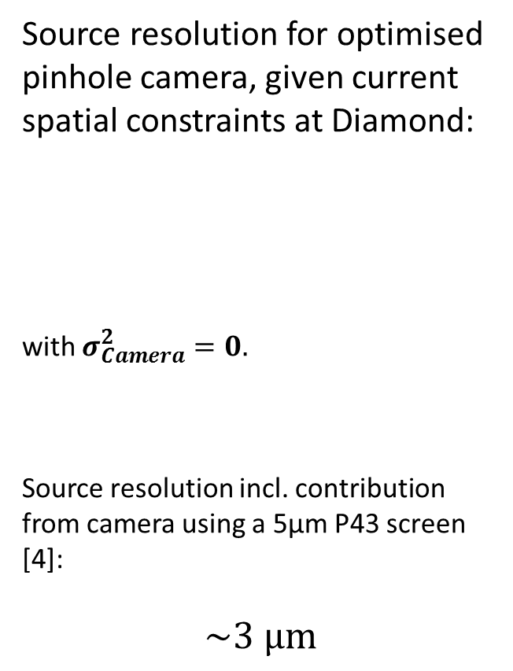
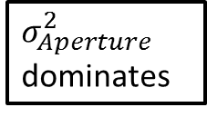
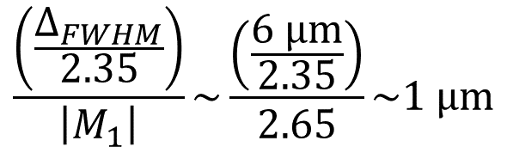
Fundamental Limitations
$$σ_{PSF}^{2}= σ_{Pinhole}^{2}+ σ_{Camera}^{2}>0$$
Source resolution for optimised pinhole camera, given current spatial constraints at Diamond:
with $σ_{Camera}^{2}=0.$
Source resolution incl. contribution from camera using a 5µm P43 screen [4]:
$$\sim \text{3} \text{μ}\text{m}$$
$$\frac{\left(\frac{∆_{FWHM}}{2.35}\right)}{\left|M_{1}\right|}\sim \frac{\left(\frac{6 \text{μ}\text{m}}{2.35}\right)}{2.65}\sim 1 \text{μ}\text{m}$$
$σ_{Diffraction}^{2}$ dominates
$σ_{Aperture}^{2}$ dominates

Slide 12
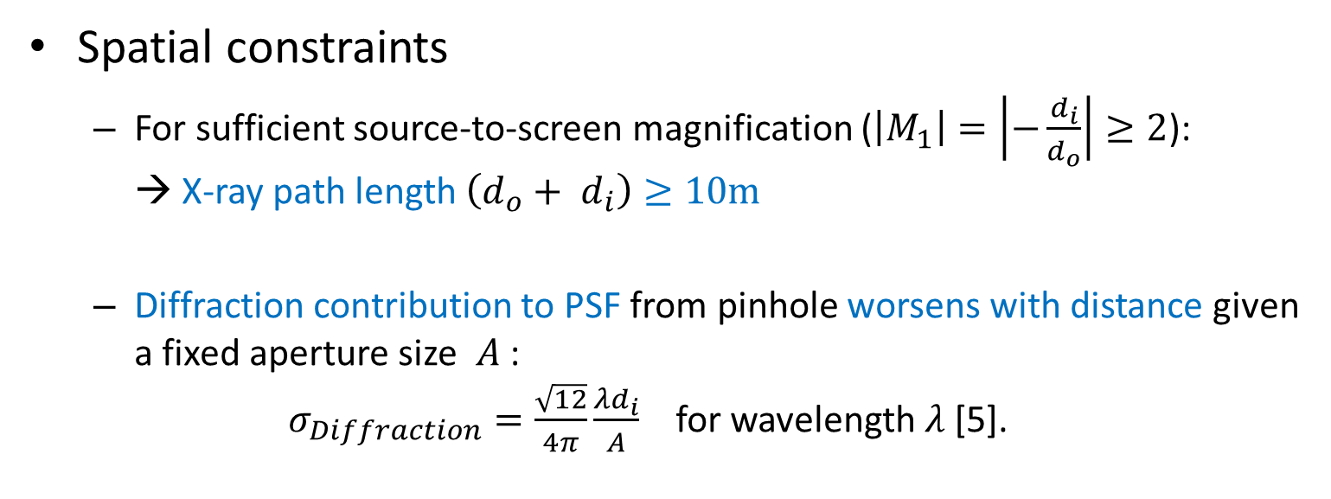

Practical Challenges
Spatial constraints
  For sufficient source-to-screen magnification ($\left|M_{1}\right|=\left|−\frac{d_{i}}{d_{o}}\right|≥2$):
  → X-ray path length $\left(d_{o}+ d_{i}\right)≥10\text{m}$
  Diffraction contribution to PSF from pinhole worsens with distance given a fixed aperture size $A$ :
  $σ_{Diffraction}=\frac{\sqrt{12}}{4π}\frac{λd_{i}}{A}$ for wavelength $λ$ [5].
Source
Pinhole
$$A$$
Scintillator screen
$$d_{o}$$
$$d_{i}$$

Slide 13
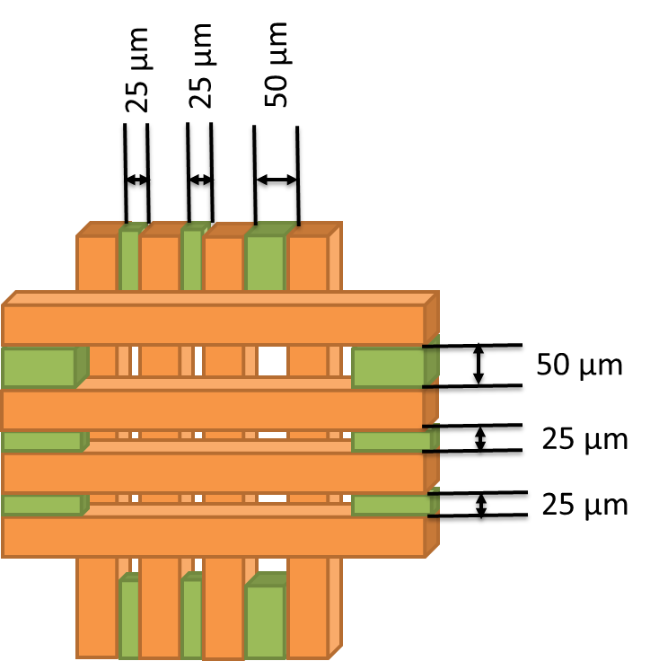
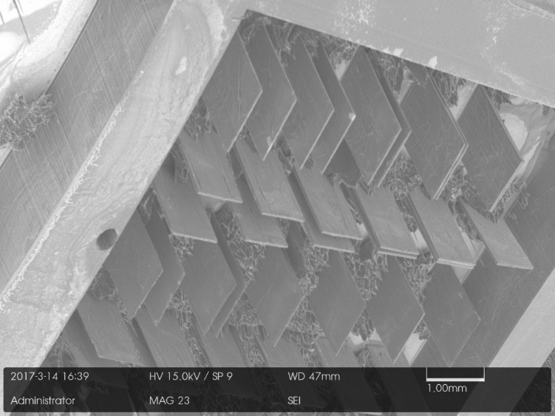
Practical Challenges
Pinhole fabrication
  For the pinhole to be opaque to keV X-rays a high Z material is required e.g. 1mm thick Tungsten.
  Often these materials are difficult to machine.
  Especially given the high aspect ratio
  10 µm (aperture): 1mm (thickness)
  → 1:100
Environment and oxidation
  Air, nitrogen or vacuum?
  Lifetime and maintenance considerations

Slide 14
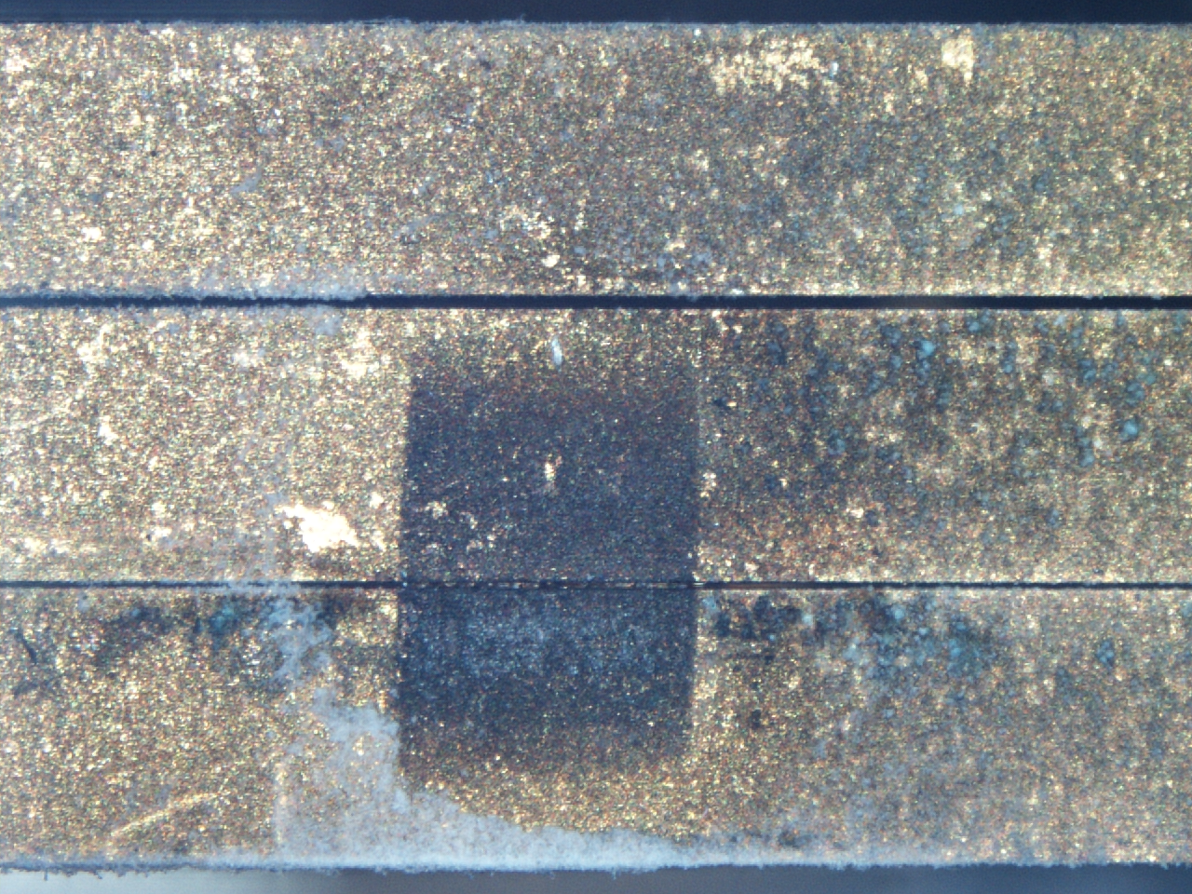
Nov 2014: Gold Plated Tungsten Blades
400 µm
Tungsten Oxide (blue) forms on bare Tungsten areas
50 µm
25 µm
Gold “nuggets” clogging pinhole
Fluffy white deposits
= Aluminium Oxide
Upstream view of Pinhole 2

Slide 15
Now tell us the perks!
Simple design. Simple alignment. Simple maintenance. Simple analysis. Simple…
  Quick to commission e.g. < 1 week at Diamond (2006)
  So simple, a human can learn a lot just by looking…!
Provides 2D transverse profile.
Non-invasive.
Cheap options are available.
Possible to custom build the imager to optimise for spatial resolution, turn-by-turn acquisition, dynamic range etc.
Fast image processing, thus suitable for feedback systems.

Slide 16
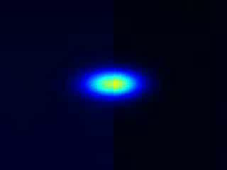
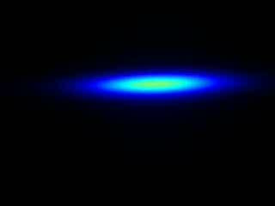
Dual Purpose Diagnostic
Emittance Monitoring
+
CCTV
While we have human operators, the importance of easy human interpretation shouldn’t be overlooked.
Injection at Diamond 2015
TMBF at Diamond 2015

Slide 17
Dual Purpose Diagnostic
Emittance Monitoring
+
CCTV
Beam sizes (2D)
X-ray pinhole camera image
Transverse profile
Skew
Beam instabilities
Beam position

Slide 18
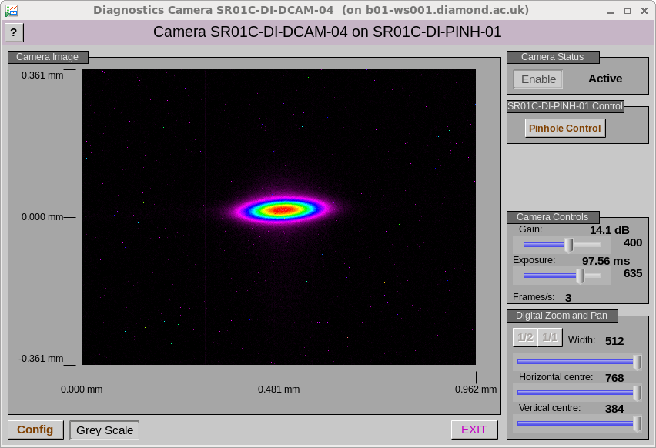
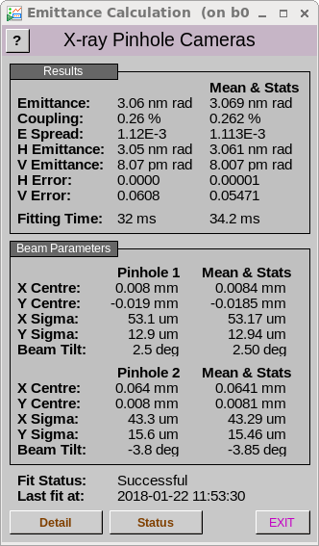
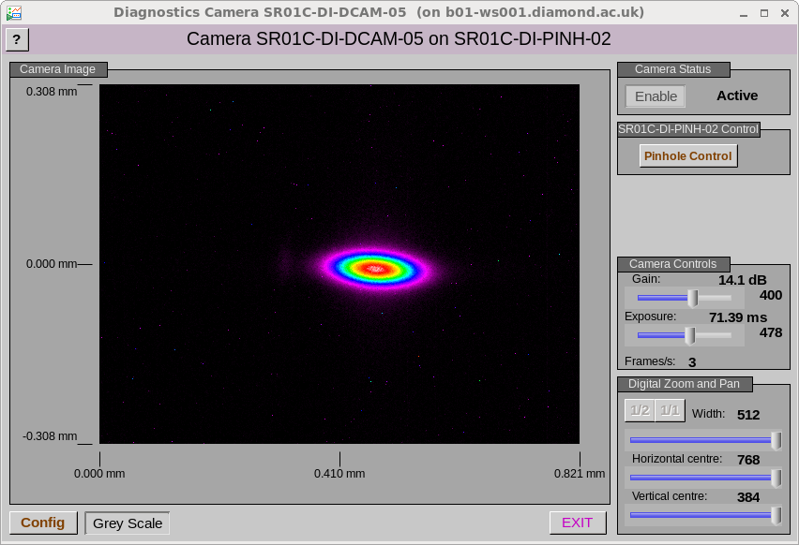
In Operation

Slide 19
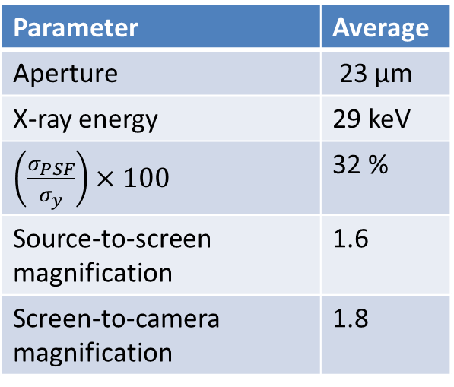
“Snapshot” of Current Status
Parameter | Average
Aperture | 23 µm
X-ray energy | 29 keV
$\left(\frac{σ_{PSF}}{σ_{y}}\right)×100$ | 32 %
Source-to-screen magnification | 1.6
Screen-to-camera magnification | 1.8
π-polarisation
Diffraction
Interferometry
CRL imaging
Air (6)
Vacuum (3)
Nitrogen (1)

Slide 20
Summary
Simple! → Easy to commission → Easy maintenance
Survey shows primary instrument for emittance monitoring
Fundamental limitations, given space and 30 keV X-rays etc., mean sub-micron beam size measurements are not possible.
Many practical challenges are being improved with technological advances.
Complementary general diagnostic → CCTV
Suitable for emittance feedback
Easy human interpretation

Slide 21
References
[1] V. Popovic et al., Design and Implementation of Real-Time Multi-Sensor Vision Systems, Springer, 2017.
[2] E. S. Forster, Problemata by Aristotle, translated to English, Vol VII, 912b, 1927.
[3] E. Renner, Pinhole Photography from Historic Technique to Digital Application, Fourth Ed., Focal Press, 2009.
[4] C. Thomas et al., X-ray pinhole camera resolution and emittance measurement, Phys. Rev. ST Accel. Beams 13, 022805 (2010).
[5] P. Elleaume et al., J. Synchrotron Radiat. 2, 209 (1995).
[6] M. Madou, ``Chapter 10: Micromolding Techniques - LIGA'', Fundamentals of Microfabrication and Nanotechnology, Vol. 2, Third Ed., CRC Press, 2012, p.591-642.
[7] L.M. Bobb et al., ``Performance Evaluation of Molybdenum Blades in an X-ray Pinhole Camera'', Proc. IBIC2016, p. 796-799.

Slide 22
Acknowledgements
Thank you for your attention.
Thanks to the Diamond Diagnostics group and to all those who participated in the survey!
Ximenes Rocha Resende | Brazilian Synchrotron Light Laboratory |  | Kuo-Tung Hsu | TPS/NSRRC
Åke Andersson | MAX IV Laboratory |  | Marcel Schuh | KARA / KIT
Volker Schlott | PSI |  | Suntao Wang | CESR/CHESS
Yongbin | SSRF/SINAP |  | Friederike Ewald | ESRF
Shiro TAKANO | SPring-8 |  | Marie Labat | SOLEIL
Rohan Dowd | Australian synchrotron |  | Gero Kube | DESY
Akash Deep Garg | RRCAT Indore INDIA |  | Ubaldo Iriso | ALBA
Oleg Meshkov | BINP |  | Jeff Corbett | SLAC

