Slide 1


Magnet Dimensions
Daniel Schoerling
On behalf of EuroCirCol WP5 and the FCC-hh Magnet Development Program
9th of January 2018
D.Arbelaez¹¹, B.Auchmann¹, H.Bajas¹, M.Bajko¹, A.Ballarino¹, E.Barzi¹⁰, G.Bellomo², M. Benedikt¹, S.Izquierdo Bermudez¹, B.Bordini¹, L.Bottura¹, L.Brower¹¹, M.Buzio¹, B.Caiffi⁵, S.Caspi¹¹, M.Dhalle³, M.Durante⁴, G. de Rijk¹, P.Fabbricatore⁵, S.Farinon⁵, P.Ferracin¹, P.Gao³, S.Gourlay¹¹, M.Juchno¹¹, V.Kashikhin¹⁰, F.Lackner¹, C.Lorin⁴, M.Marchevsky¹¹, V.Marinozzi², T.Martinez ⁶, J.Munilla⁶, I.Novitski¹⁰, T.Ogitsu⁷, R.Ortwein¹, J.Perez¹, C.Petrone¹, S.Prestemon¹¹, M.Prioli¹, J.M.Rifflet⁴, E.Rochepault¹, S.Russenschuck¹, T.Salmi⁸, F.Savary¹, D.Schoerling¹, M.Segreti⁴, C.Senatore⁹, M.Sorbi², A.Stenvall⁸, E.Todesco¹, F.Toral⁶, A.P.Verweij¹, S.Wessel³, F.Wolf¹, A.V.Zlobin¹⁰
1.CERN, 1211 Geneva, Switzerland; 2.INFN, 20133 Milano, Italy; 3.Twente University, 7500 Twente, Netherlands; 4.CEA, 91400 Saclay, France; 5.INFN, 16146 Genova, Italy; 6.CIEMAT, 28040 Madrid, Spain; 7.KEK, 305-0801 Tsukuba, Japan; 8.Tampere University, 33100 Tampere, Finland; 9.University of Geneva, 1211 Geneva, Switzerland; 10.FNAL, Batavia IL 60510, USA; 11.LBNL, Berkeley, CA 94720, USA

Slide 2
Distance between Magnets
Arc magnet type | Strength
Main Dipole (MB) | 16 T
Main Quadrupole (MQ) | 360 T/m
Lattice Sextupole (MS) | 7,000 T/m²
Lattice Octupole (MO) | 200,000 T/m³
Dipole Corrector (MCB) | 4 T
Trim Quadrupole (MQT) | 220 T/m
Skew Quadrupole (MQS) | 220 T/m
The target distance between the magnetic lengths of the different elements in the arcs is set to:
MB-MB (a) | 1.5 m
MB-SSS (b) | 1.3 m
MQ-Magnetic Element inside SSS | 0.35 m
Magnetic Element inside SSS-Magnetic Element inside SSS | 0.35 m
May be longer if stronger spool pieces are required
Does not include a BPM

Slide 3
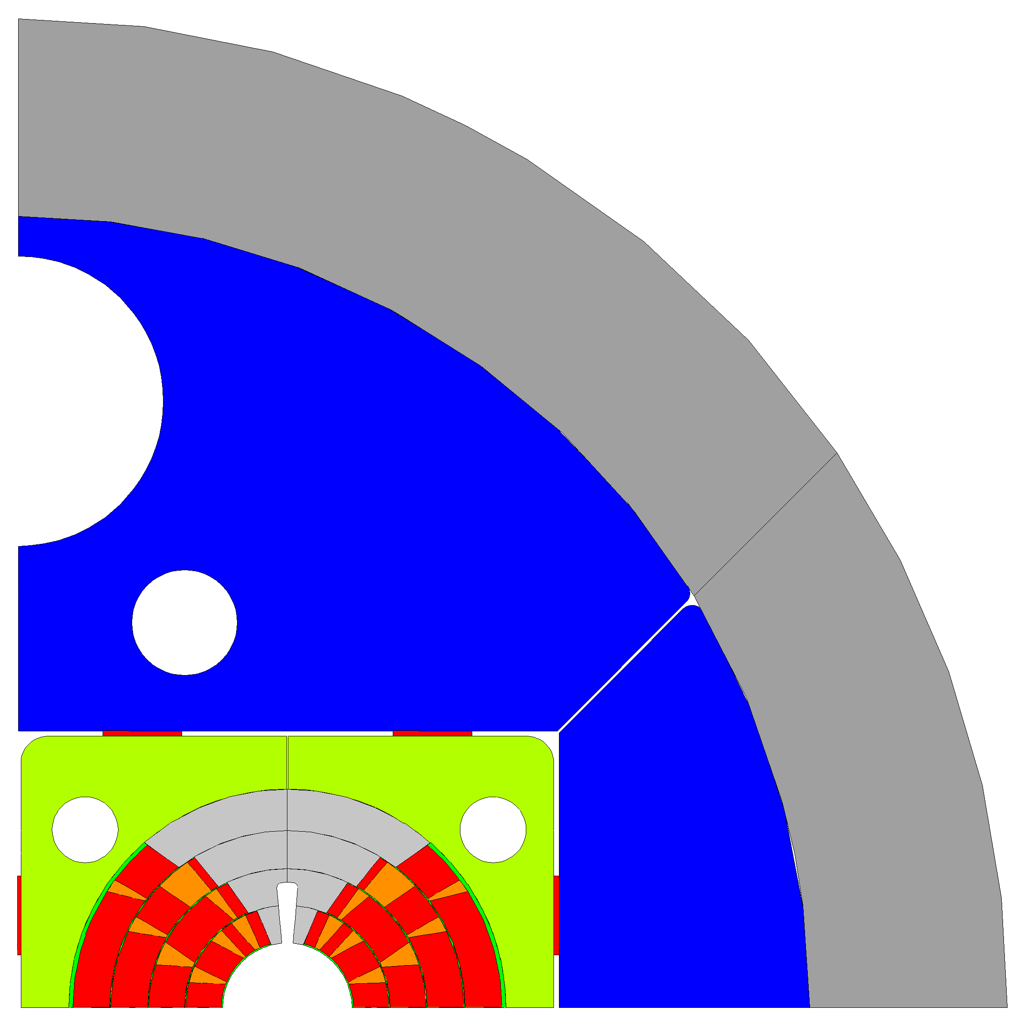
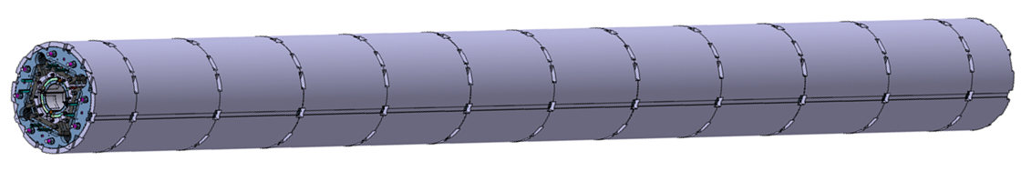
Magnet Dimensions
LHC dipole magnets were produced straight and then curved in a press before welding the outer shell
The current baseline foresees a bladder and key structure with approximately 0.8 m long aluminum shells
Making the segments shorter ‘Aluminum collar shell’ may allow bending the structure without concentrating the stress at few positions
Using Invar (FeNi36) as yoke material may allow to replace the Al shell (sufficient pre-stress and compensating the lower magnetic saturation may not allow for smaller overall size, studies are on-going)
Collaring and using yoke materials with larger stress limit may allow to further reduce the overall size (explorative studies will start soon)
Stainless steel shell
Aluminum shell
Iron yoke
Steel pad
Titanium pole
Copper wedges
Conductor
∅ 600 mm
∅ 750 mm
MQXFB
∅ 790 mm

