Slide 1


Compact magnet design & field quality versus injection energy
Daniel Schoerling
On behalf of EuroCirCol WP5 and the FCC-hh Magnet Development Program
9th of January 2018
D.Arbelaez¹¹, B.Auchmann¹, H.Bajas¹, M.Bajko¹, A.Ballarino¹, E.Barzi¹⁰, G.Bellomo², M. Benedikt¹, S.Izquierdo Bermudez¹, B.Bordini¹, L.Bottura¹, L.Brower¹¹, M.Buzio¹, B.Caiffi⁵, S.Caspi¹¹, M.Dhalle³, M.Durante⁴, G. de Rijk¹, P.Fabbricatore⁵, S.Farinon⁵, P.Ferracin¹, P.Gao³, S.Gourlay¹¹, M.Juchno¹¹, V.Kashikhin¹⁰, F.Lackner¹, C.Lorin⁴, M.Marchevsky¹¹, V.Marinozzi², T.Martinez ⁶, J.Munilla⁶, I.Novitski¹⁰, T.Ogitsu⁷, R.Ortwein¹, J.Perez¹, C.Petrone¹, S.Prestemon¹¹, M.Prioli¹, J.M.Rifflet⁴, E.Rochepault¹, S.Russenschuck¹, T.Salmi⁸, F.Savary¹, D.Schoerling¹, M.Segreti⁴, C.Senatore⁹, M.Sorbi², A.Stenvall⁸, E.Todesco¹, F.Toral⁶, A.P.Verweij¹, S.Wessel³, F.Wolf¹, A.V.Zlobin¹⁰
1.CERN, 1211 Geneva, Switzerland; 2.INFN, 20133 Milano, Italy; 3.Twente University, 7500 Twente, Netherlands; 4.CEA, 91400 Saclay, France; 5.INFN, 16146 Genova, Italy; 6.CIEMAT, 28040 Madrid, Spain; 7.KEK, 305-0801 Tsukuba, Japan; 8.Tampere University, 33100 Tampere, Finland; 9.University of Geneva, 1211 Geneva, Switzerland; 10.FNAL, Batavia IL 60510, USA; 11.LBNL, Berkeley, CA 94720, USA

Slide 2
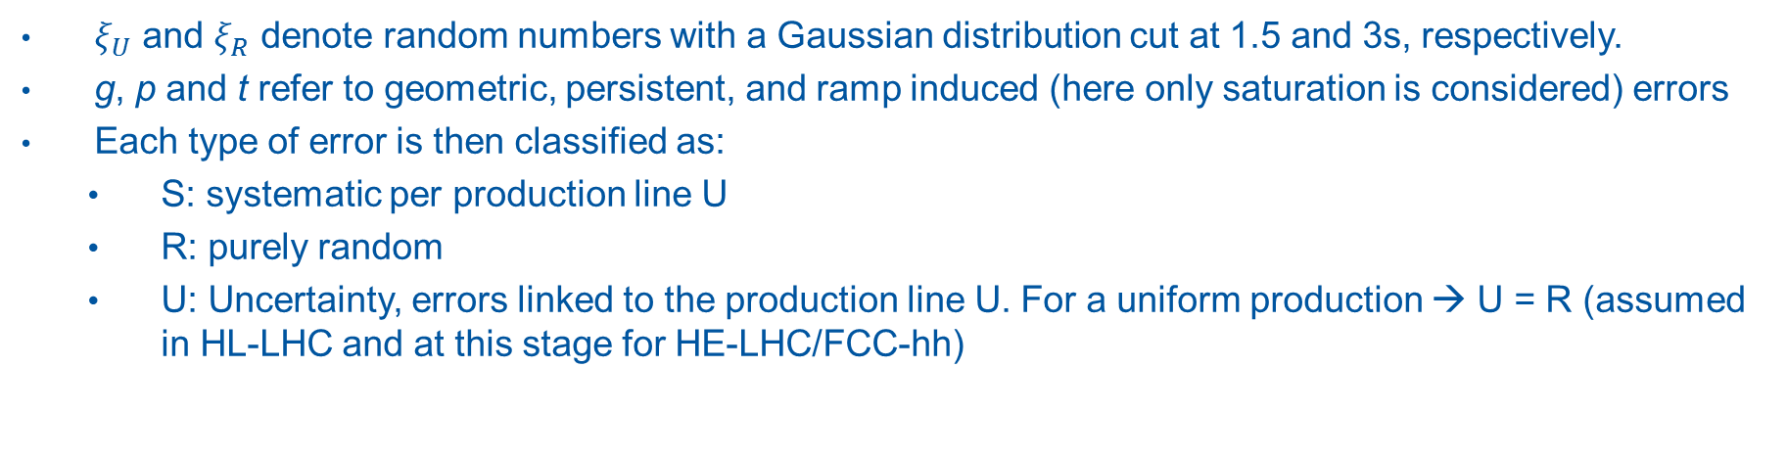
Field quality versus injection energy for HE-LHC
We follow the LHC criteria for field error naming conventions (EDMS 90250), results are given for aperture 2.
Each harmonic is written as [1]:
$$b_{n}=\left[b_{n_{g}S}+b_{n_{p}S}+b_{n_{t}S}\right]+\frac{ξ_{U}}{1.5}\sqrt{b_{n_{g}U}^{2}+b_{n_{p}U}^{2}+b_{n_{t}U}^{2}}+ ξ_{R}\sqrt{b_{n_{g}R}^{2}+b_{n_{p}R}^{2}+b_{n_{t}R}^{2}}$$
$ξ_{U}$ and $ξ_{R}$ denote random numbers with a Gaussian distribution cut at 1.5 and 3s, respectively.
g, p and t refer to geometric, persistent, and ramp induced (here only saturation is considered) errors
Each type of error is then classified as:
  S: systematic per production line U
  R: purely random
  U: Uncertainty, errors linked to the production line U. For a uniform production → U = R (assumed in HL-LHC and at this stage for HE-LHC/FCC-hh)
[1] S. Fartoukh and O. Brüning, “Field Quality Specification for the LHC Main Dipole Magnets”, LHC Project Report 501.

Slide 3
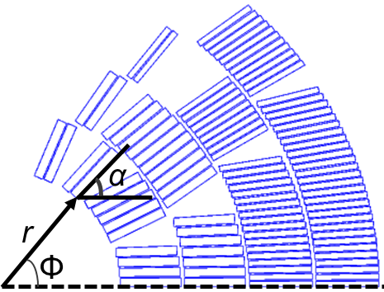
Calculation method & assumptions
Systematic field errors
g : Geometric and saturation can be accurately calculated using for example ROXIE (~10⁻⁶)
p : Persistent current induced multipoles. Calculation is performed using a semi-analytical hysteresis model for the superconductor, which is implemented in ROXIE [1]; successfully verified for LHC magnets and HL-LHC magnets (for Nb₃Sn with empirical reduction of strand magnetization at low field due to flux jumps [2]). The amplitude of the field error depends on:
  Strand magnetization (D_{eff} = 50 μm, J_{c} (1.9 K, 16 T)= 2300 A/mm², and Cu-NonCu) → worst case
  Coil geometry
  Hysteresis, for nominal cycle on reset current (I = 100 A)
t : transient effects, neglected as ramp rates are relatively small and a high-resistive core in the cable is foreseen
Random and uncertainty field errors
Geometric errors, average displacement of zero and a RMS of d/√3 (d = 0.05 mm):
  Radial displacement. r_{min} = r – d and r_{max} = r + d.
  Angular displacement. Δφ = d / (r + w_{cable}/2). φ_{min}= φ – Δφ and φ_{max}= φ + Δφ.
  Coil block rotation. Δα = 2d / w_{cable}. α_{min}= α – Δα and α_{max}= α + Δα.
  →Odd (allowed) multipoles are doubled (good agreement to measurements)
Persistent current: J_{c} ± 10% with respect to the nominal performance (entire coil)
[1] C. Vollinger, Superconductor magnetization modelling for the numerical calculation of field errors in accelerator magnets. PhD thesis, 2002, https://cds.cern.ch/record/633599/files/thesis-2003-022.pdf
[2] S. Izquierdo Bermudez et al., Persistent Current Magnetization effects in High-Field Superconducting Accelerator magnets, IEEE 2016.

Slide 4
Field quality table for 450 GeV (SPS injection)
Systematic:
Injection = Geometric + Persistent
High Field/Collision = Geometric + Saturation
Beam acceleration
Beam acceleration
Cos-theta, D_{eff} = 50 μm
Courtesy S. Izquierdo Bermudez

Slide 5
HE-LHC Field quality table for 900 GeV (sclSPS injection)
Courtesy S. Izquierdo Bermudez

Slide 6
HE-LHC Field quality table for 1300 GeV (scSPS injection)
Courtesy S. Izquierdo Bermudez

Slide 7
FCC Field quality table for 1300 GeV (scSPS injection)
 | FCC Dipole field quality version 2 - 3 Oct 2017- R_{ref}=16.7 mm. 1.3 TeV Injection
 | Systematic |  |  |  |  | Uncertainty |  | Random
Normal | Geometric | Saturation | Persistent | Injection | High Field | Injection | High Field | Injection | High Field
2 | -2.230 | -44.610 | 0.000 | -2.230 | -46.840 | 0.922 | 0.922 | 0.922 | 0.922
3 | -18.140 | 17.000 | 222.990 | 204.850 | -1.140 | 57.000 | 1.351 | 57.000 | 1.351
4 | -0.100 | -0.930 | 0.100 | 0.000 | -1.030 | 0.449 | 0.449 | 0.449 | 0.449
5 | -0.690 | -0.340 | -40.190 | -40.880 | -1.030 | 12.000 | 0.541 | 12.000 | 0.541
6 | 0.000 | -0.010 | 0.000 | 0.000 | -0.010 | 0.176 | 0.176 | 0.176 | 0.176
7 | 1.610 | 0.140 | 4.260 | 5.870 | 1.750 | 1.500 | 0.211 | 1.500 | 0.211
8 | 0.000 | 0.000 | 0.000 | 0.000 | 0.000 | 0.071 | 0.071 | 0.071 | 0.071
9 | 1.310 | 0.120 | -14.160 | -12.850 | 1.430 | 4.000 | 0.092 | 4.000 | 0.092
10 | 0.000 | 0.000 | 0.000 | 0.000 | 0.000 | 0.027 | 0.027 | 0.027 | 0.027
11 | 0.960 | 0.090 | -0.210 | 0.750 | 1.050 | 1.000 | 0.028 | 1.000 | 0.028
12 | 0.000 | 0.000 | 0.000 | 0.000 | 0.000 | 0.000 | 0.000 | 0.000 | 0.009
13 | -0.170 | -0.020 | 0.170 | 0.000 | -0.190 | 0.000 | 0.000 | 0.000 | 0.011
14 | 0.000 | 0.000 | 0.000 | 0.000 | 0.000 | 0.000 | 0.000 | 0.000 | 0.003
15 | 0.010 | 0.000 | -0.010 | 0.000 | 0.010 | 0.000 | 0.000 | 0.000 | 0.004
Skew
2 | 0.000 | 0.000 | 0.000 | 0.000 | 0.000 | 1.040 | 1.040 | 1.040 | 1.040
3 | 0.000 | 0.000 | 0.000 | 0.000 | 0.000 | 0.678 | 0.678 | 0.678 | 0.678
4 | 0.000 | 0.000 | 0.000 | 0.000 | 0.000 | 0.450 | 0.450 | 0.450 | 0.450
5 | 0.000 | 0.000 | 0.000 | 0.000 | 0.000 | 0.317 | 0.317 | 0.317 | 0.317
6 | 0.000 | 0.000 | 0.000 | 0.000 | 0.000 | 0.205 | 0.205 | 0.205 | 0.205
7 | 0.000 | 0.000 | 0.000 | 0.000 | 0.000 | 0.116 | 0.116 | 0.116 | 0.116
8 | 0.000 | 0.000 | 0.000 | 0.000 | 0.000 | 0.071 | 0.071 | 0.071 | 0.071
9 | 0.000 | 0.000 | 0.000 | 0.000 | 0.000 | 0.041 | 0.041 | 0.041 | 0.041
10 | 0.000 | 0.000 | 0.000 | 0.000 | 0.000 | 0.025 | 0.025 | 0.025 | 0.025
11 | 0.000 | 0.000 | 0.000 | 0.000 | 0.000 | 0.016 | 0.016 | 0.016 | 0.016
12 | 0.000 | 0.000 | 0.000 | 0.000 | 0.000 | 0.000 | 0.000 | 0.009 | 0.009
13 | 0.000 | 0.000 | 0.000 | 0.000 | 0.000 | 0.000 | 0.000 | 0.005 | 0.005
14 | 0.000 | 0.000 | 0.000 | 0.000 | 0.000 | 0.000 | 0.000 | 0.003 | 0.003
15 | 0.000 | 0.000 | 0.000 | 0.000 | 0.000 | 0.000 | 0.000 | 0.002 | 0.002
Courtesy S. Izquierdo Bermudez

Slide 8
FCC Field quality table for 3300 GeV (LHC injection)
 | FCC Dipole field quality version 2 - 3 Oct 2017- R_{ref}=16.7 mm. 3.3 TeV Injection
 | Systematic |  |  |  |  | Uncertainty |  | Random
Normal | Geometric | Saturation | Persistent | Injection | High Field | Injection | High Field | Injection | High Field
2 | -2.230 | -44.610 | 0.000 | -2.230 | -46.840 | 0.922 | 0.922 | 0.922 | 0.922
3 | -18.140 | 17.000 | -38.560 | -56.700 | -1.140 | 3.000 | 1.351 | 3.000 | 1.351
4 | -0.100 | -0.930 | 0.100 | 0.000 | -1.030 | 0.449 | 0.449 | 0.449 | 0.449
5 | -0.690 | -0.340 | 13.660 | 12.970 | -1.030 | 2.000 | 0.541 | 2.000 | 0.541
6 | 0.000 | -0.010 | 0.000 | 0.000 | -0.010 | 0.176 | 0.176 | 0.176 | 0.176
7 | 1.610 | 0.140 | -1.920 | -0.310 | 1.750 | 0.250 | 0.211 | 0.250 | 0.211
8 | 0.000 | 0.000 | 0.000 | 0.000 | 0.000 | 0.071 | 0.071 | 0.071 | 0.071
9 | 1.310 | 0.120 | 3.970 | 5.280 | 1.430 | 1.000 | 0.092 | 1.000 | 0.092
10 | 0.000 | 0.000 | 0.000 | 0.000 | 0.000 | 0.027 | 0.027 | 0.027 | 0.027
11 | 0.960 | 0.090 | -0.100 | 0.860 | 1.050 | 0.200 | 0.028 | 0.200 | 0.028
12 | 0.000 | 0.000 | 0.000 | 0.000 | 0.000 | 0.009 | 0.000 | 0.009 | 0.009
13 | -0.170 | -0.020 | 0.170 | 0.000 | -0.190 | 0.011 | 0.000 | 0.011 | 0.011
14 | 0.000 | 0.000 | 0.000 | 0.000 | 0.000 | 0.003 | 0.000 | 0.003 | 0.003
15 | 0.010 | 0.000 | -0.010 | 0.000 | 0.010 | 0.004 | 0.000 | 0.004 | 0.004
Skew
2 | 0.000 | 0.000 | 0.000 | 0.000 | 0.000 | 1.040 | 1.040 | 1.040 | 1.040
3 | 0.000 | 0.000 | 0.000 | 0.000 | 0.000 | 0.678 | 0.678 | 0.678 | 0.678
4 | 0.000 | 0.000 | 0.000 | 0.000 | 0.000 | 0.450 | 0.450 | 0.450 | 0.450
5 | 0.000 | 0.000 | 0.000 | 0.000 | 0.000 | 0.317 | 0.317 | 0.317 | 0.317
6 | 0.000 | 0.000 | 0.000 | 0.000 | 0.000 | 0.205 | 0.205 | 0.205 | 0.205
7 | 0.000 | 0.000 | 0.000 | 0.000 | 0.000 | 0.116 | 0.116 | 0.116 | 0.116
8 | 0.000 | 0.000 | 0.000 | 0.000 | 0.000 | 0.071 | 0.071 | 0.071 | 0.071
9 | 0.000 | 0.000 | 0.000 | 0.000 | 0.000 | 0.041 | 0.041 | 0.041 | 0.041
10 | 0.000 | 0.000 | 0.000 | 0.000 | 0.000 | 0.025 | 0.025 | 0.025 | 0.025
11 | 0.000 | 0.000 | 0.000 | 0.000 | 0.000 | 0.016 | 0.016 | 0.016 | 0.016
12 | 0.000 | 0.000 | 0.000 | 0.000 | 0.000 | 0.000 | 0.000 | 0.009 | 0.009
13 | 0.000 | 0.000 | 0.000 | 0.000 | 0.000 | 0.000 | 0.000 | 0.005 | 0.005
14 | 0.000 | 0.000 | 0.000 | 0.000 | 0.000 | 0.000 | 0.000 | 0.003 | 0.003
15 | 0.000 | 0.000 | 0.000 | 0.000 | 0.000 | 0.000 | 0.000 | 0.002 | 0.002
Courtesy S. Izquierdo Bermudez

Slide 9
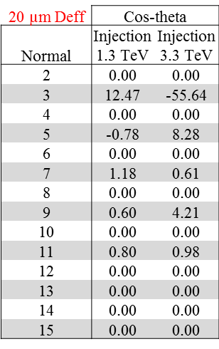

FCC Field quality table for different filament size
Field quality studies including artificial pinning as required for minimizing heat load from magnetization will be initiated and the reset current will be optimized. The random part (±10% for J_{c}) will be reviewed based on HL-LHC experience
b₂ could be reduced to ~20 units for an inter-beam distance of 250 mm or asymmetric coils could be used to compensate b₂ at collision energy (complex coil design)
Measuring each dipole magnet and having separate circuits for b₃ spool pieces could allow for correcting the random part
Courtesy S. Izquierdo Bermudez

