Slide 1
Our added value to CompactLight
VDL ETG
Strength through cooperation

Slide 2
Introduction VDL ETG
We are part of the VDL Group of companies
  Industrial conglomerate based in The Netherlands
  Family owned
  >E6B sales
  >16,000 employees
VDL ETG is all about high-tech contract manufacturing
Our relevant core competences
  Redesign for manufacturability and cost
  Ultra-precision machining (e.g. copper parts & mirrors)
  Assembly & (low power RF) test

Slide 3
Our added value to the project
Focus: X-band, accelerator structures, RF network, HP loads, pulse compressor
(re)design for manufacturability
Industrialization of designs
Cost engineering
Manufacturing & test
TEAM:
  Mathieu Breukers (engineering & manufacturing)
  Xander Janssen (physics)
  Ton Peijnenburg (system engineering)

Slide 4
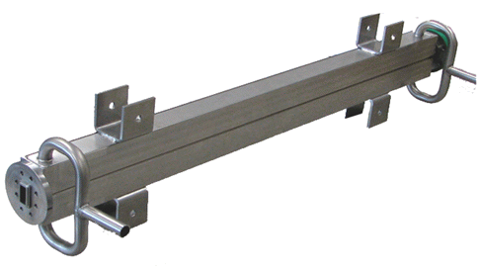
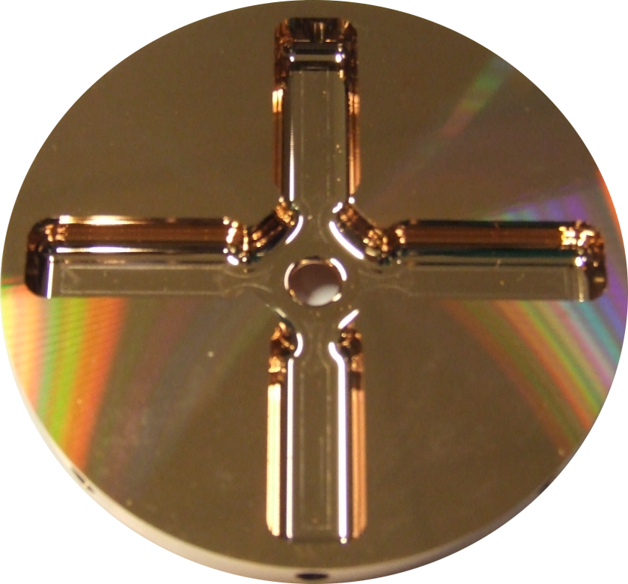
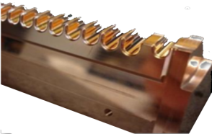
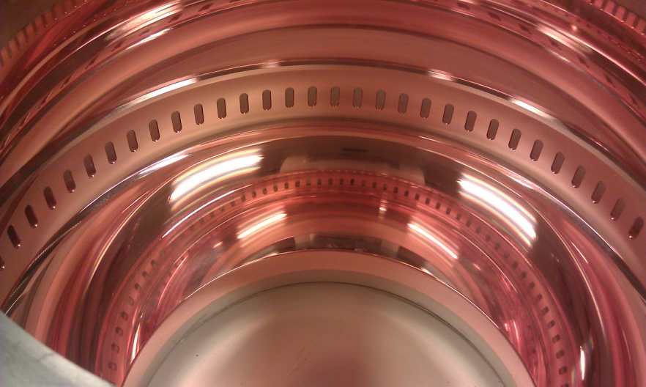
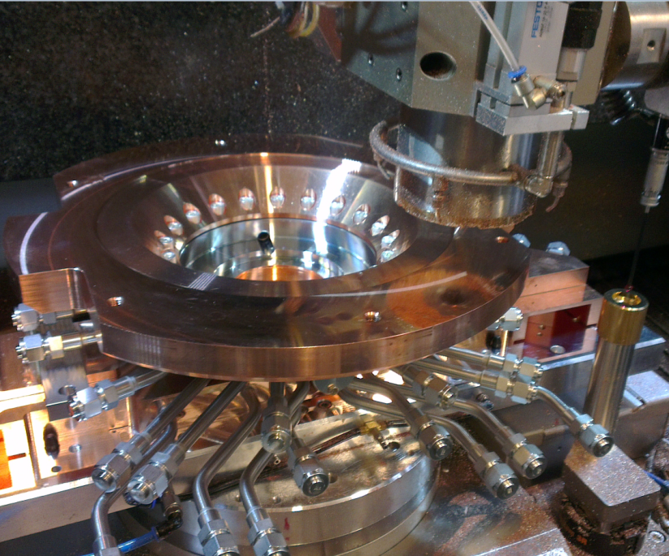
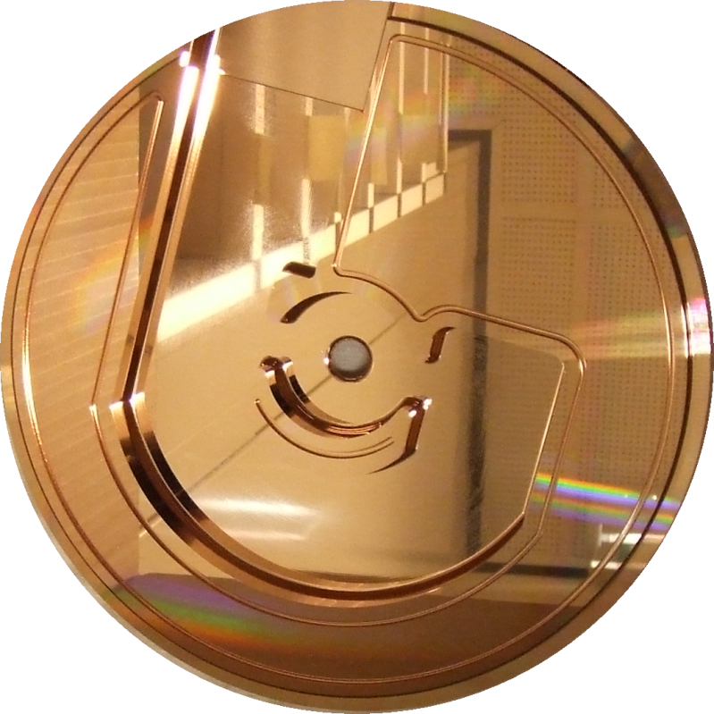
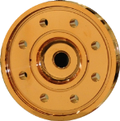
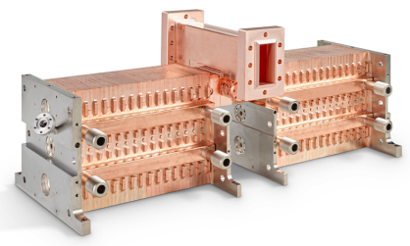
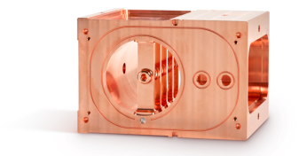
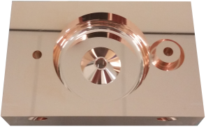
Relevant Experience
CERN CLIC
PSI SwissFEL
  X-band structures
  C-band structures
  J-couplers
  BOC Pulse compressor
  RF-Gun
ADAM proton therapy
Lancaster University - PROBE
Other: various proto typing projects

