Slide 1

… riding the wave
Presentation of Kyma
Raffaella Geometrante

Slide 2





The company and the Partners
27%
51%
22%
Kyma Srl
100%
Kyma Tehnologija d.o.o.

Slide 3
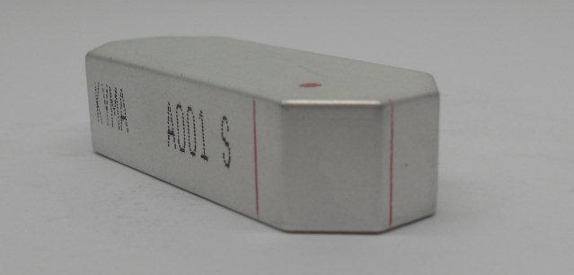
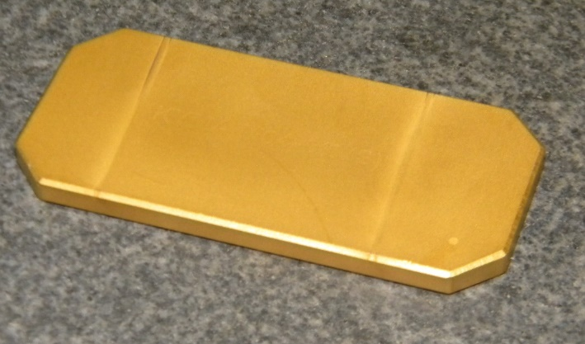
Kyma ID summary table
ID type | Short name | # of units | Status
Laser Heater Undulators | LHU | 1 1 | Operation Commissioning
Linearly Polarizing Undulators | LPU | 9 | Operation
Elliptically Polarizing Undulators – Apple-II | EPU | 24 1 3 | Operation Commissioning Realization
Short-Period Linearly Polarizing Undulator | SP-LPU | 1 | Operation
In-Vacuum Undulator (with BASC) In-Vacuum Hybrid Undulators (with RI) | IVU | 1 2 | Operation Realization
Hybrid Wiggler | HW | 1 | Operation
Permanent Magnet Phase Shifters (30 @ Kyma / 30 @ BASC) | PMPS | 60 | Delivered
Variable-Phase Compact Undulators | CCU | 2 2 | Operation Realization
Highest quality NdBFe permanent magnets
Extensive range of available grades
State of the art magnetic tolerances DBr < 1.0 %, Da < 1.0°
All quality control measurement provided to the customers
Magnets for in-vacuum use
Fast delivery time

Slide 4
KYMA Contribution to WP7
Global Integration with Research Infrastructures
Industrial perspective on:
Technical feasibility of new upgrades
New technologies impact into global industry
Cost estimation and expected budgets for upgrades and/or development of components and their fabrication

