Slide 1
YETS 2017-18 AD RING
AD Technical Coordination Meeting #4
2018-01-11
Aymeric BOUVARD
EN-EA-EC

Slide 2
YETS 2017-2018
From 18 dec 2017 to 23 march 2018
The access point will be in "general" mode during the entire shutdown with free access by the emergency exits.
An exception will be made at dangerous interventions requiring limited access to persons qualified for this work. During these periods, access control through impact will be awarded based.
All material out of the Ring will be stored in Buffer Zone and a TREC Request will be done for control, by the owner.
Each owner of equipment will be in charge of performing the EDH transport and handling referring to their equipment.
The visits will be subject to restrictions under the current work.

Slide 3
YETS AD Ring
Work Request
MSC
  Refurbishment of 3 Magnets: BHS52, QDN55, QFN56.
  Storage of the shielding blocs in AD Hall.
    BHS52:
      18 blocks 24168
      2 ventilation modules
      Cutting of the vacuum chamber in AD Hall before transfer to the b.867. This intervention will be supervised by RP and EN-EA.
    QDN55
      4 shielding blocks 24168
    QFN56
      6 concrete beams
    The exhibition magnets, near ELENA should be removed in another place in the AD Hall. Probably on the shielding in front of ASCUSA and ALPHA experimental areas.
  BCCC
  Installation of new controlled flow valve and insulation vacuum valve

Slide 4
YETS AD Ring
Work Request
BI
  General maintenance of the E.Cooler.
  General maintenance BTV
  Kickers:
  General maintenance + Test
CV:
  Removal of ventilation modules (BHS52)
  Maintenance of demineralized water.
  Water maintenance
  RP:
  Source Test:
    PMIA604
    PAXA604
    PAXT113
  EL:
  AUG Test
VSC
  Disconnection and reconnection: BHS52, QDN55, QFN56
  Works and Maintenance:
    Sector 1A
    Sector 1B
    Sector 2A
    Sector 2B
    Sector 3
    Sector 4
    DE Experimental Lines
  Bakeout Sector 1 (BHS52, QDN55, QFN56)
  Bakeout Sector 2A (SHV1305)
  SU
  Alignment: BHS52, QDN55, QFN56
  STI
  Replacement of the scraper SHV1305 (sector2)
  RF
  Maintenance + Test ADC02 and ADC10

Slide 5
Works from W48 2017 to W02 2018
2017
W48
  CV: Removal ventilation
  modules.
W50
  HE: Removal, exhibition magnets
  EA: Preparation of the shielding area
    Removal floor protection
    Removal gateway
    Removal railings
W51
  MSC:
    Removal BHS52
    Removal QDN55 and QFN56 (if possible)
  VSC: Cutting, vacuum chamber (RP supervision)
2018
W02
  MSC:
    Removal QDN55 and QFN56 if it was not possible to do it in week 51
    Refurbishment of magnets. In progress
  RP: Source test
  Kickers: General maintenance. Postponed W11
  VSC: Works sector 2A and 2B. In progress
  BI: Maintenance e-cooler
  STI: Scraper SHV1305. In progress
  BCCC:
    Installation of new controlled flow valve and insulation vacuum valve
    Warm-up and purge cryostat
  EL: Test AUG (scheduled the week-end W02)

Slide 6
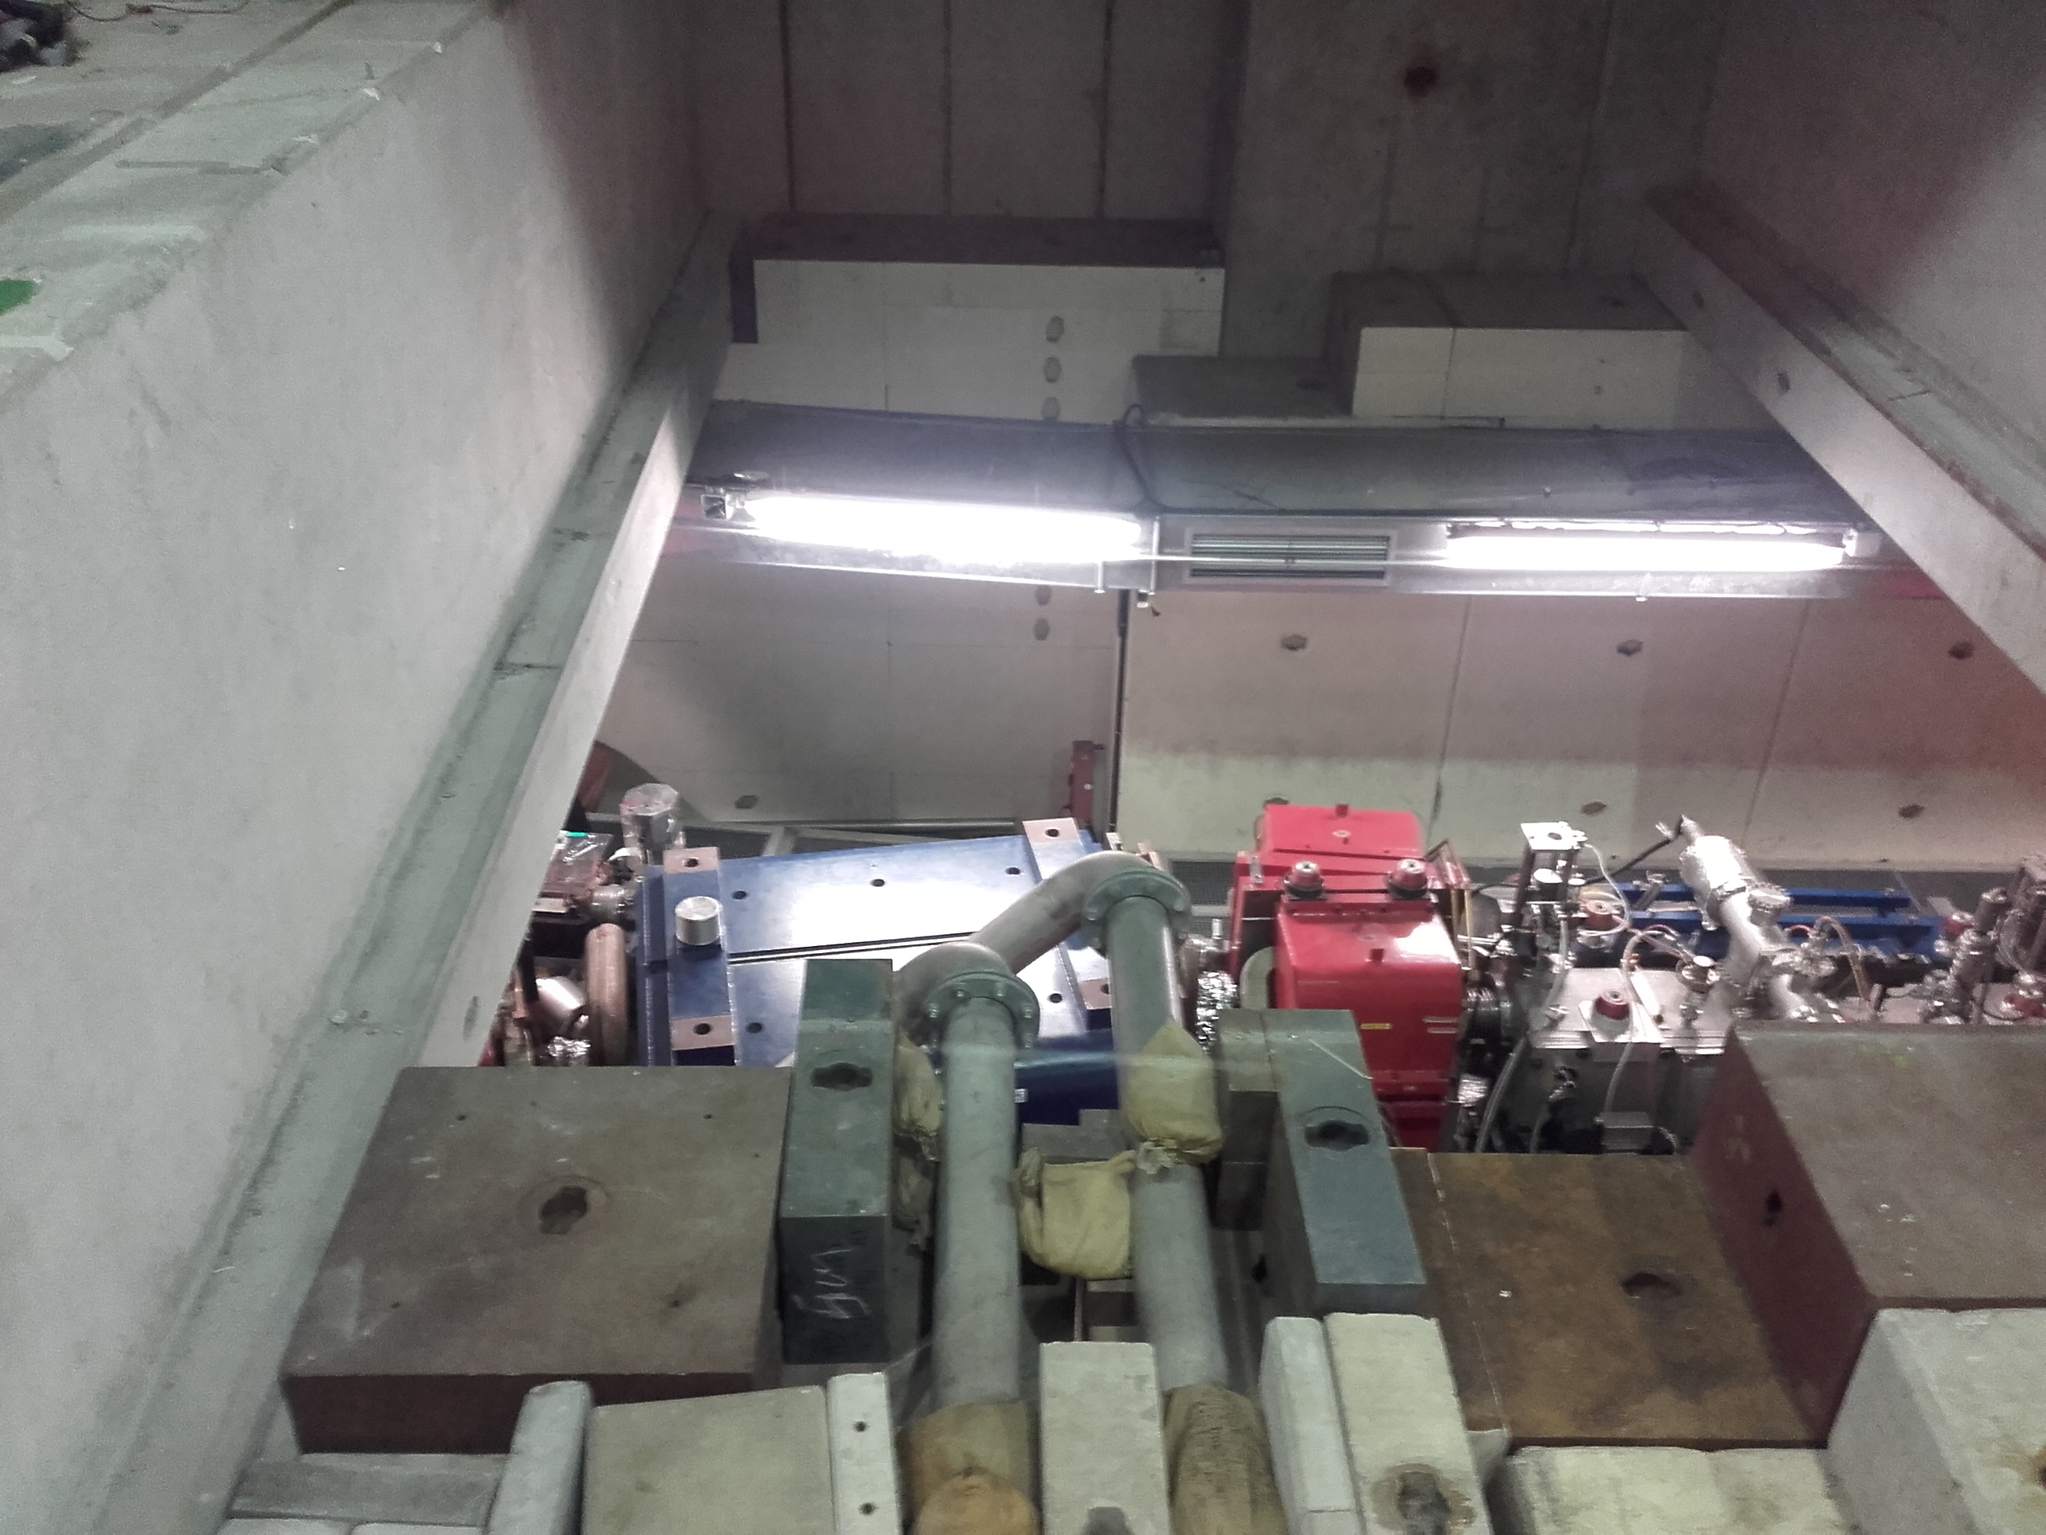
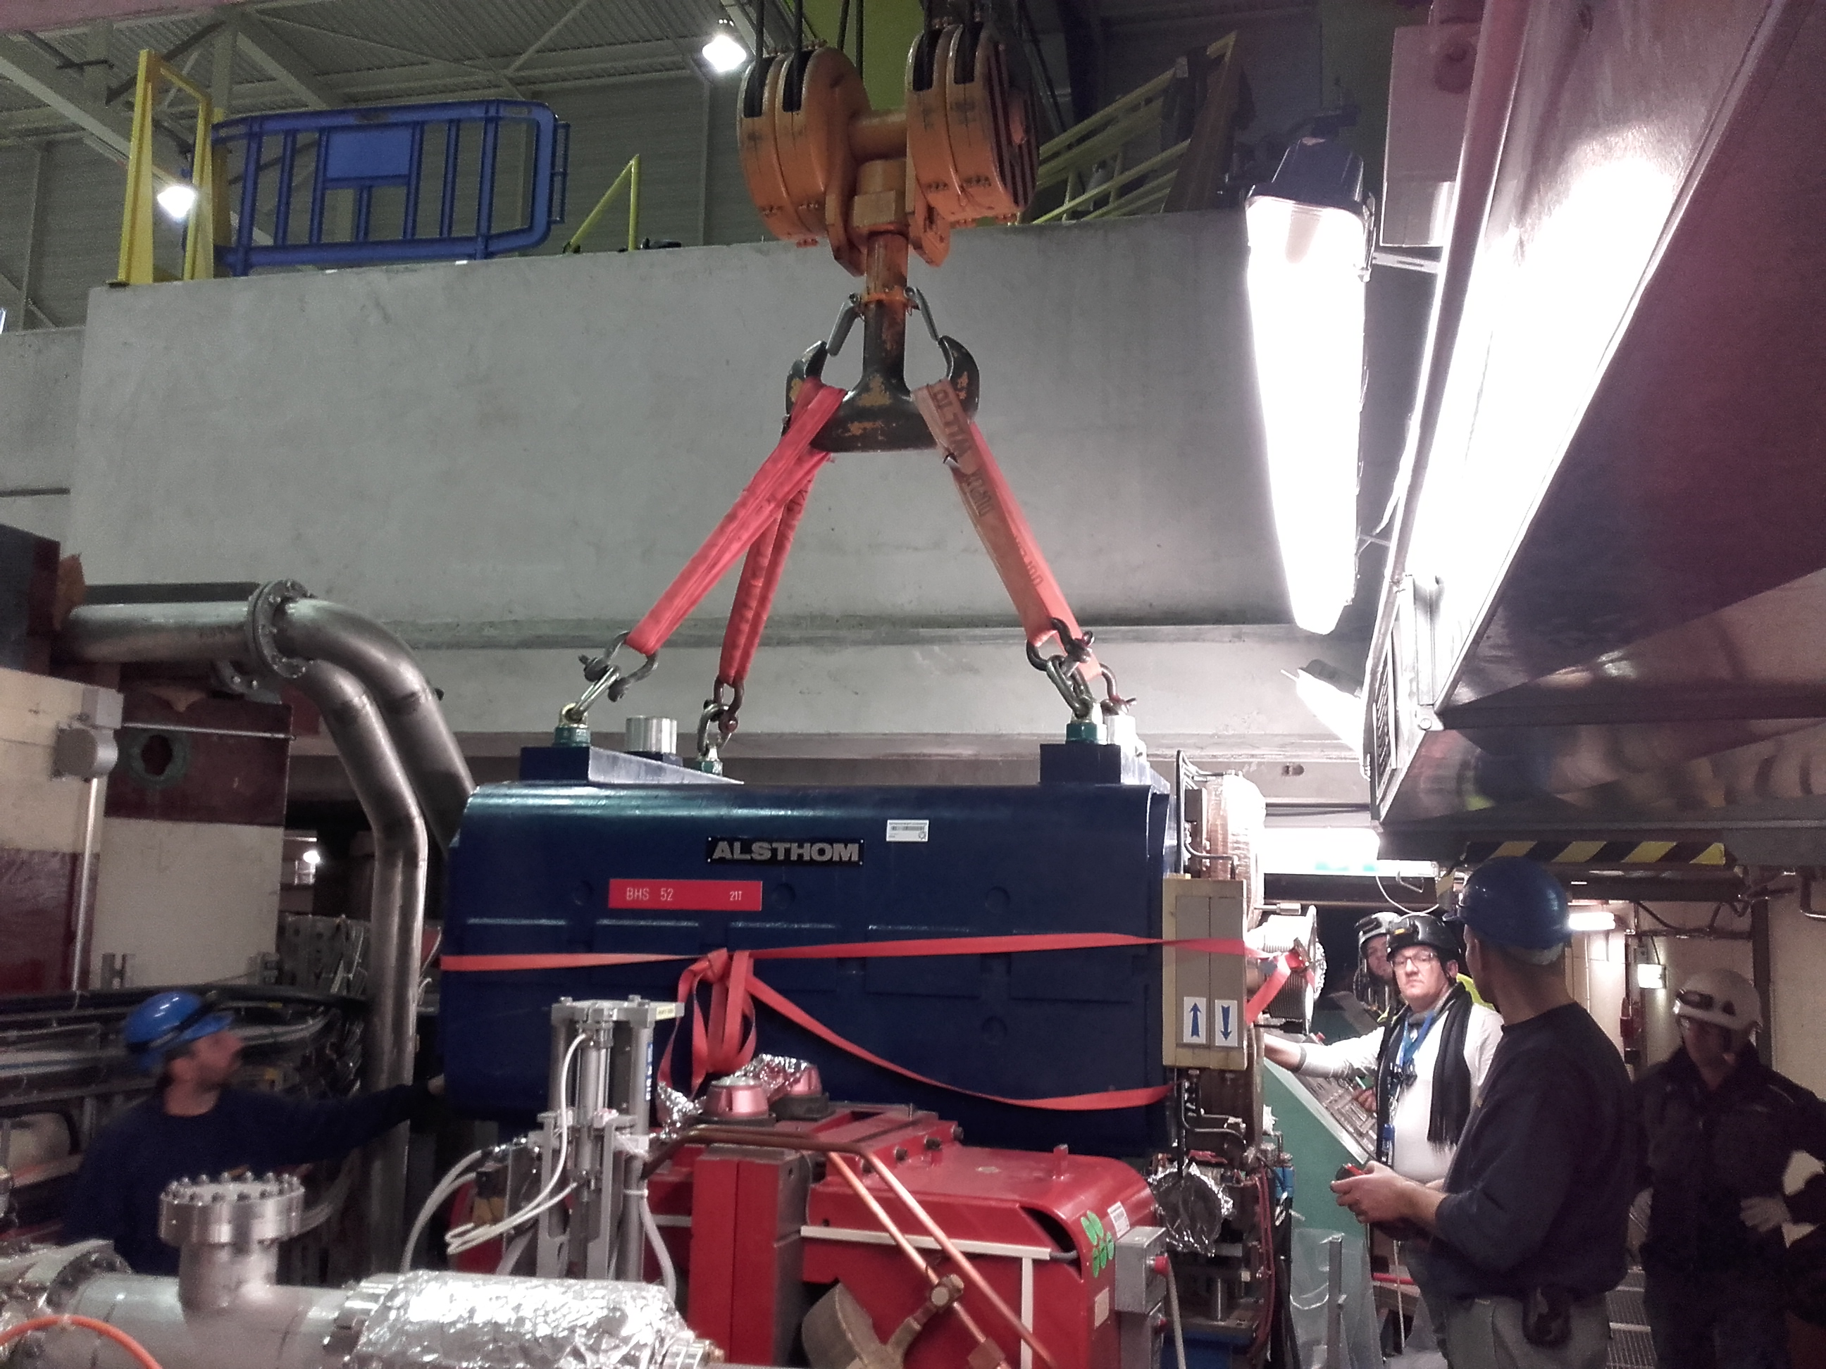
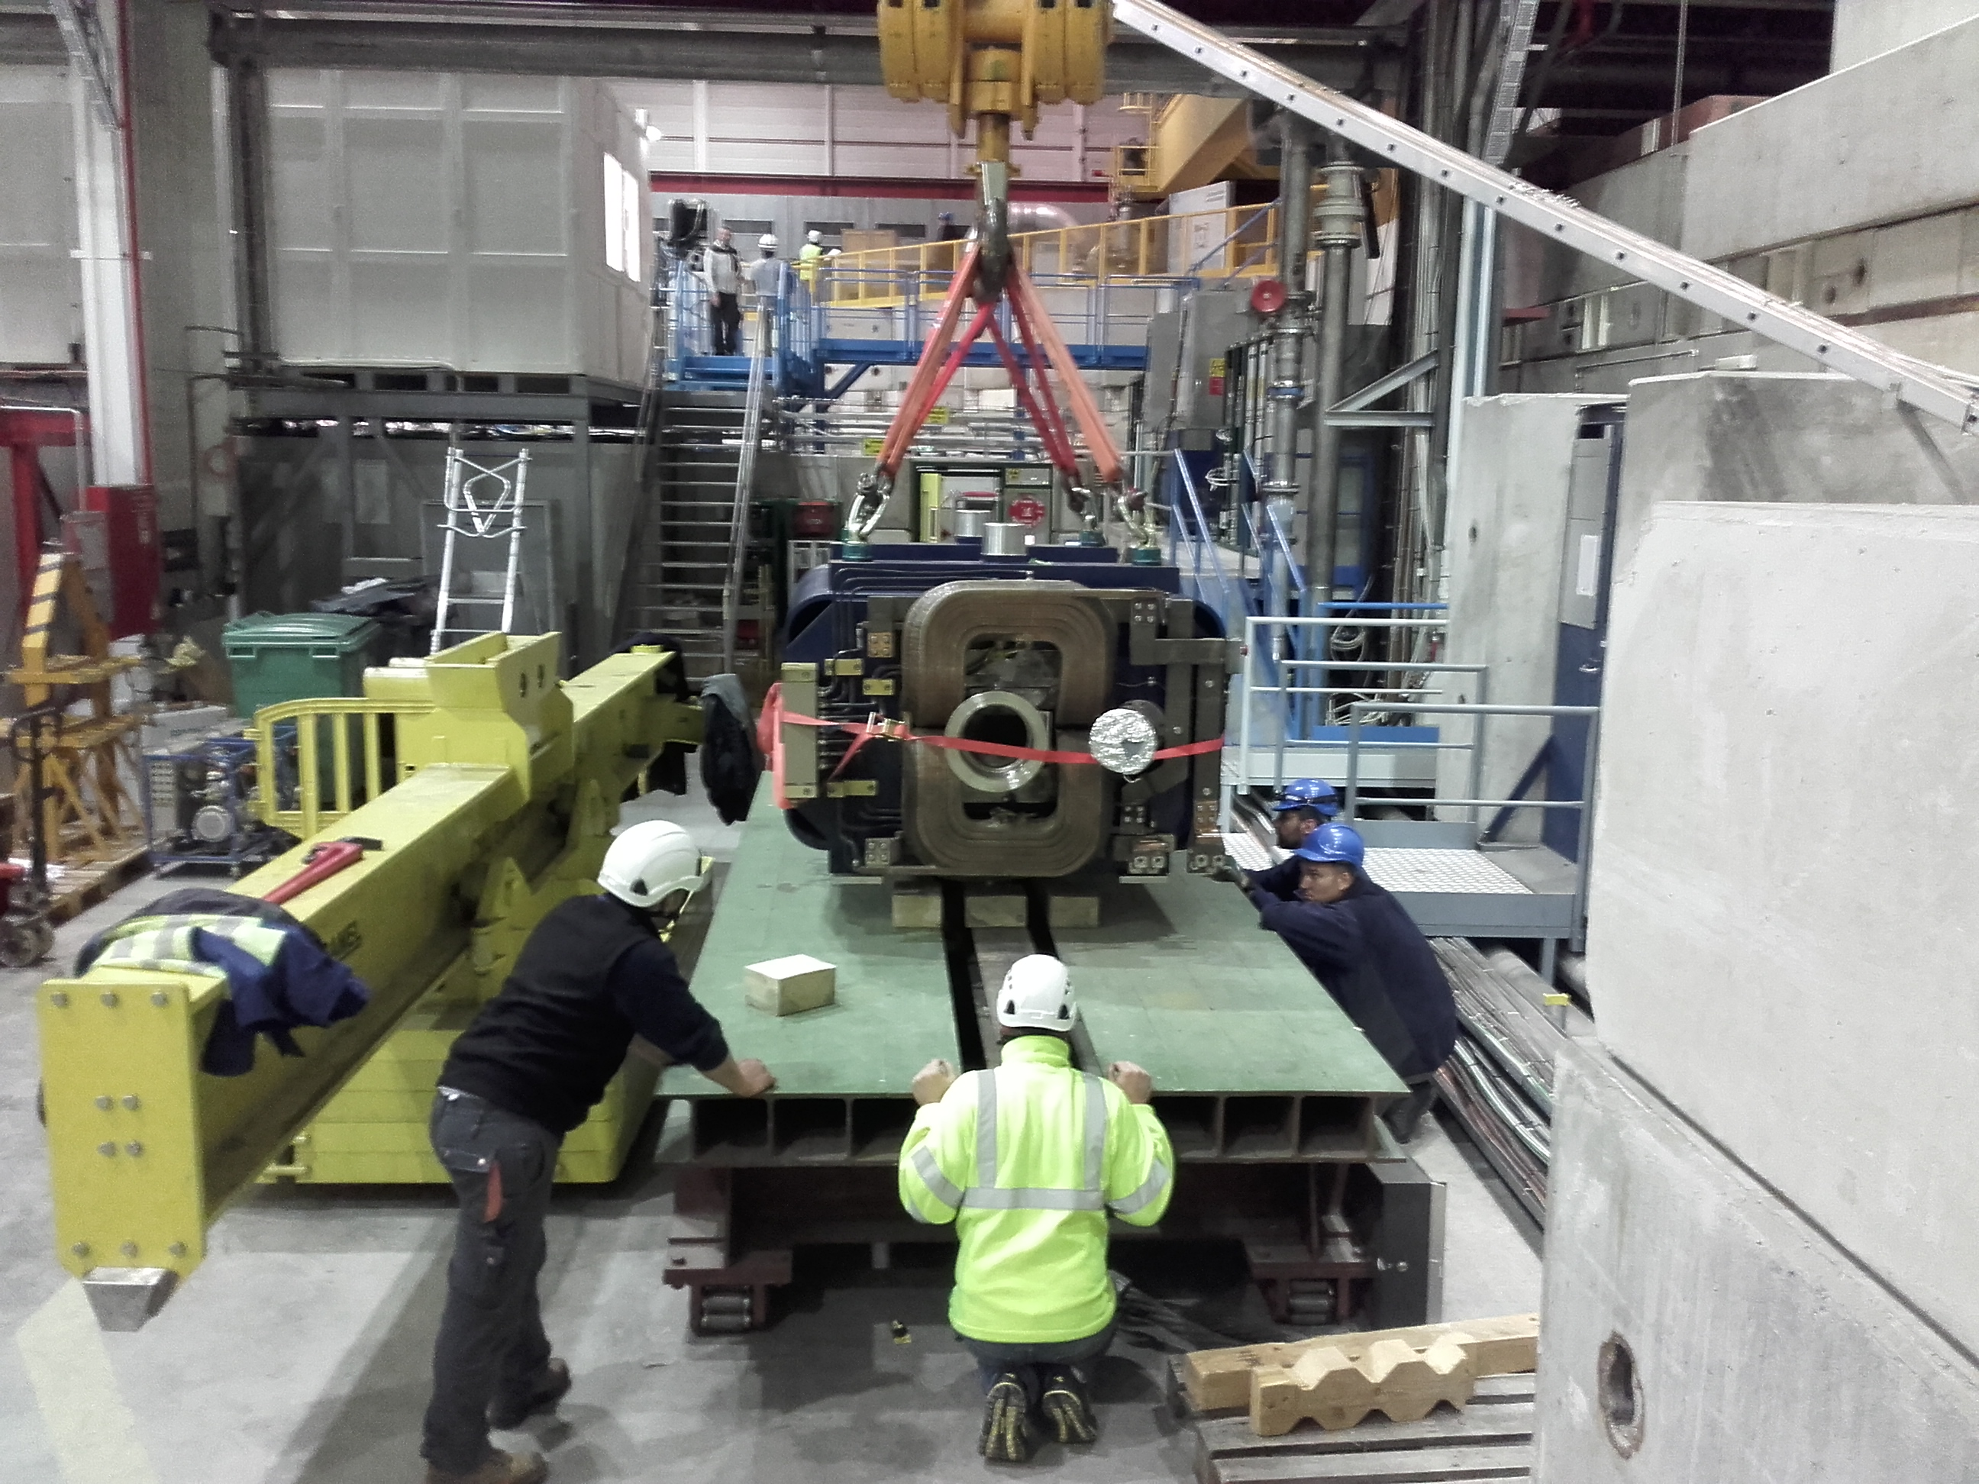
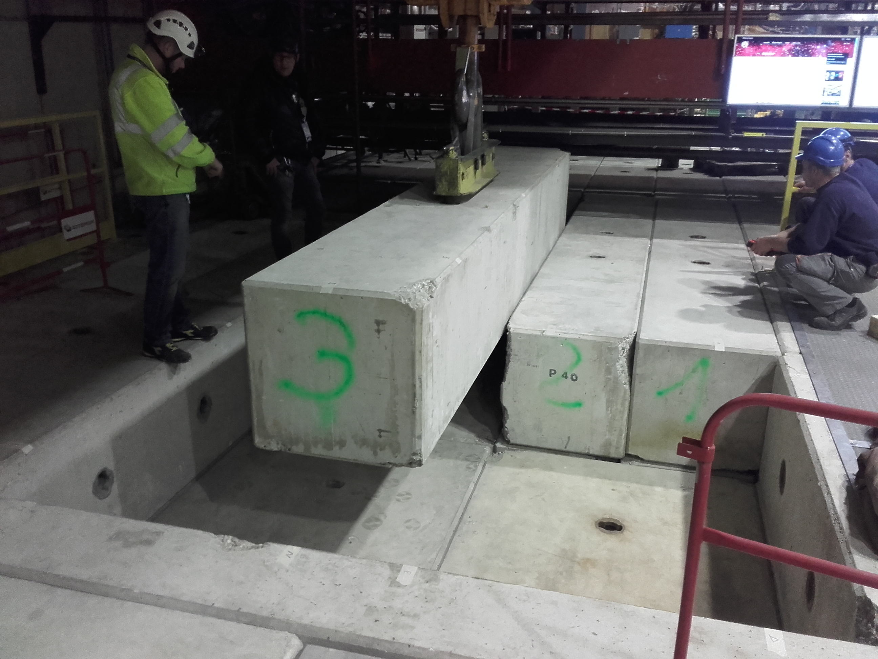
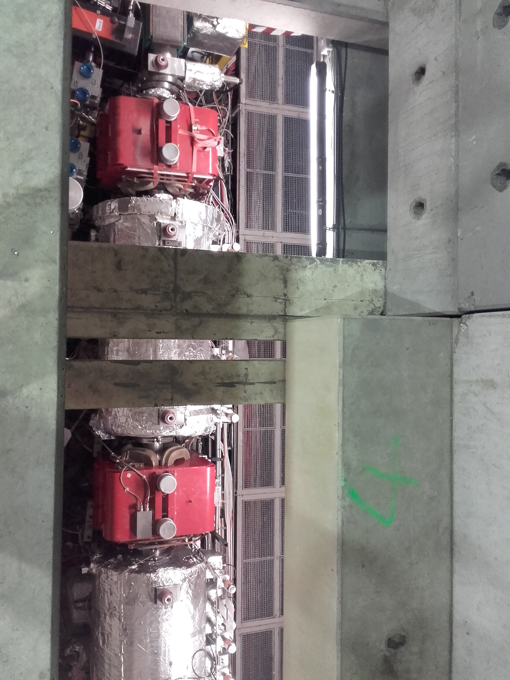
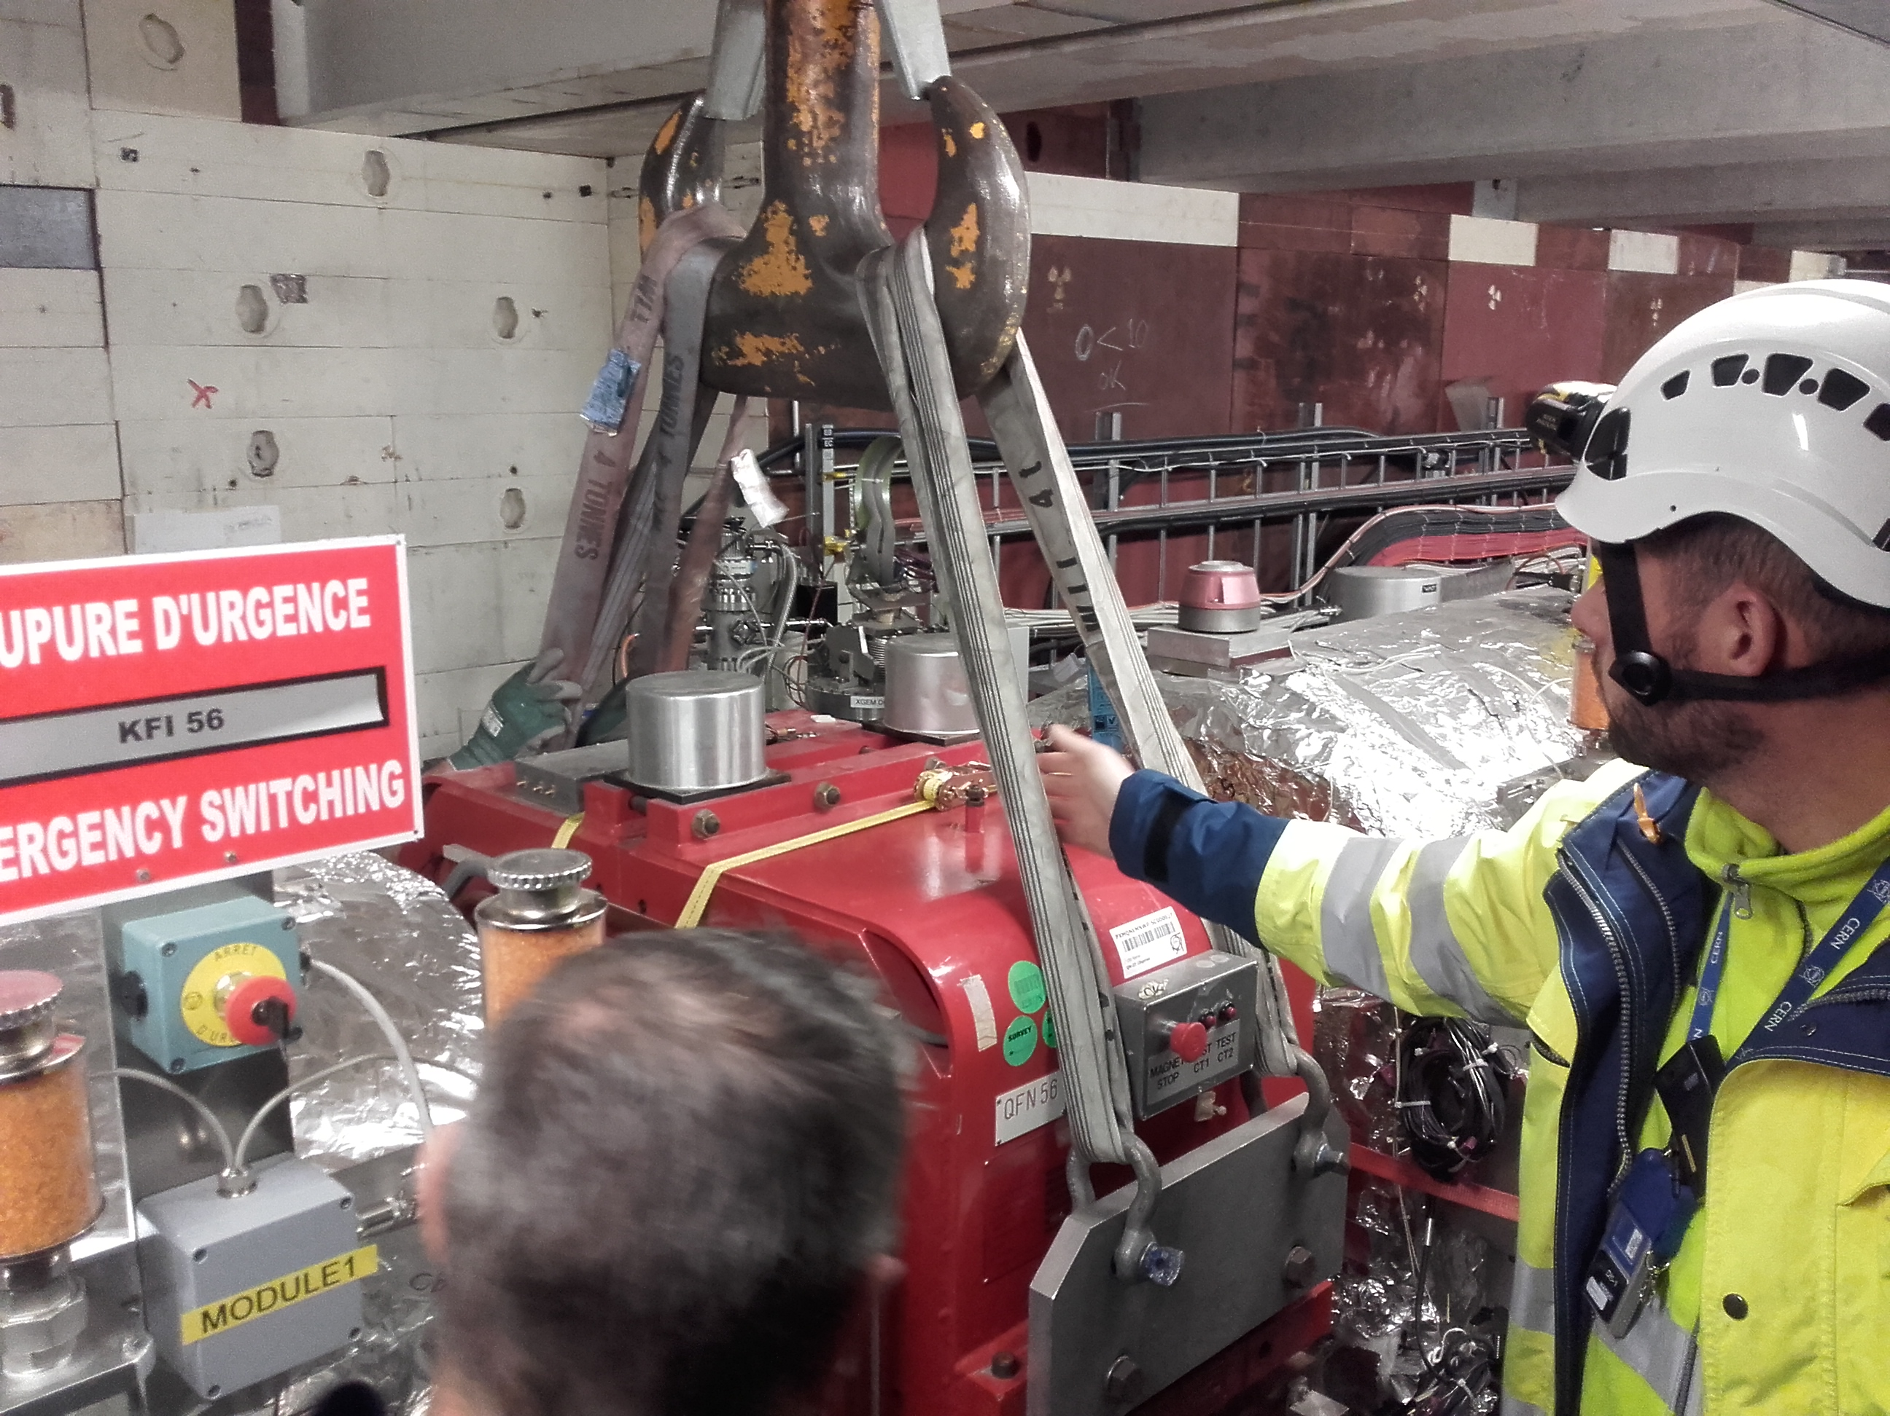
Magnets
The BHS52, QDN55 and QFN56 was removed before the Christmas Break (VSC, HE, MSC, EA).
The line 7000 has been ventilated to allow the removal of a gauge in conflict with the QDN55.
BHS52
QDN55 and QFN56

Slide 7
Works from W03 to W06
MSC:
  Refurbishment BHS52, QDN55 and QFN56
  Return of QDN55 and QFN56 in AD Ring (W06) -> Preparation area + opening of shielding, end of W05 (EA+HE)
BCCC
  Pump Insulation Vacuum
STI:
  Maintenance BTV
RP:
  Source test
SU:
  Alignment QDN55 and QFN56
EA:
  Cleaning of cables line 8000
VSC:
  AD Ring:
    Sector 2A and 2B
    Magnets group sector 1A
    Sector 1B
    Sector 3
    Sector 4
  ELENA:
    LNR30-40-50: Bakeout
    LNE50
    LNI-LNE
EL:
  Installation of cables for Scraper
RF:
  Maintenance ADC02/ADC10

Slide 8
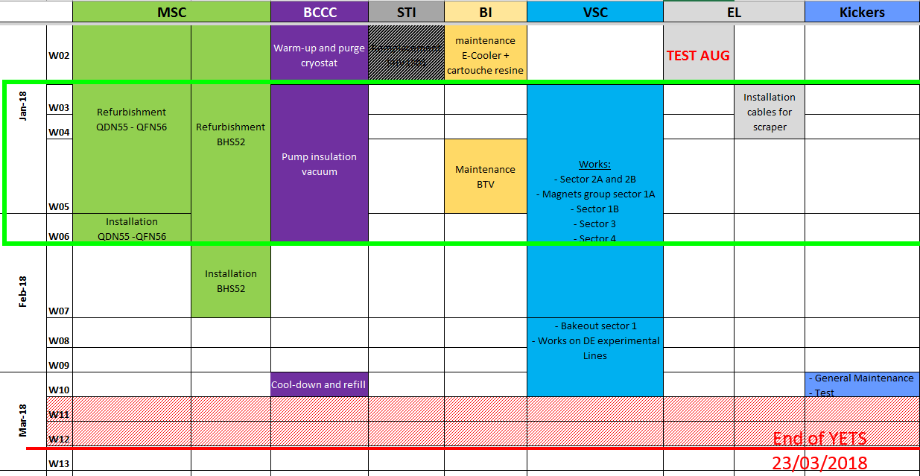
Planning

Slide 9
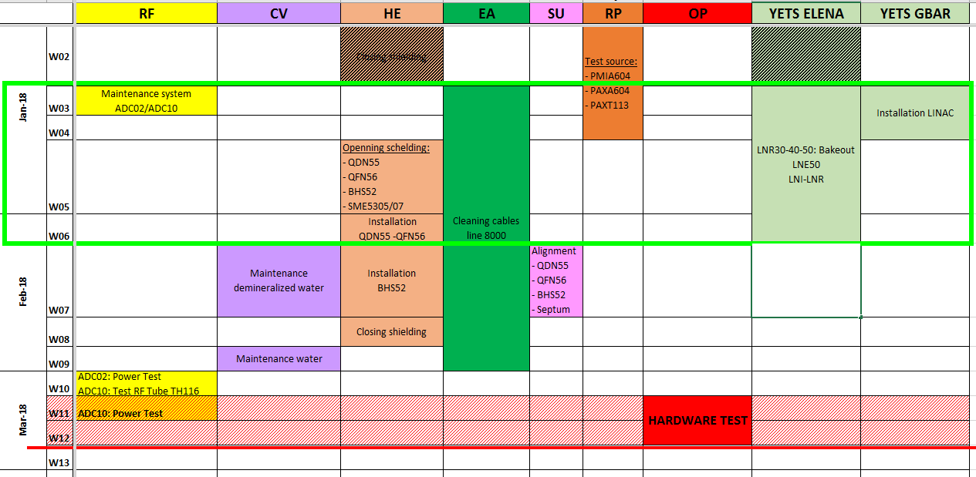
Planning

Slide 10
Thank You

