Slide 1
BE-RF-IS Activities – LS2
AD
M. HAASE

Slide 2
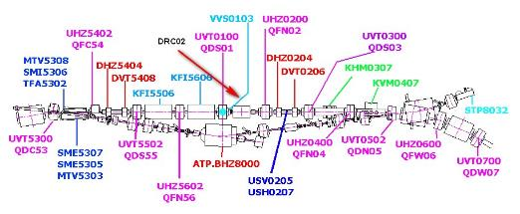
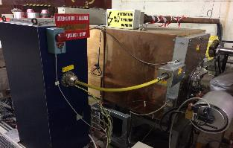
BE-RF-IS Activities – LS2
EXISTING SITUATION
A new RF system has to be installed in the AD to cope a long run for ELENA.
It will be installed in the straight sections now occupied by the present RF system.
The RF cavity are presently installed in the INJECTION zone.
Figure 1 – Ring Layout
Figure 2 – ADC02 Cavity INJECTION zone

Slide 3
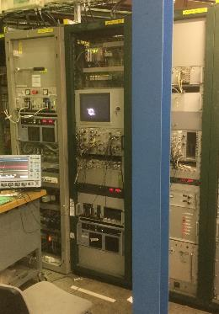
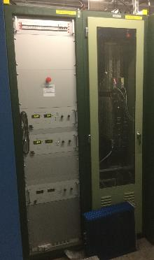
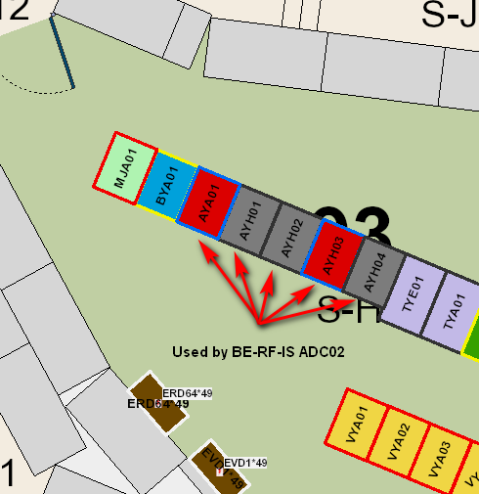
BE-RF-IS Activities – LS2
EXISTING SITUATION: Layout AD Hall B.193 S-H03
Figure 3/4/5 – Equipment ADC02
Bui.193 S-H03 Racks AYA01, AYH01, AYH02, AYH03 and AYH04

Slide 4
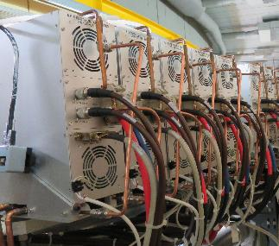
BE-RF-IS Activities – LS2
SITUATION AFTER LS2 RING INJECTION ZONE
The RF Cavity installed in the Injection zone will be removed and replaced with the Finemet Cavity.
Figure 6 – Ring Layout
Figure 7 – Single wideband system

Slide 5
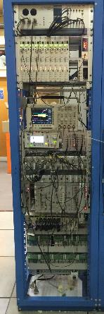
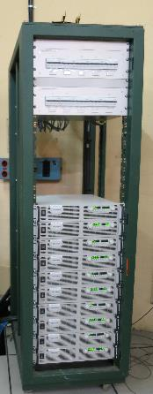
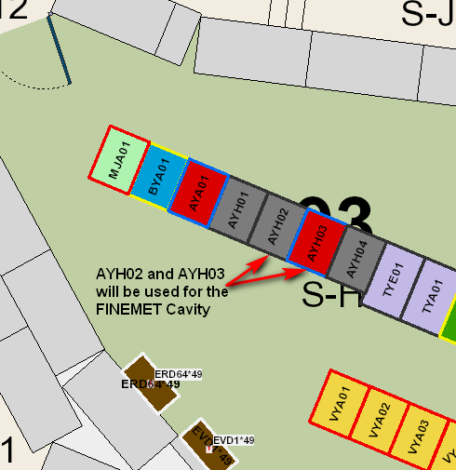
BE-RF-IS Activities – LS2
SITUATION AFTER LS2: Layout AD Hall B.193 S-H03
Figure 8/9/10 – Equipment ADC02
Bui.193 S-H03 Racks AYH02 and AYH03

Slide 6
BE-RF-IS Activities – LS2
Proposed planning LS2
Removing Cavity C02 end of 2019,
About 2 days work to disconnect everything
Transport needed only short time to remove the cavity
Cleaning up the Racks in 193 S-H03, sometime in 2019
De-cabling and cabling beginning 2020
Installing the Finemet Cavity and the power supplies, PLC and control Electronic middle 2020
Installation Cavity about 5 days
Transport needed only short time to put the support and cavity at place
Connection vacuum chamber before beam

Slide 7
BE-RF-IS Activities – LS2
NEEDS CLARIFICATION
Transport:
- When we remove the Cavity C02?
- When we install the FINEMET Cavity?
De-cabling and cabling
- Which date?
Vacuum
- Back out?

Slide 8
BE-RF-IS Activities – LS2
TECHNICAL DRAWINGS

Slide 9
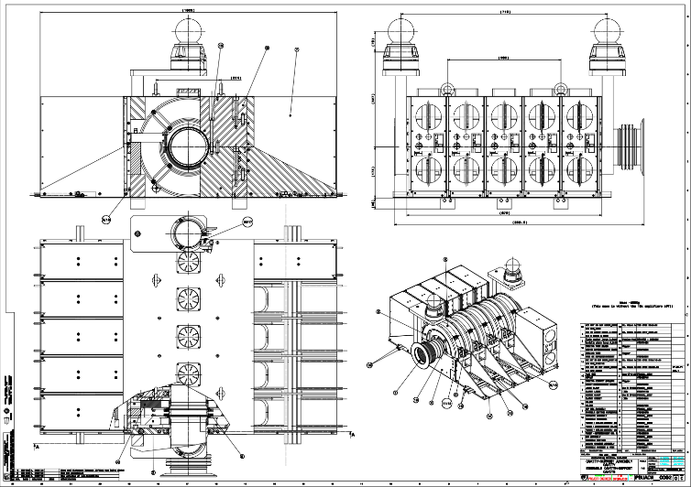
BE-RF-IS Activities – LS2
https://edms.cern.ch/document/1151014/AC

Slide 10
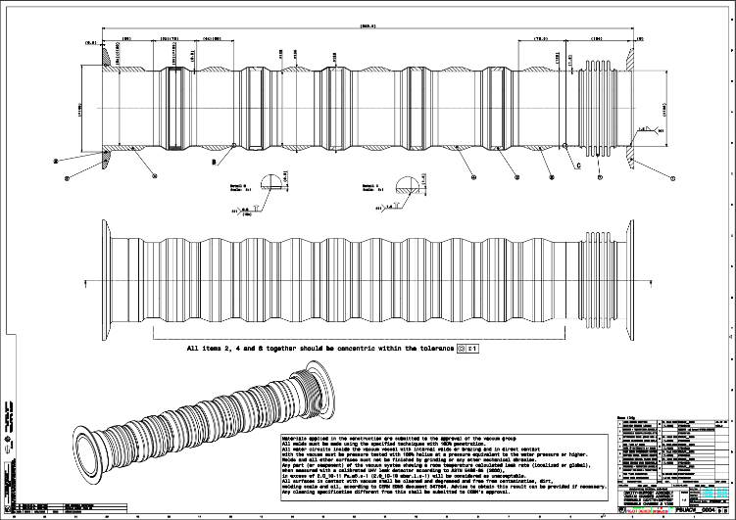
BE-RF-IS Activities – LS2
https://edms.cern.ch/document/1151033/AB

Slide 11
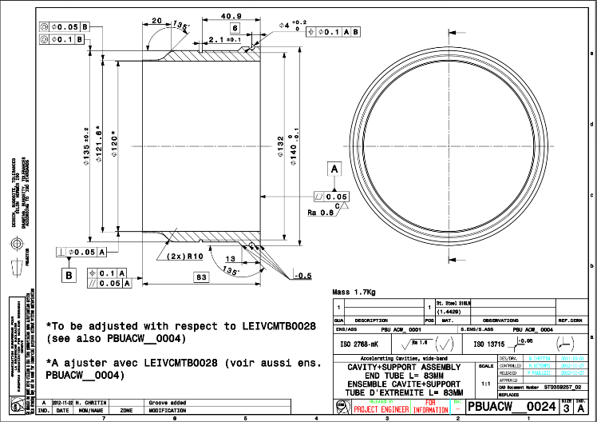
BE-RF-IS Activities – LS2
https://edms.cern.ch/document/1157294/AA

Slide 12
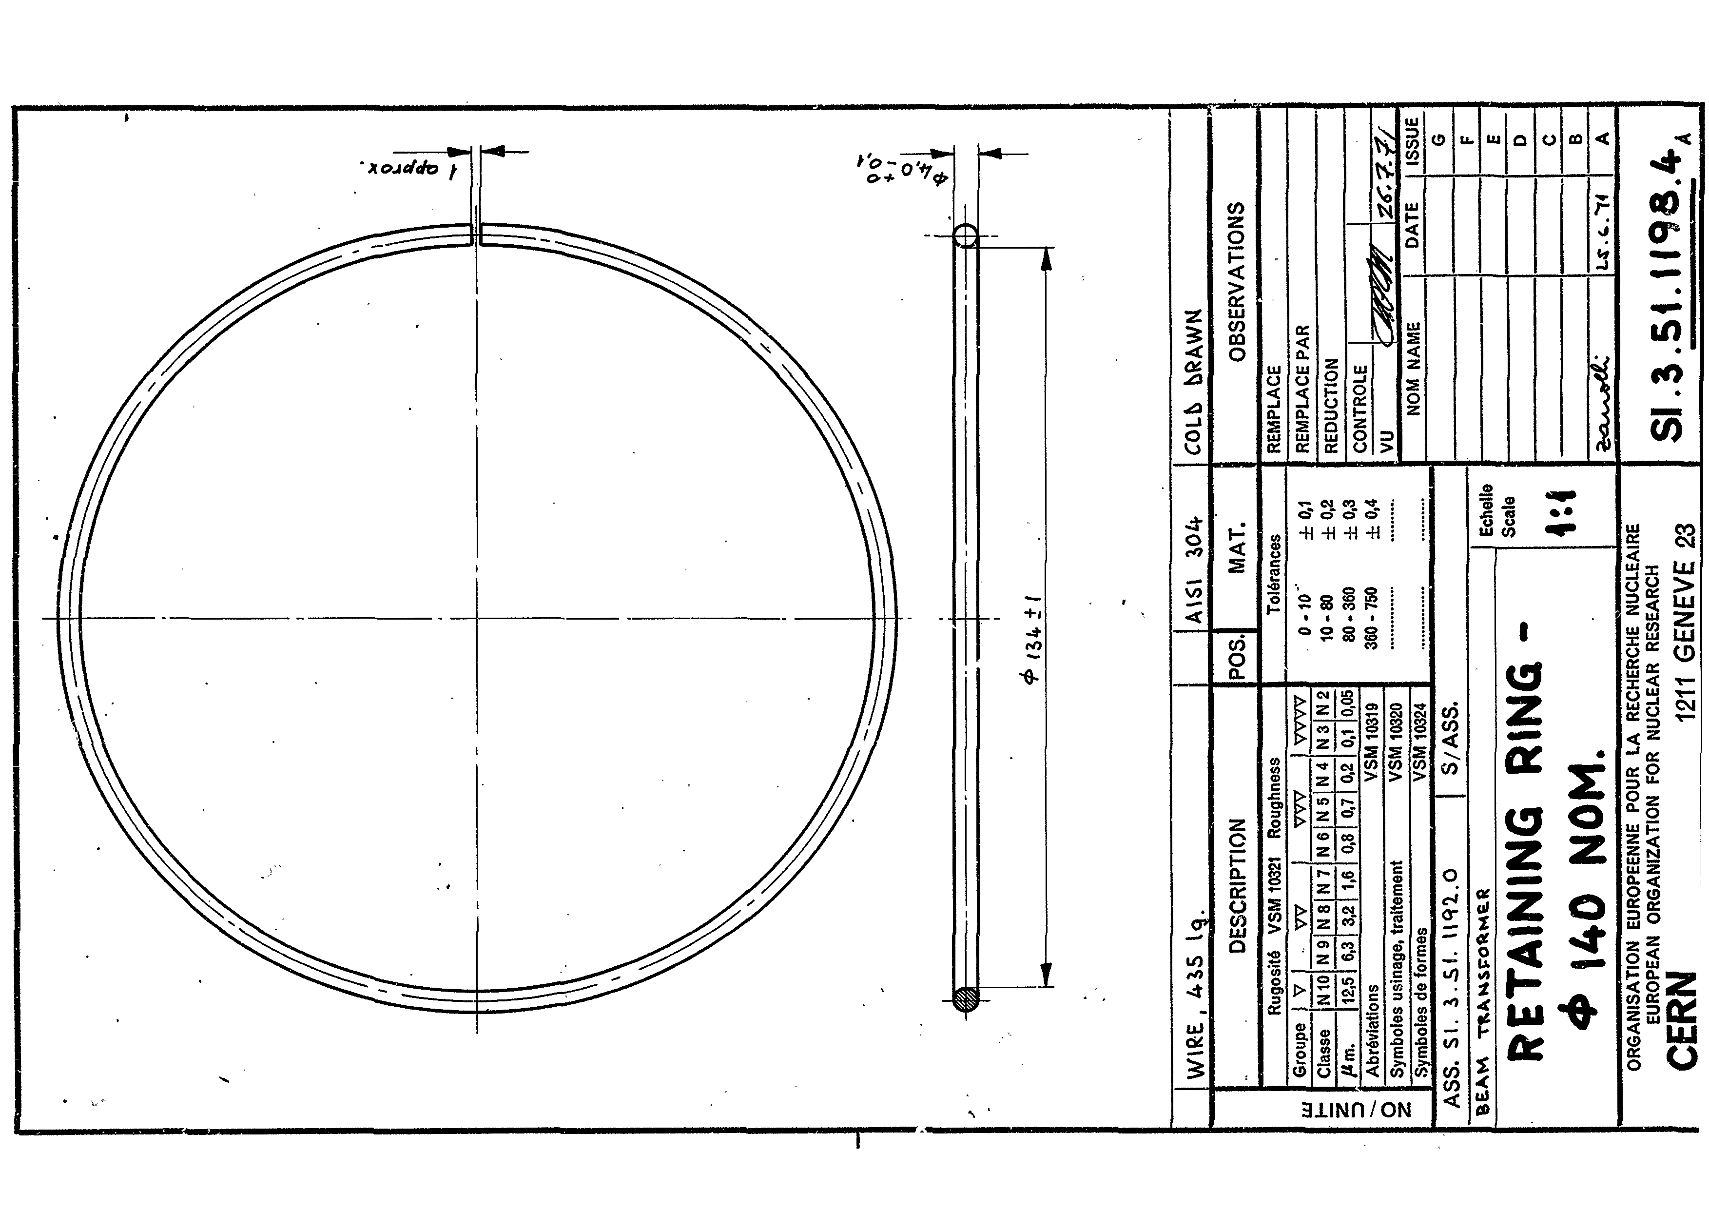
BE-RF-IS Activities – LS2
https://edms.cern.ch/document/1157293/0

Slide 13
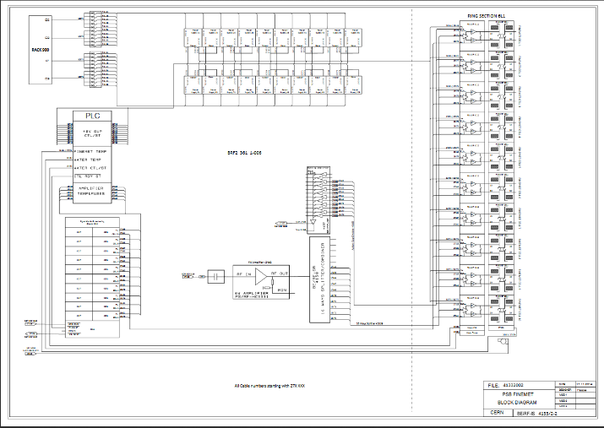
BE-RF-IS Activities – LS2
https://edms.cern.ch/ui/file/1182958/2/41332002.pdf

