Slide 1


AWAKE Laser Synchronization
D. Barrientos, T. Bohl, A. Butterworth, H. Damerau, S. Döbert, W. Höfle, J. Molendijk, S. Rey, U. Wehrle, B. Woolley (CERN)
J. Moody, P. Muggli (MPP)
CERN – Lancaster meeting, 11/01/2018

Slide 2
Introduction
AWAKE Synchronization and RF distribution must deliver wide range of RF signals for laser, electron and proton beams
Reference: signals (f_{ML}, f_{rep}) for laser
All signals derived from a GPS-referenced 5.9958 GHz low-jitter reference oscillator (Laurin AG)
Signal | Frequency | Ratio
Laser phase locked loop, f_{LPLL} | 5.9958 GHz | 1
Electron acceleration, f_{RF,e} | 2.9979 GHz | f_{LPLL}/2
2×Laser mode-locker, 2f_{ML} | 176.347 MHz | f_{RF,e}/17
Laser mode-locker, f_{ML} | 88.1735 MHz | f_{RF,e}/34
2×SPS RF system freq., 2f_{RF,SPS} | 400.8 MHz | 2f_{ML}×25/11
Common frequency, f_{c} | 8.68 kHz | f_{ML}/10164
Pulse repetition rate, f_{rep} | 9.97 Hz | f_{c}/870
Laser pulse
φ
Electron beam
φ
τ
Proton beam
τ
Simultaneous arrival of beams in AWAKE

Slide 3
Laser synchronization
AWAKE laser synchronization to external reference designed in two stages
  88.2 MHz (f_{ML}, mode locker frequency)
  Synchronize laser pulse to 88.2 MHz from reference divider
  Standard photo diode with electronic phase discriminator
  6 GHz (f_{LPLL}, laser PLL frequency)
  Lock laser to reference source with low jitter (design: ~30 fs)
  BOM-PS
Commercial system as locking loop controller
  Menlo system RRE-SYNCHRO Repetition Rate Stabilization

Slide 4























Menlo
Systems
Syncronizati
on
CurrentSystem Layout v1.1
ASOPS
Systems
5995 MHz
(laser)
Fast
PD
BPF
P. Dominguez, Menlo Systems
~6 GHz
GPS
10MHz
Monitor
PD^{BPF}
88MHz
Menlo Laser
88MHz, 1560nm
RF-
Reference
5995 MHz
BOM-PD
88 MHz
(divider)
Reference
5995 MHz
Harmonic
lock
Fundamental
lock
RF-
Distribution
Piezo + Tracker
feedback
SYNCRO

Slide 5
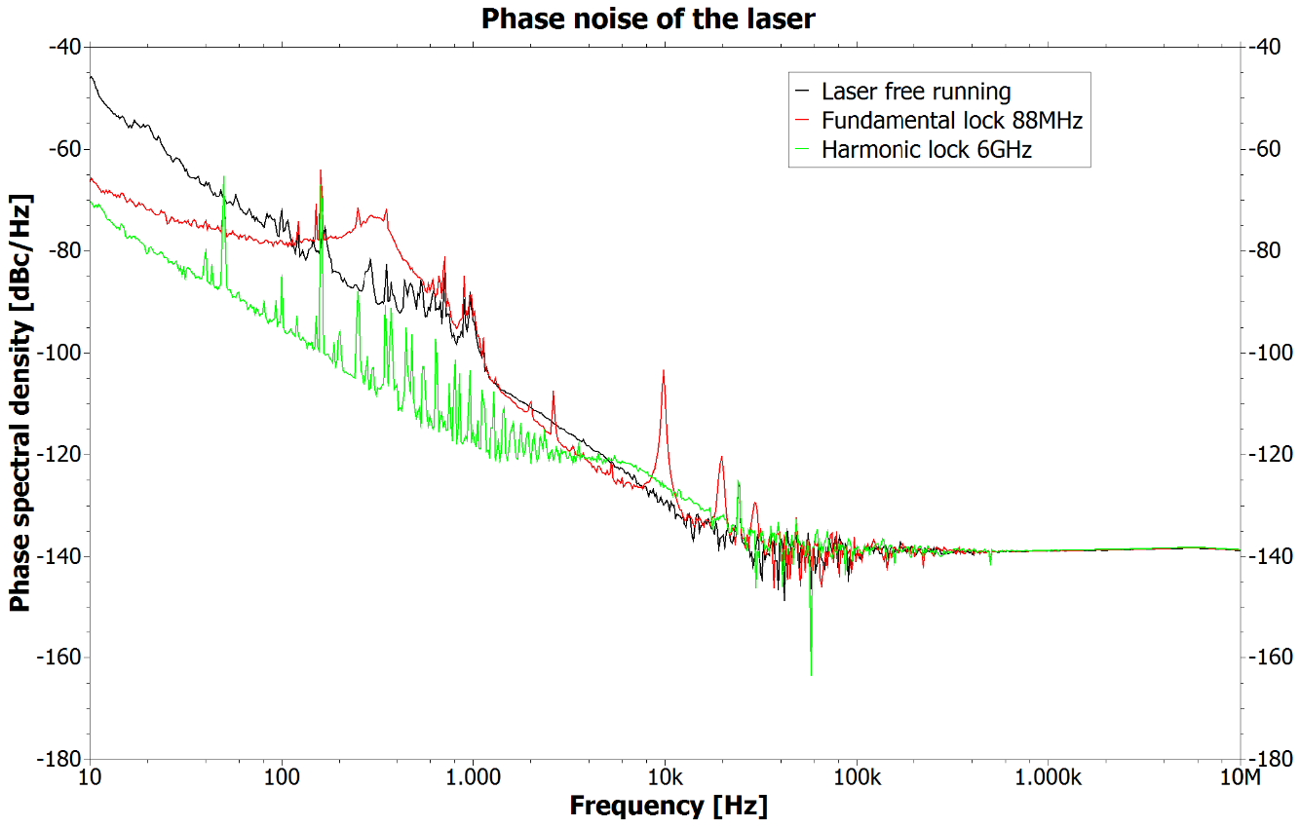
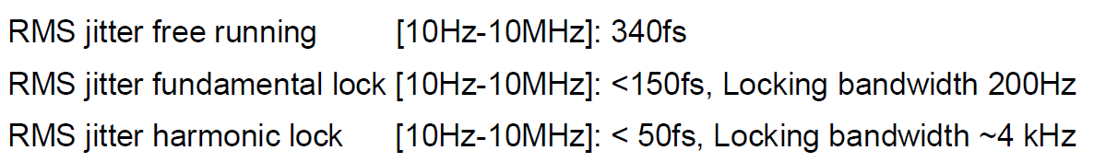
Initial laser synchronization commissioning
Commissioning of harmonic lock with Menlo in 10/2016
P. Dominguez, Installation Protocol

Slide 6
Laser synchronization status
Harmonic lock sensitive due to
  Large harmonic ratio with respect to fundamental harmonic: 68
  Small linear phase detection range of BOM-PS: ~±30°
1° error at fundamental lock may move harmonic lock beyond linear range
Decided to keep only fundamental lock for AWAKE runs
No operational experience with harmonic lock system
What can be improved?
Possible ‘Brute-force’ options:
  Introduce intermediate synchronization step?
  Re-synchronize AWAKE main divider at 88.2 MHz?

Slide 7
Questions for discussion
Possible options to increase lock range of present BOM-PD or other optical phase detector?
Similarities/differences of CLARA and AWAKE synchronization systems?
Additional parallel synchronization observation in AWAKE?
Needs of signals in AWAKE for parallel installation?
Clarify organizational framework of J. Hendersons stays at CERN. Possible schedule for tests with AWAKE laser?

