Slide 1
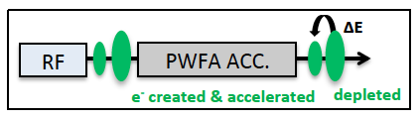
WP9 - Beam Driven Plasma Acceleration
Status Report
Massimo Ferrario (INFN) & Jens Osterhoff (DESY)
July 4, 2018, Liverpool

Slide 2
WP9 Deliverables
Del 9.1. Baseline design report including electron beam optics, plasma modules, plasma diagnostics and beam transport to applications [May 2018] (WP2+WP5).
Del 9.2. Staging analysis [May 2019].
Del 9.3. Tolerance analysis [May 2019].
Del 9.4. Full design report EUPRAXIA, contribution from WP9 [October 2019].

Slide 3
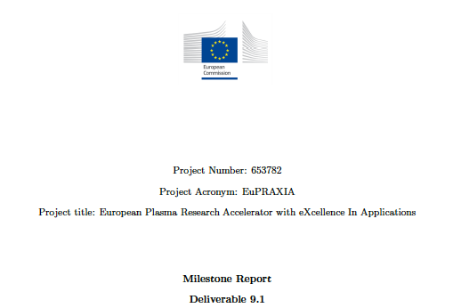
Thanks to A. Marocchino

Slide 4
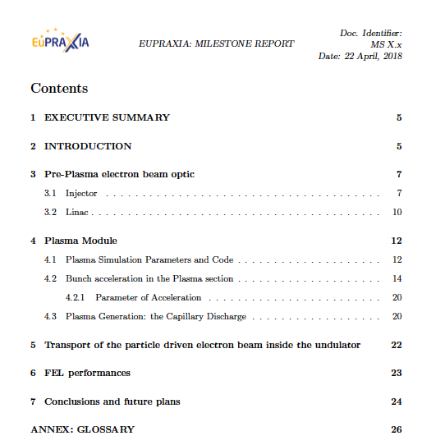

Slide 5
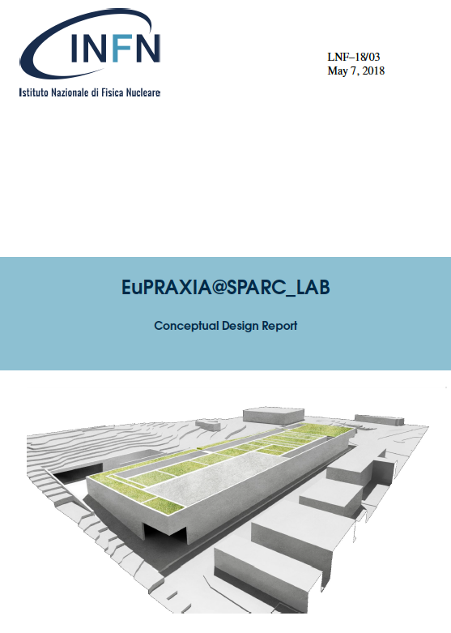
Conceptual Design Report Ready
for the LNF site
http://www.lnf.infn.it/sis/preprint/pdf/getfile.php?filename=INFN-18-03-LNF.pdf

Slide 6
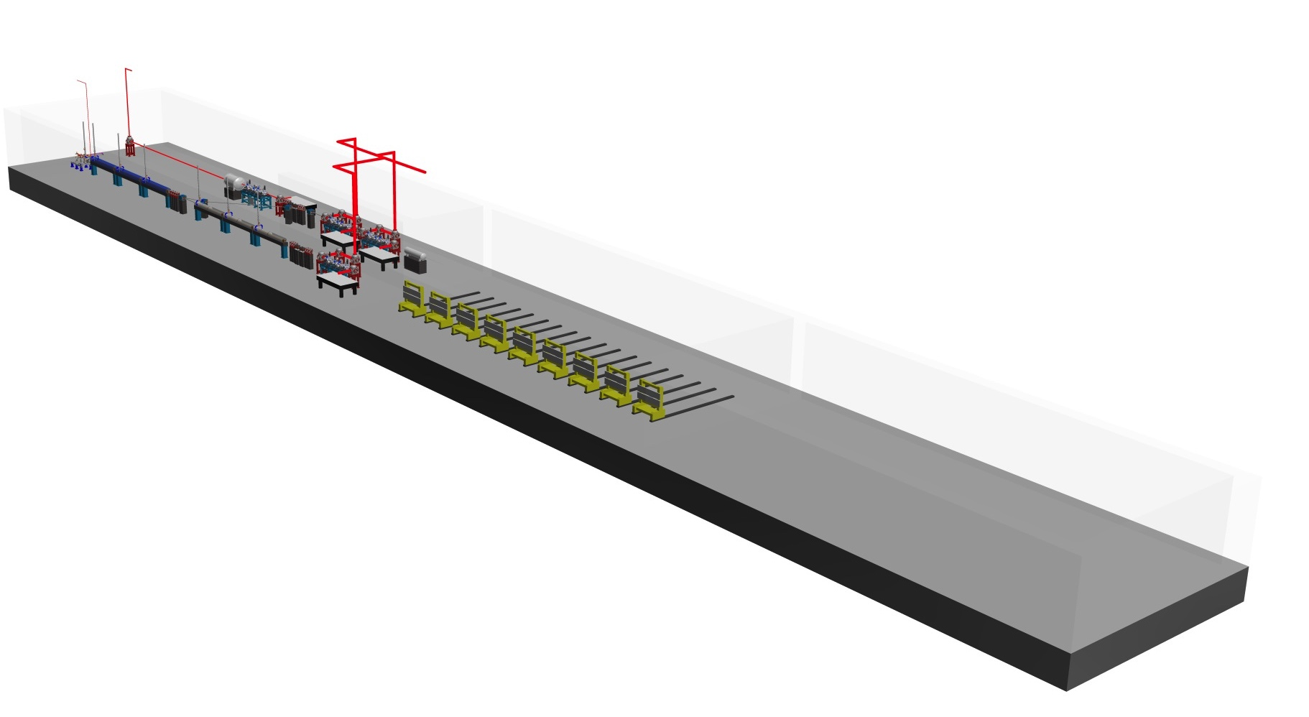


Overall layout status (ongoing)
Accelerator research, undulators and user areas are located on the first level
accelerator tunnel
laser path
undulator hall (assumed conventional)
X-ray transport
and user areas
~ 30 m
User Area HEP and Others
FEL User Area
Design by A. Walker (DESY) and
Dariusz Kocoń (ELI-Beams)

Slide 7
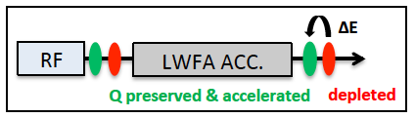
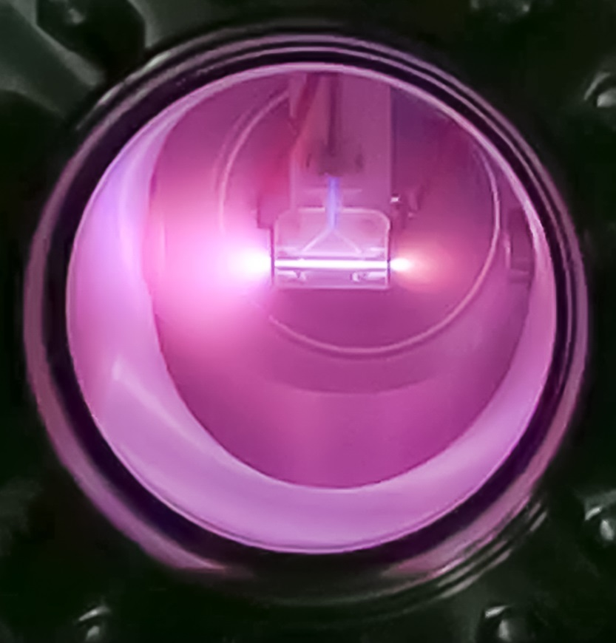
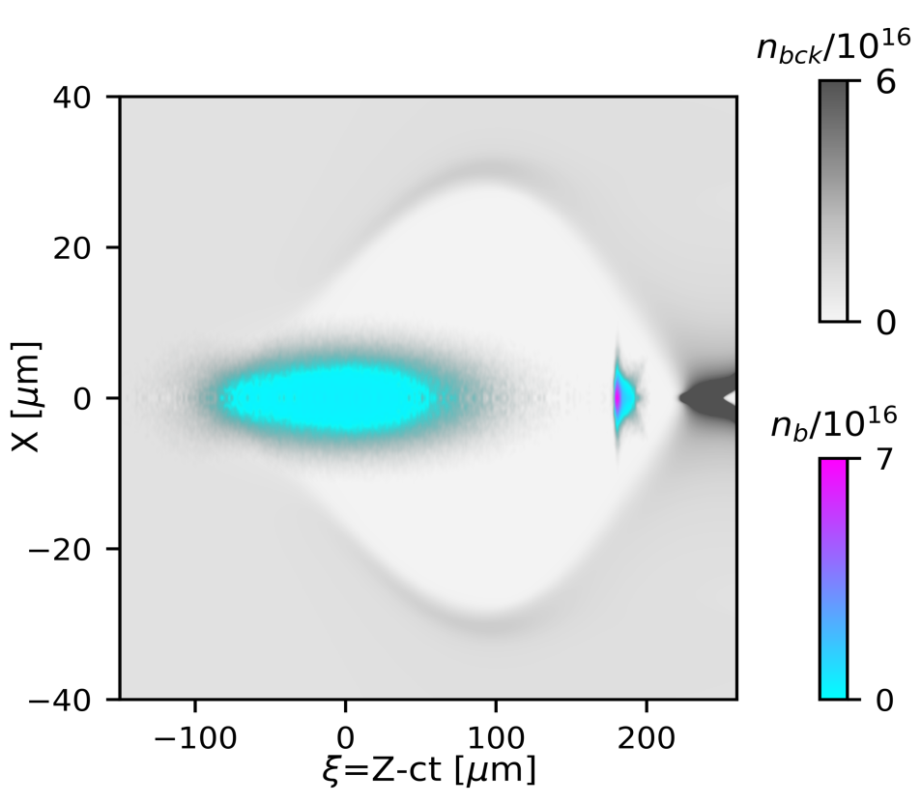
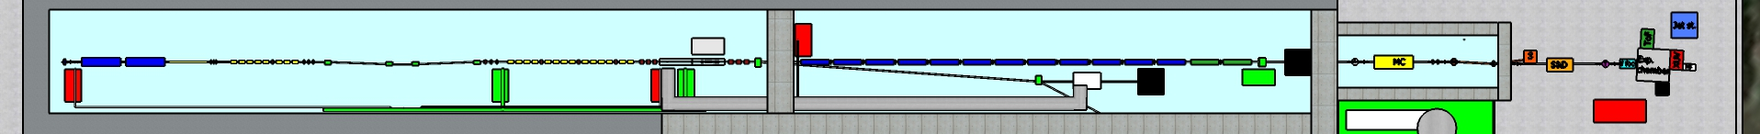
Plasma WakeField Acceleration – External Injection
driver
witness
Capillary discharge at SPARC_LAB
55 m

Slide 8
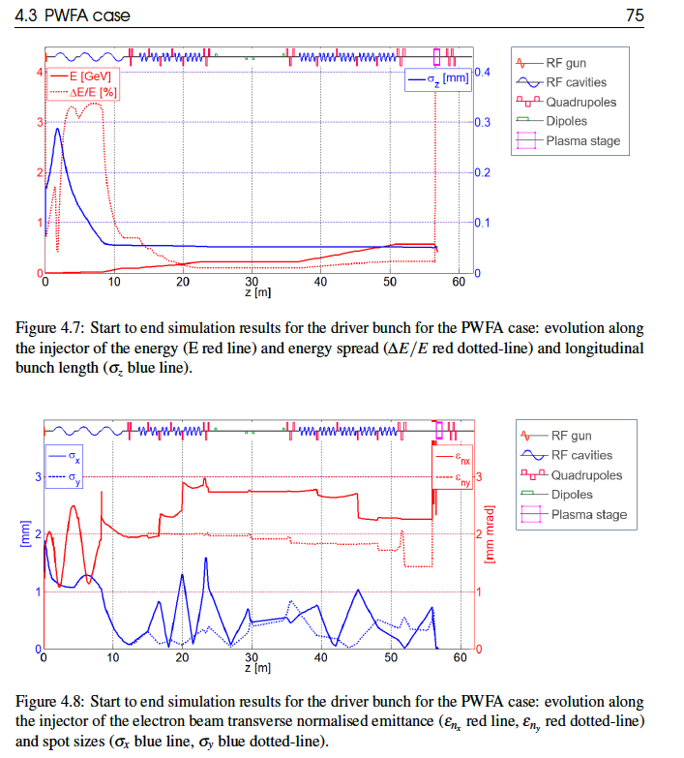
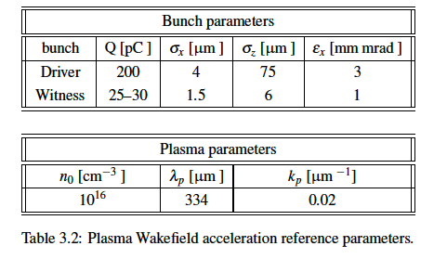
Driver S2E

Slide 9
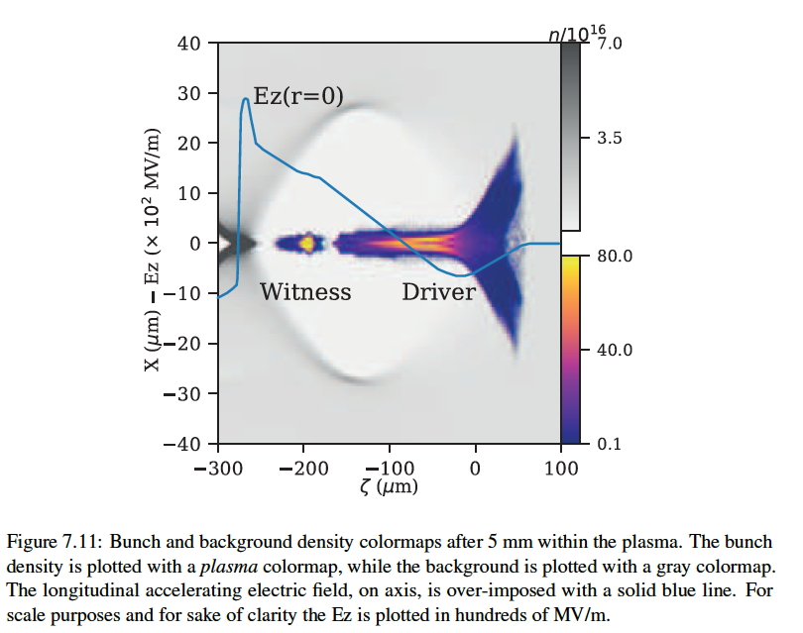
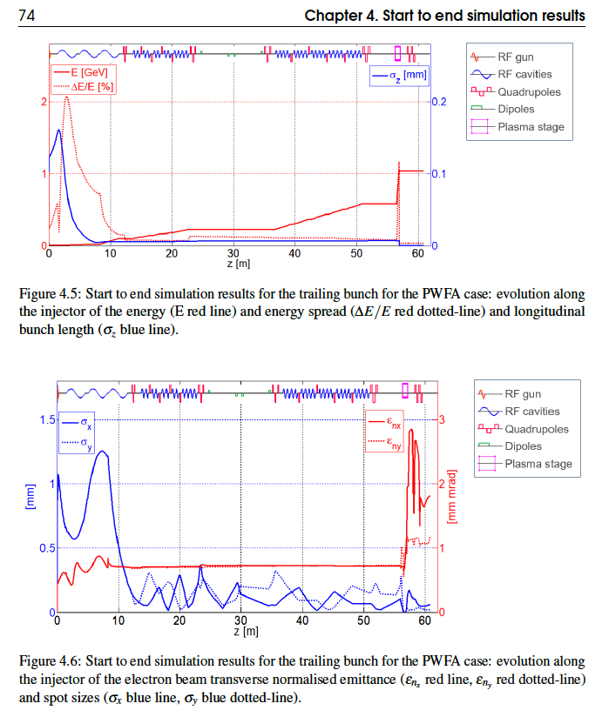
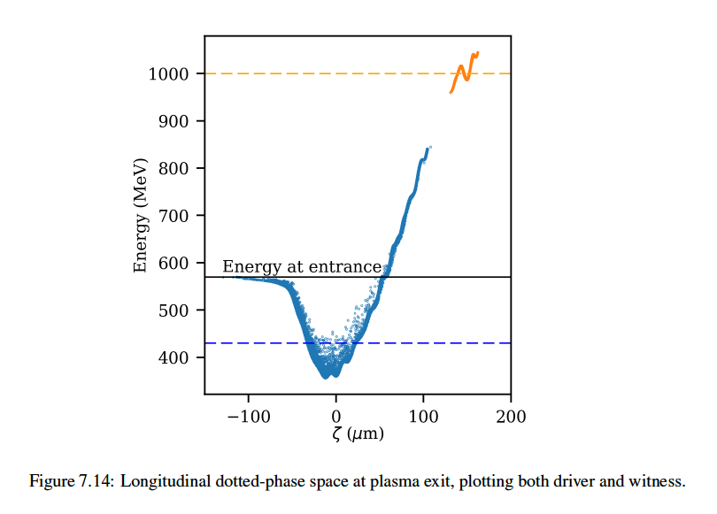
Witness S2E

Slide 10
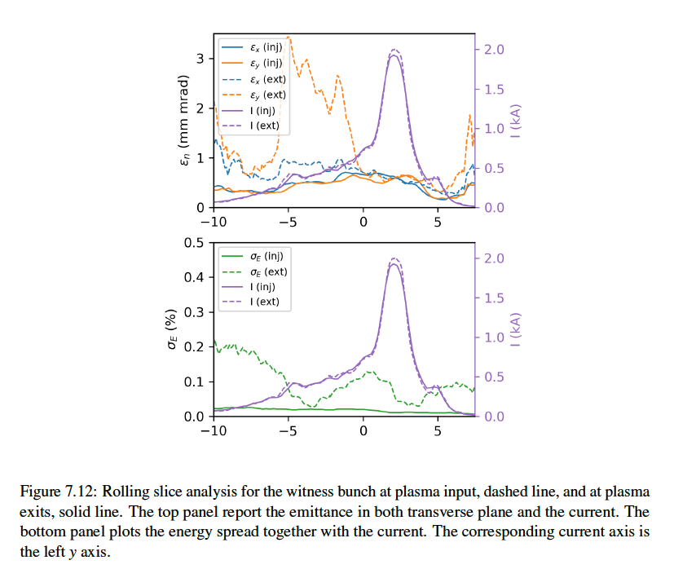
Plasma Exit: Rolling Slice analysis

Slide 11
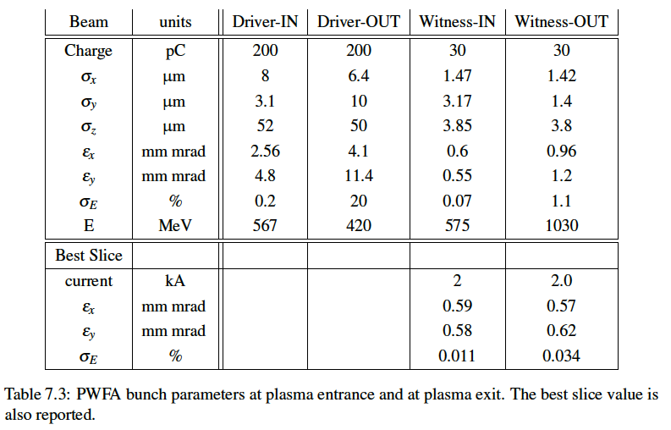

Slide 12
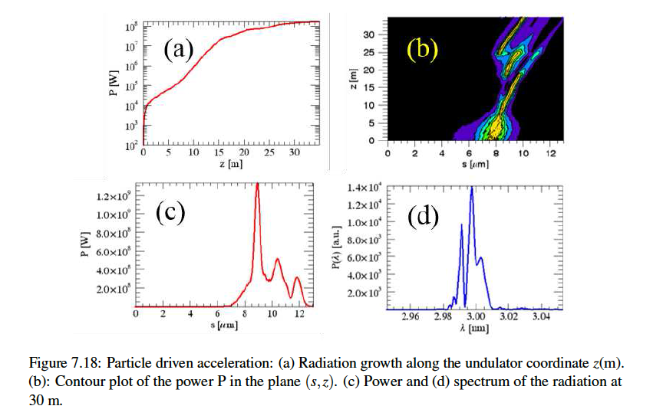
FEL Simulations (Genesis)

Slide 13
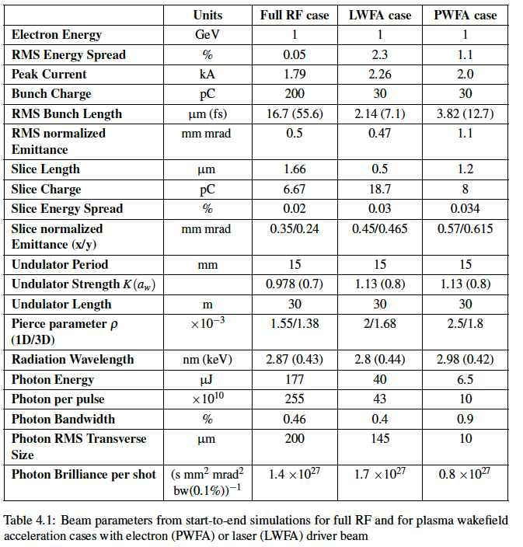

Slide 14
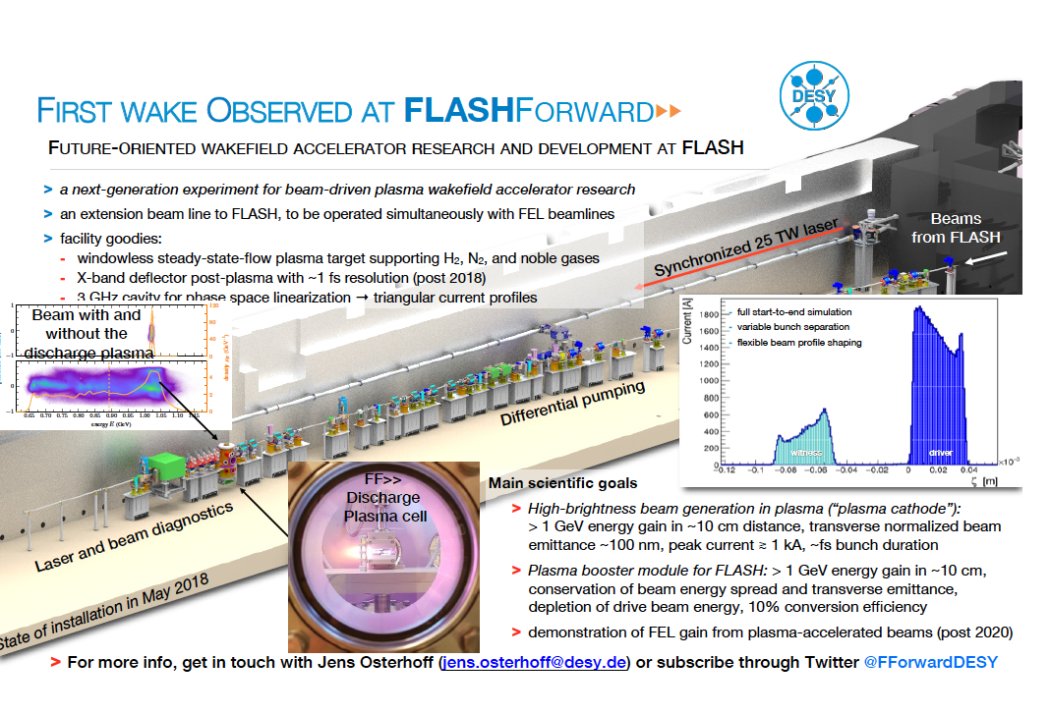

Slide 15
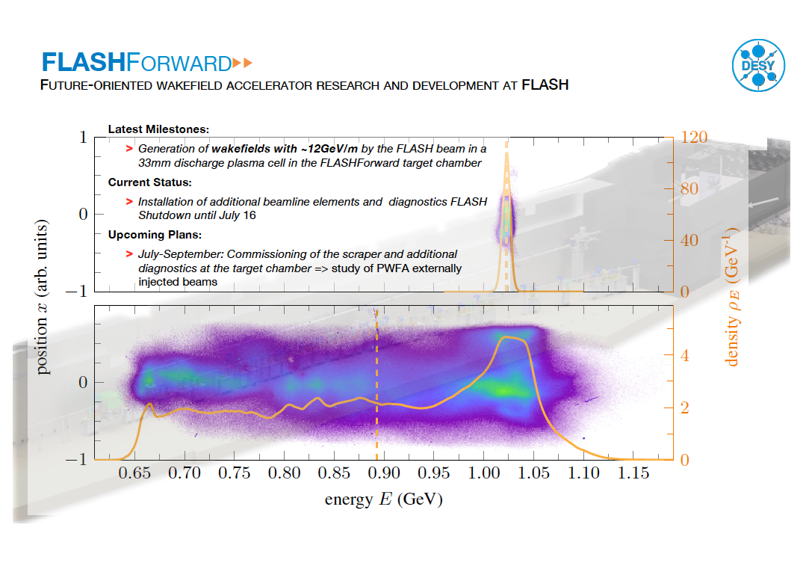

Slide 16
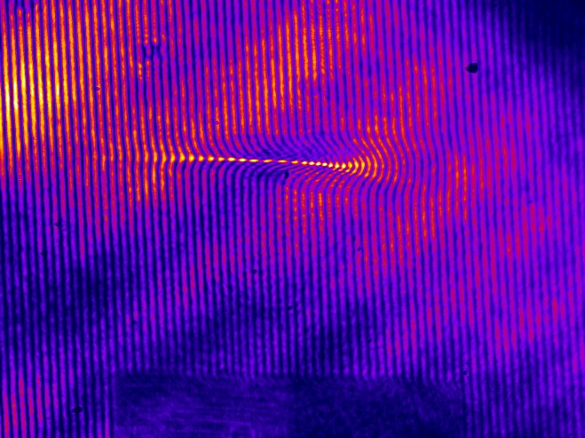


Thank for your attention

