Slide 1
Use of Other Novel Technologies (WP10)
U. Dorda (DESY)
G. Xia (University of Manchester)

Slide 2
Contents
Fiber lasers
Dielectric-based accelerators
Plasma beam dumps

Slide 3
Fiber lasers
Fiber lasers (advantages: high efficiency, high repetition rate, low loss, heating is not an issue)
10 GW per stage, need 100s fiber lasers combined to achieve TW level, even more for achieving hundreds TW or PW level laser for EuPRAXIA
ICAN and XCAN (Gerard Mourou)
  61 pulsed fibers combined (CW), with each beam controlled separately on phase (adding flexibility), 91 next step, 500 fibers for future (1 μm precision core to core)
  10,000 fiber lasers can be combined in principle, 10s of Joules, more than 10 kHz repetition rate)
  Combination of two high power Ti: Sapphire lasers planned
Status, problems, limitations, potentials
Industry involvement, Thales and others

Slide 4
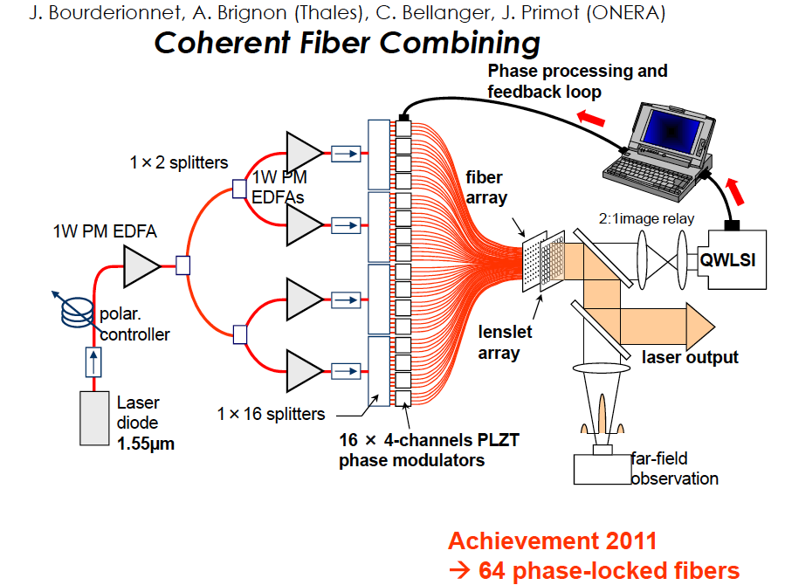
Fiber lasers

Slide 5
Dielectric based accelerators
  Current status of dielectric laser accelerators, THz driven dielectric accelerators and compact electron gun setup based on dielectric accelerators are reviewed.
Updates from ACHIP project
  ANL/UCLA/SLAC/
  DESY
  PSI
  SLAC
  …
Update from DATA program at Cockcroft Institute
  DLW as energy dechirper (for FELs)
  DLW as THz source
  DWA for two beam acceleration

Slide 6
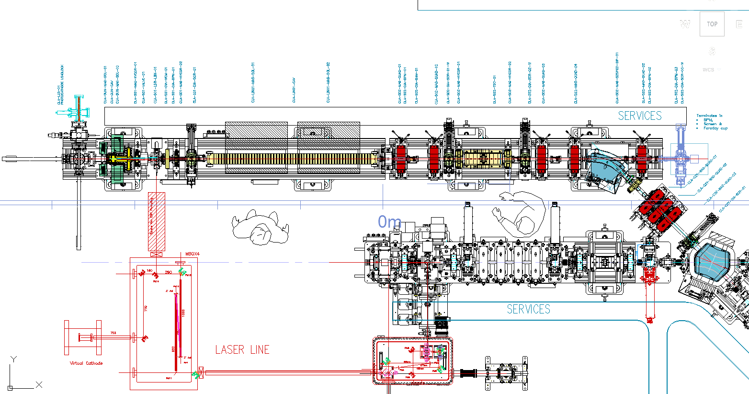
CLARA front-end
~5 MeV
~50MeV
~50MeV
~50MeV
~ 5 MeV
Phase 1 parameters:
Max energy ~50 MeV
Max charge 250 pC
Norm. emitt. < 1 mm mrad
Min bunch length 50 fs (rms)
Max peak current 2 kA
Bunches/RF pulse 1
Pulse rep. rate 10 Hz (400Hz later)

Slide 7
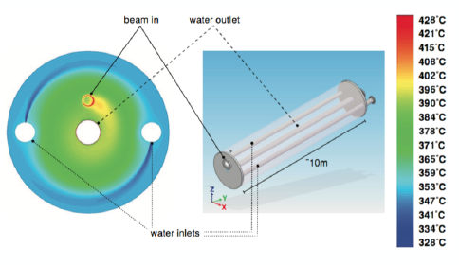
Plasma beam dump
Conventional beam dumps use high density materials – metal, water etc.
They require high power density cooling, can produce radionuclides and (for water) explosive gasses through decomposition.
Stopping a beam with a low density material could have advantages.
Plasma beam dump
H.C. Wu, T. Tajima et al. PR-STAB 13, 101303 (2010)
High decelerating gradients with low density dump medium.
Effectiveness depends on bunch parameters.
Possibility for electrical energy recovery.

Slide 8
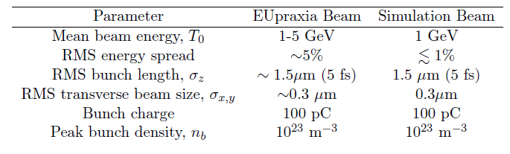
Plasma beam dump
Plasma beam dump for EuPRAXIA 1 GeV beam
EPOCH code is used to model the energy loss of the electron beam
The results are very encouraging

Slide 9
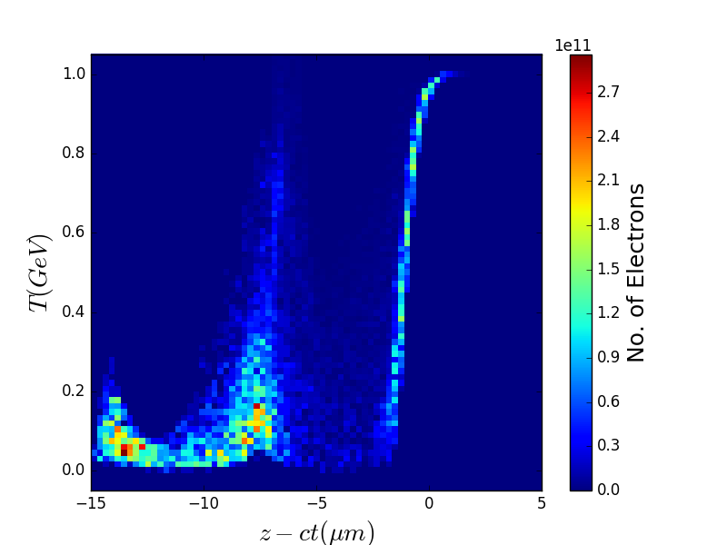
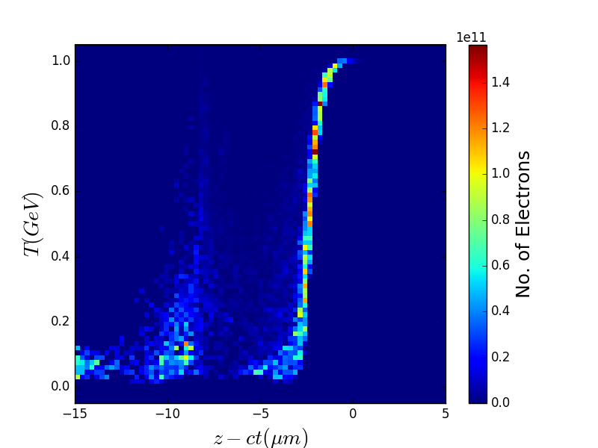
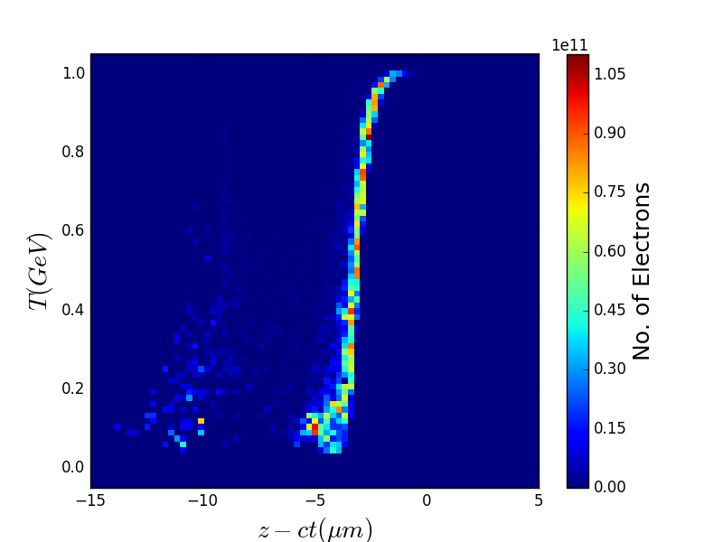
Results – Structured Plasmas
Example: Linearly Increasing Plasma Density
5cm
6cm
8cm
Nearly all tail particles removed.
Particles at the bunch head still remain.

Slide 10
Conclusions
Latest development of fiber lasers is discussed (ICAN and XCAN)
Latest development of the dielectric based acceleration program worldwide are reviewed. It might not be able to use as electron injector. However the dielectric structures, e.g. DLW might be used to improve the LWFA beam (energy dechirper), especially for FEL applications
Plasma beam dump is very promising and will provide the key input to the EuPRAXIA novel beam dump design. The initial study shows that a 10 cm long plasma can dump ~90% of the 1 GeV EuPRAXIA beam energy
Our next step is to optimize the design of the plasma beam dump for EuPRAXIA beam. Further experiment will be conducted at CLEAR and CLARA to verify this enabling technology

Slide 11
Workshop on Plasma Beam Dumps
https://indico.hep.manchester.ac.uk/conferenceDisplay.py?confId=5343. (30-31 August 2018 in Manchester)
Toshi Tajima (UCI), Alex Chao (SLAC), Kazuo Tanaka (ELI), Alex Bonatto (UFCSPA), T. Saeki (KEK), Denis Perret-Gallix (CERN), W. Lu (Tsinghua Univ.)
With the aim to implement the plasma beam dump to the EuPRAXIA and other LWFA facilities

