Slide 1
Final Focus quads (QC1)
FCC-ee
S. Sinyatkin
Budker Institute of Nuclear Physics
31 January 2018, CERN

Slide 2
Outline
Magnetic design of FF quadrupole.
DA with multipole components produced by FF quads.
Closed Orbit Distortion produced by FF quads.

Slide 3
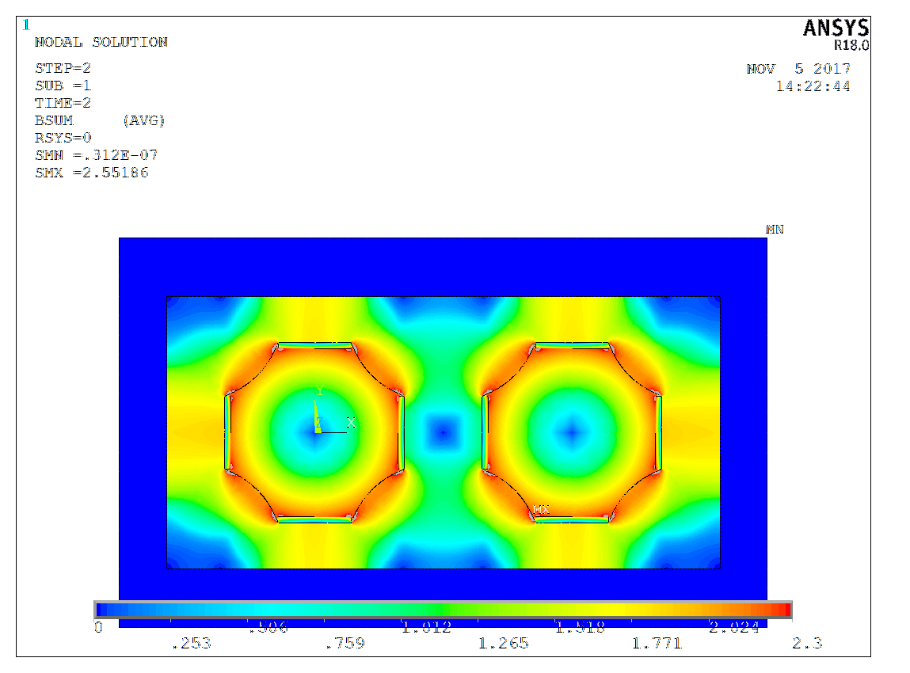
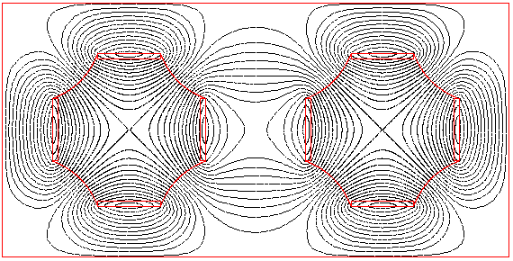
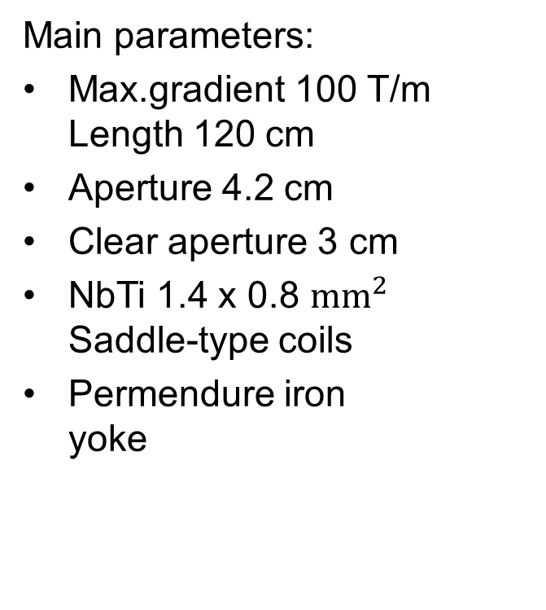
Iron yoke twin-aperture quadrupole
2D model
Main parameters:
Max.gradient 100 T/m Length 120 cm
Aperture 4.2 cm
Clear aperture 3 cm
NbTi 1.4 x 0.8 ${\text{mm}}^{2}$ Saddle-type coils
Permendure iron yoke
70 mm
66 mm
Edge of quad close to IP
152 mm

Slide 4
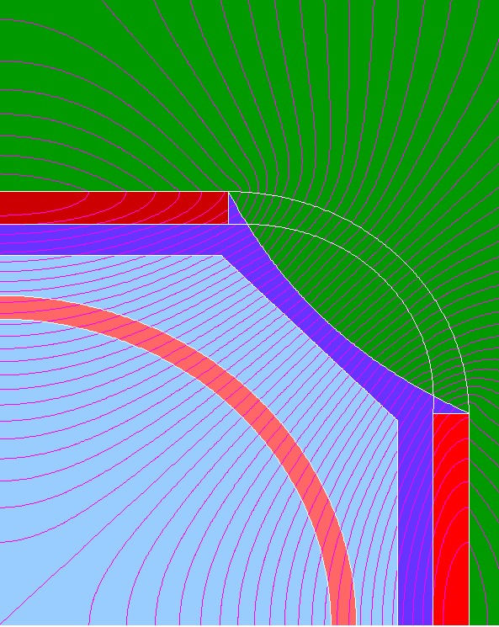
Design of final-focus magnets for FCC ee
Superconducting coil
Stainless vacuum camber
Iron
NbTi Superconducting cable has a rectangular shape, the size is 1.4 * 0.8 mm x mm
N=18
I = 961 A
I_{critical} (4.2 K; 4 T) = 2400 A
15 mm
21 mm
Nitrogen screen
Notes:
4

Slide 5
Iron yoke twin-aperture quadrupole
2D model
Edge of quad close to IP
№ | An, T | Bn, T
1 | 0.00000 | 0.00050
2 | 0.00000 | 0.99630
3 | 0.00000 | 0.00000
4 | 0.00000 | 0.00000
5 | 0.00000 | 0.00010
6 | 0.00000 | 0.00040
7 | 0.00000 | 0.00010
8 | 0.00000 | 0.00000
9 | 0.00000 | 0.00000
10 | 0.00000 | 0.00000
11 | 0.00000 | 0.00000
12 | 0.00000 | 0.00000
13 | 0.00000 | 0.00000
14 | 0.00000 | 0.00000
70 mm
R_{harm} = 10 mm
66 mm
Radial shift of magnetic axis:
152 mm

Slide 6
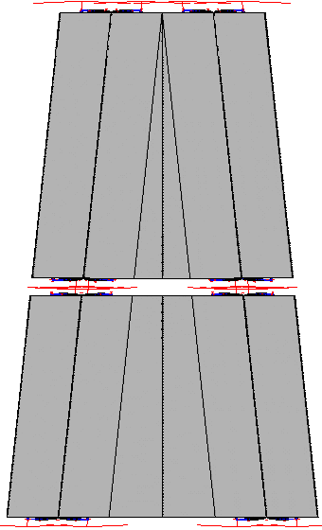
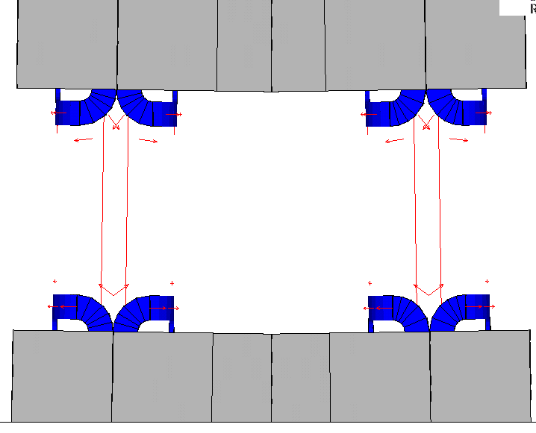
Iron yoke twin-aperture quadrupole
3D model
66 mm
1.2 m
1.2 m
1.2 m
1.2 m
80 mm
80 mm
12 mm
188 mm
1 m
220 mm

Slide 7
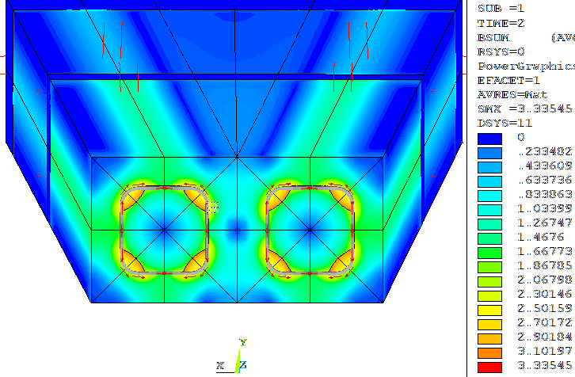
Iron yoke twin-aperture quadrupole
3D model
Integrated field multipole components
№ | An, T*m | Bn, T*m
1 | 0.00000 | -0.00100
2 | 0.00000 | 1.20373
3 | 0.00000 | -0.00010
4 | 0.00000 | -0.00030
5 | 0.00000 | -0.00001
6 | 0.00000 | 0.00038
7 | 0.00000 | 0.00000
8 | 0.00000 | 0.00085
9 | 0.00000 | 0.00000
10 | 0.00000 | -0.00000
R_{harm} = 10 mm
Radial shift of magnetic axis:

Slide 8
Distribution of the multipole field components along axis
3D model
QC1_1
QC1_2
R_{harm} = 10 mm
Gradient
B₄, B₆ >1*10⁻⁴
A₁₋₁₁ = 0
Normal multipole components of field
Skew multipole
components of field
Skewl multipole components of field

Slide 9
Distribution of the multipole field components along axis
3D model
Dipole field
R_{harm} = 10 mm
Radial shift of magnetic axis:

Slide 10
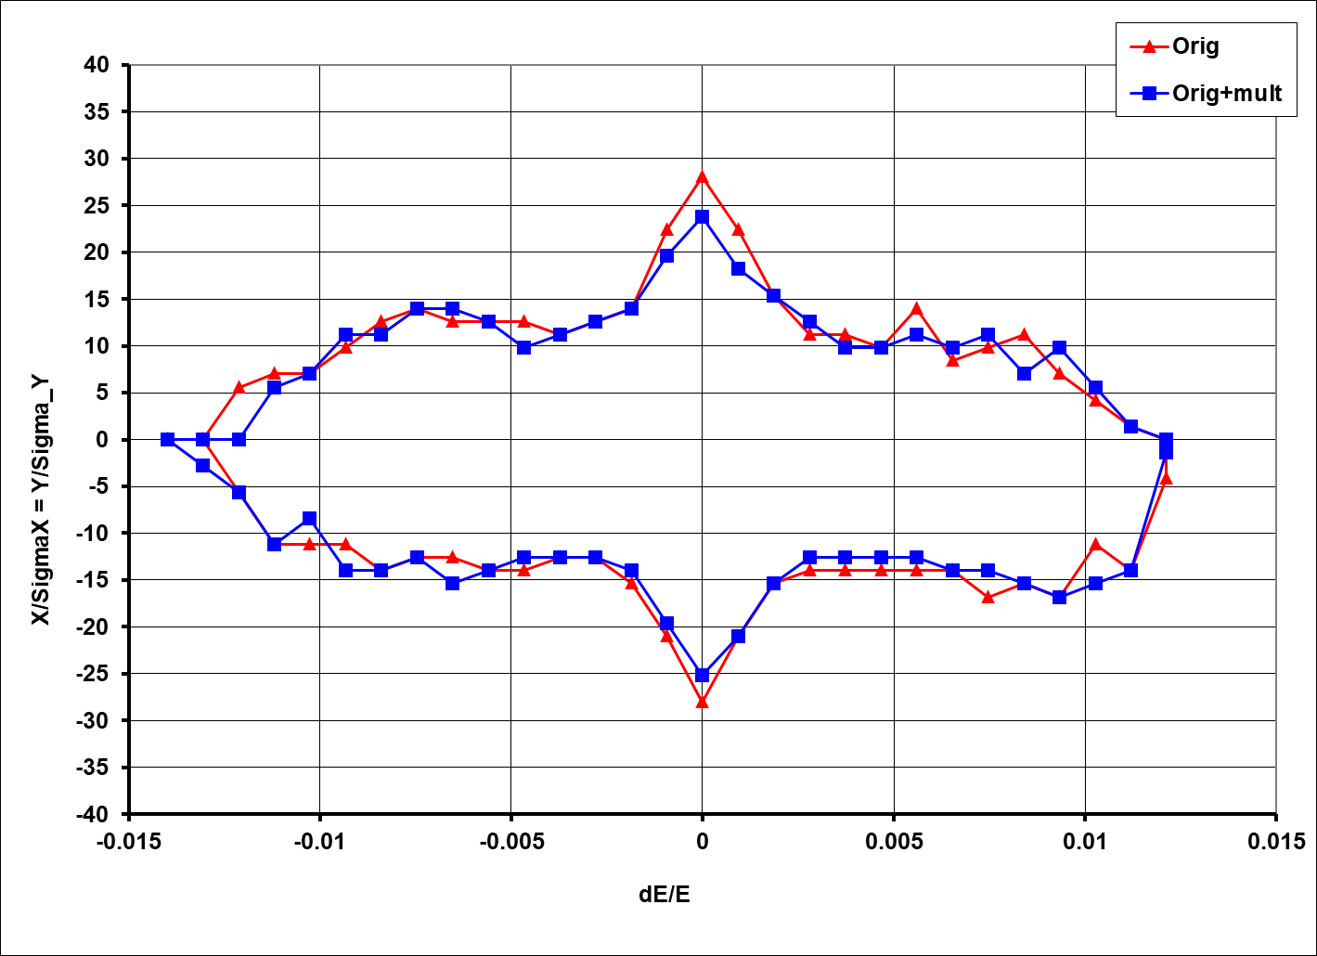
DA aperture with multipole components from QC1_1 magnetic model
(3D model, A1,B1 excluded)
Lattice: FCCee_z_213_nosol_18.seq
MAD-X ptc_tracking
Damping is included
Nslises = 130
ds = 1 cm
Nturn=200, εX=0.26nm*rad, couple= 0.36 %

Slide 11
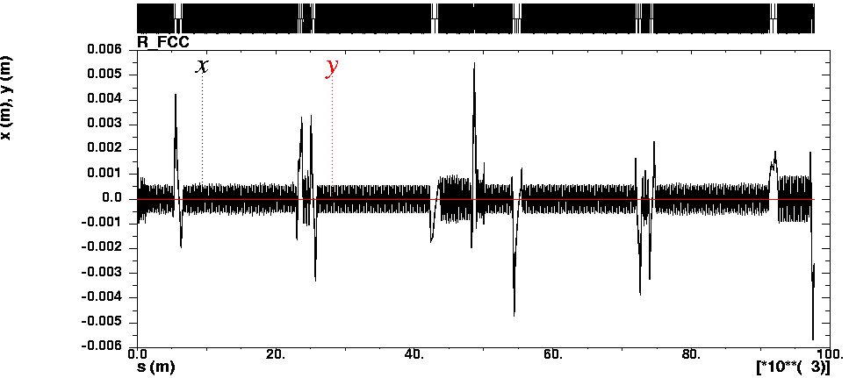
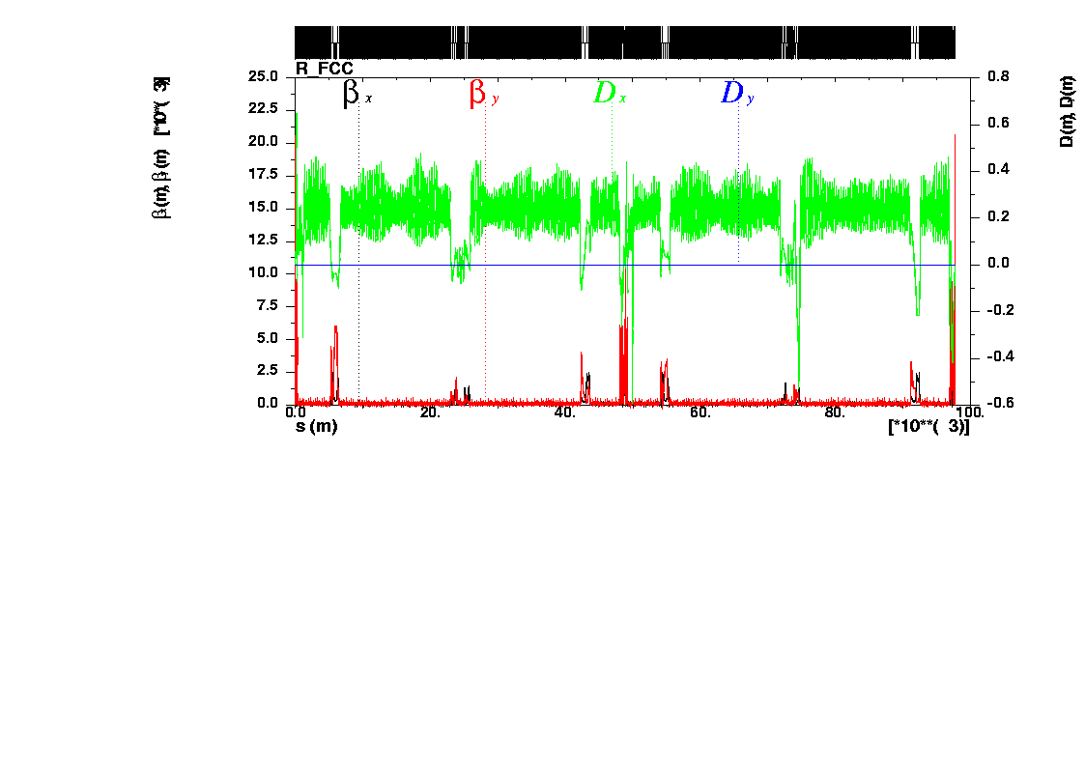


COD excited by QC1 misalignments
Before correction
Radial shift of magnetic axis
QC1L1.1:
QC1R1.2:
$ΔX=\frac{By}{G}=−8µ$m
$ΔX=\frac{By}{G}=8µ$m
σX = 0.5 mm

Slide 12
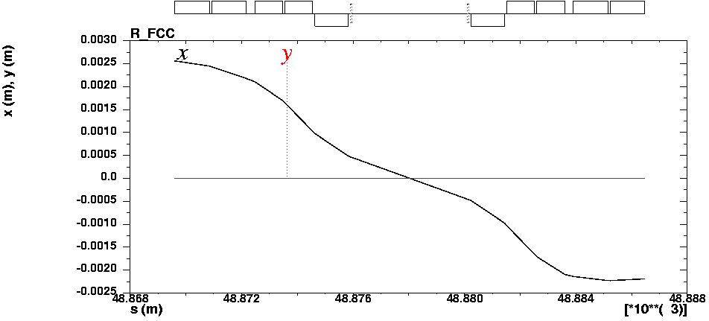
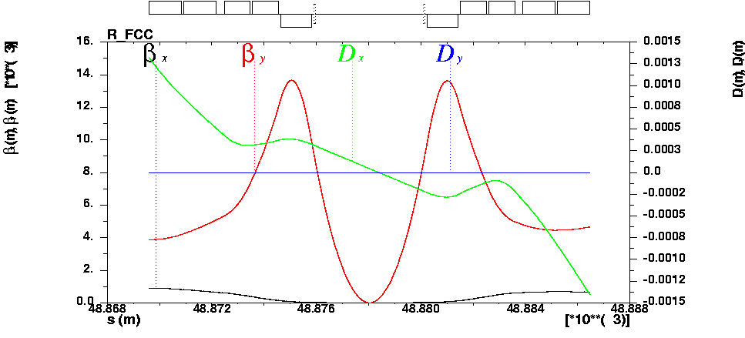


COD excited by QC1 misalignments
Before correction
Radial shift of magnetic axis
QC1L1.1:
QC1R1.2:
$ΔX=\frac{By}{G}=−8µ$m
$ΔX=\frac{By}{G}=8µ$m
IP:
X= -0.22 µm
PX=-0.22 mrad
βx= 0.150 m
αx= -0.005
βy= 1.63 mm
αy= -1.52
ηx= 44 µm
η`x= -0.34 mrad

Slide 13
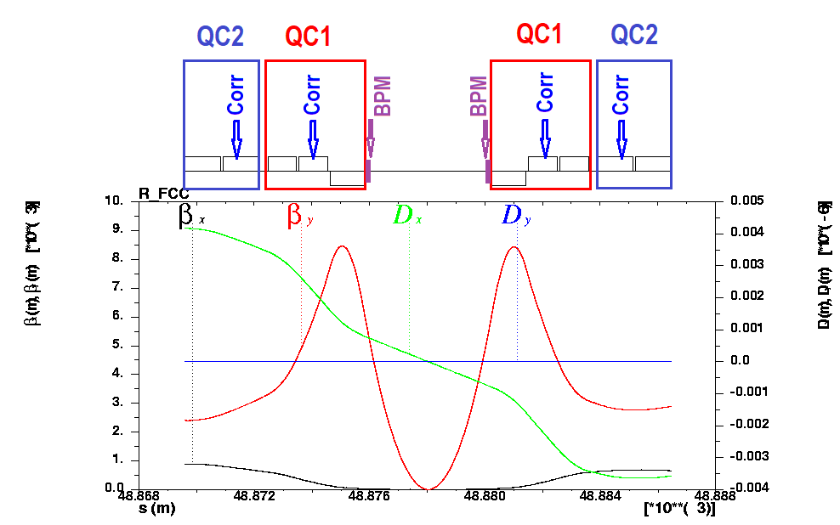


COD excited by QC1 misalignments
Scheme correction
Radial shift of magnetic axis
QC1L1.1:
QC1R1.2:
$ΔX=\frac{By}{G}=−8µ$m
$ΔX=\frac{By}{G}=8µ$m

Slide 14
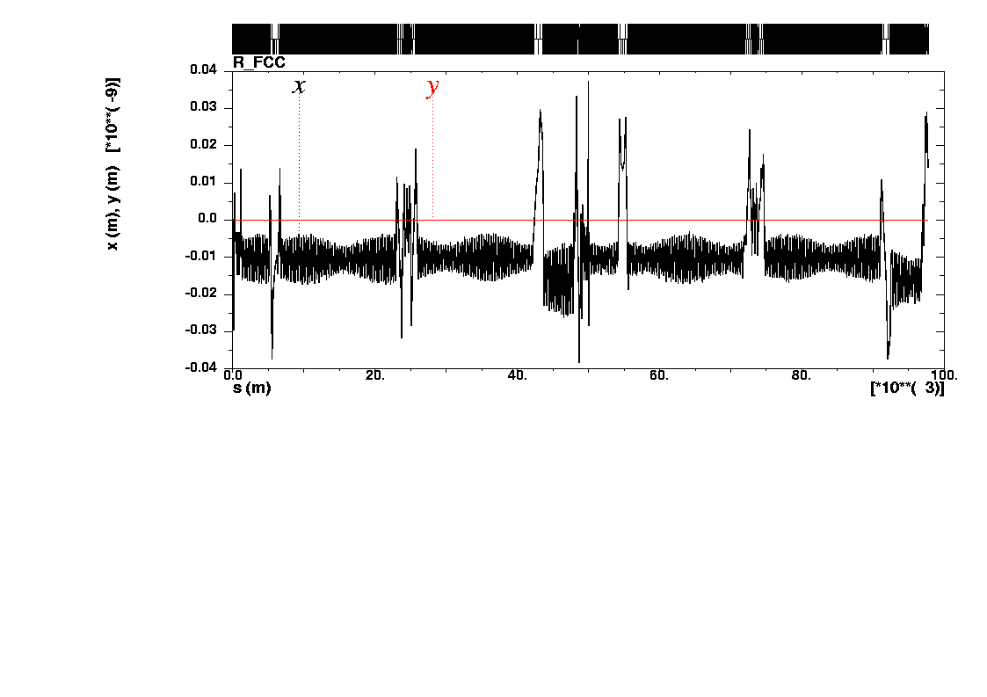
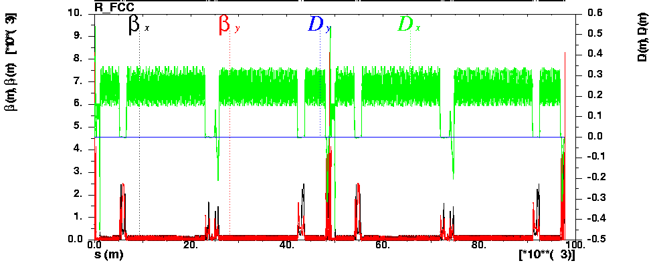
COD excited by QC1 misalignments
After correction
Steering magnets
KICK (µrad):
QC1L2.1 = -7.7
QC1R2.2 = 7.5
QC2L1.1 = 3.9
QC2R1.2 =-4.0

Slide 15
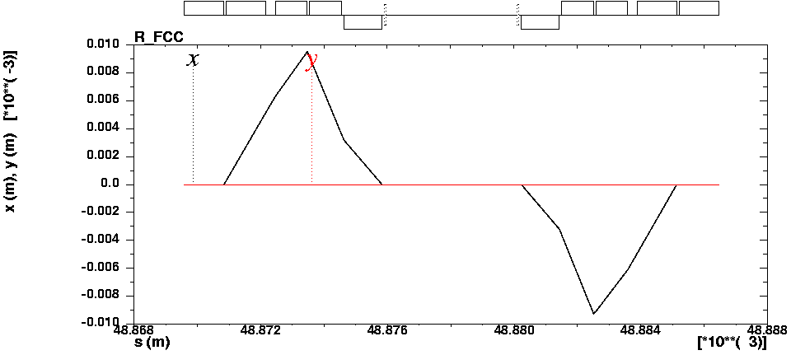
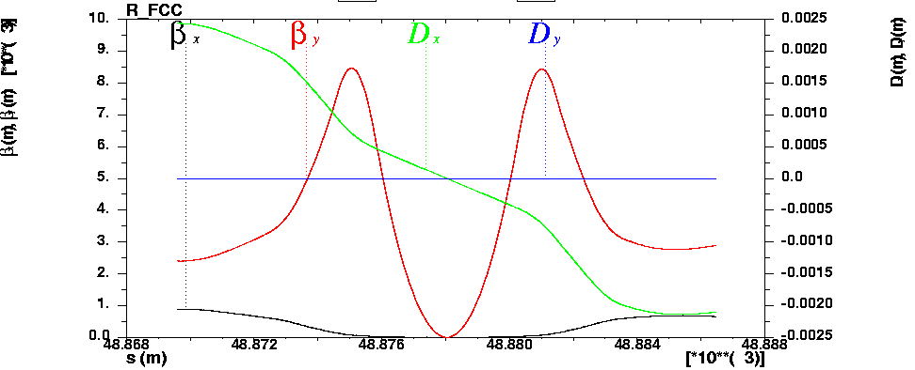
COD excited by QC1 misalignments
After correction
Radial shift of magnetic axis
QC1L1.1:
QC1R1.2:
$ΔX=\frac{By}{G}=−8µ$m
$ΔX=\frac{By}{G}=8µ$m
IP:
X= 0 µm
PX=0 mrad
βx= 0.150 m
αx= 0.0
βy= 0.8 mm
αy= 0.0
ηx= -2 µm
η`x= -0.21 mrad

Slide 16
Panofsky style quadrupole
Pros:
  Ordinary production of lenses.
  Remaining solenoidal magnetic field in QС1 area is additionally screened by iron yoke of lenses.
  No skew components of magnetic field created by lenses.
  There is small crosstalk between apertures of lenses.

Slide 17
Panofsky style quadrupole
Cons:
  Saturation of iron yoke (nonlinearity) at large gradient.
  High order multipole components at quadrupole edges.
  No way to introduce high order multipole and skew components of magnetic field to compensate lattice nonlinearity.
  Gradient is not large and limited by iron yoke saturation and critical current.

Slide 18
Summary
Ordinary production of lenses.
DA and Energy acceptance is about the same.
COD is corrected by additional steering coils of nearby QC1_2 and QC2_1 lenses.
Gradient is not large and limited by iron yoke saturation and critical current.

Slide 19
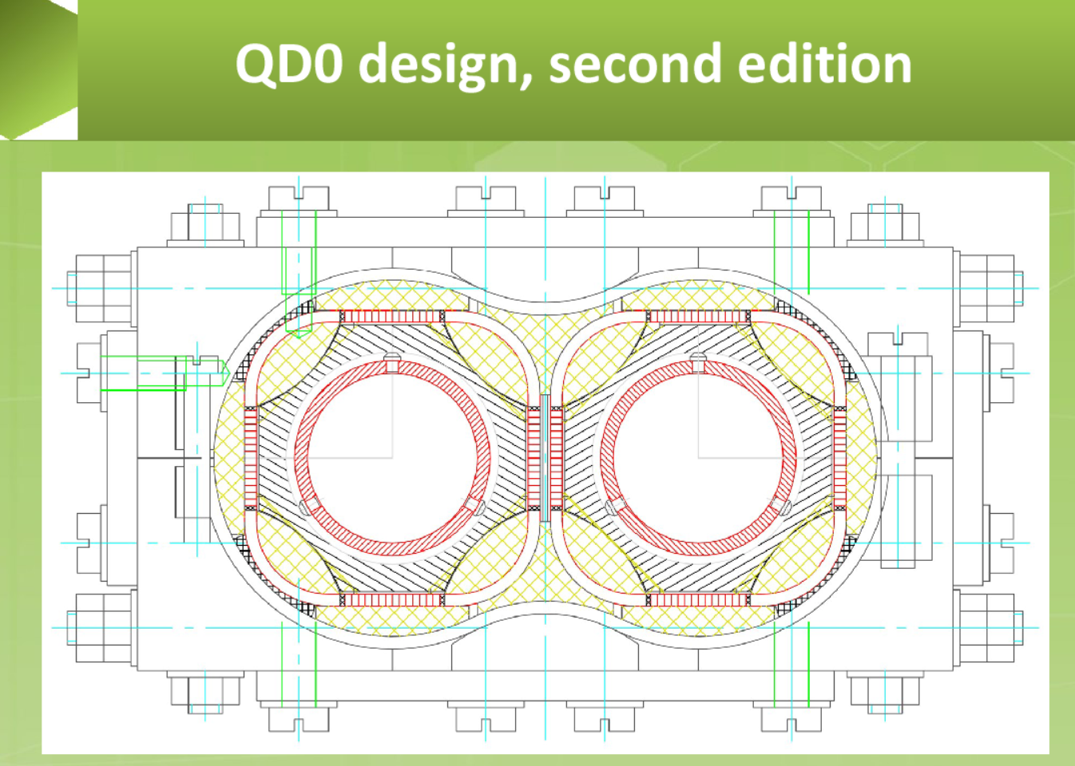
Old version

Slide 20
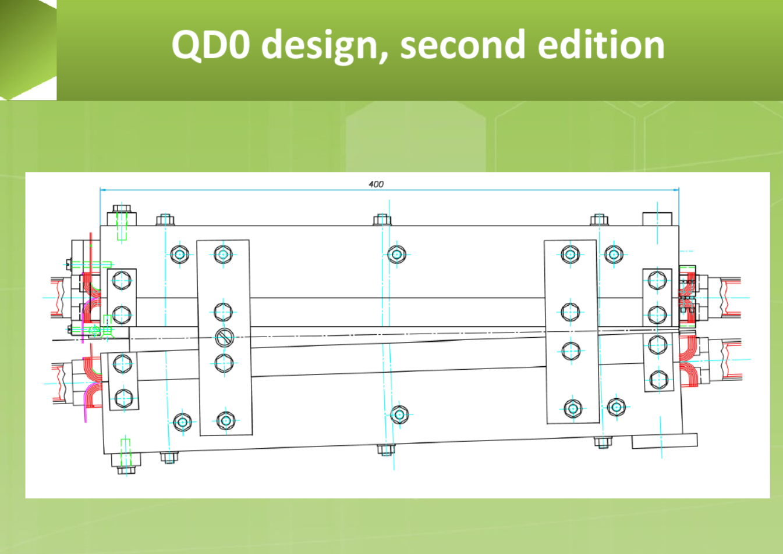
Old version

Slide 21
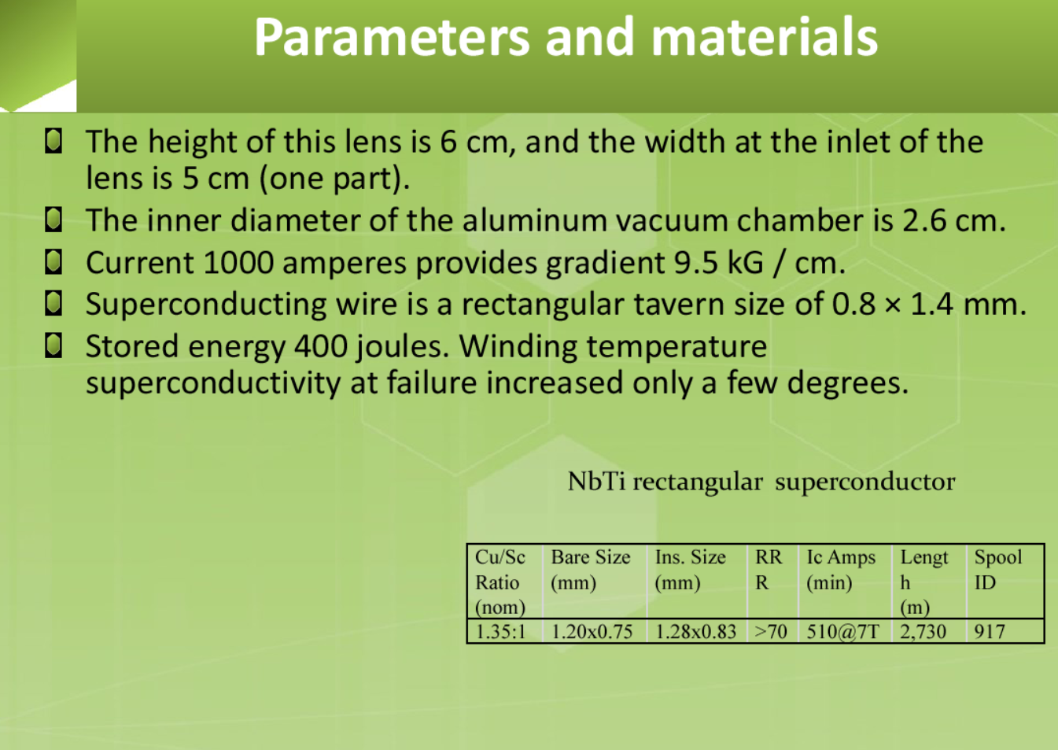
Old version

Slide 22
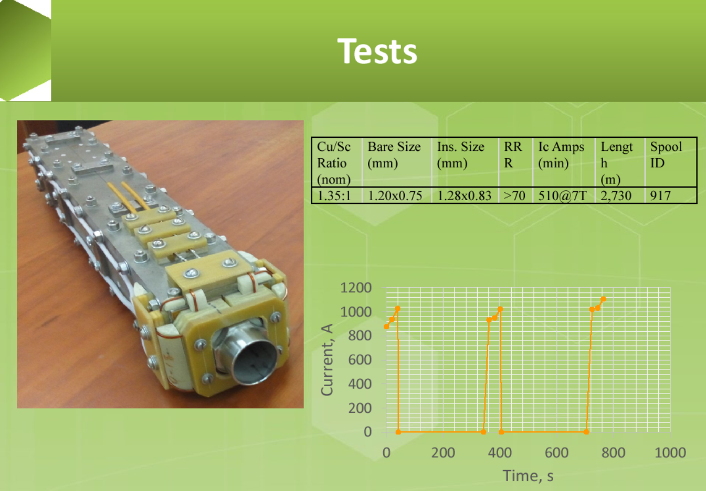
Old version

