Slide 1
FCC-ee MDI design as outcome of the first week of MDI workshop and goal of this week workshop
M. Boscolo
Thanks to all participants for inputs and discussions
my slides are based on last weeks presentations, more details there
Workshop on the mechanical optimization of the FCC-ee MDI
January 30- February 9 2018, CERN

Slide 2
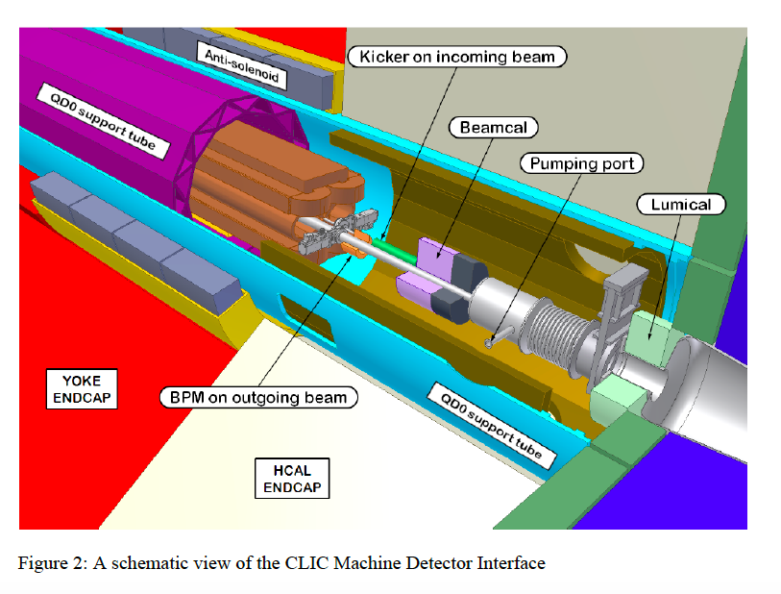
Goal
We aim at a first mechanical 3D design that can be easily changed and updated
We aim this week at discussing the assembly concept of our MDI design
Few iterations will be probably needed
(for example after impedance budget estimation)
example: CLIC MDI
arXiv:1202.6511

Slide 3
parameter | Z | W | H (ZH) | ttbar
beam energy [GeV] | 45.6 | 80 | 120 | 175 | 182.5
arc cell optics | 60 / 60 | 60 / 60 | 90 / 90 | 90 / 90
momentum compaction [10⁻⁵] | 1.48 | 1.48 | 0.73 | 0.73
horizontal emittance [nm] | 0.27 | 0.84 | 0.63 | 1.34 | 1.46
vertical emittance [pm] | 1.0 | 1.7 | 1.3 | 2.7 | 2.9
horizontal beta* [m] | 0.15 | 0.2 | 0.3 | 1
vertical beta* [mm] | 0.8 | 1 | 1 | 1.6
length of interaction area [mm] | 0.42 | 0.85 | 0.9 | 2.0 | 2.1
RF frequency [MHz] | 400 | 400 | 400 | 400 | 400
tunes, half-ring (x, y, s) | (0.57, 0.61, 0.0125) | (0.562, 0.60, 0.0253) | (0.565, 0.60, 0.0179) | (0.554, 0.59, 0.0299) | (0.554, 0.59, 0.0311)
longitudinal damping time [ms] | 415 | 77 | 23 | 7.5 | 6.6
SR energy loss / turn [GeV] | 0.036 | 0.34 | 1.72 | 7.8 | 9.2
total RF voltage [GV] | 0.10 | 0.75 | 2.0 | 8.8 | 10.3
RF acceptance [%] | 1.9 | 3.5 | 2.3 | 3.5 | 3.5
energy acceptance [%] | ±1.3 | ±1.3 | ±1.7 | +2.4 / -2.8 | +2.4 / -2.8
energy spread (SR / BS) [%] | 0.038 / 0.132 | 0.066 / 0.165 | 0.099 / 0.165 | 0.144 / 0.196 | 0.150 / 0.200
bunch length (SR / BS) [mm] | 3.5 / 12.1 | 3.0 / 7.5 | 3.15 / 5.3 | 2.75 / 3.82 | 2.76 / 3.78
Piwinski angle (SR / BS) | 8.2 / 28.5 | 3.5 / 8.7 | 3.4 / 5.8 | 1.1 / 1.6 | 1.1 / 1.5
Crab sextupoles [%] | 97 | 92 | 80 | 50 | 50
bunch intensity [10¹¹] | 1.7 | 2.3 | 1.8 | 3.2 | 3.35
number of bunches / beam | 16640 | 1300 | 328 | 40 | 33
beam current [mA] | 1390 | 147 | 29 | 6.4 | 5.4
luminosity [10³⁴ cm⁻²s⁻¹] | 230 | 34 | 8.5 | 1.9 | 1.7
beam-beam parameter (x / y) | 0.004 / 0.133 | 0.010 / 0.141 | 0.016 / 0.118 | 0.088 / 0.148 | 0.089 / 0.144
rad. Bhabha lifetime [min] | 68 | 49 | 38 | 37 | 36
allowable asymmetry [%] | ±5 | ±3 | ±3 | ±3 | ±3
required lifetime by BS [min] | 29 | 16 | 11 | 12 | 12
actual lifetime (w) by BS [min] | > 200 | 24 | 18 | 24 | 25
D. Shatilov, 19 Jan 2018

Slide 4
parameter | Z | W | H (ZH) | ttbar
beam energy [GeV] | 45.6 | 80 | 120 | 175 | 182.5
arc cell optics | 60 / 60 | 60 / 60 | 90 / 90 | 90 / 90
momentum compaction [10⁻⁵] | 1.48 | 1.48 | 0.73 | 0.73
horizontal emittance [nm] | 0.27 | 0.84 | 0.63 | 1.34 | 1.46
vertical emittance [pm] | 1.0 | 1.7 | 1.3 | 2.7 | 2.9
horizontal beta* [m] | 0.15 | 0.2 | 0.3 | 1
vertical beta* [mm] | 0.8 | 1 | 1 | 1.6
length of interaction area [mm] | 0.42 | 0.85 | 0.9 | 2.0 | 2.1
RF frequency [MHz] | 400 | 400 | 400 | 400 | 400
tunes, half-ring (x, y, s) | (0.57, 0.61, 0.0125) | (0.562, 0.60, 0.0253) | (0.565, 0.60, 0.0179) | (0.554, 0.59, 0.0299) | (0.554, 0.59, 0.0311)
longitudinal damping time [ms] | 415 | 77 | 23 | 7.5 | 6.6
SR energy loss / turn [GeV] | 0.036 | 0.34 | 1.72 | 7.8 | 9.2
total RF voltage [GV] | 0.10 | 0.75 | 2.0 | 8.8 | 10.3
RF acceptance [%] | 1.9 | 3.5 | 2.3 | 3.5 | 3.5
energy acceptance [%] | ±1.3 | ±1.3 | ±1.7 | +2.4 / -2.8 | +2.4 / -2.8
energy spread (SR / BS) [%] | 0.038 / 0.132 | 0.066 / 0.165 | 0.099 / 0.165 | 0.144 / 0.196 | 0.150 / 0.200
bunch length (SR / BS) [mm] | 3.5 / 12.1 | 3.0 / 7.5 | 3.15 / 5.3 | 2.75 / 3.82 | 2.76 / 3.78
Piwinski angle (SR / BS) | 8.2 / 28.5 | 3.5 / 8.7 | 3.4 / 5.8 | 1.1 / 1.6 | 1.1 / 1.5
Crab sextupoles [%] | 97 | 92 | 80 | 50 | 50
bunch intensity [10¹¹] | 1.7 | 2.3 | 1.8 | 3.2 | 3.35
number of bunches / beam | 16640 | 1300 | 328 | 40 | 33
beam current [mA] | 1390 | 147 | 29 | 6.4 | 5.4
luminosity [10³⁴ cm⁻²s⁻¹] | 230 | 34 | 8.5 | 1.9 | 1.7
beam-beam parameter (x / y) | 0.004 / 0.133 | 0.010 / 0.141 | 0.016 / 0.118 | 0.088 / 0.148 | 0.089 / 0.144
rad. Bhabha lifetime [min] | 68 | 49 | 38 | 37 | 36
allowable asymmetry [%] | ±5 | ±3 | ±3 | ±3 | ±3
required lifetime by BS [min] | 29 | 16 | 11 | 12 | 12
actual lifetime (w) by BS [min] | > 200 | 24 | 18 | 24 | 25
D. Shatilov, 19 Jan 2018

Slide 5
Interaction Region Beam Pipe

Slide 6
Interaction Region Beam Pipe
screening
solenoid
HOM abs.
comp. solenoid
BPM
pump
ALSO:
cryostat
bellows
flanges
dipole corrector
High order multipoles correctors

Slide 7
Interaction Region Layout
not in scale
top view
x, horizontal plane

Slide 8
Solenoid Compensation Scheme
comment on this number from last week [slide from FCCweek17]:
The 140mrad was the outcome of last year’s MDI workshop, as best solution to minimize ε_{y} blow-up (0.3 pm out pf 1 pm nominal). Last week it was pointed out by detector group that angular acceptance for the machine (including compensating solenoid) should be 100 mrad.
M. Koratzinos are K. Oide are trying to find a good trade-off between 100 mrad requirement and acceptable ε_{y} blow-up. There will be a presentation this Wed.
Constraints:
  2T detector field
  L*=2.2m
  Space (i.e. only 6.6 cm distance at the tip closest to IP for QD0)
  must be inside the lumical acceptance ~140-170 mrad
  final focus quads inside the detector (low βy* and large crossing angle)
  leave space for luminosity detector at small angle
  field quality at each end and all along the FF quads ≲ 10⁻⁴ for all multipoles
  emittance blow-up much smaller than 1 pm
Particles on the beam axis are not on the detector axis, so they will experience vertical dispersion, that brings vertical emittance blow-up. Due to the low nominal ε_{y}~1 pm, this effect needs to be cured. A compensating and screening solenoid scheme has been designed.
[slide from FCCWEEK17]

Slide 9
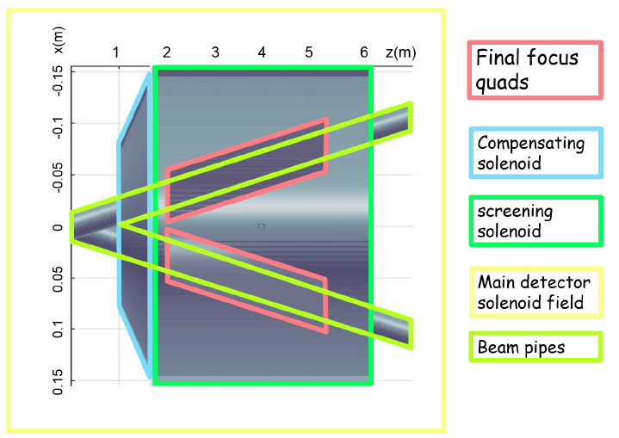
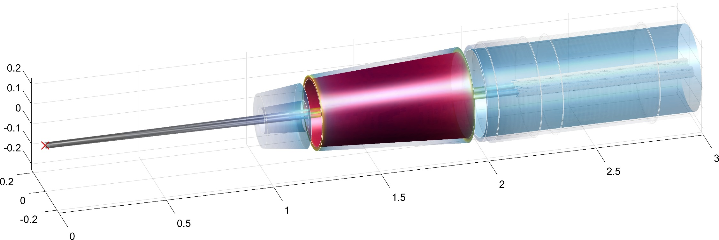
Solenoid Compensation Scheme
  see talk by E. Levichev
screening
solenoid
Compensating solenoid
Luminosity counter
FF quads
M. Koratzinos
Two solenoids are introduced in the IR:
screening solenoid that shields the detector field inside the quads (in the quad net solenoidal field=0)
compensating solenoid in front of the first quad, as close as possible, to reduce the ε_{y} blow-up (integral BL~0)
  0.3 pm is the overall ε_{y} blow-up for 2IPs @Z with this compensation design
[slide from FCCWEEK17]

Slide 10
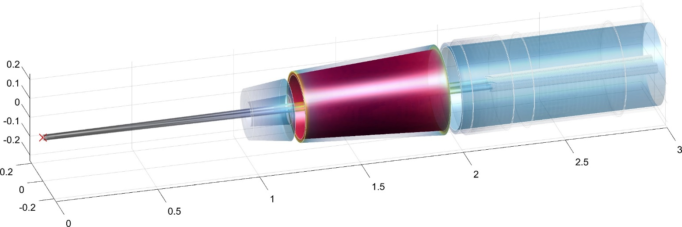
The IR 3d view with magnets
cryostat
4
y(m)
2.01
2.16
screening solenoid
1.19
1.25
1
Final focus quads
Compensating solenoid
z(m)
Luminosity counter
1.84
0.19
0.76
x(m)
detector solenoid
coordinates are from next slide
opening angle 140 mrad (as from 2017 design)
drift chamber at z=2m with 150 mrad opening angle
  detector solenoid dimensions 3.76m( inner radius) (outer radius 3.818m) × 4m (half-length)

Slide 11
Final Focus Magnets Layout
[S. Sinyatkin, summary talk MDI workshop Jan.17]
1.2 m
Luminometer
QC1R1_1
QC1R1_2
1 m
Compensating
Solenoid
Screening
Solenoid
1.25 m
Defocusing
Quads
2.01 m
1.84 m
2.16 m
2.2 m
QC1R1_1: L= 0.7 m, K1=-75 / -75 T/m, R = 0.015 m
QC1R1_2: L= 1.4 m, K1=-173 / -166 T/m, R = 0.0175 m

Slide 12
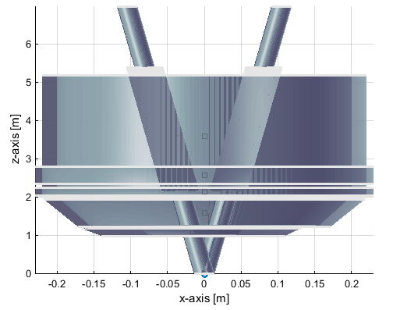
Latest layout
100mrad
100mrad
110mrad
110mrad
140mrad
140mrad
luminometer

Slide 13
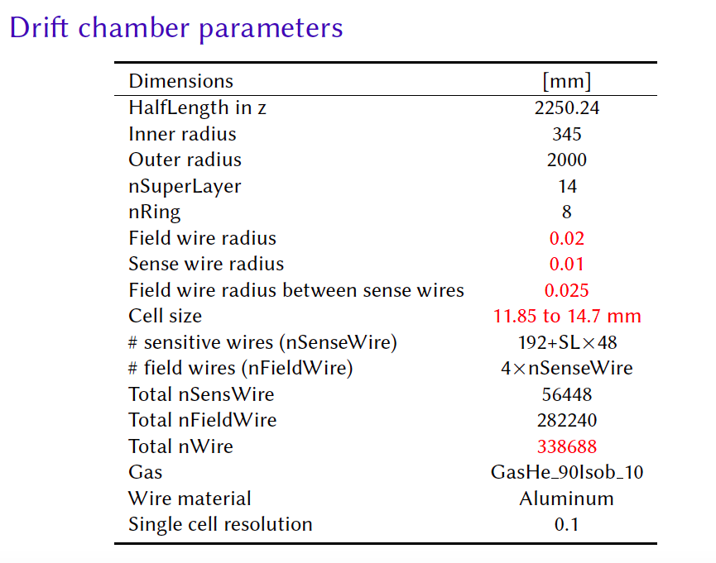
IDEA design
Length=4500 mm
Inner radius = 345 mm
Outer radius = 2000 mm
info from Niloufar Alipour Tehrani

Slide 14
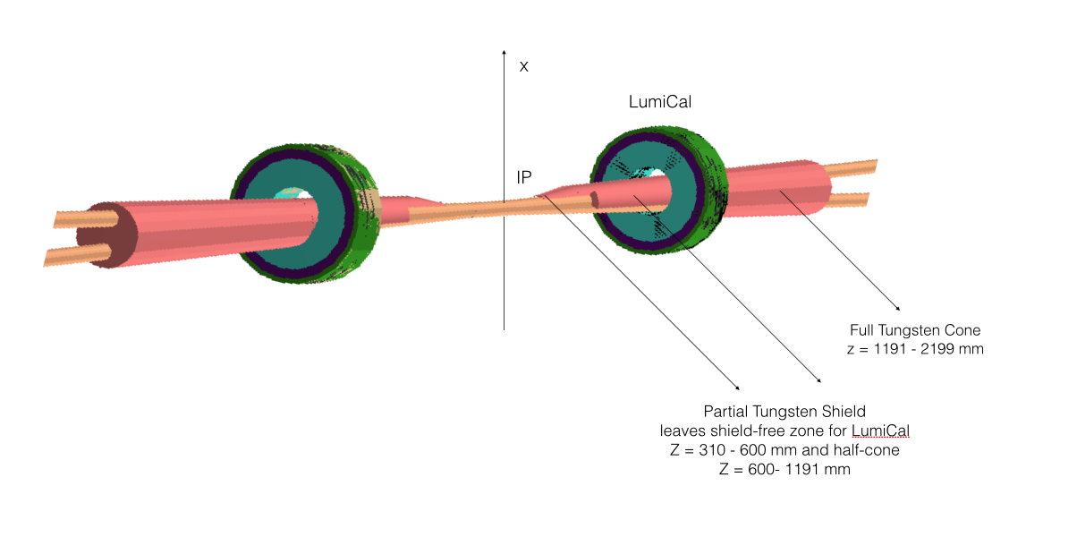
Geant-4 IR model with the shield
thanks to Anna Kolano for providing this plot

Slide 15
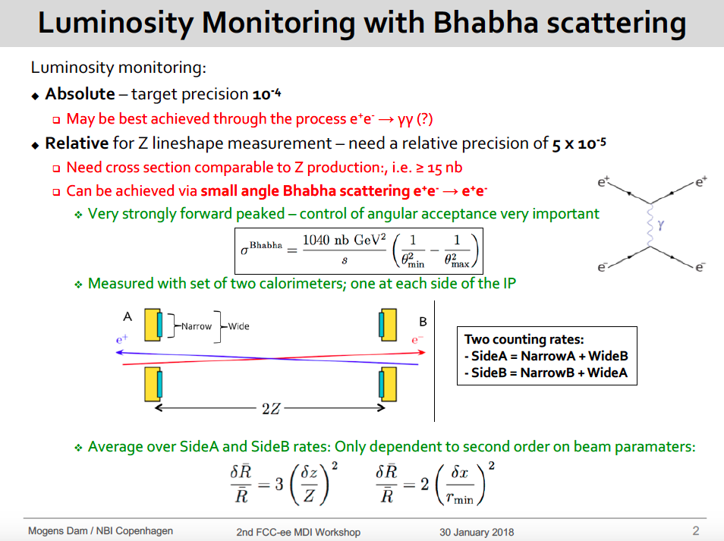

Slide 16
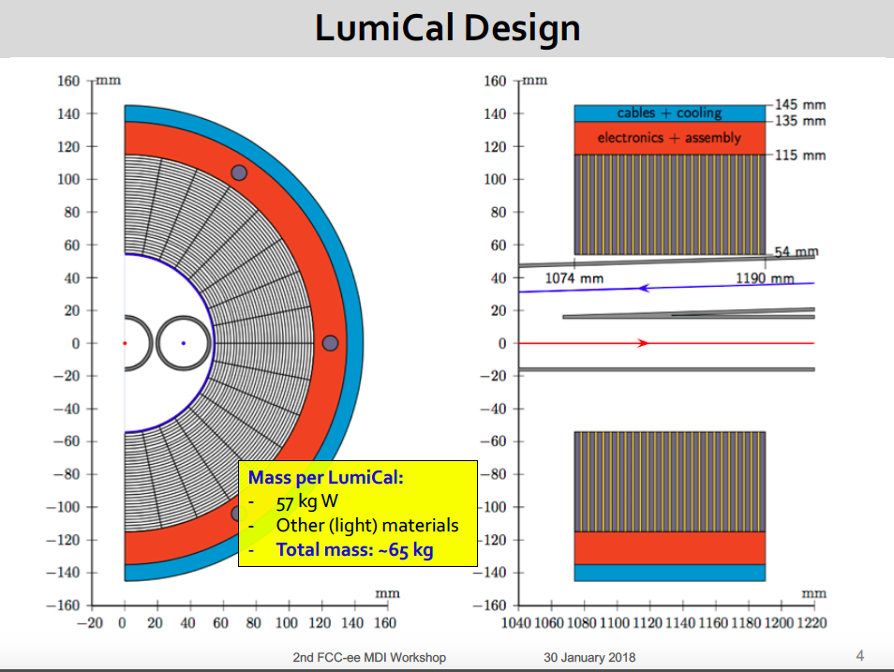

Slide 17
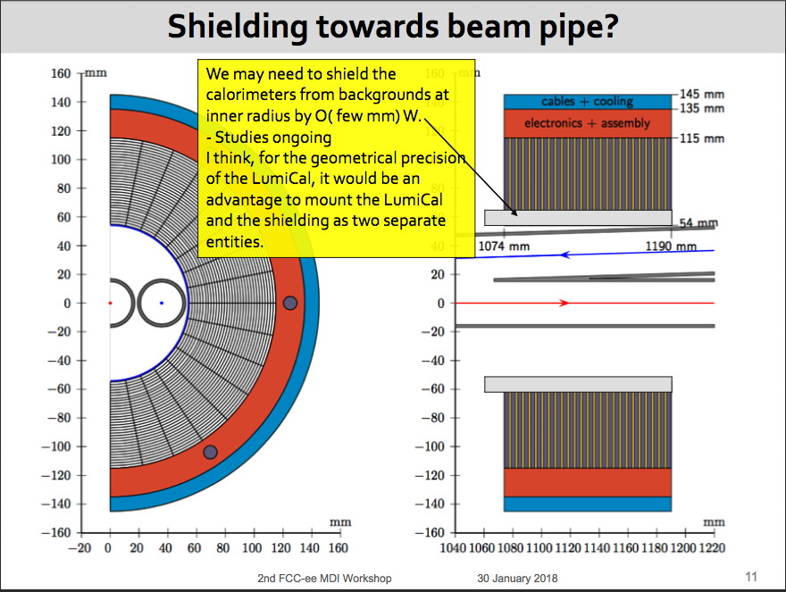

Slide 18
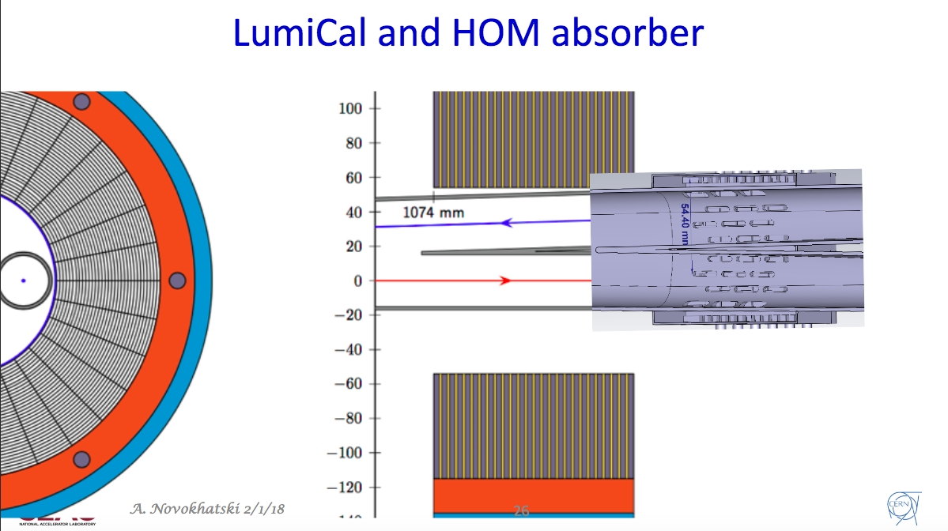

Slide 19
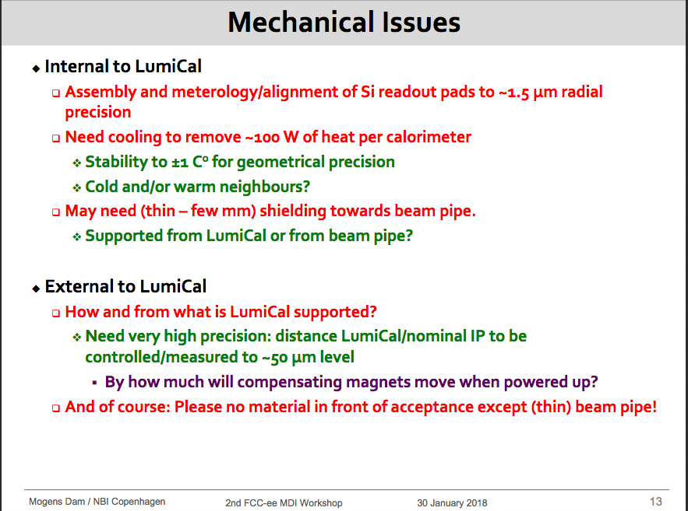

Slide 20
IR Beam pipe design for wake field calculations
details in next talk
by A. Novokhatski
Two beam pipes are merged into one central pipe in the IR
Professional CAD design of the complicated IR geometry done, essential for
CST/HFSS numerical studies for generated and/or absorbed e.m. fields, propagating or trapped in the IR
water cooling of the beam pipe needed to avoid HOM heating in the IR chamber due to absorption of e.m. fields
HOM absorber design in progress in the central chamber, following the PEP-II experience.
[slide from FCCWEEK17]

Slide 21
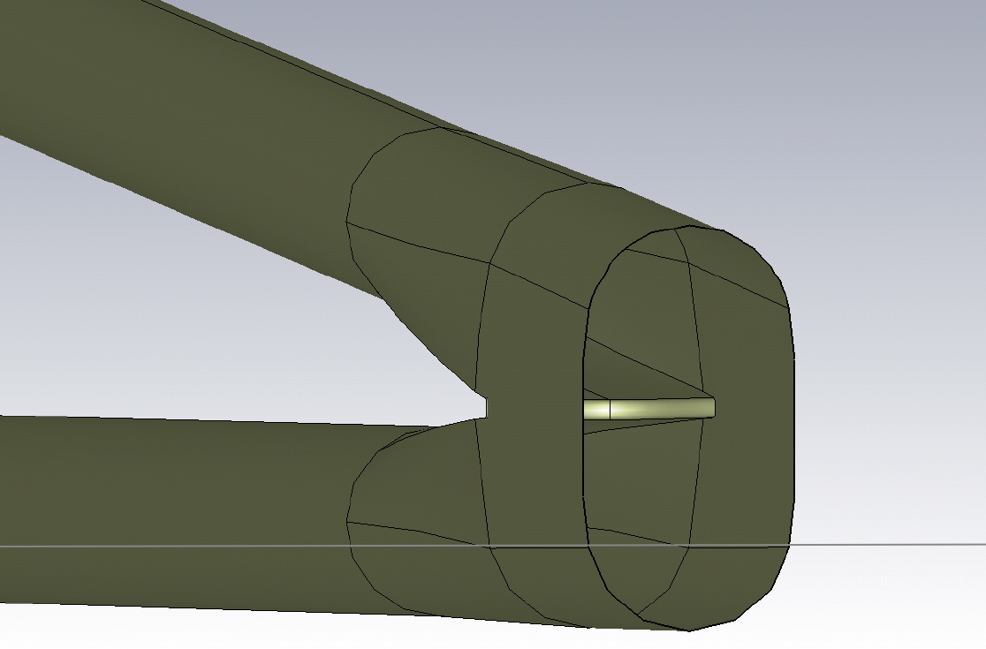
IR CAD design
complicated geometry: the area where two beam pipes merge to one single pipe
HOM Absorber

Slide 22
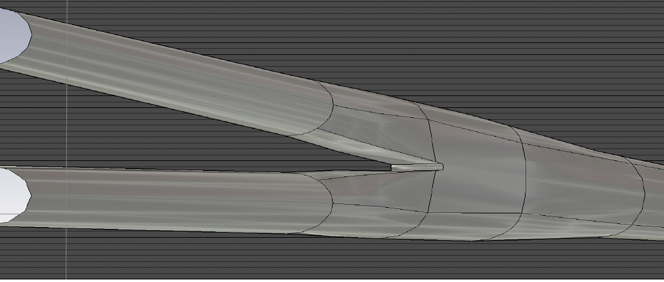
3d model of IR pipe

Slide 23
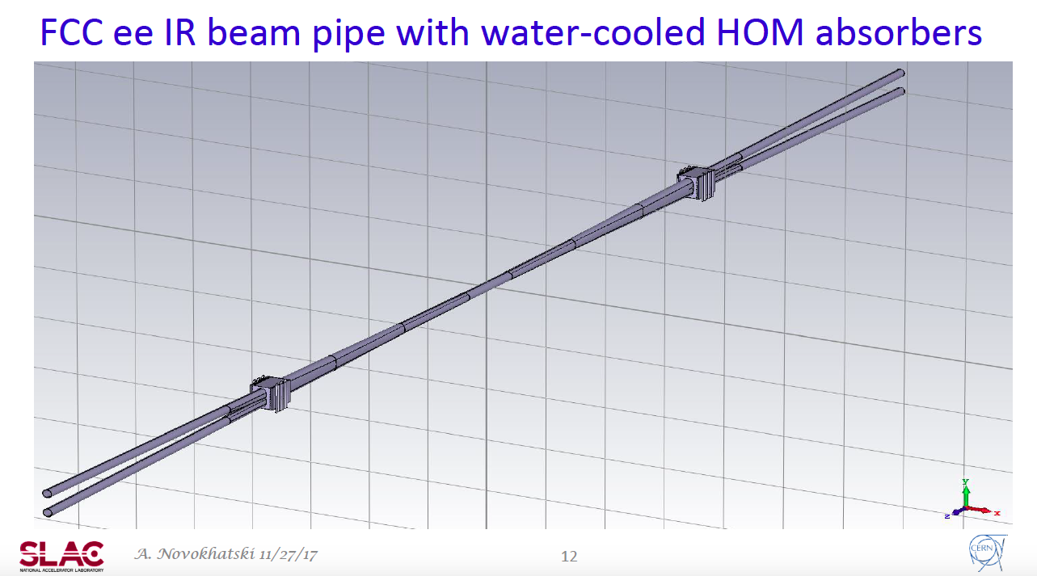

Slide 24
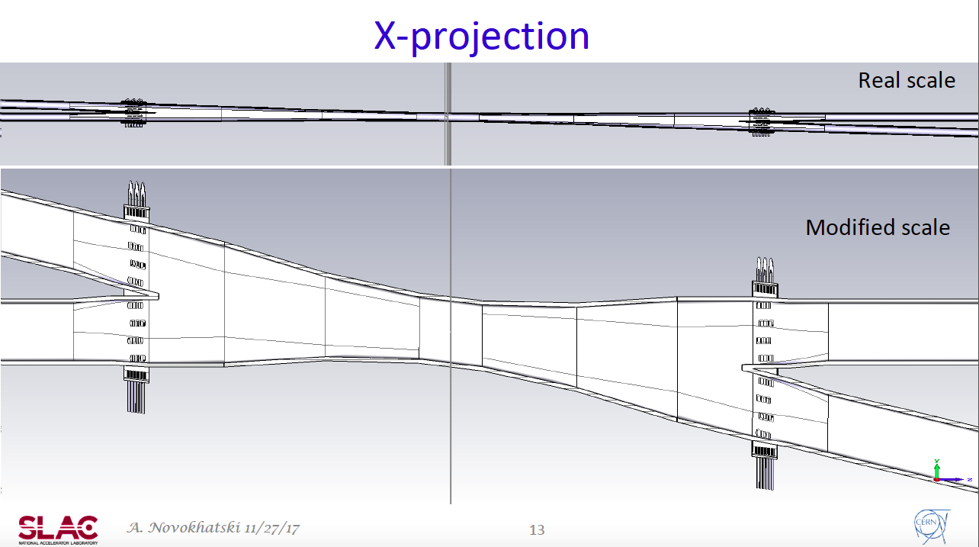

Slide 25
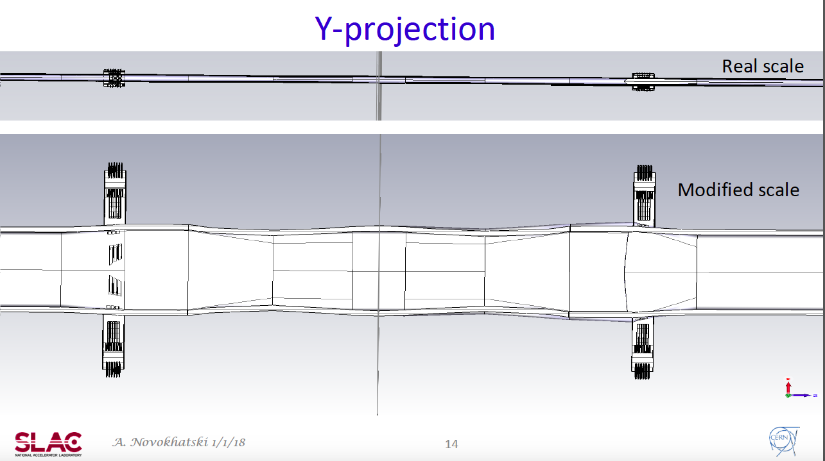

Slide 26
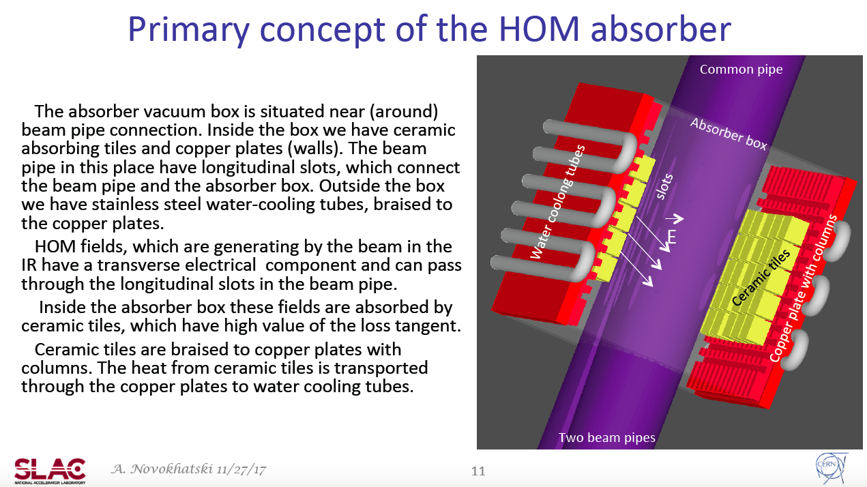

Slide 27
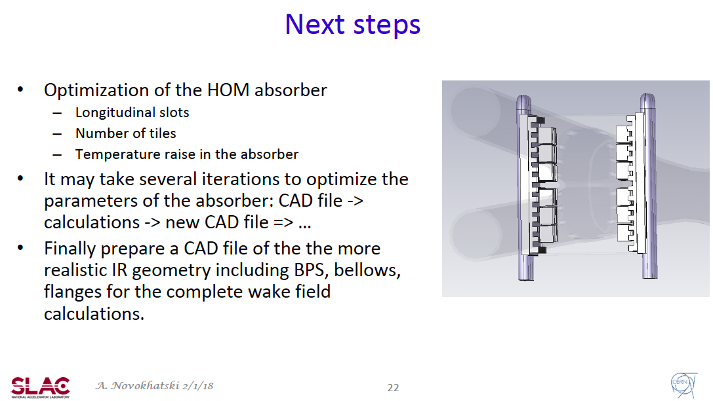

Slide 28
Beam pipe
DIMENSION
Central beam pipe has 3 cm dia.
Entering and exiting beam pipe through QC1 (3cm dia.)
Pipe size increases to 4cm dia. in QC2
Size outside QC2 is 7 cm dia. (but 6 cm in plot)
HORIZONTAL MASK TIPS
+/-12 mm radius at Z= +/-2.1 m and +/-5.44 m
+/-18 mm radius at Z= +/- 8.27 m
Vert. 1cm; +/- 0.5 mm thickness
r=15mm
r=12mm
y
MATERIAL
Be from about +/-80 cm to accommodate LumiCal
Cu afterwards
thickness of Neg coating under study, if also in the IR, on Be chamber
5 or 10 μm Au coating in the central Be chamber proposed
(pros: useful at Z, conductivity of Be, image charge; cons: multiple scattering)?
x
Warm beam pipe, 2mm thickness above vacuum chamber needed for water cooling in QC1 and through the IR where 30mm dia. (if BSC elliptical, water copper tubes in the vertical plane)

Slide 29
QC1 design
We have two designs
  BINP design: iron yoke twin aperture (superconducting, needs cooling system)
  CCT design (developed for Superb, crab-waist scheme)
More or less same space
We plan to present both design in the CDR
more details needed

Slide 30
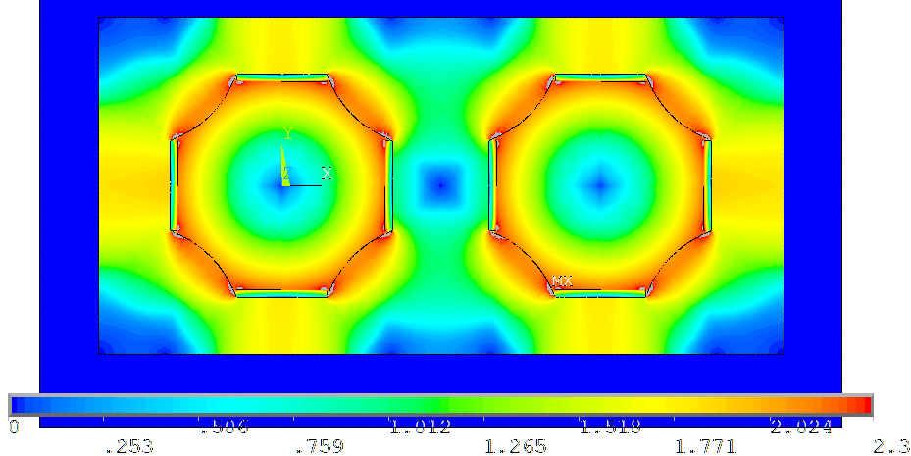
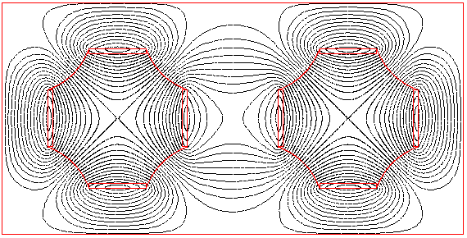
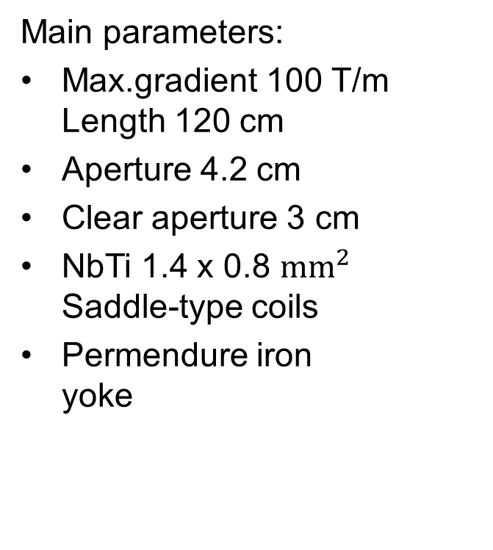
Iron yoke twin-aperture quadrupole
2D model
BINP design
Main parameters:
Max.gradient 100 T/m Length 120 cm
Aperture 4.2 cm
Clear aperture 3 cm
NbTi 1.4 x 0.8 ${\text{mm}}^{2}$ Saddle-type coils
Permendure iron yoke
70 mm
66 mm
Edge of quad close to IP
152 mm

Slide 31
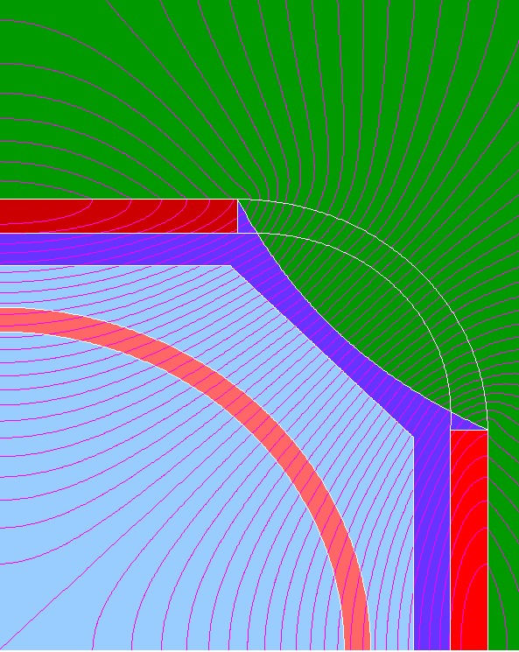
Design of final-focus magnets for FCC ee
BINP design
Superconducting coil
Stainless vacuum camber
Iron
NbTi Superconducting cable has a rectangular shape, the size is 1.4 * 0.8 mm x mm
N=18
I = 961 A
I_{critical} (4.2 K; 4 T) = 2400 A
15 mm
21 mm
Nitrogen screen
Notes:
31

Slide 32
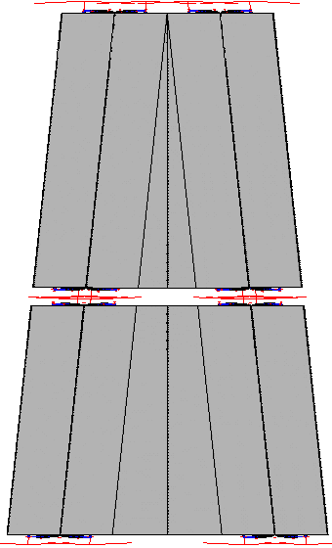
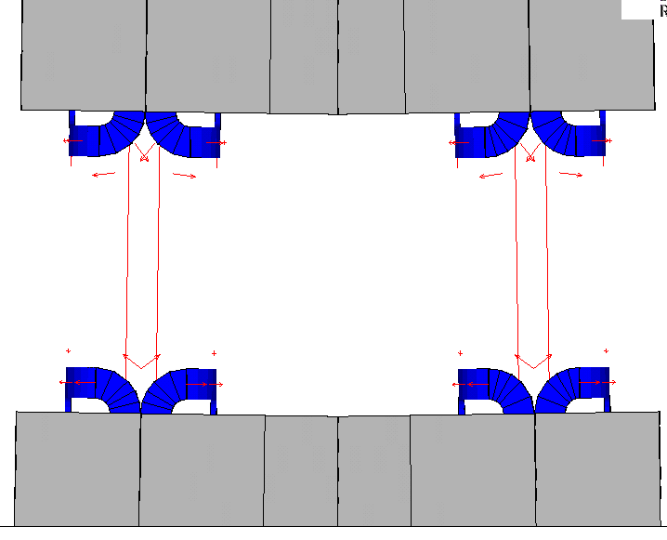
Iron yoke twin-aperture quadrupole
3D model
66 mm
BINP design
1.2 m
1.2 m
1.2 m
1.2 m
80 mm
80 mm
12 mm
188 mm
1 m
220 mm

Slide 33
Panofsky style quadrupole
BINP design
Pros:
  Ordinary production of lenses.
  Remaining solenoidal magnetic field in QС1 area is additionally screened by iron yoke of lenses.
  No skew components of magnetic field created by lenses.
  There is small crosstalk between apertures of lenses.
Cons:
  Saturation of iron yoke (nonlinearity) at large gradient.
  High order multipole components at quadrupole edges.
  No way to introduce high order multipole and skew components of magnetic field to compensate lattice nonlinearity.
  Gradient is not large and limited by iron yoke saturation and critical current.

Slide 34
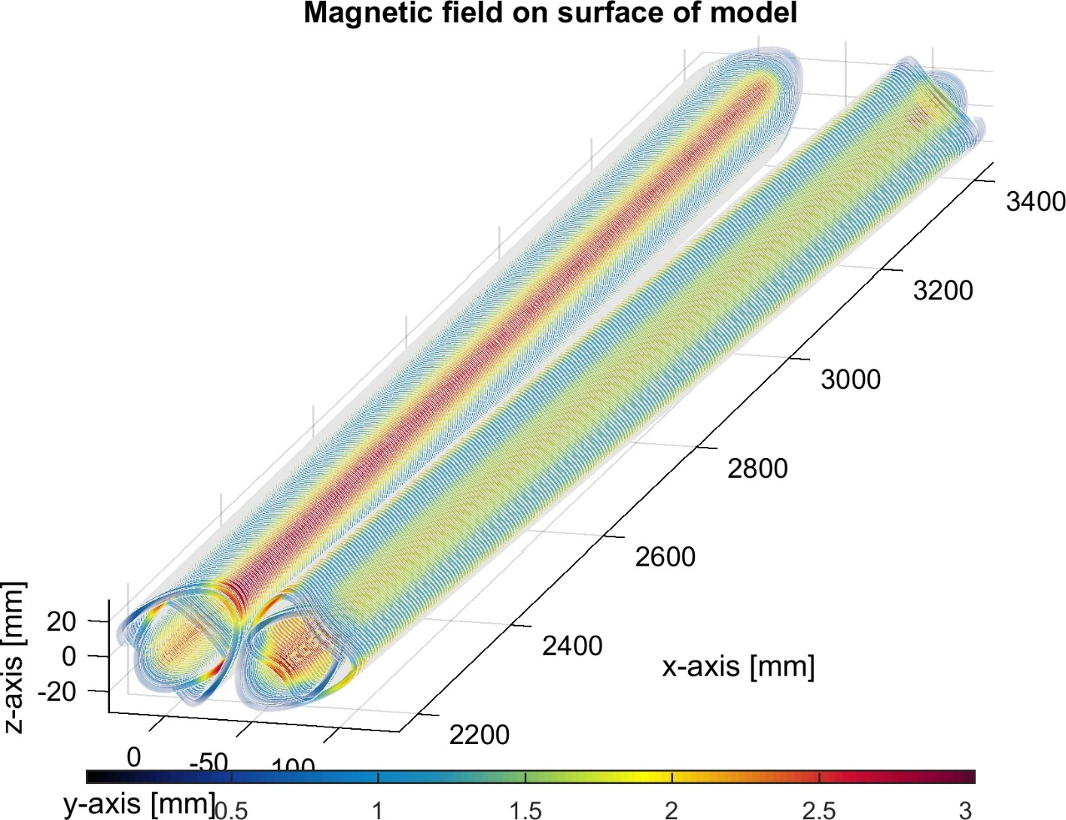
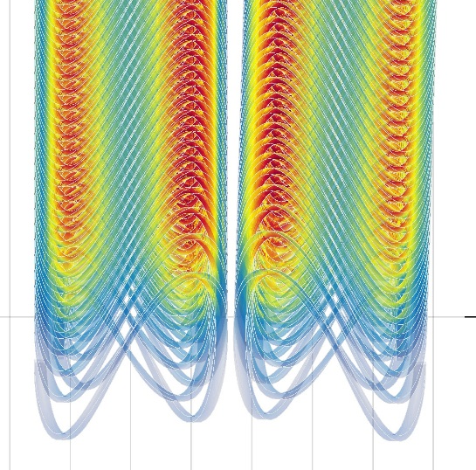
QC1 : CCT approach
CCT design
An essential ingredient that simplifies the problem

Slide 35
Dimensions - radius
CCT design
32-34mm: outer spar
28-32mm: outer s/c cable
26-28mm: middle spar
22-26mm: inner s/c cable
20-22mm: inner spar
17-20mm: vacuum + superinsulation
15-17mm: beam pipe
Water cooling

Slide 36
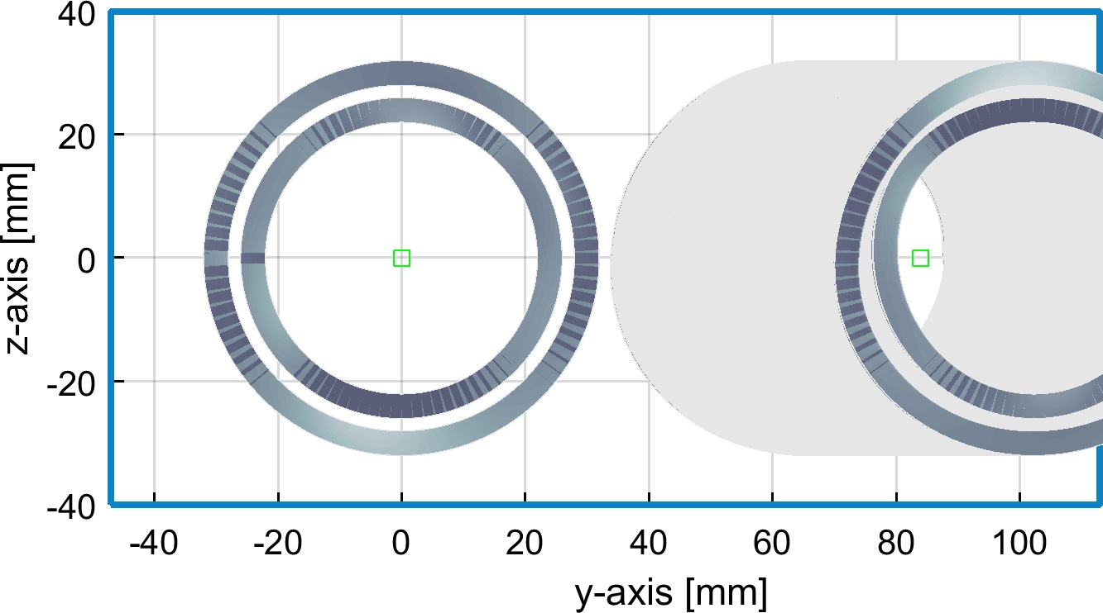
Transverse dimensions
CCT design
Vacuum
Beam pipe
Spar (aluminium)
S/C wire

Slide 37
Dimensions, specs
CCT design
The quads (QC1L1, QC2L2, QC2L3) follow the specs provided by Katsunobu
I provide the multipole files at the correct magnetic lengths and approximate strengths separately for each magnet
Katsunobu can change the strengths (linearly, as there is no iron) and combine magnets (again linearly, as there is no iron)
 | L (m) | B’ @ tt (T/m) | B’ @ Z (T/m)
QC1L1 | 1.2 | -94.4 | -96.3
QC1L2 | 1 | -92.6 | +50.3
QC1L3 | 1 | -96.7 | +9.8
QC2L1 | 1.25 | +45.8 | +6.7
QC2L2 | 1.25 | +74.0 | +3.2

Slide 38
Transverse dimensions
CCT design
Beam pipe is 30 mm diameter
In the FF quads the first winding starts at 42mm
The inner substrate starts at 40mm
We are investigating if all the cooling needed can fit between 30 and 40mm.
In this design there is a 2mm gap between the two FF quads at 2.2m
The cable used has a cross section of 2×4=8mm². The critical current through this cross section permits gradients in excess of 150T/m. If we do not need this capability, we can reduce the size of the cable to 2×3mm. In this way we can reduce the overall radius of each quad by 2 mm (or increase the gap between them by 4mm)

Slide 39
Embedded correctors
The design can have embedded correctors (x and y dipole correctors, skew quadrupole correctors, etc.)
Each corrector is very thin and comprises four extra rings that go in the outside of the main quadrupole
For excellent performance, each corrector has its compensating coil on the other aperture (powered in series)

Slide 40
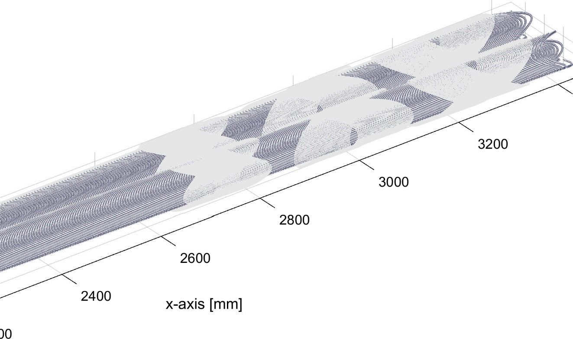
All QC1L1 correctors – A1, B1 and A2
Three correctors installed with single wire, 0.5mm, about 20cm long, current 200A (critical current @3K is 300A).
Strength of correctors:
  A1 25mT.m (210 units)
  B1 17mT.m (145 units)
  A2 35 units
Distance from IP (mm)
IP
B1 corrector
A1 corrector
A2 corrector
0.5mm wire, critical current @3T is 300A, physical length ~20cm
There is enough space for even five correctors, with no loss of packing factor

Slide 41
Conclusions on misalignment
CCT design
Internal misalignment should be better than 30um.
Beam/detector misalignment of around 1mm has a negligible effect on field quality, due to the excellent field quality of the CCT design
Ditto for 0.5mrad tilt
The values of 1mm and 0.5mrad come from optics (Katsunobu) as expected typical values

Slide 42
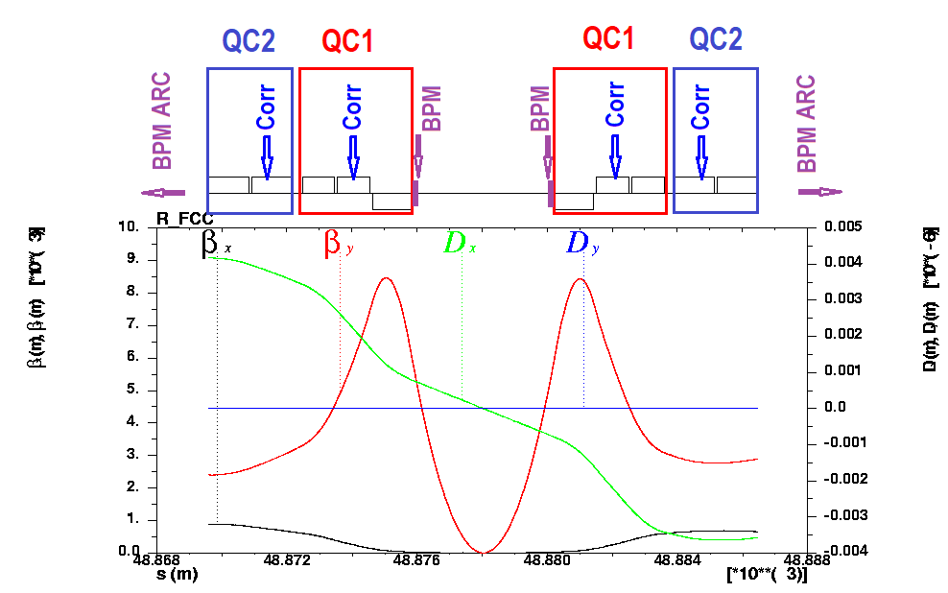
COD excited by FF quads misalignments correction scheme
Orbit errors at the FCC-ee due to the FF quadrupoles displacements (S. Sinyatkin)

Slide 43
Heat load and cooling needs
2.5 ns bunch spacing, previous parameter list
updated results in progress
According to E. Belli:
For the most difficult case, QC1L1
e-cloud: for SEY=1.1 ~20W/m, for SEY=1.2 ~200W/m
resistive wall: for copper, ~100W/m
direct SR heating: zero (I assume that masks will take all direct SR)
From the above, the heat load appears to be O(100)W/m

Slide 44
IR Vacuum Concept (R. Kersevan)
Example: What average effective pumping speed would be necessary for the Z-pole machine in order to have an average pressure lower than 1.0E-9 mbar?
Photon flux: F (ph/s) = 8.08E+17 · E (GeV) · I (mA) = 5.34E+22 (ph/s)
If k=2.47E+19 (mol/mbar/liter), then the gas load Q is:
Q (mbar·l/s) = F (ph/s) / k(mol/mbar/l) · η(mol/ph)
with η= photodesorption yield.
Typically a machine is considered vacuum conditioned when η < 1.0E-6 (mol/ph):
Q’ (mbar·l/s/m) = Q/ 2πρ = 3.44E-8 (mbar·l/s/m) (in the arcs, ρ ~10 km)
P_{avg} (mbar) = Q’ (mbar·l/s/m) / S_{eff} (l/s) · L(m)
Solving for for S_{eff}, one gets: S_{eff} (l/s) = 34.42 · L(m) (dotted line at 45 deg on previous plot)
This means that the Z-pole machine, due to its huge photon flux, would condition to P_{avg}<1.0E-9 only if 200 ÷ 500 l/s pumps are placed at a distance < 3 ÷ 4 m from each other;
This, in turn, would mean that in the arcs one would need 19000 ÷ 25000 pumps/beam;
Each lumped pump would in turn need pumping slots machined on the vacuum chamber: additional cost for machining, pumping plenum, flanges, cabling, etc...

Slide 45
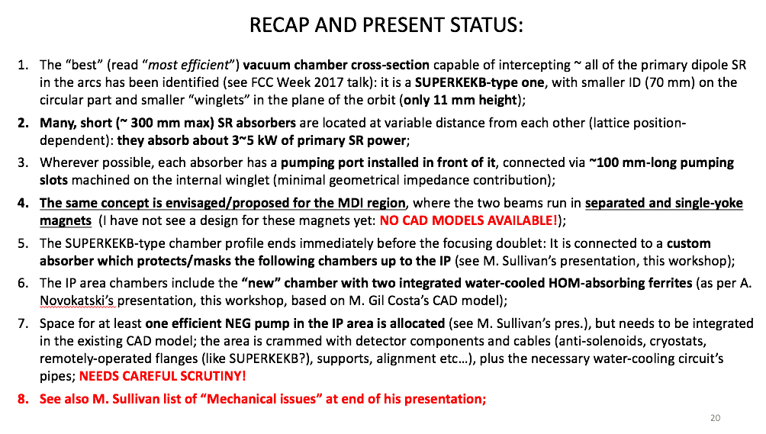

Slide 46
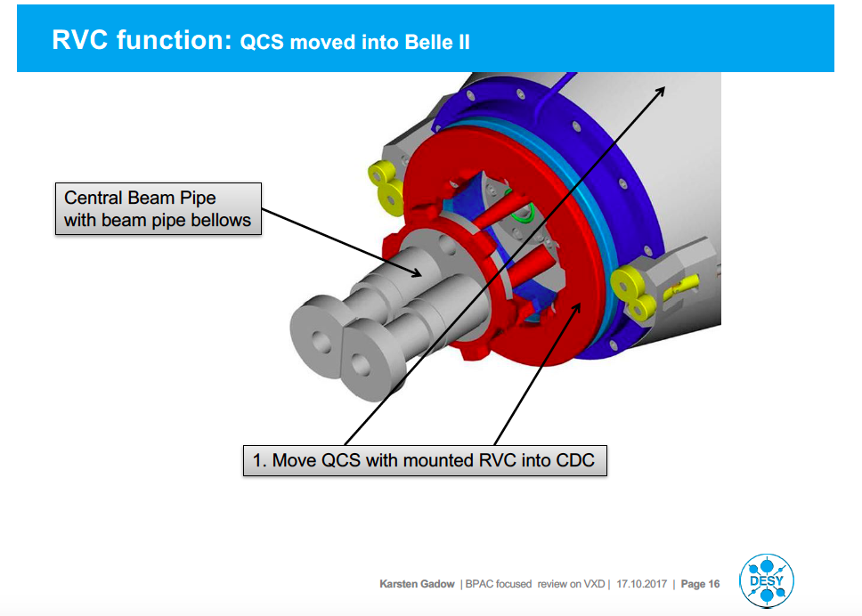
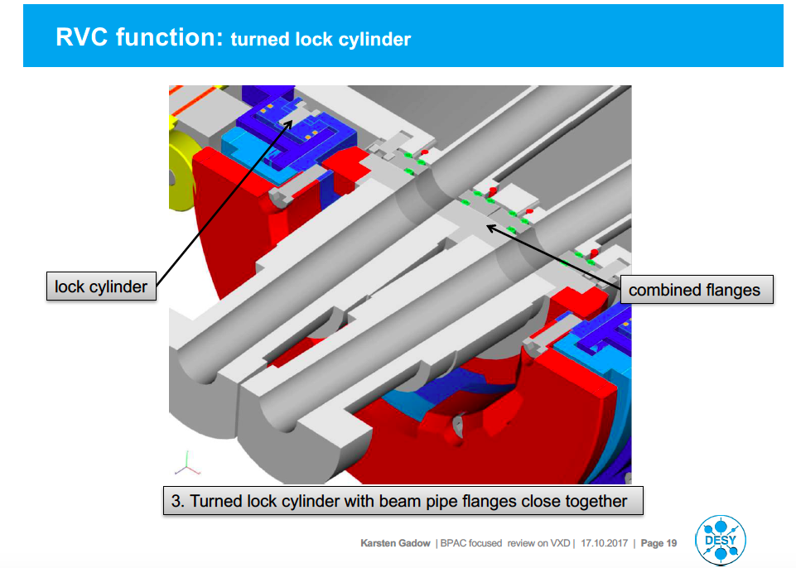
Remote vacuum connection
at Superkekb (Karsten Gadow)

Slide 47
Concerns
Assembly
  Remote vacuum connection (ala Belle II)?
  Bellows between Central chamber and cryostat chambers (at least 1-2 convolutions)
  Central chamber support
  Cable and cooling pipe space for central detectors
Vibration control
Cryostat support
Magnetic forces
  Anti-solenoids have strong expulsion forces?
  Compensating solenoids have strong expulsion force near detector field edge
Overlapping Z space
  LumiCal
  Cryostat
  Remote vacuum assembly
  NEG pump
  HOM absorbers
  Shielding

Slide 48
Summary
The IR design has been relatively stable
But now engineering concerns are coming into play
These may force a reevaluation of the IR design
We need space for bellows and vacuum connections and possibly supports
  Move the FF quads back?
  Shorten the anti-solenoid?
  Move the Lumi-Cal forward?

Slide 49
Conclusions and next steps
3d mechanical design, assembly concept
3D simulation of the magnetic fields and magnetic forces in MDI area to optimize design.
With a design that includes BPMs, bellows, flanges, a more realistic wake field calculation will be possible.
Stabilisation issues are being addressed
Alignments Alignment and mechanical tolerances

Slide 50
Back-up

Slide 51
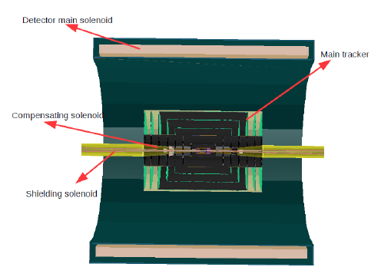
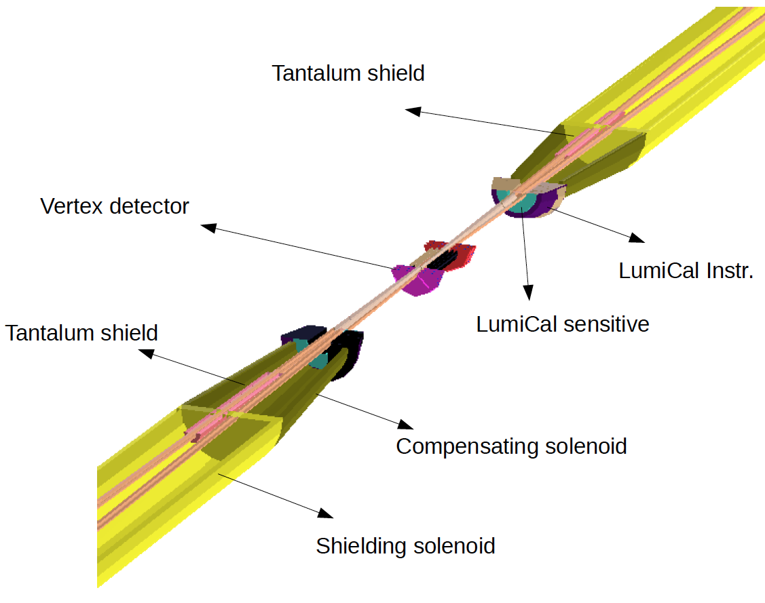
Geant4 detector modeling
modified CLIC detector model with B=2T and FCC-ee IR design

Slide 52
End view behind LumiCal
Shielding is not shown but we should be able to fit in at least 1 cm of a high Z material (Pb, W, Ta)

Slide 53
Features
Central beam pipe has 3 cm dia.
Entering and exiting beam pipe through Q1 (3cm dia.)
Be from about +/-80 cm to accommodate LumiCal
Pipe size increases to 4cm dia. in Q2
Size outside Q2 is currently 6 cm dia.
Mask tips +/-12 mm radius at +/-2.1 m and +/-5.44 m
Mask tips +/-18 mm radius at +/- 8.27 m
  Allows for possibility of cold bore magnets (shields quad beam pipes)
  Need to remove 43 W of SR power between Q1 and Q2 on upstream side
  Current IR design is for warm bores
Horizontal plane only
Horizontal plane only

Slide 54
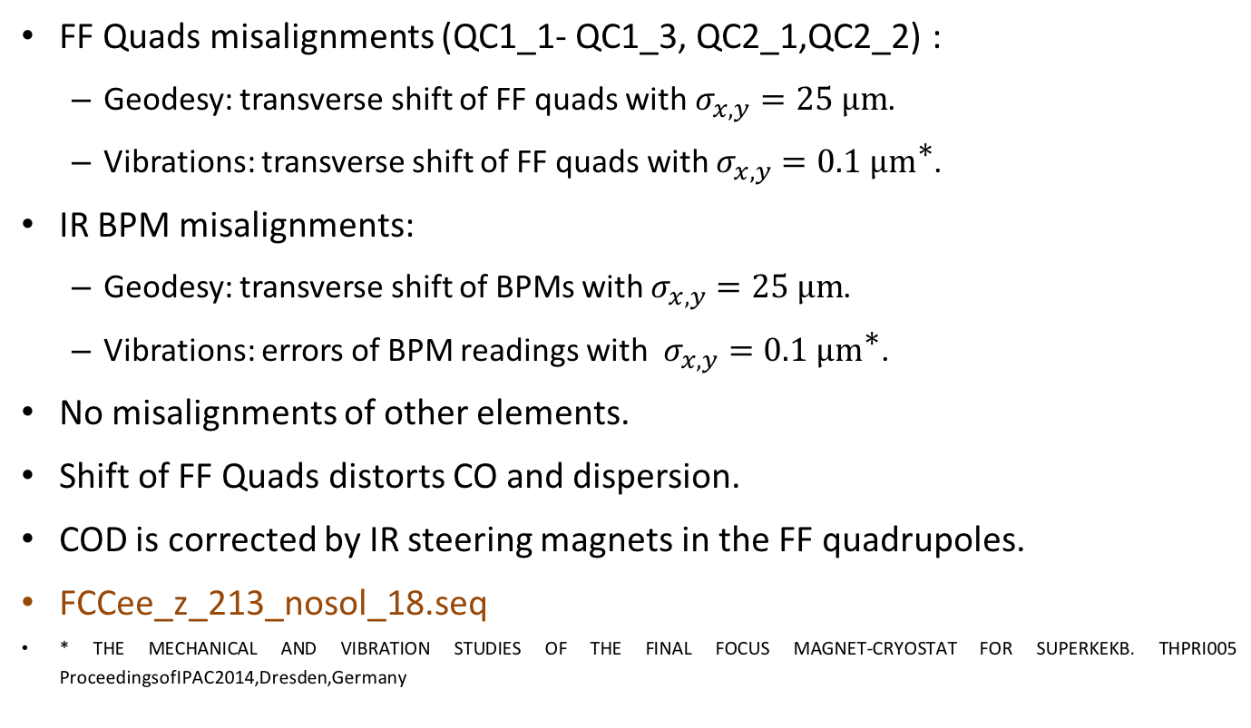
Task
Orbit errors at the FCC-ee due to the FF quadrupoles displacements
(S. Sinyatkin)
FF Quads misalignments (QC1_1- QC1_3, QC2_1,QC2_2) :
  Geodesy: transverse shift of FF quads with $σ_{x,y}=25 \text{μm}$.
  Vibrations: transverse shift of FF quads with $σ_{x,y}=0.1 \text{μ}{\text{m}}^{\text{∗}}$.
IR BPM misalignments:
  Geodesy: transverse shift of BPMs with $σ_{x,y}=25 \text{μm}$.
  Vibrations: errors of BPM readings with $σ_{x,y}=0.1 \text{μ}{\text{m}}^{\text{∗}}$.
No misalignments of other elements.
Shift of FF Quads distorts CO and dispersion.
COD is corrected by IR steering magnets in the FF quadrupoles.
FCCee_z_213_nosol_18.seq
* THE MECHANICAL AND VIBRATION STUDIES OF THE FINAL FOCUS MAGNET-CRYOSTAT FOR SUPERKEKB. THPRI005 ProceedingsofIPAC2014,Dresden,Germany

Slide 55
Conclusion
Orbit errors at the FCC-ee due to the FF quadrupoles displacements
(S. Sinyatkin)
There is no closed orbit w/o correction for 25 μm shift of Q (a small amount). After correction, the required beam parameters are restored.
The beams do not collide with 0.1 μm vibrations of FF Quads. Vertical emittance is blown up.
Feedback is required to suppress influence of the FF quads vibrations.
The beam parameters are destroyed after correction of 25 μm IR BPM misalignments. To optimize the parameters, a “golden” orbit is required.
Due to vibrations, it is impossible to use the IR BPMs for the feedback system.
It is necessary to measure Luminosity in the bandwidth 0-100 Hz. (Luminometer?)

