Slide 1

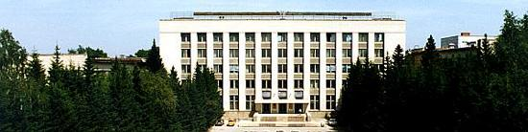

BINP
Challenges for FCC-ee MDI mechanical design
draft
Alexander Krasnov, Sergey Pivovarov
BINP, Novosibirsk
MDI FCC-ee workshop, 9th February 2018

Slide 2
3D starting
BINP

Slide 3
3D starting
BINP
CS
LumiCal
ScS
HOM Absorber
Qs
Between remote flanges
Two bellows
NEG pump, custom design
Remote flange
- Most challenging: Design of Remote Flange with double seal inside CS

Slide 4
3D first design tasks
BINP
A simplified model for HOM estimation, included NEG connection, Bellows, remote flanges, BPMs, ….
Remote flange concept
Assembly concept
3D model of cryostat envelope (resonant frequency calculation)
…

Slide 5
Known statements
BINP
Central Be-Cu tube, Lumicals, HOM absorbers, bellows – are fixed to inner part of detector
All BPMs have transvers fixation:
        Open questions
- SR re-emission (must be added to SynRad calculation), measurements of distribution of diffusely scattered photons, residual gas pressure profile, number of vacuum pumps
RT or cold vacuum chamber inside cryostat?
Cooling of beam at IP pipe, in beam pipe inside Qs, EC mitigation in Qs.
….
Needed inputs: main sizes of main components

Slide 6
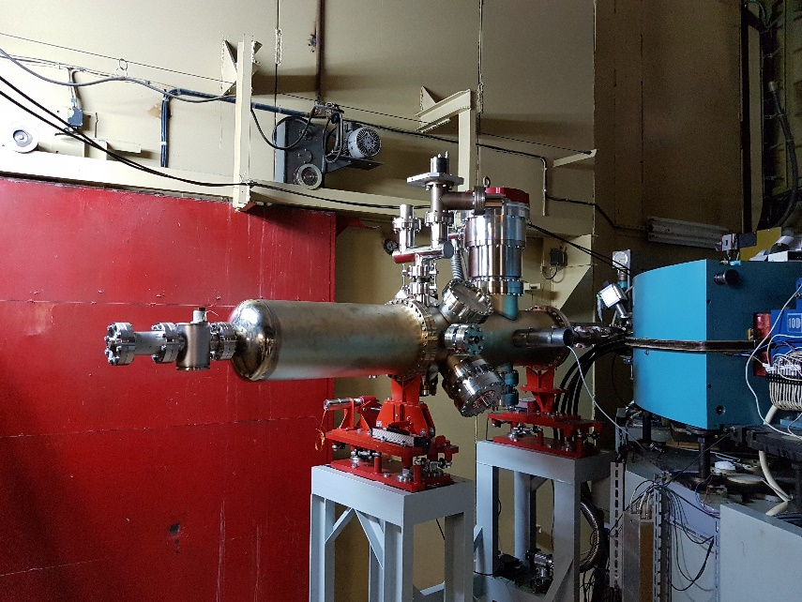
SR beam line at BINP for vacuum investigations
BINP
VEPP-2000 linked to new Injection complex
BEP after reconstruction. Maximum energy increased up to 1 GeV at circumference 22m. Max dipole field 2.6 T.
Parameter | min | nominal | max
E [MeV] | 200 | 300 | 900
Beam current [A] | 0.5 | 0.5 | 0.5
Banding magnet radii [mm] | 1280
SR critical energy [eV] | 14 | 47 | 1260
SR flux [ph/mrad/s] | 1.1E15 | 1.8E16 | 5.6E16
SR power [W/mrad] | 0.009 | 0.045 | 3.6
SR vertical divergence [mrad] at Ec | 2.5 | 1.7 | 0.56
SR Beam Line and Experimental set-up is ready for commissioning
Planning:
Experiments at RT: 01.2018 – 04.2018
Experiments at cryogenic temperature:
autumn 2018
BEP and SR parameters for incoming experiments

Slide 7
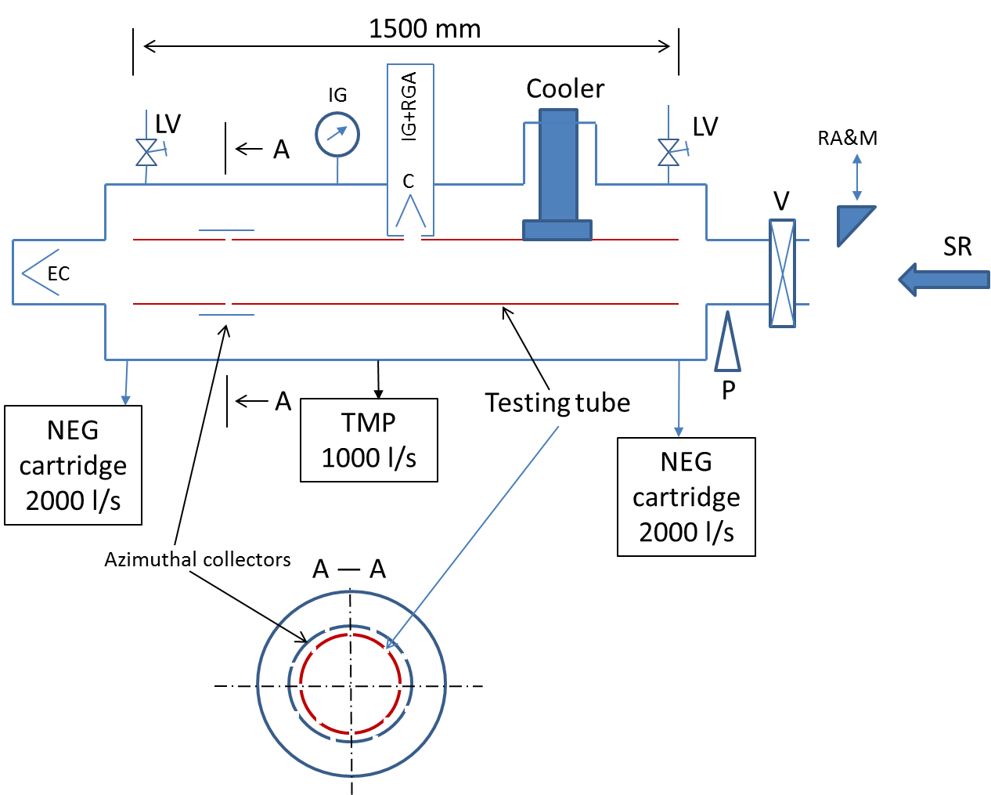
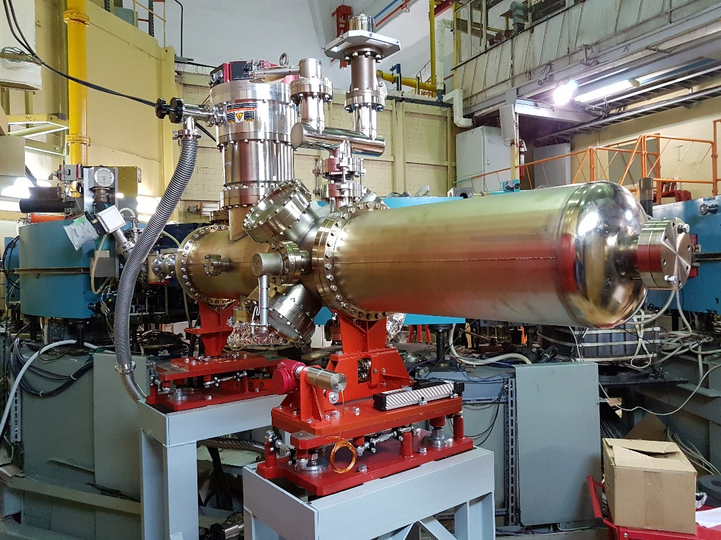
Collaboration R&D CERN – BINP (Addendum P110/A2)
BINP
In the framework of the HL-LHC project, the vacuum performance of new surface material needs to be studied in details. In particular, amorphous carbon (a-C) coating is proposed as an anti-multipactor surface with the objective to minimize the heat load deposed on the shielded beam screen and the background to the experiment due to proton scattering onto the residual gas. Since the protons in the HL-LHC Inner Triplets generates SR with ~ 10 eV critical energy and ~ 10¹⁶ ph/m/s flux, it is therefore of great importance to study the impact of such photons on a-C coating held at room and cryogenic temperature and compare the results against present LHC material.
The experimental set-up is installing
on BEP SR beam line at BINP

Slide 8
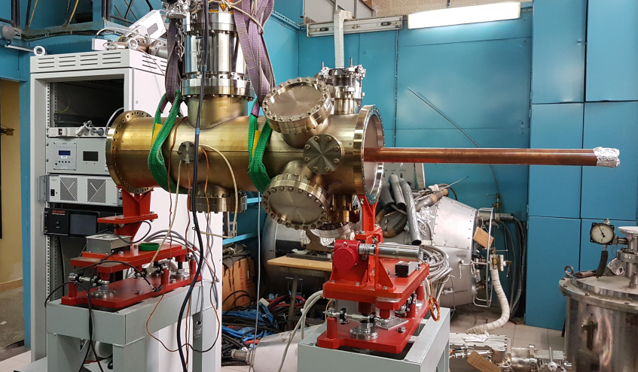
Experimental program in frame of Collaboration R&D CERN – BINP (Addendum P110/A2)
BINP
- quantitative photon stimulated gas desorption by a calibrated residual gas analyzer (RGA);
- photo-electron yield; forward reflectivity in SR power and photon flux units; azimuthal distribution of photoelectrons and azimuthal distribution of diffusely scattered photons.
These measurements will be done for two CERN supplied samples: uncoated and a-C coated OFE-Cu tubes.
The experimental program and system parameters will be the same for both samples and consist of:
- an accumulated photon dose > 10²³ ph/m, a SR incident angle of 13 mrad, a SR critical energy in accumulated photon dose mode is in the range 40 ÷ 50 eV, a scanning over SR critical energy at 100, 200, 400, 800, 1300, 1700 eV at selected doses of 10²¹, 10²², 10²³ ph/m, a total number of azimuthal collectors of 10.
BINP will repeat the measurements in the temperature range 60 ÷ 300 K for exchangeable Cu tube samples
perforated with holes in order to simulate a distributed pumping
Experimental set-up
Parameter | min | nominal | max
E [MeV] | 200 | 300 | 900
Beam current [A] | 0.5 | 0.5 | 0.5
Banding magnet radii [mm] | 1280
SR critical energy [eV] | 14 | 47 | 1260
SR flux [ph/mrad/s] | 1.1E15 | 1.8E16 | 5.6E16
SR power [W/mrad] | 0.009 | 0.045 | 3.6
SR vertical divergence [mrad] at Ec | 2.5 | 1.7 | 0.56
BEP and SR parameters for incoming experiments

Slide 9
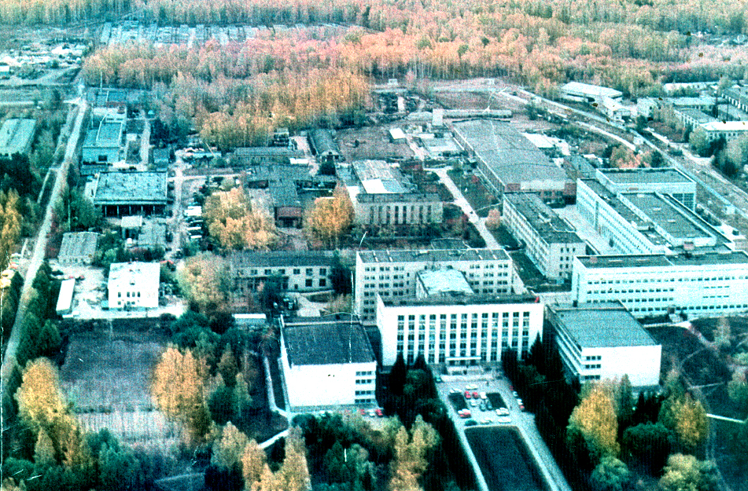
Thanks for your attention

