Slide 1

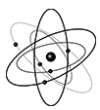

LHCb Simulation overview
Tomasz Szumlak on behalf of the LHCb Collaboration
Radiation effects at the LHC experiments and impact on operation and performance
23 – 24 April 2018 CERN, Geneva

Slide 2
Outline
Current LHCb experiment
LHCb data processing framework
Validation of the simulation code with colission data
Simulation of radiation induced effects
Simulation after the upgrade

Slide 3
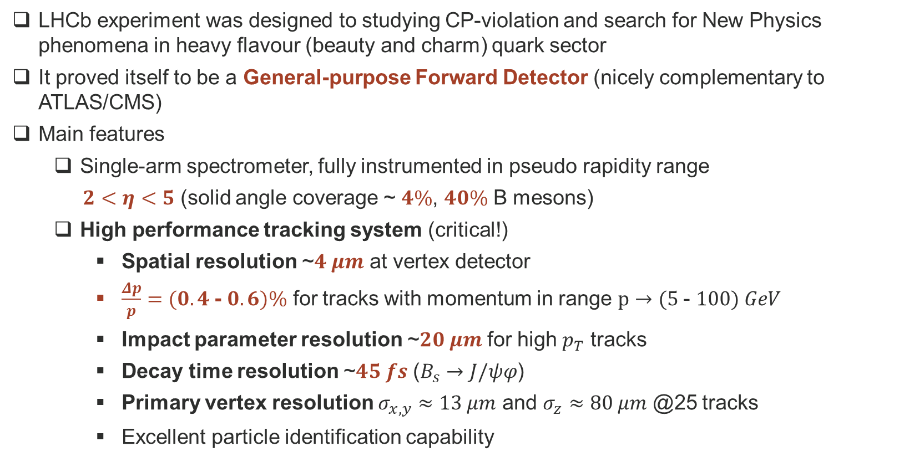
LHCb Detector at present…
LHCb experiment was designed to studying CP-violation and search for New Physics phenomena in heavy flavour (beauty and charm) quark sector
It proved itself to be a General-purpose Forward Detector (nicely complementary to ATLAS/CMS)
Main features
  Single-arm spectrometer, fully instrumented in pseudo rapidity range
  $2<η<5$ (solid angle coverage ~ $4\%$, $40\%$ B mesons)
  High performance tracking system (critical!)
    Spatial resolution ~$4 μm$ at vertex detector
    $\frac{Δp}{p}=(0.4$- $0.6)\%$ for tracks with momentum in range $p→(5$- $100) GeV$
    Impact parameter resolution ~$20 μm$ for high $p_{T}$ tracks
    Decay time resolution ~$45 fs$ ($B_{s}→J/ψφ$)
    Primary vertex resolution $σ_{x,y}≈13 μm$ and $σ_{z}≈80 μm$ @25 tracks
    Excellent particle identification capability

Slide 4
LHCb Detector at present…
LHCb experiment was designed to studying CP-violation and search for New Physics phenomena in heavy flavour (beauty and charm) quark sector
It proved itself to be a General-purpose Forward Detector (nicely complementary to ATLAS/CMS)
Main features
  Single-arm spectrometer, fully instrumented in pseudo rapidity range
  $2<η<5$ (solid angle coverage ~ $4\%$, $40\%$ B mesons)
  High performance tracking system (critical!)
    Spatial resolution ~$4 μm$ at vertex detector
    $\frac{Δp}{p}=(0.4$- $0.6)\%$ for tracks with momentum in range $p→(5$- $100) GeV$
    Impact parameter resolution ~$20 μm$ for high $p_{T}$ tracks
    Decay time resolution ~$45 fs$ ($B_{s}→J/ψφ$)
    Primary vertex resolution $σ_{x,y}≈13 μm$ and $σ_{z}≈80 μm$ @25 tracks
    Excellent particle identification capability
Quite a task to match such excellent performance in simulation software!

Slide 5
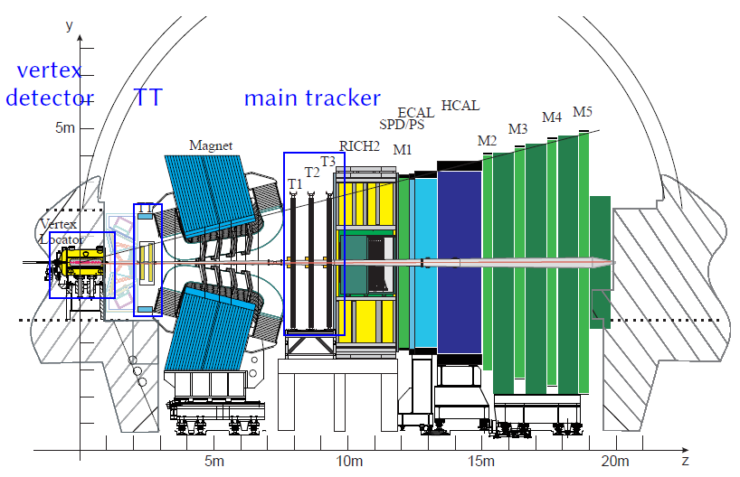




Tracking system – precise momentum reconstruction, vertexing, decay time resolution
$$\frac{∆p}{p} \sim 0.4 −0.6 \%$$
$$σ_{hit}≈4 μm$$
$$σ_{IP}≈13 μm$$
$$\sim 40 −50 fs$$
[JINST 3 (2008) S08005]

Slide 6
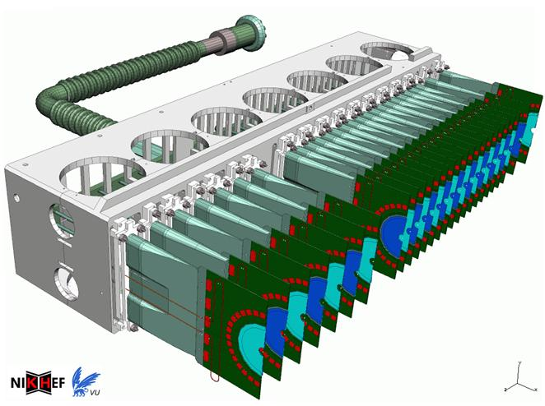
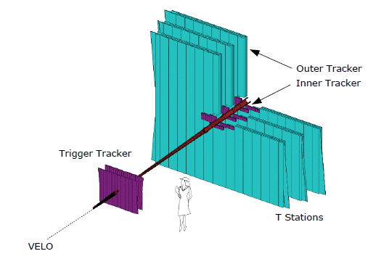
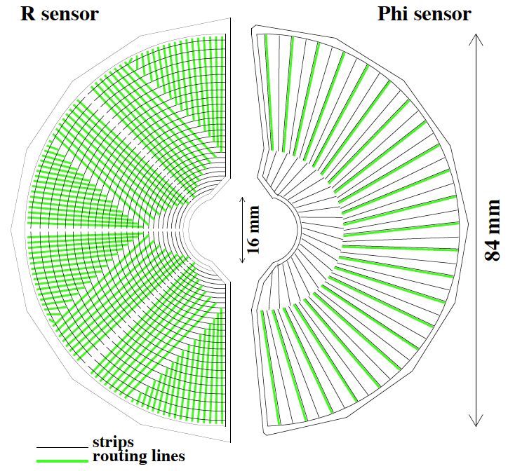

Tracking system – precise momentum reconstruction, vertexing, decay time resolution
$$\frac{∆p}{p} \sim 0.5 −1.0 \%$$
$$σ_{hit}≈4 μm$$
Inn
Inner
Tracker
$$σ_{IP}≈13 μm$$
$$\sim 40 −50 fs$$
Tracker Turicensis
[JINST 3 (2008) S08005]

Slide 7
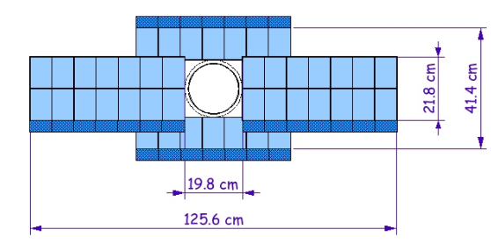
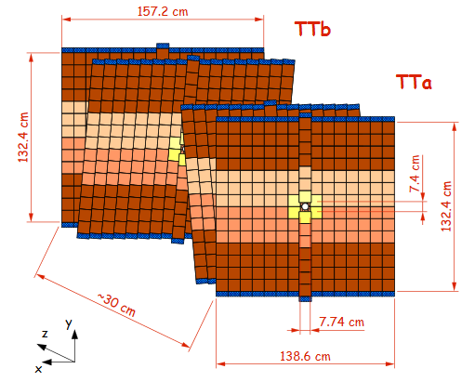
Tracking system – precise momentum reconstruction, vertexing, decay time resolution
$$\frac{∆p}{p} \sim 0.5 −1.0 \%$$
$$σ_{hit}≈4 μm$$
$$σ_{IP}≈13 μm$$
$$\sim 40 −50 fs$$
[JINST 3 (2008) S08005]

Slide 8
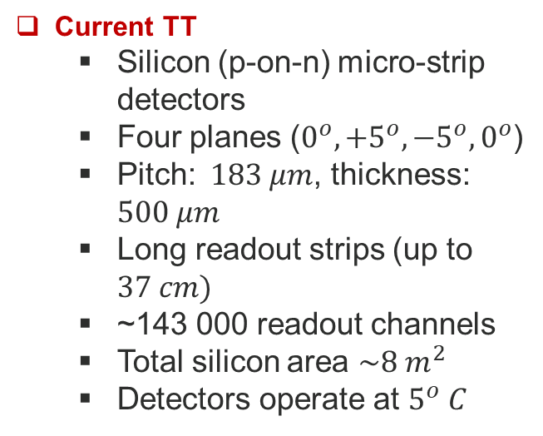
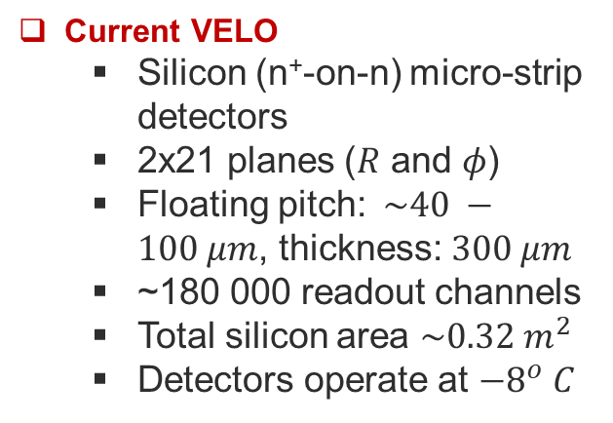
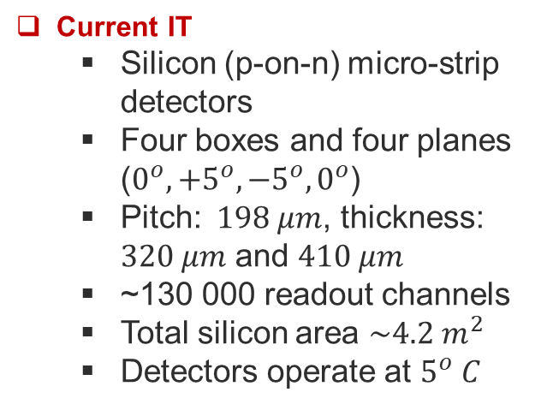
Current VELO
  Silicon (n⁺-on-n) micro-strip detectors
  2x21 planes ($R$ and $φ$)
  Floating pitch: $\sim 40 −100 μm$, thickness: $300 μm$
  ~180 000 readout channels
  Total silicon area $\sim 0.32 m^{2}$
  Detectors operate at ${−8}^{o} C$
Current TT
  Silicon (p-on-n) micro-strip detectors
  Four planes ($0^{o},{+5}^{o},{−5}^{o},0^{o}$)
  Pitch: $183 μm$, thickness: $500 μm$
  Long readout strips (up to $37 cm)$
  ~143 000 readout channels
  Total silicon area $\sim 8 m^{2}$
  Detectors operate at $5^{o} C$
Current IT
  Silicon (p-on-n) micro-strip detectors
  Four boxes and four planes ($0^{o},{+5}^{o},{−5}^{o},0^{o}$)
  Pitch: $198 μm$, thickness: $320 μm$ and $410 μm$
  ~130 000 readout channels
  Total silicon area $\sim 4.2 m^{2}$
  Detectors operate at $5^{o} C$

Slide 9

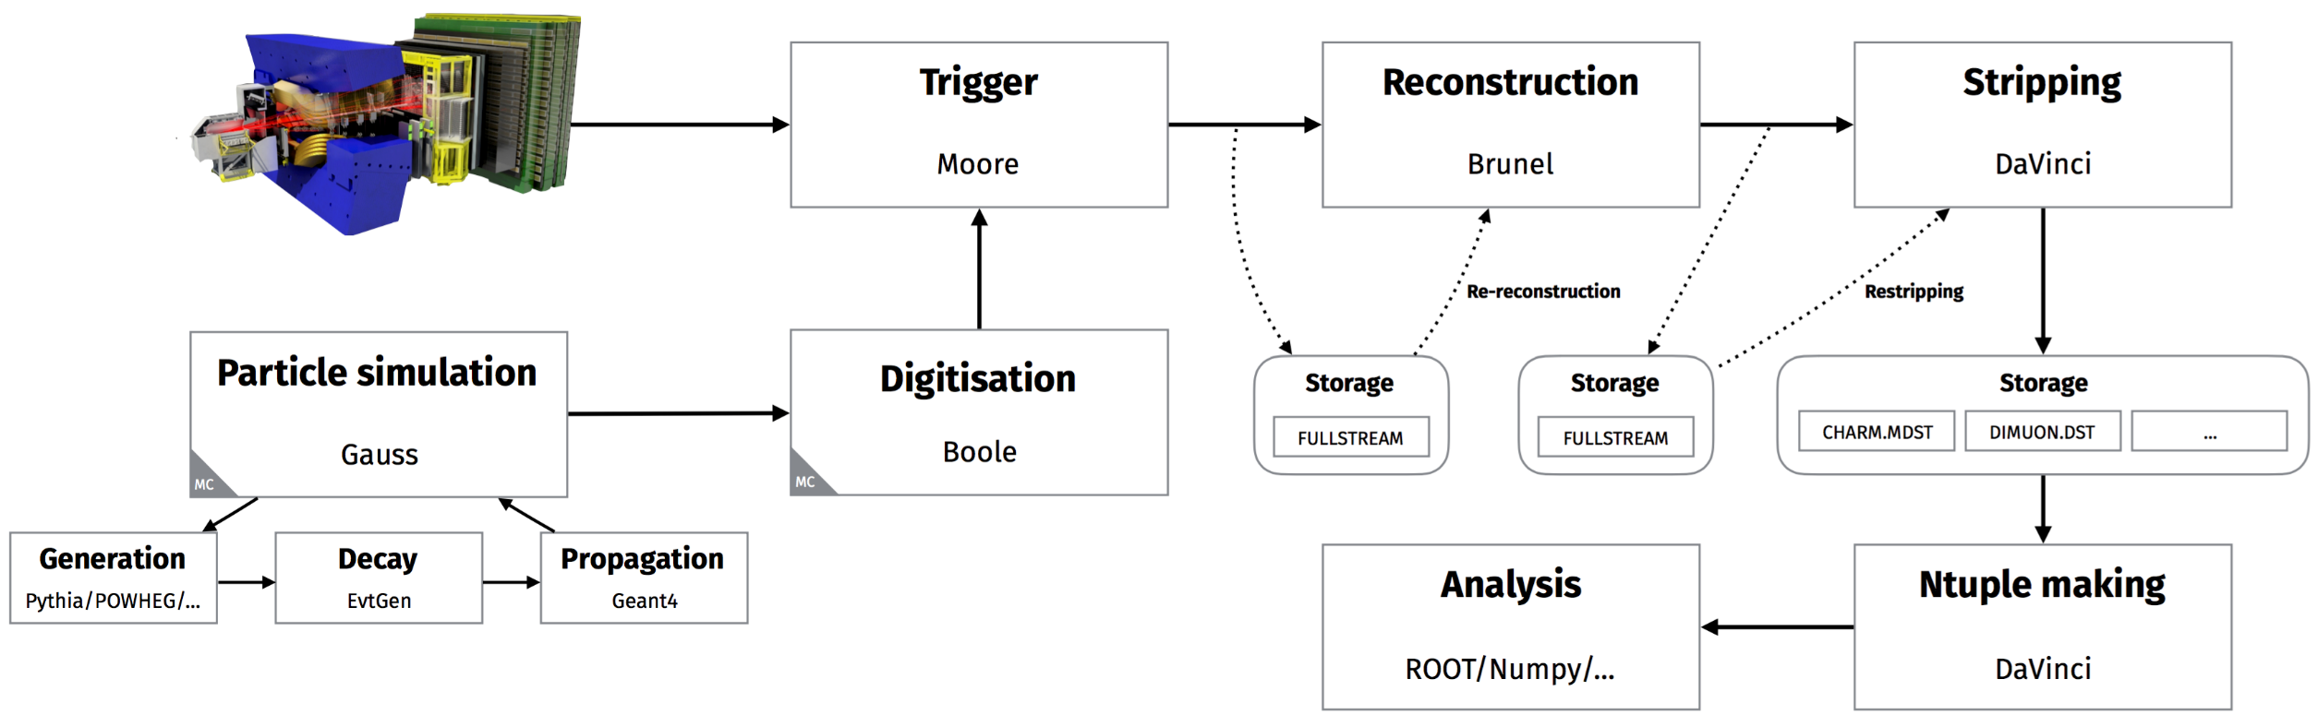
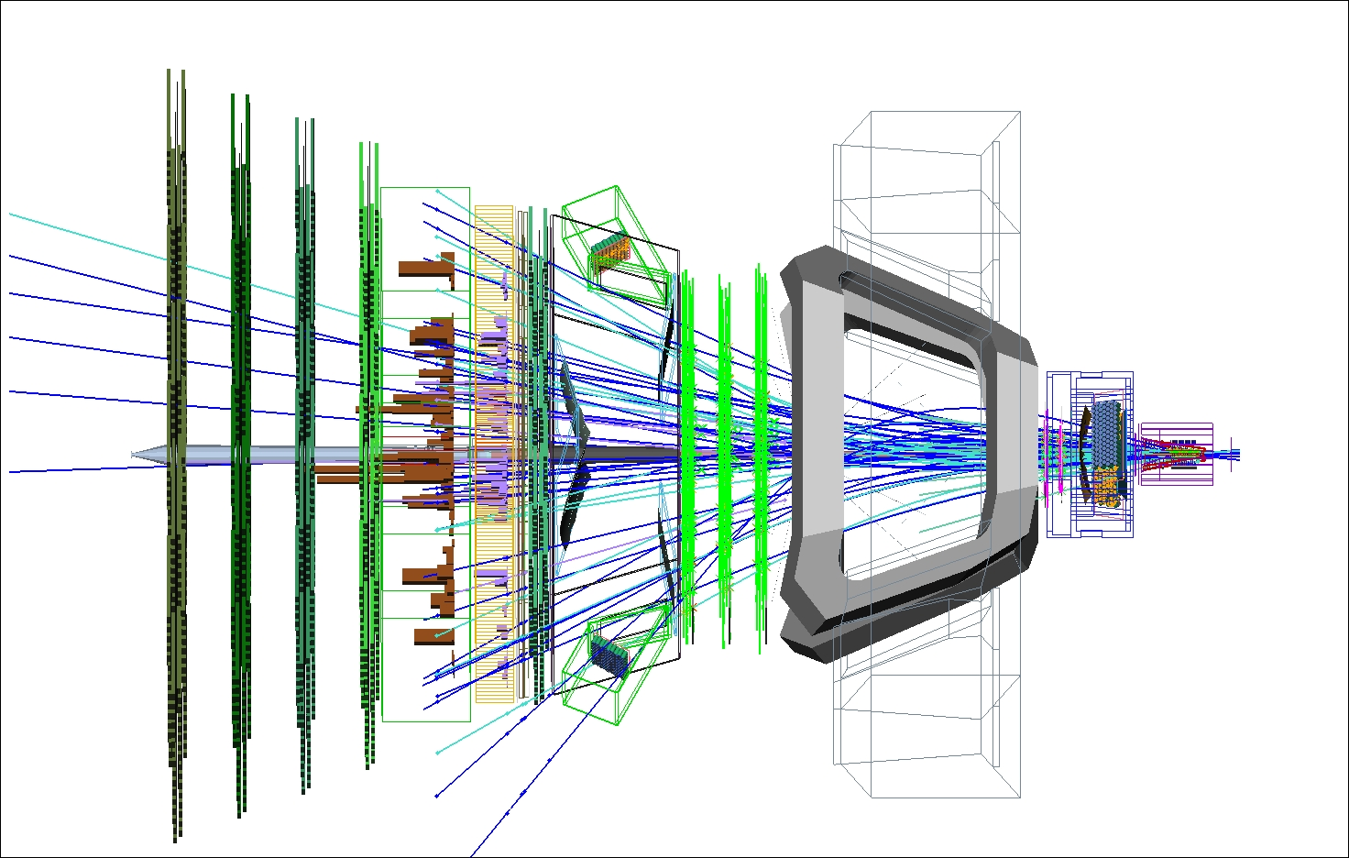
LHCb Software Suite
Real detector
Detector model

Slide 10
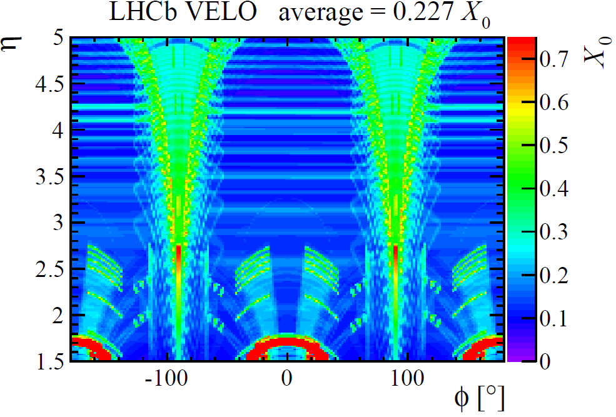
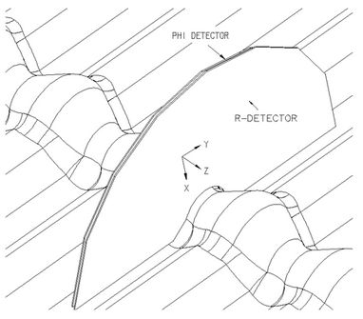
Detector Model
Simulated VELO
Critical for tracking performance
  Impact parameter resolution
  Single hit resolution
  RF foil gives dominating contribution!

Slide 11
Simulation Performance
Landau distributions
Impact parameter resolution
Primary vertex resolution

Slide 12
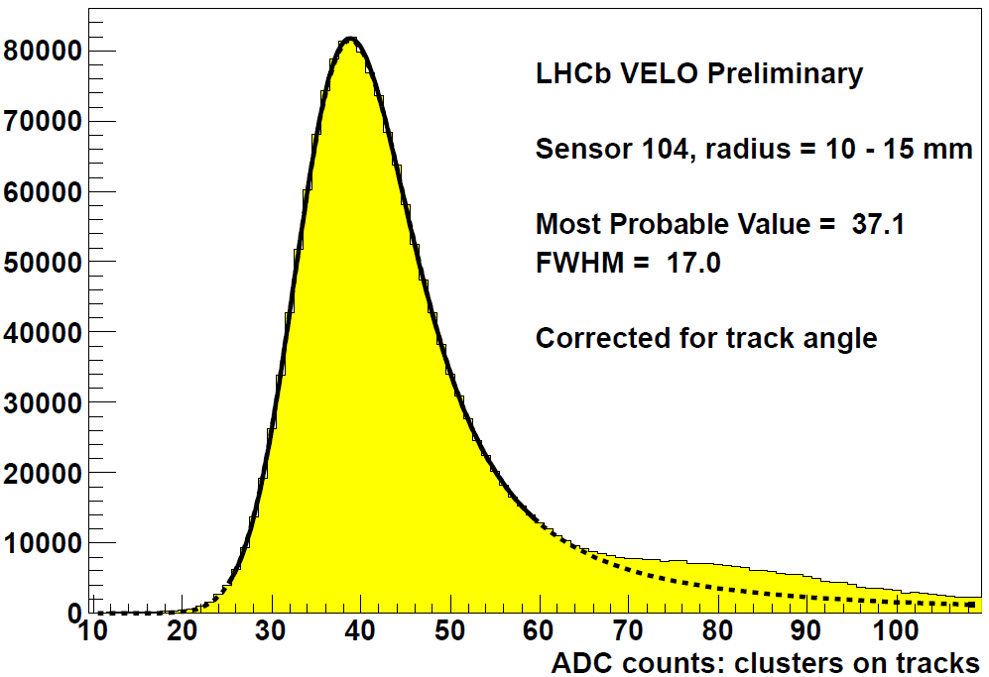
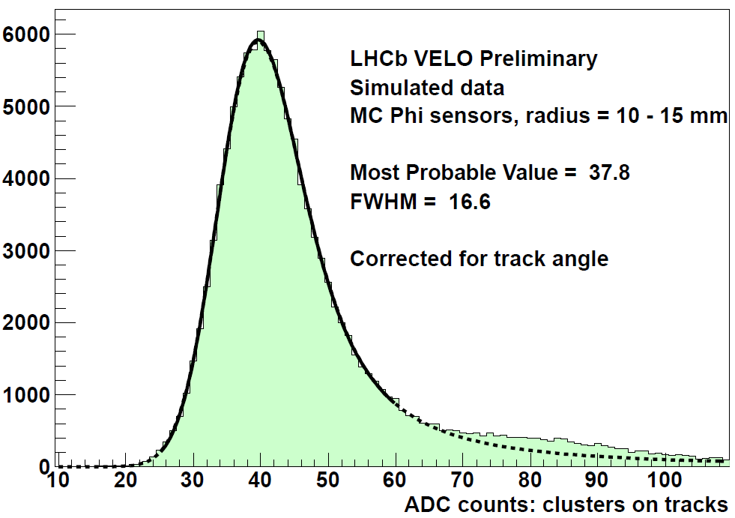
Signal Distributions – VELO

Slide 13
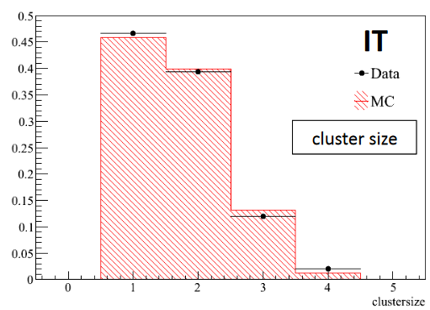
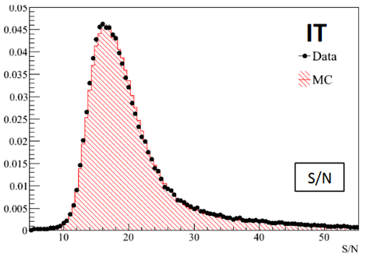
Signal Distribution – ST

Slide 14
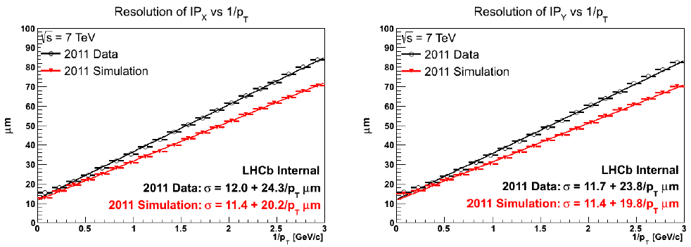
Impact Parameter Resolution
A long march for VELO - initially quite large discrepancy between data and Monte Carlo (tracks reconstructed using full LHCb system)

Slide 15
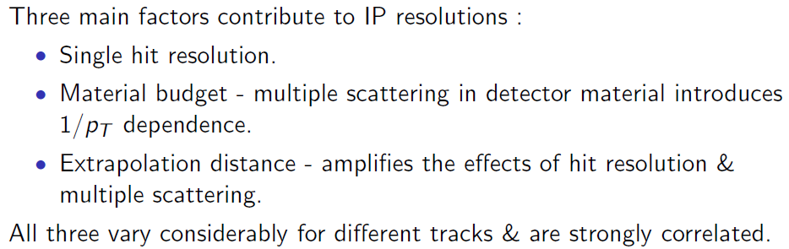

Impact Parameter Resolution
Resolutions and extrapolation
MS

Slide 16
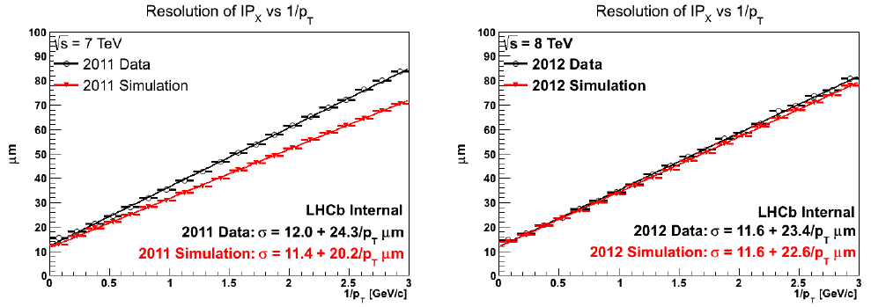
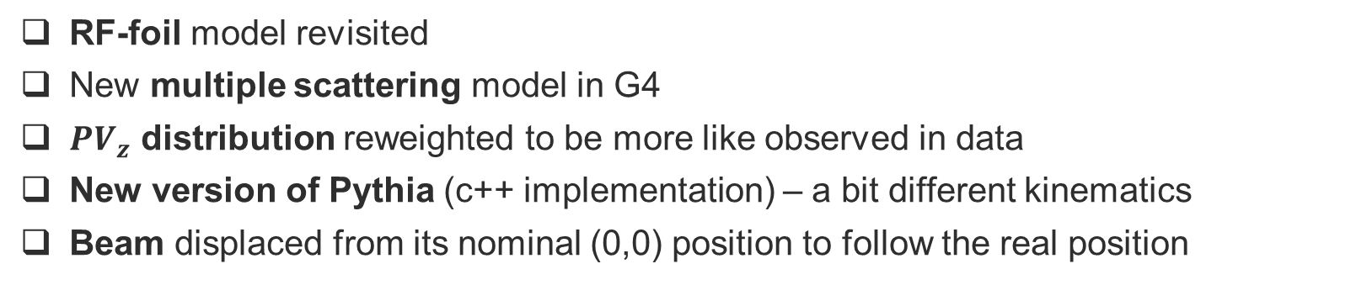
Impact Parameter Resolution - improvements
RF-foil model revisited
New multiple scattering model in G4
${PV}_{z}$ distribution reweighted to be more like observed in data
New version of Pythia (c++ implementation) – a bit different kinematics
Beam displaced from its nominal (0,0) position to follow the real position

Slide 17
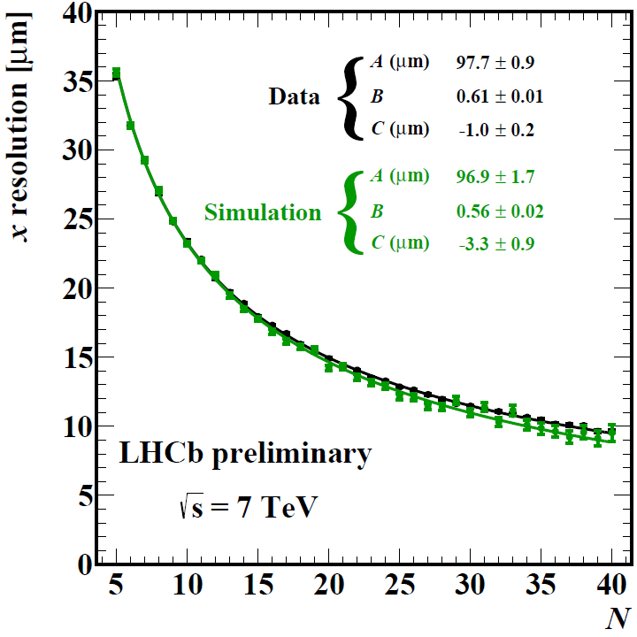
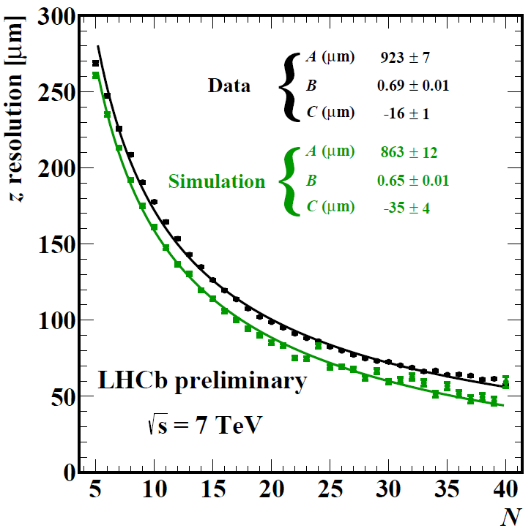
Primary Vertex Resolution
2011 data/Monte Carlo

Slide 18
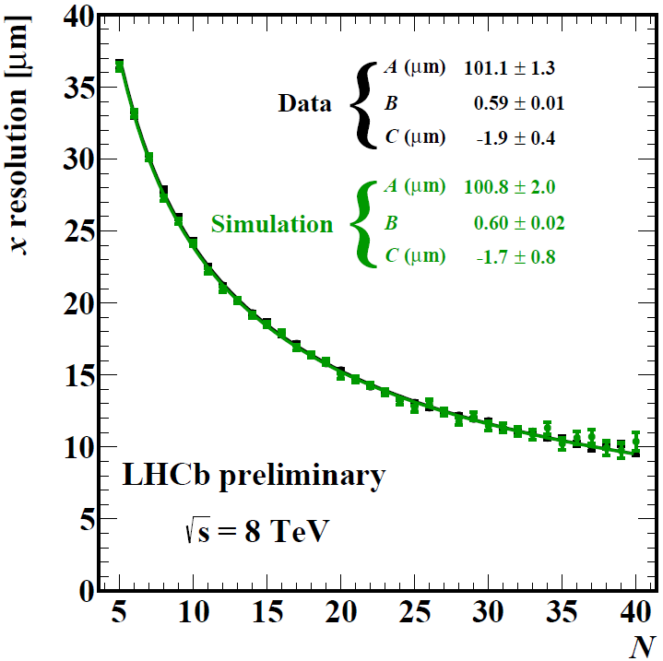
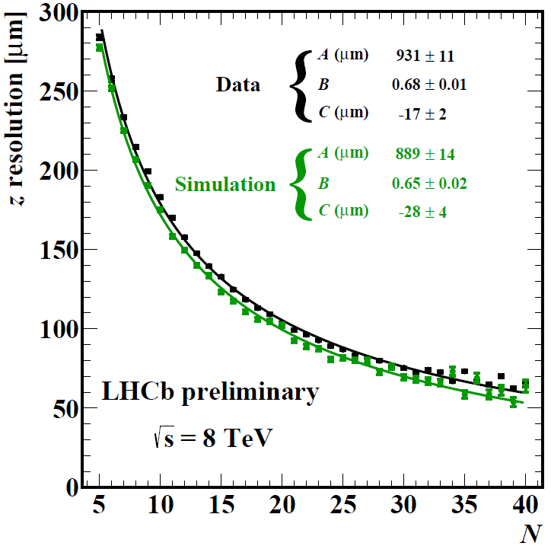
Primary Vertex Resolution
2012 data/Monte Carlo

Slide 19
Radiation Damage and Simulation
Degrading fundamental properties of silicon sensors
Impact on Charge Collection Efficiency, Cluster Finding Efficiency, Landaus
  These in turn have impact on signal to noise, spatial resolution, impact parameter resolution, tracking efficiencies…
  We learned the profound influence on a few data analyses

Slide 20
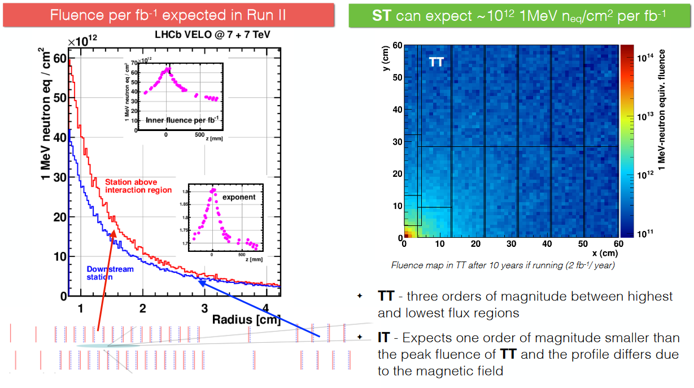
Particle Fluence
This is just to show the differences between VELO and ST
GEANT 4

Slide 21
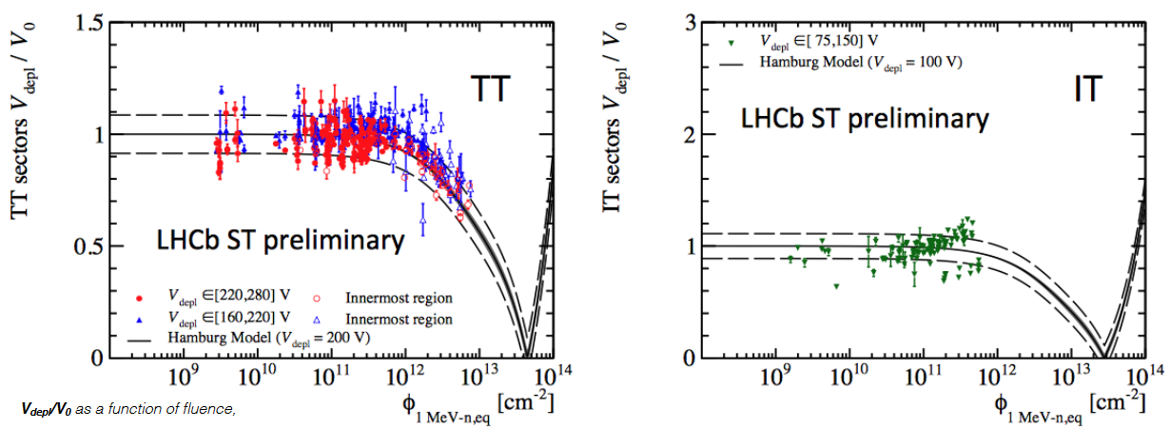
Charge Collection Efficiency – ST

Slide 22
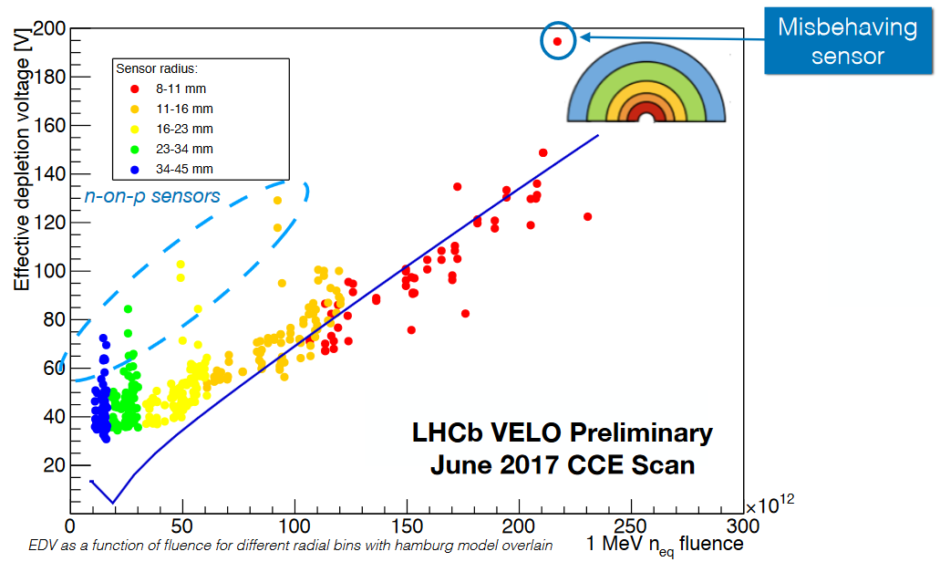
Charge Collection Efficiency – ST

Slide 23
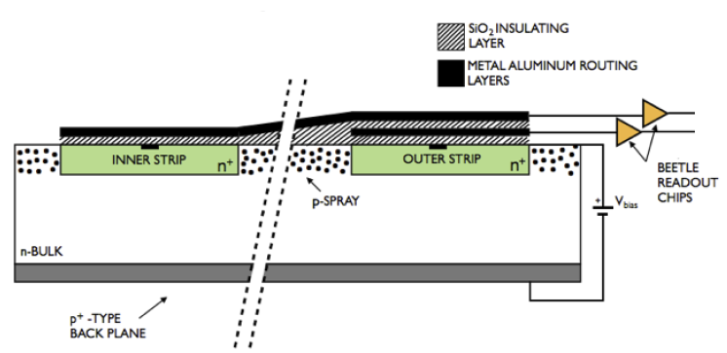
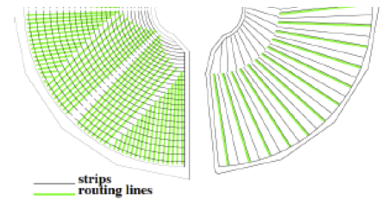
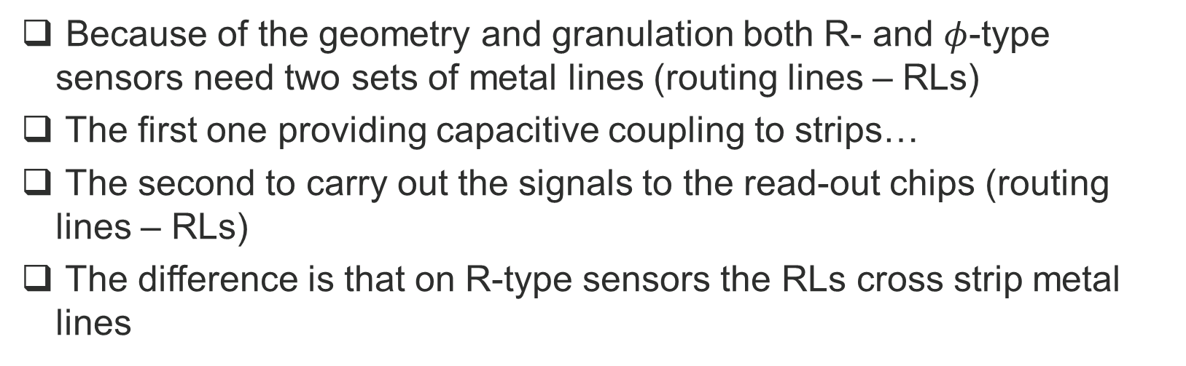
Second Metal Layer
Because of the geometry and granulation both R- and $φ$-type sensors need two sets of metal lines (routing lines – RLs)
The first one providing capacitive coupling to strips…
The second to carry out the signals to the read-out chips (routing lines – RLs)
The difference is that on R-type sensors the RLs cross strip metal lines

Slide 24
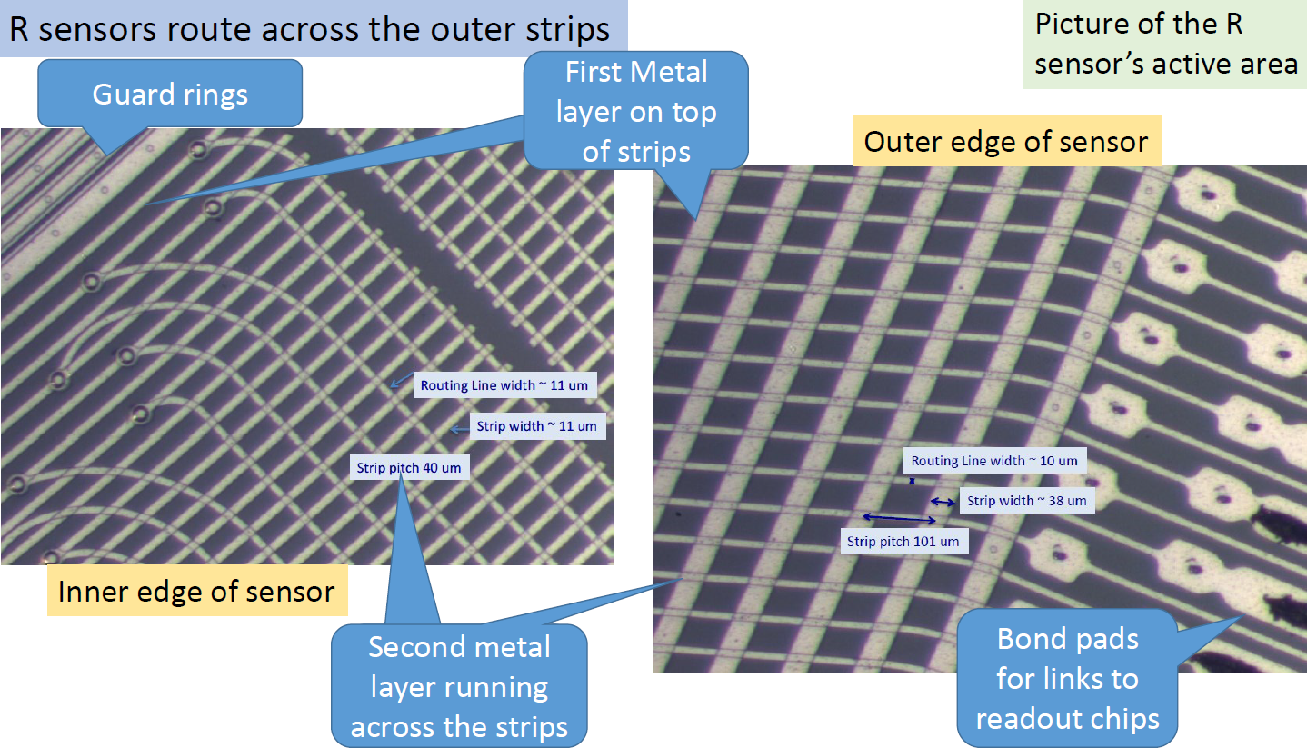

Slide 25
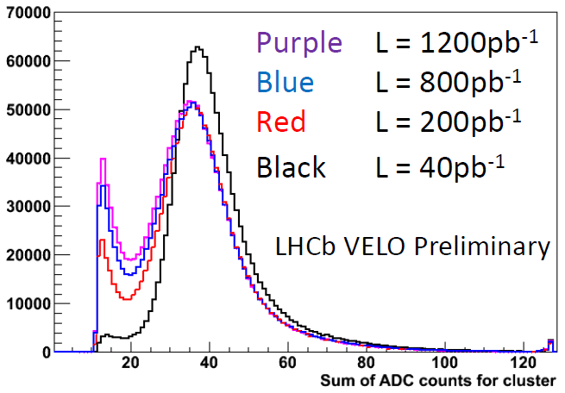
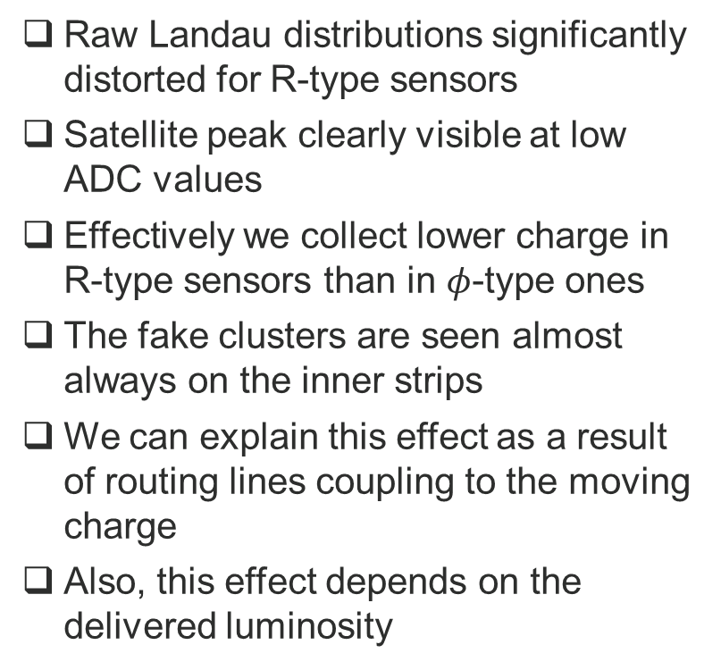
Second Metal Layer
Raw Landau distributions significantly distorted for R-type sensors
Satellite peak clearly visible at low ADC values
Effectively we collect lower charge in R-type sensors than in $φ$-type ones
The fake clusters are seen almost always on the inner strips
We can explain this effect as a result of routing lines coupling to the moving charge
Also, this effect depends on the delivered luminosity

Slide 26
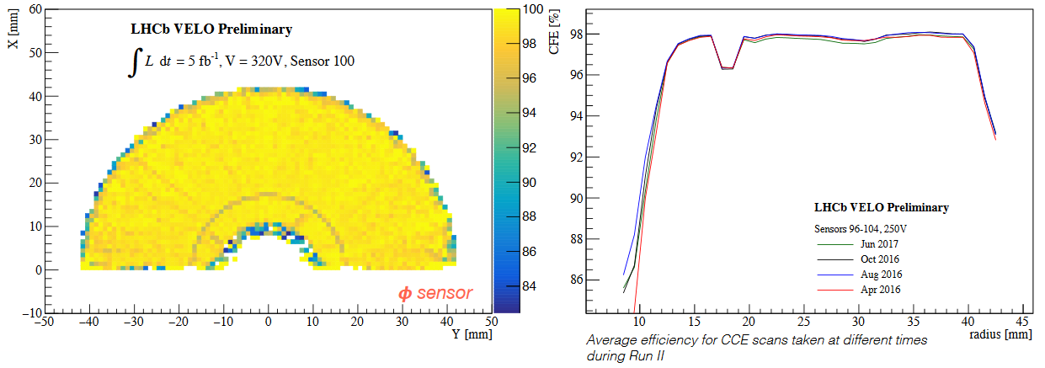
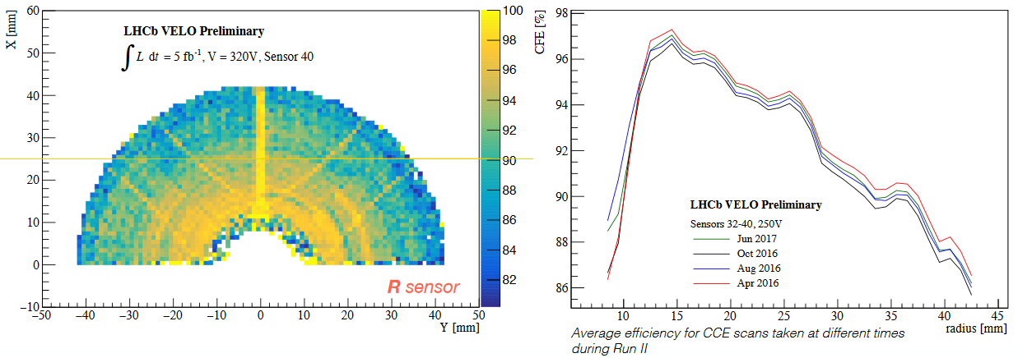
Cluster Finding Efficiency

Slide 27
Simulation of Radiation Induced Effects
Dedicated tool implemented to modify the detector response simulation and reproduce the CCE drop, second metal coupling and resolution evolution
Significant effort to make it universal over time (2012 – 2017)
Tool is used inside Boole application and process MCHit objects
  The fraction of charge that is leaked to the inner strips can be parametrised as function of sensor pitch and track pseudo-rapidity
  Tunings for respective time periods are stored in a data base and picked up using an appropriate „tag”
In order to follow the resolution we also adjusted the simulation code to reproduce the observed cluster spectrum distribution
  The purpose is to follow the cluster spectrum observed in data
  For that we parametrised the simulated charge diffusion width and capacitive coupling between adjacent strips

Slide 28
Simulation of Radiation Induced Effects
Preliminary results look promising, we are in process of validating them with dedicated large simulated samples

Slide 29
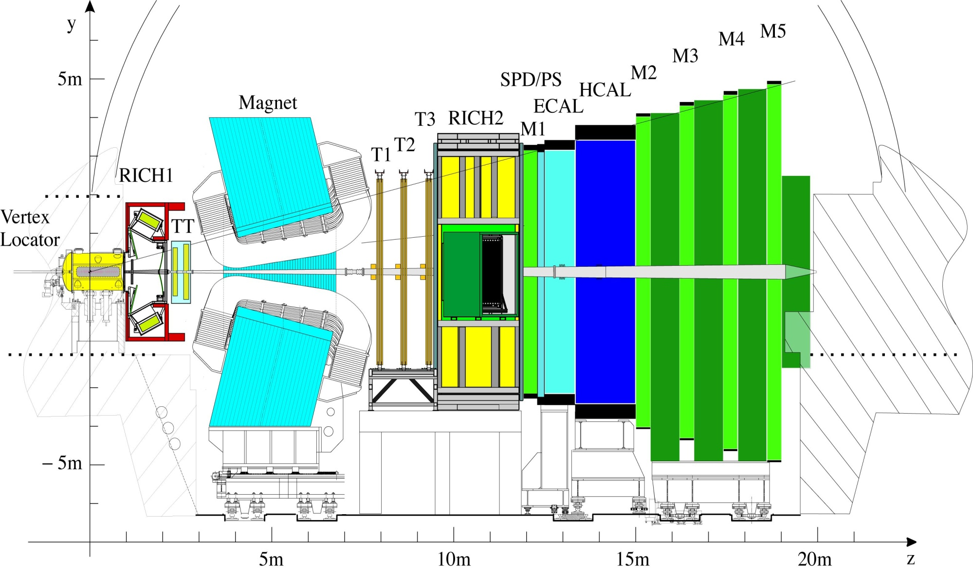
LS2 LHCb Upgrade – what is new…?
VELO
Si strips
(replace all)
Silicon Tracker
Si strips
(replace all)
Outer Tracker
Straw tubes
(replace R/O)
Muon MWPC
(almost compatible)
RICH
HPDs
(replace HPD & R/O)
Calo
PMTs (reduce PMT gain, replace R/O)

Slide 30
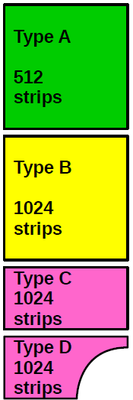
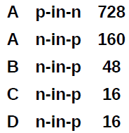
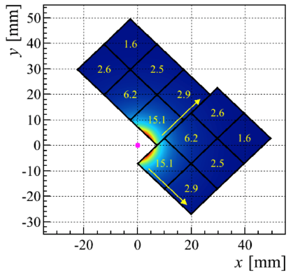
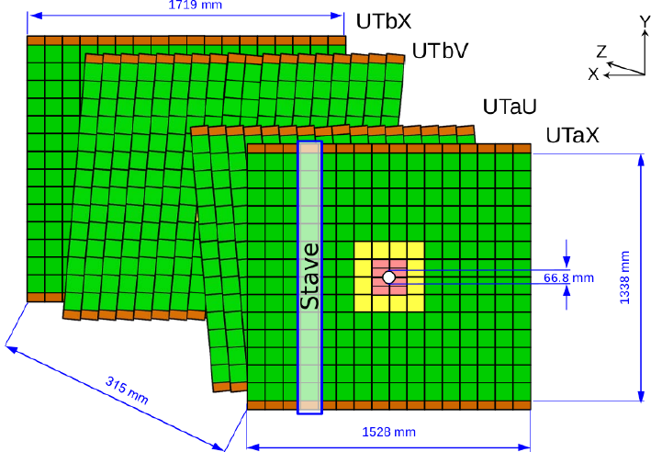
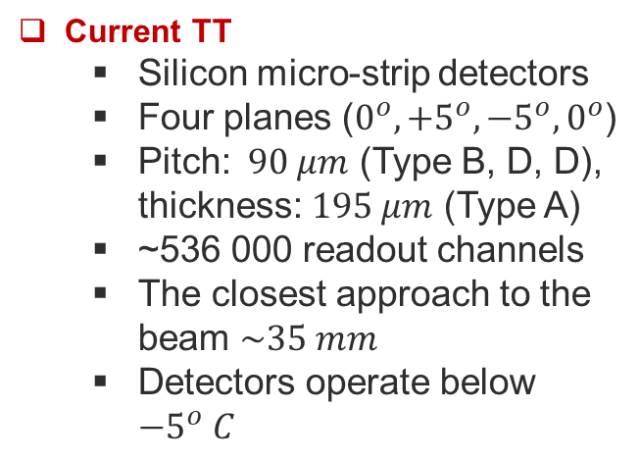
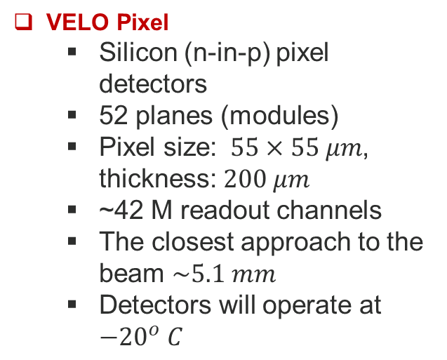
VELO Pixel
  Silicon (n-in-p) pixel detectors
  52 planes (modules)
  Pixel size: $55×55 μm$, thickness: $200 μm$
  ~42 M readout channels
  The closest approach to the beam $\sim 5.1 mm$
  Detectors will operate at ${−20}^{o} C$
Current TT
  Silicon micro-strip detectors
  Four planes ($0^{o},{+5}^{o},{−5}^{o},0^{o}$)
  Pitch: $90 μm$ (Type B, D, D), thickness: $195 μm$ (Type A)
  ~536 000 readout channels
  The closest approach to the beam $\sim 35 mm$
  Detectors operate below ${−5}^{o} C$
#

Slide 31
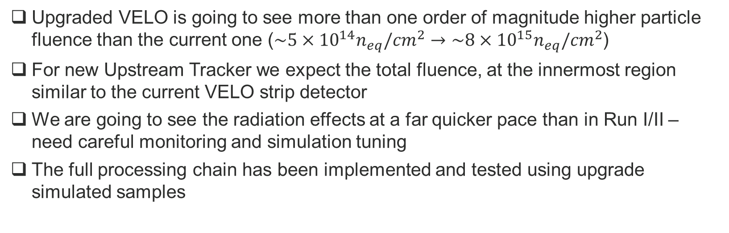
Simulation of Radiation Induced Effects - Upgrade
Upgraded VELO is going to see more than one order of magnitude higher particle fluence than the current one ($\sim 5×{10}^{14}n_{eq}/{cm}^{2}→\sim 8×{10}^{15}n_{eq}/{cm}^{2}$)
For new Upstream Tracker we expect the total fluence, at the innermost region similar to the current VELO strip detector
We are going to see the radiation effects at a far quicker pace than in Run I/II – need careful monitoring and simulation tuning
The full processing chain has been implemented and tested using upgrade simulated samples

Slide 32
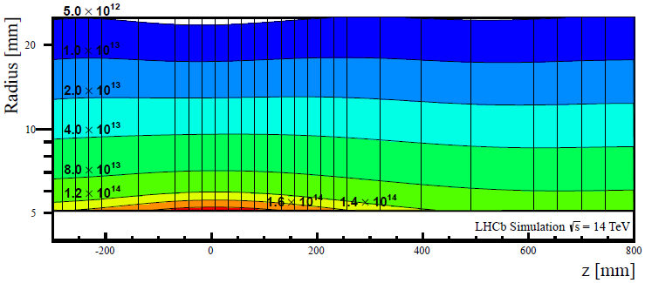
Upgrade: VELO
Software simulates the drop in CCE by implementing the full fluence map (below) and modify the diffusion constant
Using time parameter (fraction of data taken actually) we can estimate the irradiation level and adjust sensor’s active depth – no charge distribution beyond active depth

Slide 33
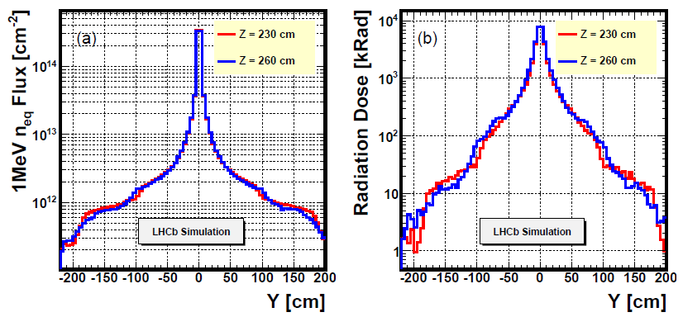
Upgrade: UT
Test beam experiments with fully irradiated sensors did not show any surprises
The current plan is to adopt a similar software (save the double metal layer modeling) tools as we have for the VELO strip

Slide 34
Conclusions
Radiation damage effects clearly visible for the current VELO strip detector, especially for Run II data taking period
Appropriate simulation tuning is important as may have significant impact on physics performance
Need to pay a lot attention to radiation damage studies during Run III
We are preparing the code using test beam data and simulation

Slide 35
Spares

Slide 36
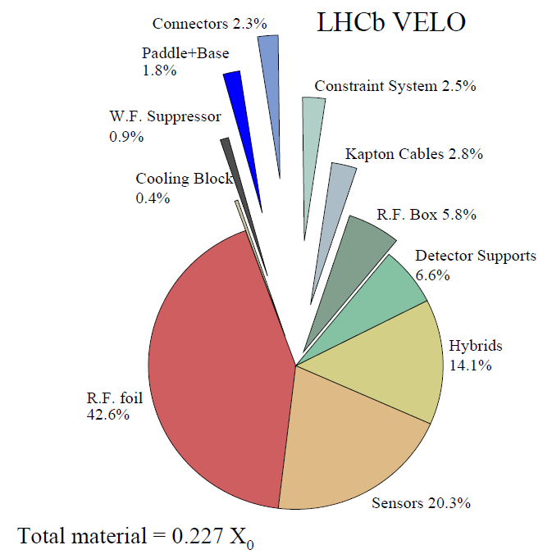
Detector Model
Simulated VELO
RF foil is extremely difficult to model accurately
  Many iterations to get it right
  Critical impact on IP resolution

Slide 37
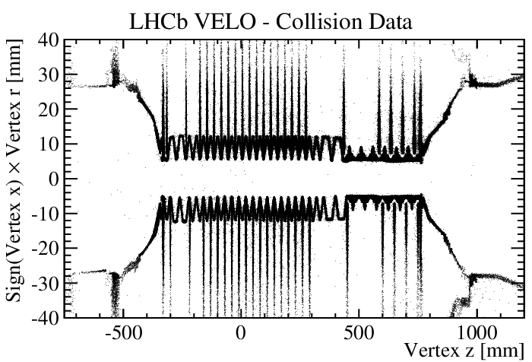
Self Imaging – Vertex Tomography (helping simulation…)
RF Foil
Outer tank

Slide 38

Self Imaging – Vertex Tomography
Much less events for MC

Slide 39


Impact Parameter Resolution - improvements
There is an intriguing time evolution of the IP seen in data, this effect is still under study

Slide 40


Impact Parameter Resolution - Improvements

Slide 41

Radiation Damage Simulation
Harsh radiation environment – silicon at 8mm from the proton beams
Fluence is function of both radius and z (sensor position)

