Slide 1
High Power Impulse Magnetron Sputtering / High Power Pulse Magnetron Sputtering (HiPIMS/HPPMS)
Technology, applications and possibilities
Anna Gustafsson

Slide 2
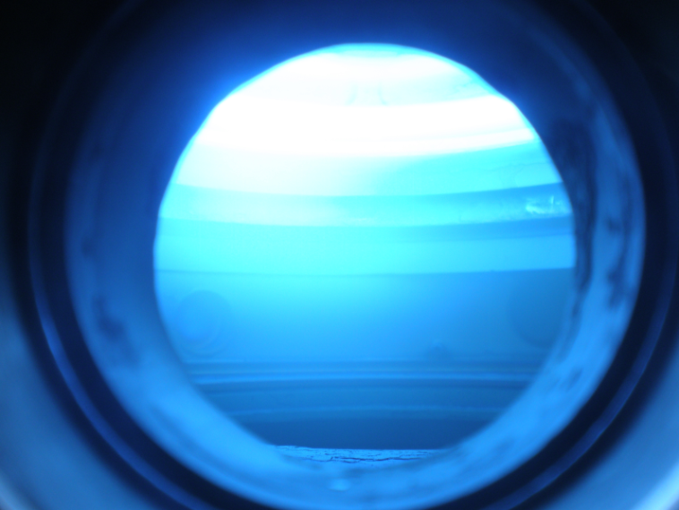
Overview
Introduction into Magnetron Sputtering
HiPIMS
  Physical processes
  Film properties
  Applications
Pro’s and Con’s
The HiPIMS Power Supply
Summary & Outlook

Slide 3
Introduction: Magnetron Sputtering
Buffer-gas atoms (e.g. Ar or Kr) are ionized. The buffer-gas ions are then accelerated towards the target and sputter atoms out of the target.
The target atoms fly towards the substrate by the kinetic energy received in the sputter process.
For more details on the spectrum of dcMS see Wil’s talk (13.11.09)
-
-
-
-
-
-
-
-
-
-
-
-
-
-
-
-
-
-
-
-
-
-
-
-
-
-
-
-
-
-
-
-
-
-
-
-
-
-
-
-
-
-
-
-
-
-
-
-
-
-
-
-
-
-
-
-
-

Slide 4
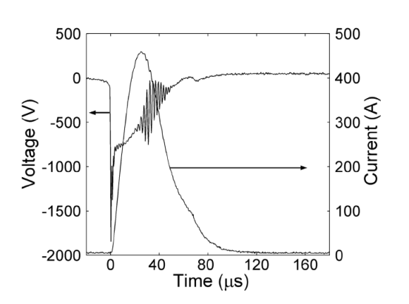
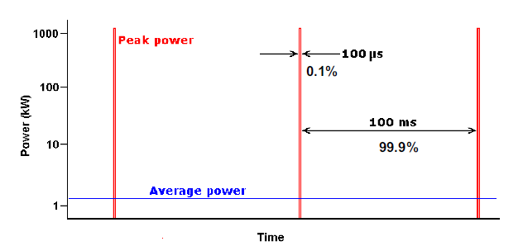
HiPIMS: Physical processes
By applying pulses of high power the sputtered target material atoms are ionized
Example of a duty cycle.
Typical voltage and current trace from a high power pulsed magnetron discharge.
J. Böhlmark et al., J. Vac. Sci. Technol. A 23 (2005) 18

Slide 5
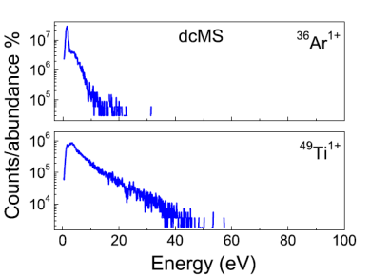
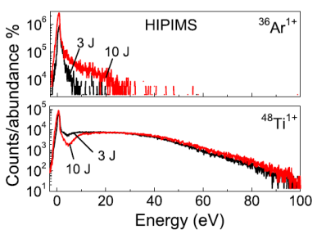
HiPIMS: Physical processes
By applying pulses of high power the sputtered target material atoms are ionized
target material ions can be accelerated towards the target, higher kinetic energy upon arrival
The energy distribution for Ar+ and Ti+
+
+
+
+
+
+
+
-
+
-
+
-
-
-
-
-
+
+
-
+
-
+
-
+
-
+
+
+
-
-
+
+
+
-
+
-
-
+
+
-
-
+
-
-
-
-
-
+
+
-
-
-
+
-
-
+
-
+
-
-
+
-
-
+
-
+
+
-
-
-
+
+
-
+
-
+
-
+
+
-
-
+
-
-
-
-
-
-
-
-
+
-
+
-
+
-
-
+
U. Helmersson et al., Thin Solid Films 513 (2006) 1-24

Slide 6
HiPIMS: Physical processes
By applying pulses of high power the sputtered target material atoms are ionized
target material ions can be accelerated towards the target, higher kinetic energy upon arrival
ions are directed to the surface, thus non-flat surfaces can be sputtered with good conformity of the film
+
+
+
+
+
+
+
+
+
+
+
+
-
+
-
+
-
-
-
-
-
+
+
-
+
-
+
-
+
-
+
+
+
-
-
+
+
+
-
+
-
-
+
+
-
-
+
-
-
-
-
-
+
+
-
-
-
+
-
-
+
-
+
-
-
+
-
-
+
-
+
+
-
-
-
+
+
-
+
-
+
-
+
+
-
-
+
-
-
-
-
-
-
-
-
+
-
+
-
+
-
-
+

Slide 7
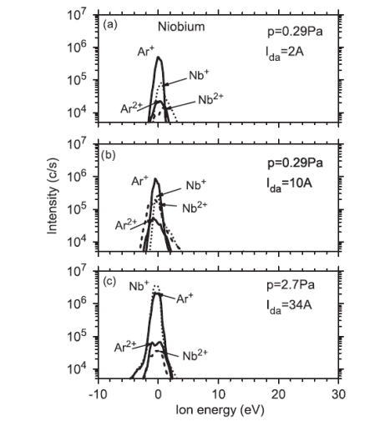
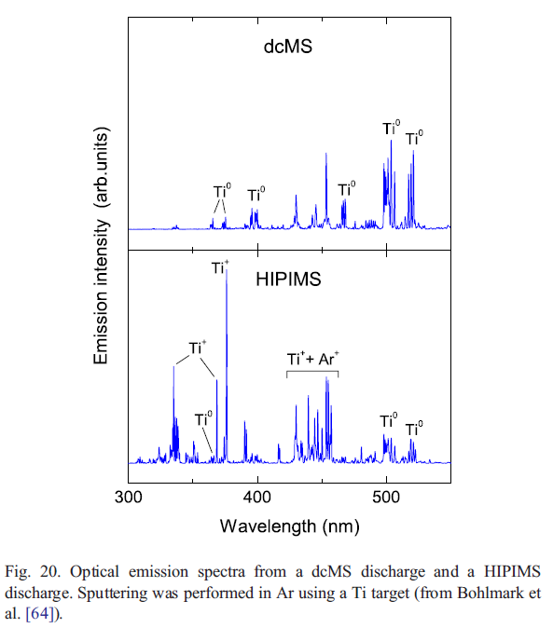
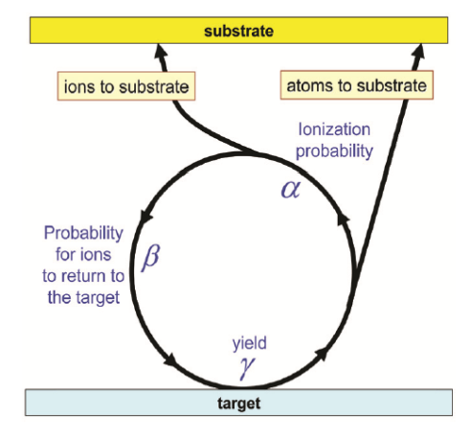
HiPIMS: Ionization
High ionization percentage
Typical values: > 90 % ionization of Ti, for Nb ~ 60 %. Nb and Ti have comparable ionization energies (6.88 eV and 6.83 eV).
Ionized target atoms can return to the target and cause self sputtering
Optical emission spectra of dcMS and HiPIMS discharge
Courtesy: A. Anders, LNL
A. Anders, AVS 56th International Symposium 2009, SE2-MoM8
K. Burcalova et al., J. Phys. D: Appl. Phys. 41 (2008) 115306
U. Helmersson et al., Thin Solid Films 513 (2006) 1-24

Slide 8
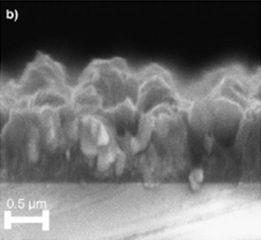
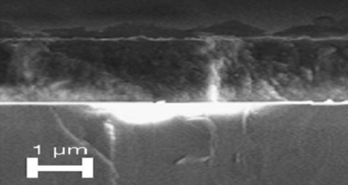
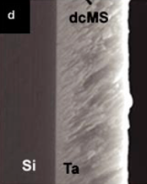
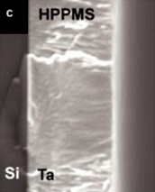
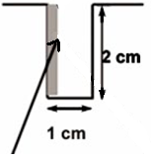
Enhanced properties of films with HiPIMS
dcMS
HiPIMS
Comment
SEM image of a Ti-Si-C film
SEM image of a Ta film grown on Si.
J. Alami et al., J. Vac. Sci. Technol. A 23 (2005) 278
J. Alami et al., Thin Solid Films 515 (2006) 1731

Slide 9
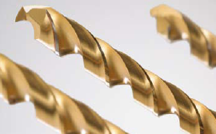
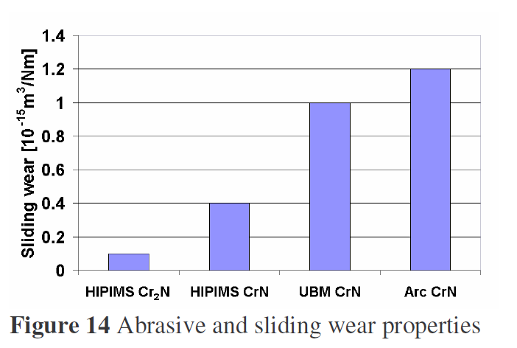
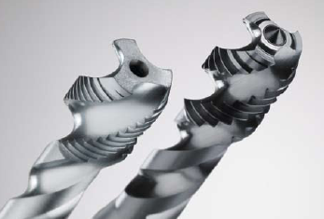
Industrial applications of HiPIMS
HiPIMS can be used on large cathodes (up to 1 m length).
Semiconductor applications (trench filling).
Sputter etching and implantation of Cr and Nb for enhanced adhesion of hard coatings.
Improved wear behaviour of HiPIMS coatings of e.g. CrN and Cr₂N coatings.
Abrasive and sliding wear properties
W.-D. Münz et al., J. of. Phys: Conf Series 100 (2008) 082001

Slide 10
Benefits
Any existing magnetron sputtering system can be used for HiPIMS by connecting a HiPIMS power supply instead of the DC power supply.
Low average power at the target due to a long duty cycle.
High ionization factor. Ionization dependent on many factors.
Typical values: > 90 % ionization of Ti, for Nb ~ 60 %. Nb and Ti have comparable ionization energies (6.88 eV and 6.83 eV).
HiPIMS can be used on large cathodes (up to 1m length)
Improved film quality: better adhesion, higher density, decreased roughness, good conformity, increased (normal) conductivity have been reported.
Applicable to non-flat surfaces.

Slide 11
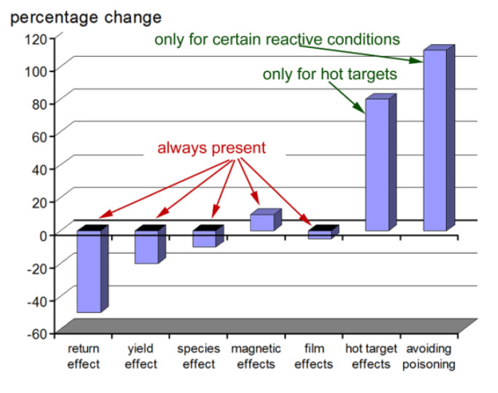
Drawbacks
(Usually) lower deposition rate than with dcMS
More expensive power supply
Cathode size limited (HIE-ISOLDE)
A. Anders, AVS 56th International Symposium 2009, SE2-MoM8

Slide 12
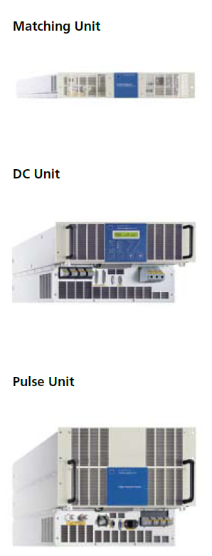
The power supply
HÜTTINGER Elektronik is the only available manufacturer of HiPIMS power supplies suitable for our systems and purposes
Average/Peak power: 20 kW/ 2 MW
Peak current: 1 kA
Peak voltage: 2 kV
Output frequency: up to 500 Hz
Pulse length: up to 200 μs
HIPIMS power supply requirements : parameters and breakthrough arc management solution, Pawel Ozimek, April 2009

Slide 13
Outlook
Establish a HiPIMS coating system for small samples by use of the DMS in Building 101, understanding the different parameters and optimize the system.
Produce Nb films on Cu samples to investigate superconducting properties as well as RF properties.
Investigations of the so-called Q-drop mechanism to possibly improve the performance of Nb film cavities by this new sputtering technique.
Tests of the HiPIMS PS on the HIE-ISOLDE coating system. Cathode is cylindrical and much bigger surface, thus the feasibility has to be tested.

Slide 14
Summary
HiPIMS will not replace the conventional DC method, due to it’s lower deposition rate and expensive power supplies.
Enhanced film properties gives an important complement to the existing systems.
Superconducting properties of Nb films have hardly been investigated yet, but the enhanced film properties give a promising hint of improvements.
The community is very convinced that HiPIMS is “the way to go”

Slide 15
Thanks for your attention
References
J. Alami et al., J. Vac. Sci. Technol. A 23 (2005) 278
J. Alami et al., Thin Solid Films 515 (2006) 1731
A. Anders, AVS 56th International Symposium 2009, SE2-MoM8
K. Burcalova et al., J. Phys. D: Appl. Phys. 41 (2008) 115306
J. Böhlmark et al., J. Vac. Sci. Technol. A 23 (2005) 18
V. Kouznetsov et al., Surf. Coat. Technol. 122 (1999) 290
W.-D. Münz et al., J. of. Phys: Conf Series 100 (2008) 082001
HIPIMS power supply requirements : parameters and breakthrough arc management solution Pawel Ozimek, April 2009
Review on Ionized Physical Vapor Deposition (IPVD):
U. Helmersson et al., Thin Solid Films 513 (2006) 1-24

