Slide 1
Heat Transfer Interface to Graphitic Foam
Fang-Ming Lin, Eric Anderssen
Lawrence Berkeley National Laboratory
Graham Beck
Queen Mary University of London
June 26th 2018

Slide 2

Overview
Hit density is expected to increase after the upgrade. Thermal management is important to ensure precise measurements.
The effective thermal conductivity of the graphitic carbon foam has been studied.
The integration between the glue and the graphitic foam should be further investigated due to graphene’s anisotropic thermal property.
A FEA model is developed to optimize the thickness of the glue by varying the carbon foam’s physical properties and also the type of filler used in the glue.
A preliminary study is done to study the effect of the amount of surface area between ligands and the titanium tube’s surface.
Preliminary testing results are compared with analysis results.

Slide 3
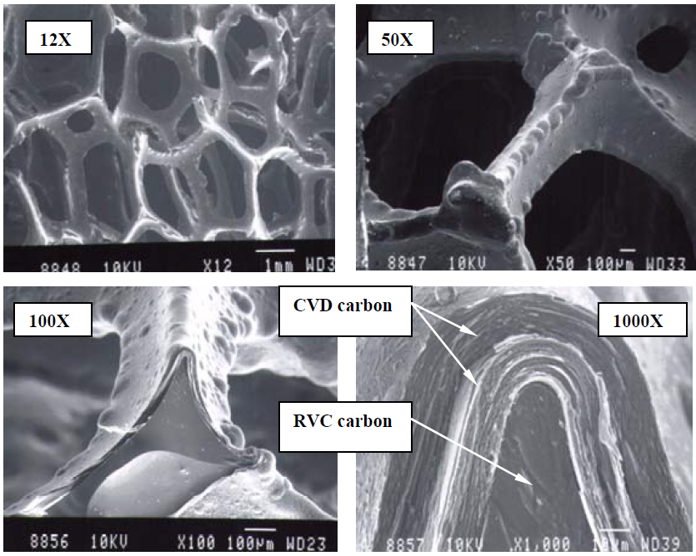
RVC Foam + CVD Process
Reticulated vitreous carbon foam
    Open-Cell
    Low density
    Glassy type
    High internal ligand surface area per unit volume
    Thermally insulative property (k = 0.085 W/mK)
Chemical vapor deposition
    Highly-ordered after graphitization
    A ligand graphitic conductivity > 1500 W/mK
AllComp Inc.

Slide 4
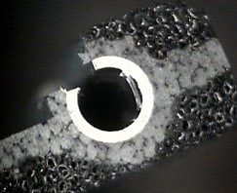

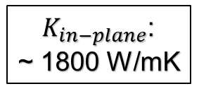


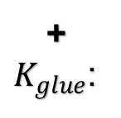
Thermal Properties at the Interface
The area where heat enters is noticeably different from out-of-plane and in-plane directions.
Without glue, heat transfers into ligand with two different thermal conductivities.
A thickness of glue is added with its own thermal conductivity.
Graphene Coating
$$K_{out−of−plane}$$
~ 3 W/mK
Ligand
Components at the Interface | K (W/mK)
Ligand | <1
Graphite (Transverse) | ~3
Graphite (Longitudinal) | ~1800
Glue (Hysol EA9396 with BN) | 1.1
Glue (Hysol EA9396 with Graphite) | 3.5
Glue (Low Thermal Conductivity) | 0.1
$$Glue$$
+
$K_{glue}$:
$K_{in−plane}$:
~ 1800 W/mK
$$Titanium$$

Slide 5
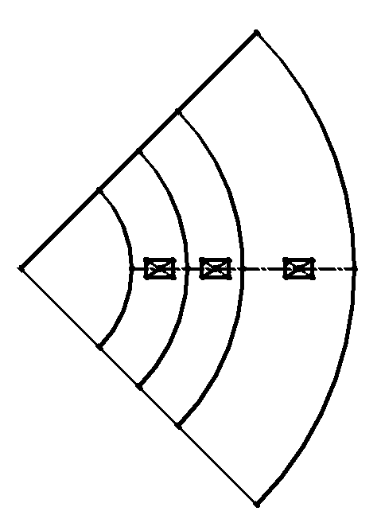

Resistance Network for the Participating Components at the Interface
$$Q=\frac{∆T}{R} → ∆T=QR$$
$$R=\frac{1}{A}[\left(\frac{t_{Ti}}{K_{Ti}}\right)+\left(\frac{t_{glue}}{K_{glue}}\right)+\left(\frac{t_{foam}}{K_{foam}}\right)]$$
Control the thickness of the glue to understand how temperature drop cross the glue layer changes → essentially trying to find the effective thermal conductivity term for where glue is infiltrated into the carbon foam.
Geometrical variations at the interface. E.g. foam density, cell (pore) size, broken ligands.
R_{foam}
Fixed terms
R_{glue}
R_{Ti}
Titanium
Glue
Foam

Slide 6
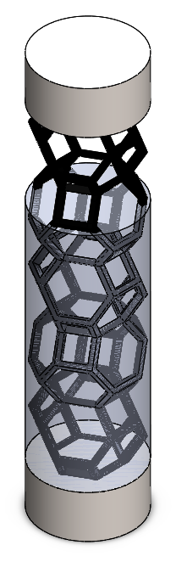
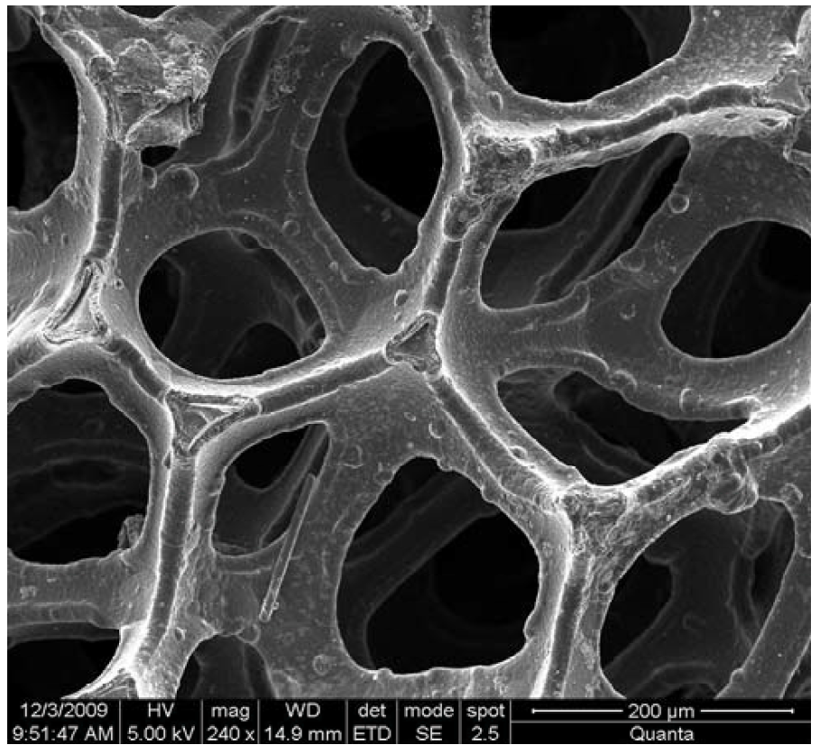
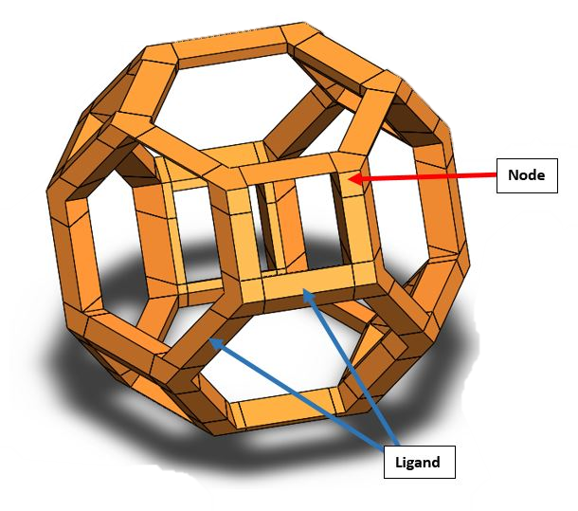
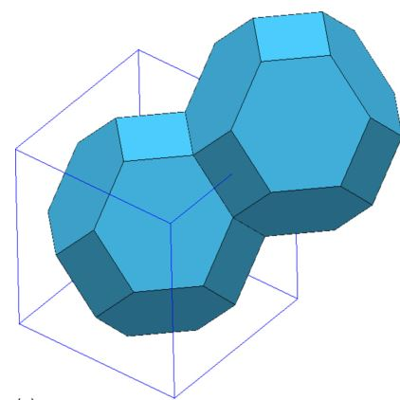
Kelvin Cell
Kevin (Tetrakaidecahedral) cell is used to represent one pore of the graphitic foam.
The skeleton of the cell is sliced into nodes and ligands.
Titanium Plate
Foam
Structure
Glue
Kelvin cell developed for ligands and nodes
Array of cells, glue is infiltrated between the spacing of the cells.
Notes:
Size the ligand in the kelvin
Tue the graphene thickness over the RVC until the density to be .22 g/cc

Slide 7
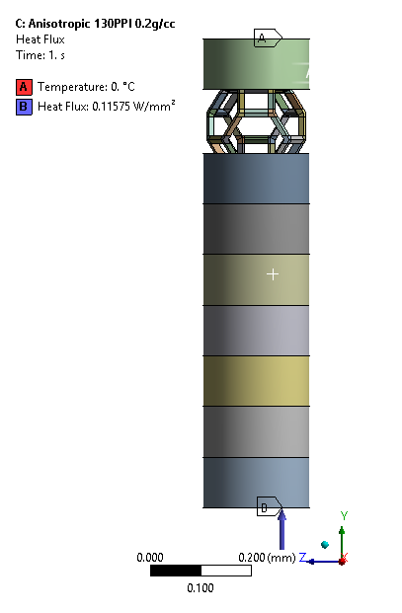
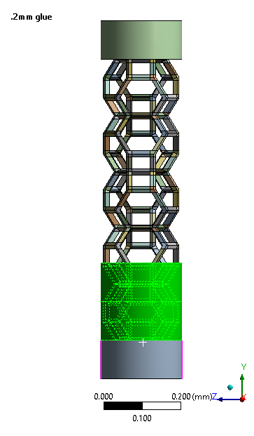
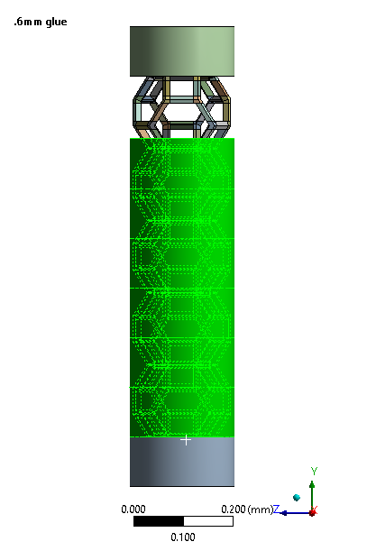
FEA Model Setups
Boundary conditions
Control on the thickness of the glue
~1.0W/cm²
4 cm
Silicon Module
CVD Foam (30-40W/mK)
OD 2.2 mm
Glue
Calculate Heat Flux using area ratio. Heat flux at the interface is calculated to be 11.6 W/cm²

Slide 8
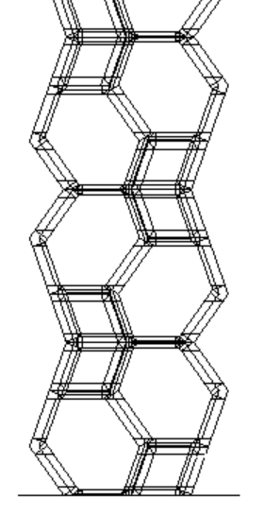
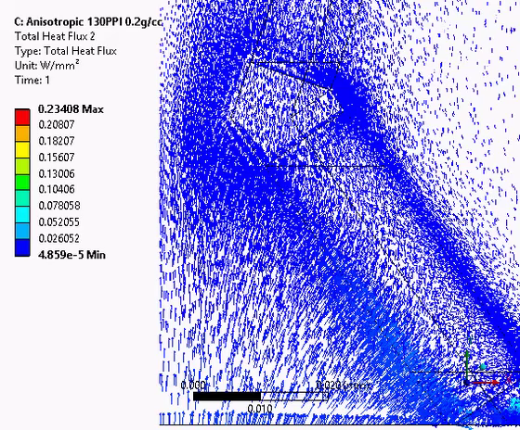
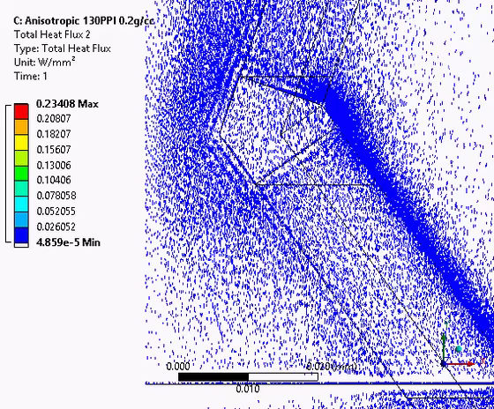
Heat Flux from the Glue into the Foam
Flux in the glue between thickness= 0mm to 0.1mm
Flux in the glue between thickness = 0.3 mm to 0.4mm mm
Q
Heat flux in the glue enters into ligands, finding the best path to conduct.
Less heat flux spreads out laterally, heat flux in the foam has reached a saturation.

Slide 9
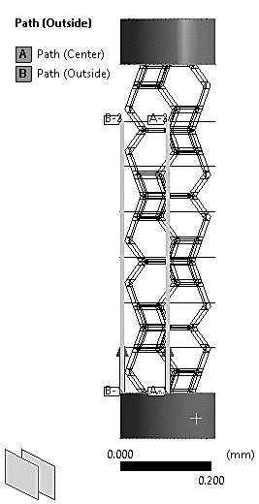
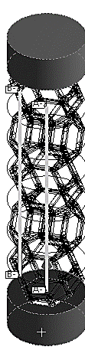
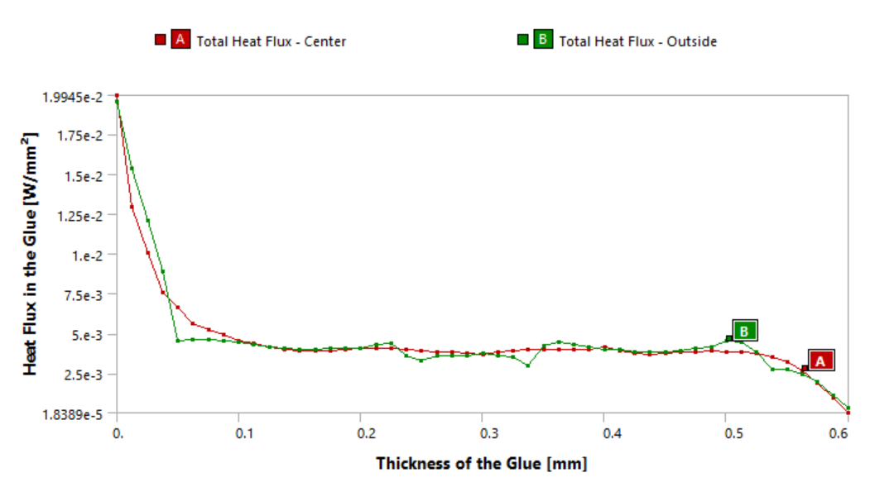
Analysis: Heat Flux in the Glue
Fluctuation of the heat flux is owing to carbon foam’s geometry; it is more clear to obtain a saturation point with the heat flux in the foam. (heat flux in the foam >> heat flux in the glue)
Subtracting the heat flux in the glue from the total heat flux equals to the heat flux in the foam.
Isometric view of the two paths

Slide 10
Varying the Filler
The desired thickness of the glue increases as the thermal conductivity of the filler increases.
Curve can be fitted with a logarithmic function → can be used to predict the thickness as the type of filler is changed.

Slide 11
Varying the Density (the thickness of the graphene coating) of the Graphitic Foam
Changing density of the carbon foam while keeping the cell size constant, essentially changing the thickness of the graphene layers.
The required thickness of the glue to reach the saturation does not vary significantly.

Slide 12
Varying the Size of the Graphitic Foam
100 PPI has larger cell (pore) size, the required thickness of the glue layer to reach the saturation point decreases as the cell size increases.
Notes:
Smaller PPI has larger cell which also has larger surface area per unit volume

Slide 13
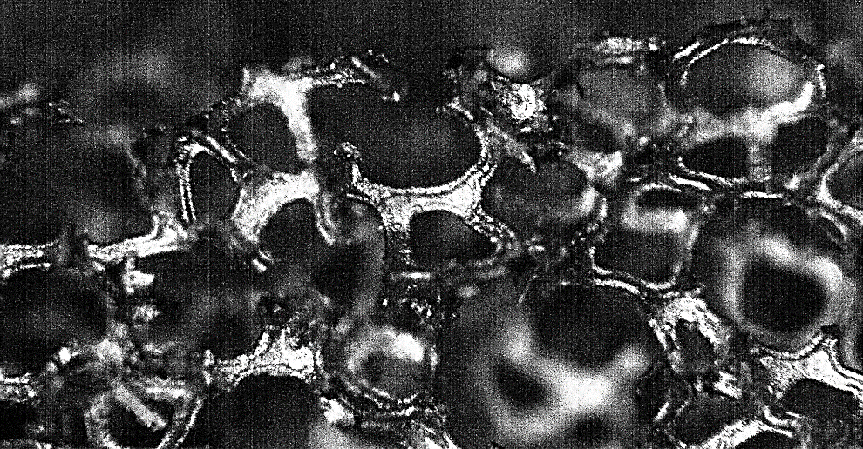
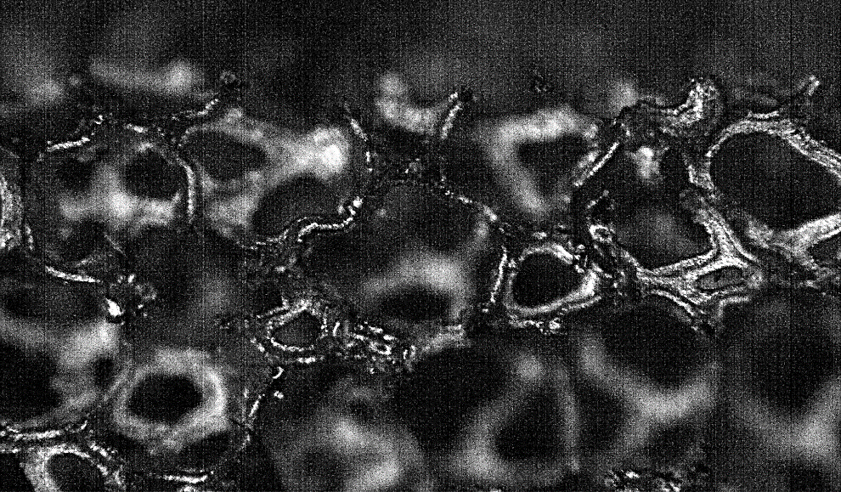
Ligands at the Interface in microscale
When ligands break, a stochastic distribution of distances are created between ligand ends to the tube, with some touch.
Try to understand how the amount of contact area and the distance affect the thermal behavior.
Titanium Tube

Slide 14
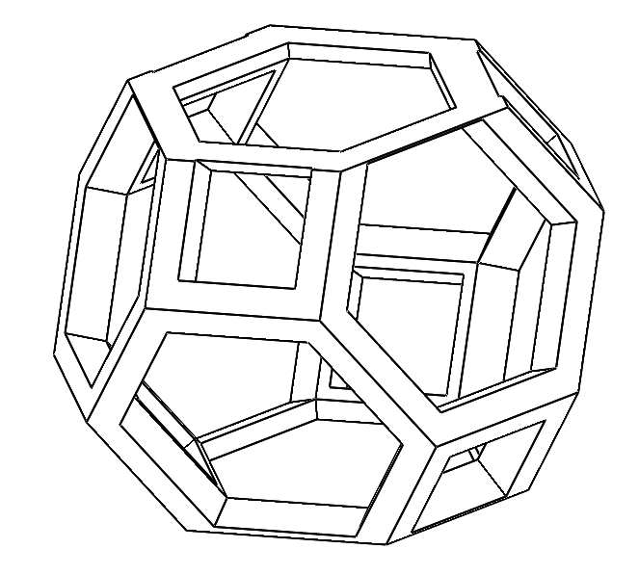
Approximation on the ligands’ touch area
Adjacent: there is a horizontal ligand connects the ligands at the first level with the ligands at the second level.
Non-adjacent: there is not a horizontal ligand connects the ligands at the first level with the ligands at the second level.
Third level
2
1
Second level
3
First level
6
5
4
Horizontal ligand
Adjacent Case
Third level
2
1
Second level
3
First level
6
5
4
Non-adjacent Case
Notes:
3 and 4 are connected by a cross ligand

Slide 15

Differences and Combinations
1
2
5
6
1 ligand Removed
2 ligands Removed
3 ligands Removed
4 ligands Removed
5 ligands Removed
Heat goes through four out of six ligands at the second level.
Adjacent
Adjacent
(2) Adjacent +
(1) Non-adjacent
(2) Adjacent +
(2) Non-adjacent
1
4
5
6
Non-adjacent
Non-adjacent
(1) Adjacent +
(2) Non-adjacent
Heat goes through six out of six ligands at the second level.
Notes:
Adjacent doesn’t matter but number of missing does matter

Slide 16
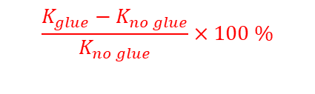
K_{eff} for the Missing Ligands Cases
Adjacent cases have a higher drop in thermal conductivity.
Glue has a higher impact when more ligands are removed.
$$\frac{K_{glue}−K_{no glue}}{K_{no glue}}×100 \%$$
Notes:
Adjacent cases have a higher drop in thermal conductivity.
Glue has a higher impact when more ligands are removed.

Slide 17
Heat Flux for the Two Cases
Analysis shows that the difference is negligible; but heat flux now converges around 0.165 mm.
(Analysis was run with 130 PPI with graphite filler for the glue)
Notes:
Adjacent cases have a higher drop in thermal conductivity.
Glue has a higher impact when more ligands are removed.

Slide 18
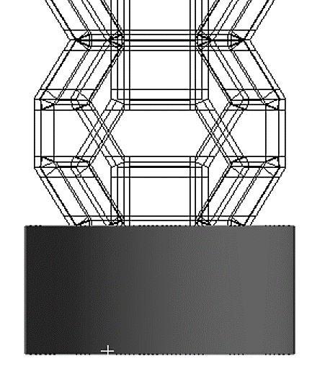
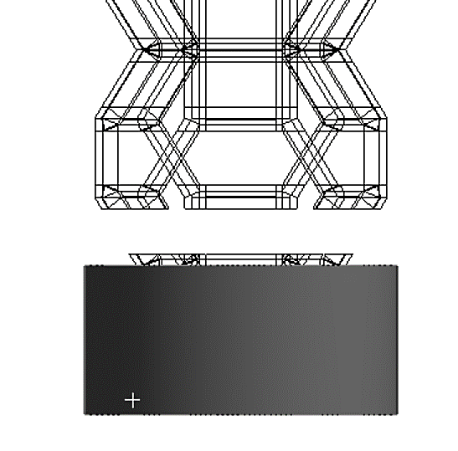
Heat Flux in the Foam vs. Number of Missing Ligands
The required thickness of glue to reach the saturation depends on the number of missing ligands at the interface and also the distance from the ligands to the interface.
(Analysis was run with 130 PPI with BN filler for the glue)

Slide 19
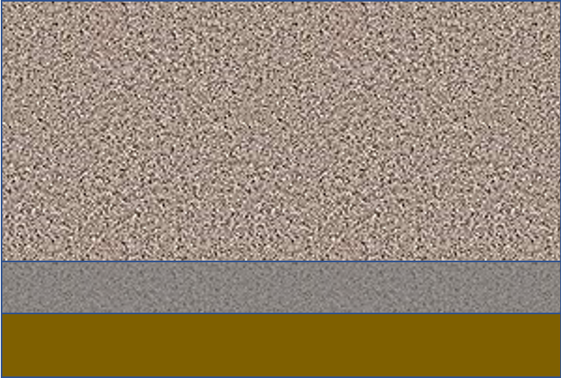

Design of Experiment
Foam touches foil, glue penetrates and wets both.
0.2mm Titanium
New Glue for this half stack
Repeat Region
0.2-0.6mm Glue
3 – 4 mm Foam
Previous Glue
0.2-0.6mm Glue
Foam sets the gap between foil layers, glue penetrates foam to defined depths (0.2-0.6mm).
Glue is applied to foil in controlled thickness, then foam is bonded to foil.
Layers will repeat as 2^{n} as sample is cut down and glued to itself.
Divide in half
Repeat n times…
Cut in half, apply glue to bottom of one half then stack
Divide in half

Slide 20
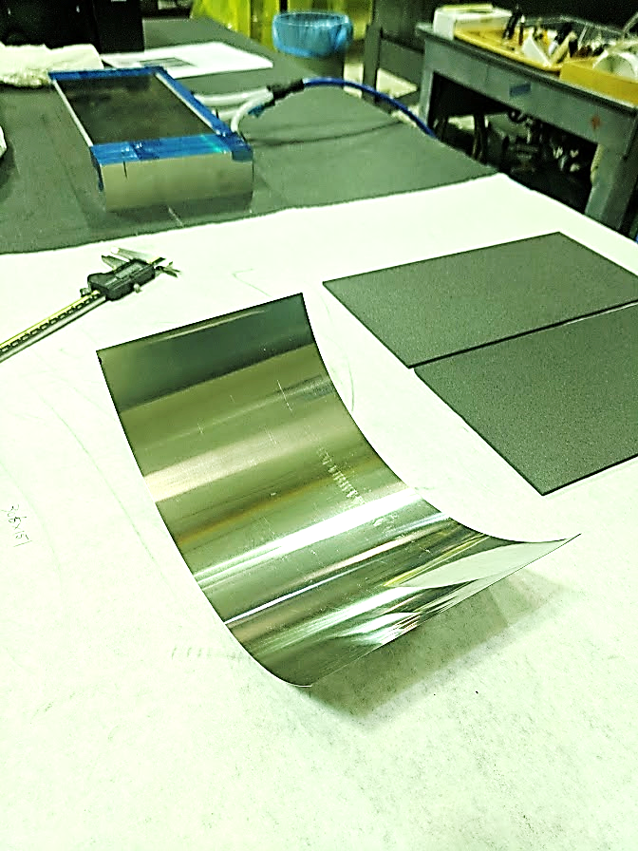
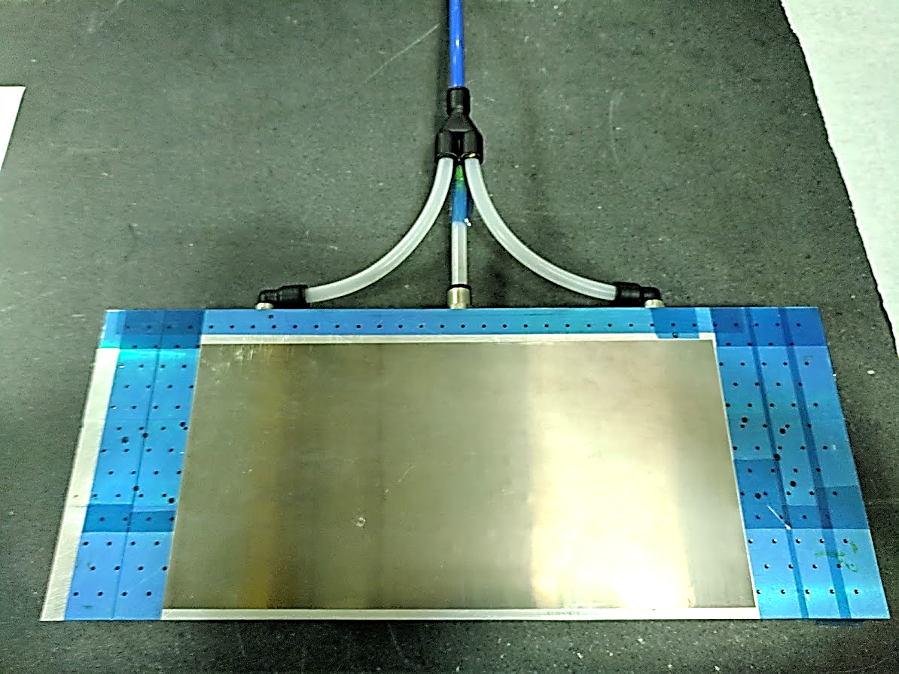
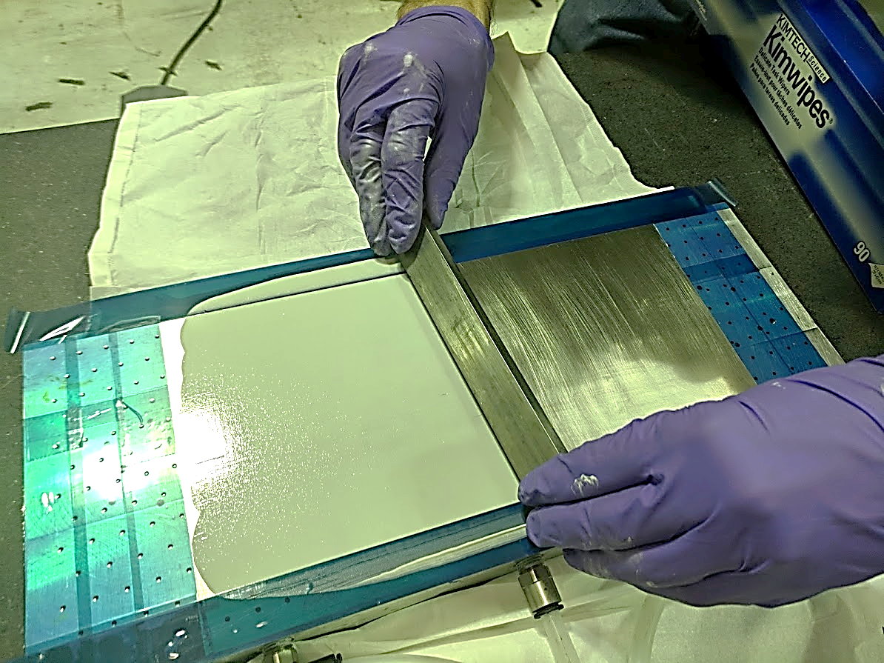
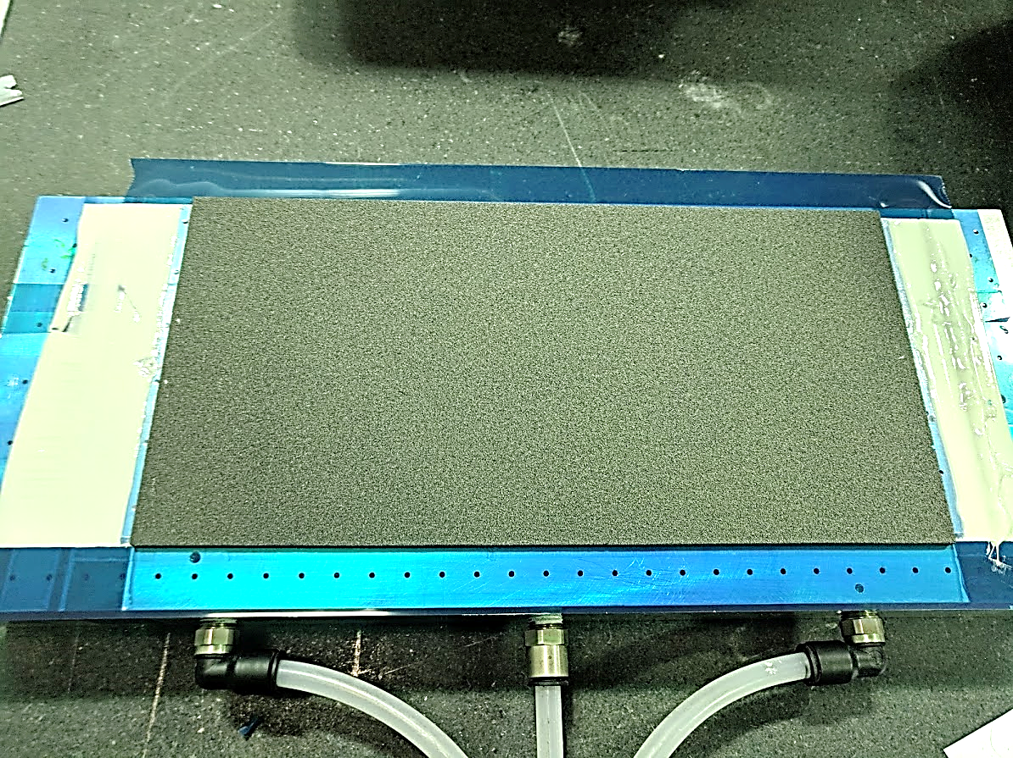
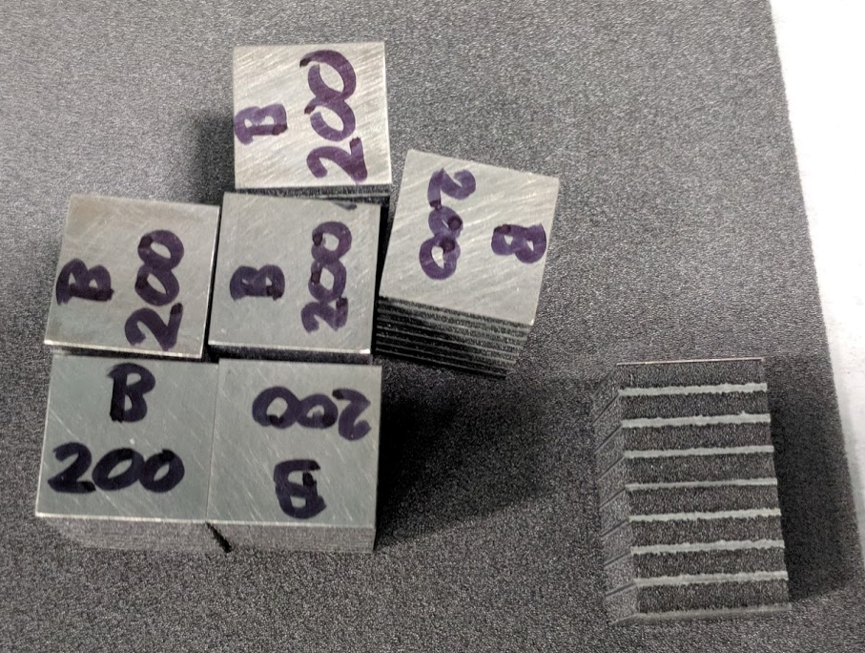
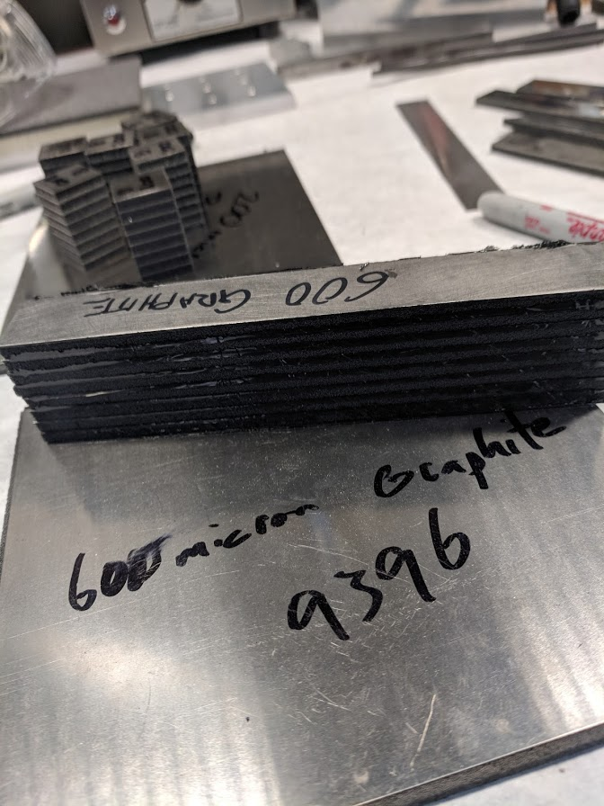
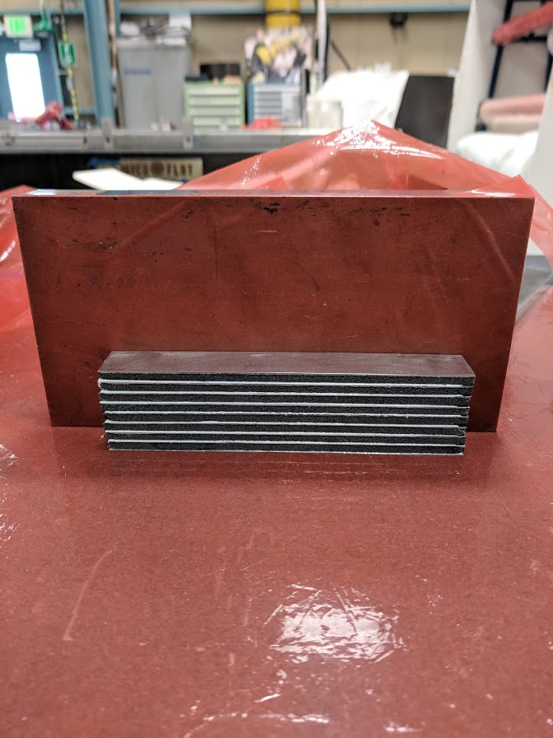
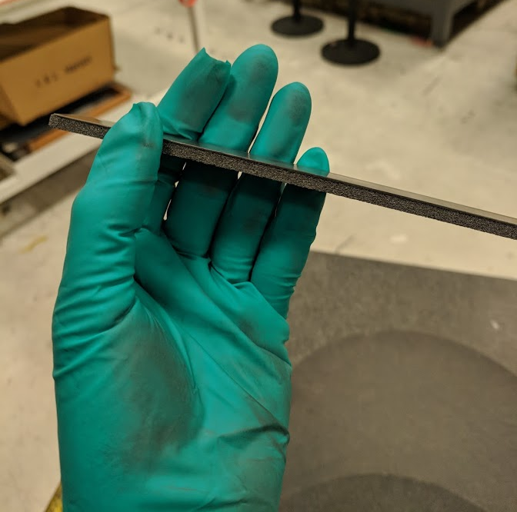
Sample Fabrication
Titanium Foil is flatten with the vacuum chuck.
Applying the glue, thickness is controlled by the tape.
Placing the carbon foam on top of the glue.
The completed sample for the 8 layers with BN filler.
aaa
Stack layers of (Titanium + Glue + Foam)

Slide 21
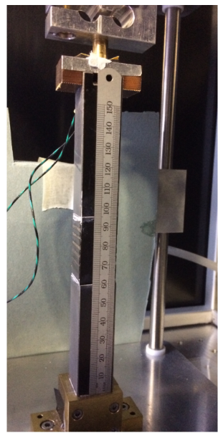
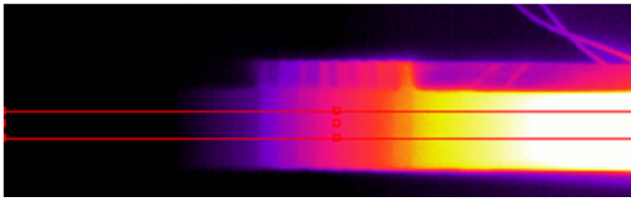
Sample Testing
Infrared camera (FLIR A40M with 320 pixels wide) is used to measure the temperature drop in the sample.
Two lead pillars are placed at each end of the sample.
Calibration is only needed for the lead pillars. It is not needed for the sample part, the thermal resistance [K/W] can be obtained from the slop of plot (T vs. h)
The lead pillars and the sample are covered by black tape with high emissivity for reaching an equilibrium temperature with the target object.
2.11 W over a 4 cm² sample, Q loss through the sample.
Top lead pillar
Sample
Bottom lead pillar
Ruler is temporary, used for calibrate IR pixels vs. mm
Graham Beck QMUL
Notes:
The reason for this is that both lead and foam (and I expect titanium) have low emissivity (don’t quote me, but around 75% for the foam).
It follows that they have appreciable reflectivity. (emissivity+ transmissivity + reflectivity = 1).
As a result of all this, it is difficult to get an accurate measurement of temperature from the infrared radiation emitted from the surface.

Slide 22
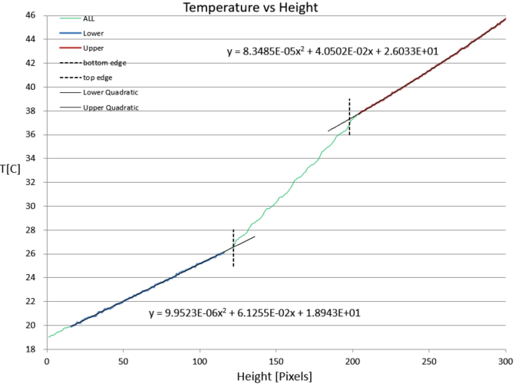
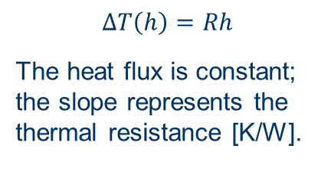
Preliminary Testing Plot
$$∆T\left(h\right)=Rh$$
The heat flux is constant; the slope represents the thermal resistance [K/W].
Sample
Graham Beck QMUL

Slide 23
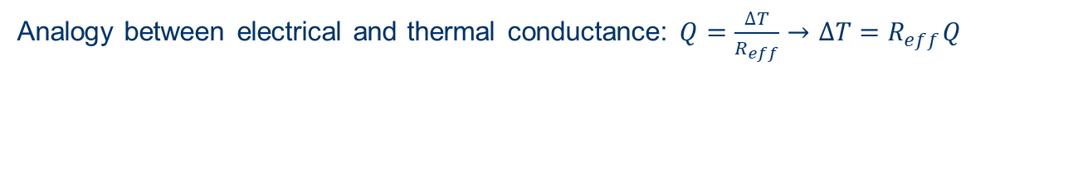
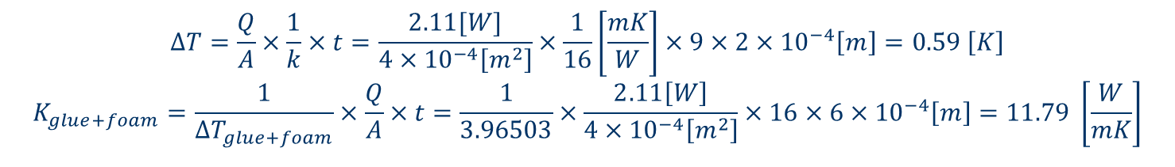
Preliminary Testing Calculations
Analogy between electrical and thermal conductance: $Q=\frac{∆T}{R_{eff}}→∆T=R_{eff}Q$
Graphite Filler with 0.6mm glue thickness, 130PPI, 0.205 g/cc |  |  |  |  | Total Δ T
 |  |  |  |  | 10.77
 | # of layers | Thickness [m] | Total Thickness [m] | K or K_{eff} [W/mºC] | ΔT [ºC]
Grease | 2 |  |  |  | 0.30
Titanium | 9 | 0.0002 | 0.0018 | 16 | 0.59
Foam | 8 | 0.0040 | 0.0320 | 28.7 | 5.88
Glue + Foam | 16 | 0.0006 | 0.0096 | 11.79 | 3.97
Glue |  |  |  | 3.5
Calculated and subtracted from the total temperature drop to get the temperature drop across the (glue + foam) layers
(-)
(-)
(-)
(=)
Varied Term
Fixed Terms
The value we are interested in
$$∆T=\frac{Q}{A}×\frac{1}{k}×t=\frac{2.11[W]}{4×{10}^{−4}\left[m^{2}\right]}×\frac{1}{16}\left[\frac{mK}{W}\right]×9×2×{10}^{−4}\left[m\right]=0.59 \left[K\right]$$
$$K_{glue+foam}=\frac{1}{∆T_{glue+foam}}×\frac{Q}{A}×t=\frac{1}{3.96503}×\frac{2.11\left[W\right]}{4×{10}^{−4}\left[m^{2}\right]}×16×6×{10}^{−4}\left[m\right]=11.79 \left[\frac{W}{mK}\right]$$

Slide 24
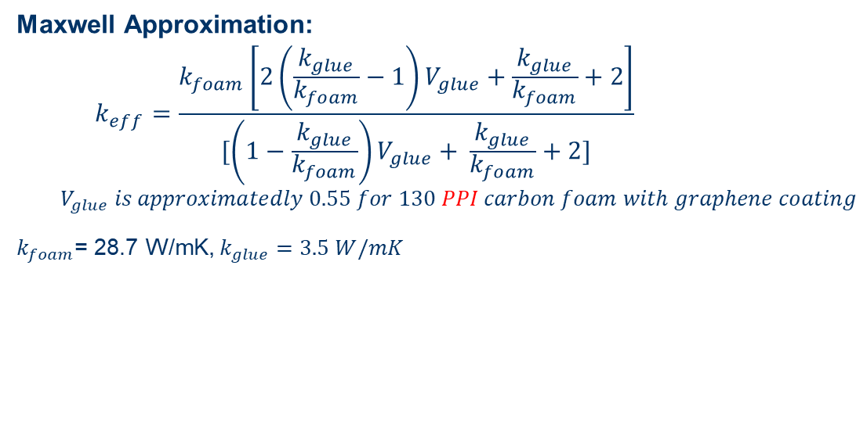
Preliminary Testing Calculations
Maxwell Approximation:
$$k_{eff}=\frac{k_{foam}\left[2\left(\frac{k_{glue}}{k_{foam}}−1\right)V_{glue}+\frac{k_{glue}}{k_{foam}}+2\right]}{[\left(1−\frac{k_{glue}}{k_{foam}}\right)V_{glue}+ \frac{k_{glue}}{k_{foam}}+2]}$$
$$V_{glue} is approximatedly 0.55 for 130 PPI carbon foam with graphene coating$$
$k_{foam}$= 28.7 W/mK, $k_{glue}=3.5 W/mK$
t_{saturation}
Titanium
K_{foam+glue} = ?
 | Experimental Results, K [W/mºC] | Analysis Results (saturation thickness), K [W/mºC] | Maxwell Approximation, K [W/mºC]
Graphite 0.6mm | 11.79 | 16.12 | 12.79
BN 0.6mm | 7.44 | 12.46 | 11.01
Notes:
Show Ratio
Maxwell no ligands loss, foam dominates
Maxwell approximation is the upper bound
1/3 of the equivalent K if using 200 micro

Slide 25
Preliminary Testing Results
HTC = K_{eff}/L
Preliminary testing results for the 600 micron cases.
Have results for 200 micron but unsure if variability is due to noise or difference within the sample.
Will continue work over the summer
Notes:
Show Ratio
Maxwell no ligands loss, foam dominates
Maxwell approximation is the upper bound
1/3 of the equivalent K if using 200 micro
We could describe (‘characterise’ or ‘quantify’) the glue layer by its thickness [mm] and thermal conductivity of the glue [W/m-K]. But since the layer is thin, the effect of heat spreading laterally i.e. in the plane of the layer is negligible. So the natural way to quantify its effect is to say how much heat per unit area it conducts for a given T rise across the layer.

Slide 26
Closing Remarks and Future Plans
From this study:
The required thickness of the glue to reach a saturation of the heat flux in the glue depends on the size of the foam and the type of filler used for the glue, but not so much on the density.
The distance from the ligands to the bonded (titanium) surface and also the amount of contact surface might alter the required thickness of the glue layer.
Future Plans:
Develop a statistical approach to analyze the stochastic distribution of the distance between the ligands and the bonded (titanium) surface.
Complete more sample testing to validate the results obtained from the analysis (e.g. using 100 PPI carbon foam or a different density for the graphitic foam).

Slide 27
Q & A
Thank you for your attention

Slide 28
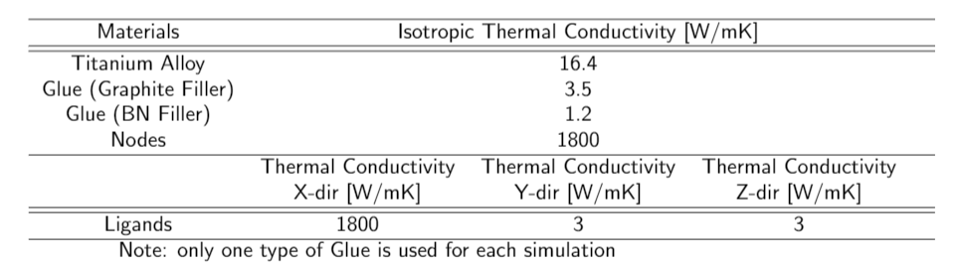
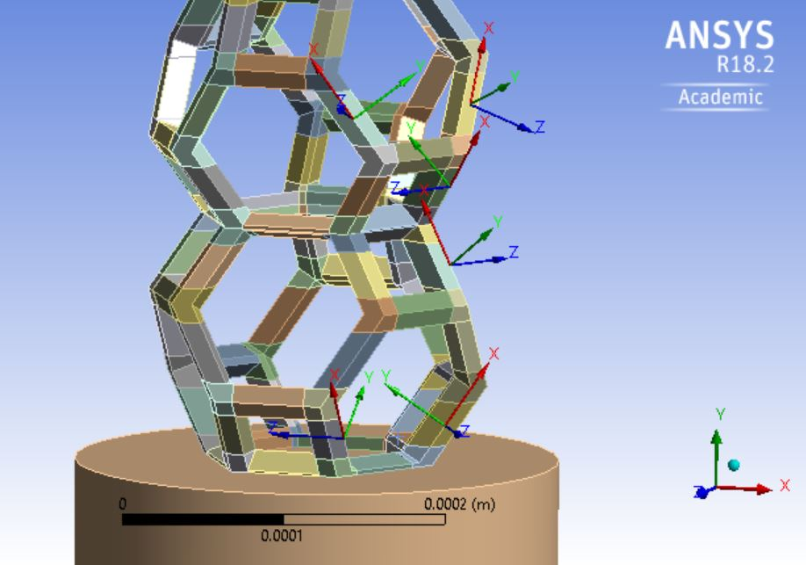
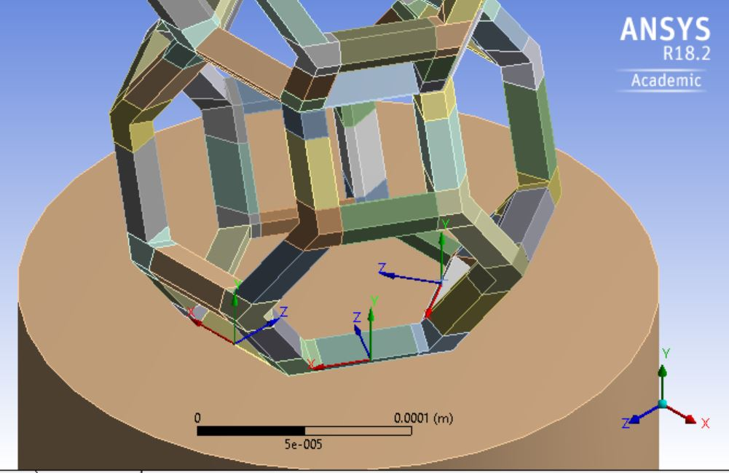
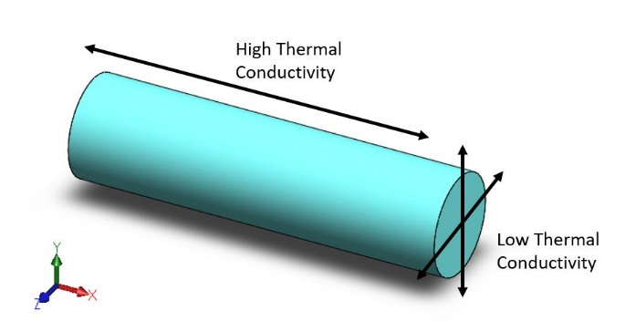
Local Coordinates Setups for the Anisotropic Thermal Properties
Six local coordinates are created for the vertically orientated ligands and three local coordinates are created for the horizontally orientated ligands.
X-direction is defined to have the high thermal conductivity; Y-direction and Z-direction are both defined to have the low thermal. conductivity.

Slide 29
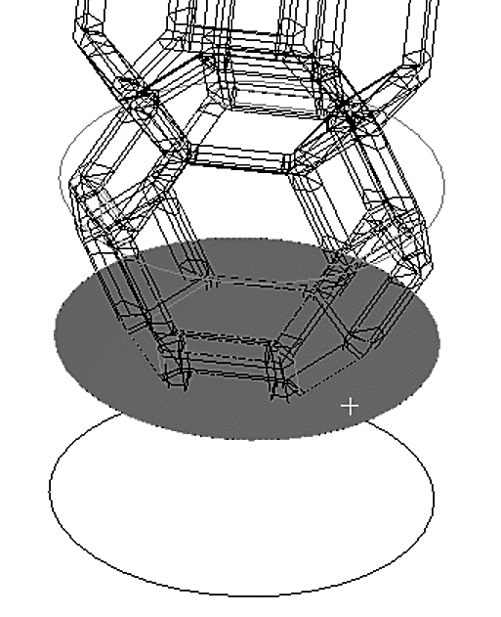
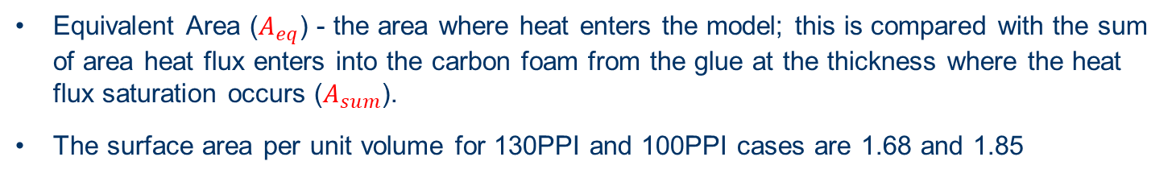
Area Comparison
Equivalent area
Equivalent Area ($A_{eq}$) - the area where heat enters the model; this is compared with the sum of area heat flux enters into the carbon foam from the glue at the thickness where the heat flux saturation occurs ($A_{sum}$).
The surface area per unit volume for 130PPI and 100PPI cases are 1.68 and 1.85
Notes:
Surface area per unit volume for 130 PPI and 100 PPI cases …. Replace “the ratio”

