Slide 1


Introduction to 16 T dipole magnet manufacturing & target cost
Daniel Schoerling
On behalf of EuroCirCol WP5 and the FCC-hh Magnet Development Program
12th of January 2018
D.Arbelaez¹¹, B.Auchmann¹, H.Bajas¹, M.Bajko¹, A.Ballarino¹, E.Barzi¹⁰, G.Bellomo², M. Benedikt¹, S.Izquierdo Bermudez¹, B.Bordini¹, L.Bottura¹, L.Brower¹¹, M.Buzio¹, B.Caiffi⁵, S.Caspi¹¹, M.Dhalle³, M.Durante⁴, G. de Rijk¹, P.Fabbricatore⁵, S.Farinon⁵, P.Ferracin¹, P.Gao³, S.Gourlay¹¹, M.Juchno¹¹, V.Kashikhin¹⁰, F.Lackner¹, C.Lorin⁴, M.Marchevsky¹¹, V.Marinozzi², T.Martinez ⁶, J.Munilla⁶, I.Novitski¹⁰, T.Ogitsu⁷, R.Ortwein¹, J.Perez¹, C.Petrone¹, S.Prestemon¹¹, M.Prioli¹, J.M.Rifflet⁴, E.Rochepault¹, S.Russenschuck¹, T.Salmi⁸, F.Savary¹, D.Schoerling¹, M.Segreti⁴, C.Senatore⁹, M.Sorbi², A.Stenvall⁸, E.Todesco¹, F.Toral⁶, A.P.Verweij¹, S.Wessel³, F.Wolf¹, A.V.Zlobin¹⁰
1.CERN, 1211 Geneva, Switzerland; 2.INFN, 20133 Milano, Italy; 3.Twente University, 7500 Twente, Netherlands; 4.CEA, 91400 Saclay, France; 5.INFN, 16146 Genova, Italy; 6.CIEMAT, 28040 Madrid, Spain; 7.KEK, 305-0801 Tsukuba, Japan; 8.Tampere University, 33100 Tampere, Finland; 9.University of Geneva, 1211 Geneva, Switzerland; 10.FNAL, Batavia IL 60510, USA; 11.LBNL, Berkeley, CA 94720, USA

Slide 2
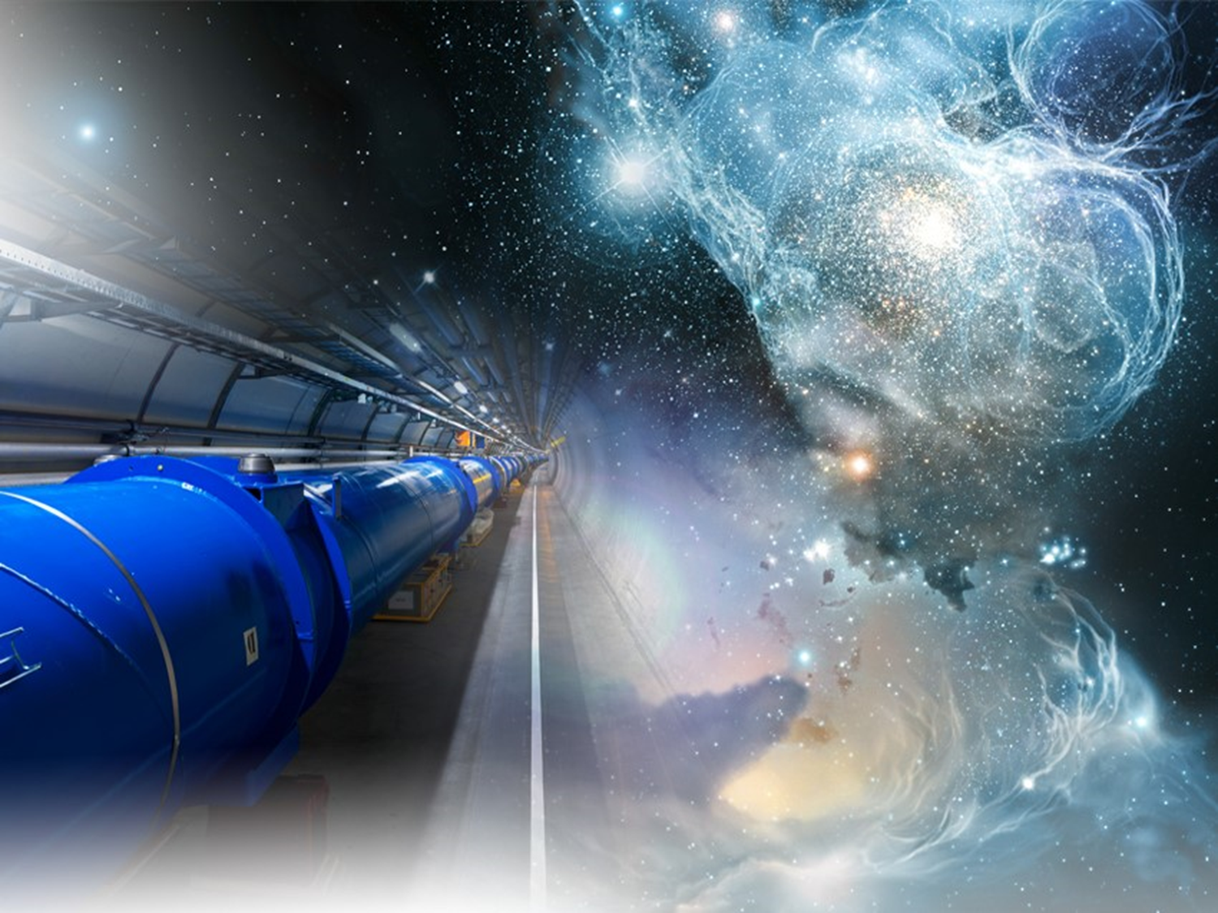
Outline
Introduction to CERN
The Future Circular Colider (FCC) study
The dipole magnets for FCC – Design options
Technological and production challenges for 16 T dipole magnets
Target cost model

Slide 3
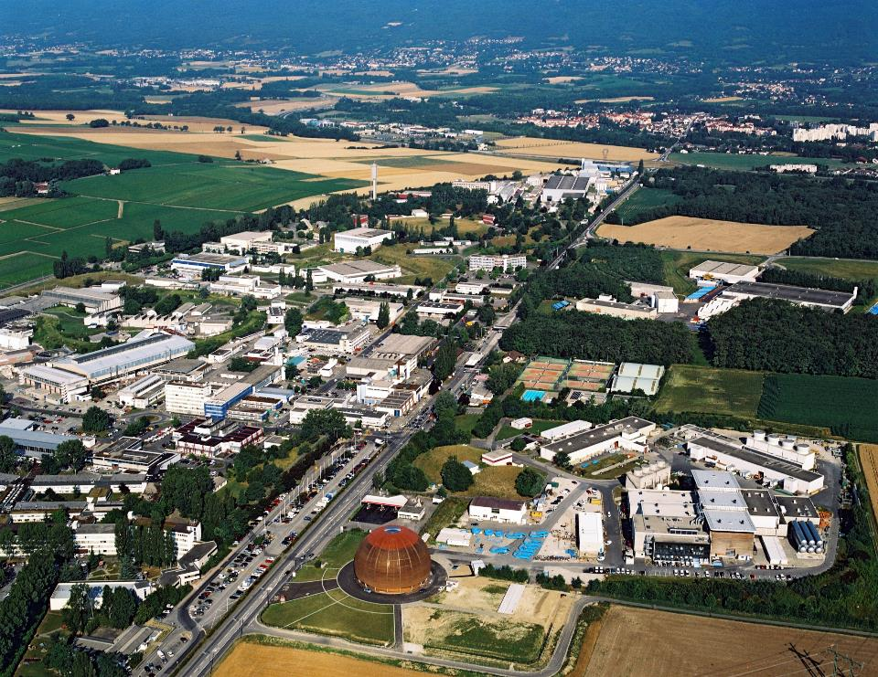


Daniel Schoerling TE-MSC-MNC

Slide 4
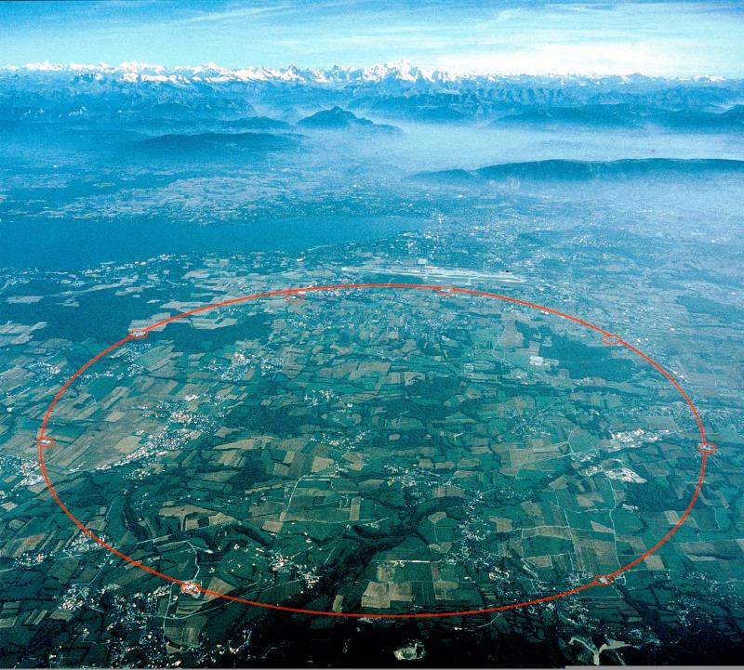

Slide 5
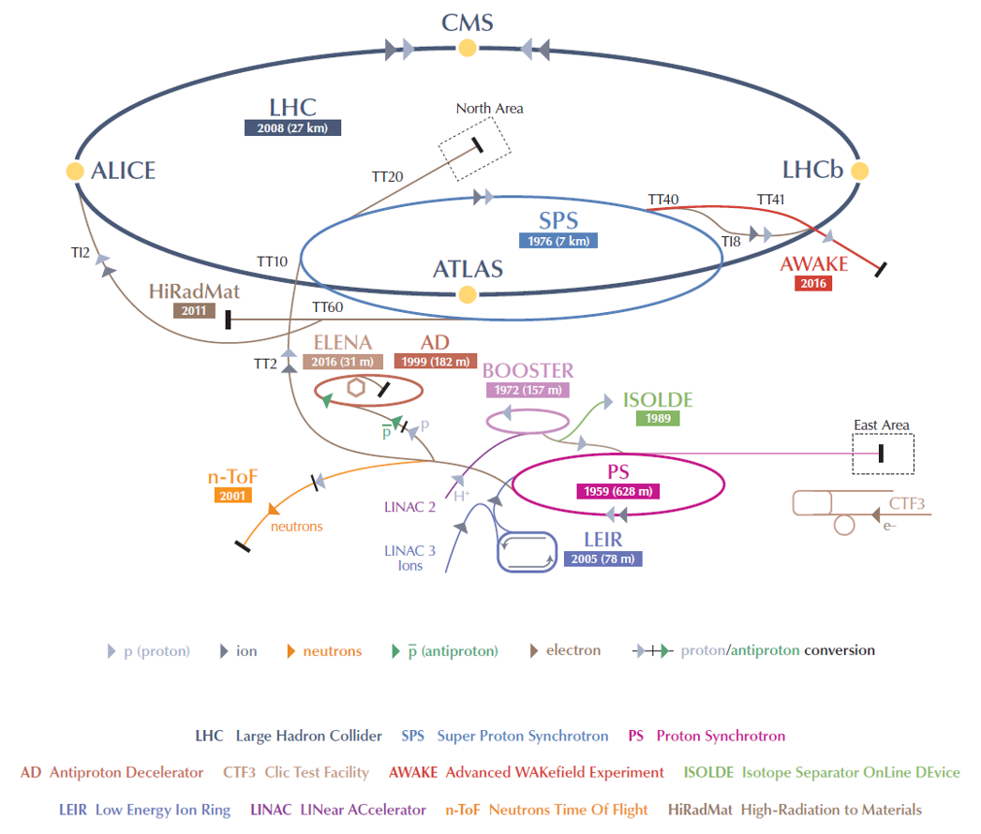
The CERN accelerator chain
50 000 tons of normal conducting magnets & 50 000 tons of superconducting magnets

Slide 6
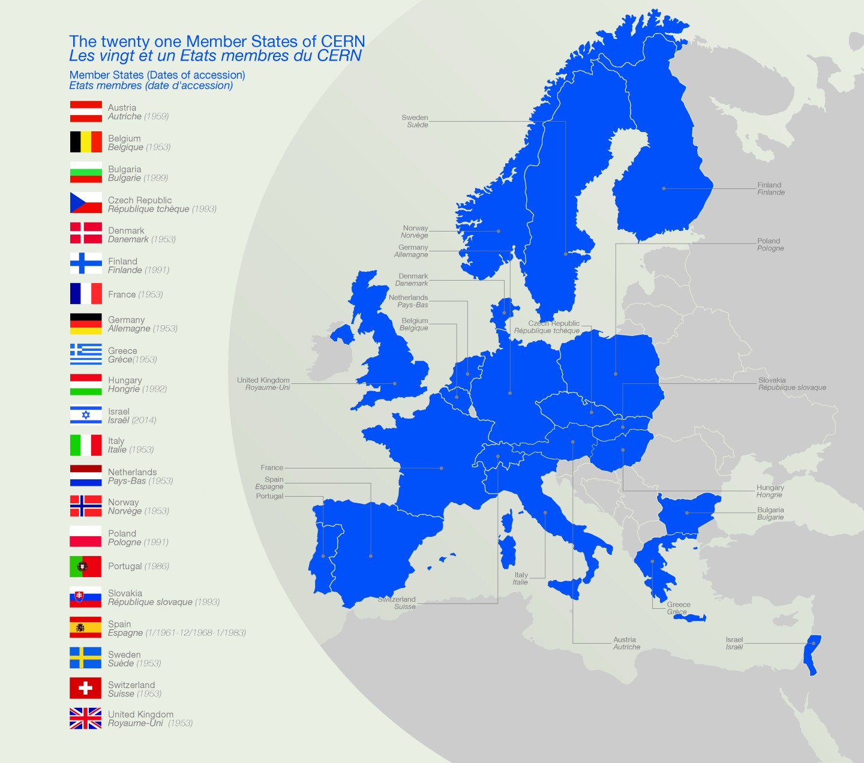
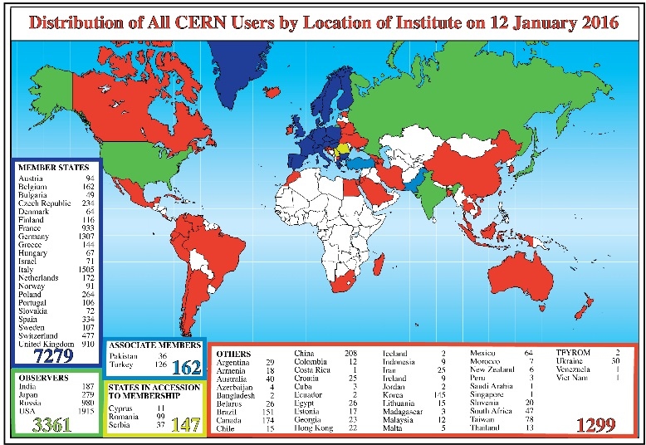
CERN member states
~ 2300 staff
~ 1600 other paid personnel
~ 12000 users
Budget ~1000 MCHF
Dedicated PhD program for technical students
Notes:
6
6

Slide 7
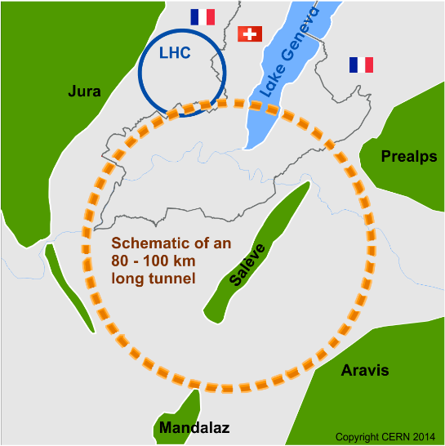
LHC, what next?
International FCC collaboration (CERN as host lab) to study:
80-100 km tunnel infrastructure
pp-collider (FCC-hh)
e⁺e⁻ collider (FCC-ee) as potential first step
p-e (FCC-he) option
HE-LHC with FCC-hh technology
Notes:
7
7

Slide 8
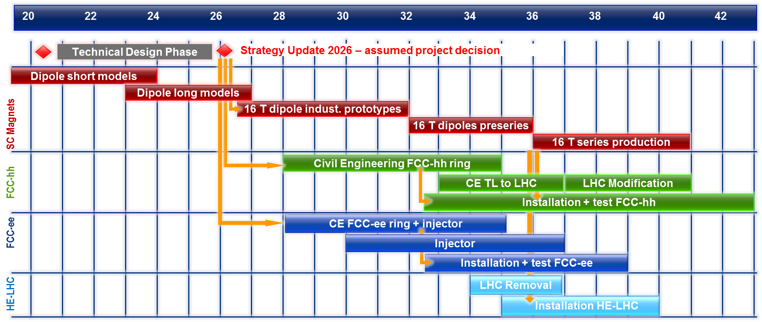
CERN Circular Colliders & FCC
Notes:
8
8

Slide 9
State-of-the-art: LHC
Superconductor: Nb-Ti
Nominal field: 8.33 T
Operating temperature: 1.9 K
1232 dipoles

Slide 10
The choice of the superconductor
T = 4.5 K
Critical surface FCC
LHC at 1.9 K
16 T
HL-LHC
5400 mm²
3150 mm²
Different technology
~1.7 times less SC
Nb-Ti
Not possible
~10% margin
HL-LHC
~10% margin
FCC ultimate

Slide 11
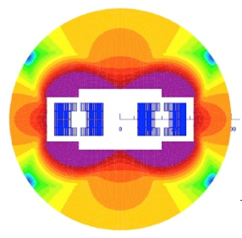
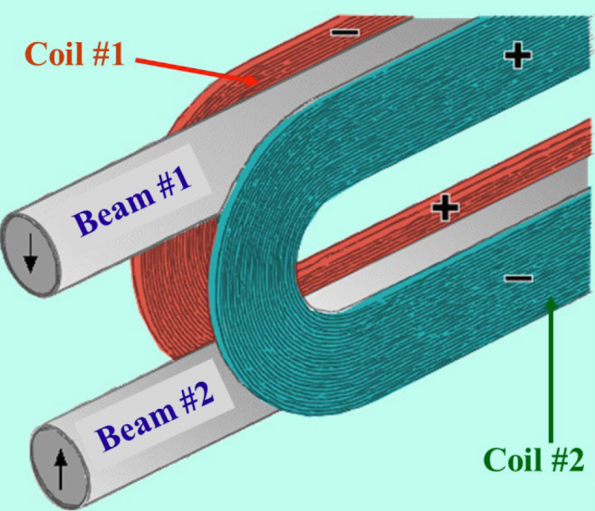
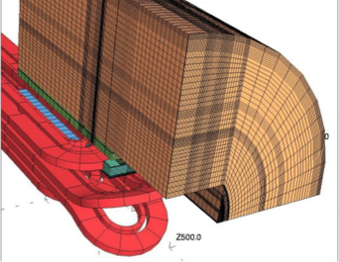
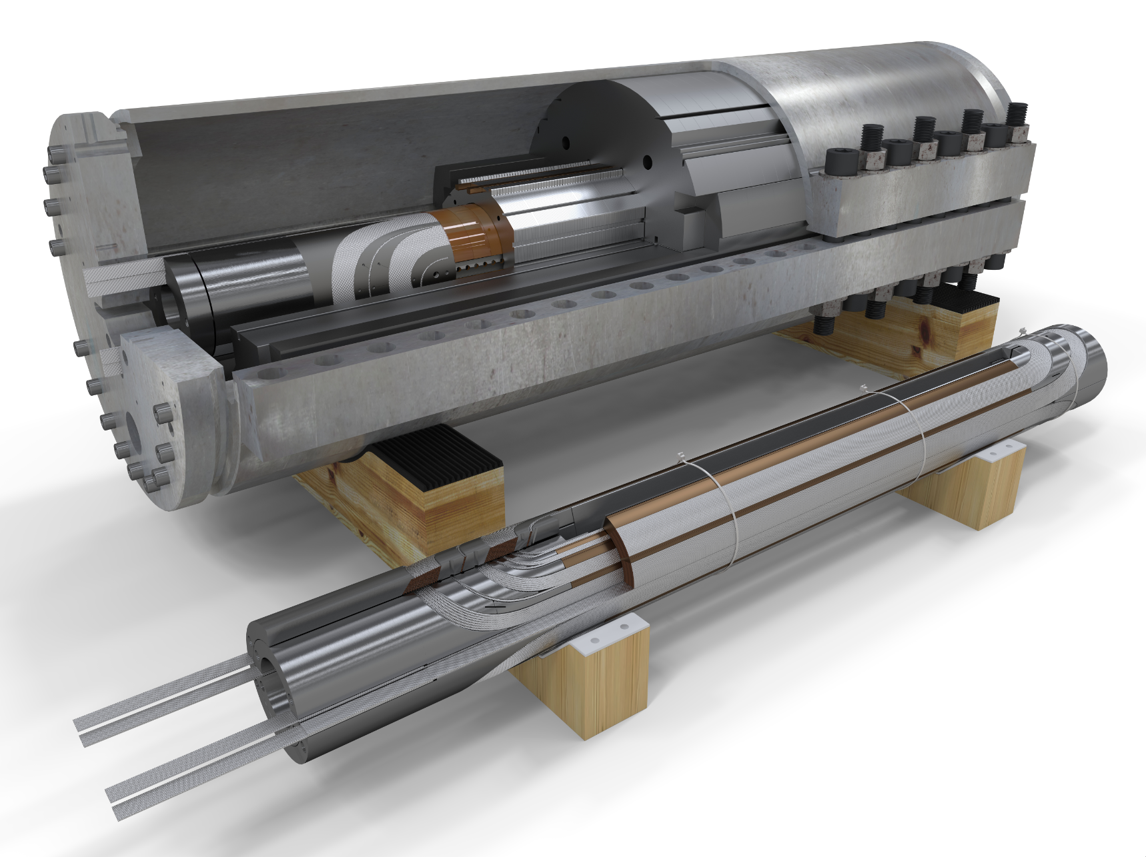
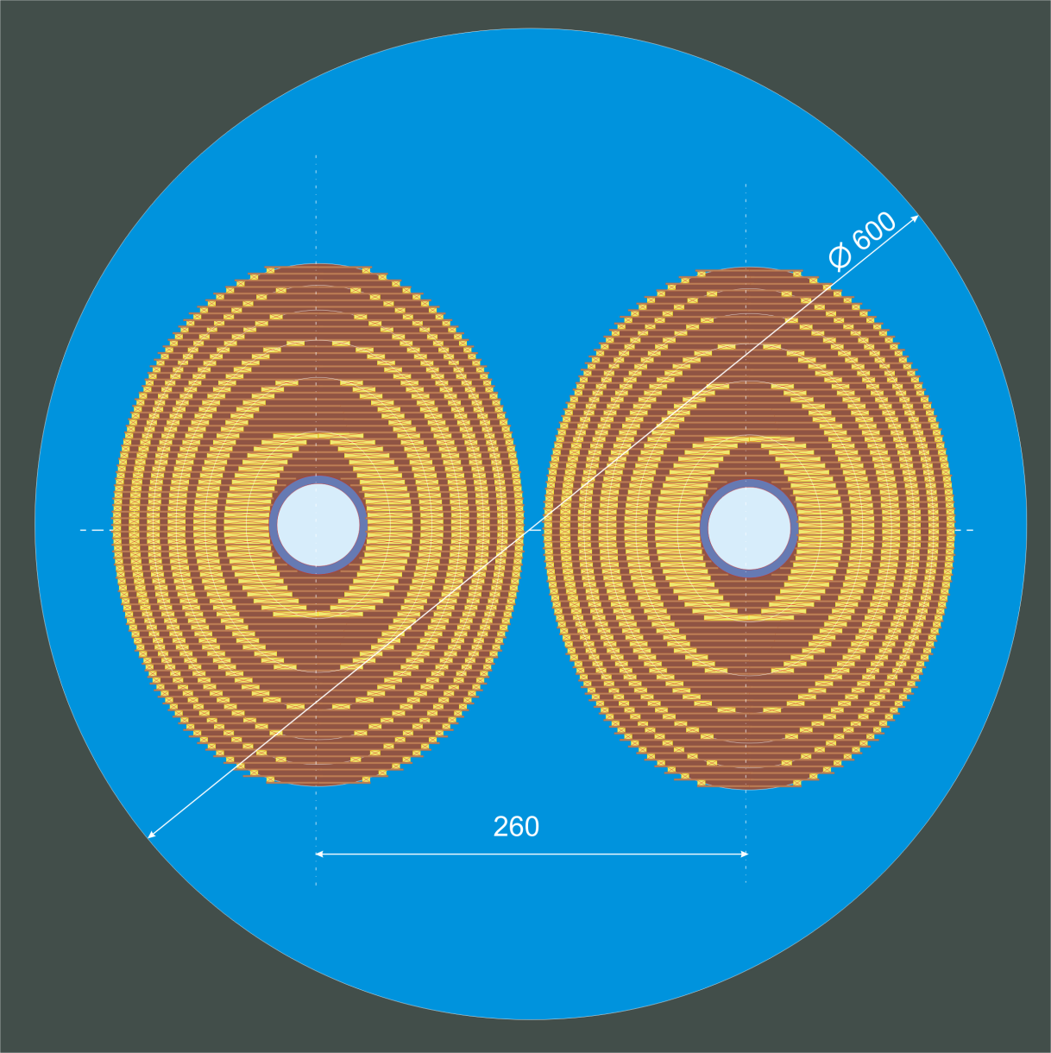
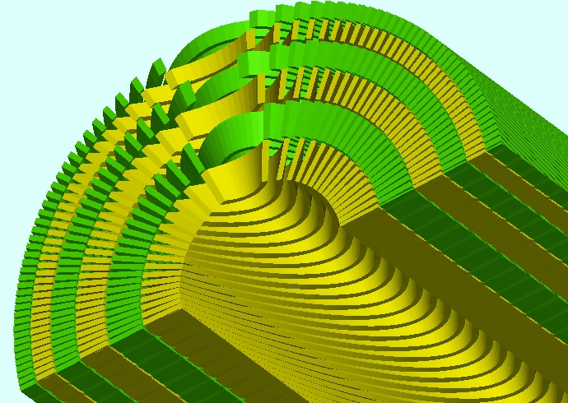
Magnet design for 16 T
Blocks
Cos-θ
Common-Coil
Laminar Elliptical
Canted Cos-θ

Slide 12
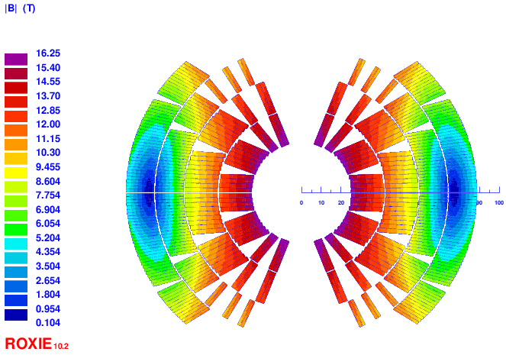
Magnet design for 16 T (cos-θ)
B peak
16.3 T
Main characteristics:
2 double-pancakes
2 conductor size
Splitting of pole blocks to decrease peak-field
Turn number:
Layer 1: 14
Layer 2: 21
Layer 3: 37
Layer 4: 43
Tot: 230/ap.
high-field
low-field cond.

Slide 13
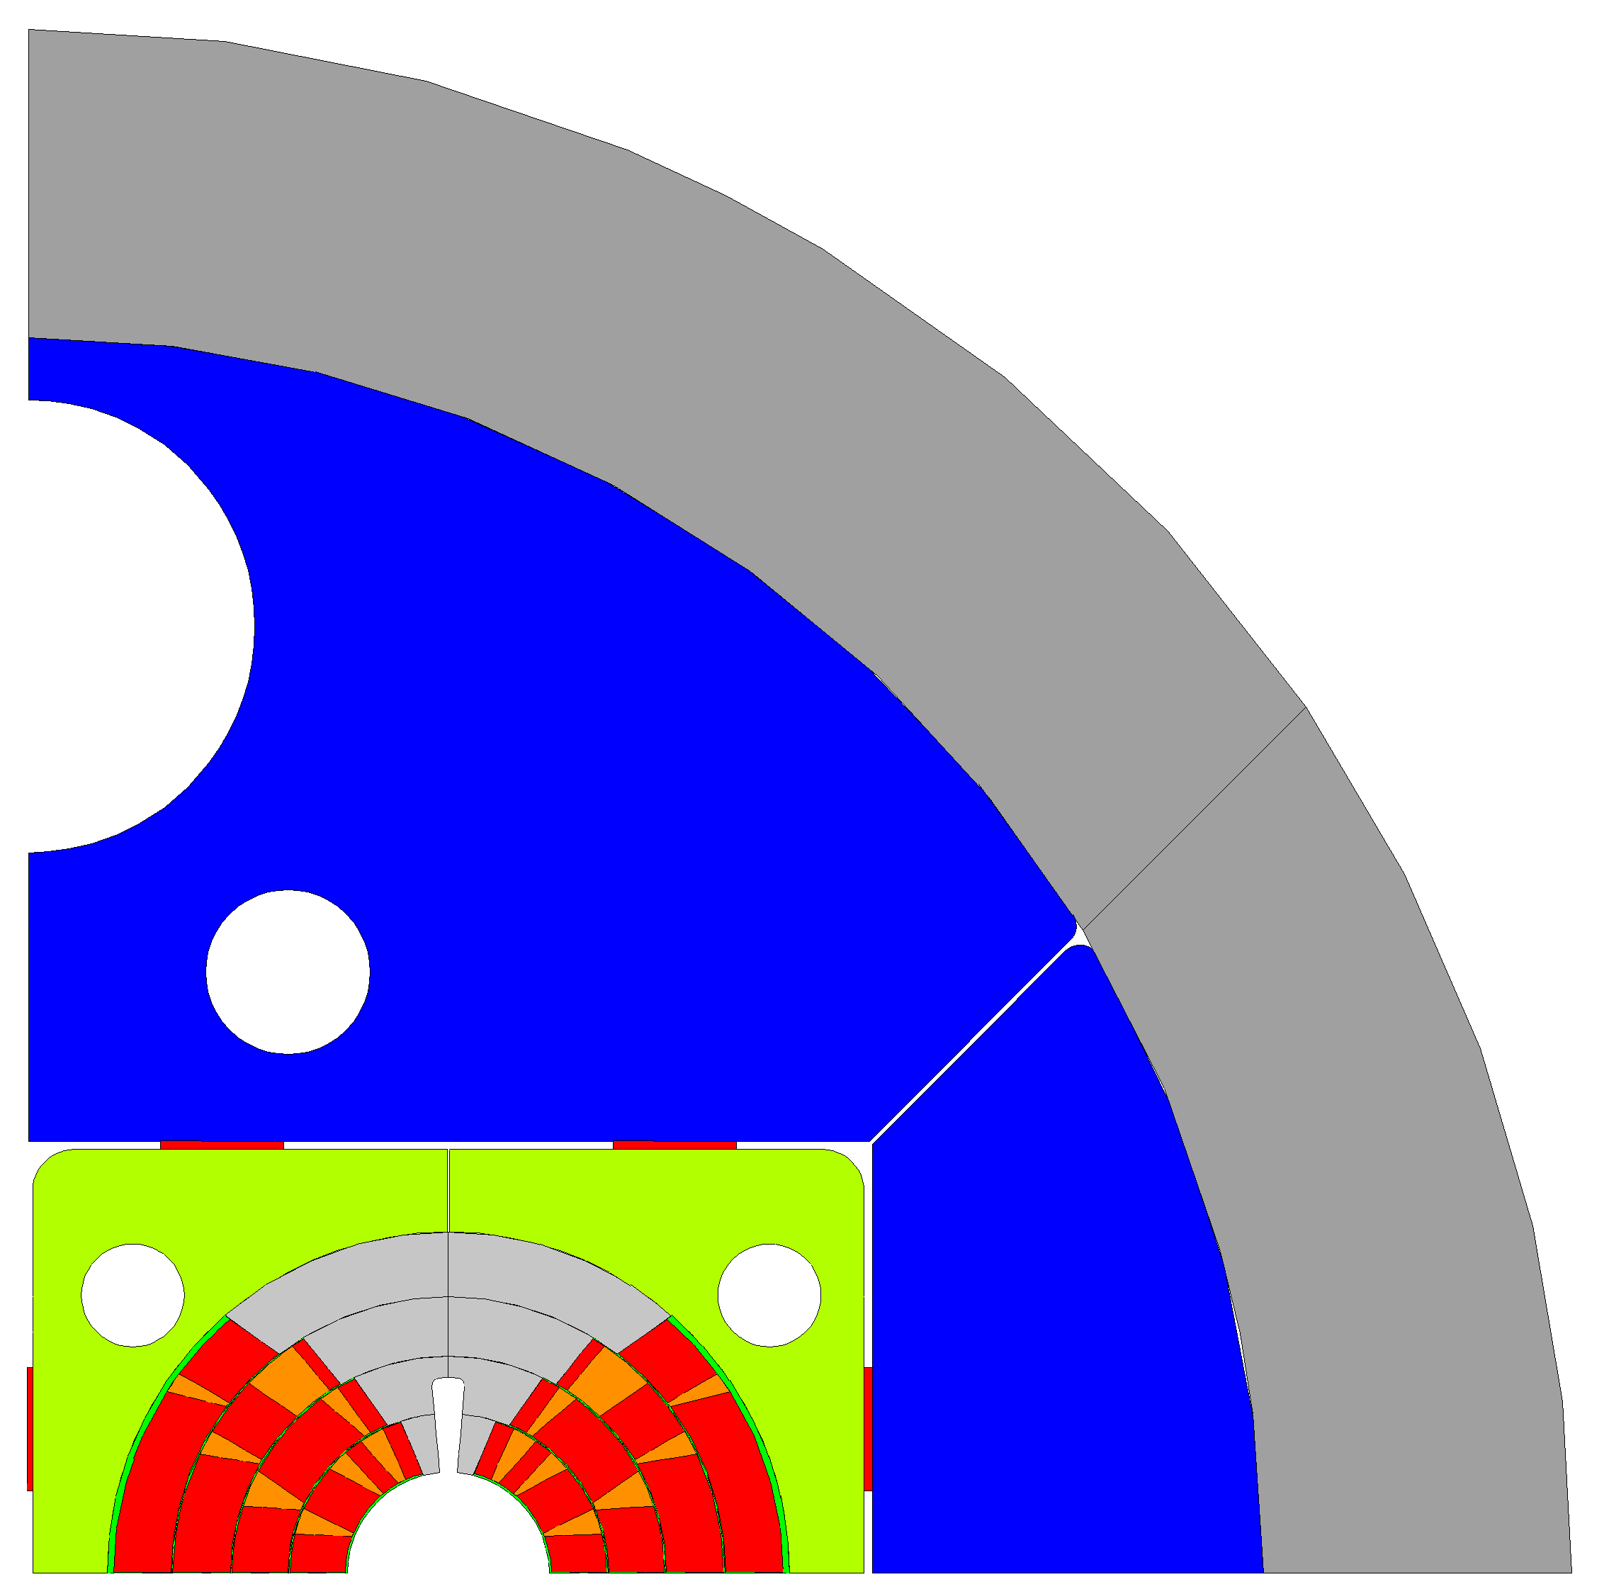
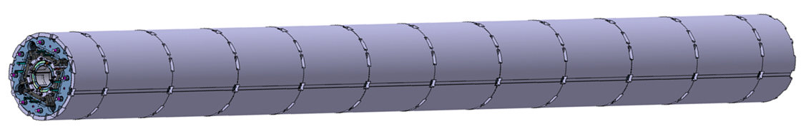
Cross section of magnets
The current baseline foresees a bladder and key structure with approximately 0.8 m long aluminum shells
Making the segments shorter ‘Aluminum collar shell’ may allow for easier production
Using Invar (FeNi36) as yoke material may allow to replace the Al shell (sufficient pre-stress and compensating the lower magnetic saturation may not allow for smaller overall size, studies are on-going)
Stainless steel shell
Aluminum shell
Iron yoke
Steel pad
Titanium pole
Copper wedges
Conductor
∅ 600 mm
∅ 750 mm
MQXFB
∅ 790 mm

Slide 14
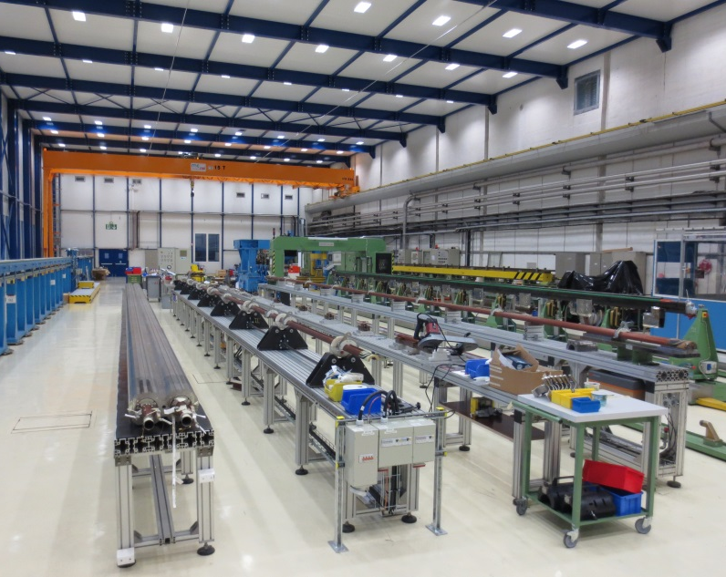
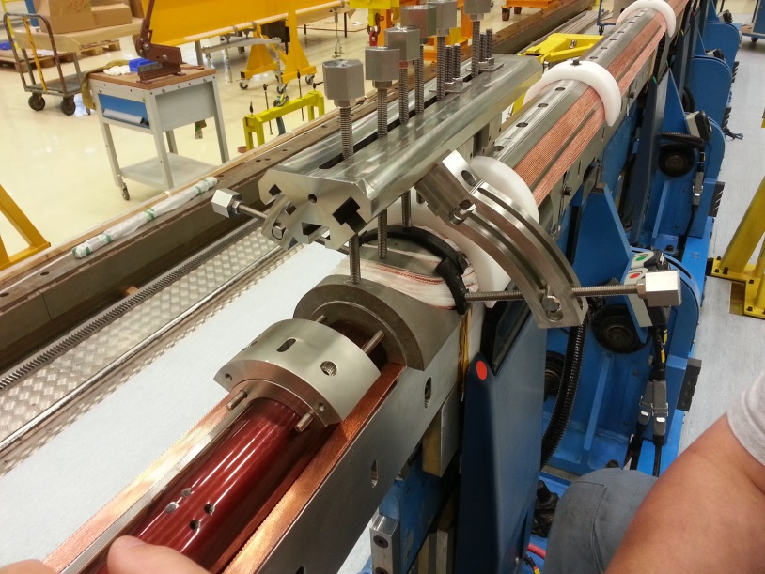
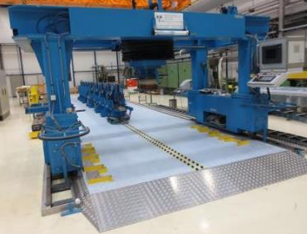
Winding

Slide 15
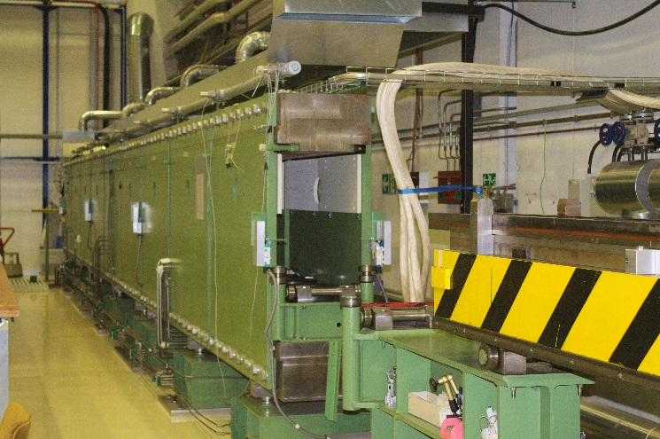
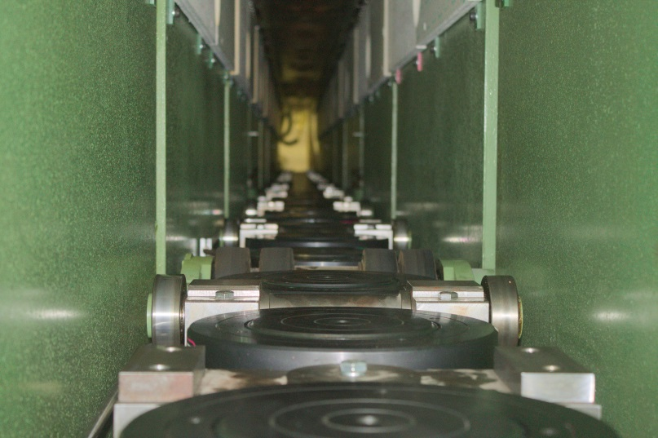
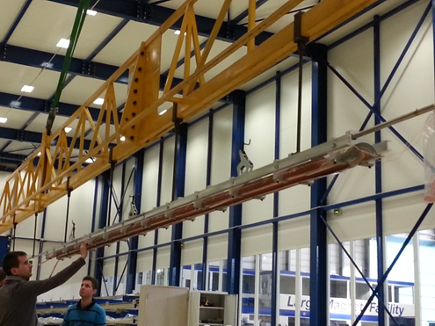
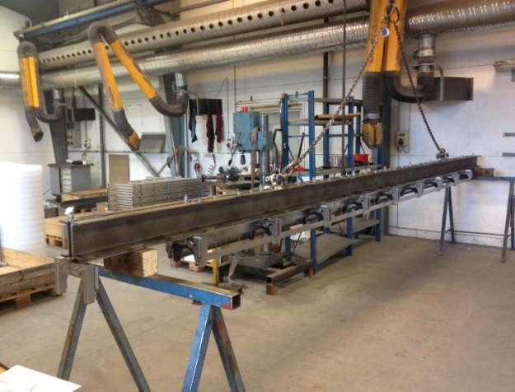
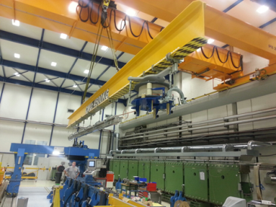
Curing

Slide 16
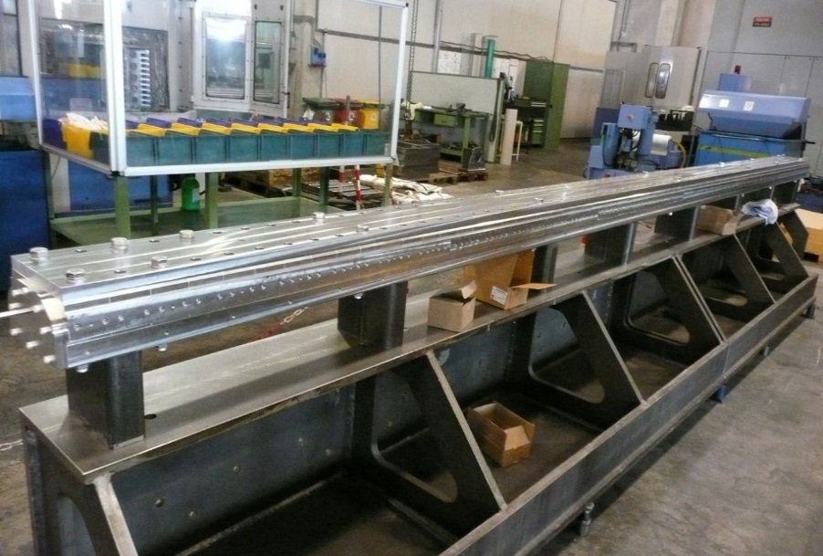
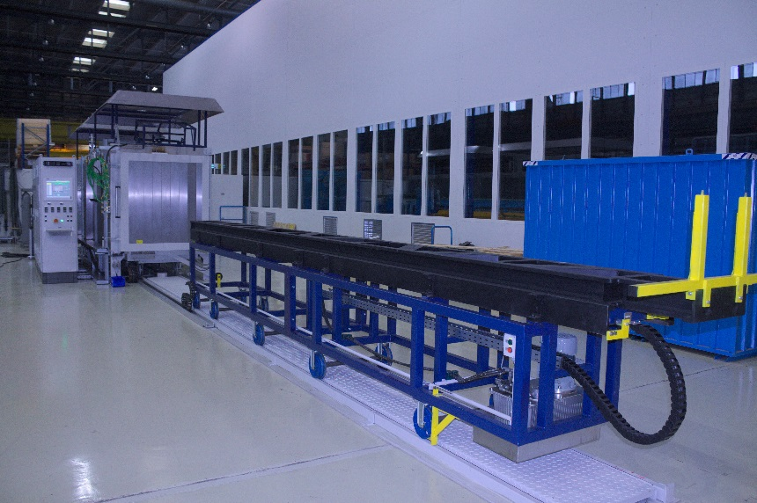
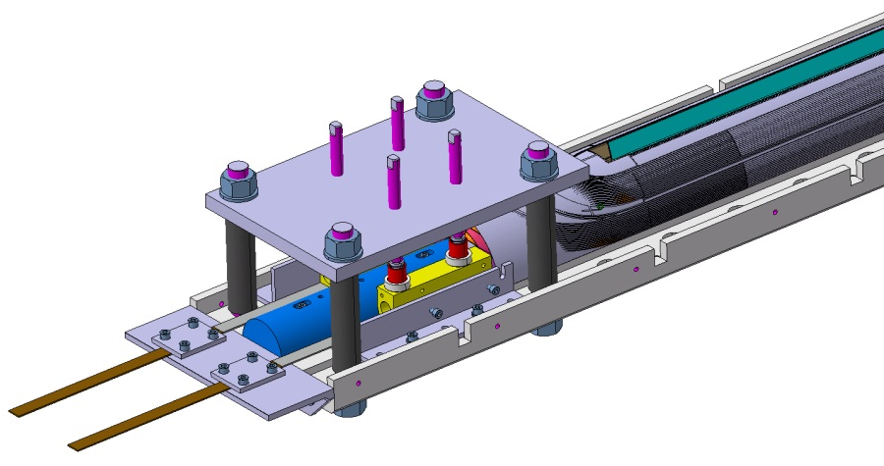
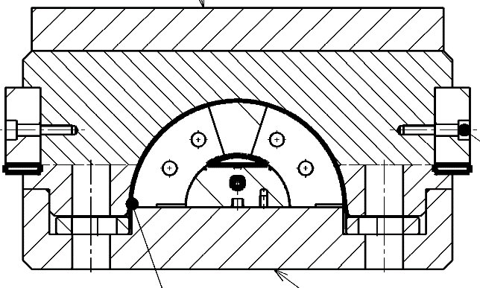
Reaction

Slide 17
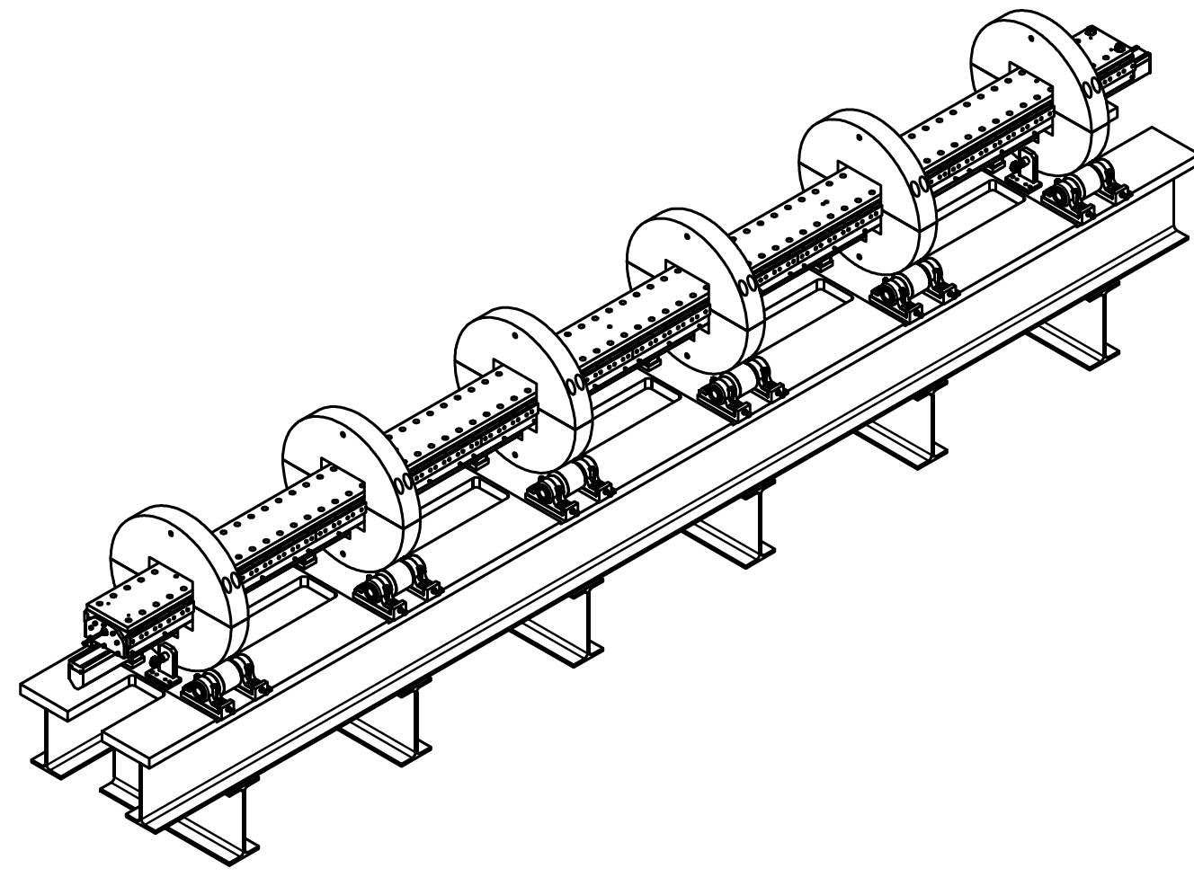
Rot. table for Winding, Splicing & Impr.

Slide 18
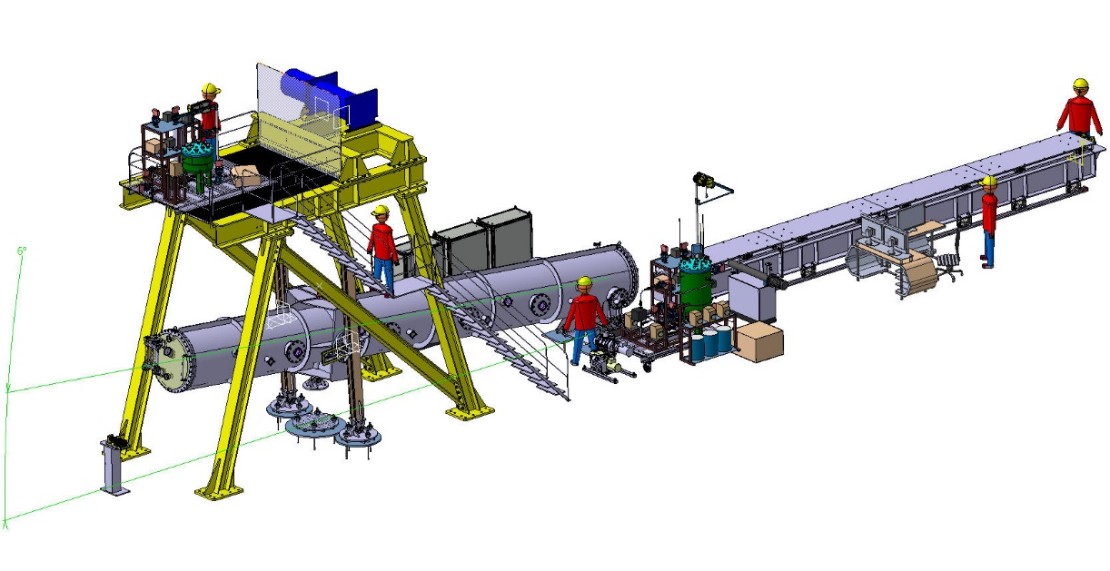
Impregnation
Courtesy: Elytt Energy

Slide 19
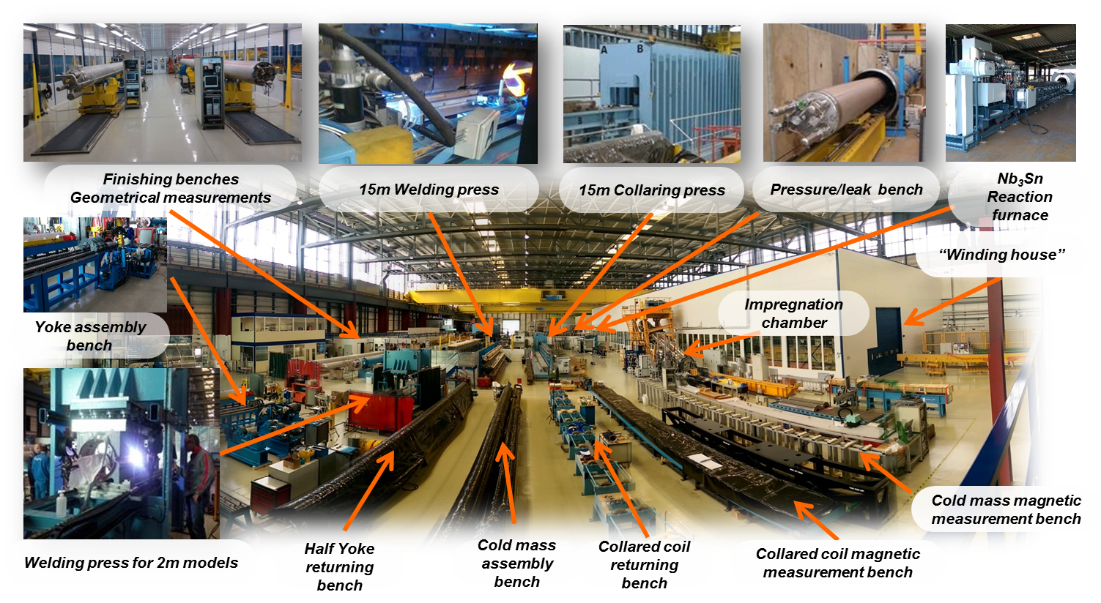
Magnet assembly

Slide 20
Target cost for HE-LHC dipole
Scaling the FCC/HE-LHC dipole magnet cost from LHC, taking the higher complexity and double number of coil layers into account (double the cost +20%) and magnet assembly (+20%), would yield a target cost for coil fabrication and assembly of about 600 kEUR/magnet, and for parts of about 420 kEUR/magnet (30% above LHC)
According to the present cost model the target cost for a 16 T magnet built according to the cos-θ design would be:
    Conductor cost: 670 kEUR/magnet
    Assembly cost: 600 kEUR/magnet
    Parts cost: 420 kEUR/magnet
    Total cost: 1690 kEUR/magnet
The calculation of the target conductor cost has been performed by assuming that the cost is insensitive to the Cu-amount in the strand. This cost is highly uncertain at this moment.
1232/4578 dipole magnets are required for HE-LHC/FCC.

