Slide 1
Summary of 1st EP R&D Working Group 3 Meeting
(Calorimetry and Light based Detectors)
Martin Aleksa and Carmelo D’Ambrosio
“Brainstorming” Contributions
5 + 2 minutes presentation
9 presentations
Thank you to all speakers (who were all inside the allotted time!)
4 presentations (mostly) on Light Detection
5 presentations (mostly) on Light Production (and transport)
20 minutes: gave space to “challenges” for the future rather than “present status”*
Disclaimer: My sincerest apologies, if I missed, misinterpret, biased slides from contributions. *There is lot more information on the slides at https://indico.cern.ch/event/704508/

Slide 2
Light Detection
2 presentations on Solid State Photo Multipliers (SSPMs; Si, GaAs, GaInP*, SiC, …);
    General presentation by Musienko;
    In the framework of RICH detectors R&D by Pestotnik;
2 presentations on Vacuum Tubes:
    Hybrid Photon Detectors (HPDs), Fiorini;
    Timed Photon Counter (Tipsy), Van Der Graaf.
* See B. Cox presentation in Calorimetry Section

Slide 3
SiPMs are trendy (CMS, LHCb, CTA, …)
High QE, good single photon sensitivity, becoming cheap and easy to produce arrays, insensitive to magn. field, etc
Very sensitive to neutrons/ionizing particles, count rates increase linearly with dose/flux;
High dark count rates, depend on:
  Temperature, a factor ~2 every 10 ºC,
  Surface, ~linear,
  Structure,
  Operational electric conditions.
Cool down (develop cooling and vacuum systems to host the array);
Use microlenses to decrease diode surface: optimize diode shape, increase array active surface and improve time resolution;
Minimize acquisition gate duration;
Implement neutron plastic shields;
Continue a strong R&D in close collaboration with industry.

Slide 6
Vacuum Tubes will never die
Good QE, good single photon sensitivity, fast, almost insensitive to radiation, time and space resolutions, almost a centennial experience and know-how, etc
Sensitive to magnetic fields, photocathode, limited QE spectrum, relatively expensive, limited time and space resolutions
However, new schemes have “broken the ice” in the last years:
From the closest to “classics”, Multi Anode PMTs, to MCP Image Intensifiers with special anodes, to Hybrid Photon Detectors (1), to Typsi (1), on the other side of the spectrum.
Somewhere was a reference to an “active photocathode” (Van der Graaf)

Slide 7
Van Der Graaf

Slide 8
Van Der Graaf
~100 μm
~100 μm

Slide 10
Light Production and Transport
1 presentations on SciFi detectors R&D (Organic Scintillators), Leverington;
3 presentations on Inorganic Scintillators (Crystals, Fibres and Metamaterials,
calorimetry and medicals, RD18), Auffray, Lecoq and Zhu*;
1 presentations on Cherenkov radiators (Photonic Crystal), Easo;
1 presentation on RICH detectors R&D, Blago.
*In the Calorimetry Section

Slide 11
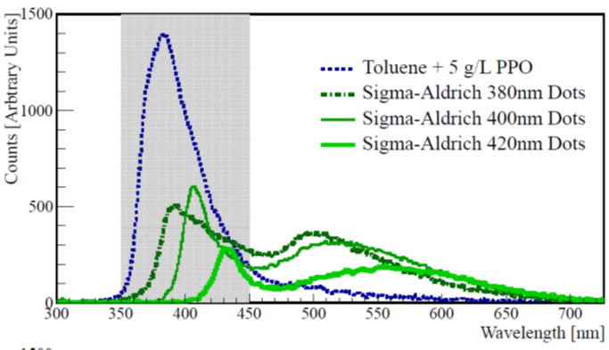
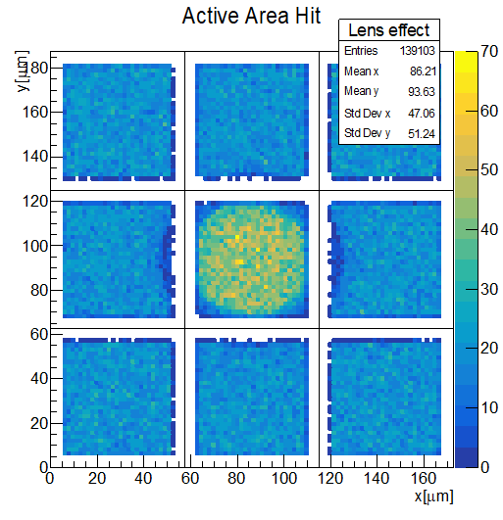
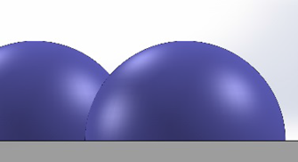
Scintillating Fibre Detector R&D
Current and Future Areas for Development
New Organic Scintillators
  Quantum-Dot-doped scintillator (IOP Link) (<2ns, >500nm) (tunable)
  Nanostructured Organosilicon Luminophores (NOL) (Link) (<2ns, 430-480nm peak)
    tested as fibre already by C. Joram [initiated the fibre development with Kuraray and Luminotech. Seven iterations over 2.5 years. Development ongoing. ]
  Polyethylene based plastics (PEN, PET, PES) (Link1, Link2 ) (no dyes, slower, rad. hardness)
  Others?
Photodetectors
  Micro-lenses for SiPMs (EPFL R&D) → improved collection efficiency
    See a potential for 30% gain in light yield on current gen. SiPM
    Potential to reduce pixel area (reduces dark noise)
  Vacuum packaging of SiPM arrays (cooling to -120 degC)
  See talk by Yuri on radiation hard SiPM development
Applications
  High light yield and radiation hardness needed for high luminosity applications
  Fast fibers would be needed for any application with timing
  Addition of a TDC in the PACIFIC (ASIC) (coarse position along the fibre length +/20cm)
  Combine thin fibre mat technology with calorimetry(?)

Slide 12
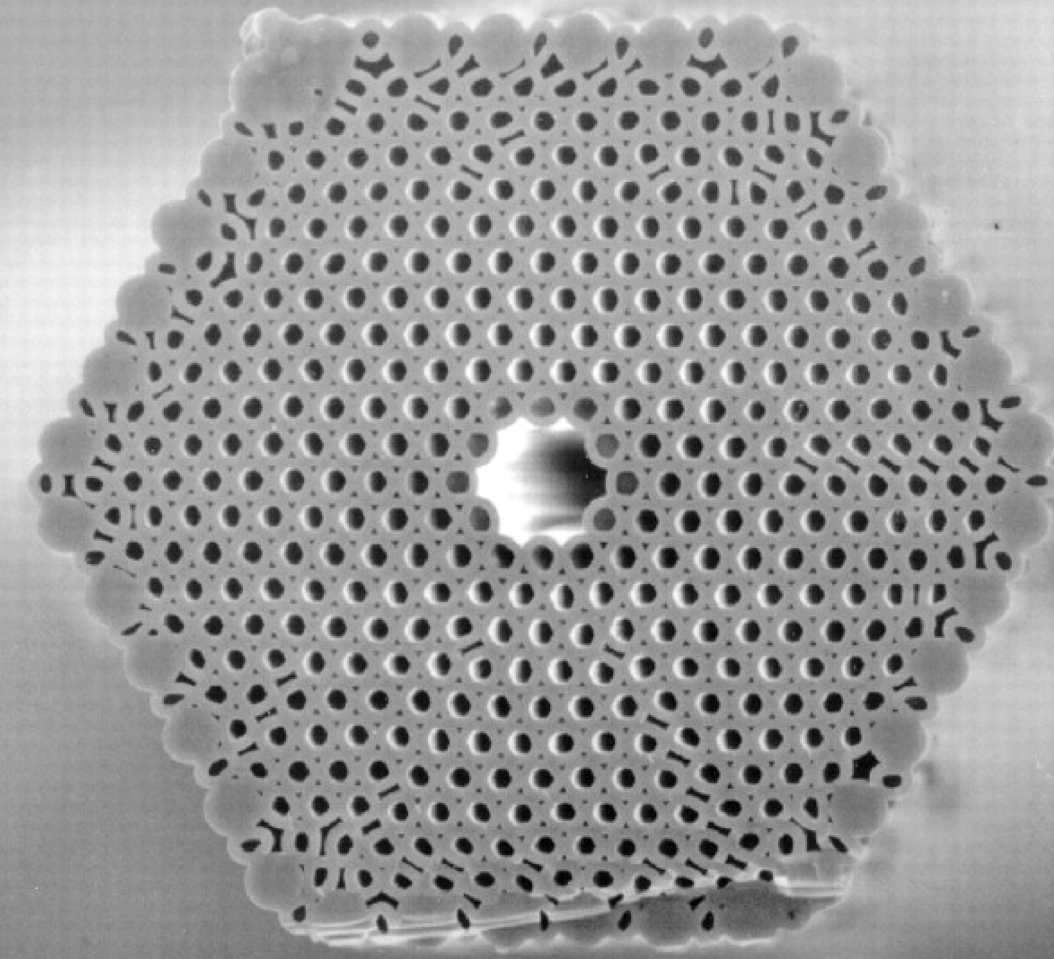
Meta-scintillators for HEP
A scintillator-based calorimeter cell has to fulfill 3 requirements
  Light production
  Light transport
  Light photo-conversion
Combining these 3 functions in a bulk scintillator cell will result in a compromise between the 3 parameters of interest in calorimetry
  Spatial resolution
  Energy resolution
  Timing resolution
A micro- and nano-structured meta-scintillator can help optimizing the 3 functions independently and considerably improve the calorimetric performance
SiPMTs
Quantum dot
loaded polymer
with a gradient
of QD radius
along the fibre
MOEMS diffractive optics
light concentrator
MOEMS diffractive optics
light concentrator
Heavy scintillating fibers
(LuAG, LSO …)
Φ = 500μm
Hollow core
Photonic fibers
Φ = 100μm
SiPMTs
Paul Lecoq, 1st EP R&D Working Group 3 Meeting

Slide 14
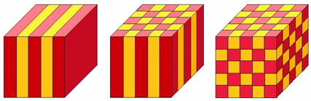
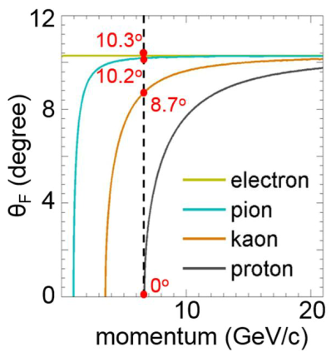
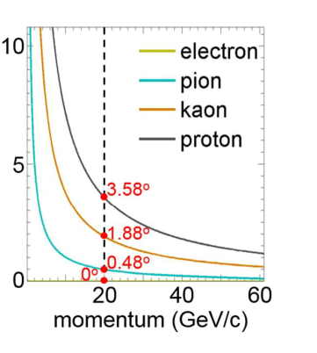

Development of photonic crystals for Cherenkov detectors
Limitations of conventional Cherenkov radiators:
A solution :
Simulations for 1d crystal designs:
Dearth of suitable materials to cover the full momentum range 1-10 GeV/c for hadrons
Above 10 GeV/c one is left with large gas radiators, which take up lot of valuable space and
increase the emission point uncertainty
Electron identification impossible above a few GeV/c
Assemble materials to produce desired ‘effective refractive index’.
Design photonic crystals from transparent dielectrics.
Solve Maxwell’s equations: Ref. backup slide
Example configurations:
Overall thickness=2 mm, ε₁=10.6 (GaP), ε₂=2.1 (SiO₂)
forward setup: 2800 periods with (214.3 nm+500.0 nm)
backward setup: 10200 periods with (117.3 nm+78.1 nm)
1d 2d 3d
forward
backward
R&D started at CERN, potential for:
Significant improvements in RICH detector performance
Reduction in space used by radiators
Extension of momentum coverage
S. Easo, 27-2-2018

Slide 15
Reduce uncertainties to maintain PID perf in high occupancy environment

Slide 16

Conclusions (personal and far from being binding)
If I could choose between all these possible R&D ideas, I would choose …. all of them!!
All extremely interesting and promising for the close and far future of particle detectors.
Some programmes are already well established, some new,
but all of them in need of
close collaboration with industry,
cross-fertilization with different research fields (essentially almost all the other WGs)…
… and resources of course!
Coming months
We shall try to streamline all the ideas, receive more ideas, discuss with the other WGs to highlight common areas and goals (today it is a first), hold a few more meetings with WG3 members and experts.
Consolidate and evaluate ideas
and finally move to R&D proposals with a project-like structure.

