Slide 1
LIU-PS EVM Status
Data extraction: 22 January 2018

Slide 2
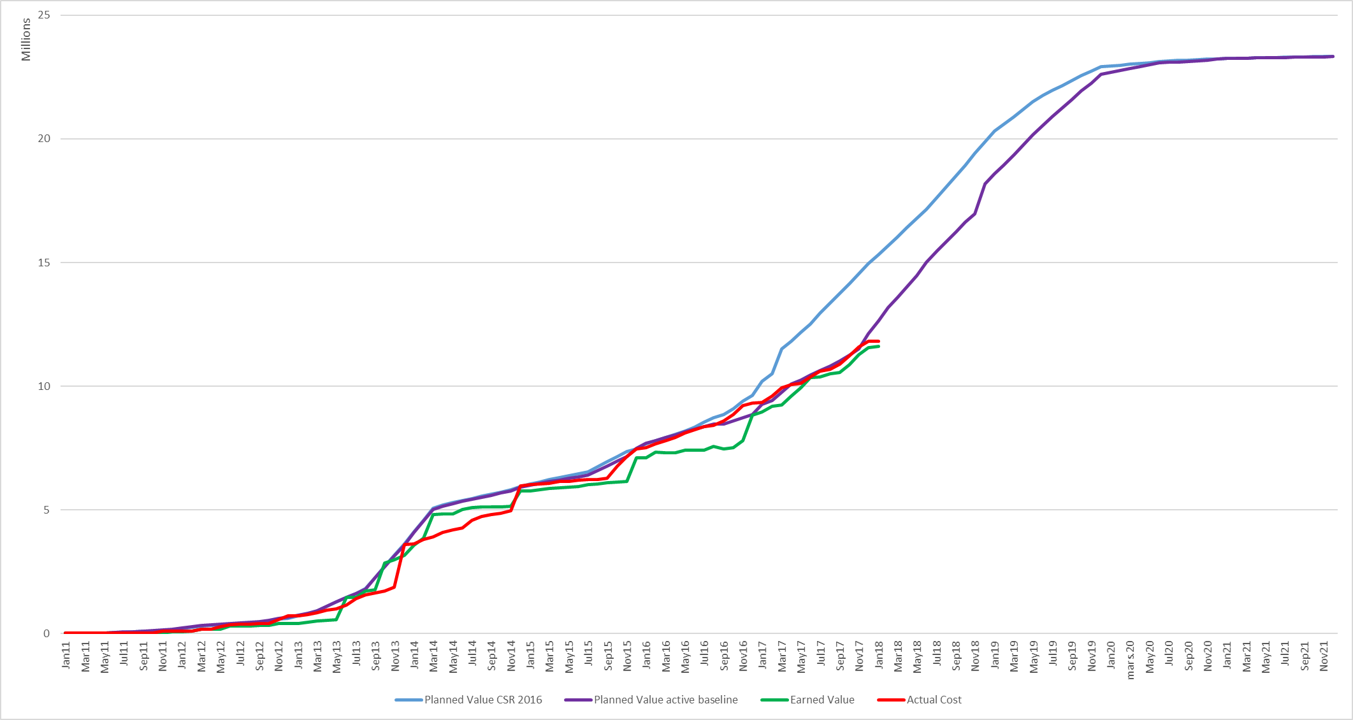
LIU-PS Dashboard

Slide 3
LIU-PS Crosstab by Group

Slide 4
Preparation Steps for the CSR 2018
Next LIU/HL-LHC Cost and Schedule Review will take place on 26-28 March 2018
Extraction of EVM metrics data on the 31th January 2018 ➔ EVM reporting up-to-date
In a 2nd phase (06-Feb-18 to 21-Feb-18) : EVM baselines opened for bottom-up updates (update of workunits, weights, deliverables)
CET budget 2018 to follow

Slide 5
Spare Slides

Slide 6
LIU-PS Crosstab – BE Department

Slide 7
LIU-PS Crosstab – EN Department

Slide 8
LIU-PS Crosstab – HSE Department

Slide 9
LIU-PS Crosstab – SMB Department

Slide 10
LIU-PS Crosstab – TE Department

