Slide 1
LIU/BI Beam Size Review Summary
A. Guerrero on behalf of BI

Slide 2
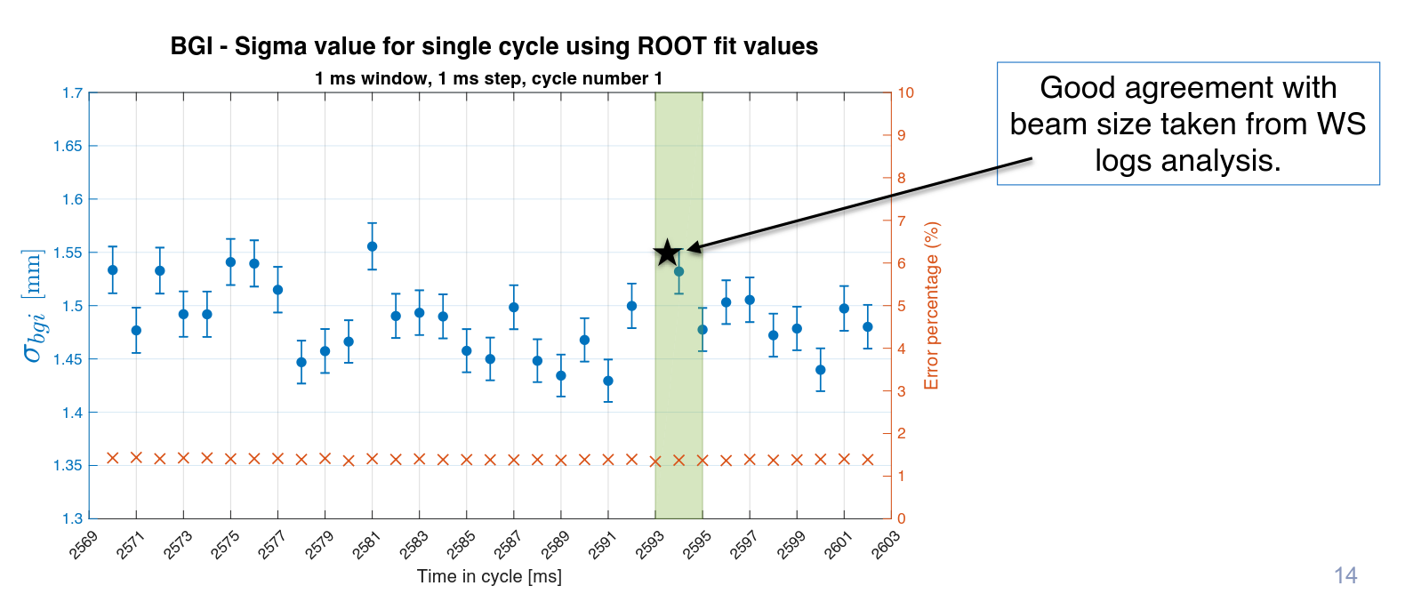
BGI
New monitor based on hybrid pixel detector installed & tested in PS during 2017
1-2% error on beam width for single bunch consistent with statistical analysis for Gaussian fit on profile constructed from single electron counting
Multiple acquisitions show error dominated by injection to injection variations
1% error achieved with ~1ms integration: can improve by increasing cathode voltage but already within specification
Functional specification (EDMS 1233010)
  Update frequency 0.1-1 kHz ✅
  Continuous acquisition for 5000 turns (11.5 ms) ✅
  Precision on beam sigma < 2 % ✅
YETS17/18:
  Fix chip #3 & install colder cooling water
2018 run:
  new high speed readout & full FESA integration foreseen
Decision required on vertical monitor: built with injection of 250kCHF

Slide 3
Wire scanners: Mechanics
Good advancement with mechanical production: Orders for 90% of components placed
Integration nearing completion in all machines
ECRs being completed as drawings become available
PS Prototype - everything on track (installation done)
Series Assembly
  Foreseen to start in April 2018
  Delivery of all scanners foreseen by end 2018
Solution required for slipping glass disk
  Metallic disk as baseline (awaiting delivery of first full disks)
Fallback solutions being investigated
  Design change to PSB scanner with SPS holder design which does not slip
  Brazed glass disk
Wire studies
  Wires from carbon nanotubes under study & to be tested in SPS in 2018
  Could provide same diameter with similar strength but much lower density

Slide 4
Wire scanners: Acquisition
Following PSB Beam Test Results: Improvements made to acquisition system
  Managed to reduce error of new scanner compared to operational scanners
  Taking shot-to-shot variations into account reached 0.8% uncertainty compared to 1.4% uncertainty with current operational system
Use of 4 parallel acquisition channels with different gains based on multi-PMT system
  Successfully showed that dynamic range of 1e3 can be covered with no tuning required
YETS17/18: Install M-PMT in PS
Milestones for the acquisition system:
  End 2017 Final acquisition baseline
  Sep 2018 Detector side validation (multiPMT concept) in all machines

Slide 5
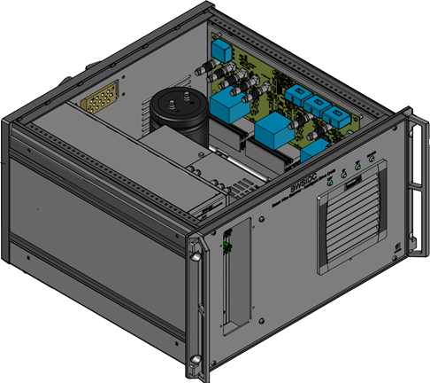
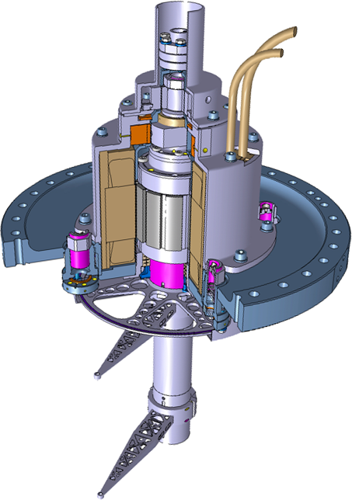
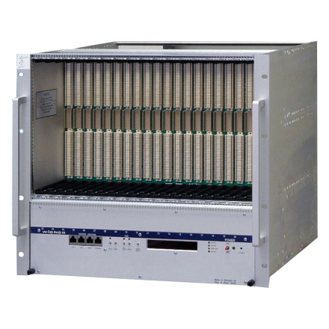

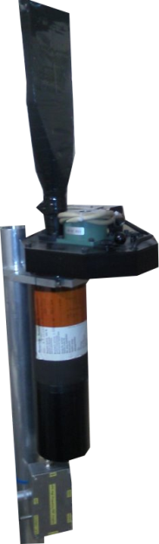
LIU Wire scanner system architecture
Intelligent drive crate
Position (Resolver)
Acquisition
and Supervision
crate
Power
CPU
CTR
V
VFC
1
VFC
2
HV
VME boards configuration
Machine Synchro triggers
PMT acquisition
Particle beam
Position (Optical)
Losses
Scintillator
PMT

Slide 6
Wire scanners: Electronics
In-house power driver
  New DC-bus charger concept to reduce the time between consecutive measures
  Developing & testing the link between Motion Control Unit – Power Driver
VFC-based surface digitalization with several fast ADCs in parallel
Milestone for the electronics control:
  Apr 2018 Pre-series production and assembly
  Jun 2018 Validation using calibration bench (Bld. 867) of the final system. Motion performance optimization.
  Sep 2018 Validation with the PS scanner prototype in the machine.
  End 2018 Validation of final electronics with beam
  2019 Production and tests of series

Slide 7
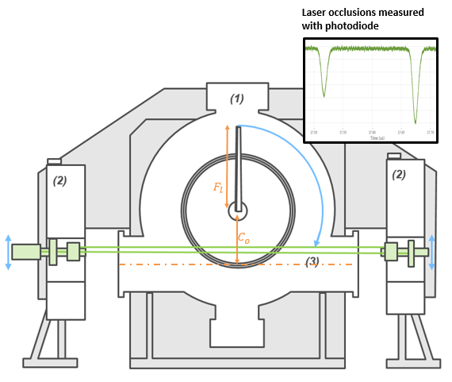
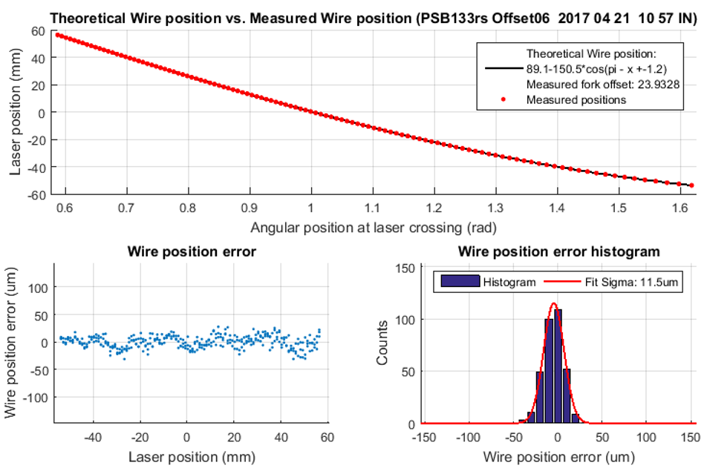
Wire scanners: Calibration
New lab test bench constructed & used throughout the year
Stable performance demonstrated
Residual error similar with & without vacuum
Residual single scan position error depends on scan speed
  12um and 6um for 20ms-1 & 8ms-1 respectively
  Different motion profiles being considered to try and reduce error at 20ms-1
Calibration to calibration offset reproducibility at 20-30um level
  Should not influence beam size calculation
  Source nevertheless under investigation
$$Y= C_{o}−F_{l}cos\left(π−α_{Sensor}+θ\right)$$

Slide 8
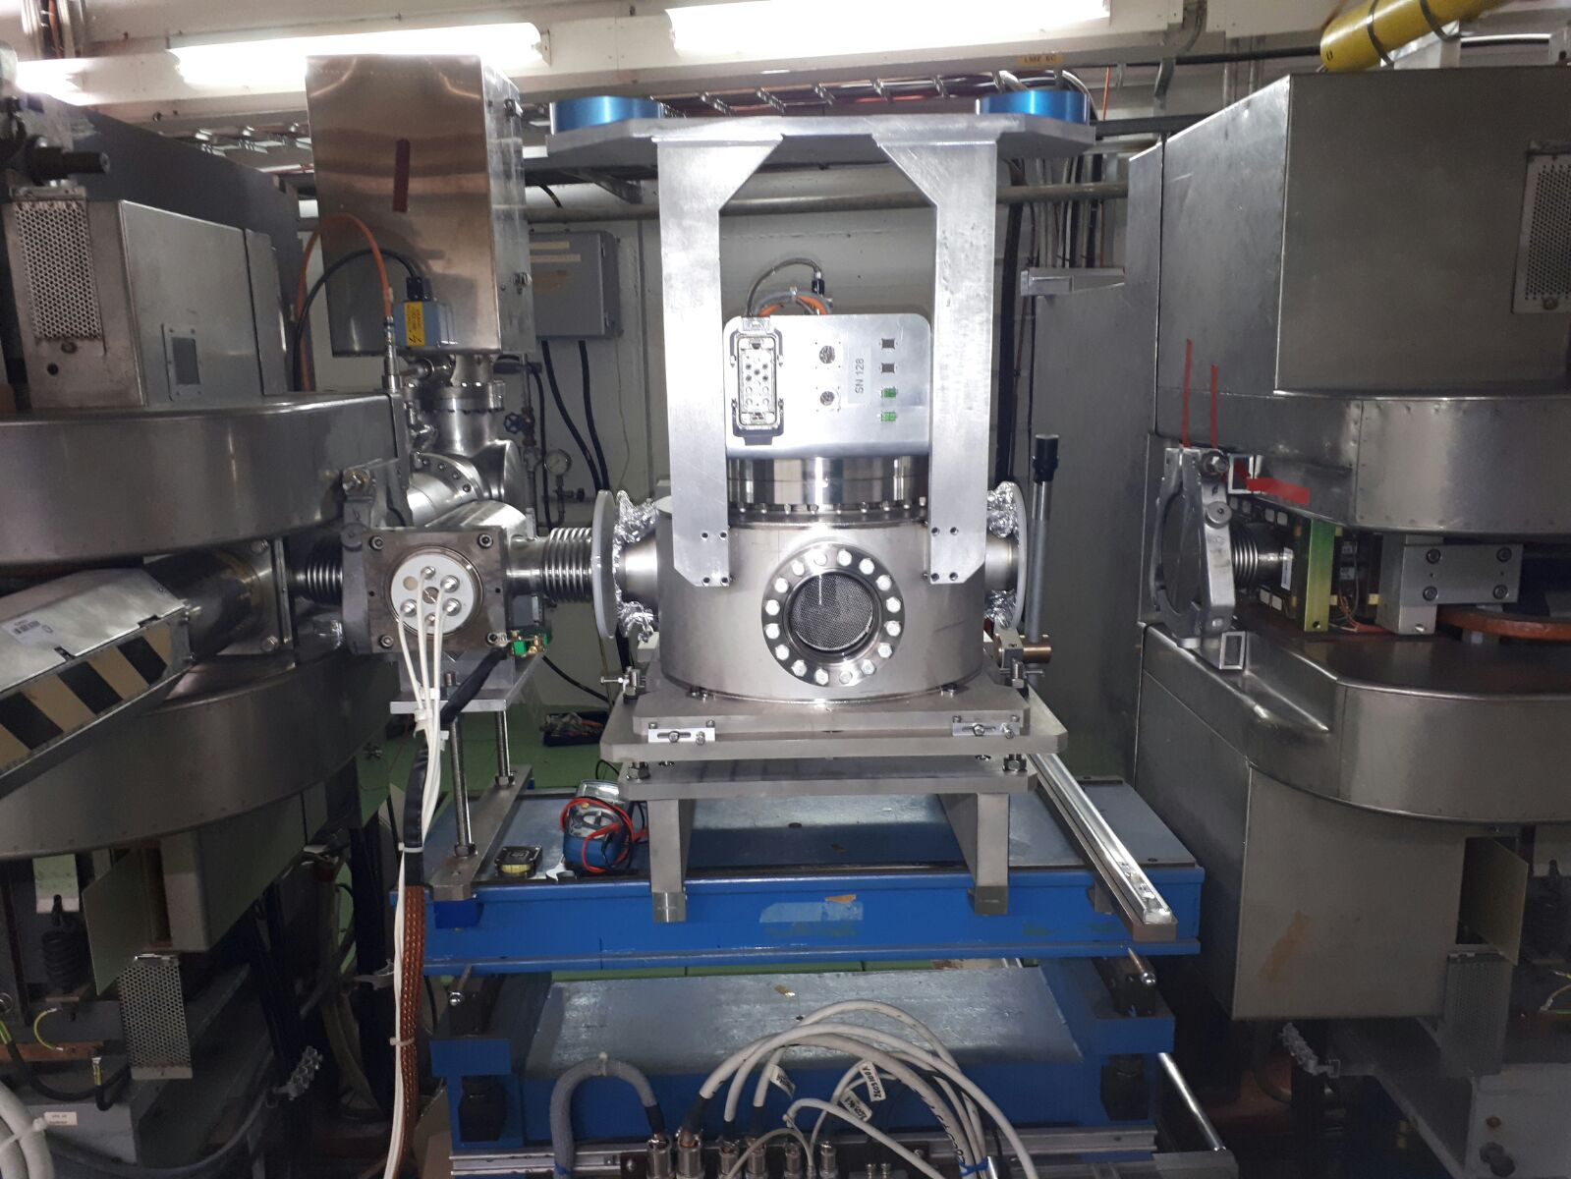
BWS 54H
Calibrated scanner installed on the 18.01.18
Test of the device with development electronics
Power and position control electronics are currently being finalized
Acq and supervision electronics expected for July
Installation of final electronics foreseen in the last TS of the run
SW to be started by a new staff coming in June

Slide 9
TxT electronics for injection SEM-grids
Common design PSB and PS
  Amplification adapted to the machine
System includes
  ADC to be installed in a VME crate with RS-422 interface for amplification control
  Power supply and control electronics for amplification
  Amplifier crates in the tunnel
Foreseen to install the prototype in the last TS of the run on 1 grid
  Control electronics to be received by March
  Amplifiers expected in June
  ADC prototype OK for assembly
  Skeleton of FESA class available for test

Slide 10
Conclusion
BGI
  BGI H monitor has provided promising results
  Green light to start the construction of the BGI V monitor
  Operational instrument to be developed in 2018
Wire scanners
  Tests in other machines show expected performance
  Issues of operational WS have been addressed
  Follow planning: test of 54H in stages, full system after last TS of 2018
TxT SEM-grid acquisition
  Prototype to be installed during last TS of 2018 for dedicated MD by the end of the run

