Slide 1
Production of phosphorus-vacancy centers in diamond for optical and spin characterization
58th Meeting of the INTC
B. L. Green,¹ M. E. Newton,¹ and K. Johnston²
¹Department of Physics, University of Warwick, Coventry CV4 7AL, United Kingdom
²CERN, CH-1211 Geneva, Switzerland

Slide 2
Single emitters in diamond
Diamond is an ideal host matrix for functional point defects with optically-accessible quantum properties:
  high Debye temperature
  low spin-density
  large band gap → broadband optical transparency (220 – 2400 nm)
Adapted from I. Aharonovich et al., Adv. Opt. Mater. 2, 911 (2014)

Slide 3
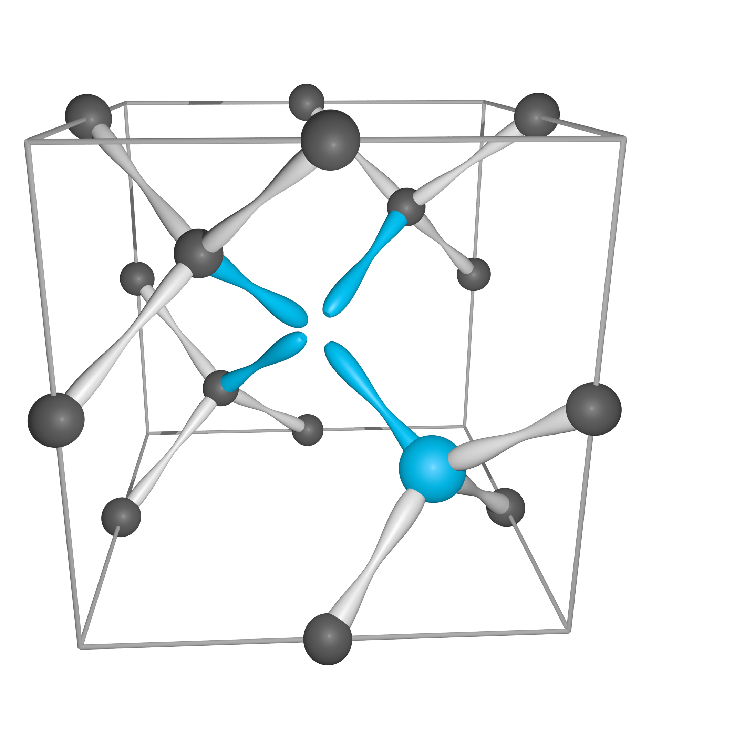
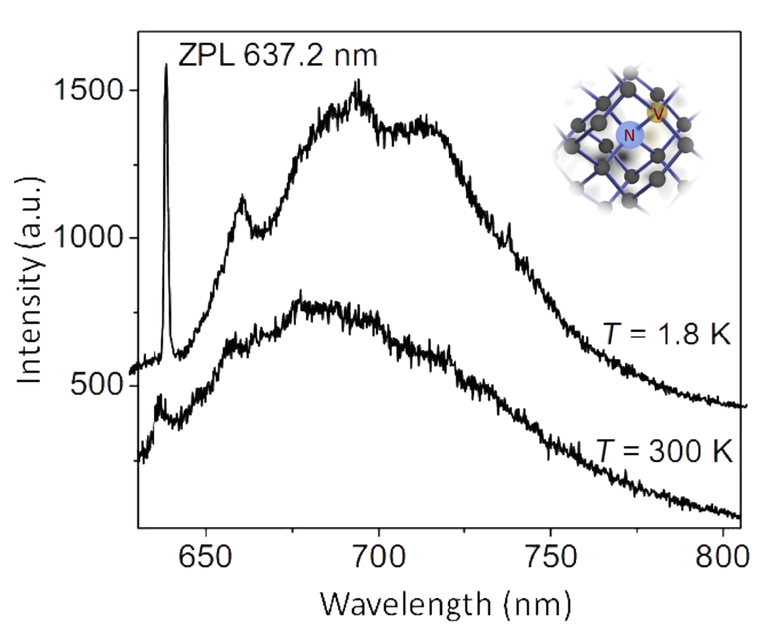
NV—
Fast optical spin initialization
High fidelity optical spin readout at room temperature
Long coherence times
Broadband emission
Sensitive to strain
1.8 K
293 K
S. Yang et al., Nat. Photonics 10, 507 (2016)
S. Zaiser et al., Nat. Commun. 7, 12279 (2016)
B. Hensen et al., Nature 526, 682 (2015)
W. B. Gao et al., Nat. Photonics 9, 363 (2015)
Y.-C. Chen et al., Nat. Photonics 11, 77 (2017)
W. Pfaff et al., Science 345, (2014)
H. Bernien et al., Nature 497, 86 (2013)
A. Jarmola et al., Phys. Rev. Lett. 108, 197601 (2012)

Slide 4
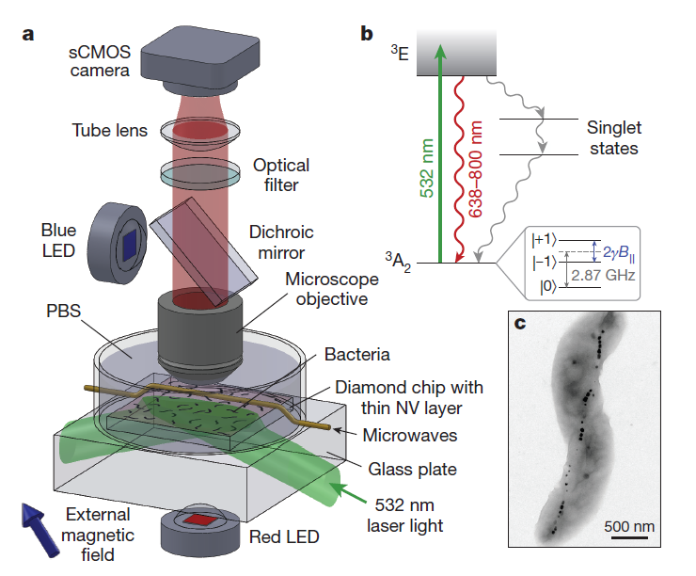
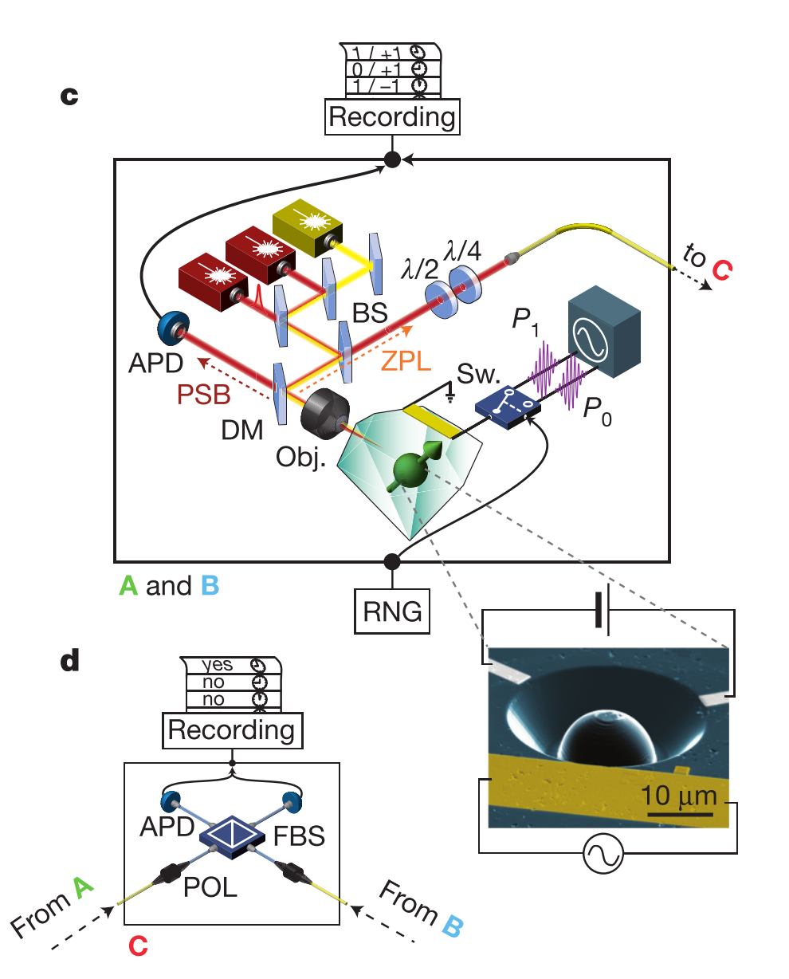
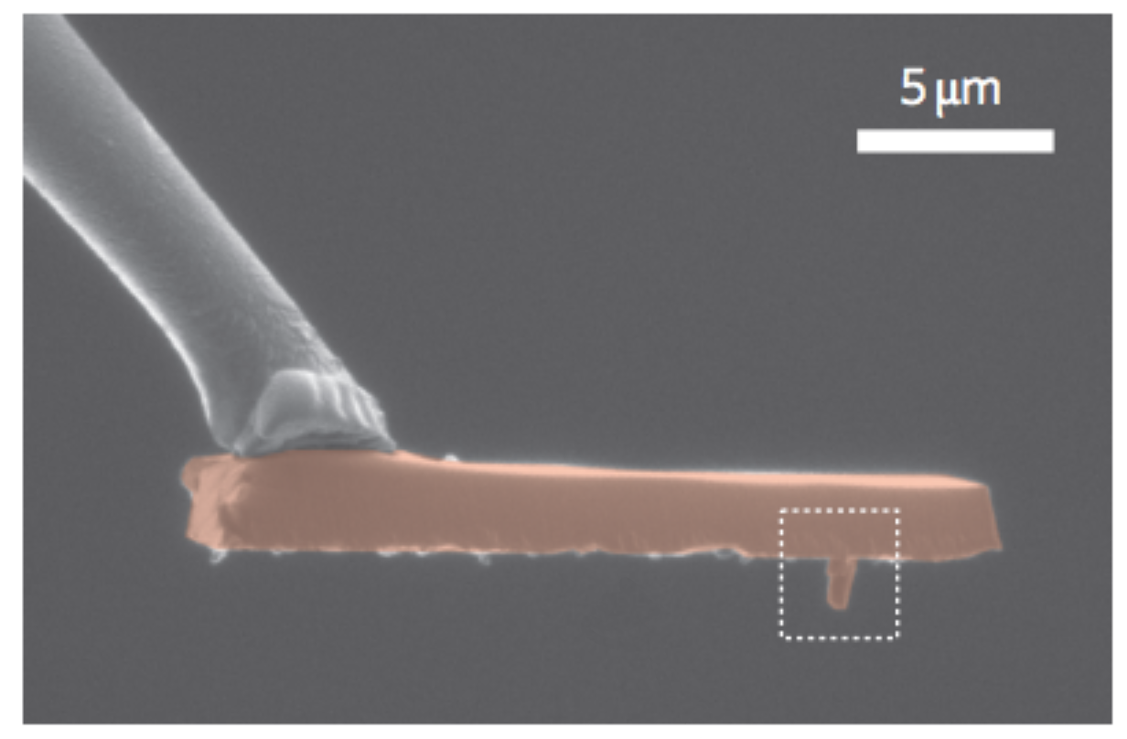
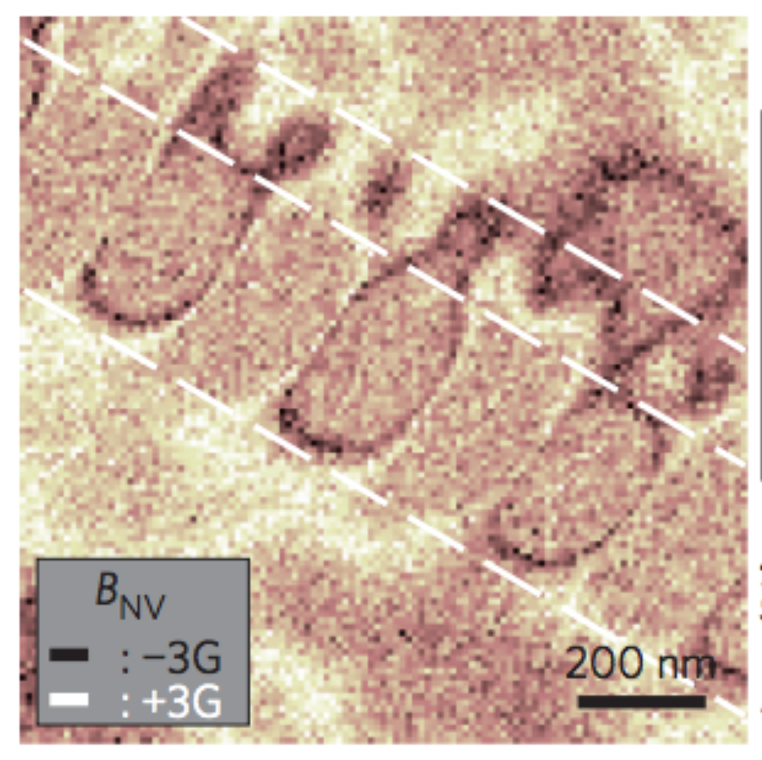
NV—
Now a well-understood system
Applications include:
Fundamental quantum mechanics
10.1038/nature15759
Nanoscale metrology
10.1038/nnano.2012.50
Widefield biological magnetometry
10.1038/nature12072

Slide 5
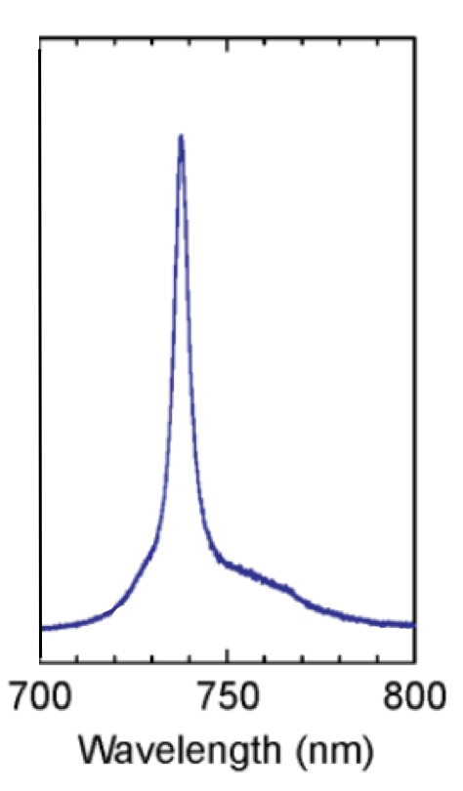
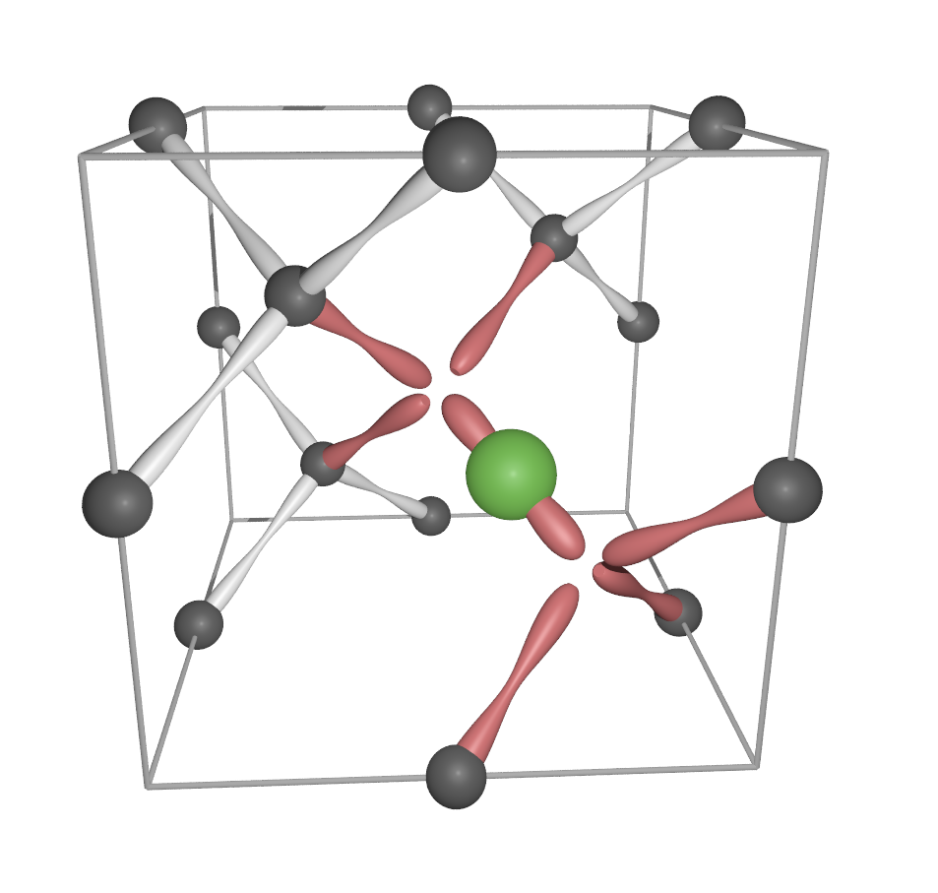
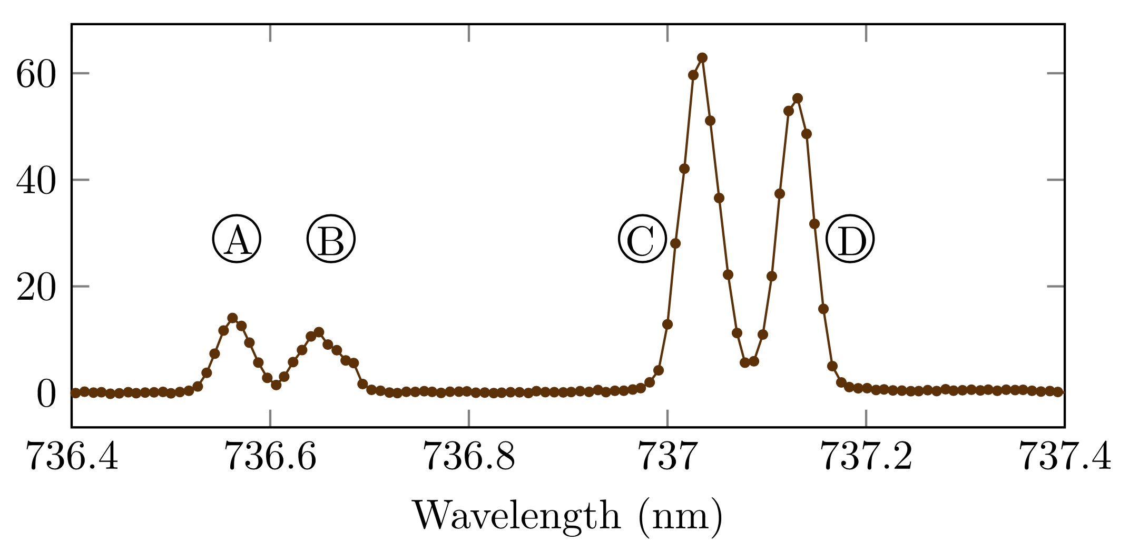
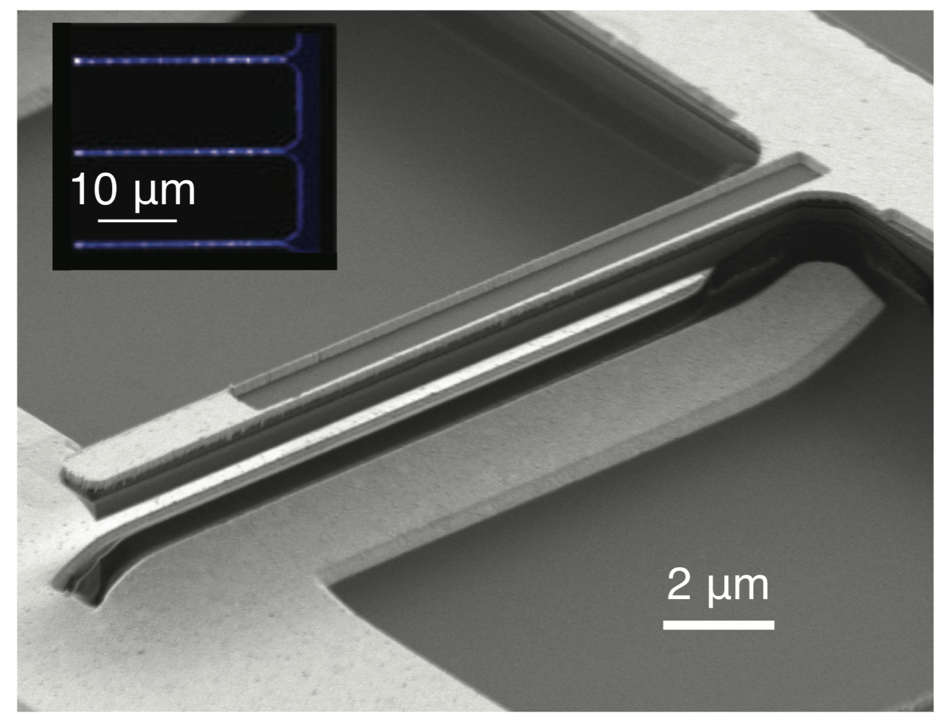
293 K
4.2 K
SiV—
Slow spin initialization
Slow spin readout (and only at 4 K or lower)
Short coherence at >100 mK
Narrowband emission
Tuneable ZPL
B. Pingault et al., Nat. Commun. 8, 15579 (2017)
D. D. Sukachev et al., Phys. Rev. Lett. 119, 223602 (2017)
A. Sipahigil et al., Phys. Rev. Lett. 113, 113602 (2014)
A. Sipahigil et al., Science 354, 847 (2016)
Y.-I. Sohn et al., arXiv:1706.03881 (2017)

Slide 6
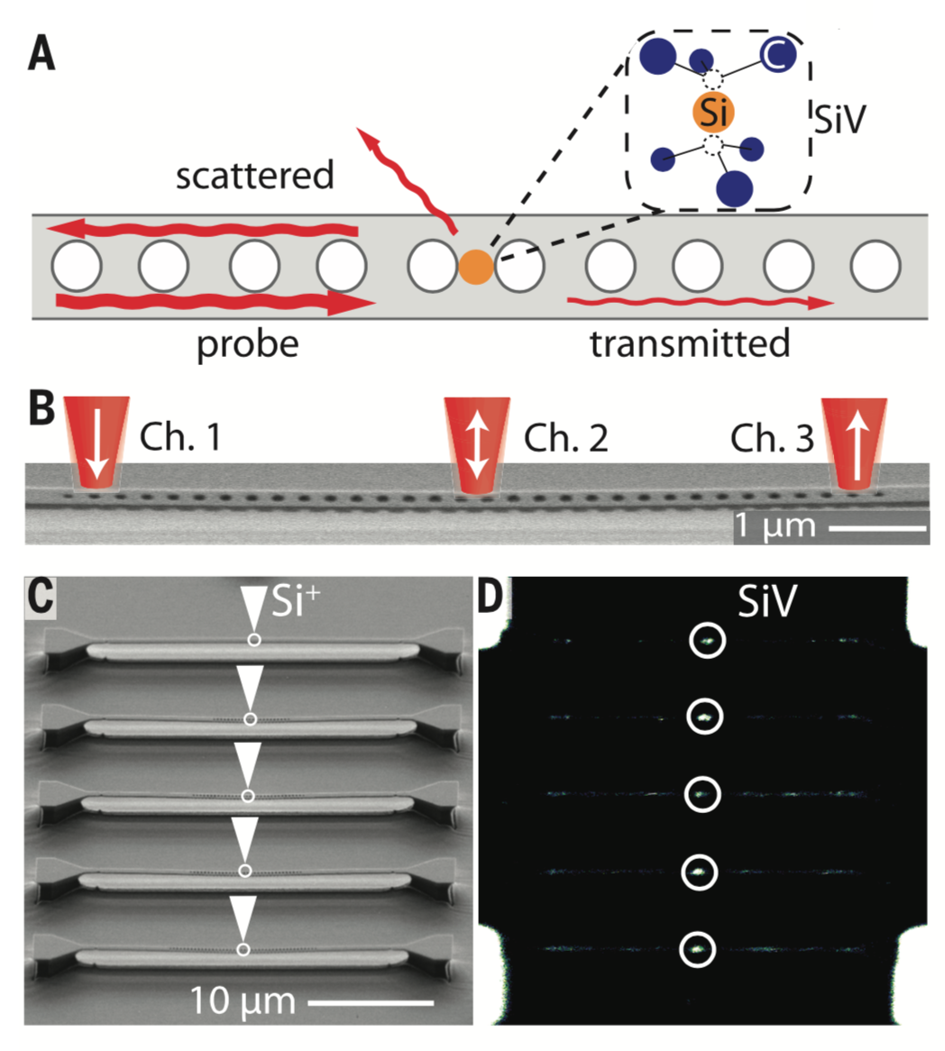
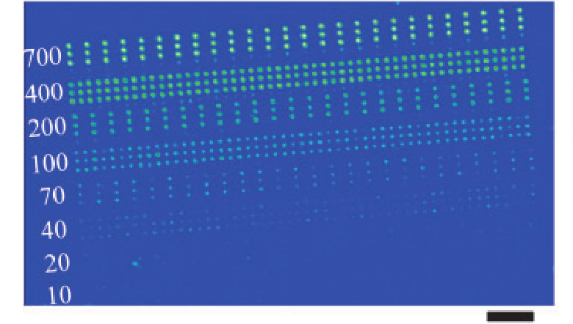
Applications primarily photonic
SiV—
Integrated photonic networks
10.1126/science.aah6875
Slow spin initialization
Slow spin readout (and only at 4 K or lower)
Short coherence at >100 mK
Narrowband emission
Tuneable ZPL
Arrays of SiV— for QKD
10.7567/APEX.7.115201

Slide 7
NV—
SiV—
Fast optical spin initialization
High fidelity optical spin readout at room temperature
Long coherence times
Broadband emission
Sensitive to strain
Slow spin initialization
Slow spin readout (and only at 4 K or lower)
Short coherence at >100 mK
Narrowband emission
Tuneable ZPL

Slide 8
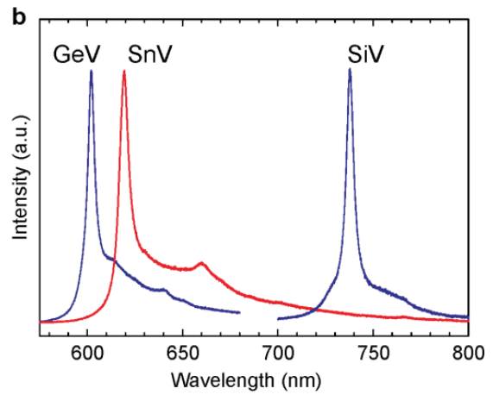
Single emitters in diamond
Significant similarities between different “vacancy-cage” optical emitters
?
[1]
PV—
PV⁰
PV⁺
SnV^{2—}
SnV—
Optically
inert
GeV^{2—}
GeV—
SiV—
SiV⁰
Optically
initializable
spin
SiV^{2—}
NV⁰
NV—
S=0
S=½
S=1
[1] T. Iwasaki et al., arXiv:1708.03576 (2017)

Slide 9
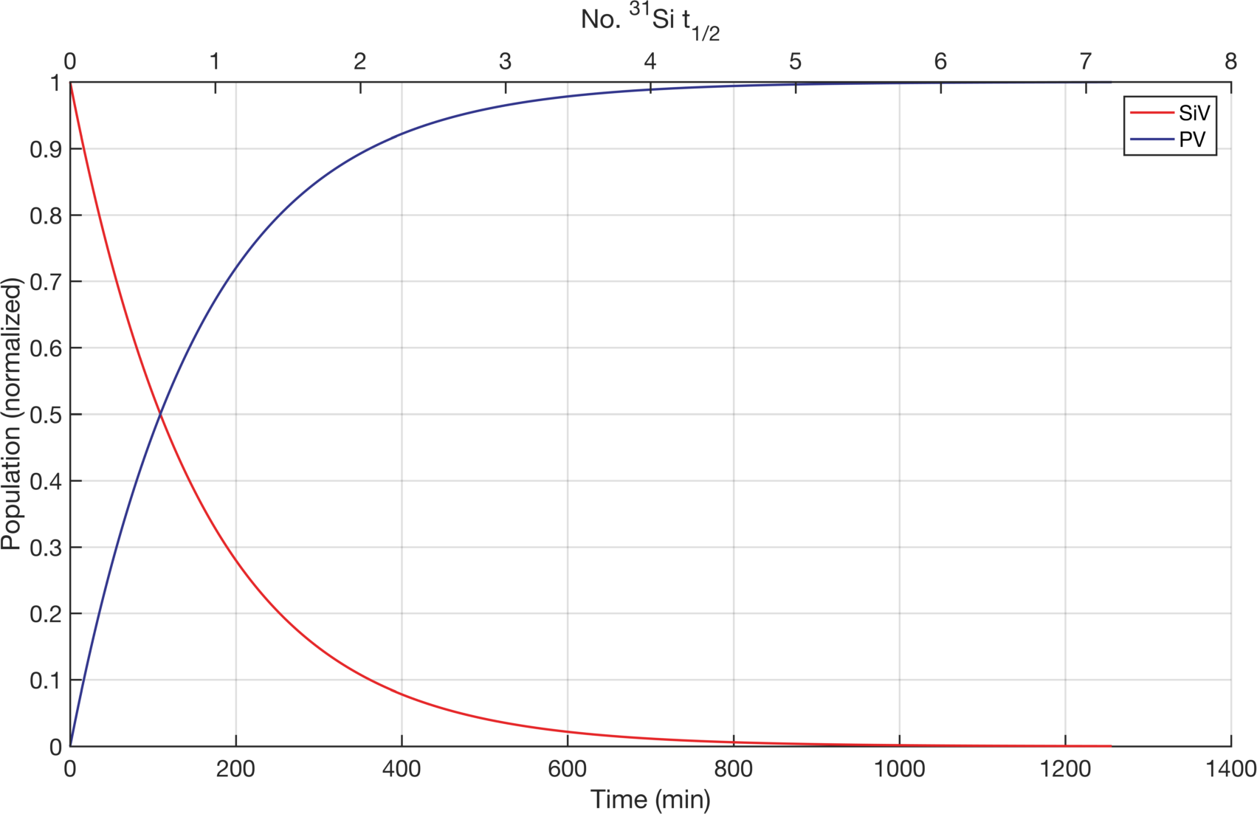
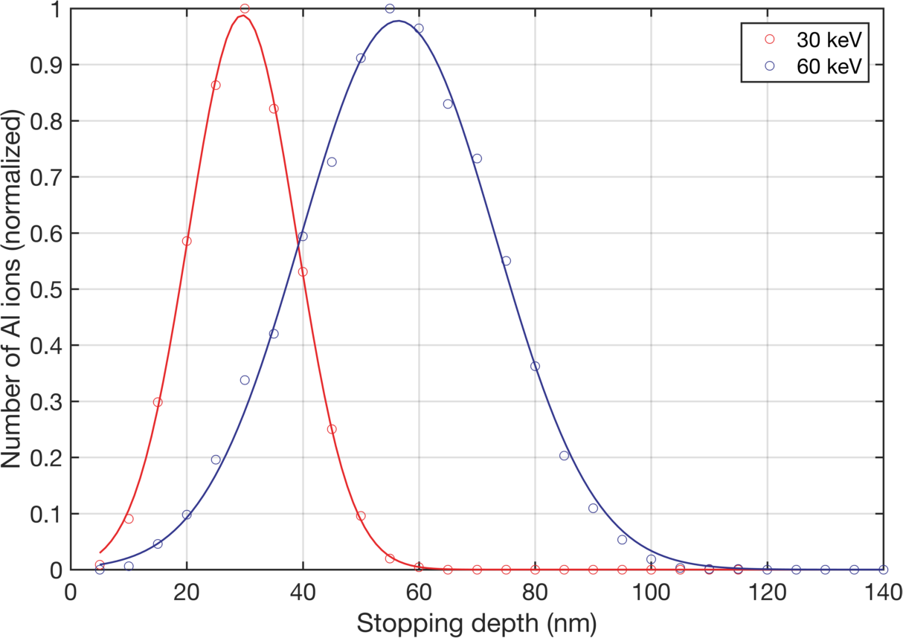
Production at ISOLDE
³¹Si
157 min
³¹P
98.4%
³¹Al
644 ms
1.6%
³⁰Si
Monitor decay of SiV
Look for PV spectrum
Implant at ~50 keV
Anneal to form ³¹SiV
>800°C to mobilize vacancies

Slide 10
Production at ISOLDE
³¹Si
157 min
³¹P
Implant
Anneal
Measure
Time | No. ³¹Si t_{1/2} | Stage | Notes
00:00 | 0 | Implantation of ³¹Al | Decays to Si with t_{1/2}<1 s
02:30 | 1.0 | Insertion into furnace | Furnace at 850°C
04:30 | 1.7 | Removal from furnace
05:00 | 1.9 | Insertion into cryostat | Cryostat pre-cooled to 100 K
05:30 | 2.1 | PL measurements begin

Slide 11
Measurement at ISOLDE
Close proximity of implantation beam and measurement enables rapid turnaround
  Measurements start at ~2 t_{1/2}
  Matrix of doses (single to ensemble)
Modular PL system
  Simple to add additional excitation
Wide detection window
  High efficiency detection 350-1700 nm
Conditions at ISOLDE are unique for maximising the probability of detecting PV^{x}

Slide 12

Charge state control
SiV⁰
e_{g}
e_{u}
a_{2u}
a_{1g}
Problem:
  substitutional phosphorus in diamond is a donor (~0.6 eV)
  PV is predicted to be a deep acceptor [1]
  Hard to stabilize neutral and positive charge states of PV:
    P⁰ + PV⁰ → P⁺ + PV—
Solution:
  charge state control through doping and surface termination
  Light (~10¹⁷ cm⁻³) B-doping → p-type
  Ultrapure (<10¹³ cm⁻³ impurities) material → intrinsic
  Samples to be supplied at zero cost by the Quantum Technologies group at Element Six Ltd.

Slide 13
Conclusion
Identification and optical / spin characterization of PV^{x} in diamond
Use rapid turnaround, high-efficiency measurements at ISOLDE to maximise the chance of detecting transient decay of
Use offline time between first and second requested runs to:
  feedback from original measurements and optimize second run
  perform additional experiments at Warwick e.g. confocal microscopy, optically detected magnetic resonance
Primary goal:
Approach:
³¹SiV → ³¹PV

