Slide 1









EUROPEAN ORGANIZATION FOR NUCLEAR RESEARCH
Proposal to the ISOLDE and Neutron Time-of-Flight Committee
Hyperfine interactions in hydrogenated TiO₂ thin films
and powders for photocatalytic reactions
Dmitry Zyabkin ¹
Juliana Schell^{2,3}, Doru C. Lupascu³, Haraldur Pall Gunnlaugson⁴, Hilary Masenda⁵, Roberto Mantovan⁶, Krish-Baruth-Ram^{7,8}, Sveinn Ólafsson⁹, Hafliði P. Gíslason⁹, BingCui Qi⁹, Petko Krastev¹⁰, Joao Guilherme Martins Correia^{2,11}, Ulrich Vetter¹, Peter Schaaf¹
1. Department of Materials for Electronics, Institute of Materials Science and Engineering, TU Ilmenau, Ilmenau, Germany
2. EP Department, ISOLDE-CERN, CH-1211 Geneva 23, Switzerland
3. Institute for Materials Science and Centre for Nanointegration, Duisburg-Essen (CENIDE),
4. Science Institute, University of Iceland, Dunhaga
5. School of Physics, University of the Witwatersrand, Johannesburg, 2050, South Africa
6. Laboratorio MDM, IMM-CNR, Via Olivetti 2, 20864, Agrate Brianza (MB), Italy
7. Durban University of Technology, Durban, 4000, South Africa.
8. School of Chemistry and Physics, University of KwaZulu-Natal, Durban, 4000, South Africa
9. Science Institute University of Iceland
10. Institute for Nuclear Research and Nuclear Energy, Bulgarian Academy of Sciences, 72, 1784, Bulgaria
11. Centro de Ciências e Tecnologias Nucleares (C2TN), Instituto Superior Técnico, Universidade de Lisboa, Portugal
Notes:
Resolve questions upon PhD
Study defects they’re main reason for improved photocat activity

Slide 2
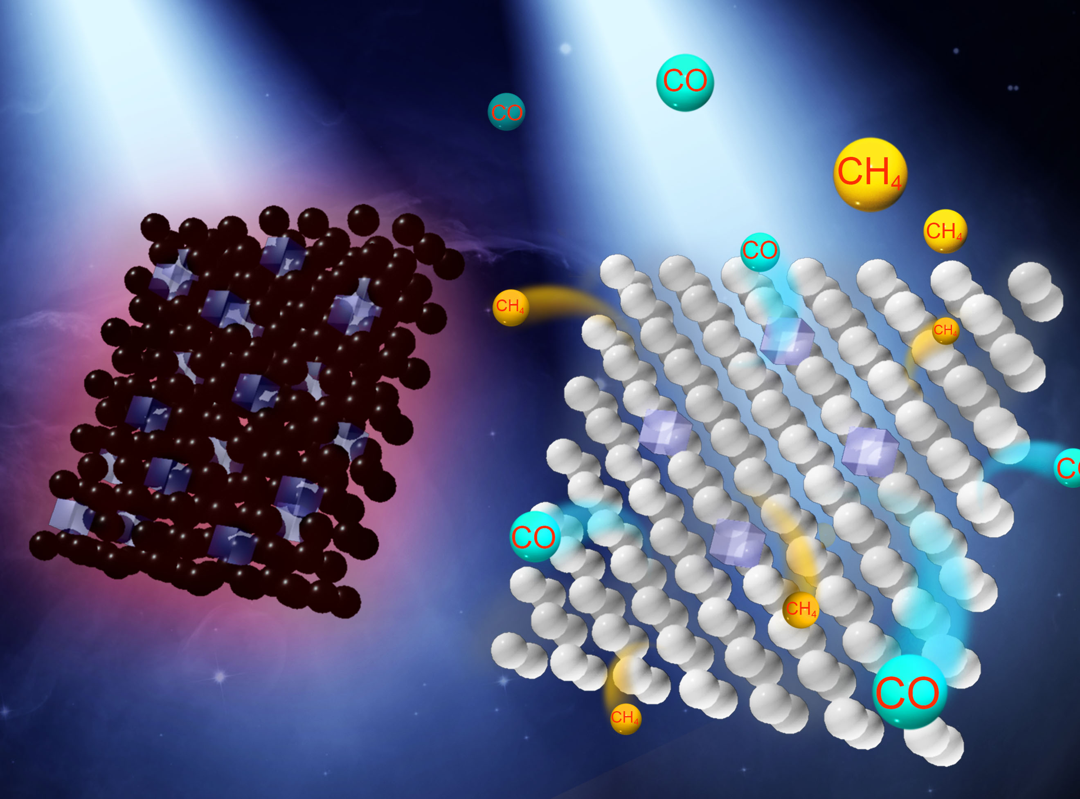
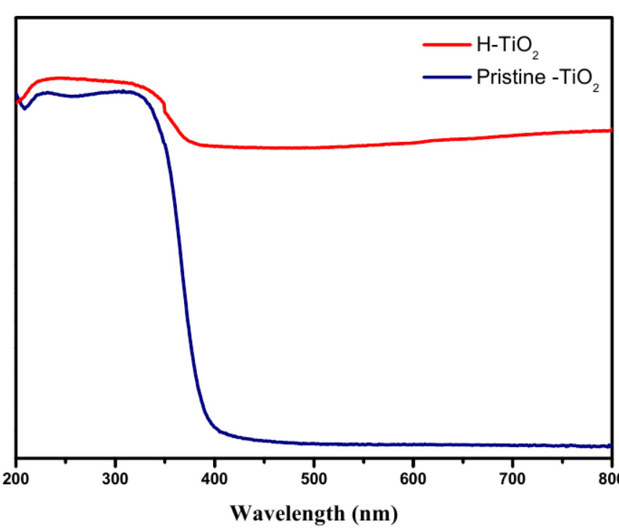
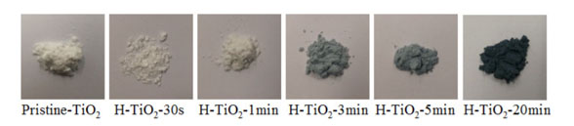
Why study TiO₂:H?
TiO₂+ H₂ Plasma
Black TiO₂
Lots of defects (V_{O}, V_{H}, Ti )
Absorption improved
More electron-hole pairs
Better performance?
Absorption
_{3 hours of H treatment}
Notes:
1)Plasma treatment which does…., but is there truly better perfomance?
2)

Slide 3
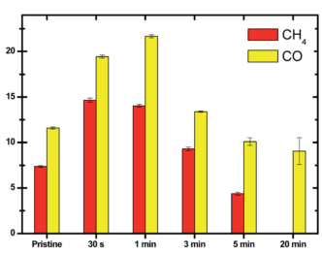
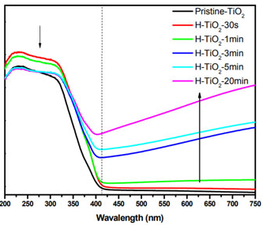
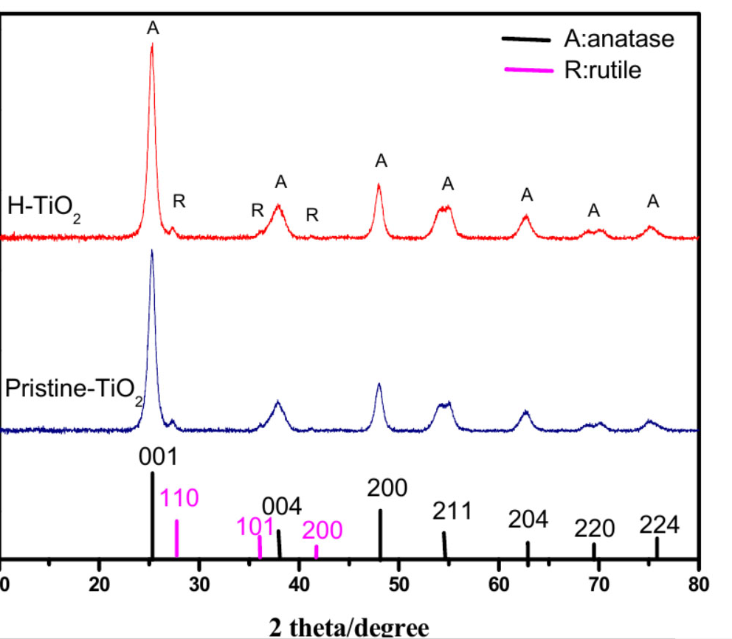
Why study TiO₂:H?
Generation rates for methane and CO in the photocatalytic reduction of CO₂ with H₂O through H-TiO₂: H₂
MILD PLASMA
doesn’t alter structure
photocatalytic performance rates better
defects (Ti2+,Ti3+ Vo, VH)
Rate
H:TiO2
Light absorption
TiO2
TiO₂
H₂ 30 sec
H₂ 1 min
Notes:
1)Better perfomance? At least not in every reported paper
2) Thats why there is another mild plasma where less defects but they are still
3

Slide 4
OBJECTIVES
Investigation of
local defects induced with plasma in the nanostructured TiO₂ materials by PAC and eMS having a significant impact on the electron-hole recombination;
dopants and H₂ interactions i.e. possibly leading to a “new” black TiO₂ ;
charge transfer?
defects evolution under various atmospheres and conditions.
Sample production& characterisation
(PVD,CVD, XPS, UV/Vis, TEMS, CEMS)
TDPAC& eMS
measurements
TU Ilmenau
ISOLDE
Notes:
1. Доппинг имеет серьезное влияние на дефекты, абсорбция это еще не все

Slide 5
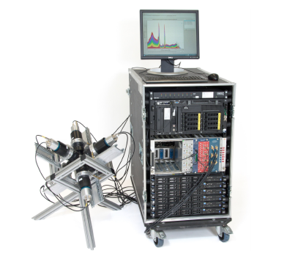
PAC SPECTROSCOPY at ISOLDE
^{111m}Cd is used in doping of TiO₂ and only at ISOLDE
Experience and sufficient amount of setups
Interactions of Cd with VH, Vo and Ti defects
        + no after-effect
How?
As a function of
sample stoichiometry with different amount of defects H₂ annealing and measuring temperature from 450-700 K
Implantation depth at 30 keV is ~ 10-12 nm (^{111m}Cd in TiO₂)
Notes:
Just to understand how the material interact with diff atmost either healing out, water nucleation;
111m no after effect

Slide 6
Emission MÖSSBAUER SPECTROSCOPY at ISOLDE
Complement of the PAC study:
Probe-host or probe-defect interaction
Valence(/spin) state of probe atom (X^{n+})
In earlier work (2014)* Ti and Vo defects were probed
HOW?
As a function of
Sample stoichiometry
Annealing and measuring temperature
Implantation depth at 30 keV is ~ 11-16 nm (⁵⁷Mn in TiO₂)
*Gunnlaugsson et al J. Phys. D: Appl.Phys.47 (2014)

Slide 7
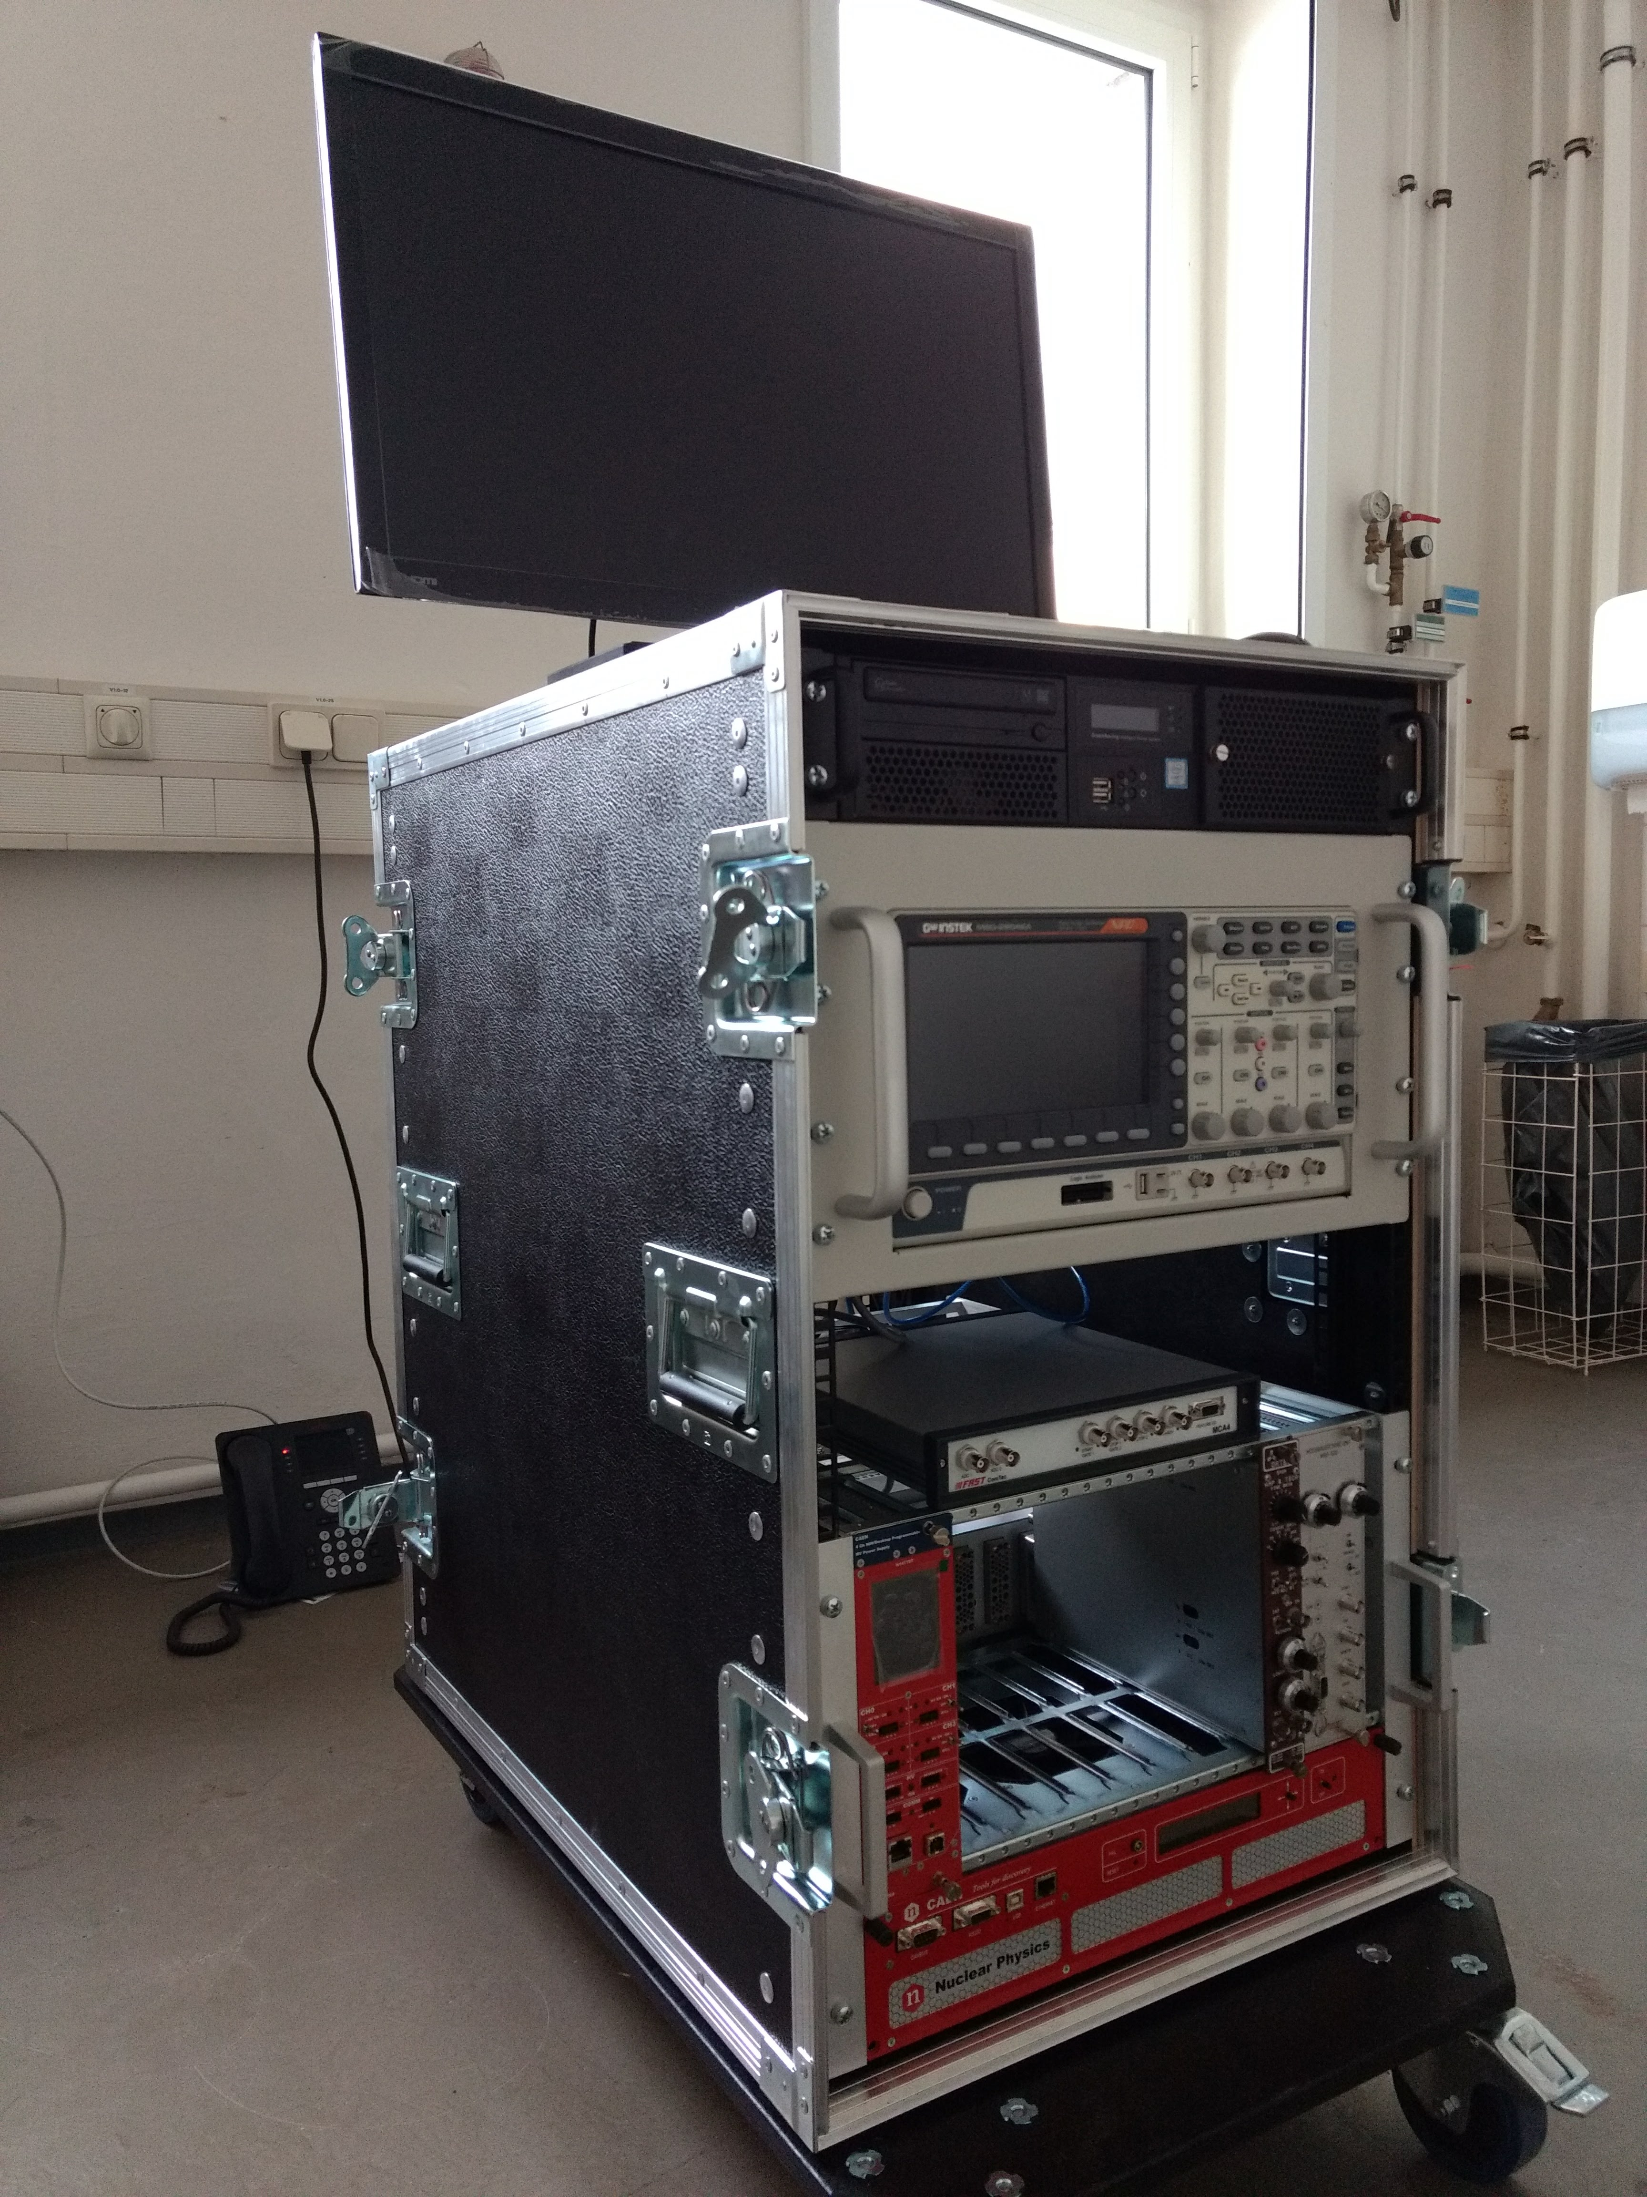
The eMS setups
The old setup:
Limitations (such as temperatures, additional vibrations, long-sample-changing option)
Complexity of extension for chemical experiments
The new setup:
UV irradiation (laser 365 nm, 3B class)
Better vibration isolation
Less pumping time
Compact & easy to assemble for a run
Precise T-control
Compatible with old cryo, magnetic lids

Slide 8
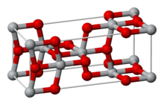
FEASIBILITY OF CURRENT PROPOSAL
Gunnlaugsson et al J. Phys. D: Appl.Phys.47 (2014)
eMS spectra of TiO₂ :H-RT
TU Ilmenau/ISOLDE 2017
Ti
Fe ²⁺ S=0 or S=2 ?
Fe ³⁺ ?
Does H act as an electronic donor?
Leading to a charge transfer?
Fe³⁺ + Ti³⁺ <-> Fe²⁺ + Ti^{4+?}
O
Mn
H?
Notes:
Preliminary measurements and differ from 2014
Fe2/Fe3+ related to a charge transfer during lifetime of 57Mn (Ti3+ XPS)
TiO₂ Mn/Fe doped + H2 ?
New black co-doped Titania?
The SL component observed above 600 K is presumably due
to the collapsing of the sextet belonging to the Sz = ± 1/2
Kramers doublet state

Slide 9
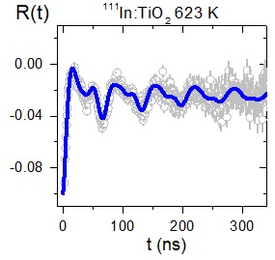
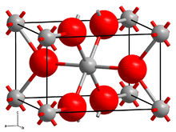
TiO₂ pristine films (TDPAC)
Schell et al, JAP 121, 145302 (2017)
Rutile structure
ω₀ ~100 Mrad/s
and η ~0.1
¹¹¹In(¹¹¹Cd) in TiO₂
TU-Ilmenau/ISOLDE 2017
Cd
Rutile structure
ω₀ ~100 Mrad/s
and η ~0.2
^{111m}Cd(¹¹¹Cd) in TiO:H₂
Notes:
In prostine samples there are the same frequency and asymmetry parameter like in Schell et al
Then with hydrogen treatment

Slide 10
TiO₂ hydrogenated films (TDPAC)
TU-Ilmenau/ISOLDE 2017
Two local enviroments with static nuclear quadrupole interactions:
Site 1: well-defined frequency for Cd at the Ti-site with distortion caused by the presence of H atoms (η ~0.5).
Site 2: major fraction at 150ºC and 200ºC
Hydrogenation treatment with high frequency distribution. Higher EFG asymmetry in respect to site 1 (η ~1).
Notes:
We couldclearly say there are
Two local environments with pure static QPI
2 different plasma induced defects
Second site has large width of freq-cies distributions, assigned to local defects from ion implantation
Fraction 1 dominates till H200, then 2 starts

Slide 11
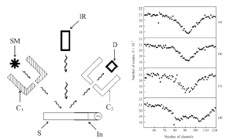
Mössbauer spectroscopy under light irradiation
Sample: CdS:57Fe(0.2%)
A. H. Mkrtchyan, R. P. Vardapetyan, E. M. Harutyunyan, A. V Khachatryan, V. V Nalbandyan, and H. R. Muradyan, “Modification of Mössbauer Reflection Spectra of Group AIIBVI Single Crystals with Fe 57 Nuclei under Influence of Infrared Radiation,” J. Contemp. Phys., vol. 44, no. 4, pp. 194–196, 2009.

Slide 12
BEAM TIME REQUEST
Perturbed Angular Correlations Studies
Required isotope | Implanted beam | Probe element | Type of experiment | Intensity [at/μC] | Target / Ion source | Atoms per sample | № of shifts
^{111m}Cd (48 min) | ^{111m}Cd | ¹¹¹Cd | γ-γ PAC | 10⁸ | Molten Sn; plasma | 2x10¹⁰ | 3
Mössbauer studies
⁵⁷Mn (1.5 min) + TESTING of eMS | ⁵⁷Mn | ⁵⁷Fe | eMS | 2 x 10⁸ | UCx, RILIS (Mn) | 1x10¹² | 2 + 2
Notes:
Whats why we need just these amont of shifts to measure the main points and after that the picture is clear

Slide 13
FUNDING INVOLVED
BMBF
Bundesministerium für Bildung und Forschung
Erforschung kondensierter Materie mit Großgeräten
Ausbau und Unterhalt der Einrichtungen an ISOLDE/CERN
Germany, contract: 5K16SI1

Slide 14
Thank you for your attention!

Slide 15
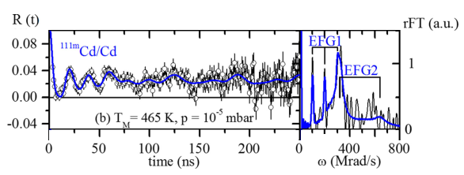
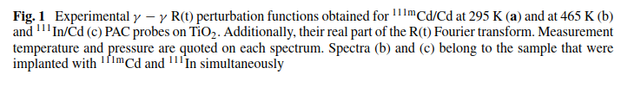
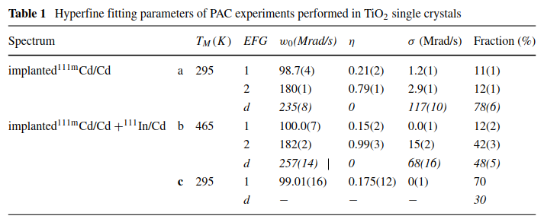


Additional information TDPAC
Schell et al, Hyp. Int. (2017) 238:2.
Similar frequency value (257 Mrad/s) in respect to the well-defined frequencies obtained with H:TiO₂ (300 Mrad/s), but since it had no H and the sample was a single crystal, it presents lower EFG asymmetry:
^{111m}Cd:TiO₂ Syngle Crystal
ω₀ ~257 Mrad/s
and η ~0

Slide 16
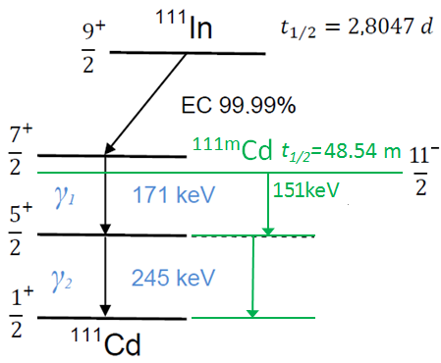
Additional information TDPAC
^{111m}Cd⁽¹¹¹Cd)
μ(5/2⁺)= -0.766(3)μ_{N}
Q(5/2⁺)= +0.74(8)b
A₂₂ (^{111m}Cd) = 0.1786
A₂₂ (¹¹¹In) = -0.1782

Slide 17
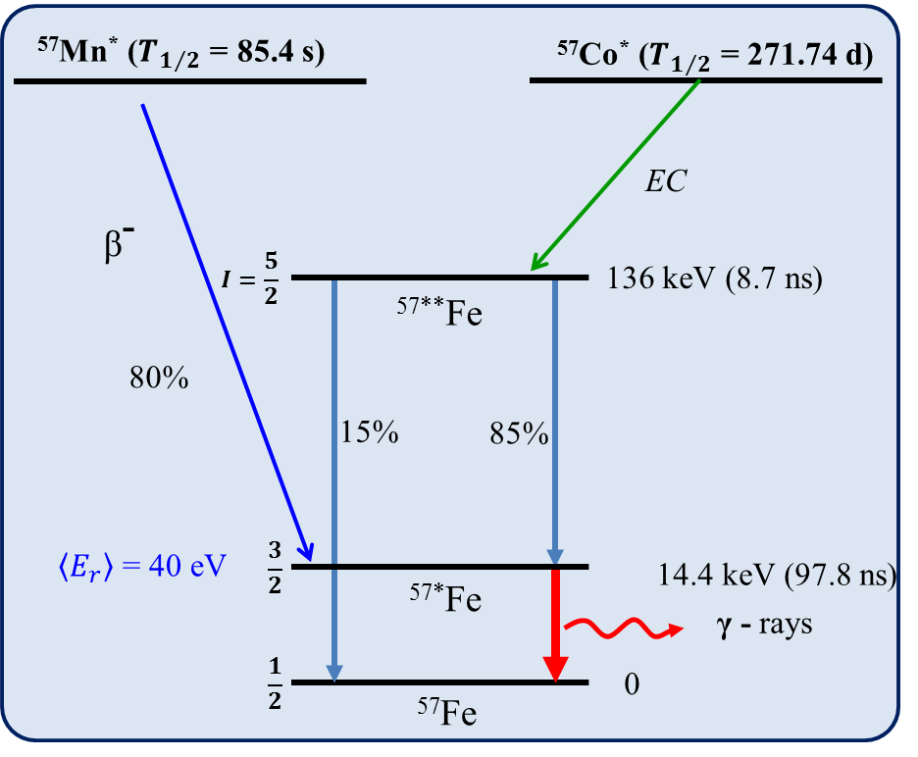
Additional information eMS
⁵⁷Mn/⁵⁷Fe

