Slide 1
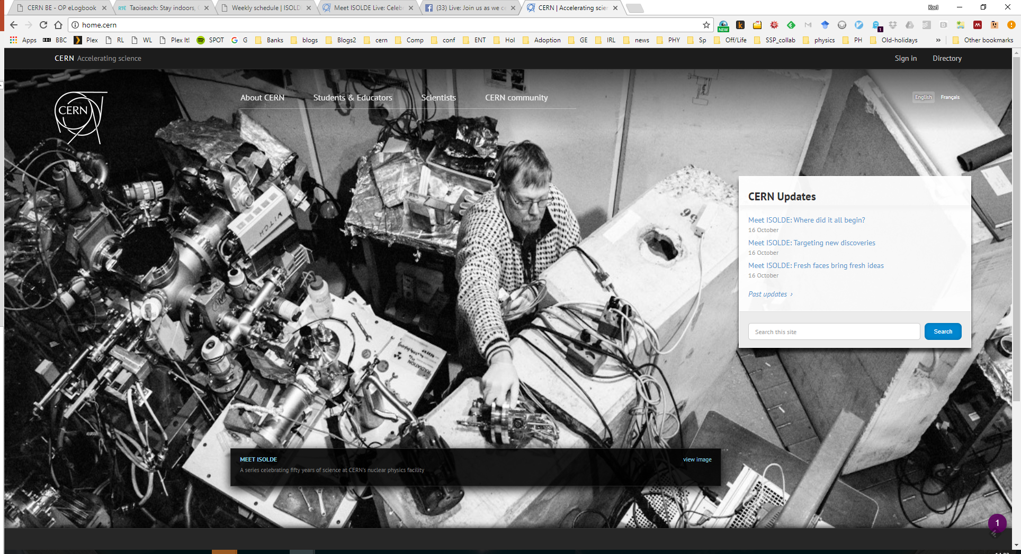
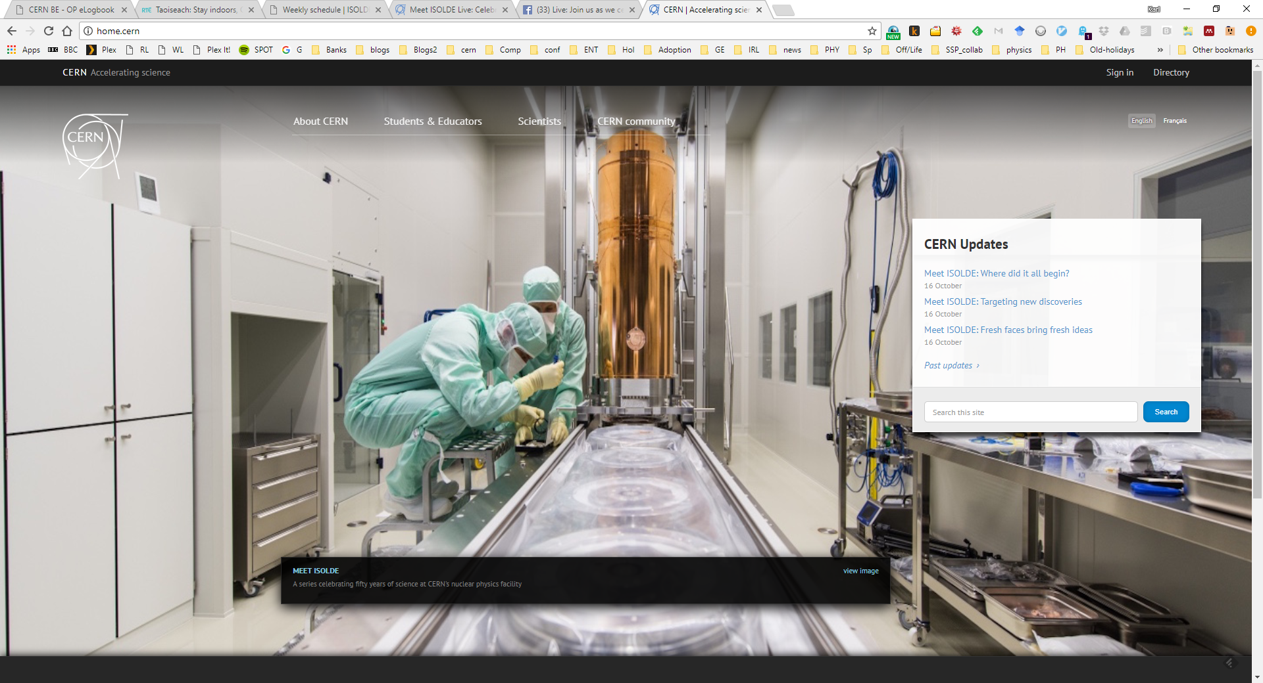
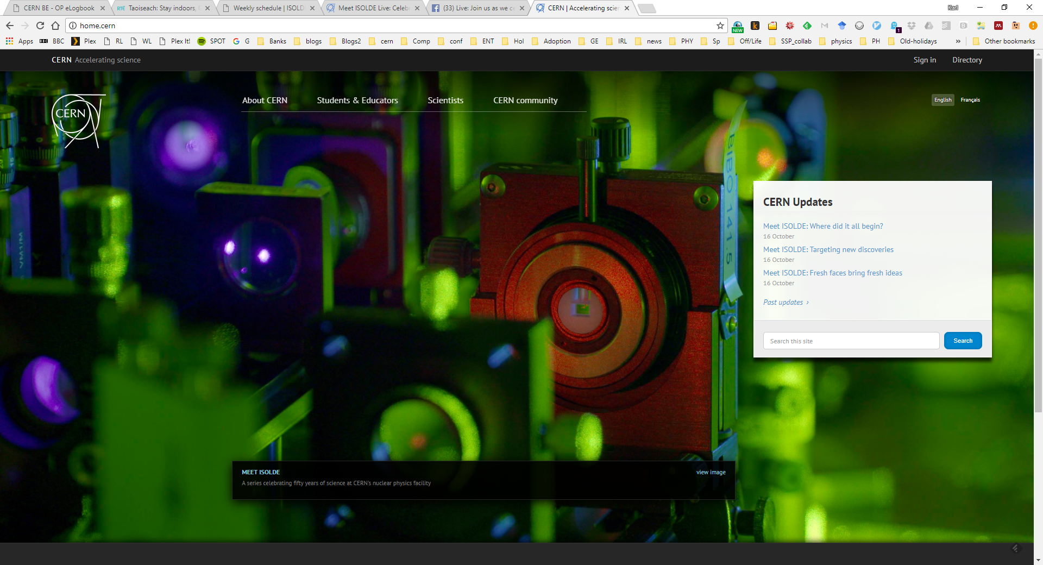
ISOLDE Technical and physics update: INTC 58
Richard Catherall/Sebastian Rothe/Karl Johnston

Slide 2

Power supply consolidation
GPS + REX Power converter replacement
  Consolidation of the following GPS and REX converters: RPSEV.197.YGPS.SEP70, XSEP.RB.1000, XL9GP.RCV.0400 and XL9GP.RCH.0400.
60kV HT power supply and modulator
  To be used mainly for the HRS
  Includes new controls so will have 2 separate control applications for the different HT power supplies.
  Depending on operational experience, 2nd new PS and modulator to be installed in 2021/2022 shutdown

Slide 3
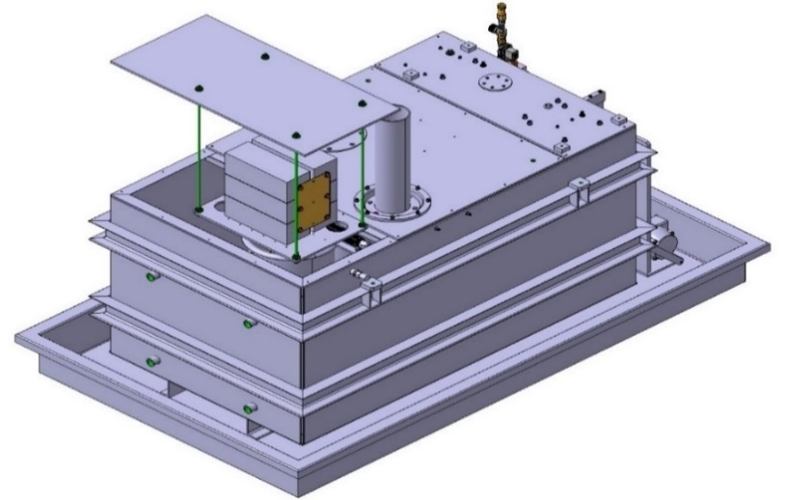
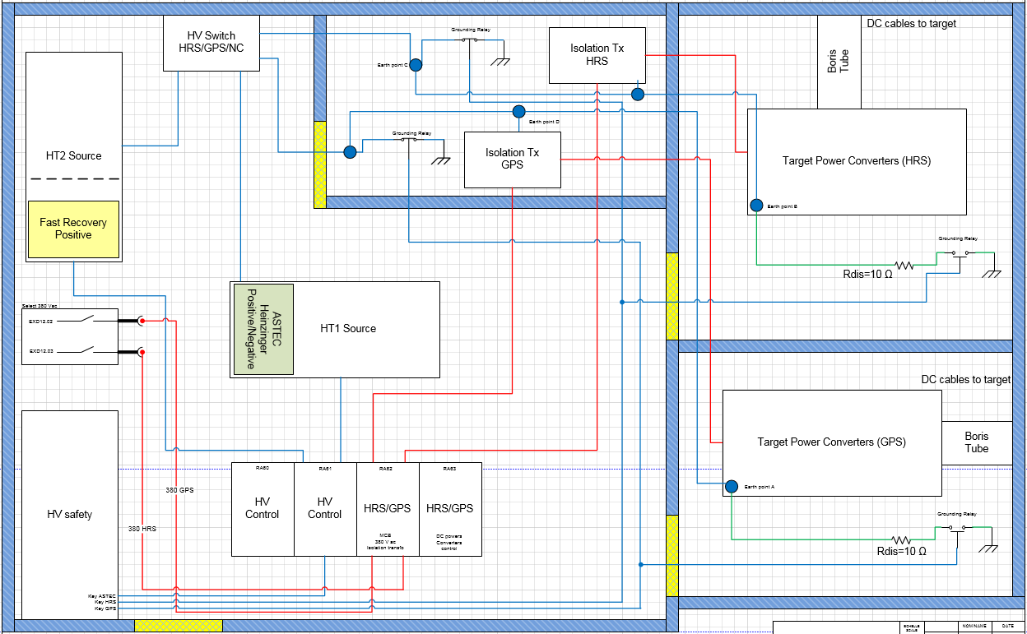
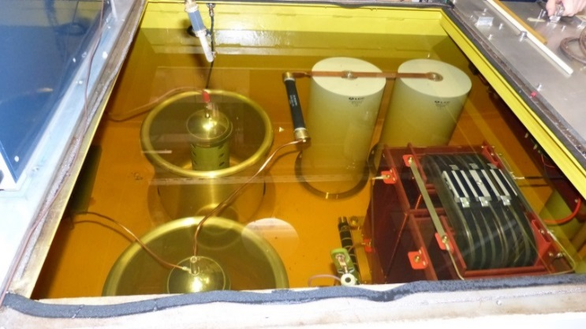
ISOLDE HT PROPOSAL UPGRADE
New device sits
in existing housing
Install the fast recovery system only on HT2 during YETS 2017/2018
Easy reversal to present configuration system in case of major problems
As a negative solution is not yet available, better to keep HT1 unchanged
Full consolidation of both modulator during LS2 with positive and negative HT
ISOLDE HT room - Building 170
Re-use of the ROSS dividers

Slide 4
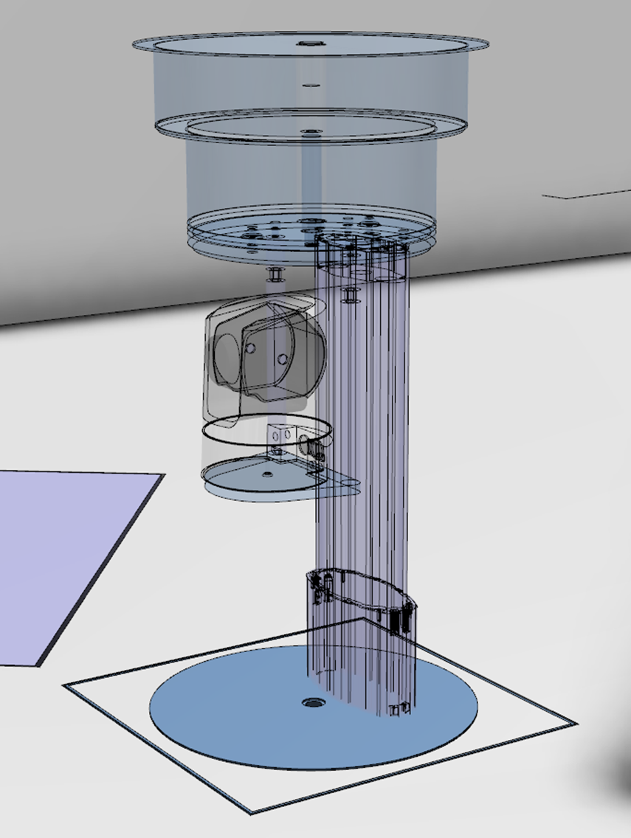
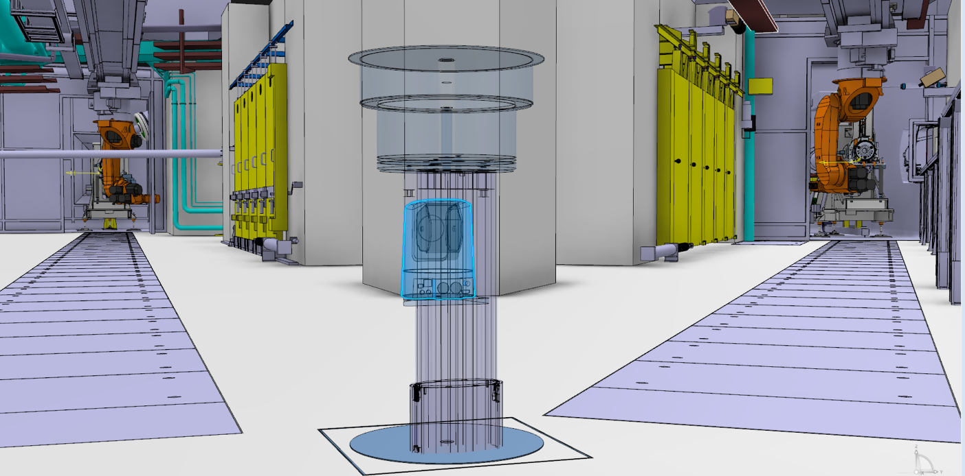
A telescopic camera for the target area
To provide an overall view of the target area (in the absence of protons)
Visualize target changes over internet
Screens to be placed in target entrance
Partially eliminates the need to call upon the Telemax robot in the event of a failure – quicker diagnostics
As presented in 2017

Slide 5
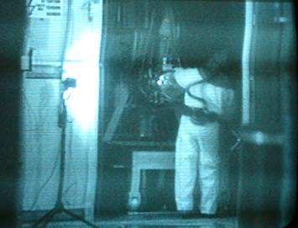
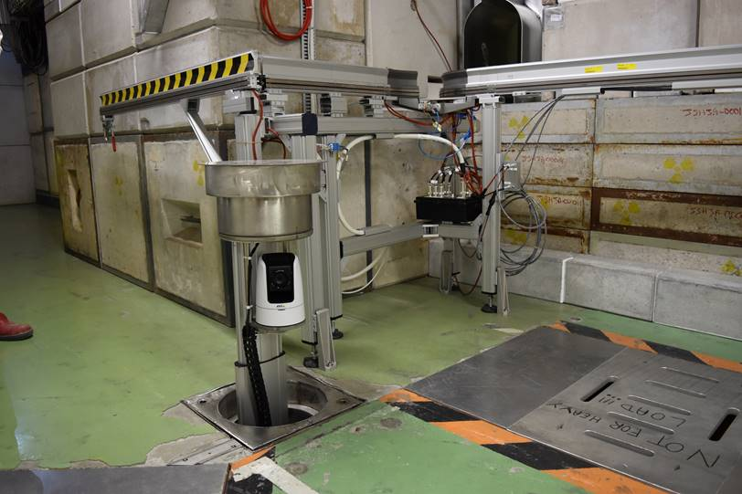
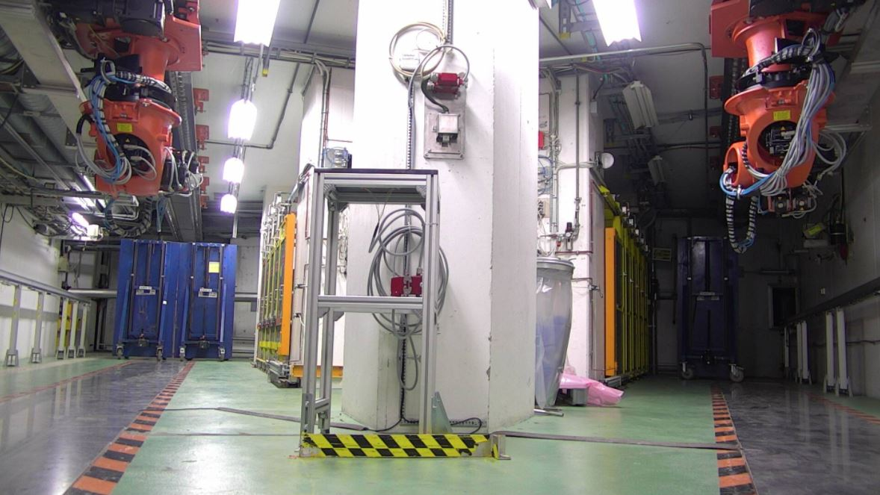
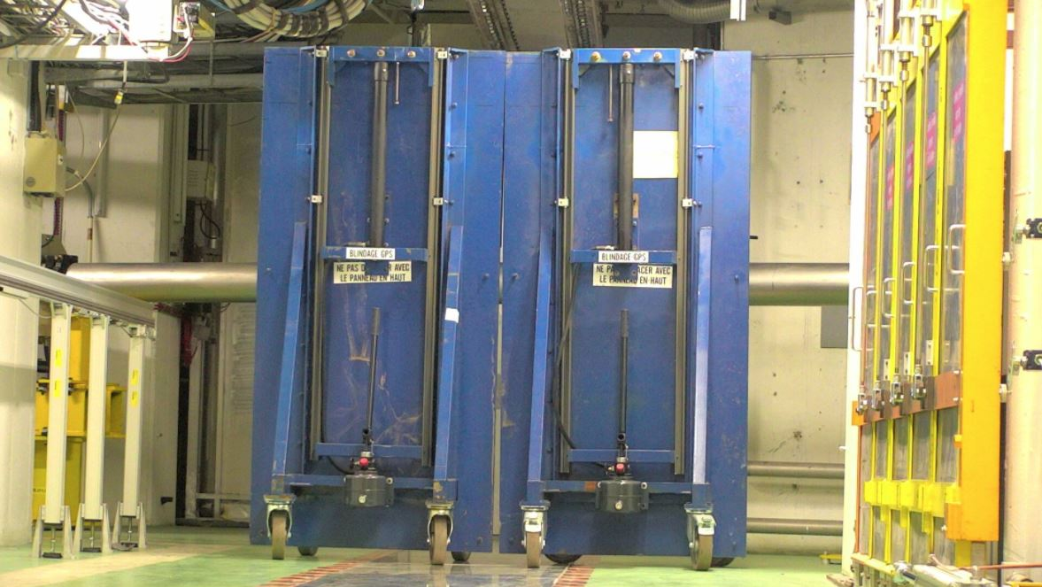
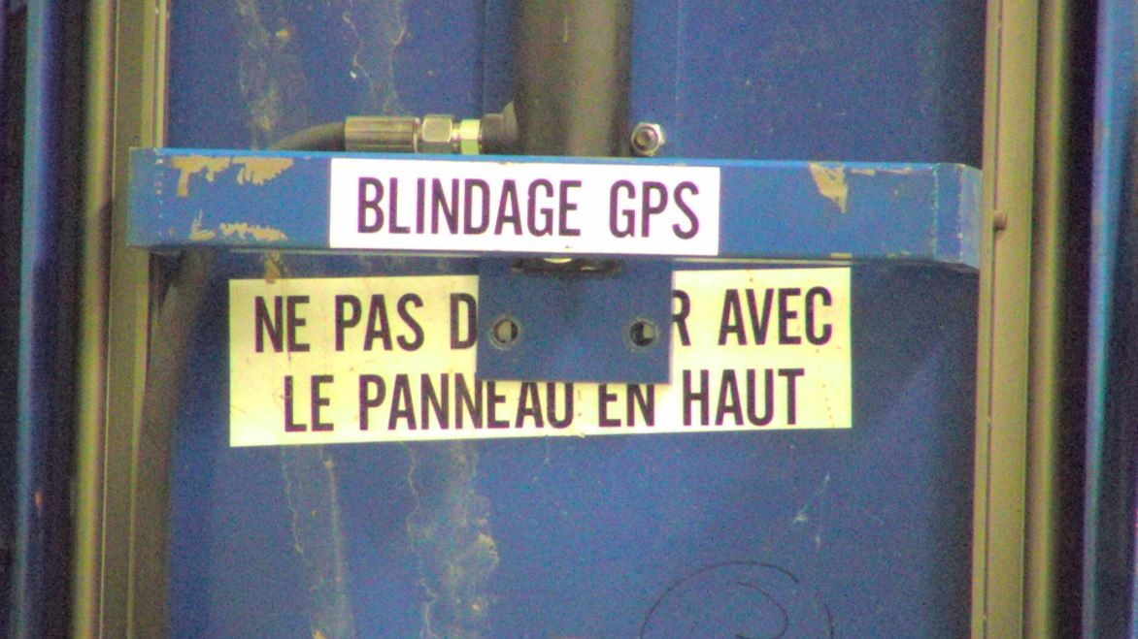
Telescopic camera in images
Existing camera images
Telescopic camera in position
Zoom

Slide 6
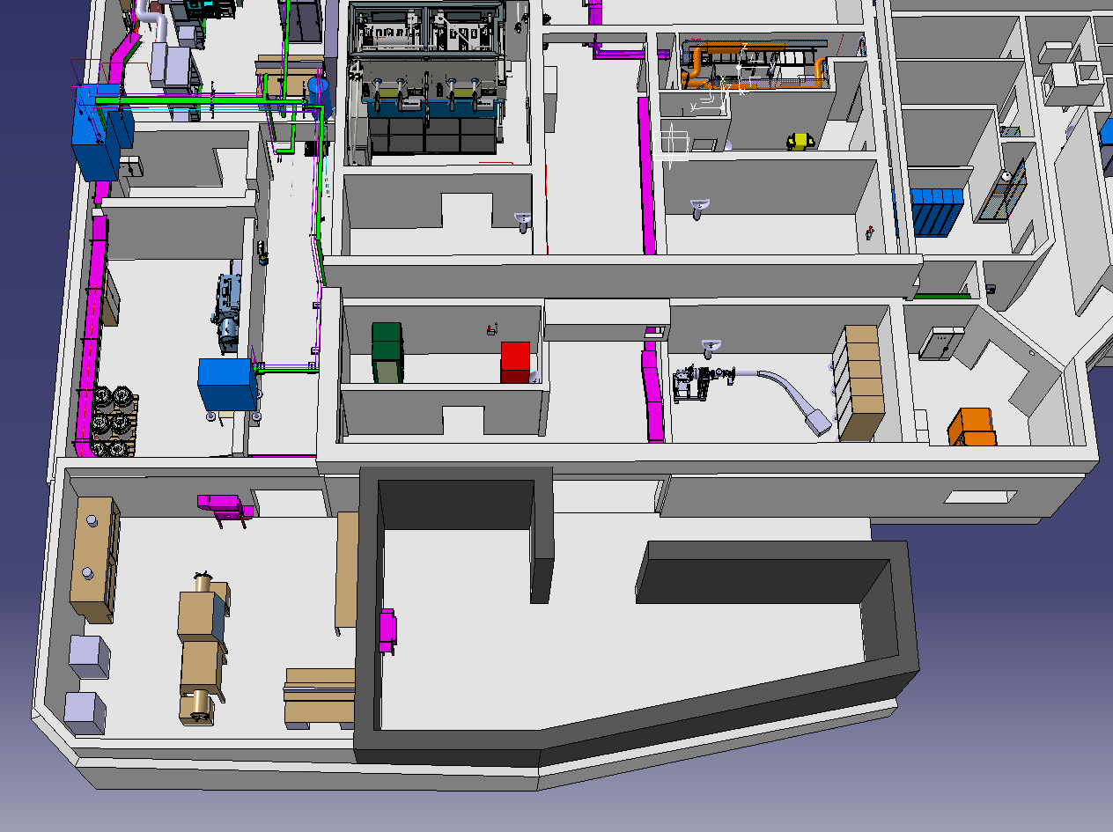
Nano lab
V. Barozier

Slide 7
Nano Lab
Finalisation of IPP document for end of February
  Cost analysis, functional specs, risk analysis
  Combines nano, pyrophoric, radiological and chemical risks
Start construction ~ September 2018
  Conflict with access to Class A labs and MEDICIS
Civil engineering ends June 2019
3 months required for ventilation coupling and minor civil engineering work during the last quarter of 2020

Slide 8
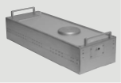
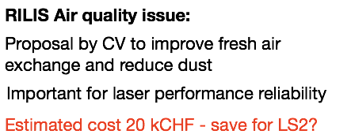
RILIS YETS equipment / upgrades
RILIS Pump lasers
RILIS tunable lasers
Ti:Sapphire pump laser failure
To be repaired/ replaced ASAP
Ready before on-line period
Injection-seeded
NB Ring Tisa
2nd Ionization laser
Coherent Blaze
March 2018
K. Chrysalidis
Pulsed dye amplifier
- annual window changes on separators, plus HRS alignment and power transmission checks with power-meter target.
C. Granados
Bruce Marsh

Slide 9
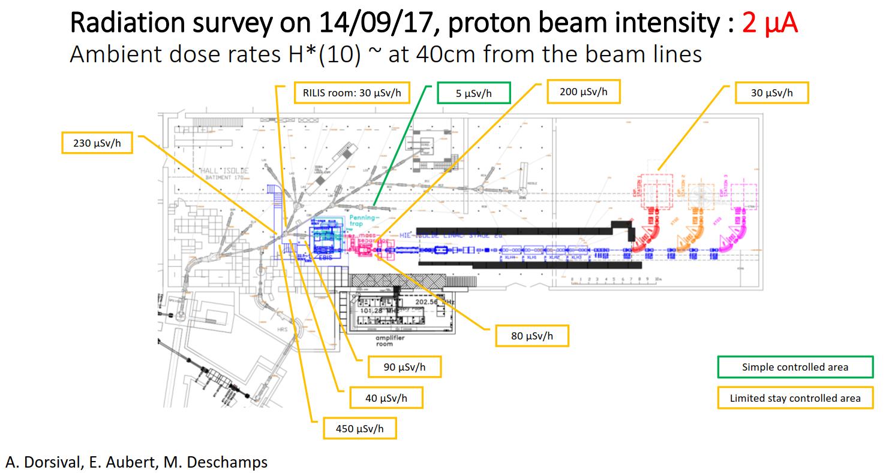
s
IS572: 94Rb @ 6.5 MeV/u

Slide 10
Operations -94Rb Issue
After an initial working group meeting to explore the possibilities, the following action plan has been outlined
Proposition
  Identify and flag high intensity RIB during TAC and schedule
  Inform ISOLDE community that hall will become a Limited Stay Controlled Area for the duration of the experiment
  Change panels and monitoring thresholds the day before the experiment starts
  Put in place mobile alarms (balise) at entrances to hall
  Do a visual inspection to:
    Inform occupants that the lab has changed classification
    Identify “hot spots” along the beam line
Proposition to be refined and presented to the PS-CSAP

Slide 11
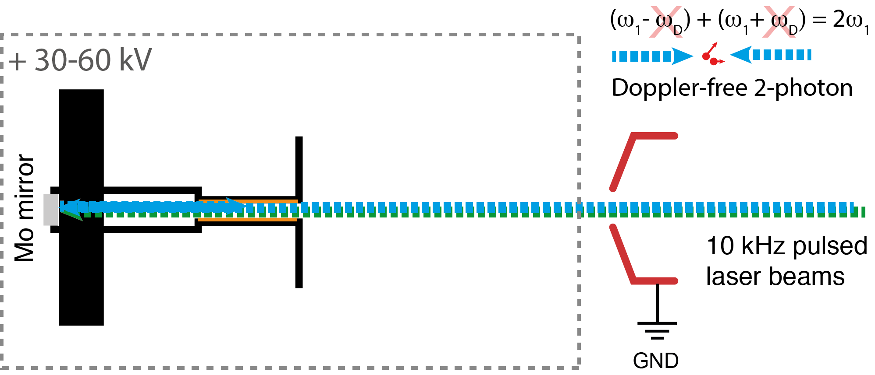
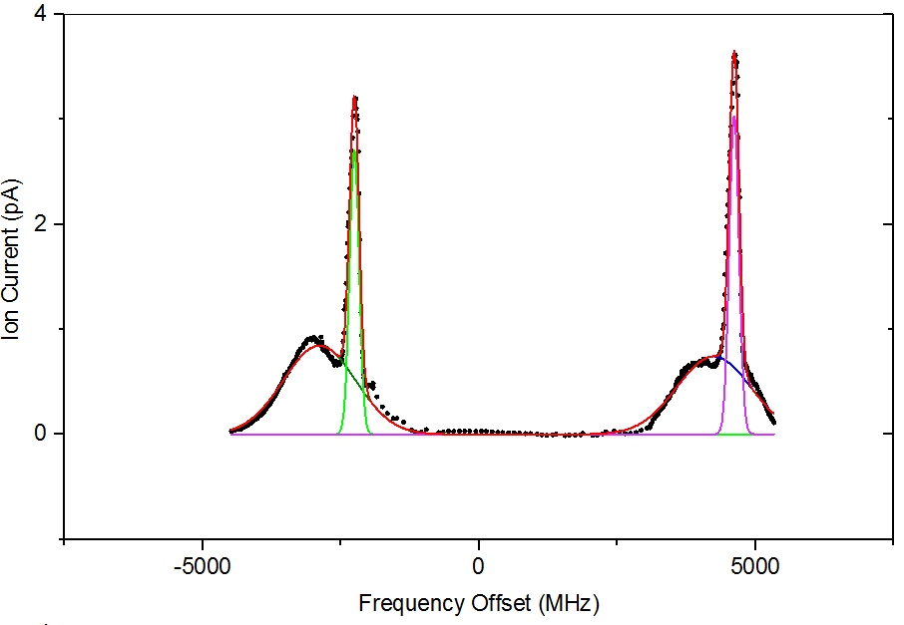
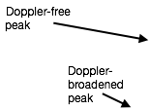

RILIS Developments before 2018 physics:
1) 2-photon spectroscopy of stable Si and Rb.
2) Samarium Efficiency measurement with alternative Blue-Blue scheme.
PhD project: Katerina Chrysalidis
Injection-seeded
NB Ring Ti:Sa
Tests planned in March
Bruce Marsh

Slide 12
RILIS Fellow: Shane Wilkins
will perform these tests
Bruce Marsh

Slide 13
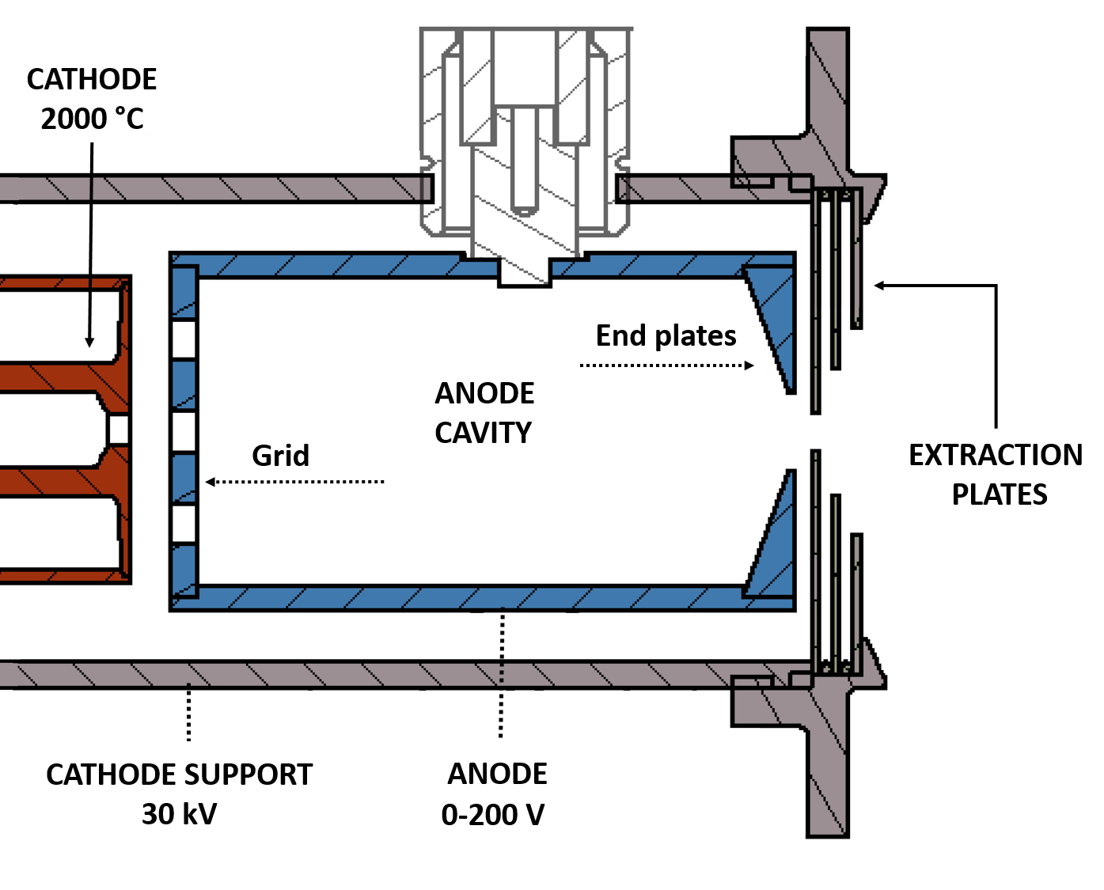
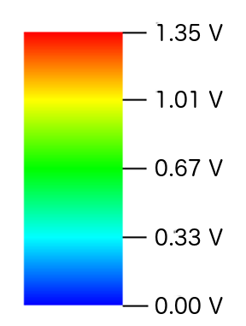
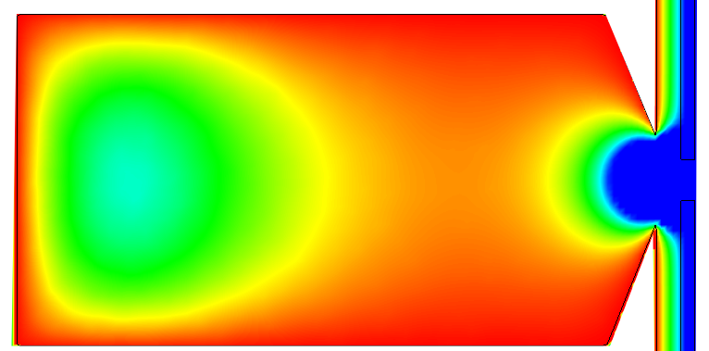
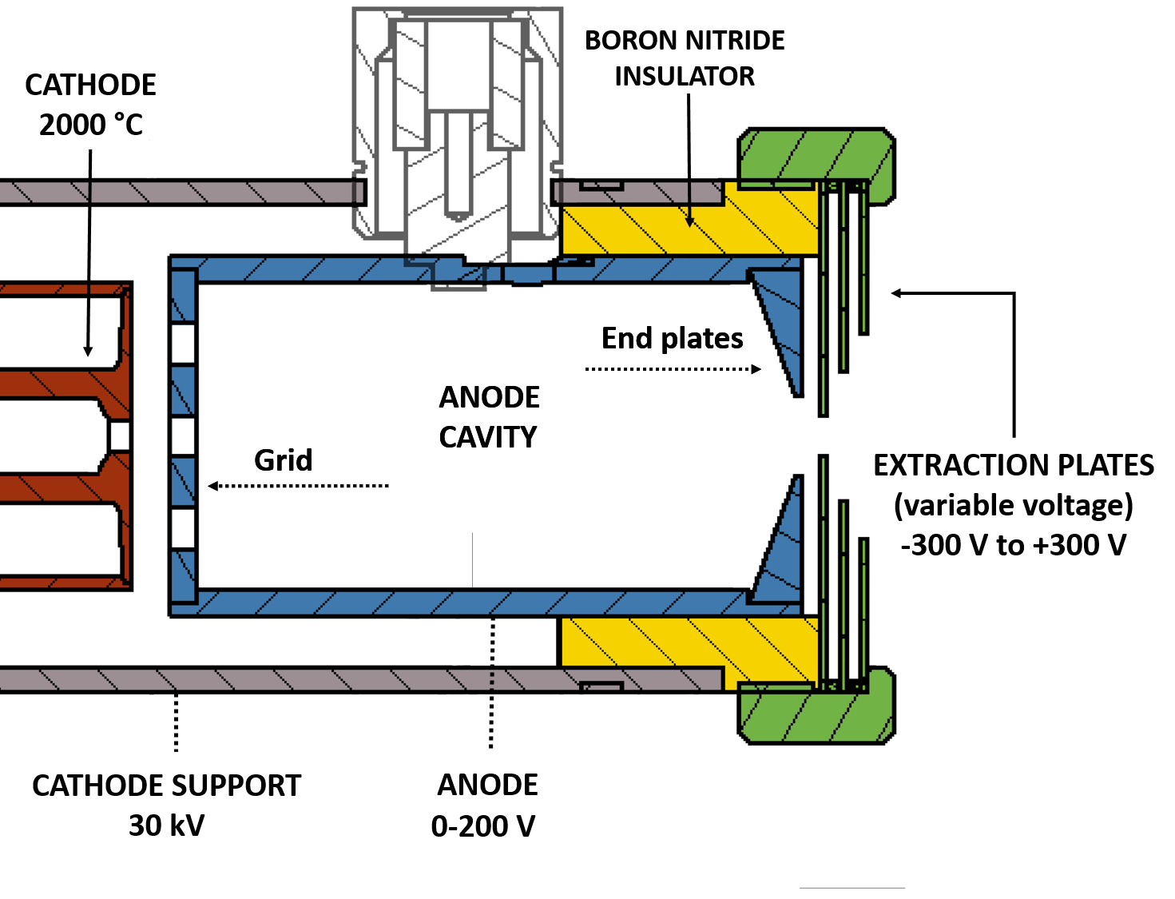
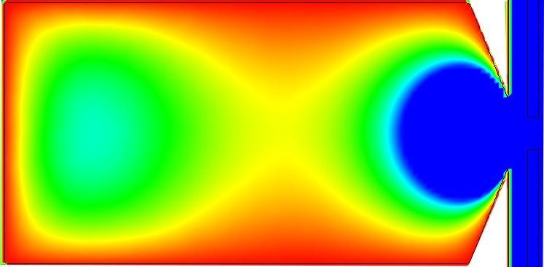
Ongoing VADLIS development
V_{extraction} = 0 V
PhD work: Yisel Martinez
Standard VADIS
=
FEBIAD MK5 (but with Mo anode)
V_{extraction} = -100 V
Prototype tested for Ga at OFFLINE 1
At least 2 X efficiency improvement
Tested at ISOLDE for Hg, Mo, Mg
Factor of >2 improvement in RILIS-mode efficiency for all cases
Continued work of PhD student
David Leimbach
Proposal For 2018:
More VADIS sources equipped with adjustable extractor?
Ongoing investigation at offline (inverted polarity cathode, further optimization of construction of anode holder)
Use VSIM to optimize geometry for RILIS-mode operation (VSIM workshop in Leuven next week)
Bruce Marsh

Slide 14
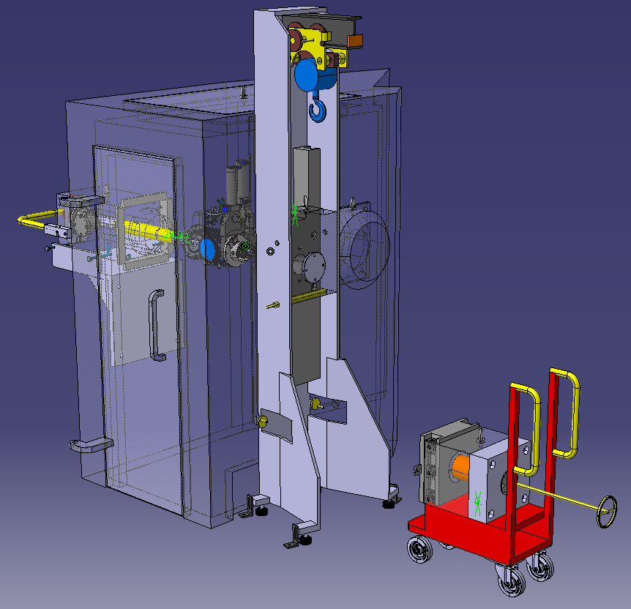
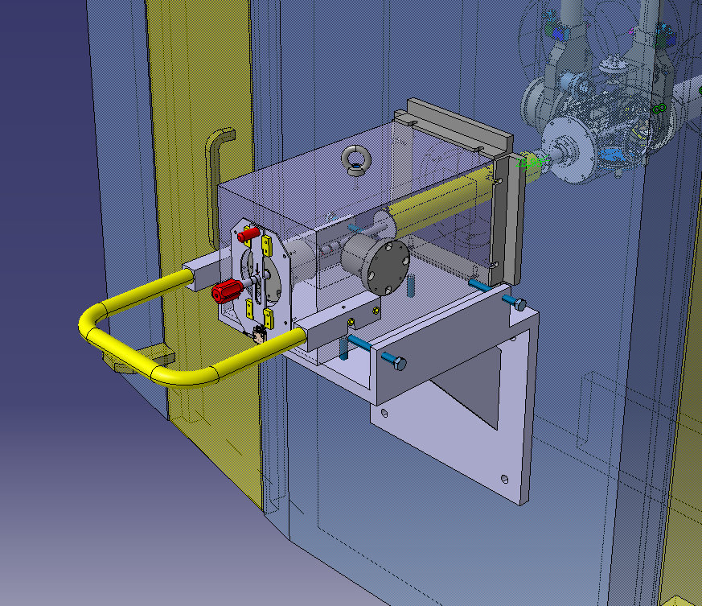
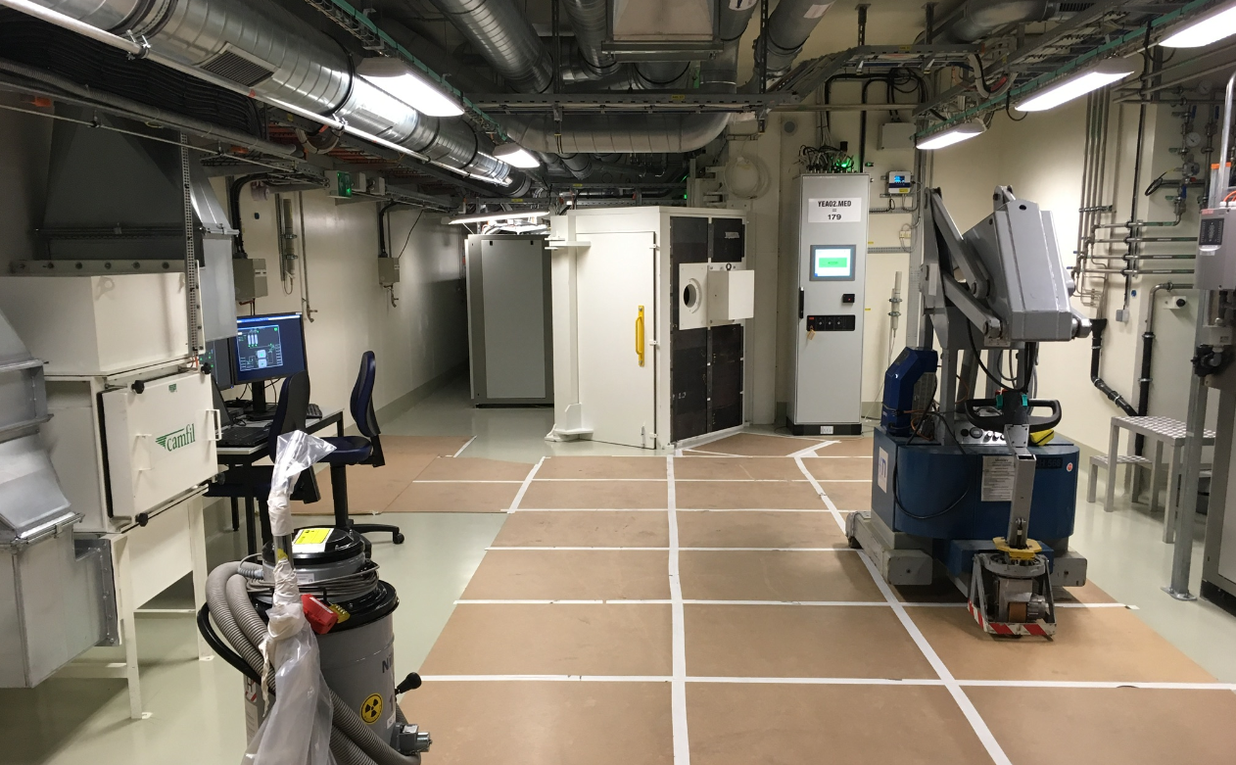
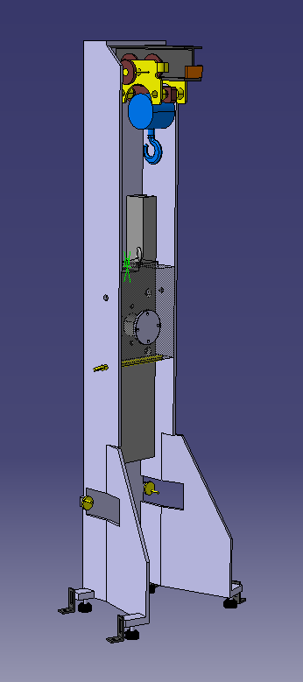
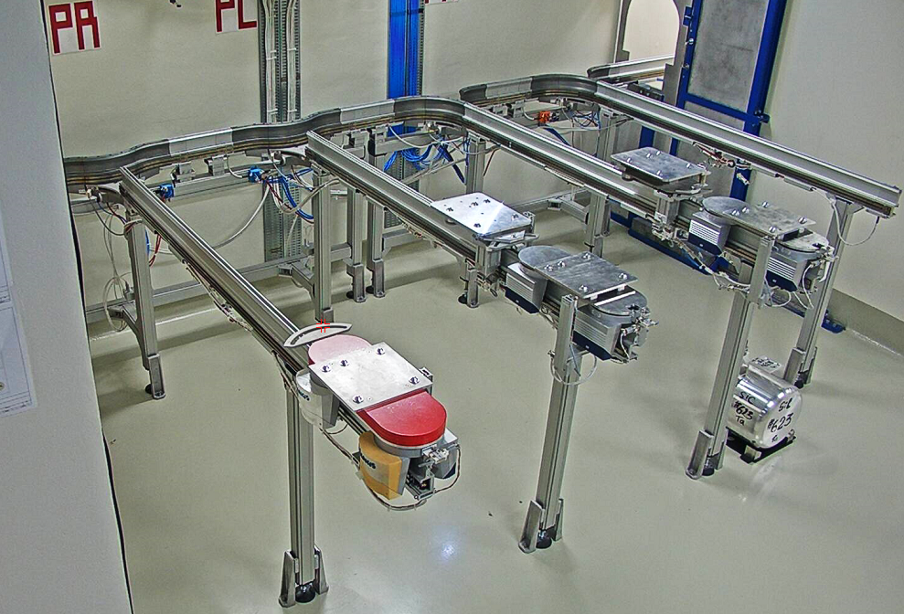
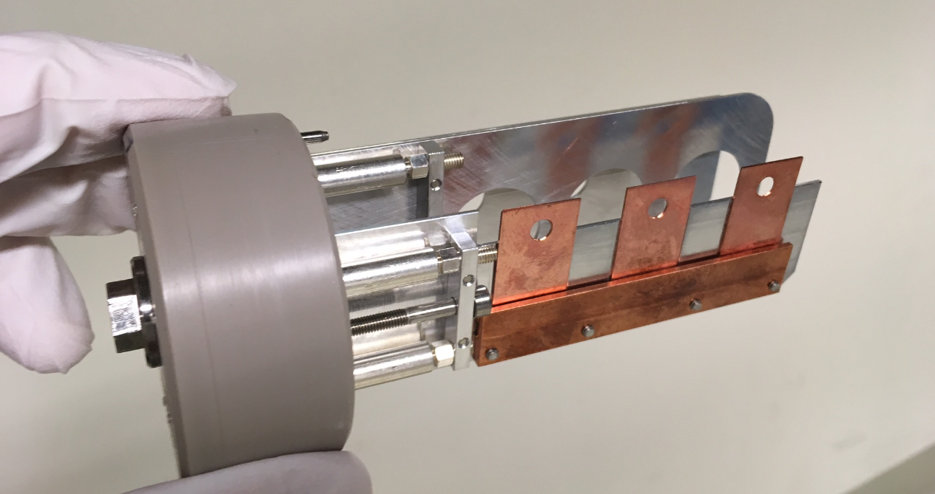
Yets 2017-2018 main works in MEDICIS
Ventilation process dismount and upgrade
First transfer port and shielded trolley delivery, alignment and installation.
Slits motorization and control completion
Collection box movement control alignment and completion
Second transfer port delivery and installation
Outgazing vacuum and collection sample design optimization
RCS Montrac upgrades and tests completion

Slide 15
Start up planning

Slide 16
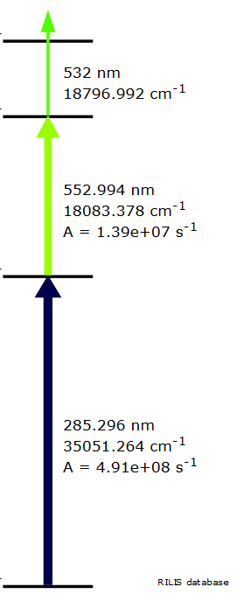
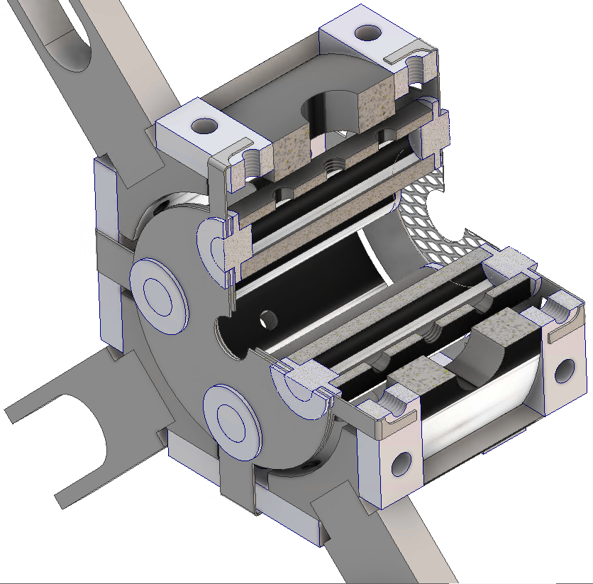
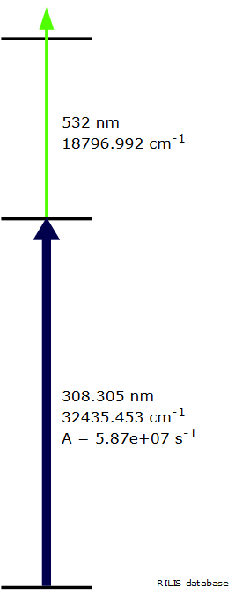
LIST v 2.0
Upgraded 2018 LIST laser ion source for
INTC-P-459: Measurement of the super-allowed branching ratio of ²²Mg
Laser ionization of Mg - suppression of surface ionized Na contamination
Compact isolator design: Narrow spacing to atomizer
Dual repeller:
Ion and electron suppression
34 mm
Adapted length:
Reduced deposition and compatibility to additional purification techniques
Mg
Al
Operation analog to 2012
1 unit available, 2 more machined at JGU workshop right now
Robot handling tests with mock up unit in shutdown
Ideal opportunity for Al yield checks
R.Heinke

Slide 17

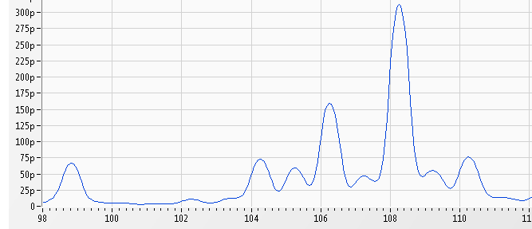

Neutron deficient SeCO beams
Target #605 and #612
Zirconia fibers, stabilized with ca. 10% Yttria
Principle:
Se + CO → SeCO
Shifting the mass to get pure beams
Why does SeCO disappear,
even if we inject CO₂?
Beam available since many years.
but….
Injecting ¹³CO₂….
⁷¹Se
…extracting Se¹²CO
CF₄
injection
⁷¹SeCO
Injected CO₂ gas does not
promote SeCO formation!
What’s the source of carbon?
Carbon from the ion source?
-> Placed graphite grid, but still depleting
Carbon from the target material?
-> EDS (preliminary) shows no carbon in ZrO fibers
SeCO gone after a few days
Atomic Se still released after days
Indications, that CF₄ gas might serve as carbon source. Work in progress.
J.Ballof

Slide 18
Studying molecular beam formation
Concept for a dedicated development unit for molecular beams
Study chemical reactions
Injection of gases and vapor of solid samples into reaction volume
Suppression by quartz and other materials
Parameters
2 gases, controllable flow rates
2 mass markers
Controllable temperatures in reaction volume and chromatography column
Materials for chromatography and
Materials in reaction volume (target matrix)
RGA
Heated reaction volume
VADIS source
Chromatography
Faraday
Cup
Magnet
Scanner
Faraday
Cup
Solid Samples
(mass markers)
Gas 1
better understanding of molecule formation
improve reliability of existing beams, tailor new beams
Gas 2
J.Ballof
18

Slide 19
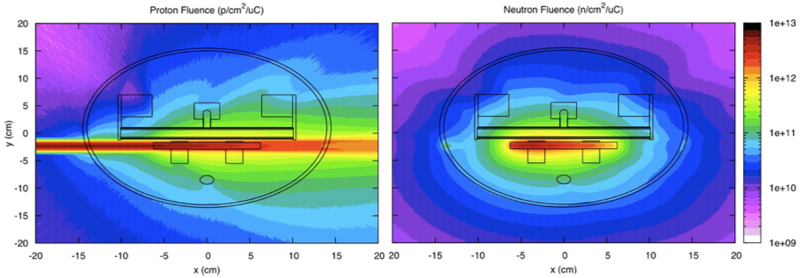
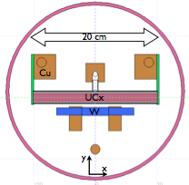
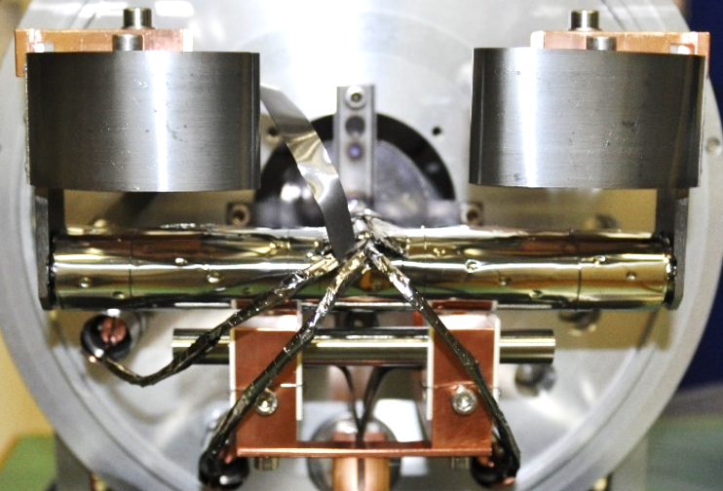


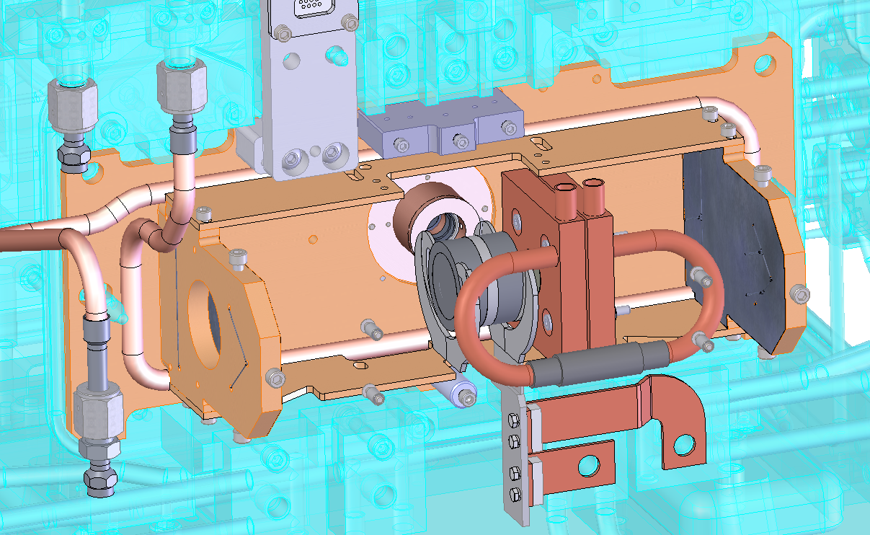

p2n-converter 1.0
p beam
Brings high purity neutron-induced fission fragments
Collaboration started to design two p2n-converters:
Improve the one of ISOLDE
Design one for TRIUMF ISAC
500 MeV
100 μA
cw
50 kW
1.4 GeV
2 μA
pulsed
2.8 kW
2.0 GeV
6 μA
pulsed
12 kW
L. Egoriti, et al. (TRIUMF)
J.P.Ramos

Slide 20

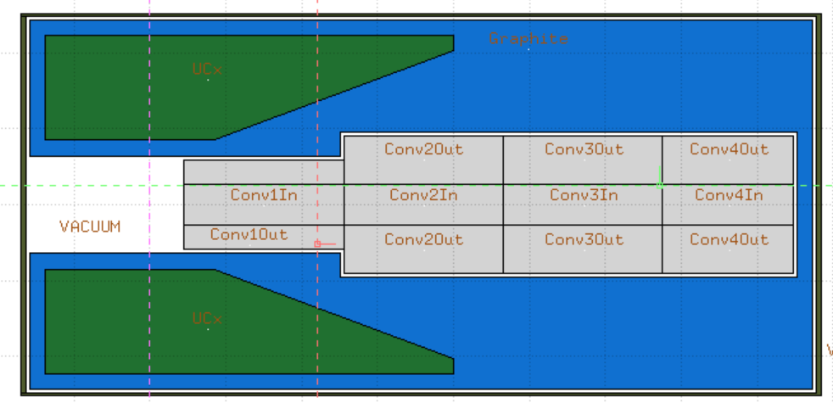
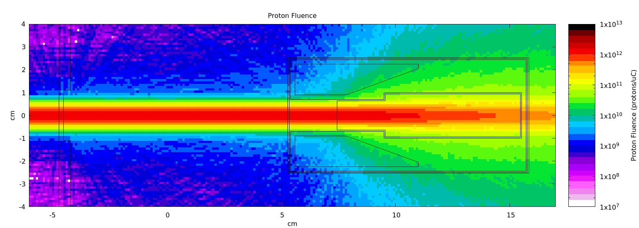
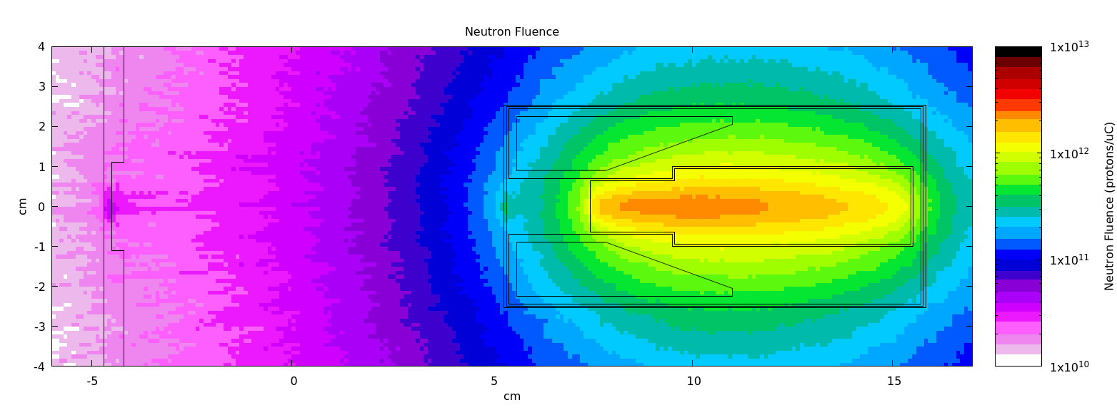
p2n-converter 2.0
100 mm
UC_{x}
Graphite
p beam
Tungsten
51 mm
57.8 cc of lower density UCx (normally 30 cc – mass is the same to standard)
2.1 x more n-ind fissions
2.4x less %p-ind fissions
Normal shielding – several metal foils stacked
New shielding: Sigratherm material – 1 cm thick
Converter will act as internal heat source
J.P.Ramos

Slide 21














ISOLDE Schedule 2017: weeks 16 - 48
XT03
XT03
(Windmill)
ISOLTRAP: Cd/Kr/Ar/Cs/development
IDS: In/Bi/B
VITO: Ar/Na
COLLAPS: Al/Ni/Sn
CRIS: In/K/Ga
Miniball
108Sn
IS562
140Nd; 142Sm
IS546
140Sm
IS558
144Ba; 142Ba
IS553
206Hg
IS547
70Se → 66Ge
IS569
72Se
IS597
94Rb
IS572
28Mg
IS628
SSP: Mn/In/Cd/Hg/Cu
Biophysics: Tb/Cd/Hg
Medical: Tb
Scattering Chamber
15C beams to XT03
IS619
9Li
IS561
59Cu for Edinburgh chamber
IS607
Target change
CERN holiday
Setting up/proton scan/yield
Physics GPS
Physics HRS
KJ: 06.10.17

Slide 22
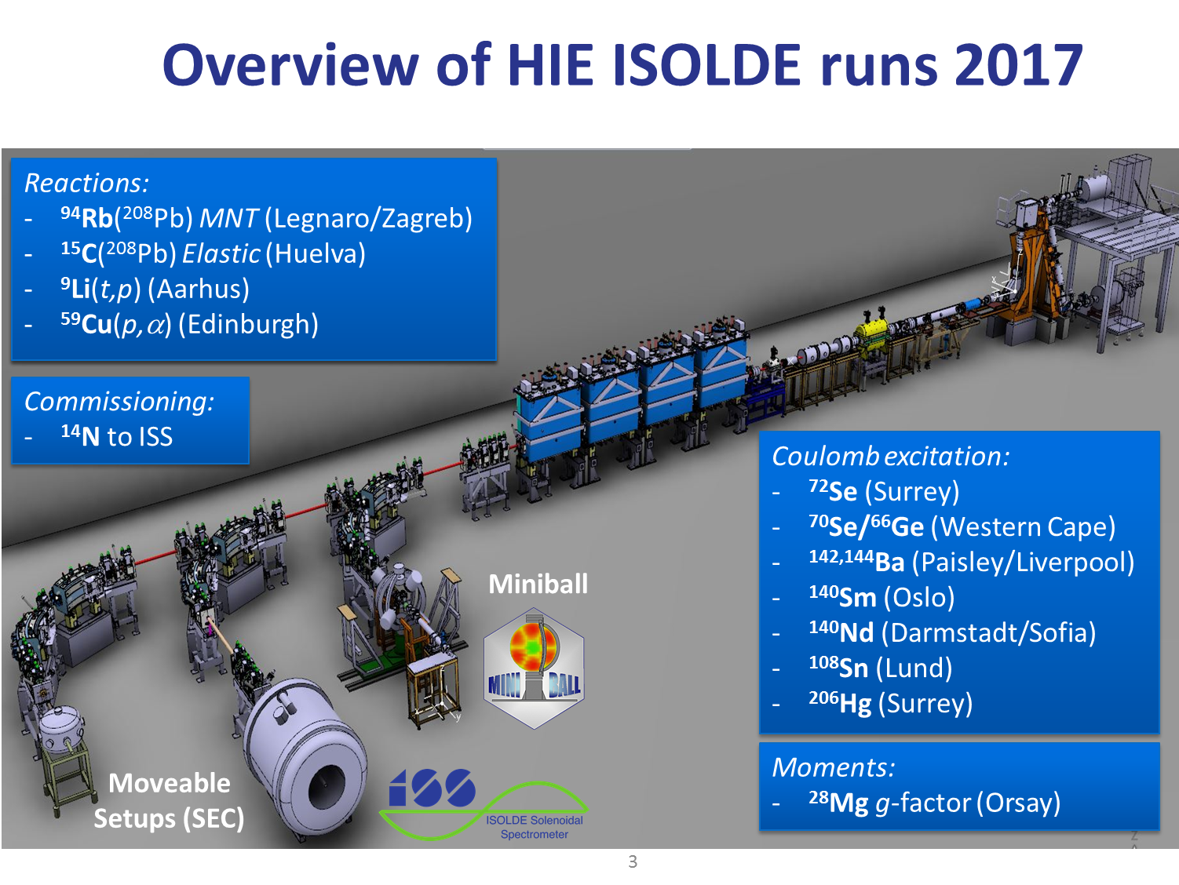
Liberally borrowed from Liam Gaffney’s talk to the ISOLDE workshop
12 Experiments scheduled (and mostly possible) from 7th July till 4th Dec

Slide 23
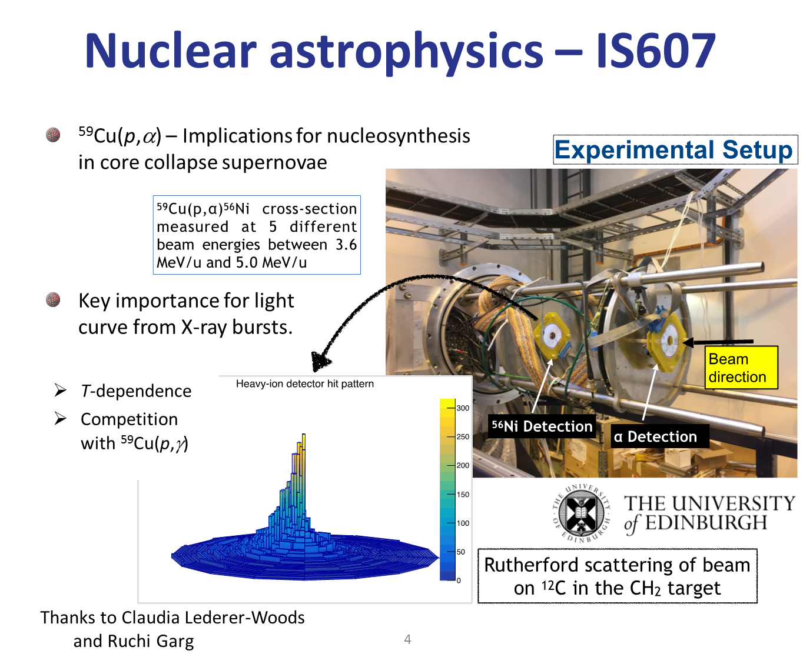
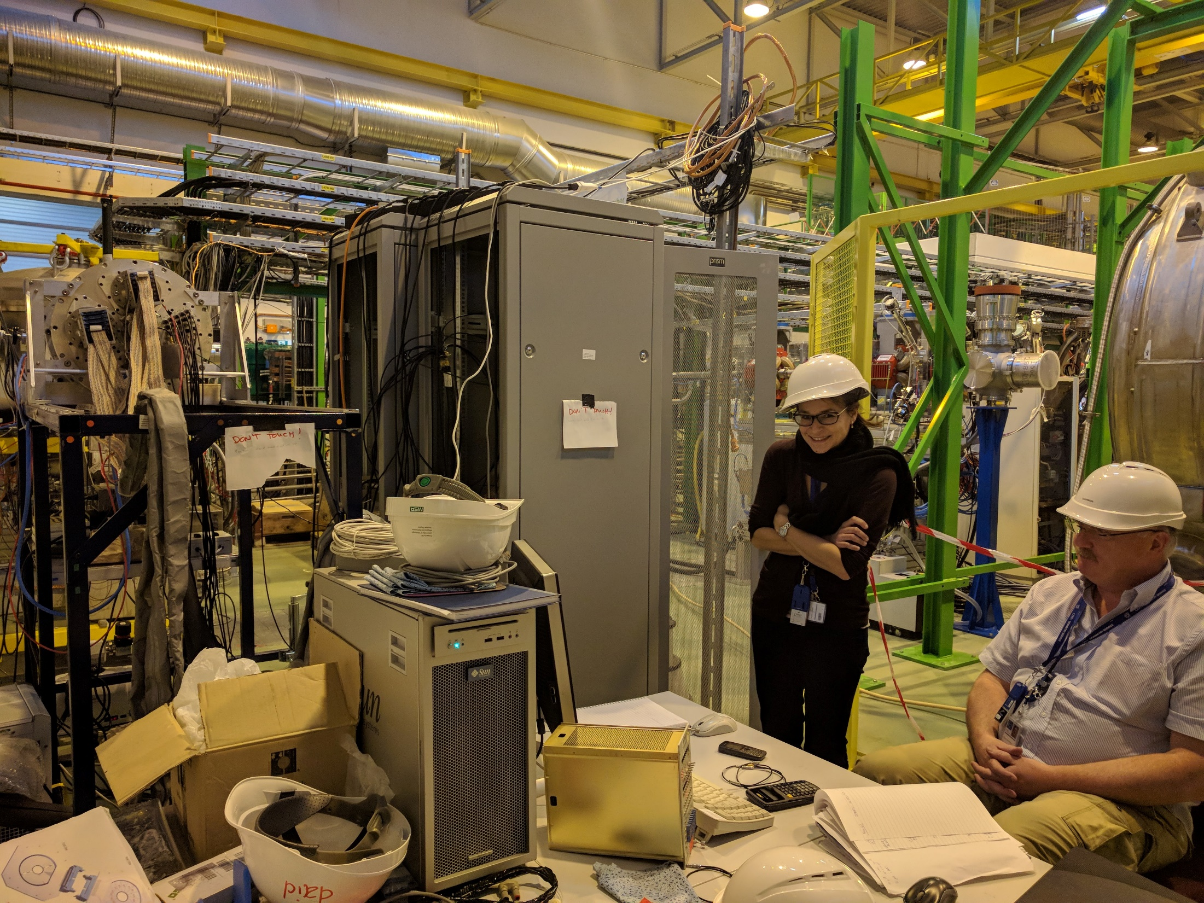

Slide 24
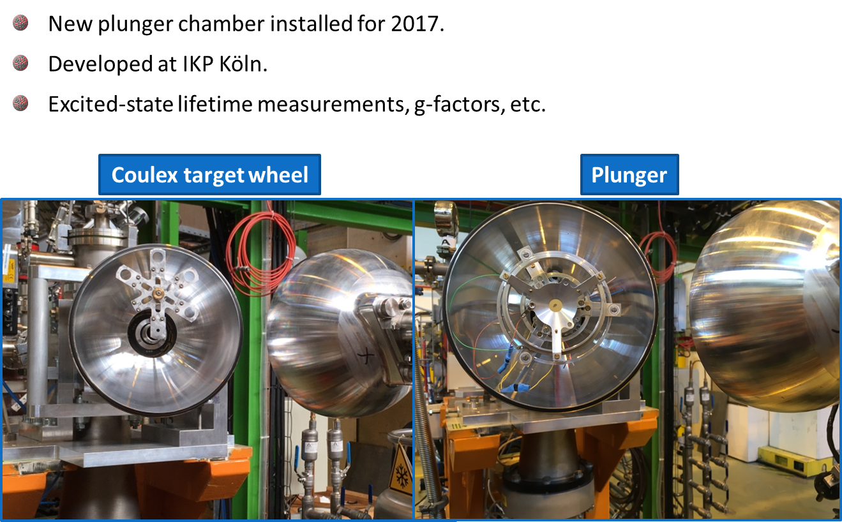
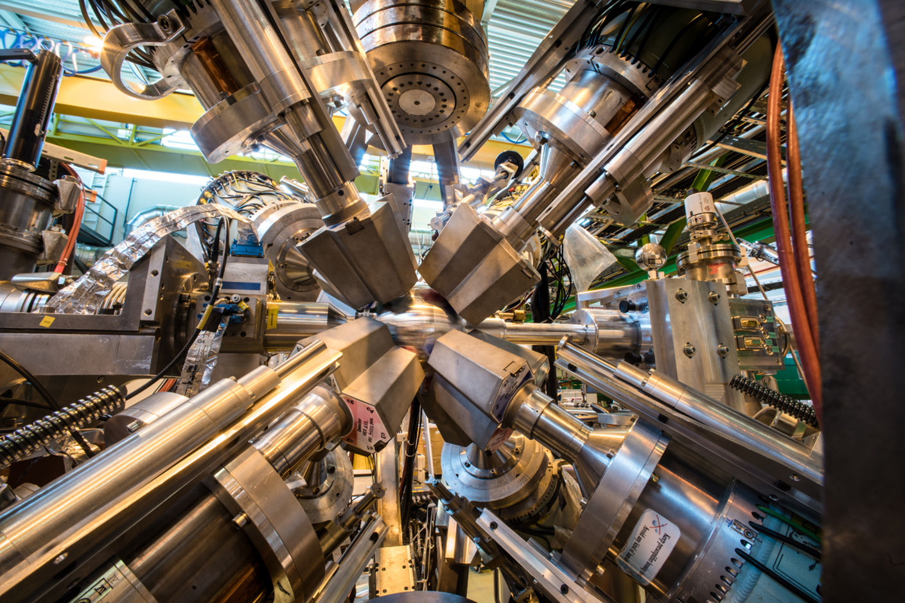
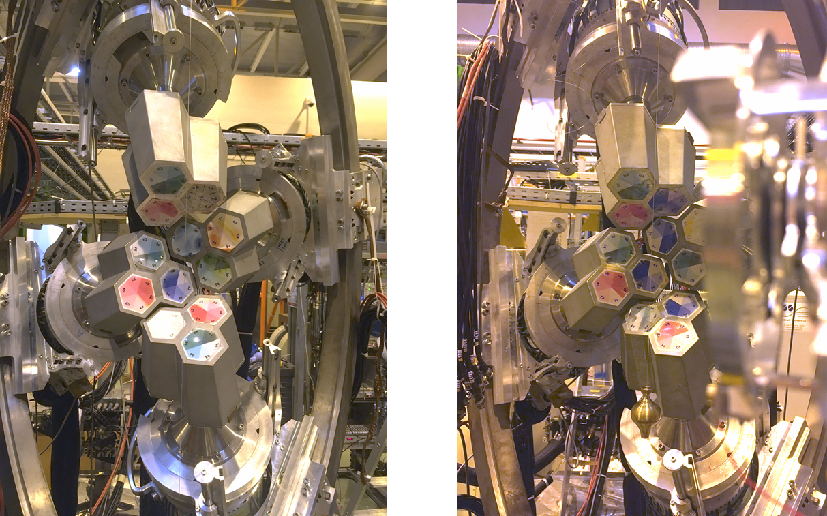
IS628: plunger measurements on ²⁸Mg
²²Ne stable beam from EBIS @ 5.5 MeV/u:
  TDRIV → Zero-point calibration of target-degrader (plunger)
  (d,n) → Angles of Ge detectors from Doppler shift (target wheel).
  Required a week of stable beam….

Slide 25
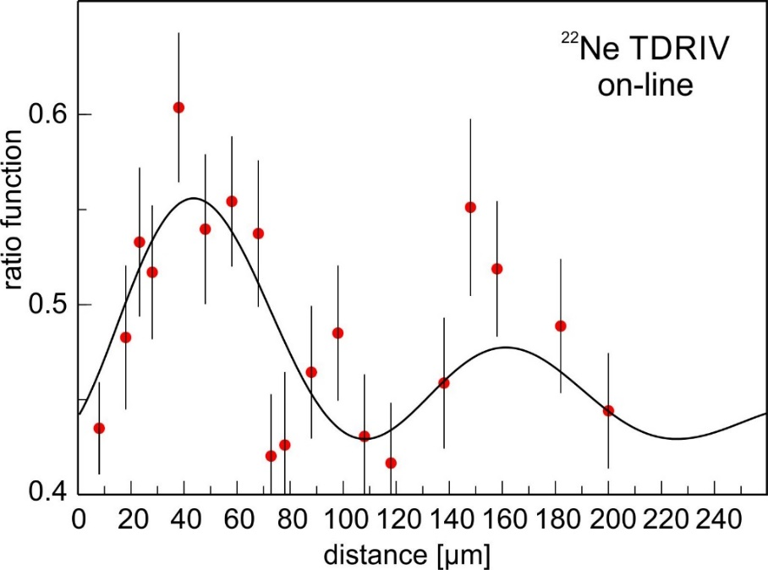
IS628 TDRIV on ²⁸Mg – on-line results
First Miniball plunger experiment
Calibration run with ²²Ne beam
  known g factor
  observed expected frequency
(Very) High intensity ²⁸Mg beam – 5x10⁶ pps/µCu
Some difficulties with RIB scattered in the chamber
Very promising results for ²⁸Mg TDRIV – presently under analysis
Thanks to Georgi Georgiev

Slide 26
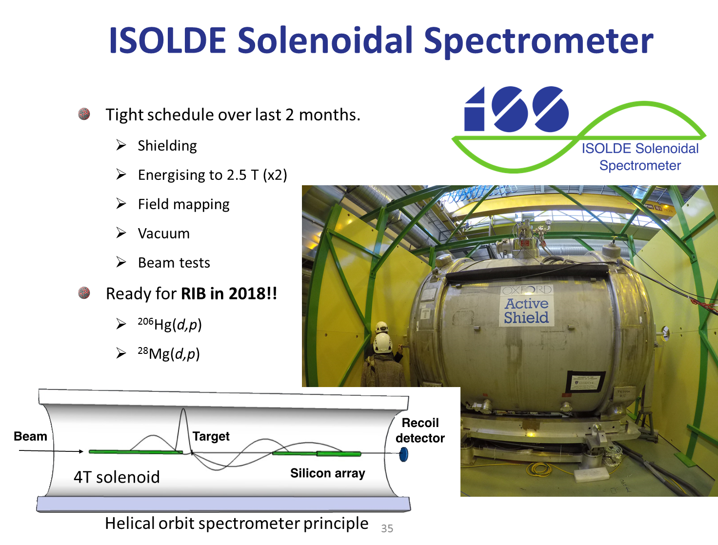


Slide 27

In total 427 RIB shifts delivered in 2017

Slide 28

CERN accelerator schedule 2018
Protons available for physics to ISOLDE from 9th April – 12th November 2018.
217 days for physics (compared to 224 in 2017)
HIE ISOLDE expected to start similarly to 2017 i.e. ~ July 9. this leads to ~ 126 days available for HIE ISOLDE, compared to 150 in 2017.
Dedicated low energy block from 9th April: ~ 90 days for LE.
Interleave HIE and LE runs as in 2017.
LIEBE postponed in 2017; end of 2018?
Strategy for HIE: 4CMS so optimized for reactions. Starting with CE then switch to T-Rex; XT03 and ISS to be accommodated.

Slide 29
Preparation of Schedule 2018
Beam requests received yesterday. Currently being compiled. In addition to usual suspects, LIST beams and negative ion requests….
Draft of low energy runs till ~ mid-June by late Feb- early March.
Mid-June – end of September released around early May
Rest of year in mid-July
Schedule will be discussed at a technical advisory panel (similar to what’s done for INTC proposals) to avoid any surprises in terms of targets, ion sources, machine parameters and recent developments. In addition, safety aspects can be addressed. Also involving user input….
Hostel reserves 10 over the Summer period rooms 1 month in advance of experiments running.
ENSAR2 funding forms sent around upon release of schedule.

Slide 30

Safety and training etc
Required training for ISOHALL
Online:
Safety at CERN
RP supervised
Basic electrical awareness
Radiation Protection - Controlled area (refreseher…new)
Hands-on:
Electrical awareness
RP handling
Every Tuesday @ 1300 – 1700), training centre Prevessin.
External trainer: Recent cancellations have been a problem. Discussions underway to mitigate this.
ISOLDE webpage a little unclear: to be re-freshed soon

