Slide 1


HIE-ISOLDE Status Report
Y. Kadi & E. Siesling for the HIE-ISOLDE project team

Slide 2
Outline:
Status and Schedule for Phase 2B
Summary
58th Meeting of the INTC – Feb. 7th 2018

Slide 3
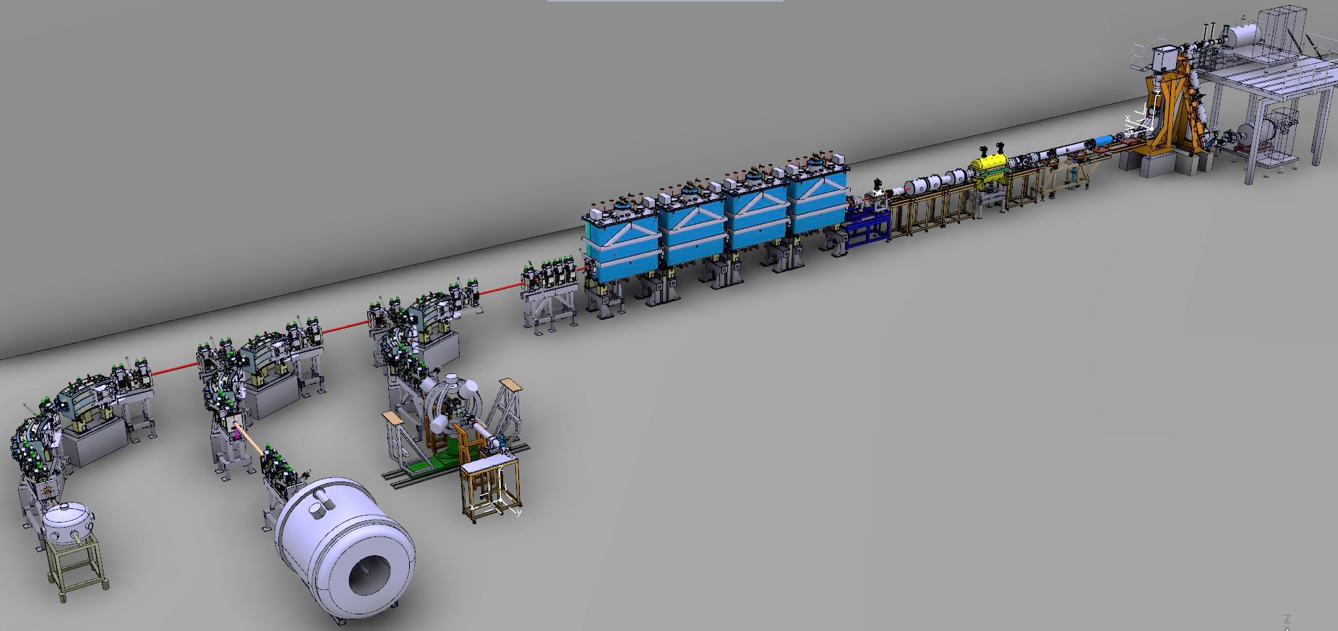
Phase2 Completion YETS 2017/2018
Additional cryomodule (CM4)
CM4 and XT00 modifications
Main activities:
Preparations for the installation of CM4
Installation of CM4 in the tunnel
Cryo dewar functional tests + maintenance of the compressor station and cold box
Repair of the Cryo Distribution System by CRIOTEC
REX RF maintenance
XT00 WIC recommissioning
Silicon detector XT02 & XT03 cabling Others: Installation Solenoid power supply, CM4 RF amplifiers, ISS He filling, tunnel roof fences, REX power supplies consolidation (YETS)
REX NC linac
HIE SC linac
Miniball
SEC
ISS
58th Meeting of the INTC – Feb. 7th 2018

Slide 4
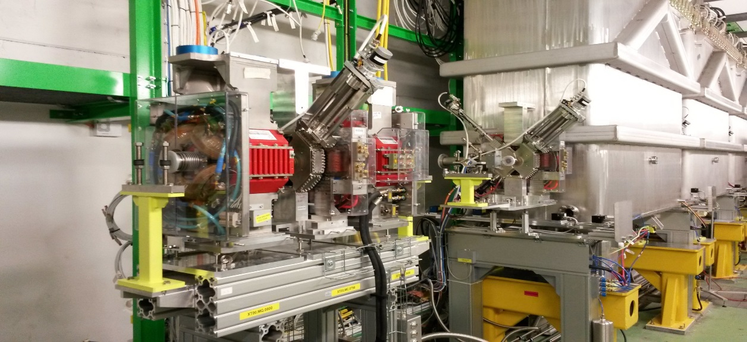
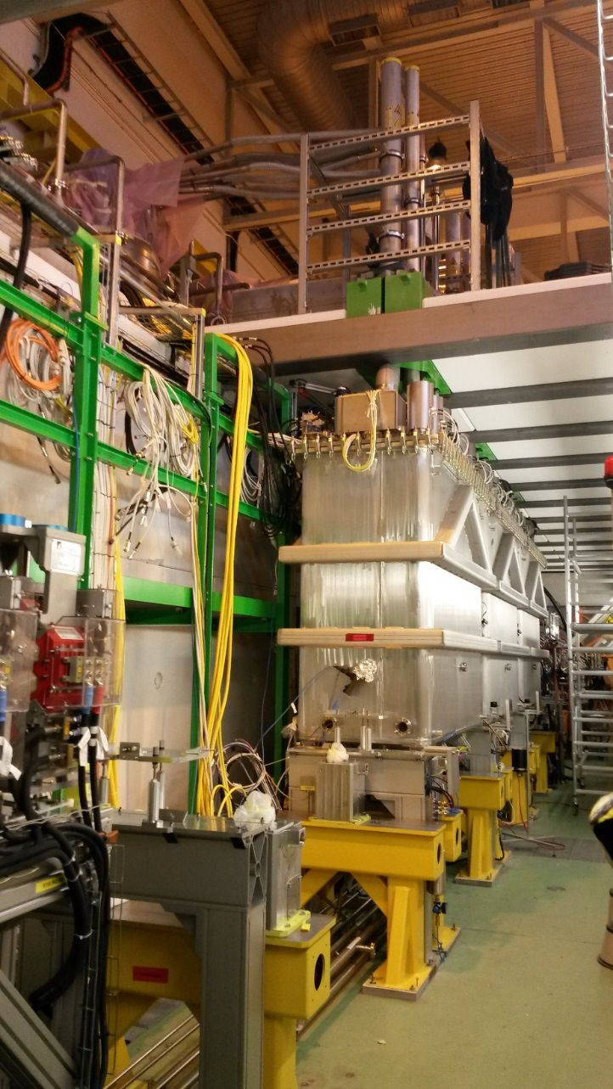
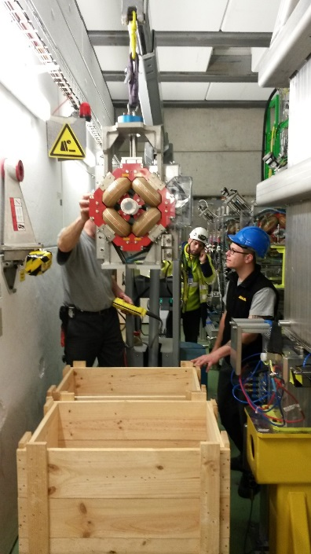
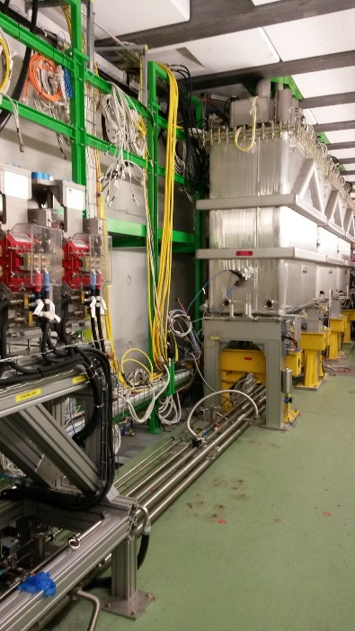
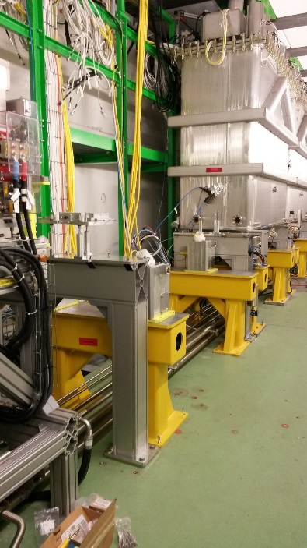
Installation work Dec/Jan
- Preparations XT00 line in the tunnel: Dismount doublet elements and intertank XLN5
- Installation of the CM4 feet and intertank XLN6 support
58th Meeting of the INTC – Feb. 7th 2018

Slide 5
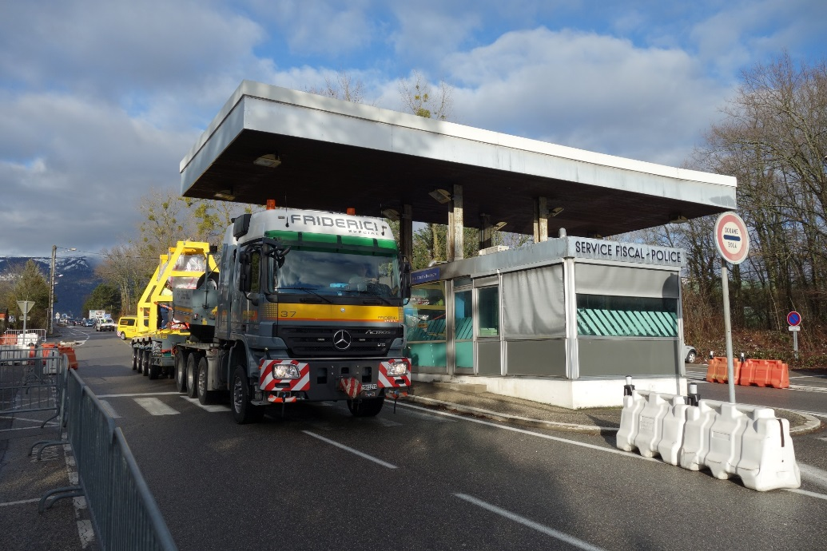
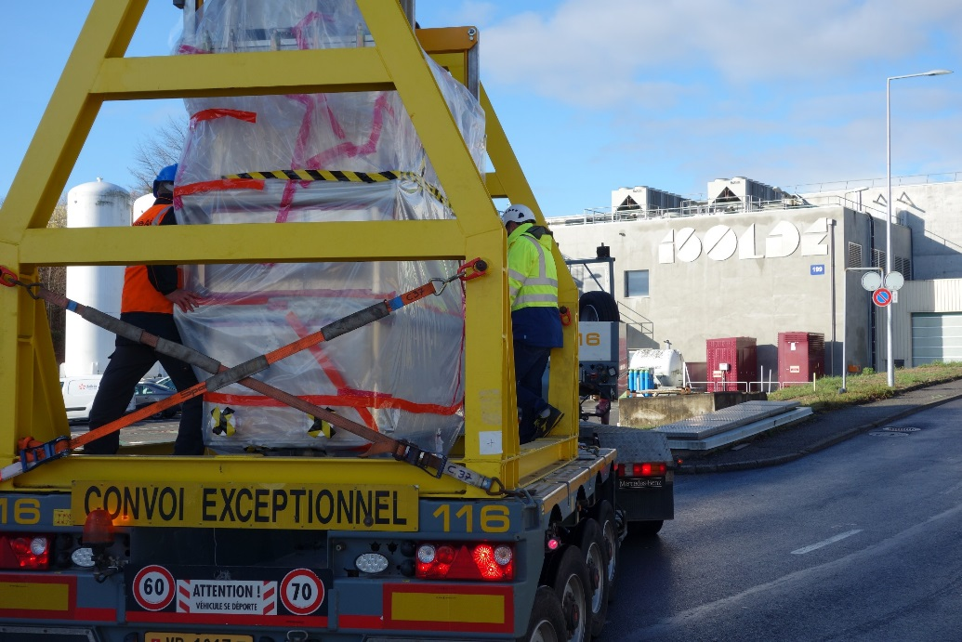
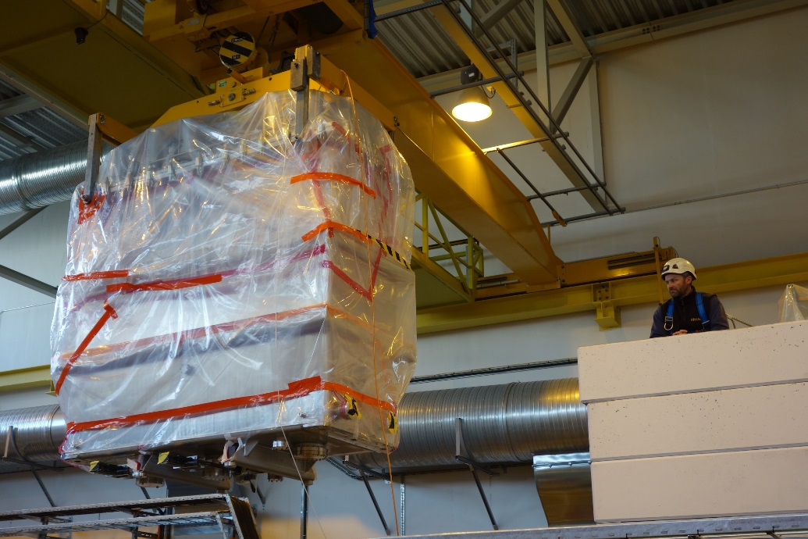
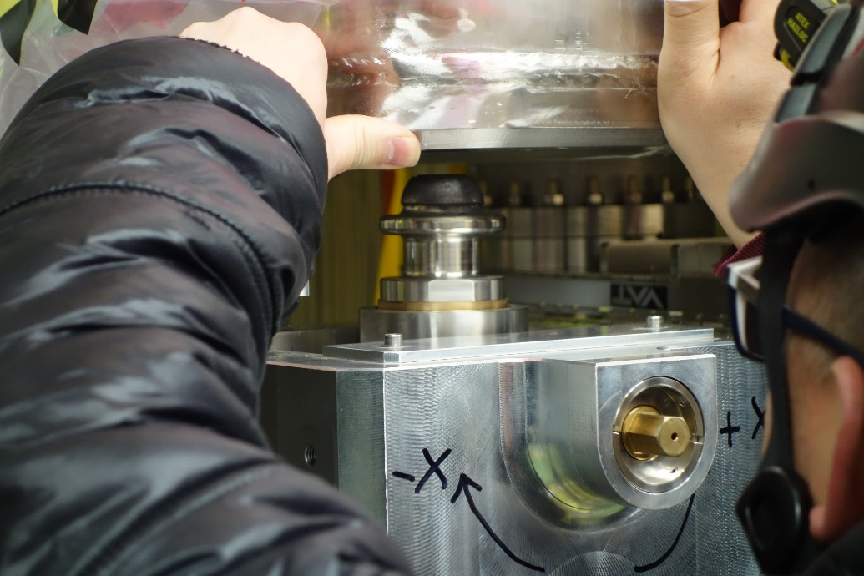
CM4 transport 23 January
58th Meeting of the INTC – Feb. 7th 2018

Slide 6
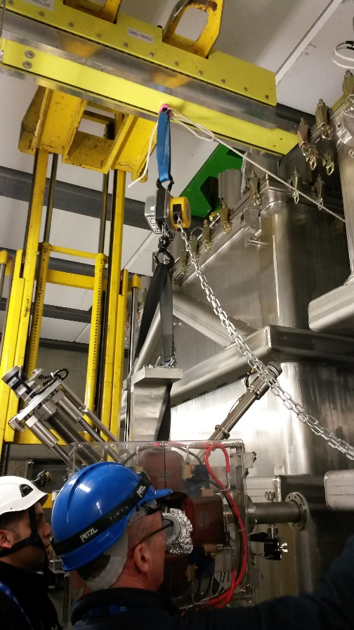
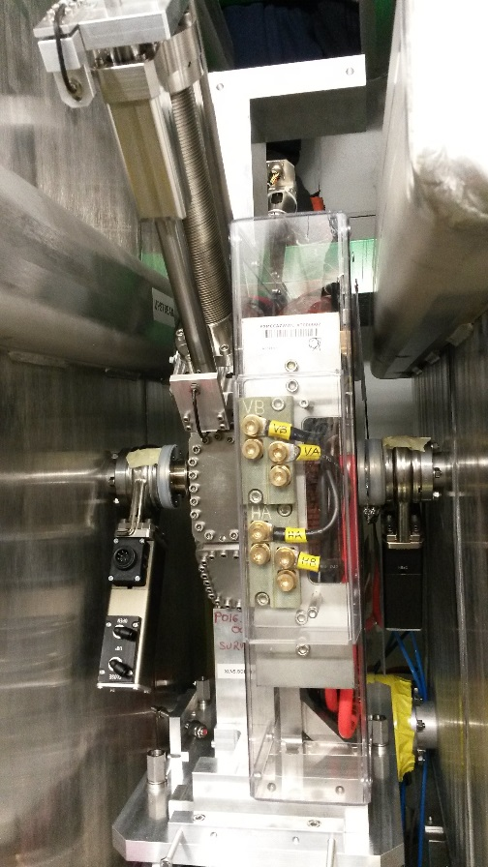
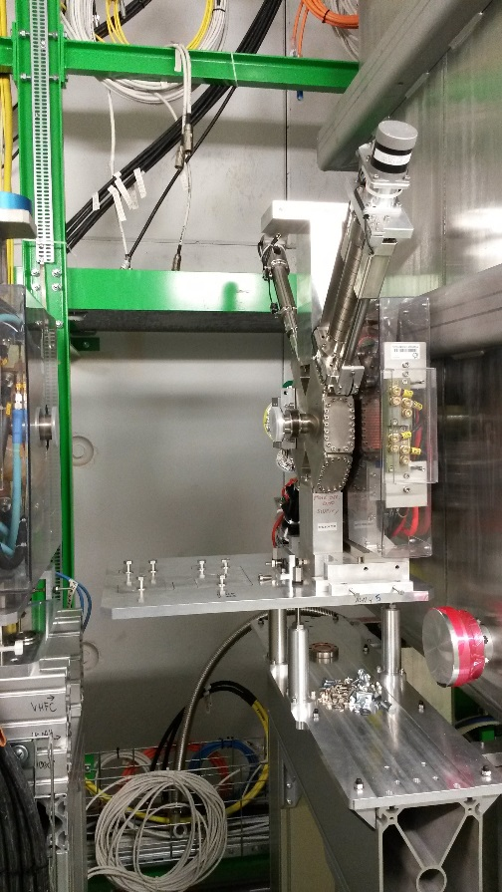
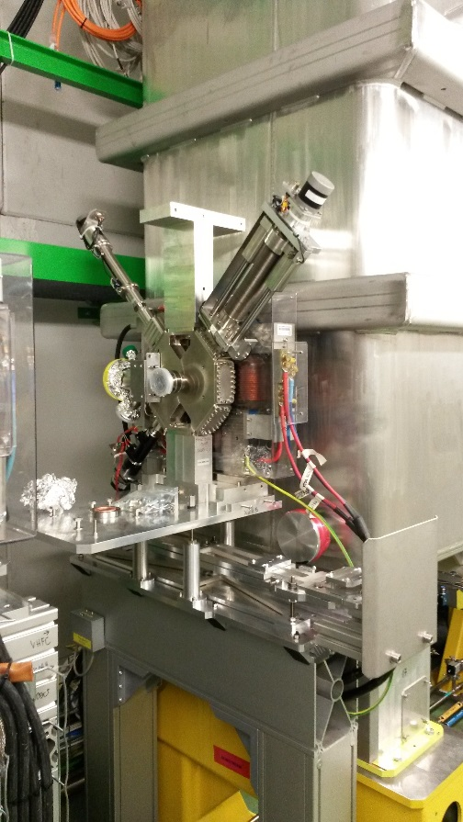
Tunnel installation work Jan/Feb
Tunnel installation work:
Installation intertank XLN5 & 6 done
Alignment of CM4 and intertanks done
Reconnection DC and water done
Installation of the BCAM system ongoing (wk 5 Feb)
58th Meeting of the INTC – Feb. 7th 2018

Slide 7
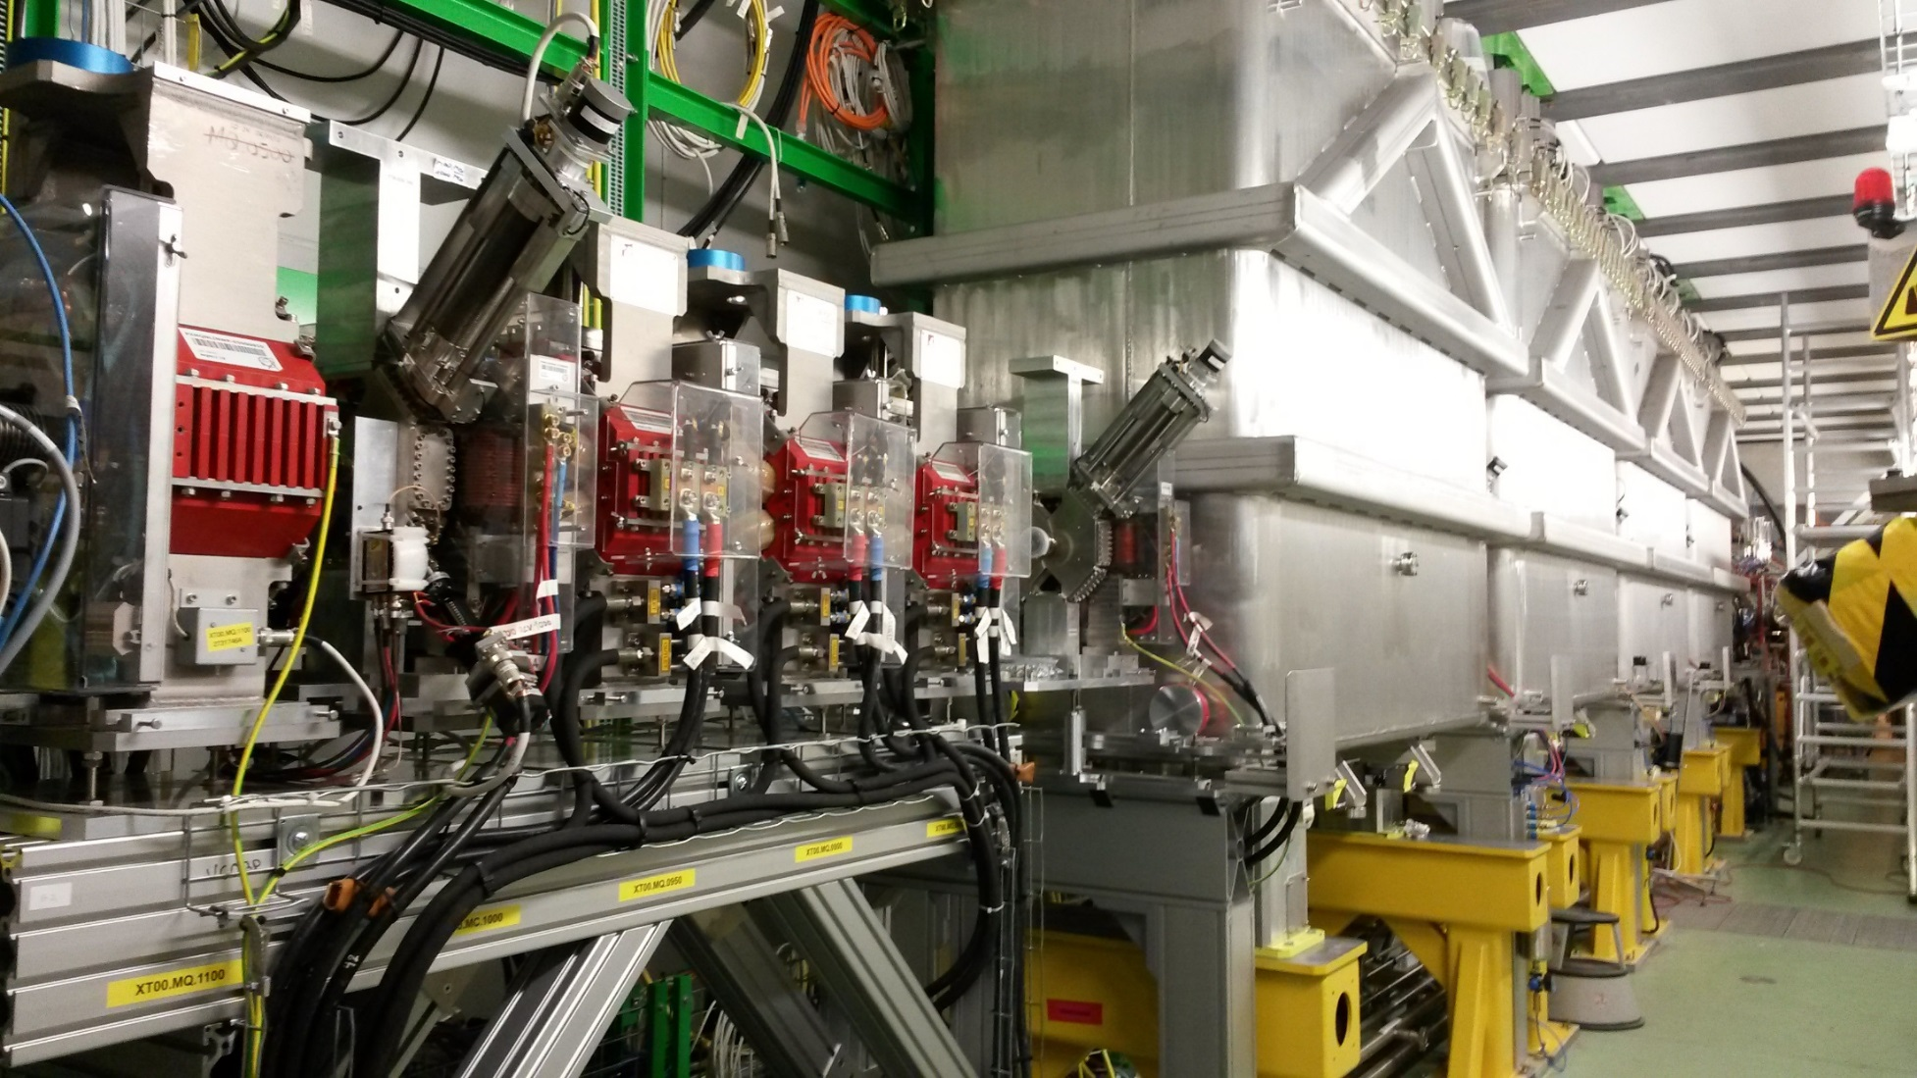
Tunnel status on 5 Feb
58th Meeting of the INTC – Feb. 7th 2018

Slide 8
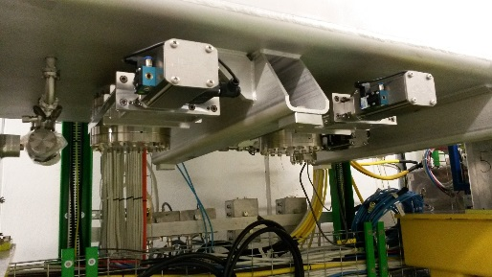
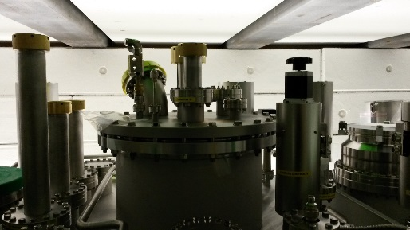
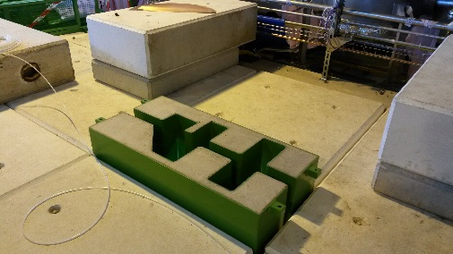
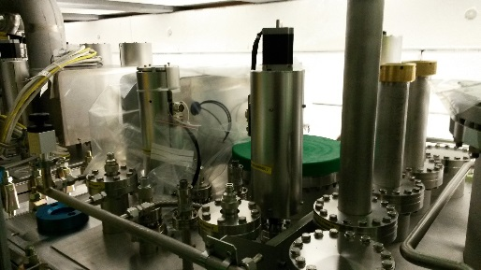
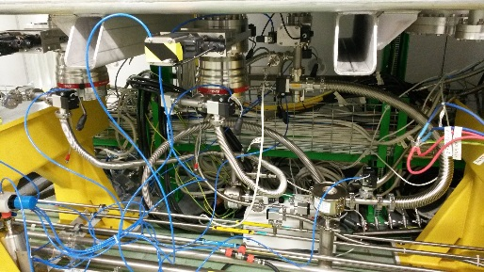
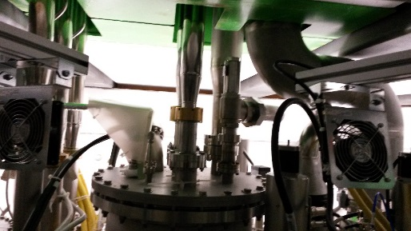
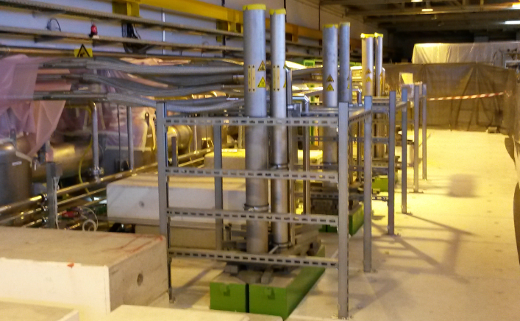
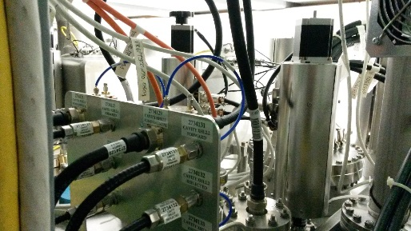
CM4 connection
Planning issues:
Vacuum installation work on CM4 has been delayed due to manpower (YETS shutdown work at all other machines). Starting date moved from 29 Jan to 19 Feb.
This does NOT affect any other activities on CM4 and milestones for CM4 and Beam commissioning can be kept.
Cryogenics installation work on CM4 has been delayed due to manpower (BA6 Crab cavities installation work (LHC)). Starting date moved from 25 Jan to 12 Feb.
This DOES affect other activities: other (fragile) CM4 top-plate related work cannot start until cryo work has finished. However due to sufficient margin in the planning the milestones for Cryo cooldown, CM4 and Beam commissioning can be kept.
CM4 bottom & top-plate infrastructure:
Vacuum underneeth
Cryo conn. top-plate
Cryo flex.& He exhausts
Top-plate RF, motors, instr.
Compared to fully installed CM3 bottom & top-plate infrastructure:
58th Meeting of the INTC – Feb. 7th 2018
8

Slide 9
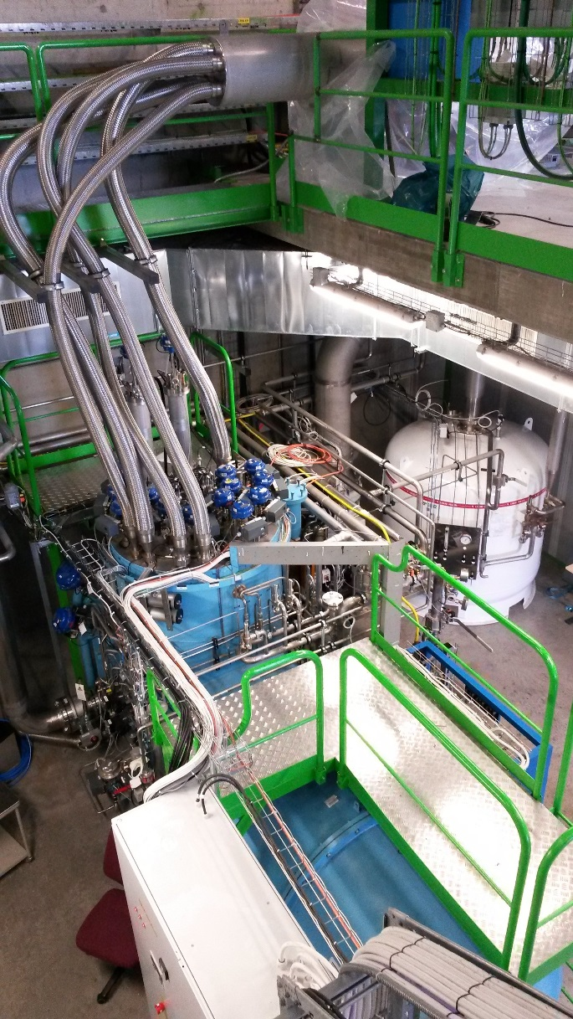
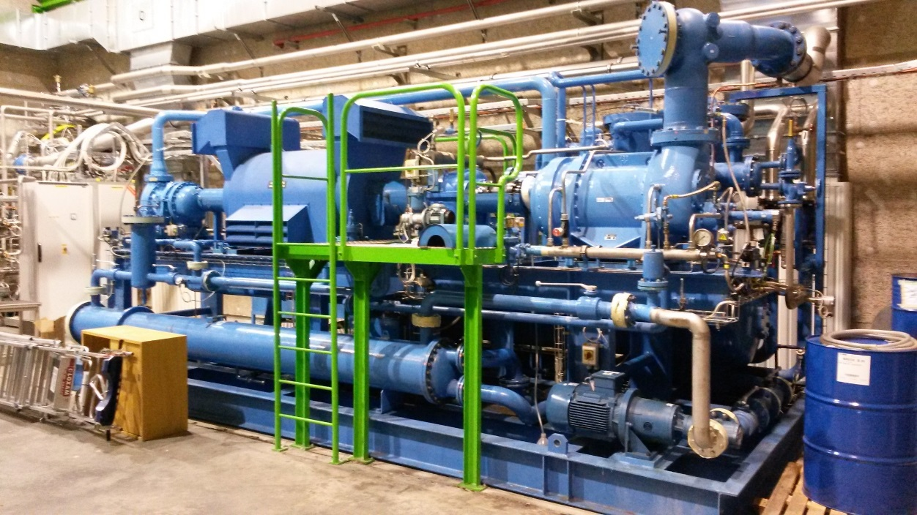
Cryo maintenance
Compressor and Cold Box
Dewar functional tests done Dec.
Preventive and corrective maintenance (10.000hr)
To be ready for cooldown 23 March
58th Meeting of the INTC – Feb. 7th 2018

Slide 10
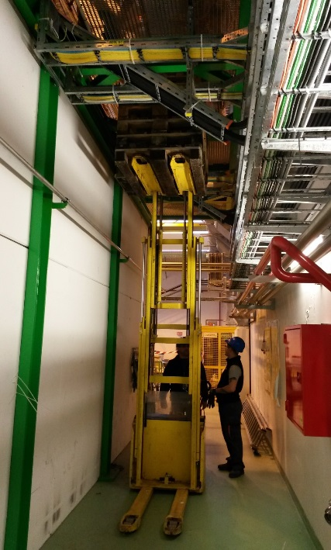
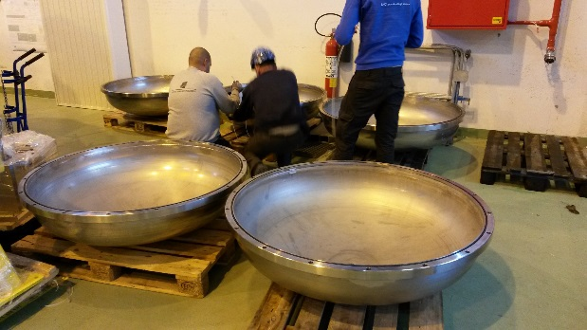
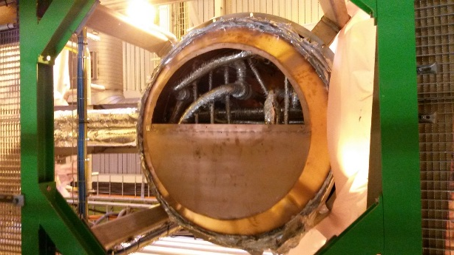
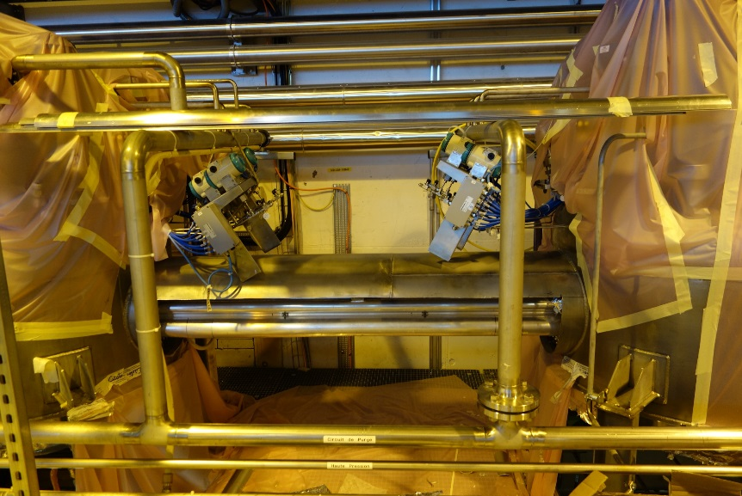
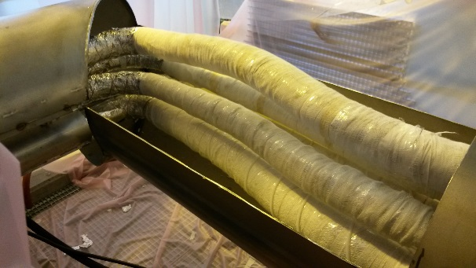
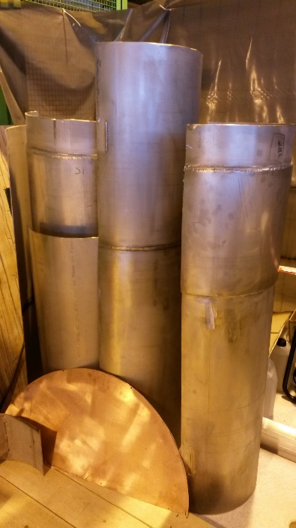
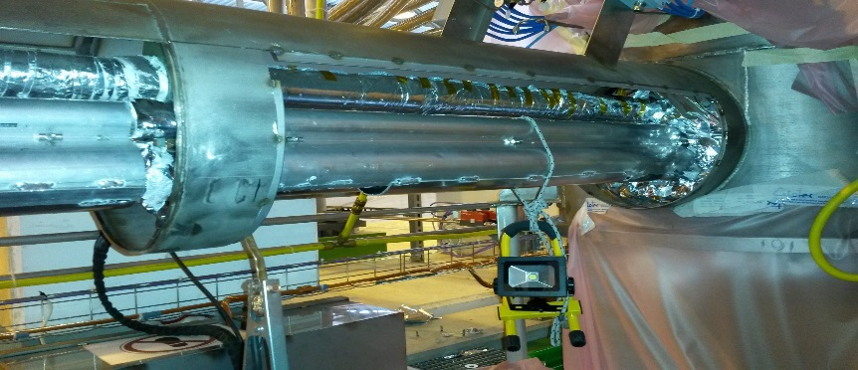
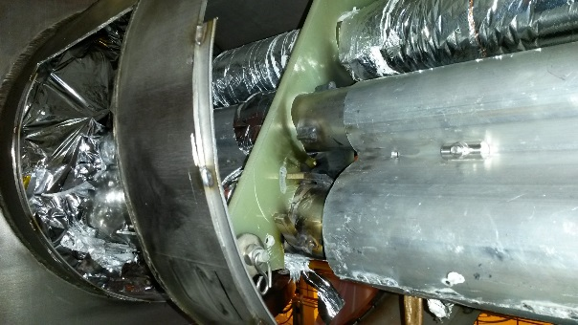
CDS repair
Cryo Distribution System repair by CRIOTEC
Dismounting of all covers for repair inside the Jumper Boxes
Opening cryo distribution line for repair spacers and isolation and to improve routing inner tubing
To be ready for reception tests 5 March
58th Meeting of the INTC – Feb. 7th 2018

Slide 11
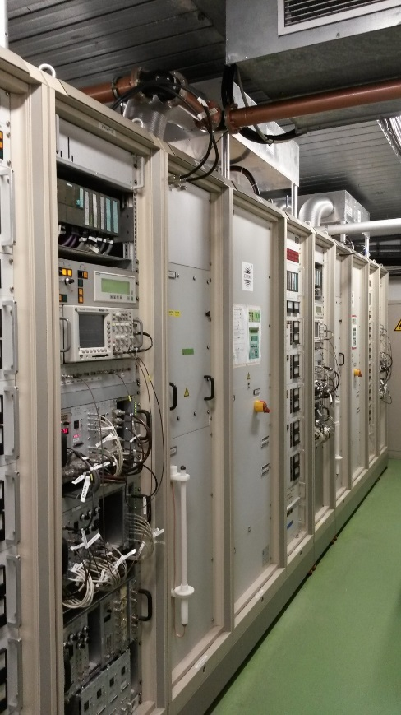
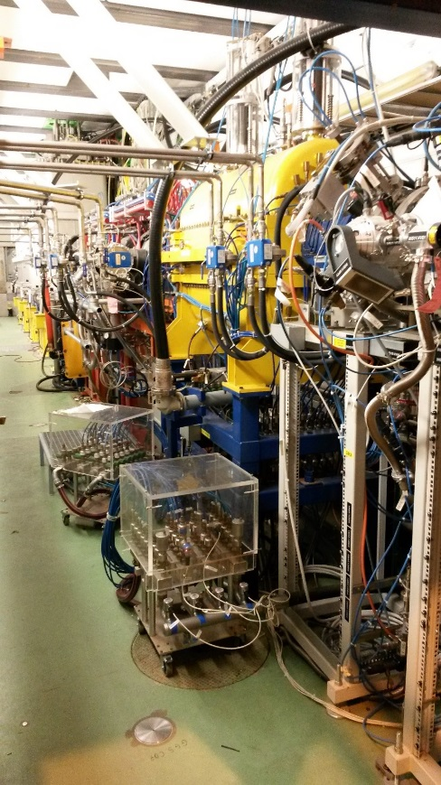
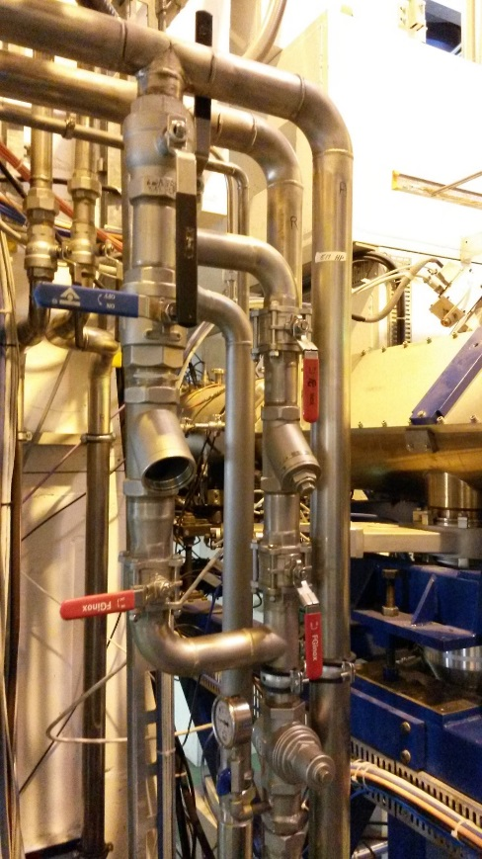
REX RF maintenance
REX RF maintenance and repair
Overall inspection, maintenance water system RF room and tunnel done
Tuners maintenance and set-up of new tuning ranges done
Maintenance, cleaning and refurbishment of power supplies and amplifiers done
IH Structure suspected to have issues with internal water circuits. Manifolds to be replaced. Consolidation points for LS2
Water (20 degree mixed) bypass installed for easy filter change
Tests of water circuits and RF tests (LLRF, calibration, tuning ranges) coming up
58th Meeting of the INTC – Feb. 7th 2018

Slide 12
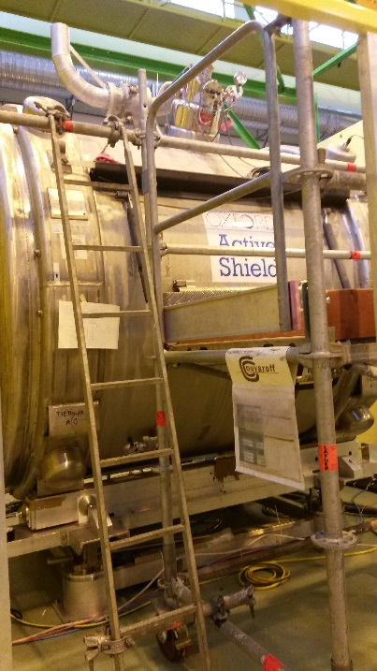
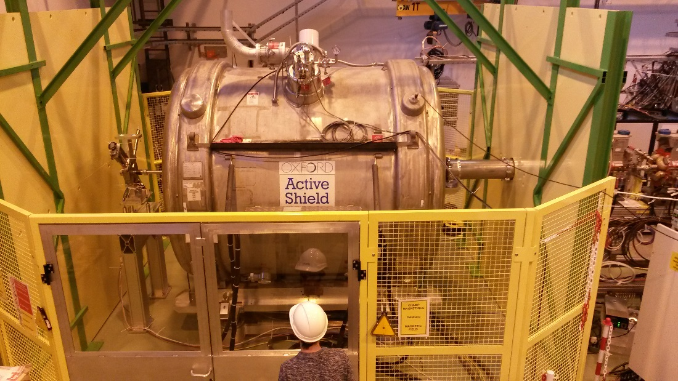
ISS installation status
ISS at XT02 installation
Shielding successfully installed Nov 2017
Field mapping done
Stable beam tests successfully done using HIE ISOLDE Dbox with FC and Slits. No significant change of shape or intensity when ramping up the ISS magnet (2.5 T)
End flanges sent off for feedthrough modification (detector cabling)
Set-up prepared for He filling (wk 12 Feb)
58th Meeting of the INTC – Feb. 7th 2018

Slide 13
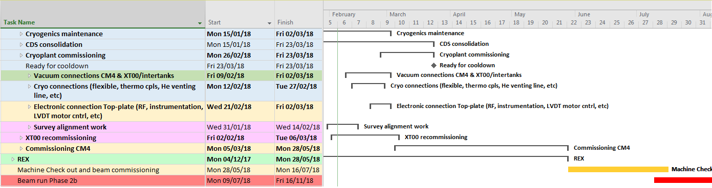
Planning of remaining Phase2 activities
Change of starting dates for the vacuum work on CM4 and XT00 as well as the Cryo work on CM4 required adaptation of the planning.
To keep impact on other CM4 top-plate activities minimal Cryo work will start first on the flexibles and He exhausts followed by modification of Jumper Box 5 (bypass)
Due to sufficient contingency and reshuffling of some of the activities the milestones for Commissioning of CM4 (5 March), Cooldown of the cryo modules (26 March), Machine check-out and beam commissioning (28 May) can be kept.
Start of physics foreseen as of 9 July.
58th Meeting of the INTC – Feb. 7th 2018

Slide 14
Summary
  Installation of phase 2b is on schedule
  CM4 is installed and aligned.
  Infrastructure CM4 being installed: Vacuum and cryo later starting dates are accounted for on the (modified) planning.
  XT00 modification done (doublet dismounted). Modification requires WIC re-commissioning.
  Cryogenics maintenance ongoing. (aim: 23 March ready for cooldown)
  Cryogenics Distribution System repair by CRIOTEC ongoing and on schedule. (aim: 5 March start of reception tests, 23 March ready for cooldown).
  Attention: It became clear to the cryo group that a possible phase 3 will not only require consolidation of the cryoplant but also of the CDS
  REX RF maintenance on track. LS2 consolidation necessary of the water distribution system for IHS (manifolds). Probably also circuits inside IHS.
  ISS integrated at XT02.
  Silicon detector cabling will be installed in March for XT02 & XT03.
58th Meeting of the INTC – Feb. 7th 2018

Slide 15
Acknowledgement
EN/EA : FABIO FORMENTI
GS/SE : DANIEL PARCHET
EN/ACE : STEPHANE MARIDOR, JEAN-CHRISTOPHE GAYDE, ESTRELLA FERNANDEZ, ANTJE BEHRENS, ALEX BEYNEL
BE/ABP / OP : FREDERIK WENANDER, JOSE ALBERTO RODRIGUEZ, ELEFTHERIS FADAKIS, MIGUEL LOZANO BENITO
PH/SME : MARIA BORGE, KARL JOHNSTON, GERDA NEYENS
BE/RF : DANIEL VALUCH, WALTER VENTURINI DELSOLARO, MATHIEU THERRASSE, AKIRA MYAZAKI
EN/CV : AZIZ AMAMOU, NICOLAS ROGET, HASSANE SABRI
EN/EL,TE/EPC : RENE NECCA, GEORGI GEORGIEV, MICHELE MARTINO, PAWEL BURDELSKI, NICOLAS DAVID
TE/CRG : JOS METSELAAR, OLIVIER PIROTTE, NICOLAS GUILLOTIN, REMI GUEYDAN
EN/STI : RICHARD CATHERALL, ANA-PAULA BERNARDES
GS/DI : CYRILLE BEDEL, YANNICK BERAUD
TE/MSC : YANN LECLERCQ, LLOYD WILLIAMS, VITTORIO PARMA, JEREMIE BAUCHE, DAVID SMEKENS, GRAEME BARLOW, JEAN BAPTISTE DESCHAMPS
DSG/RP : JOACHIM VOLLAIRE, ALEXANDRE DORSIVAL, ELODIE AUBERT
TE/ABT/ MPE : MATTHEW FRASE, RICHARD MOMPO
TE/VSC : JOSE FERREIRA SOMOZA, GUILLERMO FERNANDEZ, ABEL GUTIERREZ, PAUL DEMAREST
BE/BI : WILLIAM ANDREAZZA, SERGEY SADOVICH
EN/MME : ANTTI KOLEHMAINEN, MARC TIMMINS
EN/HE : JEAN-LOUIS GRENARD, FRANCK SCHNEITER and the entire Transport Team
58th Meeting of the INTC – Feb. 7th 2018

Slide 16
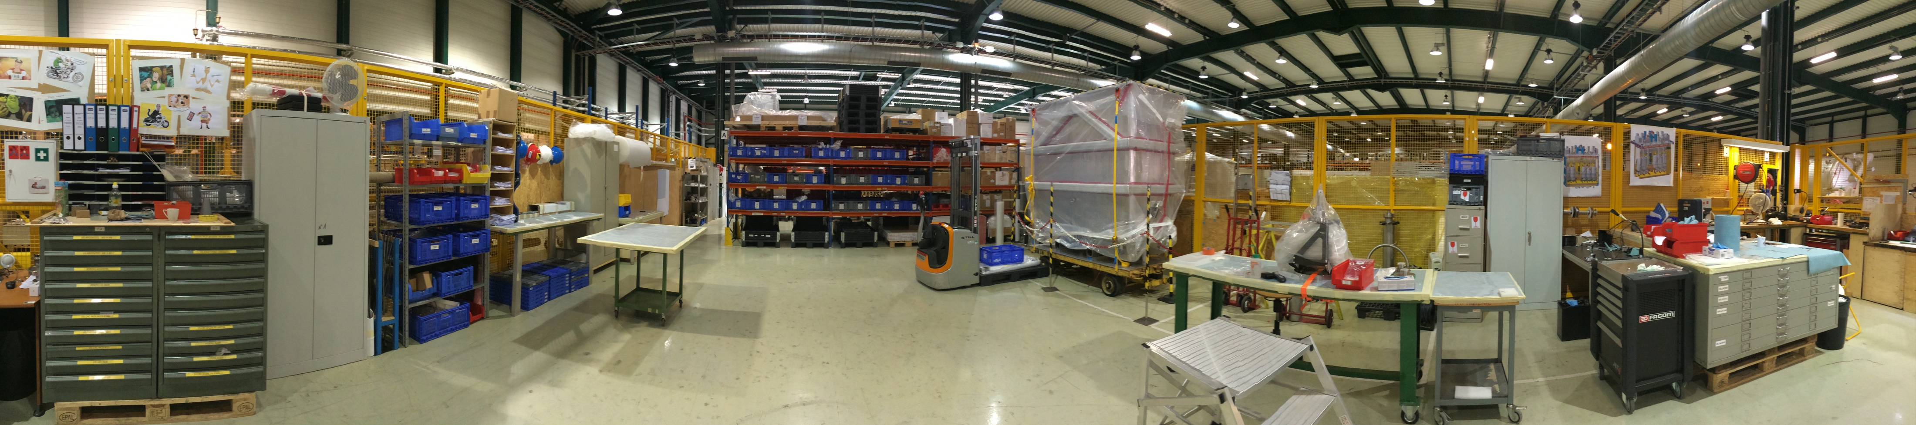
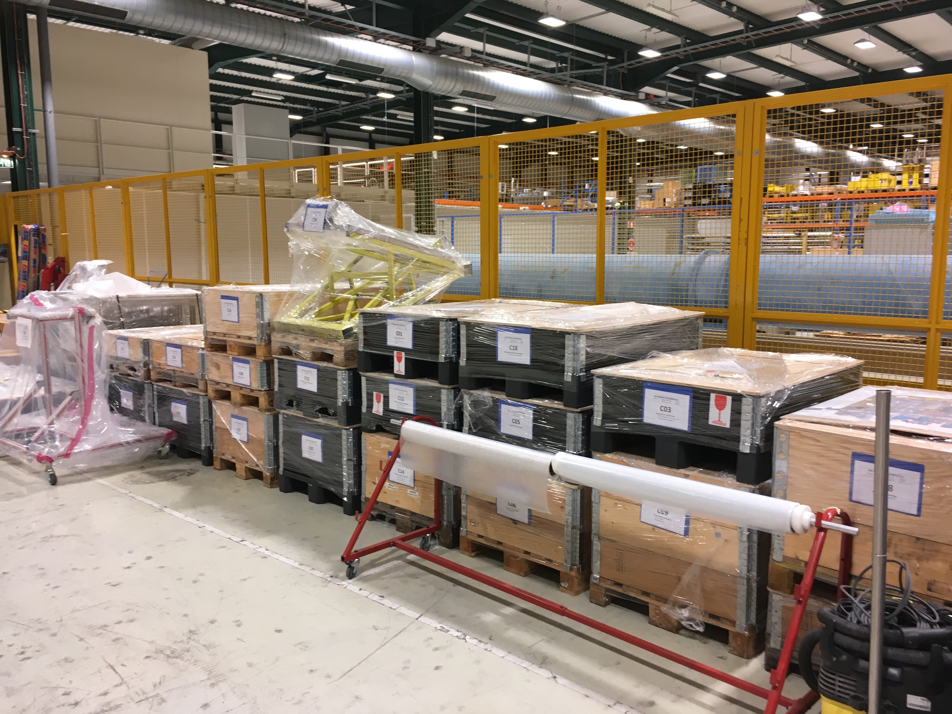
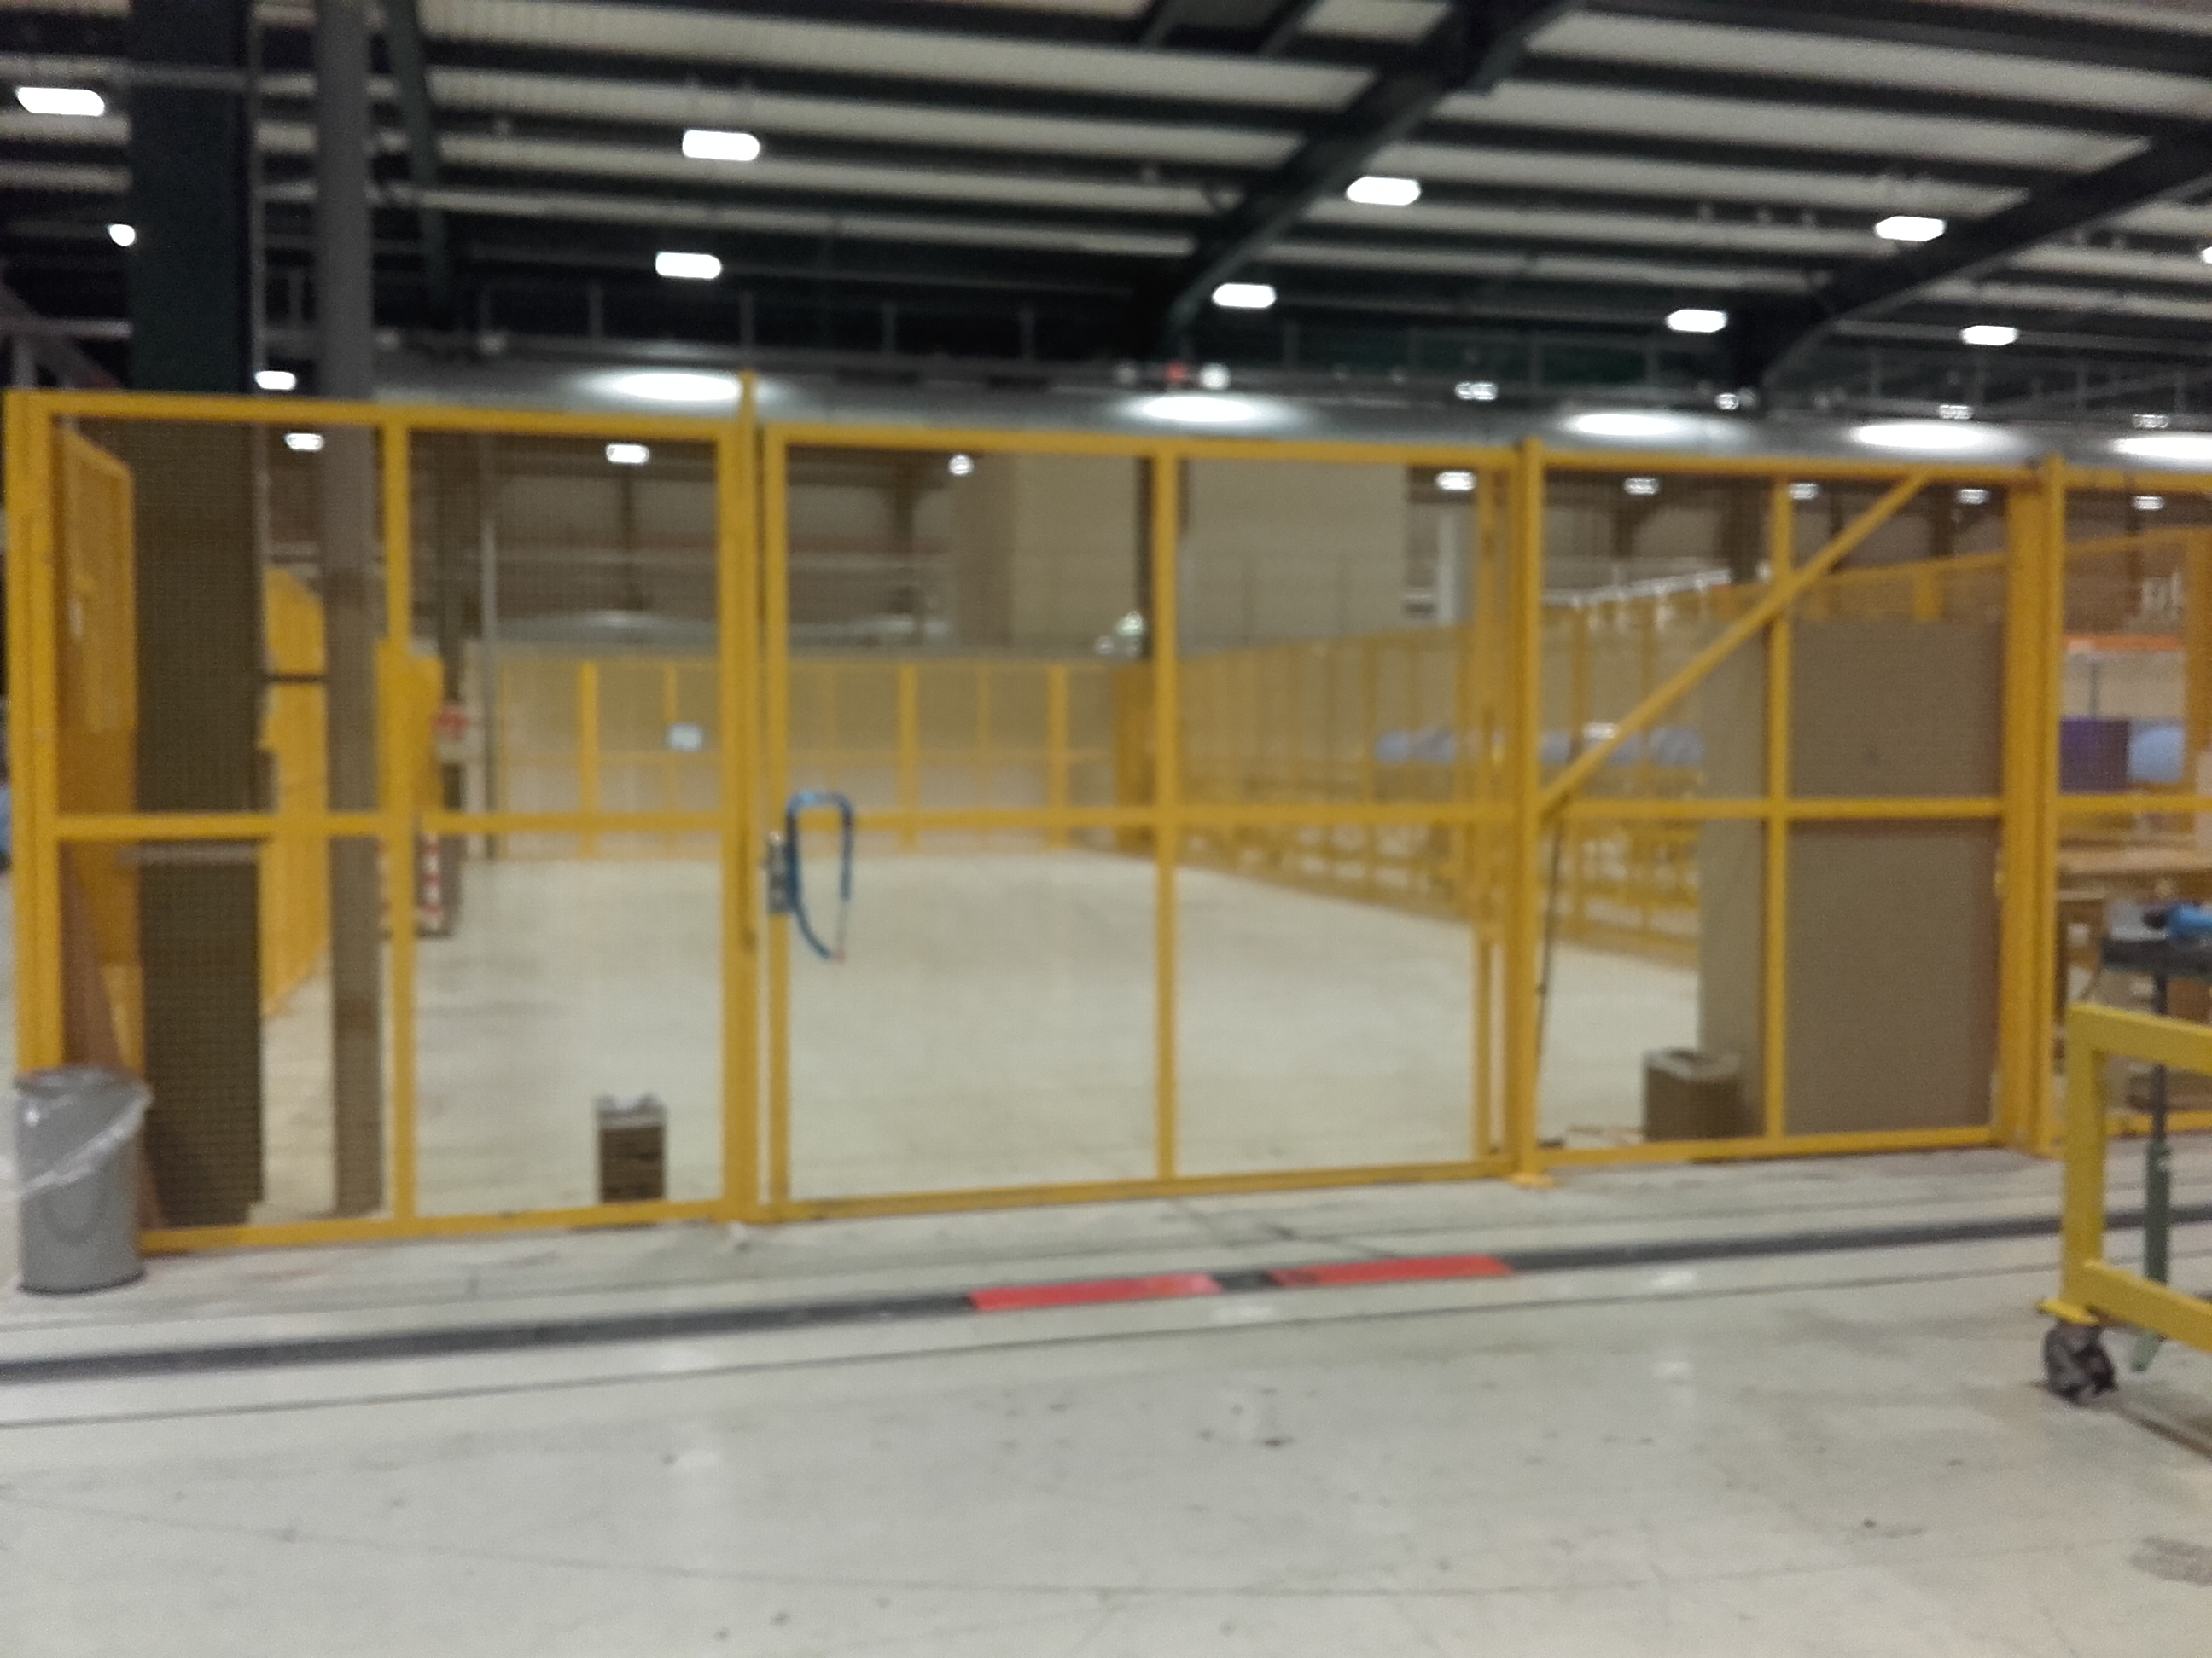
SMA18 dismantling
58th Meeting of the INTC – Feb. 7th 2018

