Slide 1


n_TOF Report
Daniela Macina
n_TOF Run Coordinator
CERN
58th INTC Meeting, 7-8 February 2018

Slide 2
OUTLINE
Last experiments in 2017
n_TOF safety: news
Operation in 2018
Draft planning 2018
Conclusions

Slide 3
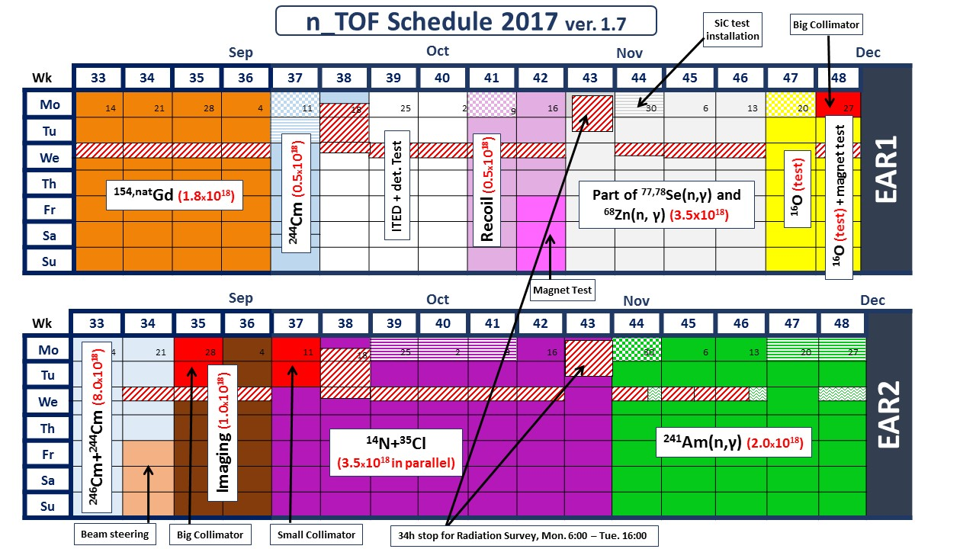
Measurements: last part 2017
Injector MD
Detector installation
No full time beam due to
activities in the other area

Slide 4
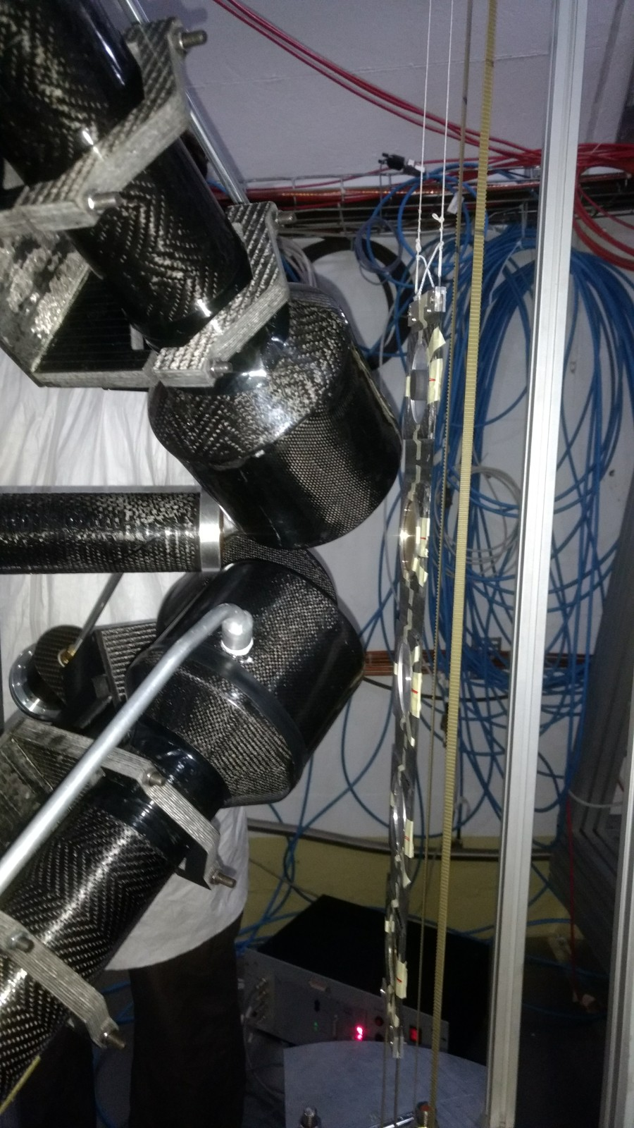
^{77,78}Se(n,γ) (and ⁶⁸Zn(n,γ) )
⁷⁷Se, ⁷⁸Se & ⁶⁸Zn abundances produced in massive stars are most sensitive to nuclear reaction rate uncertainties of ⁷⁷Se(n,𝛾)⁷⁸Se, ⁷⁸Se(n,𝛾)⁷⁹Se, and ⁶⁸Zn(n,𝛾)⁶⁹Zn.
Big uncertainties and discrepancies (10-50%) in the previous measurements of these reactions
⁷⁷Se and ⁷⁸Se successfully measured in autumn 2017, remaining beam time planned in 2018.
Se78, Count spectrum, Detector 1, Full statistics
Preliminary
C6D6 detection setup at EAR-1

Slide 5
²⁴¹Am(n,γ)
Motivation: re-measure the sample already measured in EAR1 in 2010 to:
Fully cover the thermal region (extended DAQ time-range)
Highly improve the signal to (radioactive) noise ratio (EAR2 vs EAR1)
Very preliminary: no amplitude cuts

Slide 6
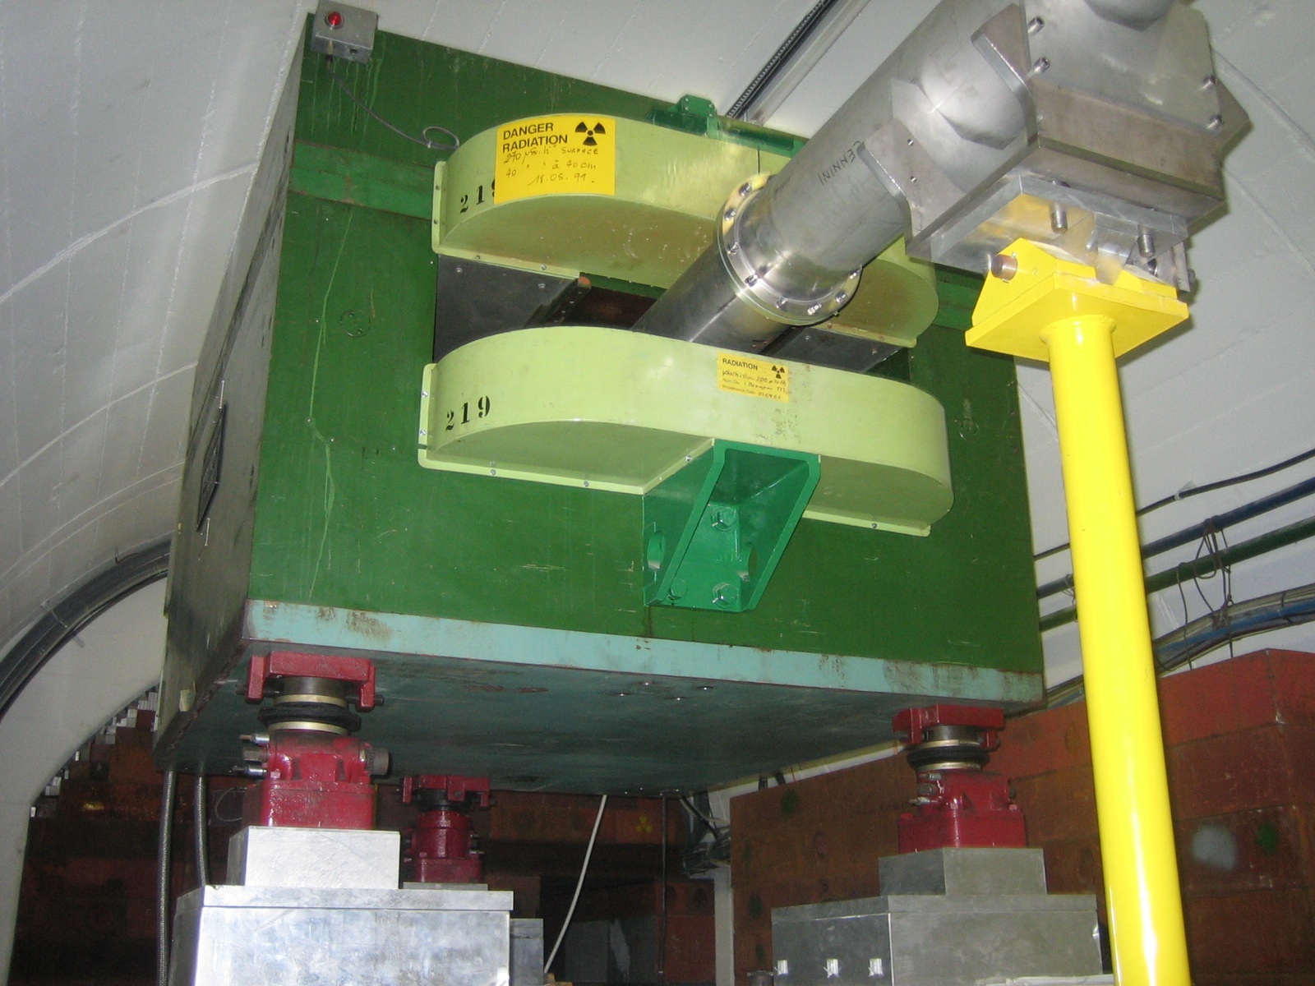
EAR1 Sweeping Magnet test
EAR1 Sweeping magnet is a very old dipole and makes use of a DC power supply
In the frame of the East area renovation, a study is being done to replace all DC power supplies by cycled power supplies for energy savings.
Based on the EAR2 experience, we are investigating the possibility to replace the EAR1 magnet with a permanent one.
Several advantages
  No power supply needed
  No external network such as electrical cabling and demineralized water.
  No operational cost.
  New magnet
The actual design studies are based on a permanent magnet field of 0.6 Tm

Slide 7
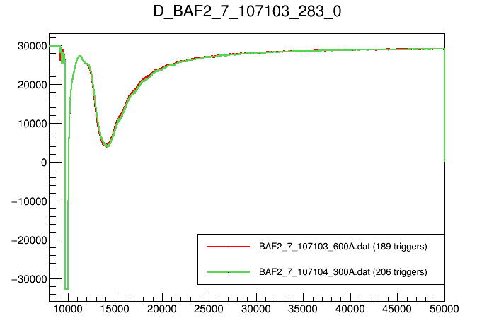
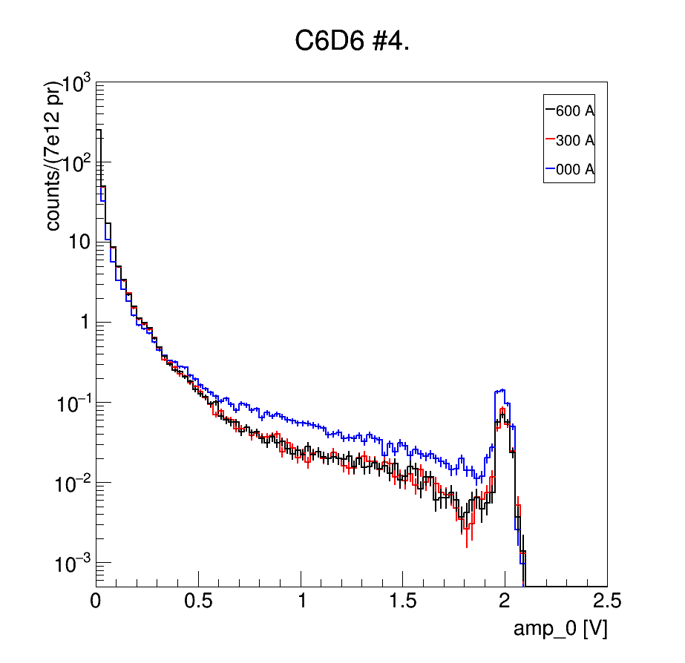
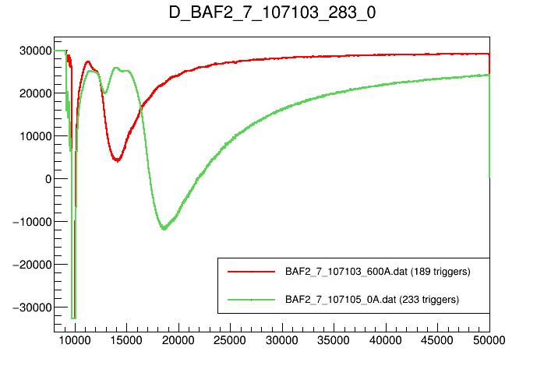
EAR1 Sweeping Magnet test (cont)
FLUKA simulations including the whole beam line and the response from different detectors show that a magnet field of 0.6 Tm is perfectly ok.
We have performed tests at 0, 0.6, 1.2 Tm with a number of detectors and validated the simulation results
Effect on the G-flash
Effect on the noise
The magnet will be replaced during the LS2

Slide 8
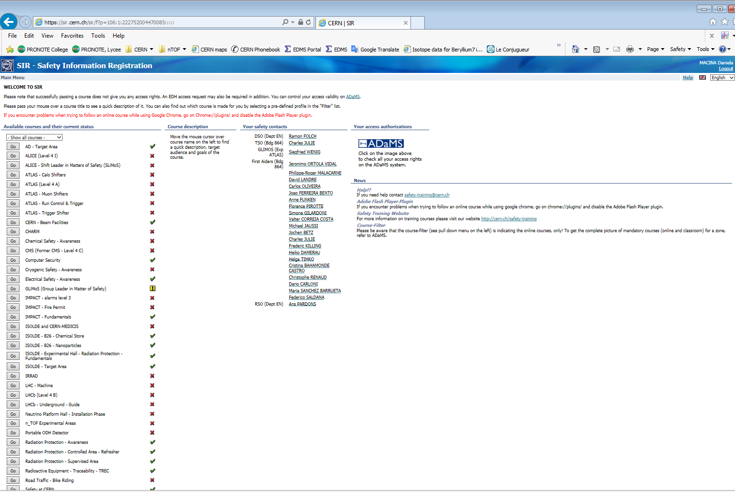
n_TOF Safety News
As of December 2017 the new online course
"n_TOF Experimental Areas"
is available on CERN's application SIR
This online course is provided for people who need to access the n_TOF experimental areas. The aim of this course is to present the hazards and risks existing in the n_TOF facility, the responsibilities and expected behaviour of everyone accessing the area and the right behaviour in the event of an emergency.
From March 1st 2018, onwards this new online course will be mandatory for people accessing the n_TOF areas "ntof-exp".
As of start of operation in 2018, the RP group will organise
a 30 minutes practical n_TOF course for each team responsible for the installation and operation of an experiment

Slide 9
n_TOF operation in 2018
Q1
….……..
Q4
32 weeks of operation
Extrapolation from 2017 => P.O.T. ~ 2.2 x 10¹⁹ (to be confirmed by the PS)

Slide 10
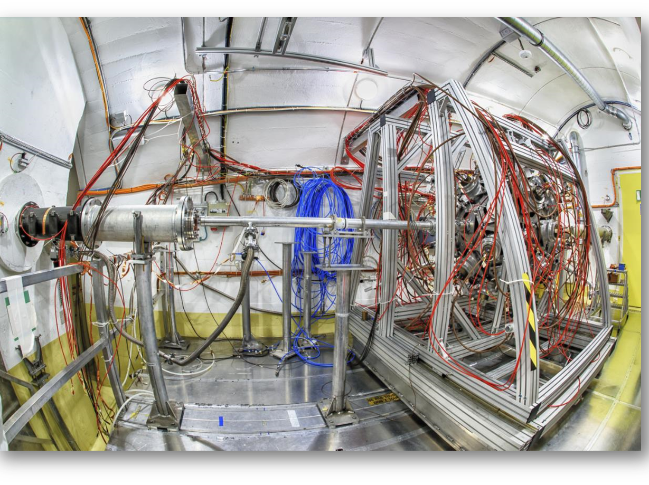
Draft Planning 2018 EAR1
Proposal | INTC | Comment | Status
⁶⁸Zn (n,g) (cont. from 2017) | INTC-P-509 | Astrophysics | Approved
¹²C(n,p) | INTC-P-488 | Basic nuclear physics | Approved
²³⁰Th(n,f) | INTC-P-493 | Basic nuclear physics & nuclear technologies | Approved
²³⁵U(n,f) | INTC-P-507 | Basic nuclear physics | Approved
⁸⁰Se(n,g) | INTC-P-536 | Astrophysics | Submitted for recommendation
³⁵Cl(n,g) | INTC-P-541 | Nuclear technologies | Submitted for recommendation
¹⁴⁰Ce(n,g) | INTC-P-533 | Astrophysics | Submitted for recommendation
²⁰⁵Tl(n,g) | INTC-P-542 | Astrophysics | Submitted for recommendation

Slide 11
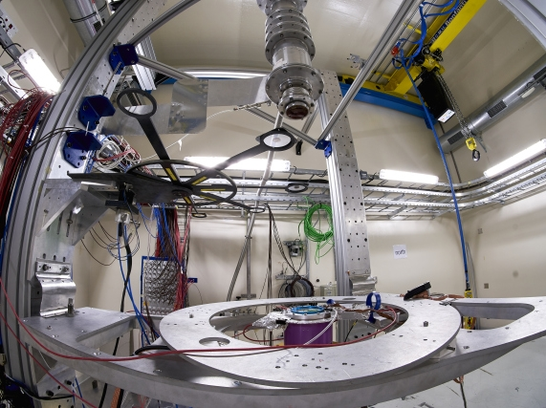
Draft Planning 2018 EAR2
Proposal | INTC | Comment | Status
²³¹Pa(n,f) | INTC-P-513 | Nuclear technologies | Approved
²⁴¹Am(n,f) | INTC-P-492 | Nuclear technologies | Approved
²³⁰Th(n,f) | INTC-P-493 | Basic nuclear physics & nuclear technologies | Approved
⁵³Mn(n,g) | INTC-P-408 | Basic nuclear physics & Astrophysics | Approved
²³⁹Pu(n,f) | INTC-P-538 | Basic nuclear physics & nuclear technologies | Submitted for recommendation
i-TED demonstrator | INTC-P-537 | Detector technology | Submitted for recommendation

Slide 12
Summary and conclusions
Data analysis going on the experiments performed in 2017
Shutdown activities: standard maintenance activities -> well on track to be ready for the 2018 start-up
New Safety Course to access the n_TOF experimental areas
Quite a number of experiments to be planned and performed before the LS2

