Slide 1
Influence of valence of doping element on local electronic and crystal structure in vanadium oxides: Time-Differential Perturbed Angular Correlations spectroscopy at ISOLDE.

Slide 2
Influence of valence of doping element on local electronic and crystal structure in vanadium oxides: Time-Differential Perturbed Angular Correlations spectroscopy at ISOLDE.
A. W. Carbonari¹, R. A. dos Santos¹,
R. N. Saxena¹, A. Burimova¹,
B. Bosch-Santos¹, L. F. D. Pereira¹,
G. A. Cabrera-Pasca²,
R. S. Freitas³,
D. Richard⁴,
J. Schell^{5,6},
J. G. Correia⁷,
D.C. Lupascu⁶,
P. Schaaf⁸,

Slide 3
Influence of valence of doping element on local electronic and crystal structure in vanadium oxides: Time-Differential Perturbed Angular Correlations spectroscopy at ISOLDE.
A. W. Carbonari¹, R. A. dos Santos¹,
R. N. Saxena¹, A. Burimova¹,
B. Bosch-Santos¹, L. F. D. Pereira¹,
G. A. Cabrera-Pasca²,
R. S. Freitas³,
D. Richard⁴,
J. Schell^{5,6},
J. G. Correia⁷,
D.C. Lupascu⁶,
P. Schaaf⁸,
¹IPEN - Instituto de Pesquisas Energéticas e Nucleares, São Paulo University
São Paulo, Brazil

Slide 4
Influence of valence of doping element on local electronic and crystal structure in vanadium oxides: Time-Differential Perturbed Angular Correlations spectroscopy at ISOLDE.
A. W. Carbonari¹, R. A. dos Santos¹,
R. N. Saxena¹, A. Burimova¹,
B. Bosch-Santos¹, L. F. D. Pereira¹,
G. A. Cabrera-Pasca²,
R. S. Freitas³,
D. Richard⁴,
J. Schell^{5,6},
J. G. Correia⁷,
D.C. Lupascu⁶,
P. Schaaf⁸,
¹IPEN - Instituto de Pesquisas Energéticas e Nucleares, São Paulo University
São Paulo, Brazil
²Universidade Federal do Pará (UFPA), Abaetetuba, PA, Brazil.

Slide 5
Influence of valence of doping element on local electronic and crystal structure in vanadium oxides: Time-Differential Perturbed Angular Correlations spectroscopy at ISOLDE.
A. W. Carbonari¹, R. A. dos Santos¹,
R. N. Saxena¹, A. Burimova¹,
B. Bosch-Santos¹, L. F. D. Pereira¹,
G. A. Cabrera-Pasca²,
R. S. Freitas³,
D. Richard⁴,
J. Schell^{5,6},
J. G. Correia⁷,
D.C. Lupascu⁶,
P. Schaaf⁸,
¹IPEN - Instituto de Pesquisas Energéticas e Nucleares, São Paulo University
São Paulo, Brazil
²Universidade Federal do Pará (UFPA), Abaetetuba, PA, Brazil.
³Instituto de Física da Universidade de São Paulo (IFUSP), São Paulo, SP, Brazil

Slide 6
Influence of valence of doping element on local electronic and crystal structure in vanadium oxides: Time-Differential Perturbed Angular Correlations spectroscopy at ISOLDE.
A. W. Carbonari¹, R. A. dos Santos¹,
R. N. Saxena¹, A. Burimova¹,
B. Bosch-Santos¹, L. F. D. Pereira¹,
G. A. Cabrera-Pasca²,
R. S. Freitas³,
D. Richard⁴,
J. Schell^{5,6},
J. G. Correia⁷,
D.C. Lupascu⁶,
P. Schaaf⁸,
¹IPEN - Instituto de Pesquisas Energéticas e Nucleares, São Paulo University
São Paulo, Brazil
²Universidade Federal do Pará (UFPA), Abaetetuba, PA, Brazil.
³Instituto de Física da Universidade de São Paulo (IFUSP), São Paulo, SP, Brazil
⁴Departamento de Física, Universidad Nacional de La Plata, La Plata, Argentina

Slide 7
Influence of valence of doping element on local electronic and crystal structure in vanadium oxides: Time-Differential Perturbed Angular Correlations spectroscopy at ISOLDE.
A. W. Carbonari¹, R. A. dos Santos¹,
R. N. Saxena¹, A. Burimova¹,
B. Bosch-Santos¹, L. F. D. Pereira¹,
G. A. Cabrera-Pasca²,
R. S. Freitas³,
D. Richard⁴,
J. Schell^{5,6},
J. G. Correia^{5,7},
D.C. Lupascu⁶,
P. Schaaf⁸,
¹IPEN - Instituto de Pesquisas Energéticas e Nucleares, São Paulo University
São Paulo, Brazil
²Universidade Federal do Pará (UFPA), Abaetetuba, PA, Brazil.
³Instituto de Física da Universidade de São Paulo (IFUSP), São Paulo, SP, Brazil
⁴Departamento de Física, Universidad Nacional de La Plata, La Plata, Argentina
⁵EP Department, ISOLDE-CERN, Geneva, Switzerland
⁶Institute for Materials Science and Center for Nanointegration, University of
Duisburg-Essen, Essen, Germany

Slide 8
Influence of valence of doping element on local electronic and crystal structure in vanadium oxides: Time-Differential Perturbed Angular Correlations spectroscopy at ISOLDE.
A. W. Carbonari¹, R. A. dos Santos¹,
R. N. Saxena¹, A. Burimova¹,
B. Bosch-Santos¹, L. F. D. Pereira¹,
G. A. Cabrera-Pasca²,
R. S. Freitas³,
D. Richard⁴,
J. Schell^{5,6},
J. G. Correia^{5,7},
D.C. Lupascu⁶,
P. Schaaf⁸,
¹IPEN - Instituto de Pesquisas Energéticas e Nucleares, São Paulo University
São Paulo, Brazil
²Universidade Federal do Pará (UFPA), Abaetetuba, PA, Brazil.
³Instituto de Física da Universidade de São Paulo (IFUSP), São Paulo, SP, Brazil
⁴Departamento de Física, Universidad Nacional de La Plata, La Plata, Argentina
⁵EP Department, ISOLDE-CERN, Geneva, Switzerland
⁶Institute for Materials Science and Center for Nanointegration, University of
Duisburg-Essen, Essen, Germany
⁷Centro de Ciências e Tecnologias Nucleares (CCTN), Instituto Superior Técnico, University
of Lisbon, Lisbon, Portugal

Slide 9
Influence of valence of doping element on local electronic and crystal structure in vanadium oxides: Time-Differential Perturbed Angular Correlations spectroscopy at ISOLDE.
A. W. Carbonari¹, R. A. dos Santos¹,
R. N. Saxena¹, A. Burimova¹,
B. Bosch-Santos¹, L. F. D. Pereira¹,
G. A. Cabrera-Pasca²,
R. S. Freitas³,
D. Richard⁴,
J. Schell^{5,6},
J. G. Correia^{5,7},
D.C. Lupascu⁶,
P. Schaaf⁸,
¹IPEN - Instituto de Pesquisas Energéticas e Nucleares, São Paulo University
São Paulo, Brazil
²Universidade Federal do Pará (UFPA), Abaetetuba, PA, Brazil.
³Instituto de Física da Universidade de São Paulo (IFUSP), São Paulo, SP, Brazil
⁴Departamento de Física, Universidad Nacional de La Plata, La Plata, Argentina
⁵EP Department, ISOLDE-CERN, Geneva, Switzerland
⁶Institute for Materials Science and Center for Nanointegration, University of
Duisburg-Essen, Essen, Germany
⁷Centro de Ciências e Tecnologias Nucleares (CCTN), Instituto Superior Técnico, University
of Lisbon, Lisbon, Portugal
⁸Department of Materials for Electronics, Technische Universität Ilmenau, Institute of Materials
Science and Engineering, Ilmenau, Germany

Slide 10
Motivation
The doping with other elements than the native cationic metal can enhance certain properties of oxides and turn them better materials for specific applications or make them suitable for new ones .
The role of the dopant and its influence in the host oxide is desirable to be understood so that a general model of the connection between dopant−oxide pairing and the functional performance must be developed.
Lack of quantitative experimental data on the local neighbourhood of the dopant, which can give information about the local structure and the electronic structure in this region, has prevented the formulation of a general theoretical description of the doping phenomenon in oxides.
The nature of the dopant (e.g. its valence) plays an important role in the electronic structure and presence of defects (e.g. oxygen vacancy) in its neighborhood, which may affect the properties of the oxide.

Slide 11
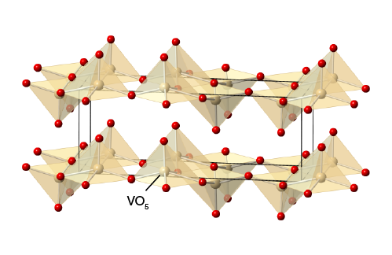
Oxides to be investigated
Vanadium oxides: V₂O₅, VO₂, V₂O₃ and VO exhibits four common oxidation states +5, +4, +3, and +2, respectively.
V₂O₅ crystallizes in an orthorhombic structure with layers of VO₅ square pyramids sharing edges and corners. These layers are weakly bond along the c-axis and the space between them permits the accommodation of guest ions.
This property along with the reversibility of valences of vanadium cations, high abundance, and theoretical high capacity makes this material an attractive candidate for the intercalation of Li-ions producing the Lithium ion batteries (LIB)
Nanostructured vanadium oxides have been widely explored to enhance the electrochemical kinetics for V₂O₅ electrodes in LIB.

Slide 12
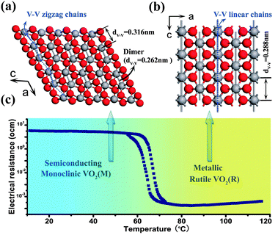
Oxides to be investigated
Vanadium oxides: V₂O₅, VO₂, V₂O₃ and VO exhibits four common oxidation states +5, +4, +3, and +2.
VO₂ undergoes a sharp metal-to-insulator transition (MIT) at 341 K (68 ºC) along with a structural phase transition from monoclinic to the rutile structure.
The origin of the unexpected insulating phase is not a consensus yet.
Doping can change the transition temperature (W-doped VO2: transition at 288 K).
Chem. Soc. Rev., 2013,42, 5157-5183 | DOI: 10.1039/C3CS35508J

Slide 13
Oxides to be investigated
Vanadium oxides: V₂O₅, VO₂, V₂O₃ and VO exhibits four common oxidation states +5, +4, +3, and +2.
Adv. Mater. Rev., 2009,79, 747 | DOI: 10.4028/www.scientific.net/AMR.79-82.747
Interestingly V₂O₅ can be transformed in VO₂ by annealing at around 600 ºC, causing a change in the Vanadium valence (+5 to +4)

Slide 14
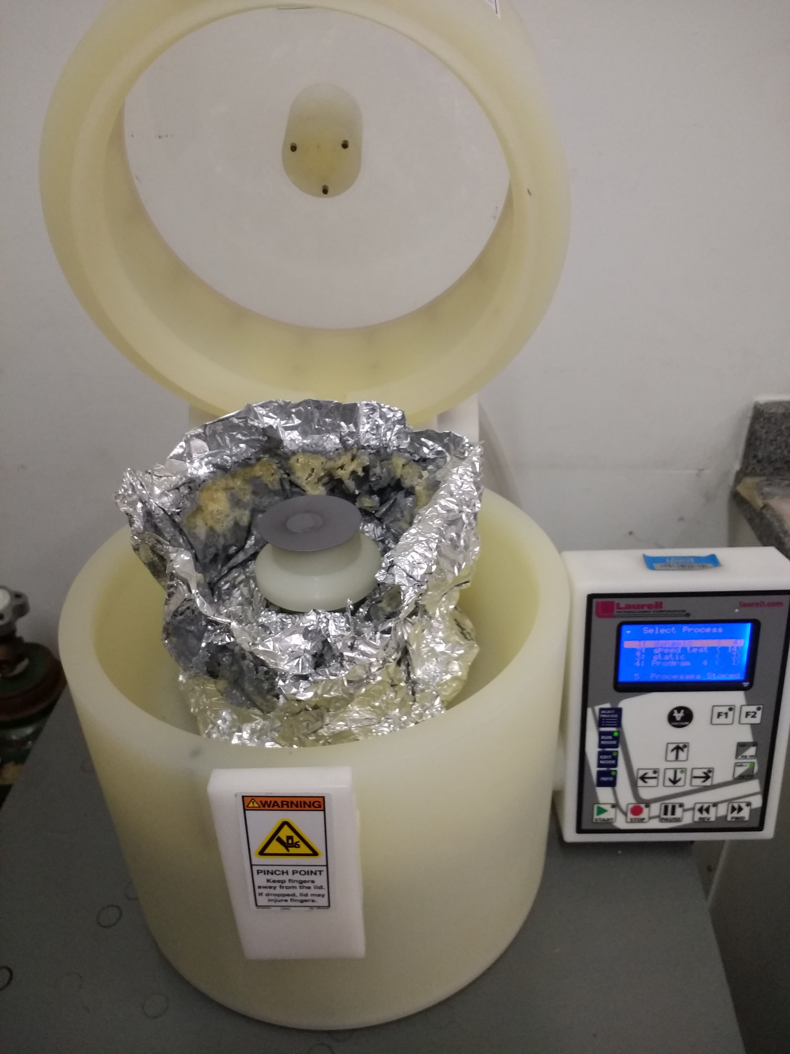
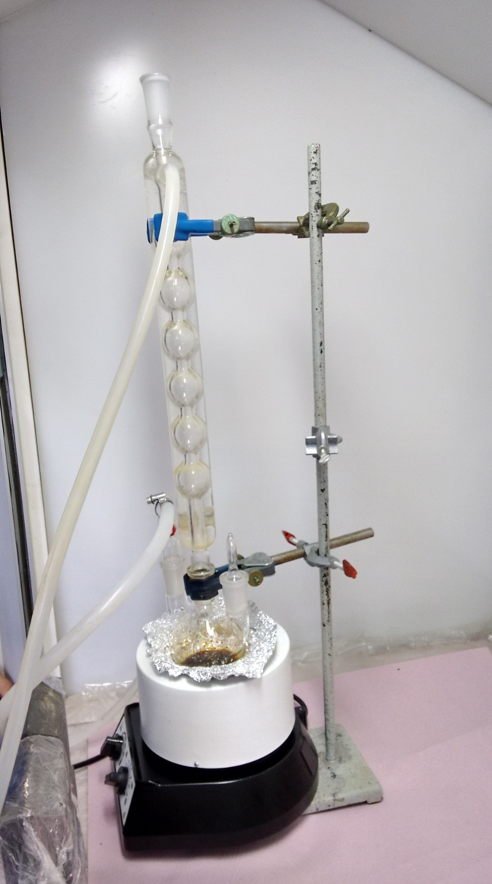
Methodology and Justification
Samples of vanadium oxides will be prepared at the hyperfine interactions laboratory in IPEN, São Paulo.
Sol-gel method will be used to prepare bulk samples as well as it is ideal to produce thin film samples deposited on substrates by spin-coating technique.
This method allows a total control of doping,
for instance the thickness.
Nanoparticles of vanadium oxides will be prepared by thermal decomposition, which produce small and monodisperse particles.
All samples will be characterized by X-ray diffraction (XRD), transmission electron microscopy (TEM), scanning electron microscopy (SEM), and Rutherford backscattering (RBS). Extended x-ray absorption fine structure (EXAFS) spectroscopy and X-ray absorption near edge structure (XANES) will be carried out for thin film samples in the synchrotron accelerator in Campinas, SP, Brazil.

Slide 15


Methodology and Justification
Oxide samples will be doped with different probe ions having different valences to investigate the local effect of doping on the charge density, oxygen vacancy occurrence, and electronic structure by measuring the electric field gradient tensor.
PAC measurements will be carried out at different temperatures to follow the behaviour of the observed parameters as well as dynamic process particularly measured by ε⁻-PAC.
$$V_{zz}$$
and
$$η=\frac{V_{xx}−V_{yy}}{V_{zz}}$$
Cd ion ( from ¹¹¹In →¹¹¹Cd or ^{111m}Cd → ¹¹¹Cd) has valence +2
¹¹¹In →¹¹¹Cd: possible after effects (fast electronic re-arrangement)
^{111m}Cd → ¹¹¹Cd: no after effects.
In ion (¹¹⁷Cd → ¹¹⁷In) has valence +3,
Complementary measurements of ¹¹¹In/Cd since in both cases incorporation is done on one element and the measurement of the other
Sn ion (^{119m}Sn →¹¹⁹Sn ) has valence +4
ε⁻ -PAC measurements: possible dynamic process
Ta ion (¹⁸¹Hf →¹⁸¹Ta) has valence +5
¹⁸¹Hf→¹⁸¹Ta probe nuclei will be produced at the nuclear reactor of IPEN, São Paulo, implanted elsewhere and exported to ISOLDE/CERN for measurements “offline” or during the Long Shutdown.

Slide 16
Methodology and Justification
First-principles calculations, using full-potential augmented plane waves plus local orbital method (FP-APW+lo) based on the DFT will be performed (by WIEN2k code) in order to simulate the doping in the host oxides to interpret mainly the experimental hyperfine interactions results.
Confronting experimental determination with theoretical predictions of the EFG using all-electron ab initio electronic structure calculations can provide information such as structural deformations, localization and charge state of defect centers and impurities, character of impurity levels
Since the substitutional dopant impurity has a nominal different character (donor or acceptor) depending on its valence, the different charge states of the impurity can be simulated by removing or adding electrons
Semicond. Sci. Technol. 32 (2017) 085010
For thin films, two ab initio methods with different basis set (FP-APW+lo method and a linear combination of numerical localized atomic-orbitals basis set, implemented in WIEN2k and SIESTA packages, respectively) will be used

Slide 17
Earlier findings
Hyperfine Interactions 80 (1993) 965-970
V₂O₅ | Vacuum at 870 K (60 min) |  | Air at 870 K (30 min)
ν_{Q} (MHz) | 88.1(3) | 221(2) | 91.4(6) | 224(3) | 265
η | 0.62 | ≈ 0 | 0.61 | ≈ 0 | ≈ 0
¹¹¹In →¹¹¹Cd
VO₂: ν_{Q1} = 42.9(7) MHz with η₁ = 0.38(4) at RT and ν_{Q2} = 89.2(2) MHz with η₂ = 0.20(2) at 420 K
First result at ISOLDE
V₂O₅ | Sol-gel
ν_{Q} (MHz) | 85.7(1) | 77(2)
η | 0.58(1) | ≈ 0

Slide 18
Objectives and expected results
Investigation (through hyperfine interactions) of the doping mechanism in V₂O₅ and VO₂ oxides using perturbed angular correlation spectroscopy (γ-PAC and ε⁻-PAC) as well as first-principles calculations based on density functional theory (DFT), by tracking the local modification produced by dopants (probe nuclei: ¹¹¹Cd, ¹¹⁷In, ¹¹⁹Sn) implanted into samples.
As ISOLDE offers a variety of radioactive nuclei, we will choose as dopants ions with different valences than that of the native cations and investigate the influence of the excess or lack of electrons.
Since hyperfine interactions have the short range of the atomic distances, we will investigate the neighborhood of the dopants (which are the probe atoms) and the local effect of the doping.
Samples of the oxides with higher concentration of dopants (2-5%) are intended to be investigated too.
Our goal in the present project is to contribute for a description of the doping effects at an atomic level.
In parallel, intrinsic proprieties of the host oxides, such as crystal phase transition, dynamic phenomena, will also be investigated.

Slide 19
IMPORTANT
It is important to emphasize that the results of this proposal can either contribute to the formulation of a general theory about the doping mechanism in semiconductor oxides as well as produce new materials for technological applications.
The proposal will strengthen the collaboration between synergetic institutes
The proposal will benefit students, particularly brazilian students, which will have the oportunity to come to ISOLDE for the experiments.
The proposal will facilitate the association of Brazil to ISOLDE.
TAC meeting: RILIS for Sn: narrow band operation required for isomeric selection? Yes, because we need as much as ^{119m}Sn as possible. Would require additional setting up time. OK, as long as we have enough implantation time

