Slide 1
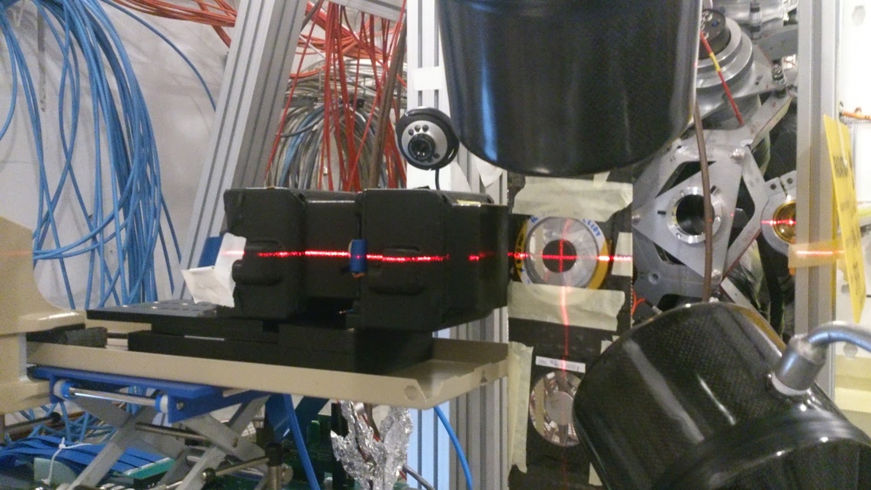




Completing the puzzle around the ⁷⁹Se s-process branching with the ⁸⁰Se(n,γ) cross-section measurement
V. Babiano Suarez, L. Caballero Ontanaya, F. Calviño, A. Casanovas, G. Cescutti, J.W. den Hartogh, C. Domingo-Pardo, C. Guerrero, S. Heinitz, R. Hirschi, I. Ladarescu, C. Lederer-Woods, J. Lerendegui-Marco, A. St. J. Murphy, N. Nishimura, R. Reifarth, D. Schumann, J.L. Taín, A. Tarifeño-Saldivia and the n_TOF Collaboration
INTC-P-536
C. Domingo-Pardo 58th meeting of the INTC, 7th February 2018

Slide 2
Outline
Motivation & Introduction: The branching around ⁷⁹Se(n,γ)
Status of the data & Need for a new ⁸⁰Se(n,γ) measurement
Proposed plans for ⁸⁰Se(n,γ) at n_TOF EAR1
Beam-time request
C. Domingo-Pardo 58th meeting of the INTC, 7th February 2018

Slide 3
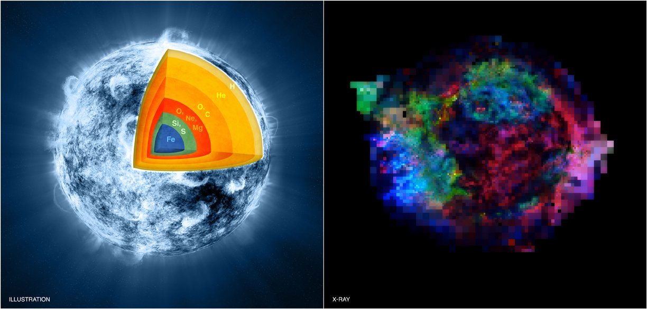
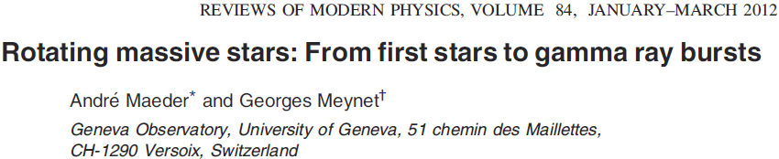
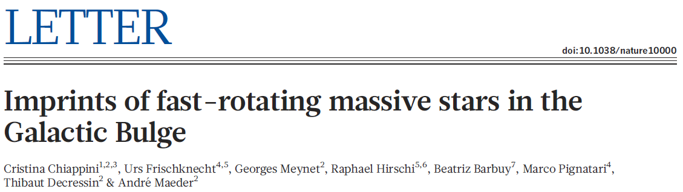
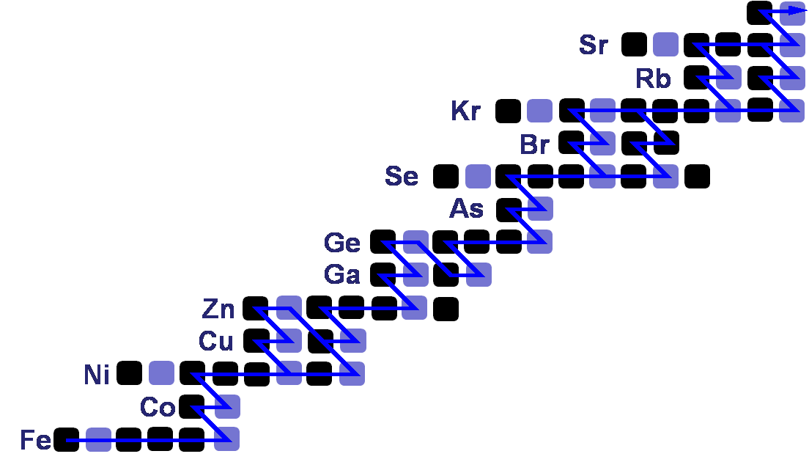

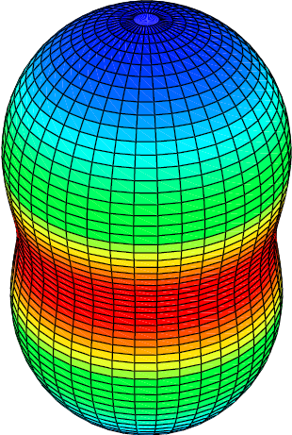
Motivation and Introduction: Massive Star structure & evolution
Anisotropic Temperature Gradients
C. Domingo-Pardo 58th meeting of the INTC, 7th February 2018
Currents, rotation, mixing

Slide 4
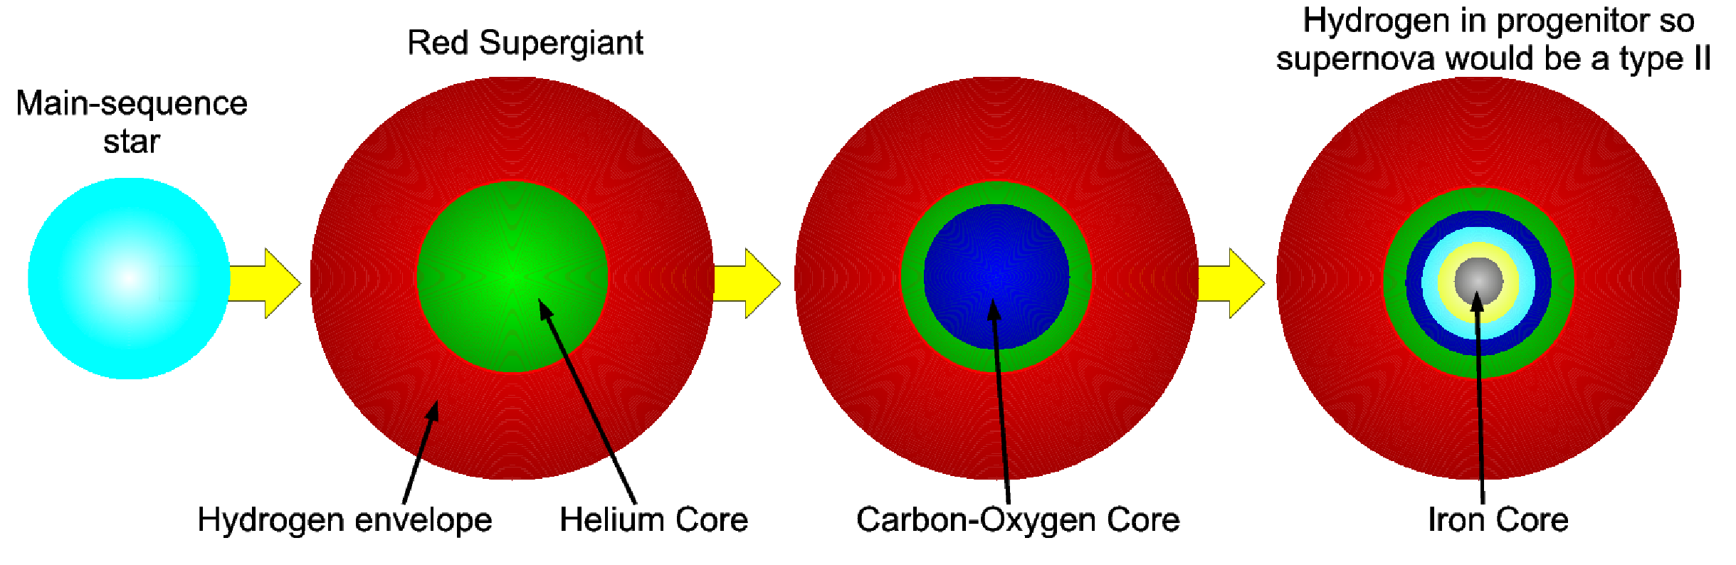
Motivation and Introduction: Massive Star structure & evolution
Core He-burning
Shell C-burning
Shell C-Burning
90 keV
²²Ne(α,n)
Core He-Burning
N.Nishimura, et al. 2017 MNRAS
C. Domingo-Pardo 58th meeting of the INTC, 7th February 2018

Slide 5
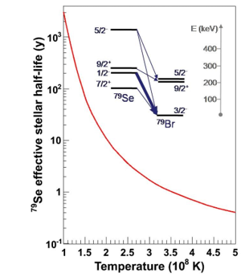

The massive-star nuclear-thermometer
⁸⁰Kr
⁸¹Kr
⁸²Kr
11 a
⁷⁹Br
⁸⁰Br
⁸¹Br
⁸²Br
17 m
35 h
⁷⁹Se
⁷⁶Se
⁷⁷Se
⁷⁸Se
⁷⁹Se
⁸⁰Se
⁸¹Se
3x10⁵a
18 m
⁷⁵As
⁷⁶As
26 h
C. Domingo-Pardo 58th meeting of the INTC, 7th February 2018

Slide 6
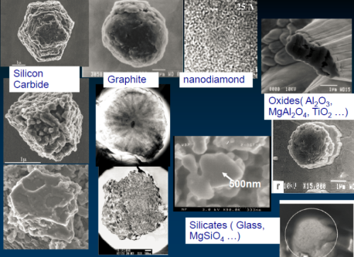
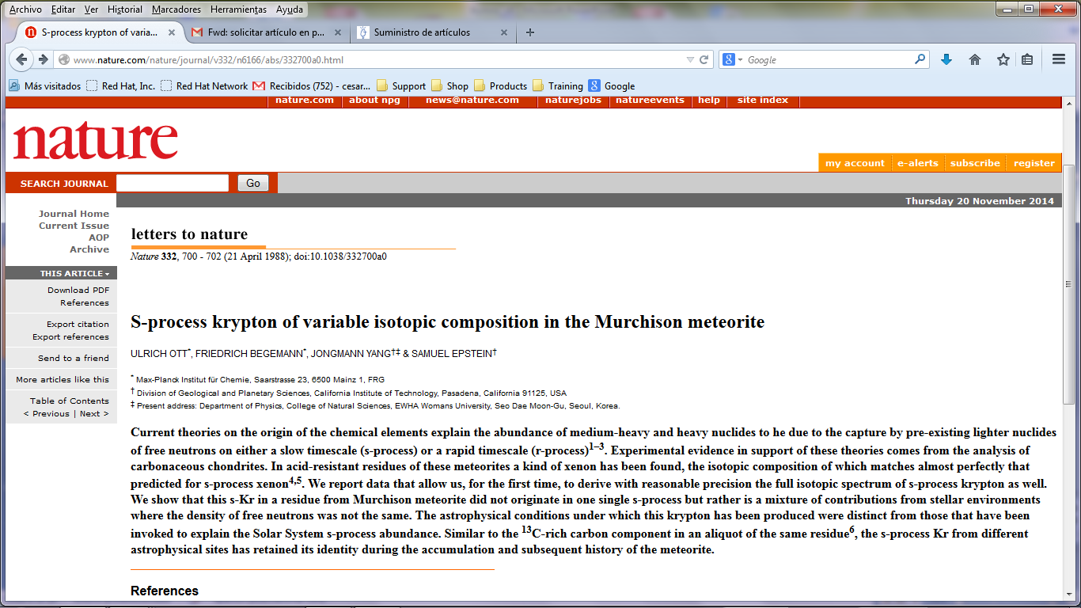
The massive-star nuclear-thermometer
⁸⁰Kr
⁸¹Kr
⁸²Kr
11 a
⁷⁹Br
⁸⁰Br
⁸¹Br
⁸²Br
17 m
35 h
⁷⁹Se
⁷⁶Se
⁷⁷Se
⁷⁸Se
⁷⁹Se
⁸⁰Se
⁸¹Se
3x10⁵a
18 m
⁷⁵As
⁷⁶As
Objective of HYMNS-ERC Project (LoI, CERN INTC 2014)
  Improvements in the detection system: i-TED
  Accurate (n,g) CSs of neighbouring nuclei
26 h
C. Domingo-Pardo 58th meeting of the INTC, 7th February 2018

Slide 7
The massive-star nuclear-thermometer
M.Heil et al. PRC2008 → Unc.(⁷⁹Br) = 5.5%
→ Unc.(⁸¹Br) = 3%
⁸⁰Kr
⁸¹Kr
⁸²Kr
11 a
⁷⁹Br
⁸⁰Br
⁸¹Br
⁸²Br
17 m
35 h
?
⁷⁹Se
⁷⁶Se
⁷⁷Se
⁷⁸Se
⁷⁹Se
⁸⁰Se
⁸¹Se
3x10⁵a
18 m
⁷⁵As
⁷⁶As
Objective of HYMNS-ERC Project (LoI, CERN INTC 2014)
  Improvements in the detection system: i-TED
  Accurate (n,g) CSs of neighbouring nuclei
26 h
C.Lederer, A. Murphy et al. (n_TOF Col.), 2017 → CS Uncertainty 4-5%
C. Domingo-Pardo 58th meeting of the INTC, 7th February 2018

Slide 8
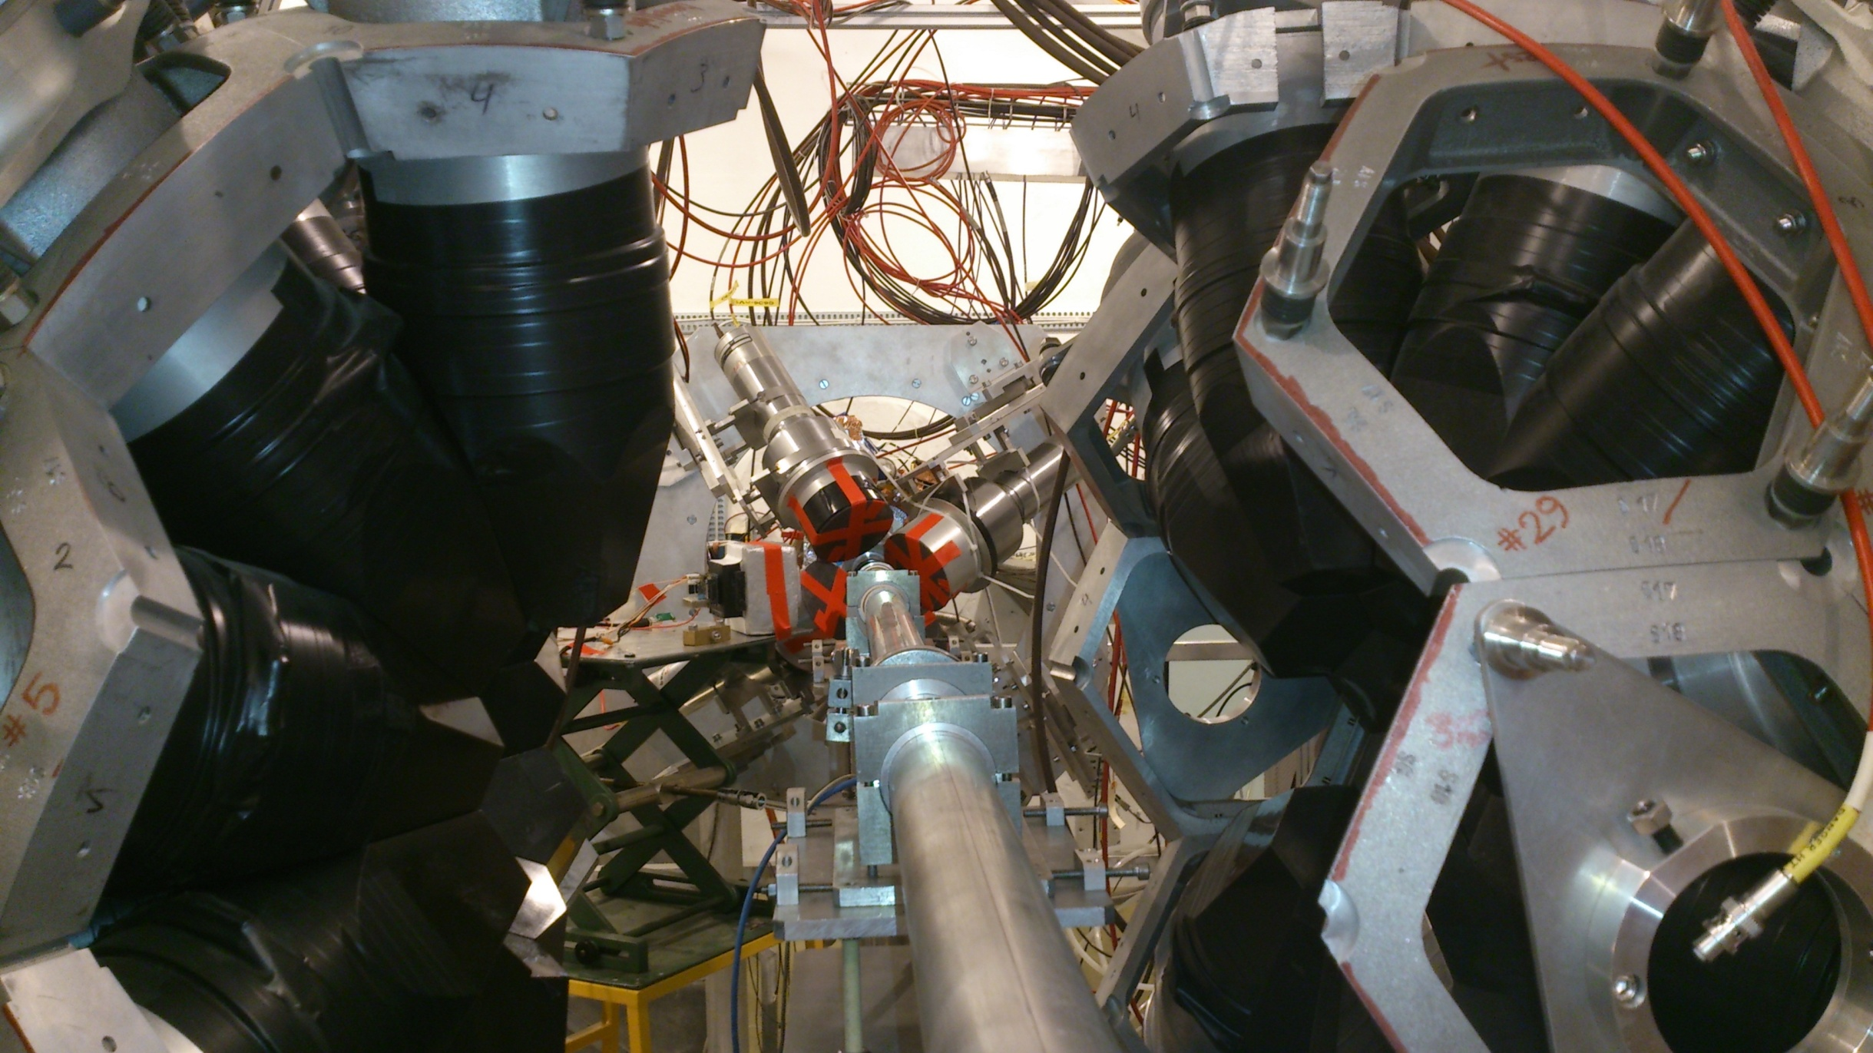
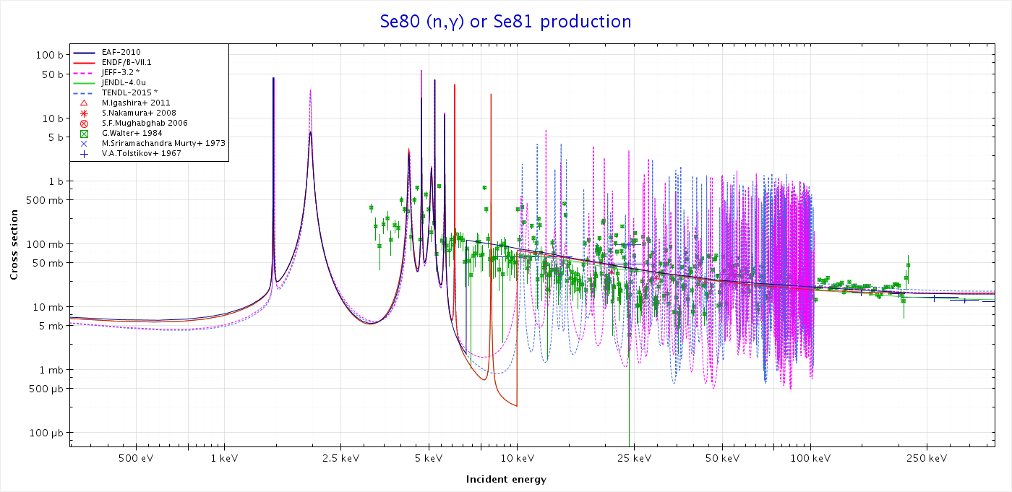
Status of the data: the previous TOF experiment
Walter et al., 1986
?
G. Walter et al., Astron. Astrophys. 167, 186 (1986)
Low energy cut-off at 3 keV
C. Domingo-Pardo 58th meeting of the INTC, 7th February 2018

Slide 9
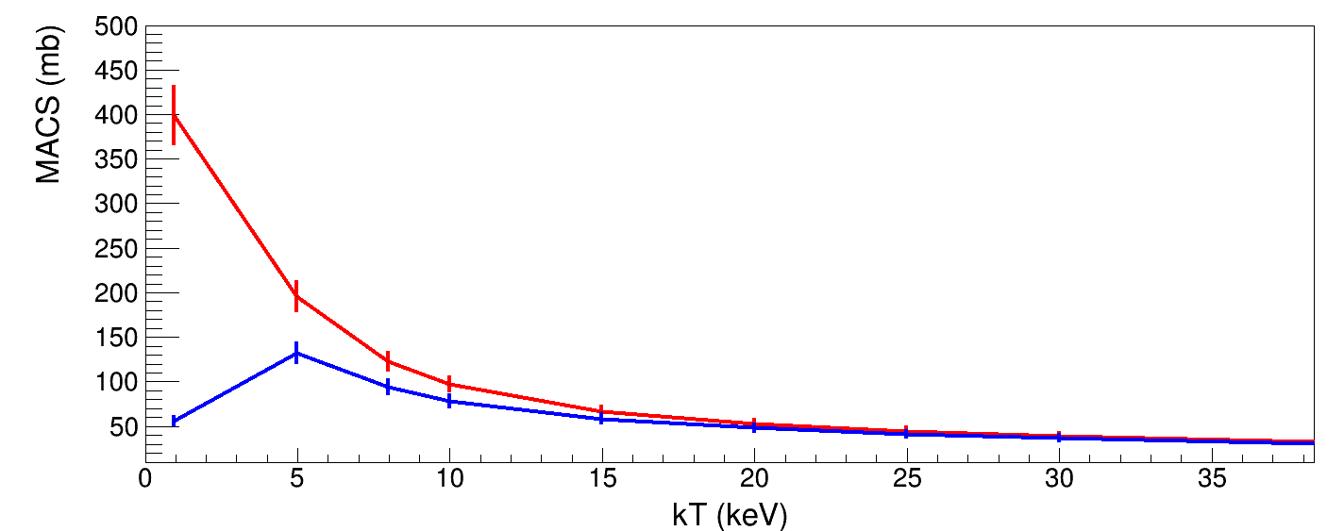
Status of the data: the previous TOF experiment
Walter et al., 1986
?
G. Walter et al., Astron. Astrophys. 167, 186 (1986)
With the 3keV Cutoff
Without the 3keV Cutoff
(SAMMY & TENDL)
C. Domingo-Pardo 58th meeting of the INTC, 7th February 2018

Slide 10
Status of the data: the previous TOF experiment
Walter et al., 1986
?
Flight path 60cm
G. Walter et al., Astron. Astrophys. 167, 186 (1986)
Low energy cut-off at 3 keV
Limited En-resolution
(Probably with strong n-sensitivity bias)
Low energy cut-off at 3 keV
Pb
C. Domingo-Pardo 58th meeting of the INTC, 7th February 2018

Slide 11
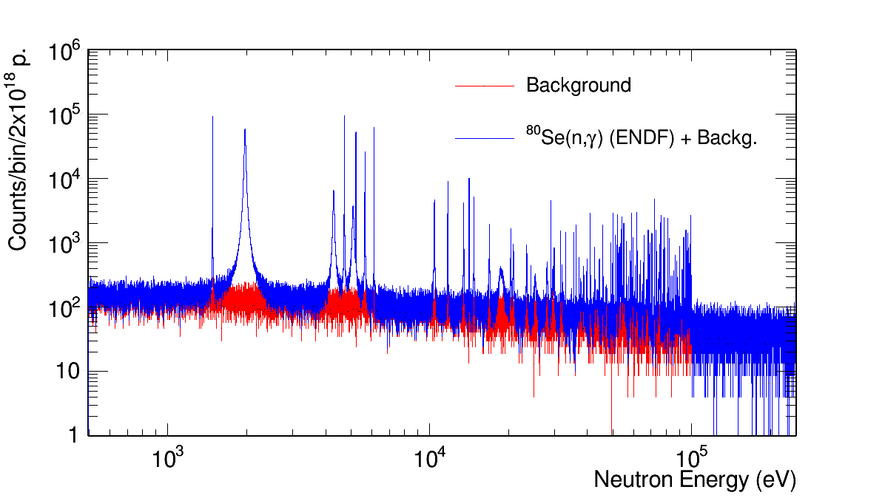
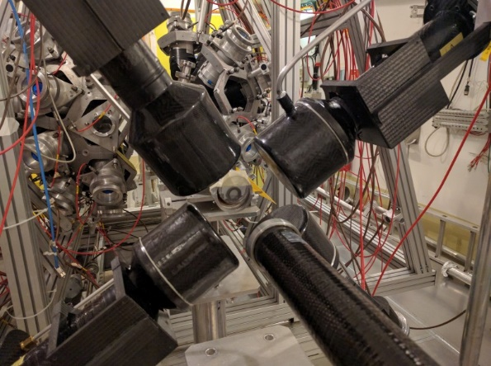
⁸⁰Se(n,γ) at n_TOF EAR1
Estimated for n_TOF EAR1
Simulation n_TOF EAR1
185 m; 4xC₆D₆ 2.5x10¹⁸p
Walter et al., 1986
?
C. Domingo-Pardo 58th meeting of the INTC, 7th February 2018

Slide 12
⁸⁰Se(n,γ) Beam Time Request
Sample | Objective(s) | Protons | Area | Set-up
⁸⁰Se | ⁸⁰Se(n,γ) | 2.5·10¹⁸ | EAR1 | 4xC₆D₆
Dummy | Background for ⁸⁰Se(n,γ) | 2.5·10¹⁷ | EAR1 | 4xC₆D₆
Au, Pb, C | Normalization ⁸⁰Se(n,γ), Beam-induced background in (n,γ) | 2.5·10¹⁷ | EAR1 | 4xC₆D₆
Total protons requested: |  | 3x10¹⁸
C. Domingo-Pardo 58th meeting of the INTC, 7th February 2018

Slide 13
backup

Slide 14
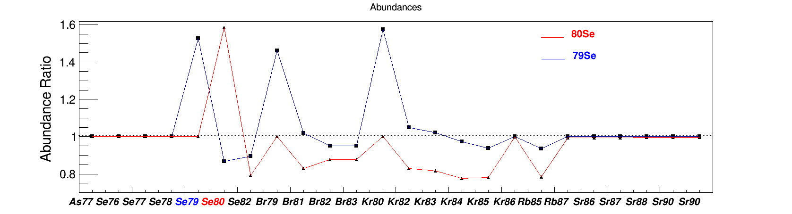
⁸⁰Se(n,γ) Status of the data
⁸⁰Kr
⁸¹Kr
⁸²Kr
11 a
⁷⁹Br
⁸⁰Br
⁸¹Br
⁸²Br
17 m
35 h
⁷⁶Se
⁷⁷Se
⁷⁸Se
⁷⁹Se
⁸⁰Se
⁸¹Se
3x10⁵a
18 m
⁷⁵As
⁷⁶As
26 h
C. Domingo-Pardo 58th meeting of the INTC, 7th February 2018

Slide 15
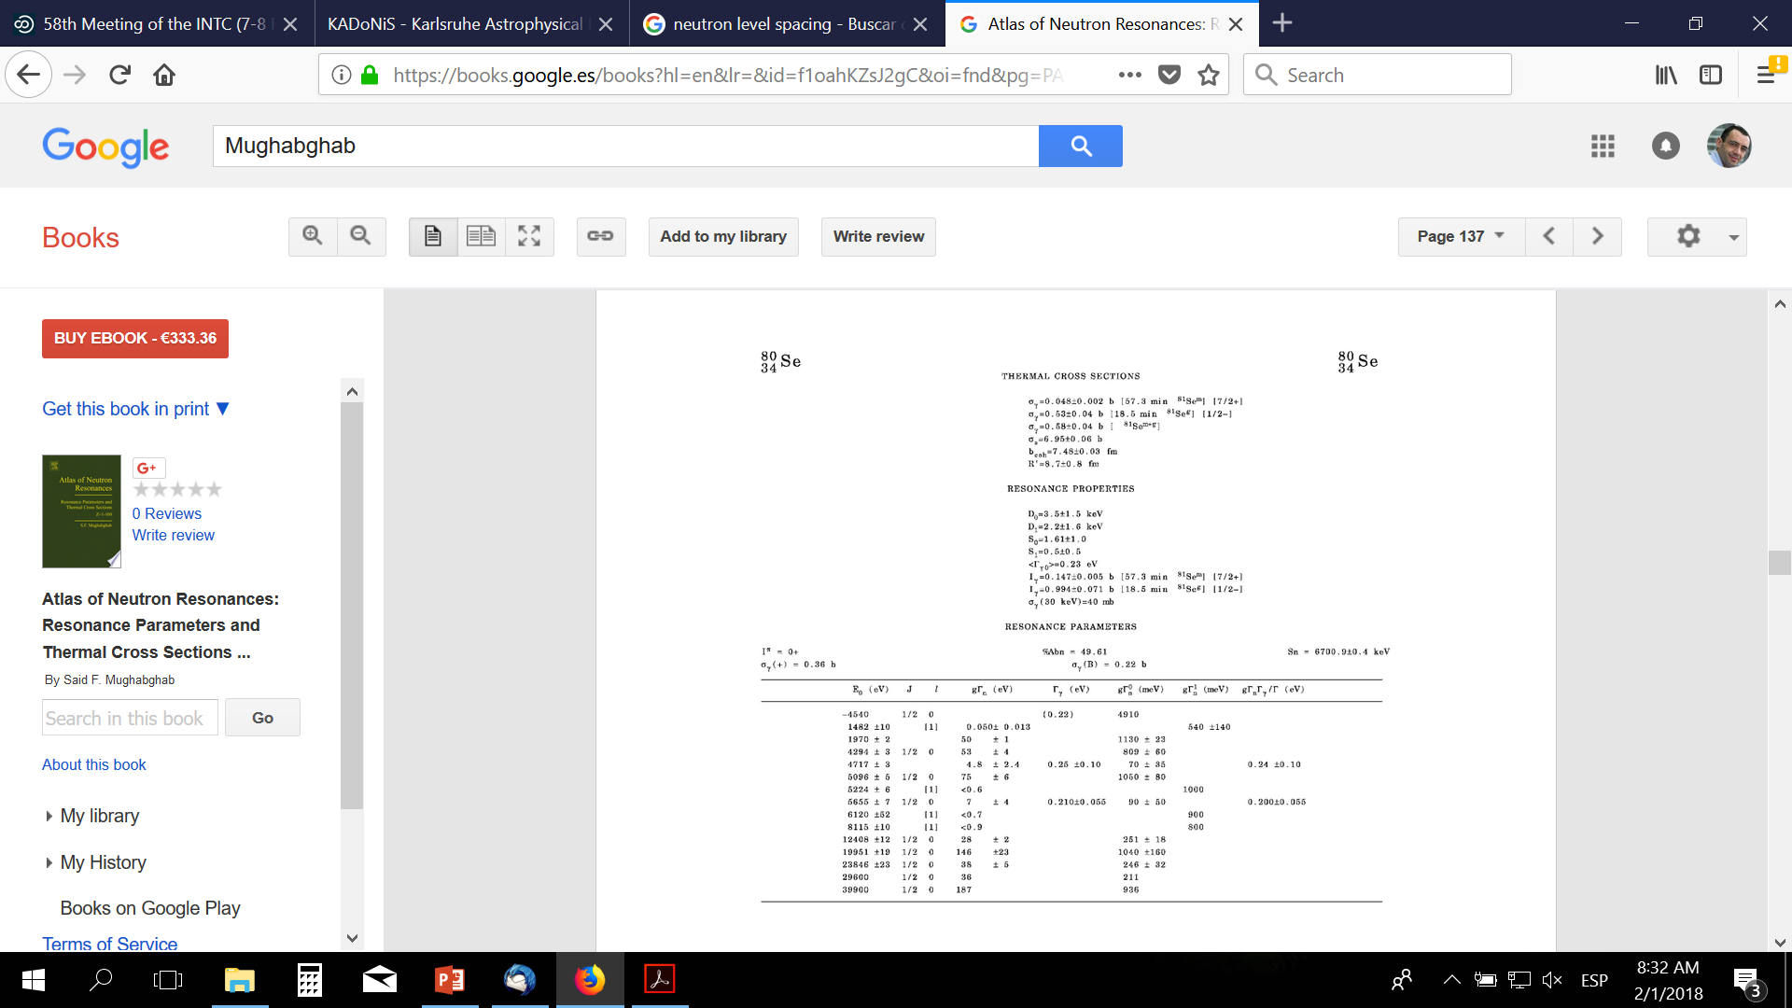

Slide 16


Slide 17


Slide 18
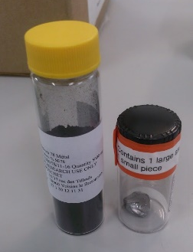
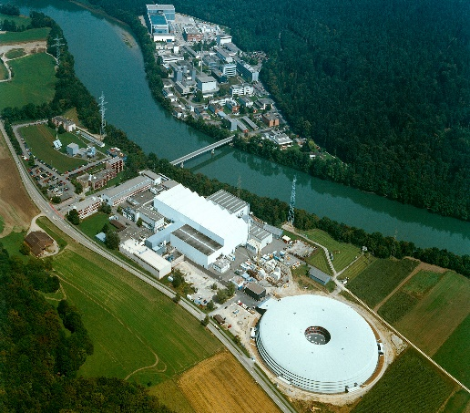

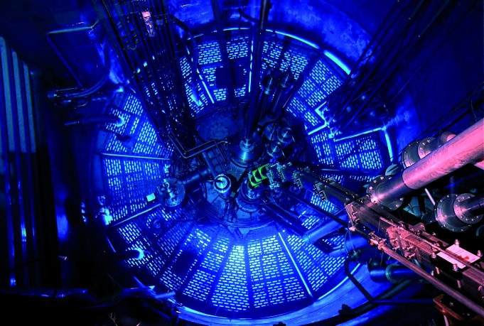

i-TED Commissioning: Motivation ⁷⁹Se(n,γ)
Radioactive sample
Small (n,g) vs. (n,n)
99.3% ⁷⁸Se [Cortecnet]
99.1% ²⁰⁸Pb [ORNL]
0.01% ⁷⁴Se → GBq of ⁷⁵Se
0.01% of ⁶⁰Co → 2.6 MBq ⁶⁰Co (10 months after EOI)
6g ²⁰⁸Pb
2.5g ⁷⁸Se
D. Schumann, S. Heinitz
U. Koster
C. Domingo-Pardo n_TOF Collaboration Meeting, CERN, 22/4 December 2016

Slide 19
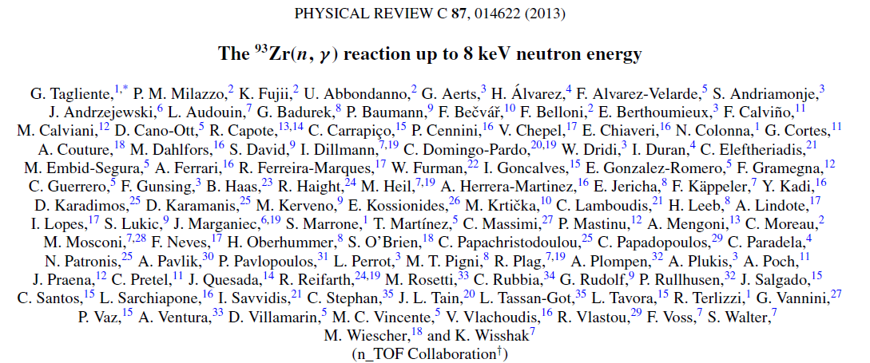
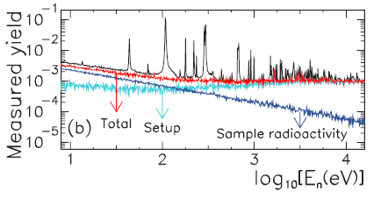
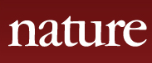
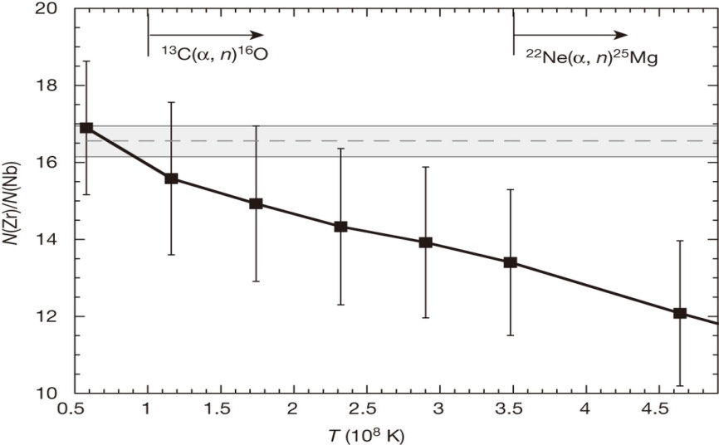
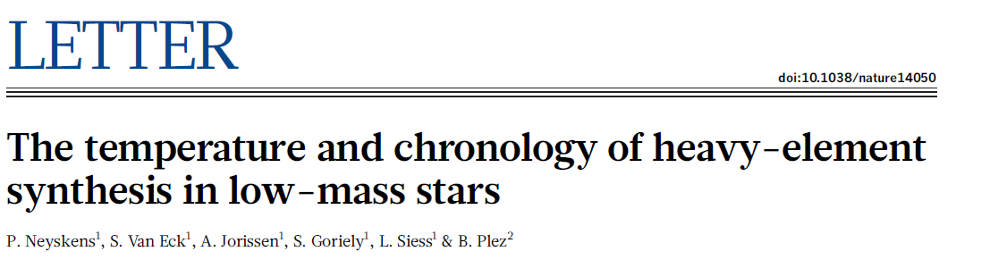
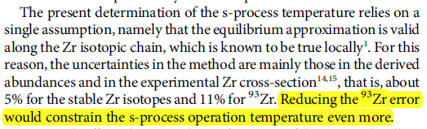
Need of new developments: illustrated with ⁹³Zr(n,γ) @ n_TOF
⁹³Zr(n,γ)
HERMES observations of Nb and Zr in S-type stars
Determination of the s-process temperature directly in evolved low-mass GSs, using Zr and Nb abundances, independent of stellar evolution models.
93Zr/93Nb provides chronometric information on the time elapsed since the start of the s-process (one-three million years).
Observational Error Band [HERMES]
N(Zr)/N(Nb)
Experimental (n,γ) CS Error Bar [CERN n_TOF]
Present s-process thermal
constraint for low-mass AGBs
[HERMES + CERN n_TOF]
T (10⁸ K)
Adapted from P. Neyskens et al.,Nature 517, 174-176 (2015)

Slide 20
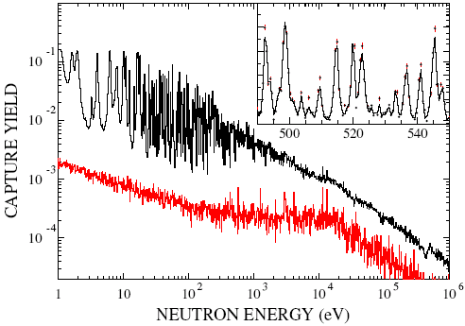
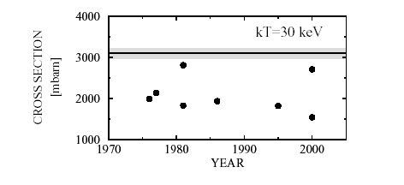
Temperature in TP AGB Stars
MACS-30 = 3100 ± 160 mb
T_{He} = 2.5-2.8x10⁸ K
T_{H} = 1x10⁸ K
¹⁵²Gd
¹⁵³Gd
¹⁵⁴Gd
¹⁵⁵Gd
¹⁵⁶Gd
¹⁵⁷Gd
¹⁵¹Eu
¹⁵²Eu
¹⁵³Eu
¹⁵⁴Eu
¹⁵⁵Eu
¹⁵⁶Eu
¹⁵⁰Sm
¹⁵¹Sm
93 a
¹⁵²Sm
¹⁵³Sm
¹⁵⁴Sm
U Abbondanno et al. Phys. Rev. Lett. 93 (2004), 161103
S. Marrone et al. Phys. Rev. C 73 (2006) 03604

Slide 21
Temperature in Massive Stars
TP-AGB Stars
H-burning, He-flash
MSs
Core He-burning,
Shell C-burning

