Slide 1




PROPOSAL
Measurement of the ³⁵Cl(n,γ) cross section at n_TOF EAR1
I. Porras¹, T. Wright², S. Bennett², F. Ogállar^{1,3}, J. Praena¹, M. Sabaté-Gilarte³, P. Torres-Sánchez¹, F. Arias de Saavedra¹, C. Lederer-Woods⁴, S.J. Lonsdale⁴, R. Garg⁴, M. Dietz⁴ and the n_TOF Collaboration.
¹Universidad de Granada, Spain
²University of Manchester, UK
³European Organization for Nuclear Research, Switzerland
⁴University of Edinburgh, UK

Slide 2
Plan of the talk
Motivations
Status of data
Setup proposed and counting rate estimations
Request of protons
1
I. Porras, Universidad de Granada, Spain
1

Slide 3
Motivations
Dual interest: Health and Environment
1. Boron Neutron Capture Therapy
Cl present in brain and in skin at 0.3%.
Important for dose calculations in healthy tissue
2. Nuclear power plants
    Cl present in the materials of the reactor
    Important for criticality calculations and waste repositories
75% of Cl is ³⁵Cl, its capture cross section is so large (44 b. at thermal) that even at low concentrations its activation is important.
2
I. Porras, Universidad de Granada, Spain

Slide 4
Boron Neutron Capture Therapy (BNCT)

Slide 5
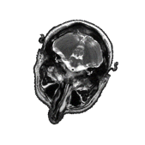

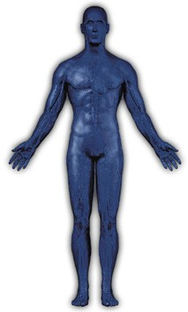
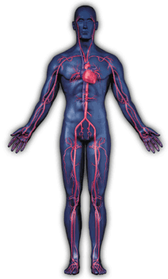
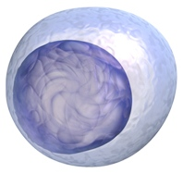
BNCT: an effective one-day treatment
Boron accumulates in malignant cells 4 times more than in healthy tissue
Irradiation with epithermal neutron beam according to Monte Carlo calculations (Evaluated data)
I.v. infusion of boron compound 4 hours before
irradiation
(BPA: 400 mg/kg)
2 x 20 min
α
Particle
¹⁰B[n,α]⁷Li
reaction
neutron
¹⁰B -nucleus
⁷Li
¹⁰B capture neutrons and produces heavy ions which has a range (5-9 um) of the order of the cell size. The biological effectiveness is much greater than conventional RT.
3
Thanks to L. Kankaanranta & M. Kortesniemi
Notes:
5

Slide 6
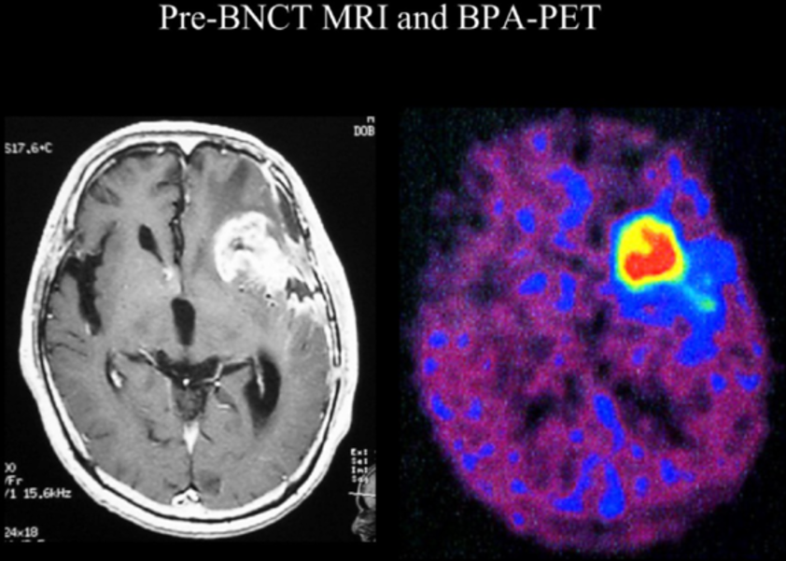
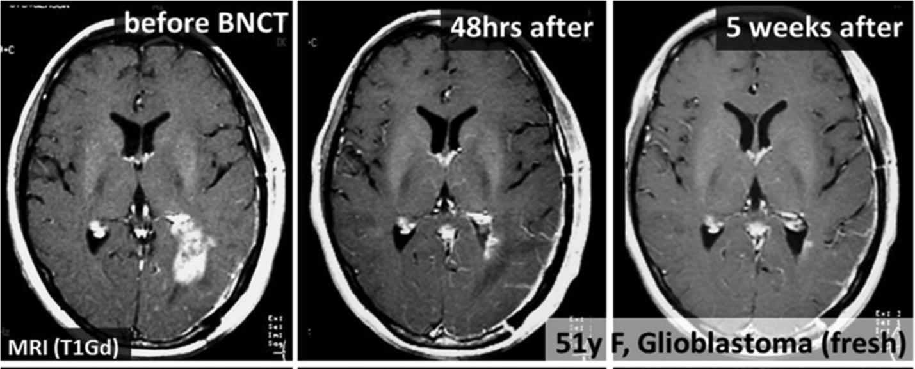
BNCT: unique RT option for infiltrative tumors
4

Slide 7
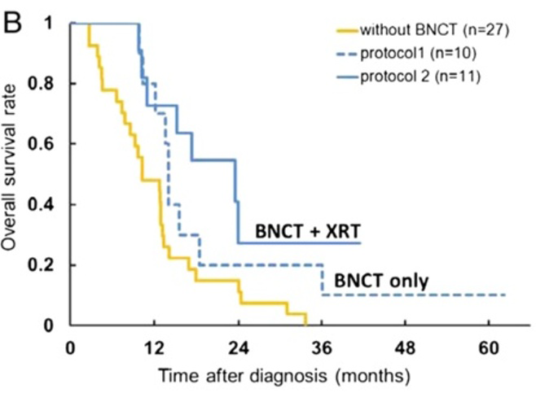
BNCT: promising therapy for brain tumors
Outcome of BNCT Osaka clinical trial for 21 brain tumor patients, combined with X-Ray Conventional Radiotherapy, and compared to standard treatments
S. Kawabata, S-I. Miyatake, T. Kuroiwa et al.,
J. Radiat. Res. 50, 51-60 (2009).
5

Slide 8
BNCT: promising therapy for brain tumors
Outcome of BNCT Osaka clinical trial for 21 brain tumor patients, combined with X-Ray Conventional Radiotherapy, and compared to standard treatments
S. Kawabata, S-I. Miyatake, T. Kuroiwa et al.,
J. Radiat. Res. 50, 51-60 (2009).
Can we optimize the treatment further?
5

Slide 9
Adjusting dose may improve outcome
Outcome of BNCT Finnish trial for 22 brain tumor patients (Glioblastoma) depending on dose delivered on Planning Tumor Volume
L. Kankaanranta, T. Seppala, H. Koivunoro et al.,
Int. J. Radiat. Oncol. Biol. Phys. 80, 369-376 (2011).
6

Slide 10
Adjusting dose may improve outcome
But …
Dose PTV (Gy) | Dose healthy tissue (Gy)
35 | 12.1
6

Slide 11
Adjusting dose may improve outcome
But …
Dose PTV (Gy) | Dose healthy tissue (Gy)
35 | 12.1
 | 16 (max tolerable)
large safe margin, because of uncertainties
6

Slide 12
Adjusting dose may improve outcome
But …
Dose PTV (Gy) | Dose healthy tissue (Gy)
35 | 12.1
46 | 16 (max tolerable)
large safe margin, because of uncertainties
6

Slide 13
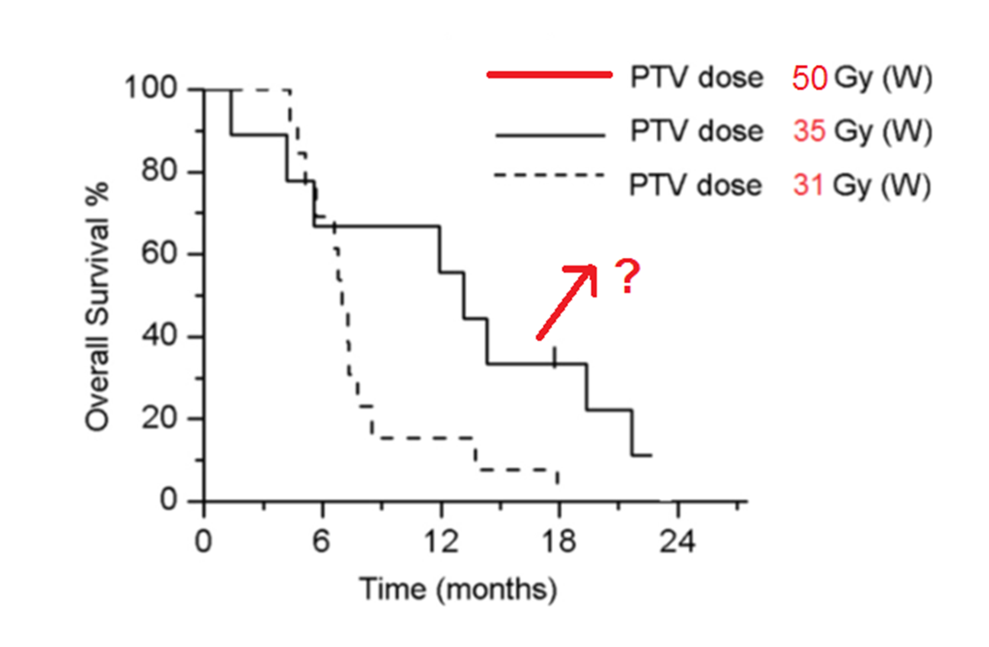
Adjusting dose may improve outcome
But …
Dose PTV (Gy) | Dose healthy tissue (Gy)
35 | 12.1
46 | 16 (max tolerable)
large safe margin, because of uncertainties
6

Slide 14
Adjusting dose may improve outcome
A more precise dose calculation (includes improving all cross sections) could lead to optimize treatment time
⇒ Better therapeutic outcome and possibly survival
But …
Dose PTV (Gy) | Dose healthy tissue (Gy)
35 | 12.1
46 | 16 (max tolerable)
large safe margin, because of uncertainties

Slide 15
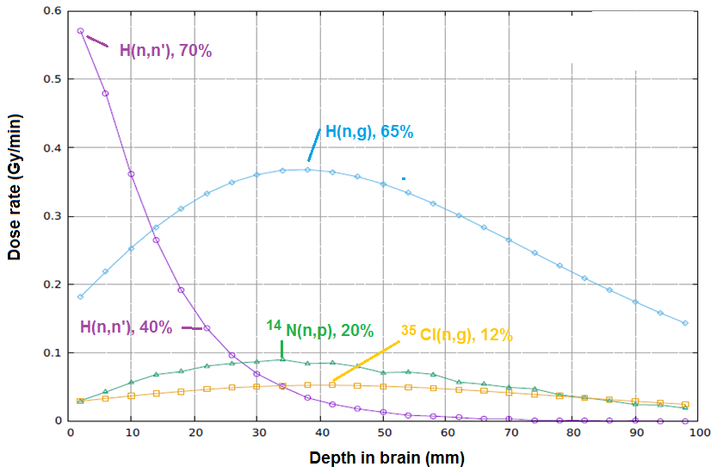
Most important processes contributing to dose in brain (healthy tissue)
7

Slide 16
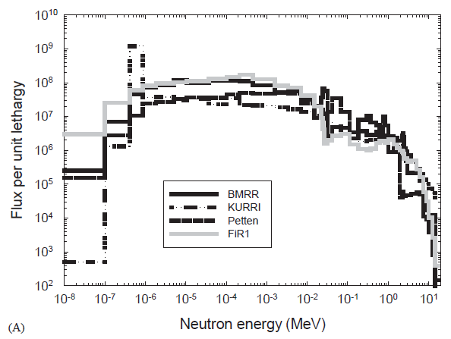
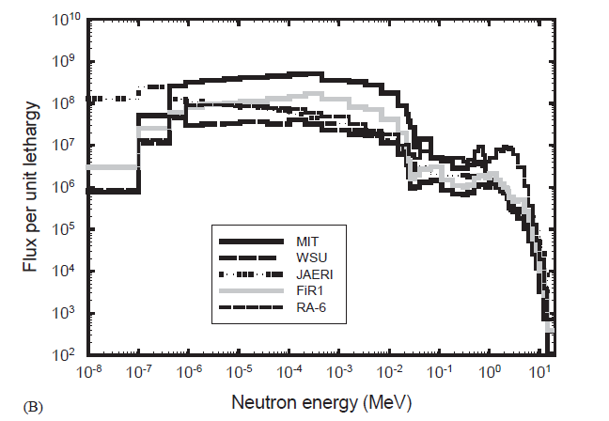
Energy range of interest: thermal to 100 keV
Spectrum of the main neutron beams for BNCT
I. Auterinen, T. Serén, K. Anttila et al.,
Applied Radiation and Isotopes 61 (2004) 1021–1026
8

Slide 17
2. Nuclear fission reactors

Slide 18
Chlorine in fission reactors
³⁵Cl is present in:
  Polyvinyl chloride pipes (is 57% Cl by weight)
  R. O. Sayer, K. H. Guber, L. C. Leal, Phys. Rev. C73, 044603 (2006)
  Chlorides are impurities in fuel cladding.
  IAEA-TECDOC-927: Influence of water chemistry on fuel cladding behaviour
  Cl in nuclear grade graphites (purification processes).
  LLWR Environmental Safety Case: Cl-36 Mobility in Reactor Circuits and its Potential Significance for the ESC 2011 Inventory, LLWRP 1106: SERCO/E003756/008
³⁶Cl is produced in fission reactors by ³⁵Cl(n,γ) capture
9

Slide 19
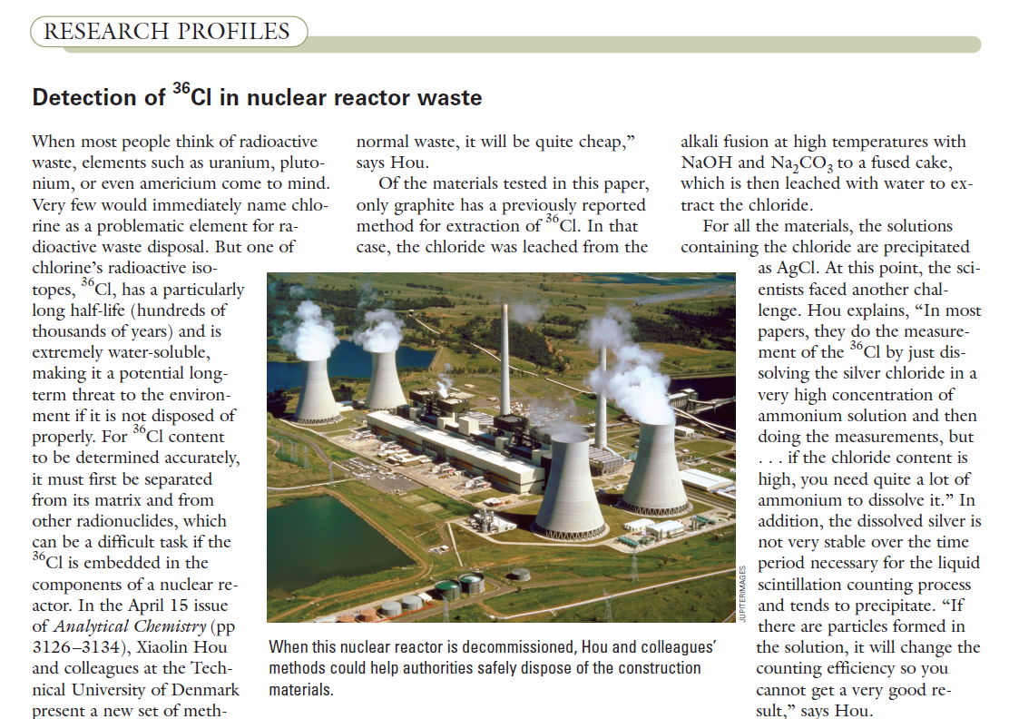
Motivations
Cl is a major concern in radioactive waste due to:
Half-life of 301000 y.
High mobility (extremely water soluble)
10

Slide 20
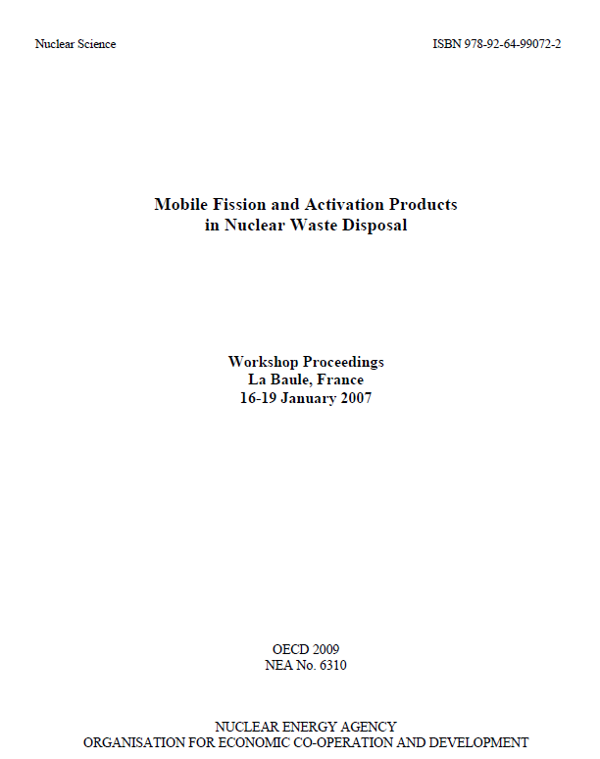
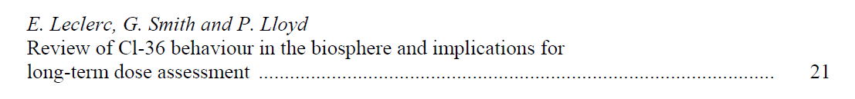
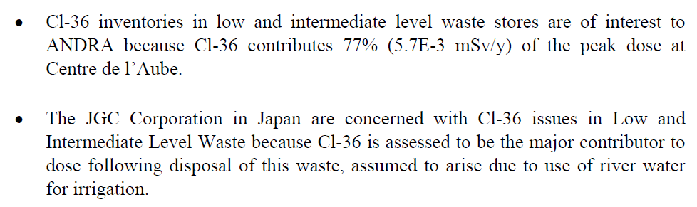
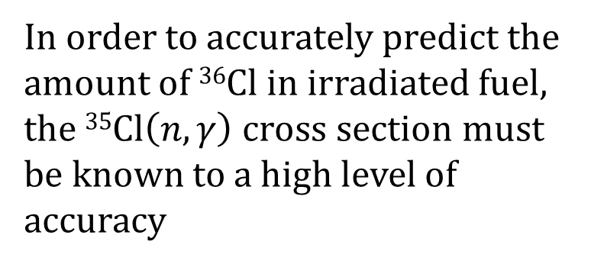
Motivations
11

Slide 21
Energy range of interest
(graphite T, K)
thermal to
~ 1 MeV
12

Slide 22
Status of data

Slide 23
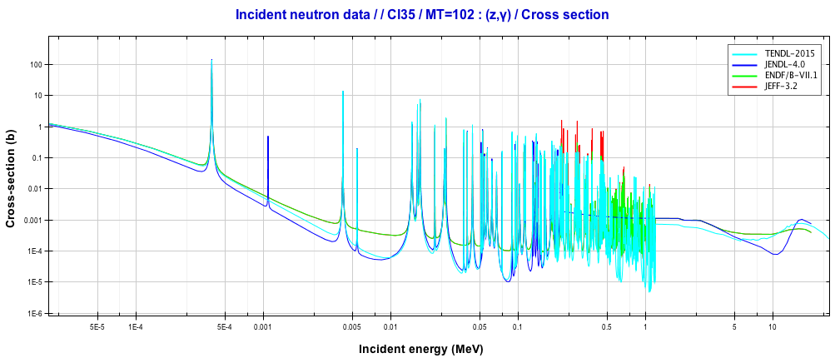
Evaluations
Uncertainties of 10% between evaluations:
too much for precise estimation of ³⁶Cl production inside the reactor core.
13

Slide 24
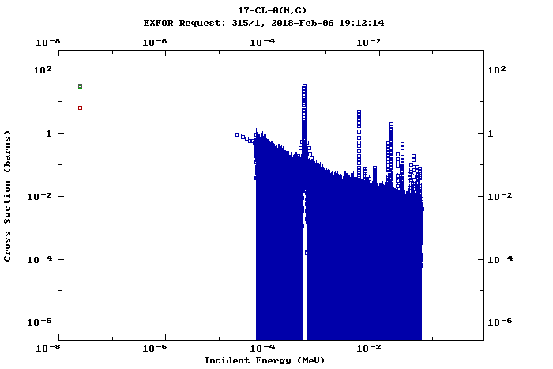
EXFOR
Only one capture measurement in resonances:
K. H. Guber, R. O. Sayer, T. E. Valentine, et al, Phys. Rev. C 65, 058801 (2002)
Discrepances in the measurement at thermal point
14

Slide 25
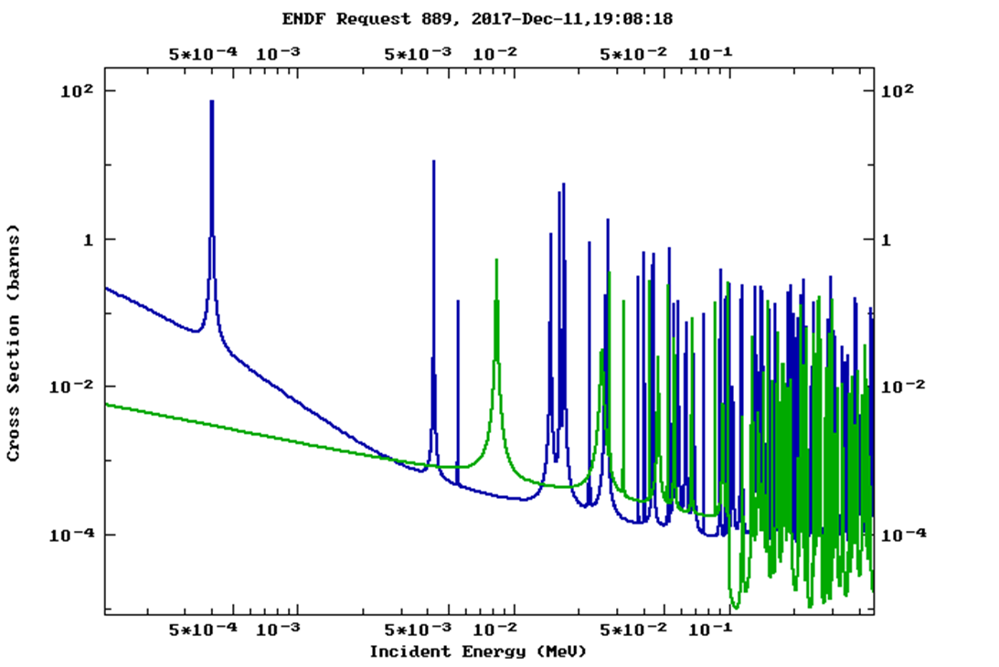
All measurements with nat Cl (75% ³⁵Cl, 25% ³⁷Cl)
³⁵Cl
³⁷Cl
We propose the first measurement with pure 35Cl
15

Slide 26
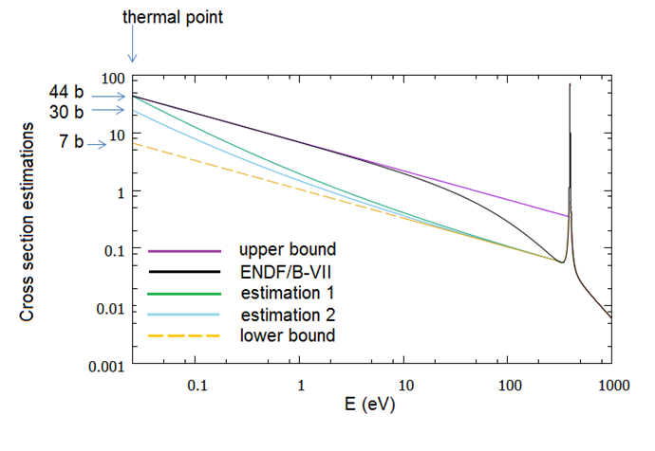
Low E behaviour: bound state
ENDF: Use bound state to fit the thermal value of Mughabghab.
-75 eV to -180 eV reported from different authors, different possibilities for low energy behaviour
16

Slide 27
Low E behaviour: bound state
ENDF: Use bound state to fit the thermal value of Mughabghab.
-75 eV to -180 eV reported from different authors, different possibilities for low energy behaviour
Has this any impact on BNCT dose delivered to brain?
MC Simulations for Snyder head model with different cross section
16

Slide 28
Low E behaviour: bound state
ENDF: Use bound state to fit the thermal value of Mughabghab.
-75 eV to -180 eV reported from different authors, different possibilities for low energy behaviour
Has this any impact on BNCT dose delivered to brain?
MC Simulations for Snyder head model with different cross section
 | Dose 35Cl (n,γ) | %Dose 35Cl(n,γ) | Total Dose
Upper bound | 0.516 | 12.446 | 4.1830
ENDF/B-VII | 0.514 | 12.410 | 4.1439
Estimation 1 | 0.551 | 13.196 | 4.1421
Estimation 2 | 0.325 | 8.167 | 3.9803
Lower bound | 0.081 | 2.162 | 3.7660
16

Slide 29
Low E behaviour: bound state
ENDF: Use bound state to fit the thermal value of Mughabghab.
-75 eV to -180 eV reported from different authors, different possibilities for low energy behaviour
Has this any impact on BNCT dose delivered to brain?
MC Simulations for Snyder head model with different cross section
ICRU: Doses must be known with less than 5% uncertainty
16

Slide 30
Set up and counting rate

Slide 31
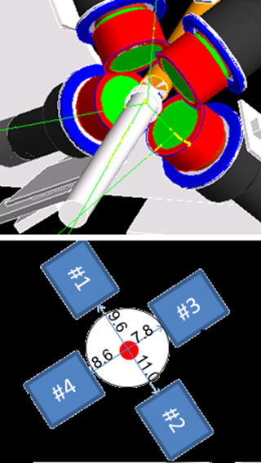
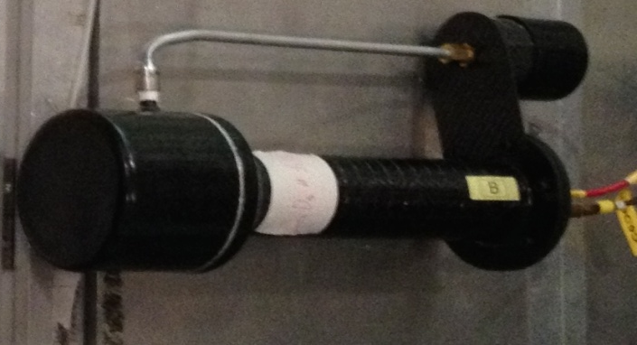
Setup
Capture Setup in EAR-1
- 4 x C6D6 detectors, (neutron insensitive)
Commonly used in capture measurements at n_TOF
17

Slide 32
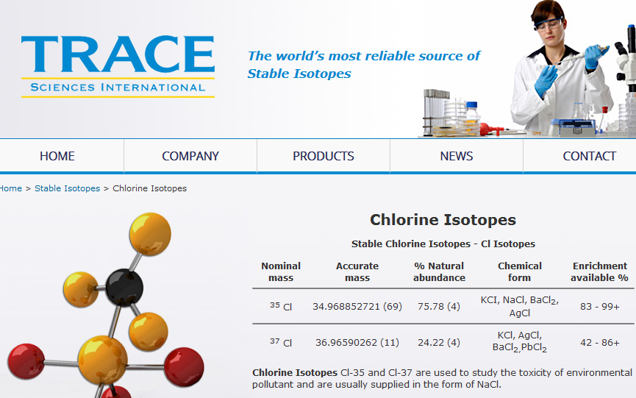
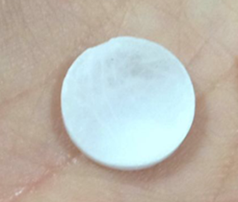
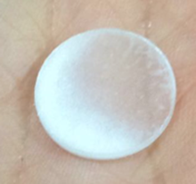
Samples of Na³⁵Cl or K³⁵Cl
Already produced:
500 mg
3.2e-3 at/b
250 mg
1.6e-3 at/b
18

Slide 33
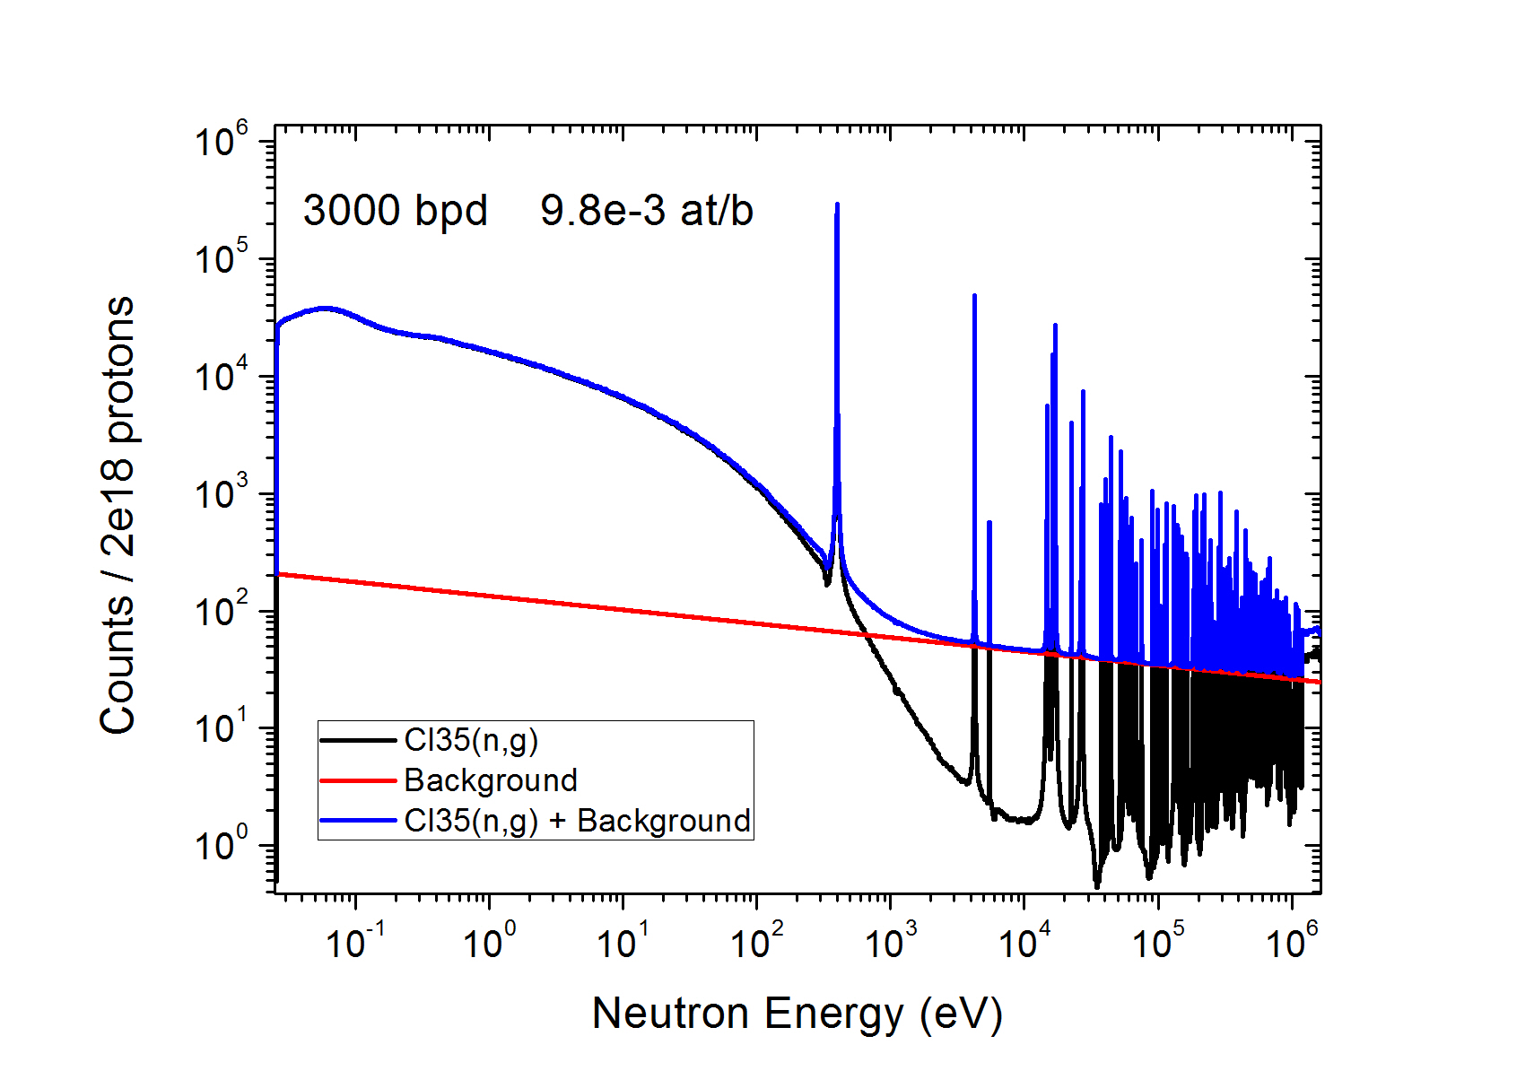
Counting rate estimation
19

Slide 34
Protons requested
1.5 x 10¹⁸ protons for 35Cl measurement
0.5 x 10¹⁸ protons for normalization and background
Total 2 x 10¹⁸ protons
20

Slide 35
2 PhD students involved
F. Ogállar (University of Granada, Spain)
  Low energy values and application to dose calculations (together with 35Cl(n,p) recently performed) for BNCT of brain tumors
S. Bennett (University of Manchester, UK)
  Resonance analysis and application to calculations of 36Cl activity
  Close coordination between groups for set-up and analysis
21

Slide 36
Conclusions
Low E data (missing data) are important for BNCT
Data in the resonance region (uncertain, only one measurement wilth nat Cl) important for radioactive waste calculation
Feasible experiment: samples and detector available and count rate above bacground guaranteed
Two PhD students from different universities benefiting from the analysis and applications
22

Slide 37


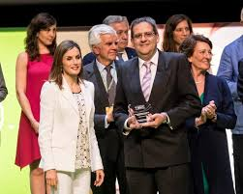


THANK YOU FOR YOUR ATTENTION

Slide 38
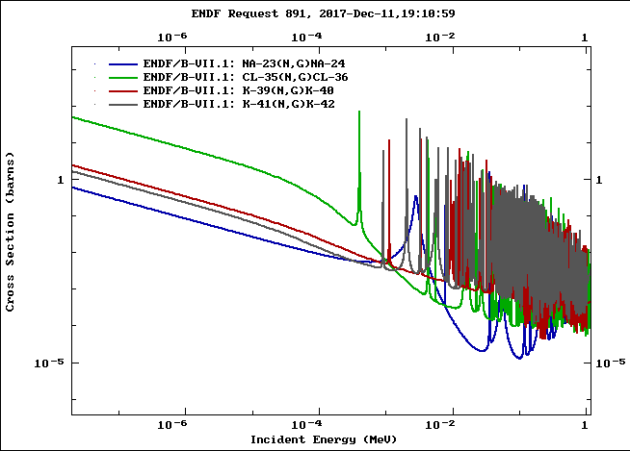


Sample of Na³⁵Cl or K³⁵Cl
Already produced:

Slide 39
BNCT: promising therapy for brain tumors
Outcome of BNCT Osaka clinical trial for 21 brain tumor patients, combined with X-Ray Conventional Radiotherapy, and compared to standard treatments
S. Kawabata, S-I. Miyatake, T. Kuroiwa et al.,
J. Radiat. Res. (Tokyo) 50, 51-60 (2009).

Slide 40
BNCT Treatment Planning – Example of protocol
BNCT neutron beams (1994 – 2013.07.05)
Finnish clinical trial – mean values
Dose not accurately known - BNCT is planned with a safe margin
 | Brain tumor (PTV) | Healthy tissue (limiting factor)
Fractionated Dose (Gy) | 60 (30 sessions of 2 Gy) | 60 (30 sessions of 2 Gy)
Current dose of the BNCT treatment (Gy-Eq) – single session | 35 | 12.1
Current photon equivalent dose of the BNCT treatment (Gy-Eq) – fractionated | 50.5 (25 sessions of 2 Gy) | 41.5 (21 sessions of 2 Gy)
Target photon equivalent Dose BNCT treatment (Gy-Eq) | 71.0 (35 sessions of 2 Gy) | 60 (30 sessions of 2 Gy)
Target BNCT dose (Gy-Eq) | 46.0 | 16.0

Slide 41

Adjusting dose may improve outcome
46
A more precise dose calculation (includes improving all cross sections) could lead to optimize treatment time ⇒ Better therapeutic outcome and possibly survival

Slide 42
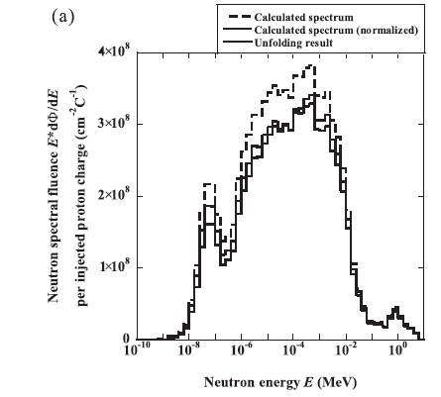
Energy range of interest: thermal to 100 keV
Spectrum of the main neutron beams for BNCT compared to the accelerator one of Ibaraki based on ⁹Be(p,n) reaction
I. Auterinen, T. Serén, K. Anttila et al.,
Int. J. Applied Radiation and Isotopes 61 (2004) 1021–1026

Slide 43
ENDF/B-VII.1
ENDF/B-VII.1:
PHYSICAL REVIEW C 73, 044603 (2006)
R-matrix analysis of Cl neutron cross sections up to 1.2 MeV
R. O. Sayer, K. H. Guber, L. C. Leal, et al.
For resonances above 500 keV, the capture widths were set to the average capture width of the resonances observed in
the capture measurements. Average ³⁵Cl capture widths were 606 MeV for s waves and 860 MeV for p waves
Only one capture measurement in resonances:
PHYSICAL REVIEW C 65, 058801 (2002)
New Maxwellian averaged neutron capture cross sections for ^{35,37}Cl
K. H. Guber, R. O. Sayer, T. E. Valentine, et al
Capture measurements performed only for ^{nat}Cl
(75% ³⁵Cl, 25% ³⁵Cl)

Slide 44
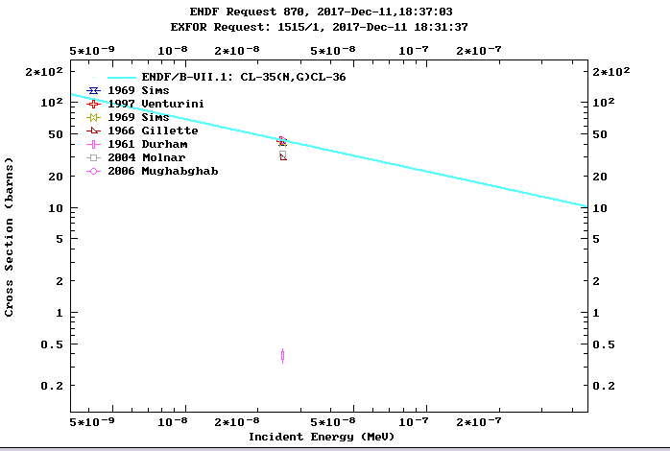
Thermal value

Slide 45
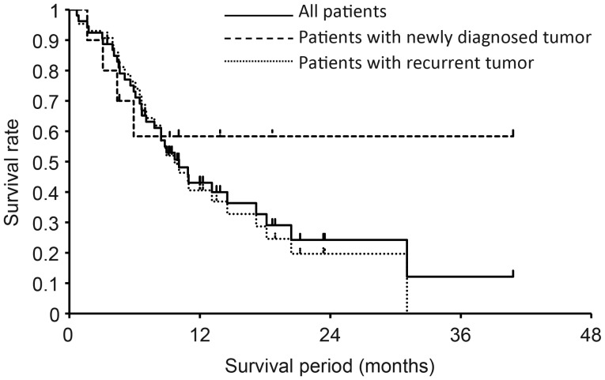
Suzuki M, Kato I, Aihara T, et al. Head & Neck tumors:
J Radiat Res. 2014 Jan; 55(1): 146–153. doi: 10.1093/jrr/rrt098
BNCT for head and neck tumors

Slide 46
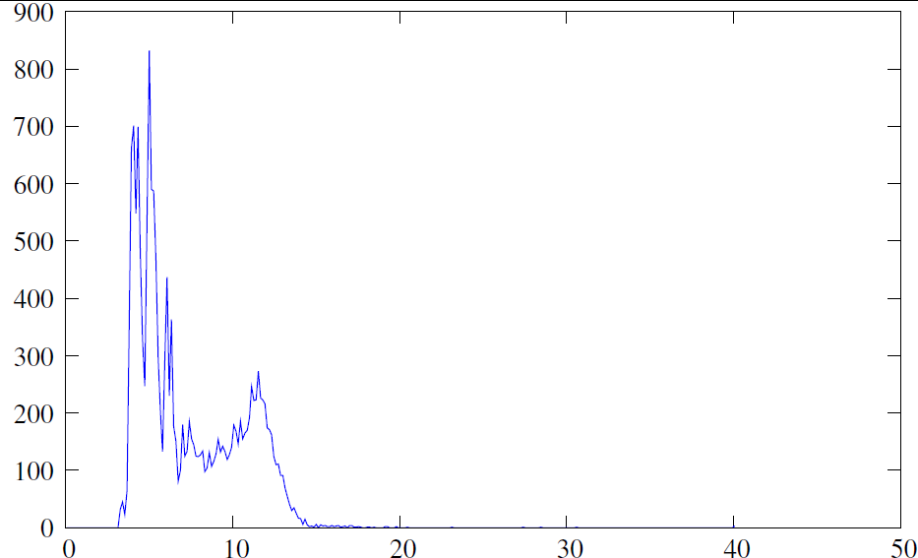
Detector response:
88Y source: γ’s of 898.0 (93.7%) and 1836 keV (99.2%)
Plot of the calibraton run, counts vs channels:
Run#200437, B6D62@900V FS 0.5V, Offset 200mV, Threshold -228
Notes:
S-36 is an indication of the s-process for light nuclei. Here I show the time integrated s-process flow in the region Si-Ca as shown by Schatz et al. The process is mostly determined by Si-28 and S-32. But also is sensitive to the interplay of S-33, Cl-36 and Ar-39 which are the main branching points in this region. In the table, I point out the important difference between the available MACS.
Reifarth et al by activation obtained the MACS of S34 that induce to thick that S34 acts as bottle-neck in this possible path for the nucleosynthesis of S36.
In any case the origin of the S36 remains an open question.

Slide 47
Detector response:
Convolution with a gaussian resolution
E(keV)
Notes:
S-36 is an indication of the s-process for light nuclei. Here I show the time integrated s-process flow in the region Si-Ca as shown by Schatz et al. The process is mostly determined by Si-28 and S-32. But also is sensitive to the interplay of S-33, Cl-36 and Ar-39 which are the main branching points in this region. In the table, I point out the important difference between the available MACS.
Reifarth et al by activation obtained the MACS of S34 that induce to thick that S34 acts as bottle-neck in this possible path for the nucleosynthesis of S36.
In any case the origin of the S36 remains an open question.

Slide 48
Detector response:
Linear transformation channel-energy of the experimental spectrum
E(keV)
Notes:
S-36 is an indication of the s-process for light nuclei. Here I show the time integrated s-process flow in the region Si-Ca as shown by Schatz et al. The process is mostly determined by Si-28 and S-32. But also is sensitive to the interplay of S-33, Cl-36 and Ar-39 which are the main branching points in this region. In the table, I point out the important difference between the available MACS.
Reifarth et al by activation obtained the MACS of S34 that induce to thick that S34 acts as bottle-neck in this possible path for the nucleosynthesis of S36.
In any case the origin of the S36 remains an open question.

Slide 49
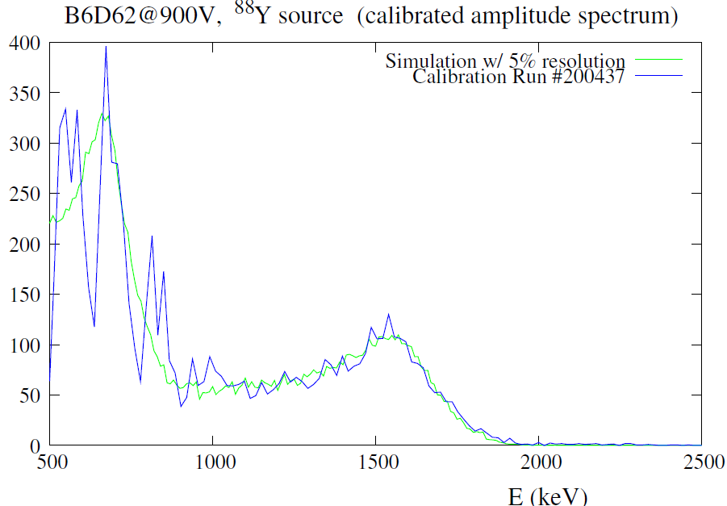
Detector response: calibration B6D6
E (keV) = a n (ch) + b a = 133.25 keV/ch b = 10 keV
Notes:
S-36 is an indication of the s-process for light nuclei. Here I show the time integrated s-process flow in the region Si-Ca as shown by Schatz et al. The process is mostly determined by Si-28 and S-32. But also is sensitive to the interplay of S-33, Cl-36 and Ar-39 which are the main branching points in this region. In the table, I point out the important difference between the available MACS.
Reifarth et al by activation obtained the MACS of S34 that induce to thick that S34 acts as bottle-neck in this possible path for the nucleosynthesis of S36.
In any case the origin of the S36 remains an open question.

Slide 50
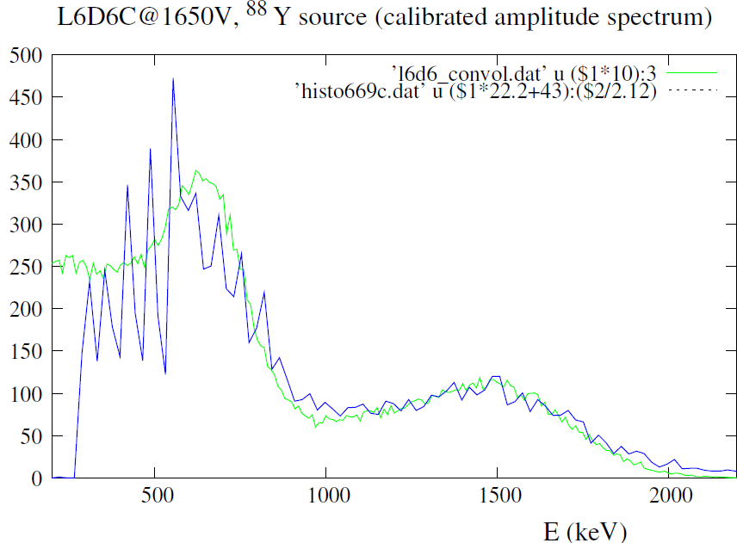

Detector response: calibration L6D6
E (keV) = a n (ch) + b a = 68.21 keV/ch b = 142 keV
Simulation w/ 10% resolution
Run #200669
Notes:
S-36 is an indication of the s-process for light nuclei. Here I show the time integrated s-process flow in the region Si-Ca as shown by Schatz et al. The process is mostly determined by Si-28 and S-32. But also is sensitive to the interplay of S-33, Cl-36 and Ar-39 which are the main branching points in this region. In the table, I point out the important difference between the available MACS.
Reifarth et al by activation obtained the MACS of S34 that induce to thick that S34 acts as bottle-neck in this possible path for the nucleosynthesis of S36.
In any case the origin of the S36 remains an open question.

Slide 51
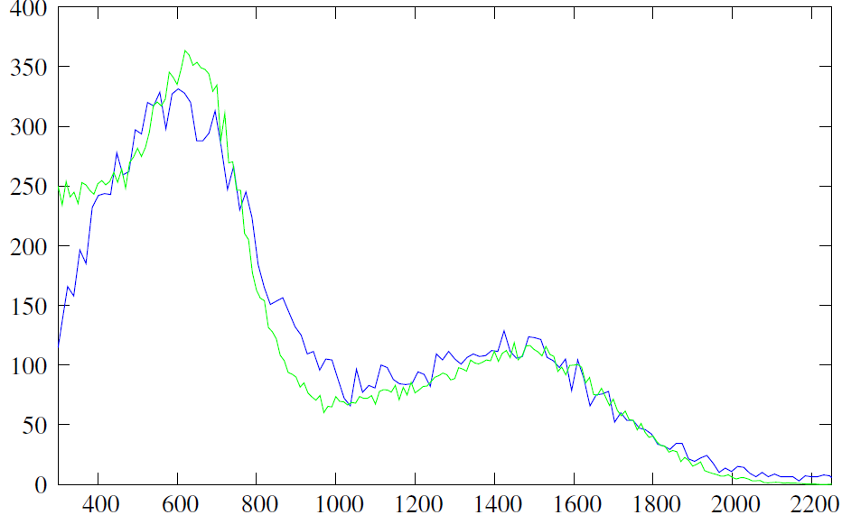
Using area instead of amplitude
Notes:
S-36 is an indication of the s-process for light nuclei. Here I show the time integrated s-process flow in the region Si-Ca as shown by Schatz et al. The process is mostly determined by Si-28 and S-32. But also is sensitive to the interplay of S-33, Cl-36 and Ar-39 which are the main branching points in this region. In the table, I point out the important difference between the available MACS.
Reifarth et al by activation obtained the MACS of S34 that induce to thick that S34 acts as bottle-neck in this possible path for the nucleosynthesis of S36.
In any case the origin of the S36 remains an open question.

Slide 52
Calibration results:
Detector | a (keV/ch) | b (keV) | Run #
B6D61@800V | 49. | 82. | 200440
B6D63@800V | 71. | 59. | 100745
B6D63@900V | 24. | 62. | 100744
L6D6B@1500V | 120. | 0. | 100741
L6D6B@1600V | 65. | 0. | 100742
L6D6C@1600V | 85. | 70. | 200440
Notes:
S-36 is an indication of the s-process for light nuclei. Here I show the time integrated s-process flow in the region Si-Ca as shown by Schatz et al. The process is mostly determined by Si-28 and S-32. But also is sensitive to the interplay of S-33, Cl-36 and Ar-39 which are the main branching points in this region. In the table, I point out the important difference between the available MACS.
Reifarth et al by activation obtained the MACS of S34 that induce to thick that S34 acts as bottle-neck in this possible path for the nucleosynthesis of S36.
In any case the origin of the S36 remains an open question.

Slide 53
Background measurements EAR-2
All measurements: Full beam in vacuum
Configuration September 2014:
Detectors: B6D62@900V, L6D6C@1600V
Positions of detectors:
Top #200465, 467-471 FS: 0.5V, Offset 200mV, Thr -228
Middle #200446-454 FS: 0.5V, Offset 200mV, Thr -228
Low #200442-444 FS: 0.5V, Offset 200mV, Thr -228
Configuration October 2014 (after shielding):
Detectors: B6D61@800V, B6D62@970V, L6D6C@1650V
Positions of detectors:
Top #200630-631 FS: 0.5V, Offset 200mV, Thr -240
Middle #200696-708 FS: 1.0V, Offset -50mV, Thr -240
Low #200626-627 FS: 0.5V, Offset 200mV, Thr -240

Slide 54
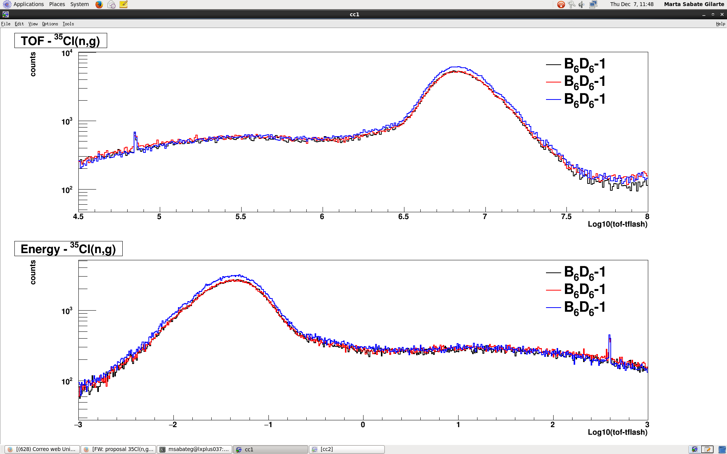
Tests EAR-2 (thans to Frank Gunsing)
54

Slide 55
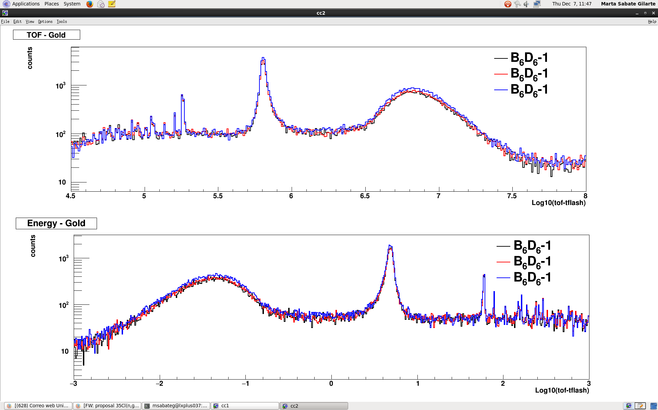
Gold for normalization
55

Slide 56
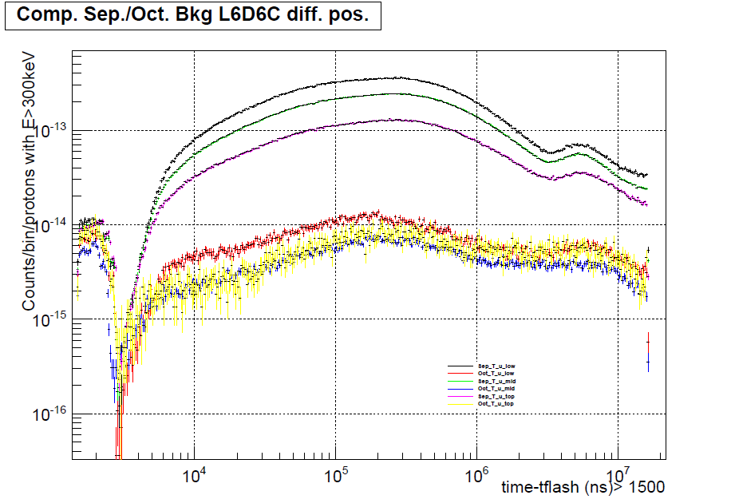
Background measurements EAR-2
56

Slide 57
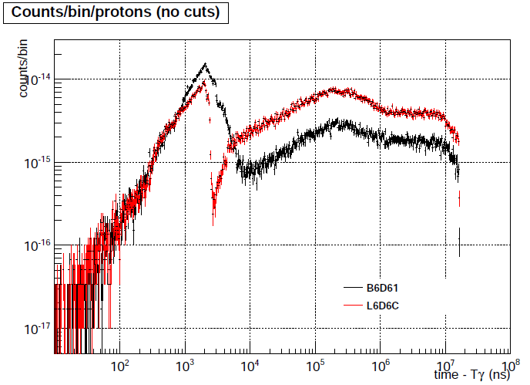
Gamma-flash recovery
57

Slide 58
Detectors2
The response detector fits well the simulations assuming an energy resolution ΔE = const E
B6D6: ΔE/E = 5%, L6D6: ΔE/E = 10%
Efficiency and recovery from γ-flash of L6D6 are superior
Notes:
58
And finally the proposal objectives and beam request: The main objective is to measure the 33S(n,α) cross section relative to the 10B(n,α) cross section by using the yet running Micromegas detector. The idea is to cover at least the astrophysics energy range of interest and to resolve the low lying resonances. We have estimated 1018 protons to have a statistical uncertainty at the peak of the lowest lying resonances better than 3%.
Nicola Colonna

Slide 59
BNCT Treatment Planning
BNCT neutron beams (1994 – 2013.07.05)
Tissue |  | Dose prescribed with photons (Gy) | Photon Isoeffective Dose of the BNCT treatment (Gy-Eq) | Target photon Isoeffective Dose BNCT treatment (Gy-Eq)
Healthy tissue | Fractionated: | 60 (30 sessions of 2 Gy) | 41.5 (21 sessions of 2 Gy) | 60 (30 sessions of 2 Gy)
 | Single-fraction: | 16 | 12.1 | 16.0
Brain tumor | Fractionated: | 60 (30 sessions of 2 Gy) | 50.5 (25 sessions of 2 Gy) | 71.0 (35 sessions of 2 Gy)
 | Single-fraction: | 41.5 | 46.7 | 61,6 (PTVdose of 50 Gy)
BNCT delivered with safe margin (12.1 Gy to healthy tissue, could receive up to 16 Gy)
A more precise dose calculation (improving all cross sections) could lead to optimize treatment time ⇒ Better therapeutic outcome and possibly survival

