Slide 1
²⁰⁵Tl(n,γ) cross section measurement at n_TOF EAR1
A. Casanovas (UPC), A.Tarifeño-Saldivia (UPC), C. Domingo-Pardo (IFIC), F. Calviño (UPC), C. Guerrero (US), J. Lerendegui-Marco (US) and the n_TOF Collaboration
¹ Universitat Politècnica de Catalunya (UPC), Barcelona, Spain
² Instituto de Fisica Corpuscular (CSIC-Universitat de Valencia), Valencia, Spain
³Universidad de Sevilla, Spain
Notes:
I would like to propose to the INTC the measurement of the 205tl neutron capture cross section at the n_TOF facility. This measurement is in collaboration with colleagues from IFIC in Valencia and the Universidad de Sevilla

Slide 2
Outline of the presentation
Introduction and motivations
  s-process nucleosynthesis at the heaviest isotopes
  The astrophysical importance of the ²⁰⁵Tl(n,γ) reaction rate
  Current status of the ²⁰⁵Tl(n,γ) data
  Nucleosynthesis calculations
Experimental setup, counting rate estimation and beam time request
Notes:
Im going to start by describing the last elements produced by s-process nucleosynthesis
Then I will go more into detail with the importance tl and pb isotopes and the importance of the Tl5 reaction rate
In the second part I will describe the experimental setup for the measurement, showing the counting rate estiamtion we’ve made and based on that our beam time request

Slide 3
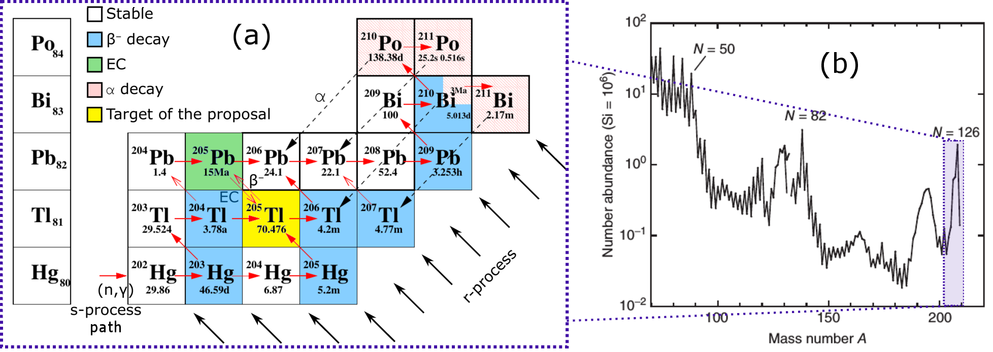
Overview of ths s-process at 203<A<210
Thallium, and especially, lead isotopes, are mainly produced by the s-process
The third s-process peak: abundance peak around double magic ²⁰⁸Pb
Accurate model of the s-process should describe faithfully the third peak
requires best nuclear data (beta decay rates & capture rates) available
Notes:
If we look at the solar elemental abundances, we see a very prominent peak a the mass range 203<2010
If we look at the nuclide chart/table of isotopes in the mass region over 200 during s-process, we know that tl lead and bi are the last elements produced….
CS is very low for lead and bi isotopes due to proximity to a double Shell clousure pb208, and this leads to a very pronounced overabundance of this elements

Slide 4
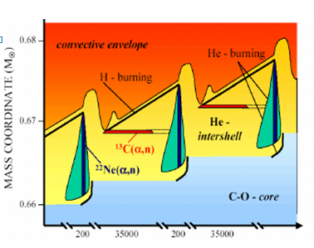
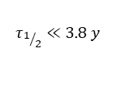
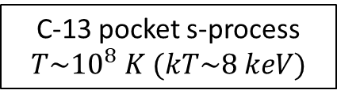
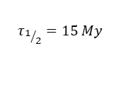
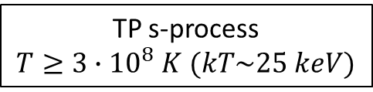
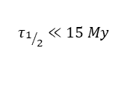
The ²⁰⁵Pb-²⁰⁵Tl decay system
²⁰⁵Tl is the most abundant (71%) stable (at earth) thallium isotope (Z=81)
Already measured at n_TOF(C. Domingo-Pardo et al.,
Phys. Rev. C 75, 015806 (2007))
After s-process
s-only
 | ²⁰⁴Pb | ²⁰⁵Pb | ²⁰⁶Pb
 | ²⁰³Tl | ²⁰⁴Tl | ²⁰⁵Tl | ²⁰⁶Tl
(n,γ)
(n,γ)
C-13 pocket s-process
$$T\sim {10}^{8} K (kT\sim 8 keV)$$
$$τ_{1/2}≪15 My$$
β⁻
$$τ_{1/2}=15 My$$
β⁻
EC
s-process flow
TP s-process
$T≥3∙{10}^{8} K$ $(kT\sim 25 keV)$
(n,γ)
(n,γ)
(n,γ)
$$τ_{1/2}≪3.8 y$$
Already measured at n_TOF (A. Casanovas Ph.D. thesis, 2018)
The ²⁰⁵Pb/²⁰⁴Pb ratio could be used as a “chronometer” of the s-process^{1,2,3}
  Time elapsed since the last injection of main s-process products into the pre-solar nebula
AGB (red giant) time evolution
Stellar effects on ²⁰⁵Pb: at s-process sites temperature, EC decay is so strongly enhanced that its survival is compromised
Activation of the bound state β decay of ²⁰⁵Tl
1. K. Yokoi et al., The production and survival of Pb-205 in stars, and the ²⁰⁵Pb/²⁰⁵Tl s-process chronometry, Astronomy and Astrophysics 145, 339-346 (1985)
2. R.G.A. Baker et al. , The thallium isotope composition of carbonaceous chondrites — New evidence for live ²⁰⁵Pb in the early solar system, Earth and Plan. Sc. Lett (2010)
3. Mowlavi, N., Goriely, S., Arnould, M., The survival of ²⁰⁵Pb in intermediate-mass AGB stars, Astron. Astrophys. 330, 206–214 (1998)
Notes:
One of the main points of interest of this región is that 204Pb and 205Pb are s-only […] , and on top of that, Pb5 is radiaoctive blablá
But there is a problem… during the first stage of s-process nucleosynthesis, where neutrons are released through the reaction c13na
However, during the second stage, during the recurrent TP, T rises due to flash He burning, and neutrons are released… The high T activates the decay…
A part from that, it is worth mentioning that most reactions affecting the Pb5 abundance have already been measured

Slide 5
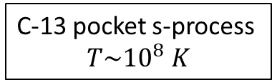
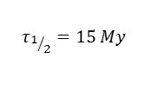
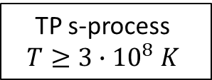
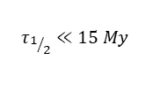
Main ideas
²⁰⁵Tl is the most abundant (71%) stable (at earth) thallium isotope (Z=81)
Already measured at n_TOF(C. Domingo-Pardo et al.,
Phys. Rev. C 75, 015806 (2007))
s-only
 | ²⁰⁴Pb | ²⁰⁵Pb | ²⁰⁶Pb
 | ²⁰³Tl | ²⁰⁴Tl | ²⁰⁵Tl | ²⁰⁶Tl
C-13 pocket s-process
$$T\sim {10}^{8} K$$
(n,γ)
(n,γ)
$$τ_{1/2}≪15 My$$
$$τ_{1/2}=15 My$$
The ²⁰⁵Pb/²⁰⁴Pb ratio has the potential to be used as a “chronometer” of the s-process
β⁻
EC
β⁻
TP s-process
$$T≥3∙{10}^{8} K$$
s-process flow
(n,γ)
(n,γ)
(n,γ)
$$τ_{1/2}≪3.8 y$$
After s-process
Already measured at n_TOF (A. Casanovas Ph.D. thesis, 2018)
The ²⁰⁵Tl(n,γ) capture reaction, by affecting the abundance of ²⁰⁵Tl, could play a relevant role in the final abundance (and survival) of ²⁰⁵Pb
Stellar effects on ²⁰⁵Pb: at s-process sites temperature, EC decay is so strongly enhanced that its survival is compromised
AGB (red giant) time evolution
Activation of the bound state β decay of ²⁰⁵Tl
The ²⁰⁵Pb/²⁰⁴Pb ratio could be used as a “chronometer” of the s-process^{1,2,3}
  Time elapsed since the last injection of main s-process products into the pre-solar nebula
1. K. Yokoi et al., The production and survival of Pb-205 in stars, and the ²⁰⁵Pb/²⁰⁵Tl s-process chronometry, Astronomy and Astrophysics 145, 339-346 (1985)
2. R.G.A. Baker et al. , The thallium isotope composition of carbonaceous chondrites — New evidence for live ²⁰⁵Pb in the early solar system, Earth and Plan. Sc. Lett (2010)
3. Mowlavi, N., Goriely, S., Arnould, M., The survival of ²⁰⁵Pb in intermediate-mass AGB stars, Astron. Astrophys. 330, 206–214 (1998)
Notes:
Now I’ll will focus on the tl and pb isotopes, and describe the nucleosynthesis process over time in this region. […] During h-Shell burning in AGB stars, neutrons are produced by the reaction c13 blablá
This decay process bounds the 205Pb abundance to the 205Tl abundance

Slide 6
Main ideas
The ²⁰⁵Pb/²⁰⁴Pb ratio has the potential to be used as a “chronometer” of the s-process
The ²⁰⁵Tl(n,γ) capture reaction, by affecting the abundance of ²⁰⁵Tl, could play a relevant role in the final abundance (and possibly survival) of ²⁰⁵Pb

Slide 7
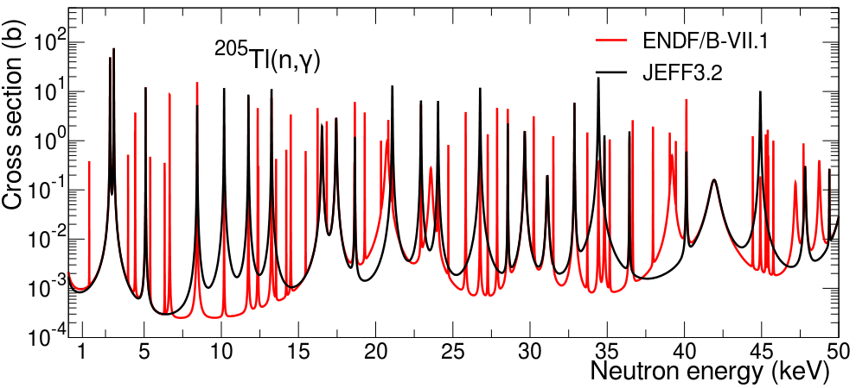
Status of the data for ²⁰⁵Tl(n,γ) : cross section
Only one previous measurement: R. L. Macklin and R. R. Winters, Stellar neutron capture in the thallium isotopes, Astrophys. J. 208, 812 (1976)
  Experimental capture cross section or resonance parameters never published
  Related EXFOR data: only resonance kernels, no uncertainties
  Explicit correction factor for systematic error at ORNL: not known (0.95 for ²⁰³Tl)
Most recent evaluations show important discrepancies:
Notes:
Issues , not problems

Slide 8
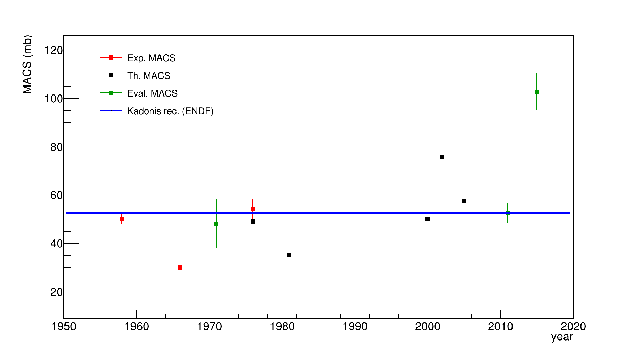
Status of the data for ²⁰⁵Tl(n,γ): MACS
MACS at 30 keV comparison:
  Kadonis reference value: 52.6 ± 3.9 mb (ENDF evaluation)
  Examination of ENDF data suggests it is based on 1976 ORNL measurement
  No direct uncertainty assessment in the whole energy range (8 keV to 50 keV)
²⁰⁵Tl(n,γ)
JEFF 3.2 (!)
MACS range variation over reference (±33%)
Macklin&Winters (1976)
±33%
Activation measurements
ENDF/B-VII.1
Estimation of the uncertainty in the accuracy of the MACS
Notes:
We selected this range as rapresentative of the uncertainty in the accuracy of the macs

Slide 9

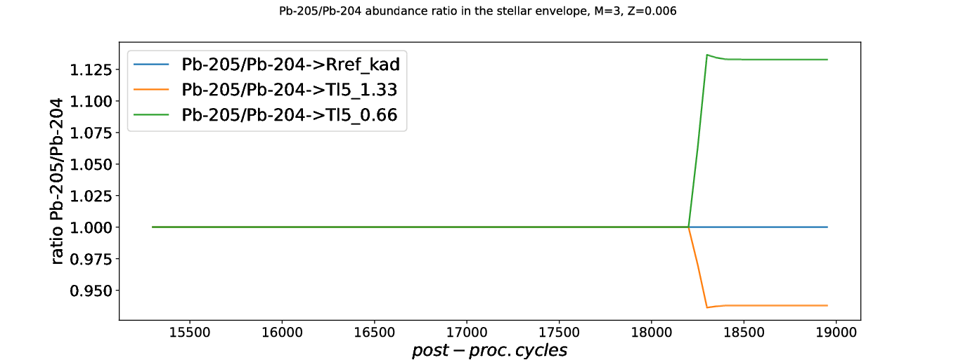
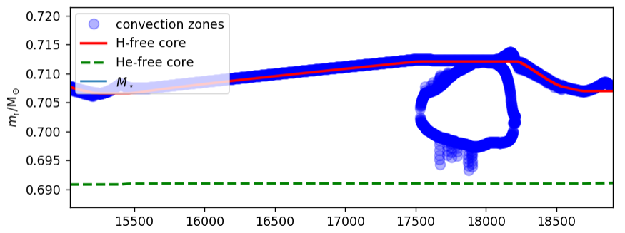
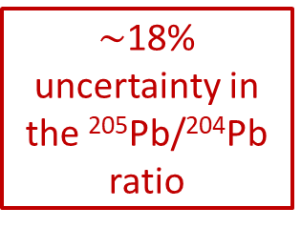
²⁰⁵Tl(n,γ) impact: Nucleosynthesis calculations
Post-processing calculation employing MSun = 3, Z=0.006 (half solar) star model from NuGrid set 1 ext. (C. Ritter et al. 2017¹)
Reference Kadonis ²⁰⁵Tl(n,γ) MACS has been varied ±33% in this simulations
²⁰⁵Pb/²⁰⁴Pb abundance ratio in the stellar envelope (normalized to the ref. rate)
$\sim$18% uncertainty in the ²⁰⁵Pb/²⁰⁴Pb ratio
[1] NuGrid Stellar Data Set. II. Stellar Yields from H to Bi for Stellar Models with Mzams = 1 to 25Msun and Z = 0.0001 to 0.02, C. Ritter, F. Herwig, S. Jones, M. Pignatari, C. Fryer, R. Hirschi, , ArXiv e-prints, arXiv:1709.0867
Notes:
To see how the uncertainties in the nuclear data affects the production of 205Pb…
We are plotting the ratio of abundances in the envelope, because there T is much lower and pb could survive blabla

Slide 10
Main points
From the current status of the data a ±33% uncertainty in the value of the 205Tl(n,γ) is assumed
This leads to an approx. 18% global uncertainty in the ²⁰⁵Pb/²⁰⁴Pb ratio only due to this reaction
Goal: increase precision and accuracy of ²⁰⁵Tl(n,γ) to reduce the uncertainty in the ²⁰⁵Pb/²⁰⁴Pb ratio
Notes:
So, to reduce this uncertainty we propose to measure this reaction

Slide 11
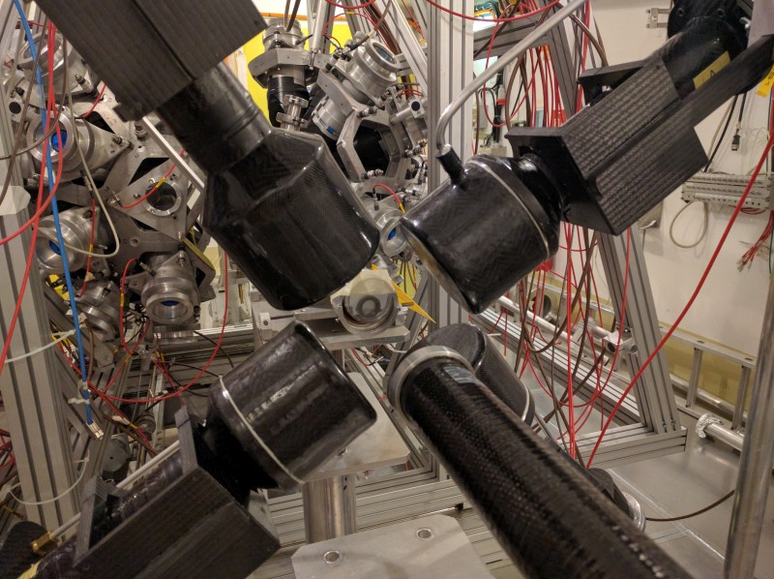
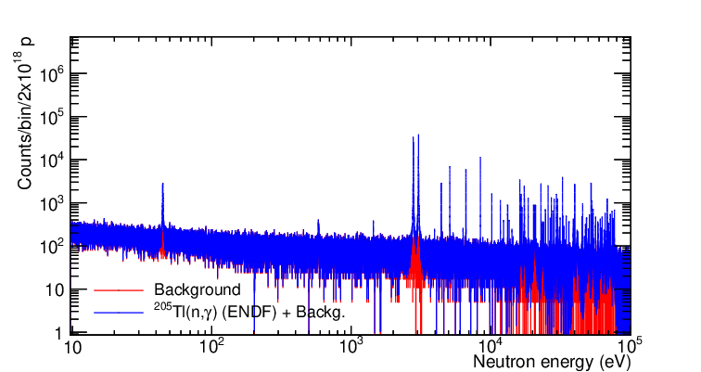
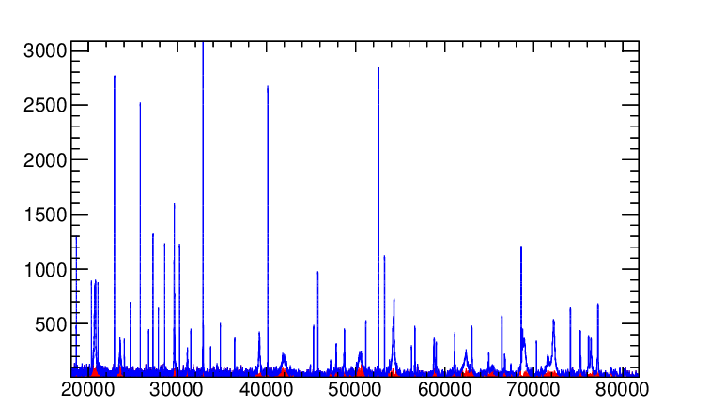
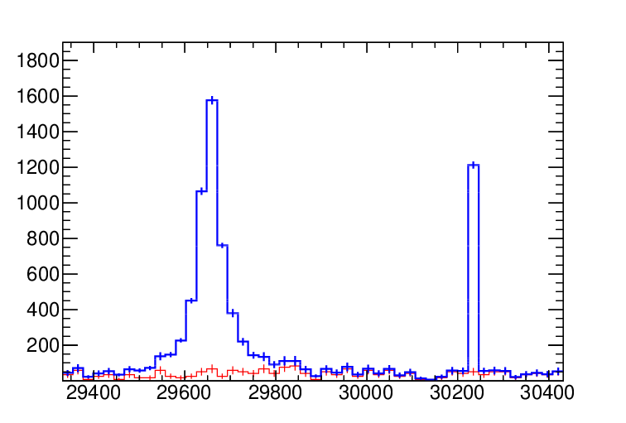

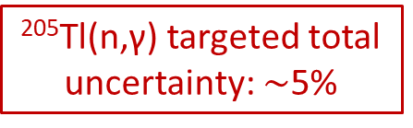

Experimental set-up and counting rate estimation
4 C₆D₆ detectors in n_TOF EAR1
  Best energy resolution at the astrophysical energy range (1-100 keV range)
Sample: 4 g of 99% pure ²⁰⁵Tl oxide (to be acquired). Size: 30 mm D., 1 mm thick.
$2×{10}^{18}$ protons to achieve a 2.5% statistical uncertainty at the 30 keV ²⁰⁵Tl predicted resonances
²⁰⁵Tl(n,γ) targeted total uncertainty: $\sim$5%

Slide 12
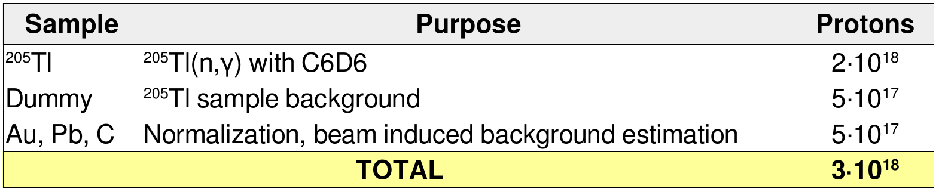
Summary of requested beam time

Slide 13
Final remarks
The examination of the literature and databases shows that the cross section for the ²⁰⁵Tl(n,γ)²⁰⁶Tl reaction in the regions of astrophysical interest remains still uncertain (33% assumed uncertainty in the MACS value).
The measurement proposed for EAR1 would improve the accuracy and precision of the ²⁰⁵Tl(n,γ) cross section in the astrophysical energy range (1-100 keV, 5% goal of total uncertainty).
The new CS will lead to an improvement of the ²⁰⁵Pb/²⁰⁴Pb ratio estimation (with the targeted CS uncertainty, down to 2.5%)
It will, as well, contribute to a complete and reliable interpretation of the branching pattern around ²⁰⁴Tl (whose capture cross-section results we expect to publish this year), important for the study of the third s-process lead isotopes peak

Slide 14
Thank you for your attention.

Slide 15
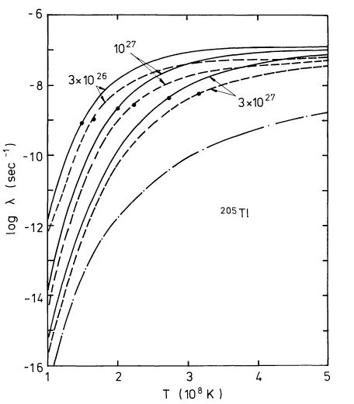
²⁰⁵Tl decay vs ²⁰⁵Pb decay

Slide 16
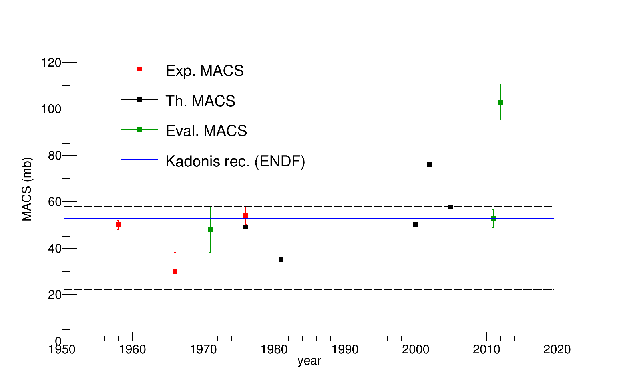
²⁰⁵Tl(n,γ) MACS: -40% to +5%
JEFF 3.2 (!)
MACS range variation over reference
Macklin&Winters (1976)
ENDF/B-VII.1
Activation measurements

Slide 17
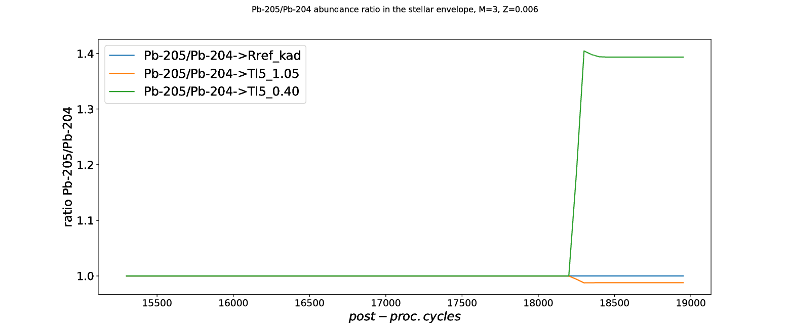
²⁰⁵Tl(n,γ) MACS: -40% to +5%
²⁰⁵Pb/²⁰⁴Pb abundance ratio in the stellar envelope (normalized to the ref. rate)

Slide 18

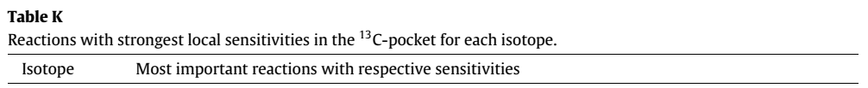
Sensibility study from A. Koloczek et al. (2016)
Atomic Data and Nuclear Data Tables 108 (2016) 1–14
Sensitivity:

Slide 19
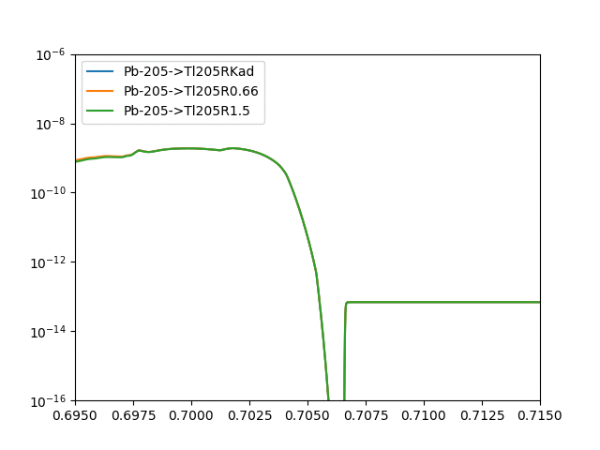


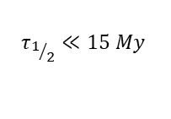
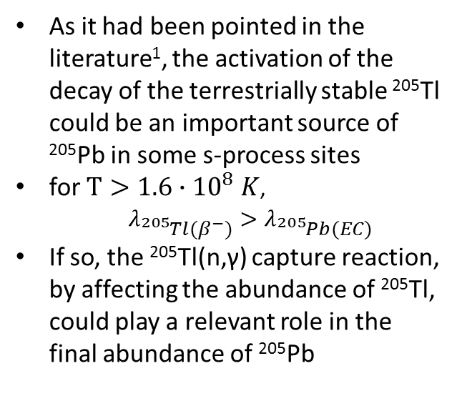
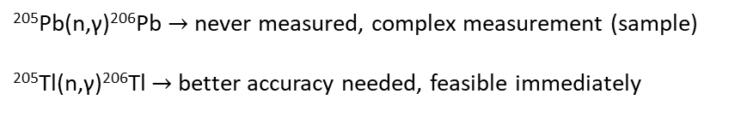
The role of the ²⁰⁵Tl(n,γ) rate in the ²⁰⁵Pb abundance
²⁰⁵Pb problem: at s-process sites temperature, EC decay is so strongly enhanced that its survival is compromised
As it had been pointed in the literature¹, the activation of the decay of the terrestrially stable ²⁰⁵Tl could be an important source of ²⁰⁵Pb in some s-process sites
for $T>1.6∙{10}^{8} K$,
$λ_{{}_{}^{205}{Tl}(β^{−})}>λ_{{}_{}^{205}{Pb}(EC)}$
If so, the ²⁰⁵Tl(n,γ) capture reaction, by affecting the abundance of ²⁰⁵Tl, could play a relevant role in the final abundance of ²⁰⁵Pb
C-13 pocket
~23% uncertainty
Mass fraction
He fusion flash
(TP, convective)
Envelope
(convective)
He Intershell
²⁰⁴Pb | ²⁰⁵Pb | ²⁰⁶Pb
²⁰³Tl | ²⁰⁴Tl | ²⁰⁵Tl | ²⁰⁶Tl
Mass coordinate m_{r} $(M_{⊙})$
(n,γ)
(n,γ)
$$τ_{1/2}≪15 My$$
β⁻
EC
²⁰⁵Pb(n,γ)²⁰⁶Pb $→$ never measured, complex measurement (sample)
²⁰⁵Tl(n,γ)²⁰⁶Tl $→$ better accuracy needed, feasible immediately
(n,γ)
(n,γ)
(n,γ)
[1] Yokoi et al. (Astron. Astrophys. 145 (339),1985*)
Proposal for n_TOF for next year

Slide 20
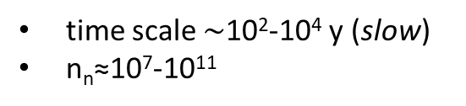
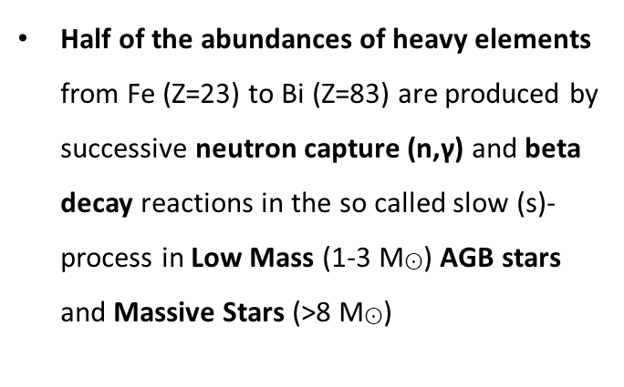
Nuclear data for astrophysics: s-process
...
Half of the abundances of heavy elements from Fe (Z=23) to Bi (Z=83) are produced by successive neutron capture (n,γ) and beta decay reactions in the so called slow (s)-process in Low Mass (1-3 M$⊙$) AGB stars and Massive Stars (>8 M$⊙$)
Y
To ²⁰⁹Bi
Sr
Rb
Kr
Br
Se
As
Ge
Ga
Zn
(n,γ)
time scale $\sim$10²-10⁴ y (slow)
n_{n}≈10⁷-10¹¹
Cu
(β⁻)
(β⁺)
Fe

Slide 21
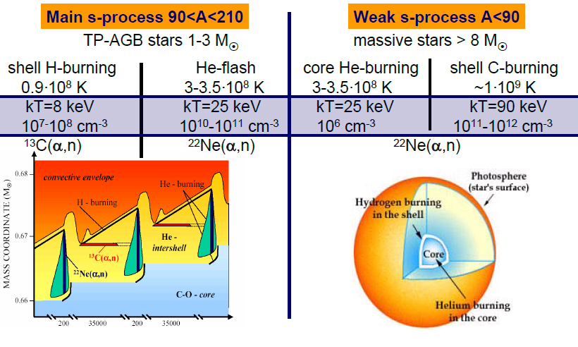
s-process in stars

Slide 22
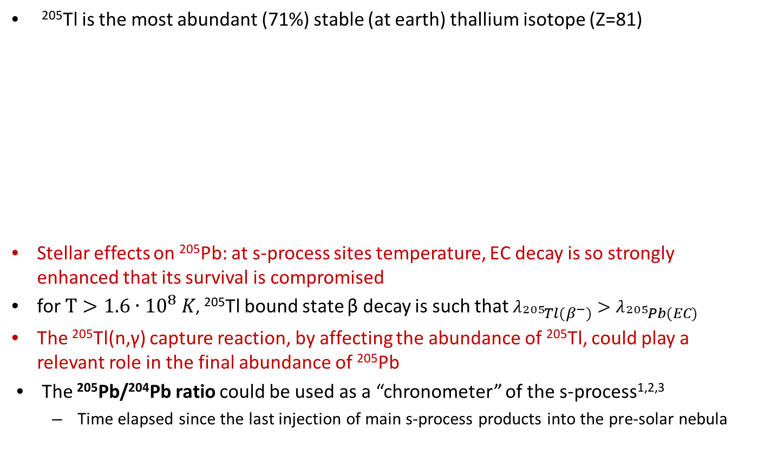
The ²⁰⁵Pb-²⁰⁵Tl decay system
²⁰⁵Tl is the most abundant (71%) stable (at earth) thallium isotope (Z=81)
Stellar effects on ²⁰⁵Pb: at s-process sites temperature, EC decay is so strongly enhanced that its survival is compromised
for $T>1.6∙{10}^{8} K$, ²⁰⁵Tl bound state β decay is such that $λ_{{}_{}^{205}{Tl}(β^{−})}>λ_{{}_{}^{205}{Pb}(EC)}$
The ²⁰⁵Tl(n,γ) capture reaction, by affecting the abundance of ²⁰⁵Tl, could play a relevant role in the final abundance of ²⁰⁵Pb
The ²⁰⁵Pb/²⁰⁴Pb ratio could be used as a “chronometer” of the s-process^{1,2,3}
  Time elapsed since the last injection of main s-process products into the pre-solar nebula
Already measured at n_TOF(C. Domingo-Pardo et al.,
Phys. Rev. C 75, 015806 (2007))
s-only
 | ²⁰⁴Pb | ²⁰⁵Pb | ²⁰⁶Pb
 | ²⁰³Tl | ²⁰⁴Tl | ²⁰⁵Tl | ²⁰⁶Tl
C-13 pocket s-process
$$T\sim {10}^{8} K$$
(n,γ)
(n,γ)
$$τ_{1/2}≪15 My$$
β⁻
$$τ_{1/2}=15 My$$
β⁻
TP s-process
$$T≥3∙{10}^{8} K$$
EC
s-process flow
(n,γ)
(n,γ)
(n,γ)
After s-process
Already measured at n_TOF (A. Casanovas Ph.D. thesis, 2018)
1. K. Yokoi et al., The production and survival of Pb-205 in stars, and the ²⁰⁵Pb/²⁰⁵Tl s-process chronometry, Astronomy and Astrophysics 145, 339-346 (1985)
2. R.G.A. Baker et al. , The thallium isotope composition of carbonaceous chondrites — New evidence for live ²⁰⁵Pb in the early solar system, Earth and Plan. Sc. Lett (2010)
3. Mowlavi, N., Goriely, S., Arnould, M., The survival of ²⁰⁵Pb in intermediate-mass AGB stars, Astron. Astrophys. 330, 206–214 (1998)

Slide 23
The ²⁰⁵Pb-²⁰⁵Tl decay system
²⁰⁵Tl is the most abundant (71%) stable (at earth) thallium isotope (Z=81)
Already measured at n_TOF(C. Domingo-Pardo et al.,
Phys. Rev. C 75, 015806 (2007))
s-only
 | ²⁰⁴Pb | ²⁰⁵Pb | ²⁰⁶Pb
 | ²⁰³Tl | ²⁰⁴Tl | ²⁰⁵Tl | ²⁰⁶Tl
C-13 pocket s-process
$$T\sim {10}^{8} K$$
(n,γ)
(n,γ)
$$τ_{1/2}≪15 My$$
β⁻
$$τ_{1/2}=15 My$$
β⁻
TP s-process
$$T≥3∙{10}^{8} K$$
EC
s-process flow
(n,γ)
(n,γ)
(n,γ)
$$τ_{1/2}≪3.8 y$$
After s-process
Already measured at n_TOF (A. Casanovas Ph.D. thesis, 2018)
Stellar effects on ²⁰⁵Pb: at s-process sites temperature, EC decay is so strongly enhanced that its survival is compromised
AGB (red giant) time evolution
Activation of the bound state β decay of ²⁰⁵Tl
The ²⁰⁵Pb/²⁰⁴Pb ratio could be used as a “chronometer” of the s-process^{1,2,3}
  Time elapsed since the last injection of main s-process products into the pre-solar nebula
1. K. Yokoi et al., The production and survival of Pb-205 in stars, and the ²⁰⁵Pb/²⁰⁵Tl s-process chronometry, Astronomy and Astrophysics 145, 339-346 (1985)
2. R.G.A. Baker et al. , The thallium isotope composition of carbonaceous chondrites — New evidence for live ²⁰⁵Pb in the early solar system, Earth and Plan. Sc. Lett (2010)
3. Mowlavi, N., Goriely, S., Arnould, M., The survival of ²⁰⁵Pb in intermediate-mass AGB stars, Astron. Astrophys. 330, 206–214 (1998)
Notes:
Now I’ll will focus on the tl and pb isotopes, and describe the nucleosynthesis process over time in this region. […] This is a schematic view of the structure on an AGB star (red giant phase of a low/intermediate mass star) where s-process nucleosynthesis takes place
During h-Shell burning in AGB stars, neutrons are produced/released by the reaction c13 blablá
This decay process bounds the 205Pb abundance to the 205Tl abundance

