Slide 2
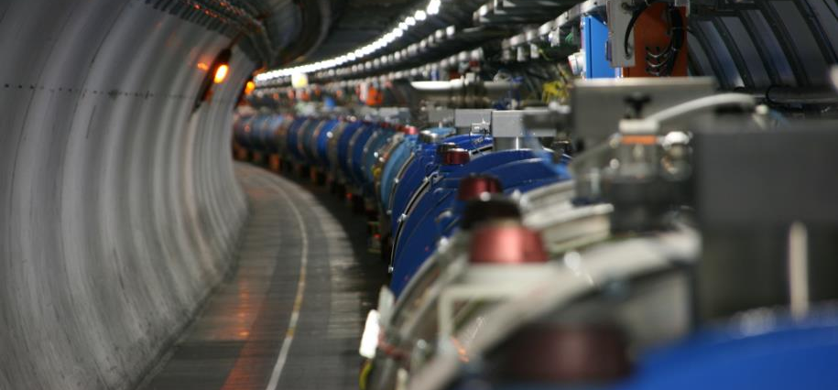
Re-commissioning of the superconducting circuits
Mirko Pojer and Matteo Solfaroli
Beams Department
Operation Group

Slide 3
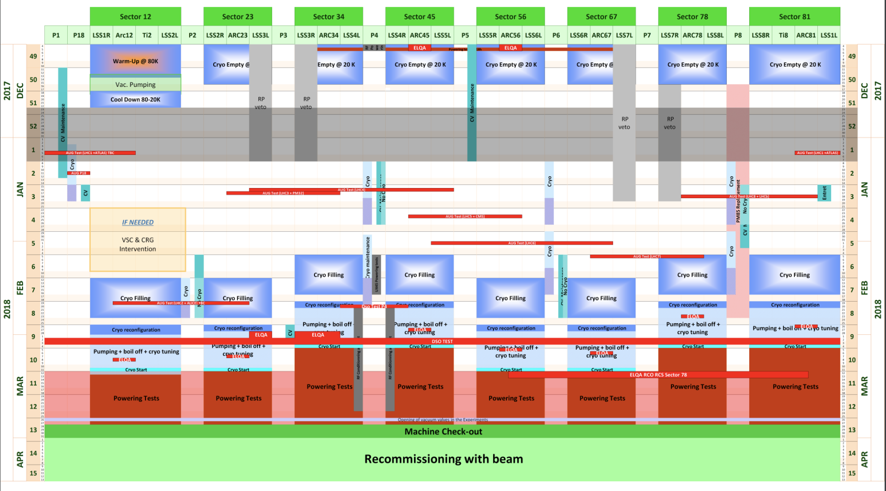
YETS 2017-2018: new baseline V4

Slide 4
Re-commissioning of the S/C circuits
The re-commissioning of the superconducting circuits will be a repetition of 16/17 YETS campaign, without additional tests for S12
Solid baseline for ‘each’ YETS established since 2 years
Cryogenics qualification and readiness
We count on a very good availability
ElQA tests
In the baseline for the Main circuits + DSLC
Preparation of the circuits
Removal of grounding and unlocking of PCs
QHPS and QPS activation
Check of cable water cooling interlocks
Extensive powering test campaign
UPS tests are not in the baseline (will be performed only after LSs)

Slide 5
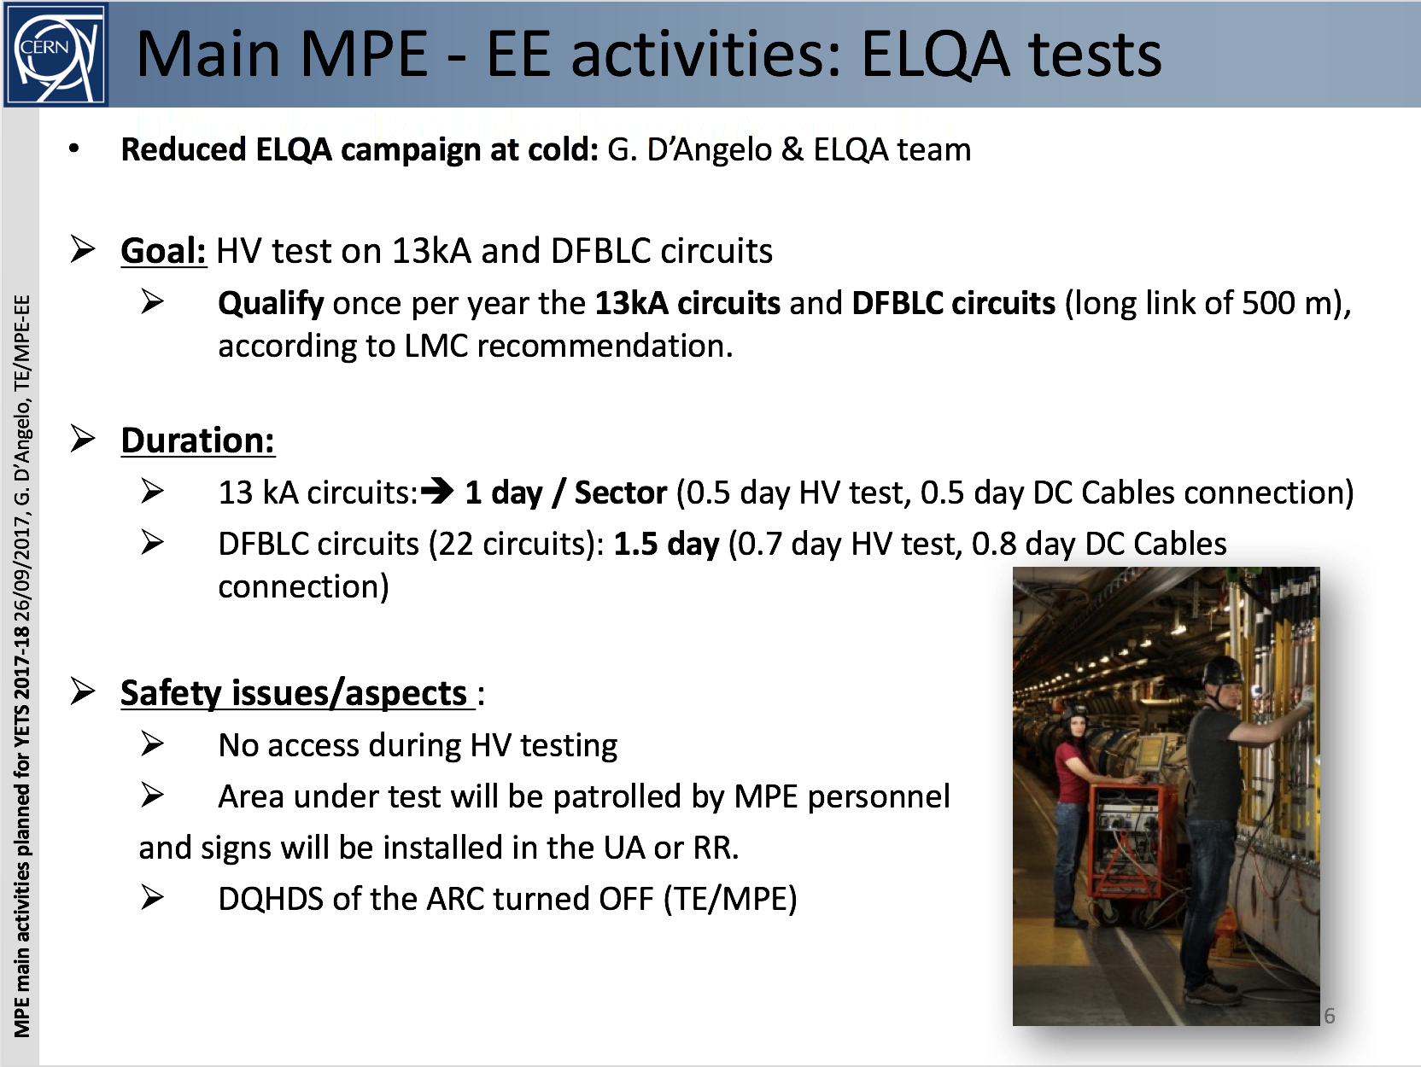
ElQA tests
What about S12?
Who is going to check the T excursions?

Slide 6
Tests to perform
60A
All tests
80-120A
PIC2
PNO.d1
600A
PIC2
PLI3.b1-SOF
PNO.d3
PNO.a3
IPQs
PIC2
PNO.a7
IPDs
PIC2
PNO.a8
ITs
PIC2
PNO.a9
RQs
PIC2
EE from 760A, 2 and 6 kA?
PNO.b3 (4h)
RBs
PIC2
EE from 760A, 2 and 6 kA?
PNO.b2 (4h)
2253
80
16
560
280
40
8
2035
96
200
48
407
16
407
48
390
24
78
8
7000 tests to be performed

Slide 7
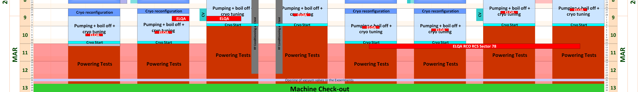
Powering tests after EYETS
When?
Early debugging during w.9, if possible
Powering from March 5 to 27
Who? (Proposal)
OP: 2 shifts a day on w.10, 3 shifts later (nights will be cancelled if not needed)
MP3: 2 shifts a day from w.10 (1 shift during w-e)
EPC and PIC on call
MPE piquet as in operation
MPE-software in CCC during normal working hours the first week, on call later
What do we need?
Nominal cryogenic conditions
No condemnation on all circuits
PIC and QPS fully operational (quench heaters charged)
Technical services (EL, CV, VAC) as in operation everywhere
Controls in their operational status (software or hardware upgrades fully qualified)
Patrols everywhere
No access during the powering tests!!!

Slide 8
MPE interventions
QPS
Primarily preventive maintenance activities and few type tests during powering: PROJOINT, didt sensors
Interlock tests for all circuits with QDS (focus on main circuits); includes mapping of the QPS interlock loop cabling (LS2 preparation)
Verification of device parameters especially for IPQ and 600 A
Deployment of next generation remote reset units in a few places + additional spares
EE
Preventive maintenance of 600A and 13kA EE systems
pin replacement campaign to mitigate events on BCM of RQD.A12
Inspection of 30 600A systems with increased number of closing failures
Installation of new measurement + FPA boards in all 13 kA systems
Full functional validation at 0A, then cycles and EE to 760A, 6kA and nominal
See slide later
Part of the QPS-IST: all ready by the date of powering!
PLI3.b1-SOF
Already in the baseline

Slide 9
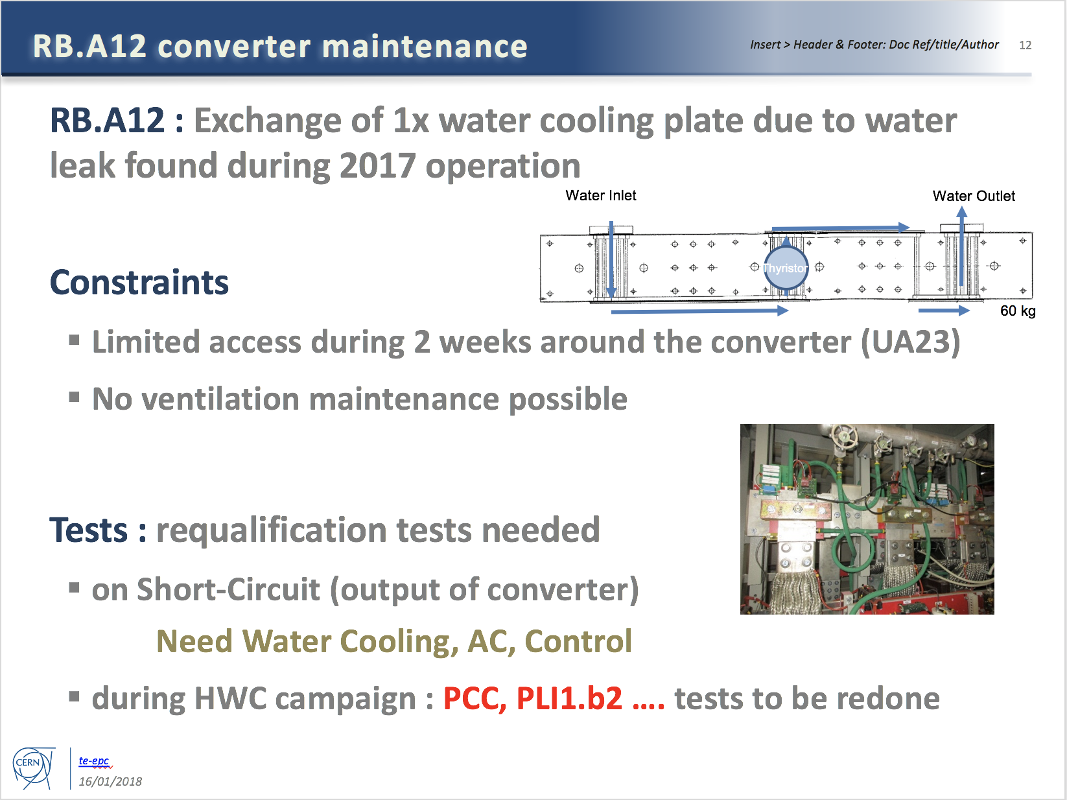
Additional intervention by EPC
Only PCC to be added to the list of tests for RB.A12

Slide 10
LHC main converter calibration
I would like to ask you to foresee a window of about half a day during hardware commissioning for the calibration of all the LHC main dipole and quadrupole and inner triplet converters.
This can also be done per sector in which case I would require about ½ hour per sector.
This is done by me remotely in coordination with the engineer in charge. It requires the converters to be unlock and OFF, with all faults cleared.
The calibration simulates a current of 13kA in the converter so any interlocks that might trip the converter at that current need to be masked. I will let you evaluate when is the best moment to do it, minimizing the impact on commissioning.
Miguel
To be organized at the end of the commissioning!

Slide 11
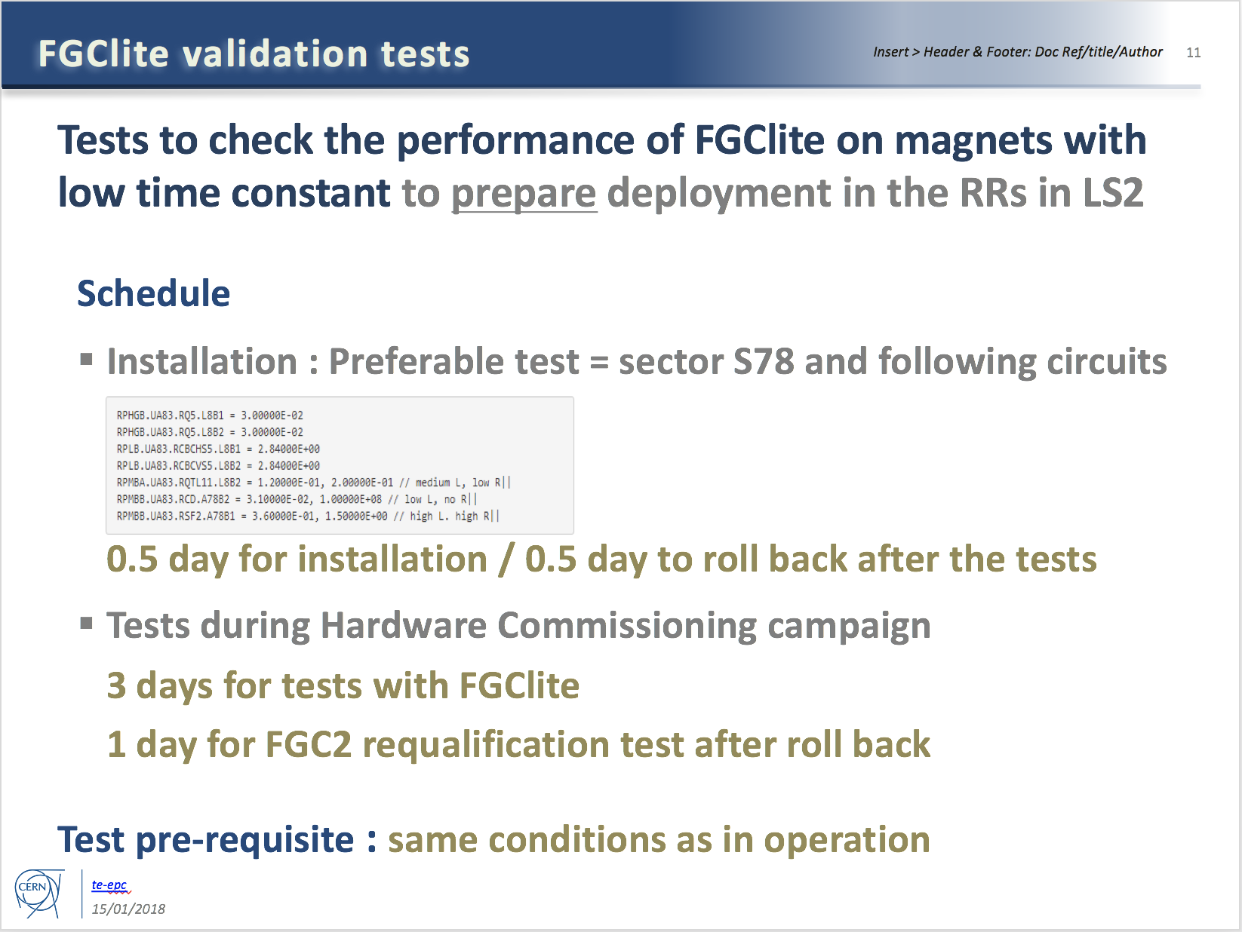
Additional tests required by EPC
To be done after circuit commissioning (if time allows)

Slide 12
Specific Powering Tests – High Priority
# | Description | Test duration * | Period | Cryo
1 | Local (30 m) localisation of shorts in RCS.A78B2, RCO.A78B1, RCO.A78B2 | 2 days | End of the powering tests. | 1.9 K
2 | Global (400 m) localisation of short in RCO.A45B1 | 1 day | Start YETS (DONE) | 1.9 K
3 | Change in EE delay of RB circuits | 0.5 day | During powering tests | 1.9 K
4a | Voltage pick-up of the QPS due to current in the bypass diode | 2 days | Anytime during YETS | <20 K
4b | Heater-induced quench on 2 MB’s | 0.5 day | Start YETS (DONE) | 1.9 K
5 | Quench heaters test in S12 | 0.5 day | End of YETS, during the QPS IST | 1.9 K
6 | Resistance in RQF.A23 and RQD.A78 | 1 day | End of powering tests | 1.9 K
*: not including the time for installation & removal of equipment

Slide 13
Specific Powering Tests – Medium Priority
# | Description | Test duration * | Period | Cryo
7 | Change in EE delay of RQD/F circuits | 0.5 day | During powering tests | 1.9 K
8 | Resistance in ROD.A56B1 | 1 day | Start of YETS (DONE) | 1.9 K
9 | Internal resistance of 3-6 MB’s | 1 day | Start of YETS or during powering tests | 1.9 K
10 | Investigate degradation of RCBXH/V in IR1/5 | 0.5 day | Start of YETS (DONE) | 1.9 K
Results of investigations priori to YETS:
Short could not be reproduced in RCO.A45B1 (only few 100kOhms occasionally visible)
2 heater induced quenches performed in S45
Location of increased resistance in ROD identified, segment in question to be bypassed in LS2
None of the 12 RCBXH/V circuits showed any visible degradation after having been cycled many times and after having seen quite a bit of radiation. Final conclusions will be made after the powering test in March 2018.
*: not including the time for installation & removal of equipment

Slide 14
New didt sensors to be tested
First of all, the tests that I’d like to perform are part of the quench detection consolidation for the IPQ magnets (symmetric quench detector).
The idea is to test our current derivative (or didt) sensor on the IPQ magnet circuit (as quench detector).
The sensor should be mounted around the cable as you can see in the figures below (SM18 installation).
https://wikis.cern.ch/display/MPEEP/6+kA+didt+quench+detector
The installation of the sensor is not invasive (the sensor measures the magnetic flux variation of the cable), and the weight is about 1 kg (the cooling pipe will not be stressed, we have experience from SM18).
We already gave a look in UA27…a possible candidate could be the RQ5, the sensor should be installed on the top of the power converter, top cable (look the photo below).
Ernesto de Matteis

Slide 15
Conical connection check in UA27
Following the problem with the conical connection after LS1, MPE would like to repeat the conical connection measurements in UA27
System installed before end of YETS
Measurements parasitically done
System to be removed at the end of commissioning (condemnation required)

Slide 16
PIC
Pour le PIC, seulement les firmware PLC vont être changé cette année mais cela ne nécessitera pas de test supplémentaire particulier (aucune fonctionnalité n’est ajoutée ni modifiée). Pour le FMCM, peut-être que une unité sera remplacée par une réserve fraichement produite mais ce n’est pas encore décidé mais, de toute façon, cela ne change rien non plus au commissioning.
Alain Antoine

Slide 17
Warm magnets test
Tests under the responsibility of P. Schwarz (MSC) and H. Thiesen
OP support to power the circuits on the following dates
Area | List of activities | Start | End
LHC | Magnet patrol point 1 | 07.03.2018 | 08.03.2018
LHC | Magnet patrol point 2 | 26.02.2018 | 27.02.2018
LHC | Magnet patrol point 3 | 12.02.2018 | 13.02.2018
LHC | Magnet patrol point 4 | 05.02.2018 | 06.02.2018
LHC | Magnet patrol point 5 | 28.02.2018 | 01.03.2018
LHC | Magnet patrol point 6 | 05.03.2018 | 06.03.2018
LHC | Magnet patrol point 7 | 20.02.2018 | 21.02.2018
LHC | Magnet patrol point 8 and TI8 | 14.02.2018 | 15.02.2018
LHC | Magnet patrol TI2 | 01.02.2018 | 02.02.2018

Slide 18
Next
Create campaign in Acc_Testing
New campaign to be created in MTF
Update LSA Database
Tests to be scheduled for the first week of March, to test
Acc_testing
PMEA
All analysis tools and communication

Slide 19
Few additional points
Annual maintenance of Static Var Compensators (Points 2, 4, 6, 8)
When?
New FIPMaster (addressing issue of GW disconnections)
Installation of two new 600A converters in point 1 for LRBB

Slide 20
Thank you for the attention!

