Slide 1

TDIS: scope and description
C. Bracco, D. Carbajo Perez, L. Gentini, A. Lechner, A. Perillo Marcone

Slide 2
Outline
Overview of the injection system and TDI function
Beam parameters
History of present TDI and reason for new HW
TDIS in a few words
Impact on vacuum layout
Summary

Slide 3
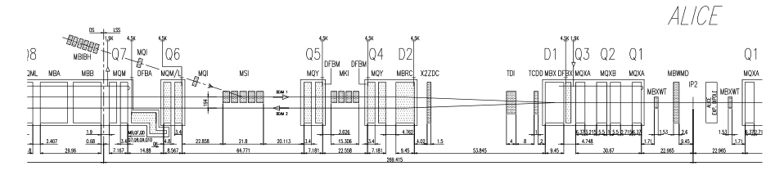
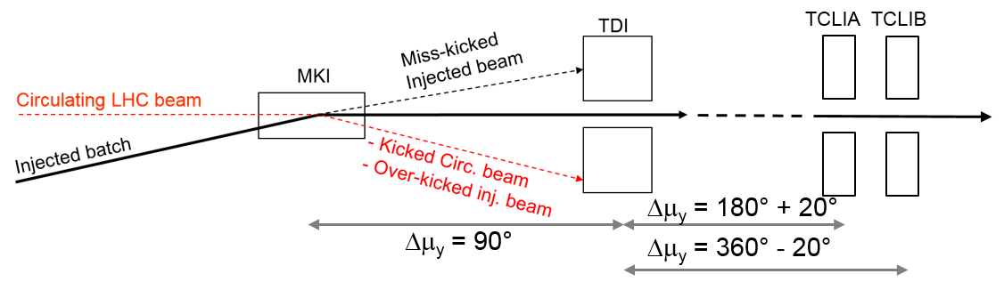
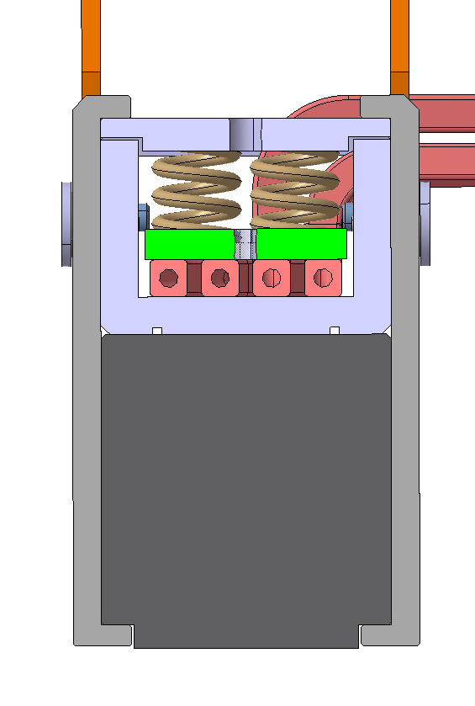
Injection System
Beam 1
Injection beam stopper TDI
Injection septum MSI
Injection kicker MKI
Auxiliary collimators
TCLIA
TCLIB
No kick
3/4 kick
Grazing

Slide 4
Beam Parameters
 | LHC design | LHC ultimate | HL-LHC standard | HL-LHC BCMS
Protons per bunch | 1.15⨯10¹¹ | 1.7⨯10¹¹ | 2.3⨯10¹¹ | 2.3⨯10¹¹
rms ε_{N} [μm] | 3.5 | 3.5 | 2.08 | 1.65
σ_{x} ⨯ σ_{y} [mm ⨯ mm] | 0.87 ⨯ 0.56 | 0.8 ⨯ 0.56 | 0.67 ⨯ 0.43 | 0.60 ⨯ 0.38
Bunch per injection | 288 | 288 | 288 | 240
Total intensity | 3.3⨯10¹³ | 4.9⨯10¹³ | 6.6⨯10¹³ | 5.6⨯10¹³
Total stored energy per injection | 2.4 MJ | 3.5 MJ | 4.8 MJ | 4.0 MJ
Total energy density (3σ area) [kJ/mm²] | 173 | 256 | 588 | 618

Slide 5
Beam Parameters
 | LHC design | LHC ultimate | HL-LHC standard | HL-LHC BCMS
Protons per bunch | 1.15⨯10¹¹ | 1.7⨯10¹¹ | 2.3⨯10¹¹ | 2.3⨯10¹¹
rms ε_{N} [μm] | 3.5 | 3.5 | 2.08 | 1.65
σ_{x} ⨯ σ_{y} [mm ⨯ mm] | 0.87 ⨯ 0.56 | 0.8 ⨯ 0.56 | 0.67 ⨯ 0.43 | 0.60 ⨯ 0.38
Bunch per injection | 288 | 288 | 288 | 240
Total intensity | 3.3⨯10¹³ | 4.9⨯10¹³ | 6.6⨯10¹³ | 5.6⨯10¹³
Total stored energy per injection | 2.4 MJ | 3.5 MJ | 4.8 MJ | 4.0 MJ
Total energy density (3σ area) [kJ/mm²] | 173 | 256 | 588 | 618
Most critical for large impact parameters

Slide 6
Beam Parameters
 | LHC design | LHC ultimate | HL-LHC standard | HL-LHC BCMS
Protons per bunch | 1.15⨯10¹¹ | 1.7⨯10¹¹ | 2.3⨯10¹¹ | 2.3⨯10¹¹
rms ε_{N} [μm] | 3.5 | 3.5 | 2.08 | 1.65
σ_{x} ⨯ σ_{y} [mm ⨯ mm] | 0.87 ⨯ 0.56 | 0.8 ⨯ 0.56 | 0.67 ⨯ 0.43 | 0.60 ⨯ 0.38
Bunch per injection | 288 | 288 | 288 | 240
Total intensity | 3.3⨯10¹³ | 4.9⨯10¹³ | 6.6⨯10¹³ | 5.6⨯10¹³
Total stored energy per injection | 2.4 MJ | 3.5 MJ | 4.8 MJ | 4.0 MJ
Total energy density (3σ area) [kJ/mm²] | 173 | 256 | 588 | 618
Most critical for small impact parameters and, in particular, grazing

Slide 7
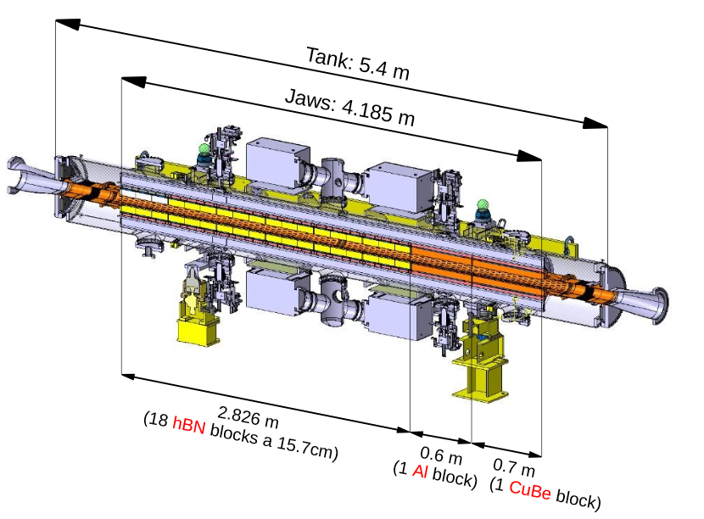
A bit of history: TDI in Run I
Original design (Run I)

Slide 8
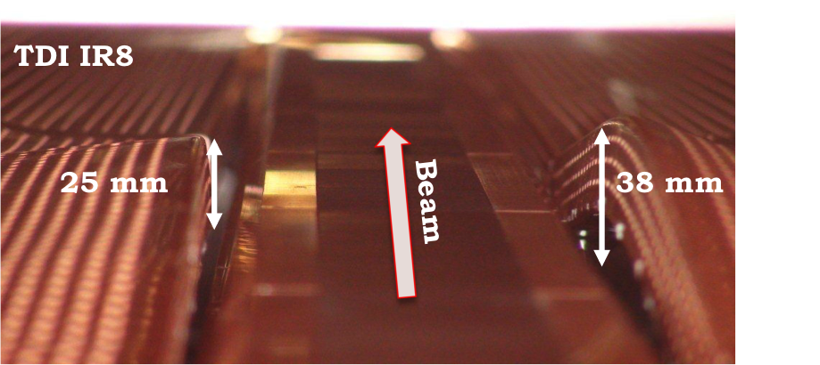
A bit of history: TDI in Run I
Cu beam screens deformed and sliding contacts blocked (TDI.4L2 and TDI.4R8)
Original design (Run I)

Slide 9
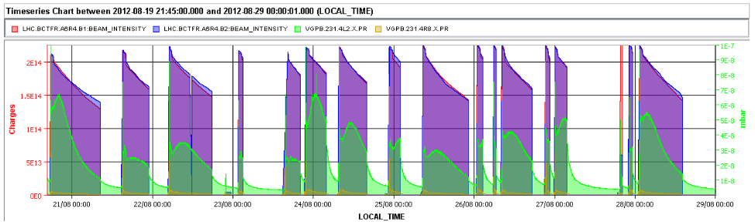
A bit of history: TDI in Run I
Cu beam screens deformed and sliding contacts blocked (TDI.4L2 and TDI.4R8)
Increased outgassing during fills (mainly at TDI.4L2 ➔ background in ALICE)
Original design (Run I)
Beam2 intensity
Beam1 intensity
Pressure at TDI.4L2

Slide 10
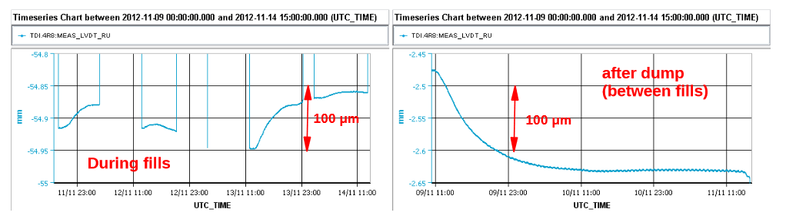
A bit of history: TDI in Run I
Cu beam screens deformed and sliding contacts blocked (TDI.4L2 and TDI.4R8)
Increased outgassing during fills (mainly at TDI.4L2 ➔ background in ALICE)
Original design (Run I)
Beam2 intensity
Beam1 intensity
Pressure at TDI.4L2
Thermal drift of jaw positions measure by LVDTs (TDI.4L2 and TDI.4R8), no straightforward correlation LVDT <-> actual jaw deformation. Interlock limits adjusted several times.
TDI.4R8_LVDT_RU [mm]

Slide 11
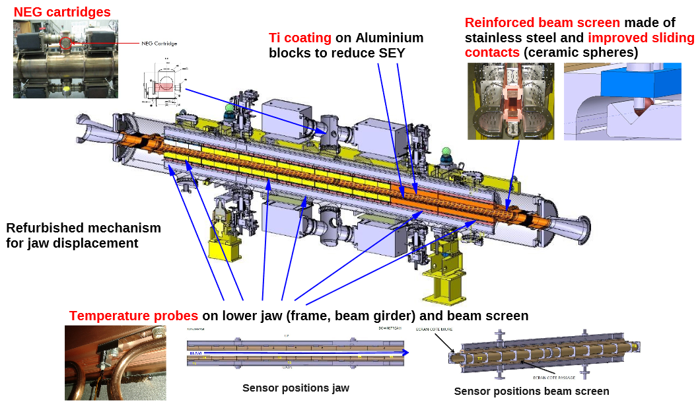
A bit of history: TDI in Run II (2015)
A. Lechner

Slide 12
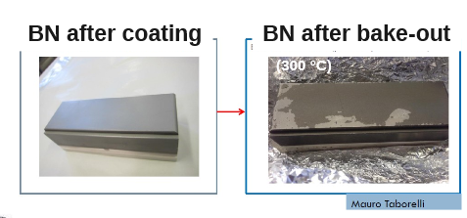
A bit of history: TDI in Run II (2015)
Quality issues with hBN blocks after treatment in vacuum at high temperature
A. Lechner

Slide 13
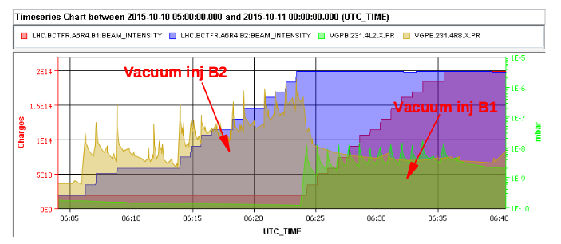
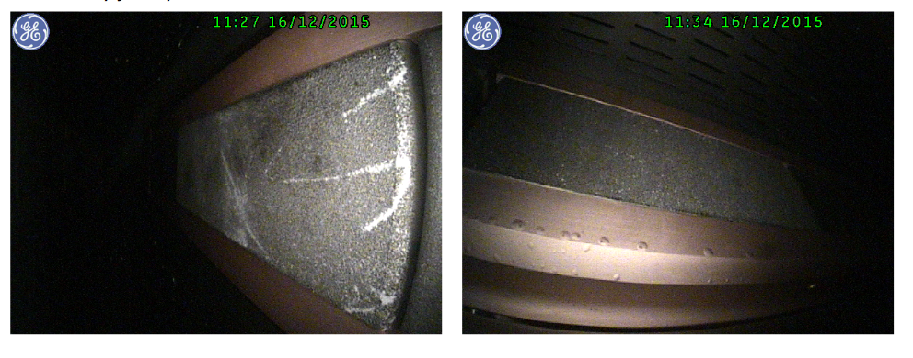
A bit of history: TDI in Run II (2015)
Quality issues with hBN blocks after treatment in vacuum at high temperature
A. Lechner
Vacuum spikes at TDI.4R8 during injections (build up pressure) and spurious spikes during physics ➔ ➔ limit on maximum number of injected bunches (96 BCMS). Ti coating found degraded over large surface areas and blisters found on Cu coating of Al frame.
Beam2 intensity
Beam1 intensity

Slide 14
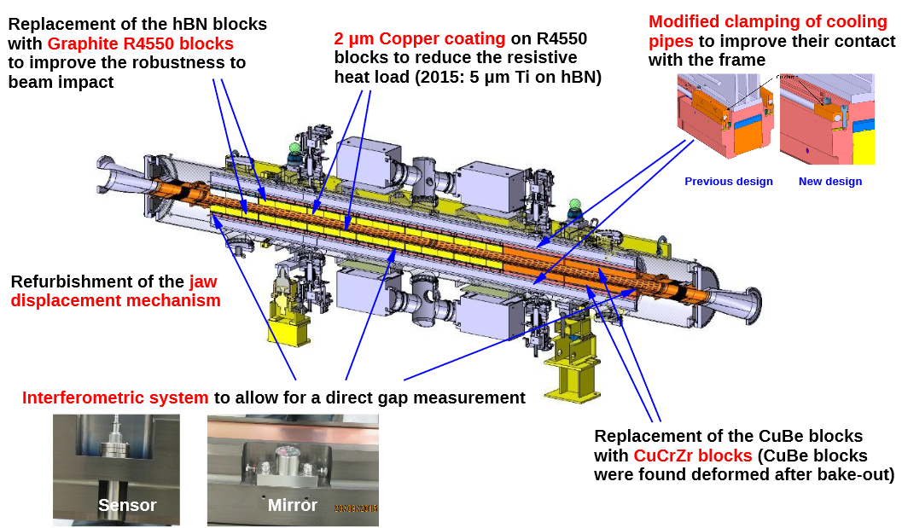
A bit of history: TDI in Run II (2016-2017)
A. Lechner

Slide 15
A bit of history: TDI in Run II (2016-2017)
Interferometric system never worked (problems with feedthrough ➔ broken connection)
A. Lechner

Slide 16
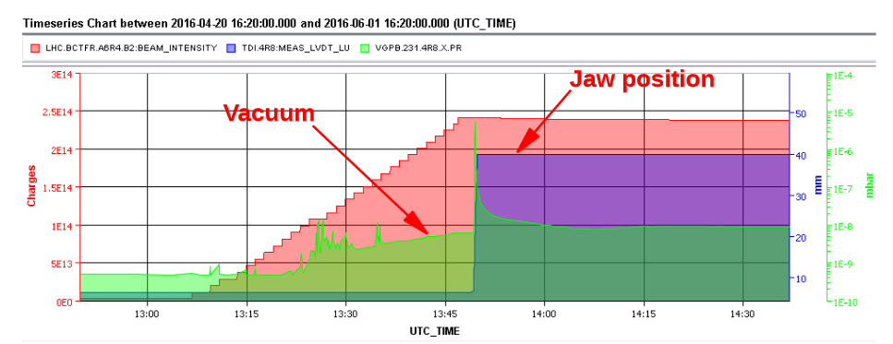
A bit of history: TDI in Run II (2016-2017)
Interferometric system never worked (problems with feedthrough ➔ broken connection)
No more intensity limitations!
A. Lechner
Strong pressure increase at TDI.4R8 while moving the jaws to parking, the problem was solved in 2016 by retracting the jaws to 40 mm instead of 55 mm (e-cloud as possible explanation)
Beam2 intensity

Slide 17
TDI Alignment
TDI is the main protection element in case of MKI failures!
It has to be correctly aligned wrt the beam in terms of position and angle to insure the adequate protection ➔ full active length!
Long jaws of the present HW imply:
  Difficult mechanical alignment of the jaws in the tank: in the past we measured >760 urad mechanical misalignment and ~ 3 mm mechanical offset ➔ 6 σ offset between UP and DOWN-stream corners if not taken into account
  Unacceptably large errors in case of non correct alignment wrt the beam ➔ loss of protection
  Larger deformation in case of beam induced heating
A beam based alignment procedure was developed which:
  Allows to measure and compensate for mechanical offsets and angle
  An accuracy of ±0.05 mm (step size) and ±100 μrad could be achieved with this method
Lengthy procedure and prone to errors

Slide 18
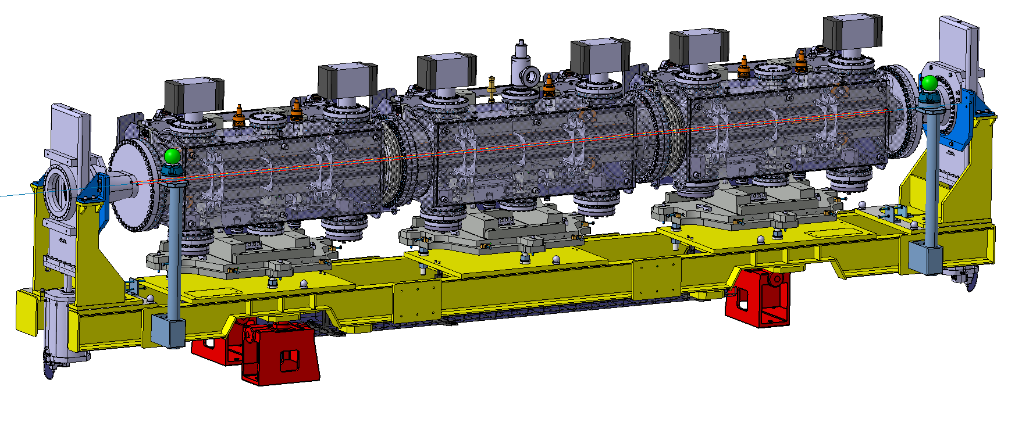
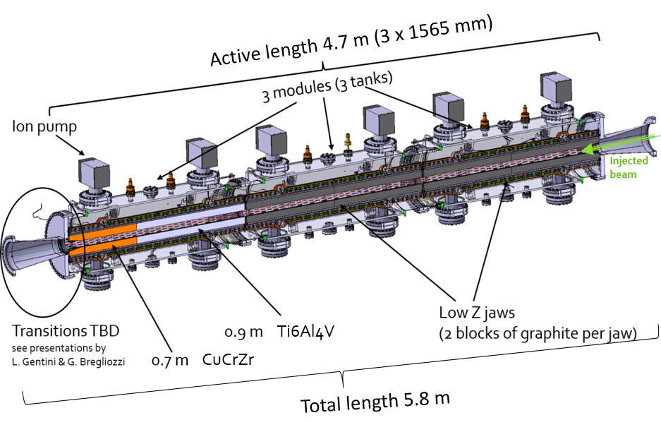
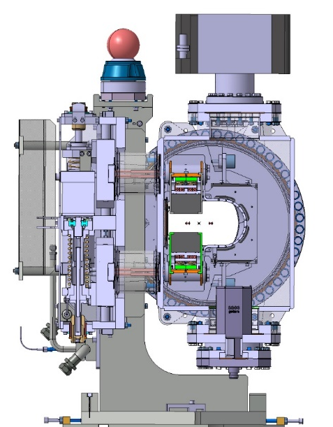
New Hardware: TDIS (segmented)
Three independent shorter modules (1.6 m each) ➔ improve alignment accuracy and reduce beam induced deformation.
The modules are installed on a common girder, aligned on surface and transported as a single device in the tunnel (spares under vacuum and ready for installation with reduced bake out in the tunnel).
Details in L. Gentini’ s talk

Slide 19
New Hardware: TDIS (segmented)
New design made taking into account past issues to:
  Minimise impedance (beam induced heating): materials, coating, longitudinal and lateral RF fingers, tapering, tank and transition geometry, cooling, etc.
  Improve vacuum performance: materials, coating, operational gaps.
  Improve mechanics and diagnostics
  Improve spare policy: full assembly vacuum conditioned (additional sector valves) for installation in tunnel without bake-out

Slide 20
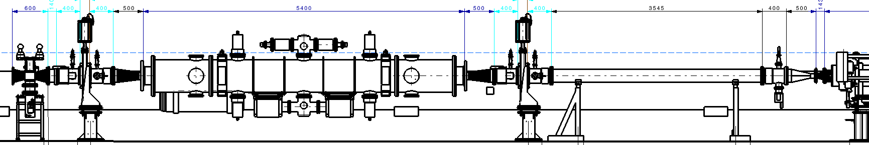
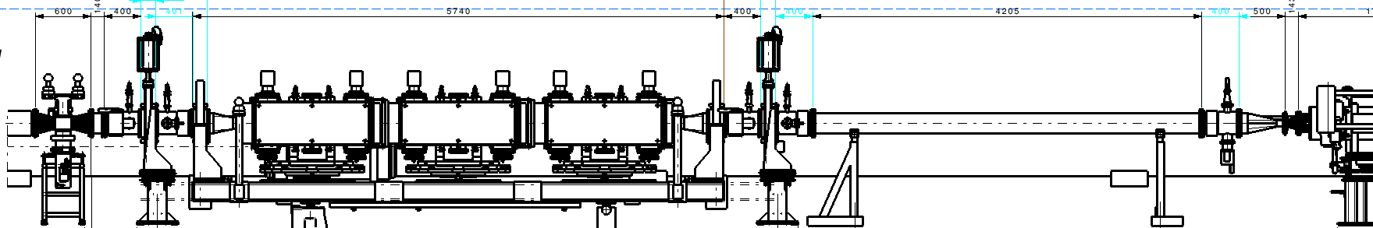
Impact on vacuum layout
The new TDIS is 660 mm shorter than the TDI; therefore, a few modifications on the layout are required. Basically, a vacuum sector assembly located next to the TDIS will be displaced towards the BTV and the vacuum chamber VCDWL will be replaced by a new longer vacuum chamber.
Present
TDI Layout
IP2
TDI
4L2
LS2
TDIS Layout
Sector valve moved
Extension of the pipe
IP2
TDIS
Support moved
Symmetric layout in IR8
This review focuses exclusively on TDIS related aspects!
https://edms.cern.ch/document/1847656/4

Slide 21
Summary
Several mechanical and operational issues encountered with the present TDI (beam screen structural damage, blocked sliding contacts, beam induced heating deformation, outgassing, etc.)
Long jaws ➔ large mechanical offsets and angles ➔ lengthy beam based alignment procedure and prone to errors ➔ risk of reduced protection
Several mitigations put in place but not sufficient for operation with HL-LHC beams
A new design was developed consisting of three shorter independent modules:
  Improved mechanics and robustness
  Lower impedance and improved cooling
  More precise (less sensitive to mechanical angles) and faster alignment
  Less prone to beam induced heating deformation.
The new HW can be integrated in the LHC layout at the same location as the present TDI (IR2 and IR8) with a limited modification of the existing vacuum layout.

Slide 22
Thank you for your attention!

