Slide 1
TDIS WP14 PRR
Manufacture and Inspection Plan
Procedures, specifications and drawings
David Carbajo Perez (EN-STI-TCD)
TDIS PRR meeting 2018/03/08

Slide 2
TDIS PRR meeting
Agenda
Manufacture and Inspection Plan
Procedures
Specifications
Drawings
Manufacture and Inspection Plan
Procedures, specifications and drawings

Slide 3
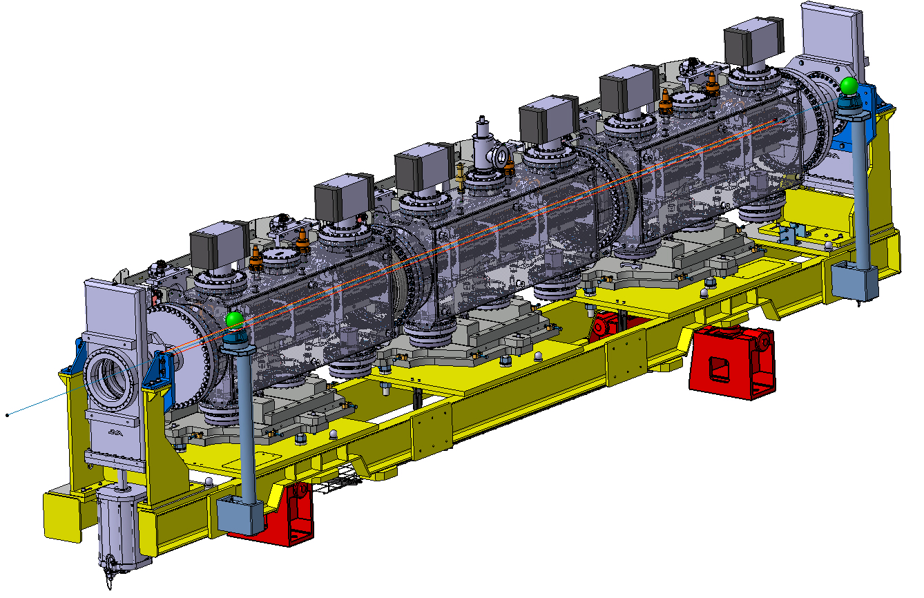
TDIS PRR meeting
Manufacture and Inspection Plan – Proto Sub-assemblies
Assembly | Process | Resources
Vacuum Tanks | Manufacturing | Cinel
 | Metrology Inspection
 | RGA test
 | Leak test
 | Shipping to CERN
Transitions | Components manufacturing | EN-MME
 | Metrology Inspection
Ion Pumps / NEG cartridges | Components manufacturing | SAES GETTERS
 | Metrology Inspection
 | Shipping to CERN
Sector valves | Components manufacturing | VAT
 | Valves assembly
 | Metrology Inspection
 | Shipping to CERN
Girder | Components manufacturing | BSB Industry
 | Girder assembly
 | Metrology Inspection
 | Shipping to CERN
Jacks | Components manufacturing | CERN warehouse
Ion Pumps
Vacuum Tanks
Transitions
Girder
Jacks
NEG Cartridges
Manufacture and Inspection Plan
Procedures, specifications and drawings

Slide 4
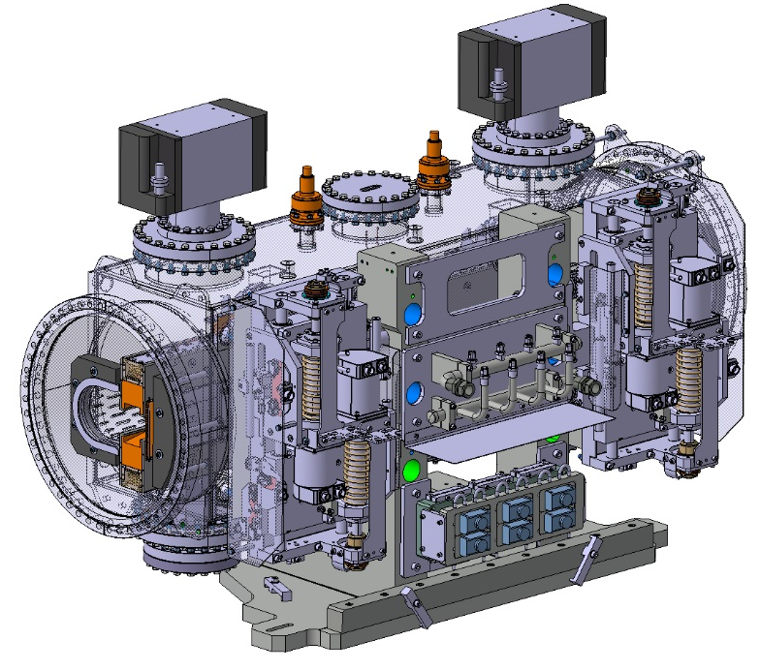
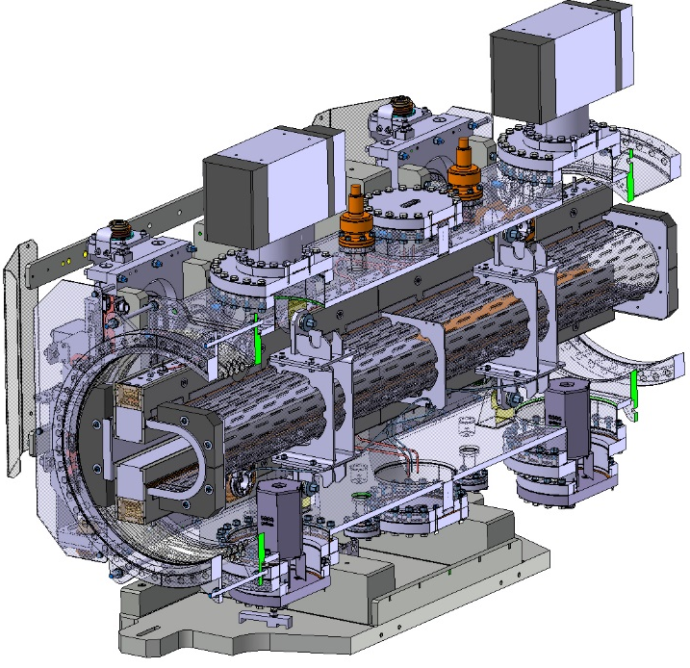
TDIS PRR meeting
Manufacture and Inspection Plan – Proto Sub-assemblies
Assembly | Process | Resources
Module supports | Components manufacturing | Ext. suppliers
 | Support assembly | EN-MME
 | Metrology Inspection
Mechanical tables | Components manufacturing | Ext. suppliers
 | Metrology Inspection | EN-MME
 | Endurance test (1 table)
Jaw | Components manufacturing | Ext. suppliers
 | Jaws assembly | EN-STI
 | Metrology Inspection | EN-MME
RF screen | Components manufacturing | EN-MME
 | RF screen assembly
 | Metrology Inspection
Complete Module | Assembly | EN-STI
Mechanical tables
RF screens
Jaws
Module supports
Manufacture and Inspection Plan
Procedures, specifications and drawings

Slide 5
TDIS PRR meeting
Manufacture and Inspection Plan – Proto Sub-assemblies
Elements to keep an eye on:
Component | Affected systems |  | Remarks
 | TDIS HRMT | TDIS Prototype
Roller screws | x | x | Delivery date tight although reachable. A close follow-up of the production is advisable
Ti clamps |  | x | Clamps for HRMT module -> machining by EN-STI. For TDIS prototype -> machining outsourced (Cinel, to be confirmed)
Cooling system | X | x | Outsourcing shifted to Cinel (with large experience in cooling systems for the collimators) since current supplier not confident in achieving requested pipes flatness by machining
TZM stiffener |  | x | Trials ongoing at supplier to improve requested back-stiffener flatness. One piece produced so far but flatness requirement not fulfilled (part to be used for HRMT, where stiffener flatness is not critical)
Manufacture and Inspection Plan
Procedures, specifications and drawings

Slide 6
TDIS PRR meeting
Inspection Plan – Proto/HiRadMat Sub-assemblies
System/Component |  | Dimensional inspection | Chemical composition | Material properties analysis |  | NDT |  |  |  |  | Remarks
 |  |  |  | Mechanical properties | Thermal properties | Ultrasound inspection | SEM analysis | X-ray inspection | Vacuum tests | Pressure test
RF-screen |  | x | x | x |  | x |  |  |  |  | Dimensional report to be prepared by CERN
Jaw | Cooling pipes | x | x | x |  | x |  | x |  | x | Radiographies of the radius areas after bending
 | Ti clamps | x | x | x | x | x |  |  |  |  | Material analysis/NDT done by raw material supplier (HWN)
 | Ti-6Al-4V blocks | x | x | x |  | x |  |  |  |  | Material analysis/NDT done by raw material supplier (HWN)
 | CuCrZr blocks | x | x | x |  | x |  |  |  |  | Material analysis/NDT done by raw material supplier (Albaksan)
 | Graphite blocks | x | x | x | x | x |  |  | x |  | Vacuum tests to be done at CERN after vacuum firing treatment
 | TZM stiffener | x | x | x |  | x |  |  | x |  | Mechanical properties measured @RT and @300°C
Mechanical table | Roller screws | x | x | x |  |  | x |  |  |  | SEM analysis before/after cycling test
Vacuum vessels |  | x | x | x |  | x |  |  | x |  | Leak test, RGA to be conducted by supplier (Cinel)
Girder |  | x | x | x |  |  |  |  |  |  | Inspection done by supplier (BSB industry)
Ion Pumps/NEG cartdriges/Valves |  |  |  |  |  |  |  |  |  |  | Validation tests on vacuum, dimensions and materials done in the past for other units. Not requested for this batch.
Sector valves
Manufacture and Inspection Plan
Procedures, specifications and drawings

Slide 7
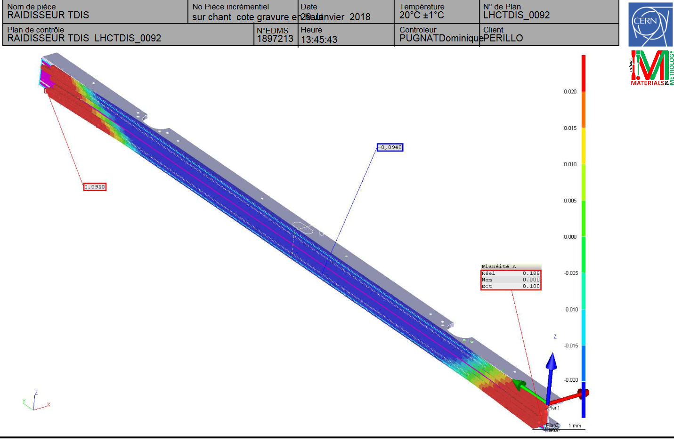
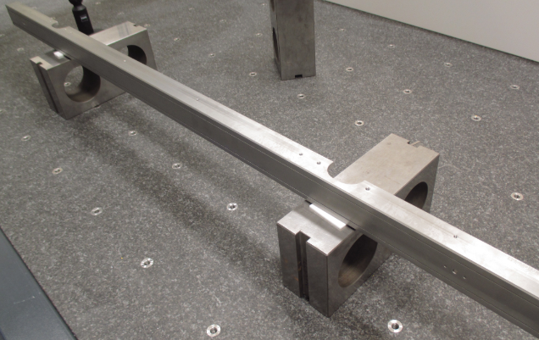
TDIS PRR meeting
Inspection Plan – Proto/HiRadMat Sub-assemblies
System/Component |  | Dimensional inspection | Chemical composition | Material properties analysis |  | NDT |  |  |  |  | Remarks
 |  |  |  | Mechanical properties | Thermal properties | Ultrasound inspection | SEM analysis | X-ray inspection | Vacuum tests | Pressure test
Jaw | TZM stiffener | x | x | x |  | x |  |  | x |  | Mechanical properties measured @RT and @300°C
EDMS 1897213
Metrology analysis of HiRadMat TZM stiffener
Manufacture and Inspection Plan
Procedures, specifications and drawings

Slide 8
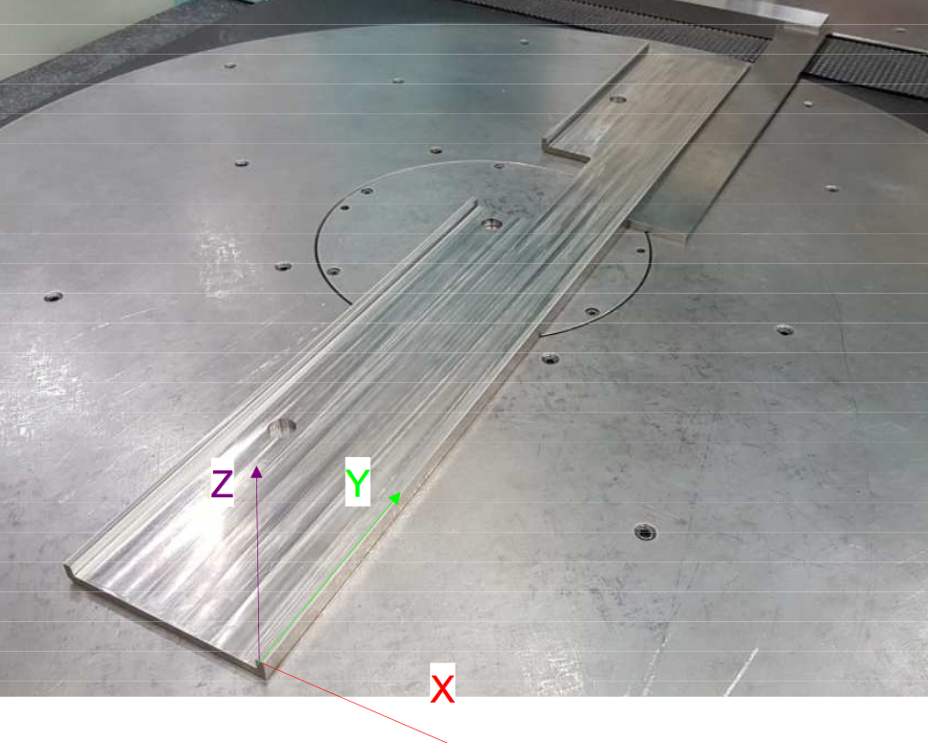
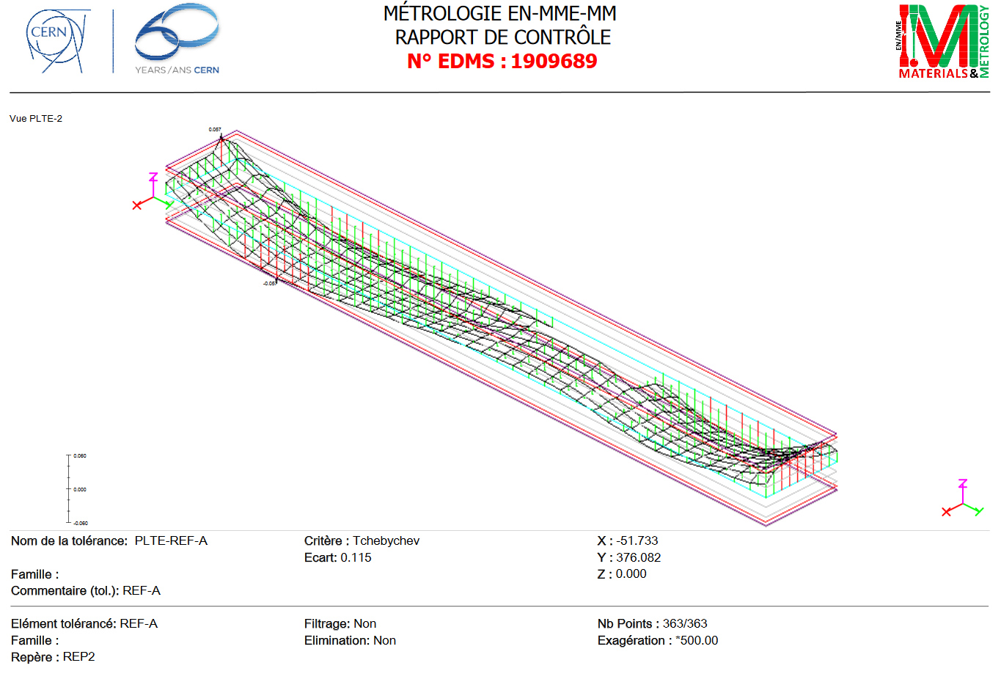
TDIS PRR meeting
Inspection Plan – Proto/HiRadMat Sub-assemblies
System/Component |  | Dimensional inspection | Chemical composition | Material properties analysis |  | NDT |  |  |  |  | Remarks
 |  |  |  | Mechanical properties | Thermal properties | Ultrasound inspection | SEM analysis | X-ray inspection | Vacuum tests | Pressure test
Jaw | Ti clamps | x | x | x | x | x |  |  |  |  | Material analysis/NDT done by raw material supplier (HWN)
EDMS 190689
Metrology analysis of the first produced titanium clamp
Manufacture and Inspection Plan
Procedures, specifications and drawings

Slide 9
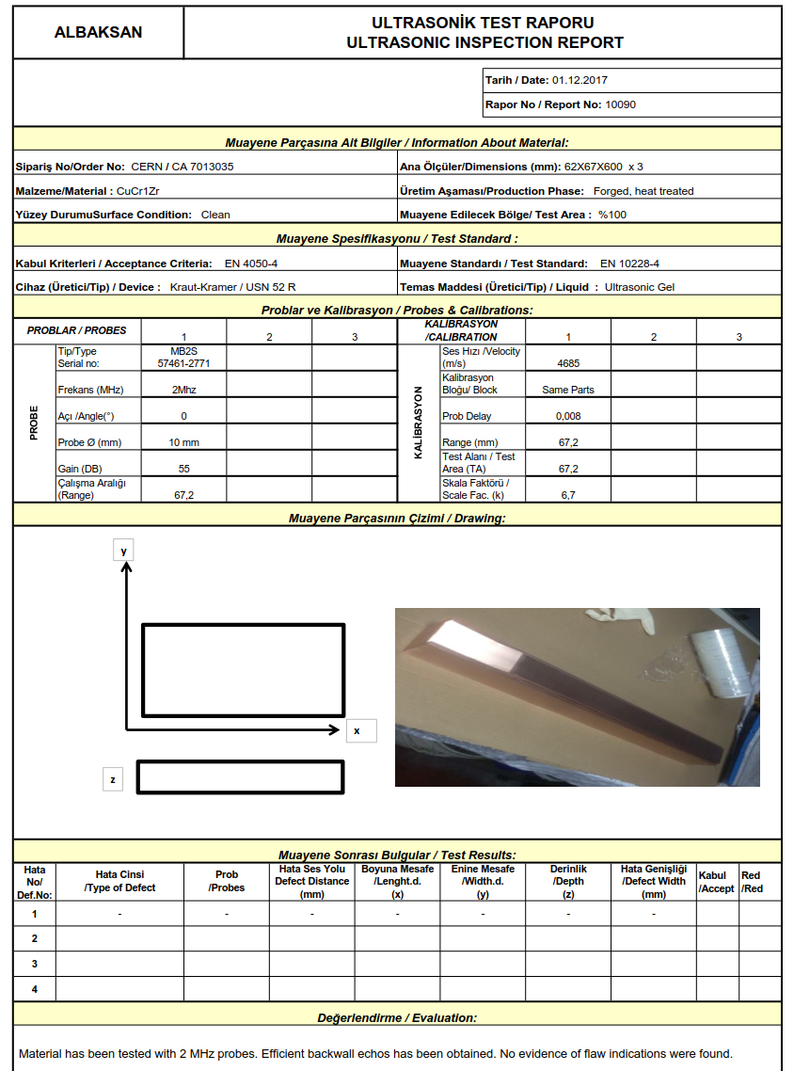
TDIS PRR meeting
Inspection Plan – Proto/HiRadMat Sub-assemblies
System/Component |  | Dimensional inspection | Chemical composition | Material properties analysis |  | NDT |  |  |  |  | Remarks
 |  |  |  | Mechanical properties | Thermal properties | Ultrasound inspection | SEM analysis | X-ray inspection | Vacuum tests | Pressure test
Jaw | CuCrZr blocks | x | x | x |  | x |  |  |  |  | Material analysis/NDT done by raw material supplier (Albaksan)
EDMS 1894119
Manufacture and Inspection Plan
Procedures, specifications and drawings

Slide 10
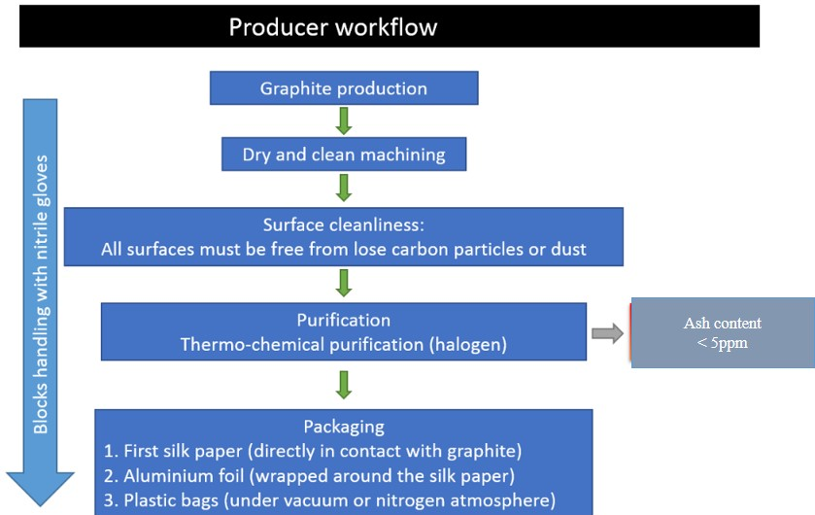
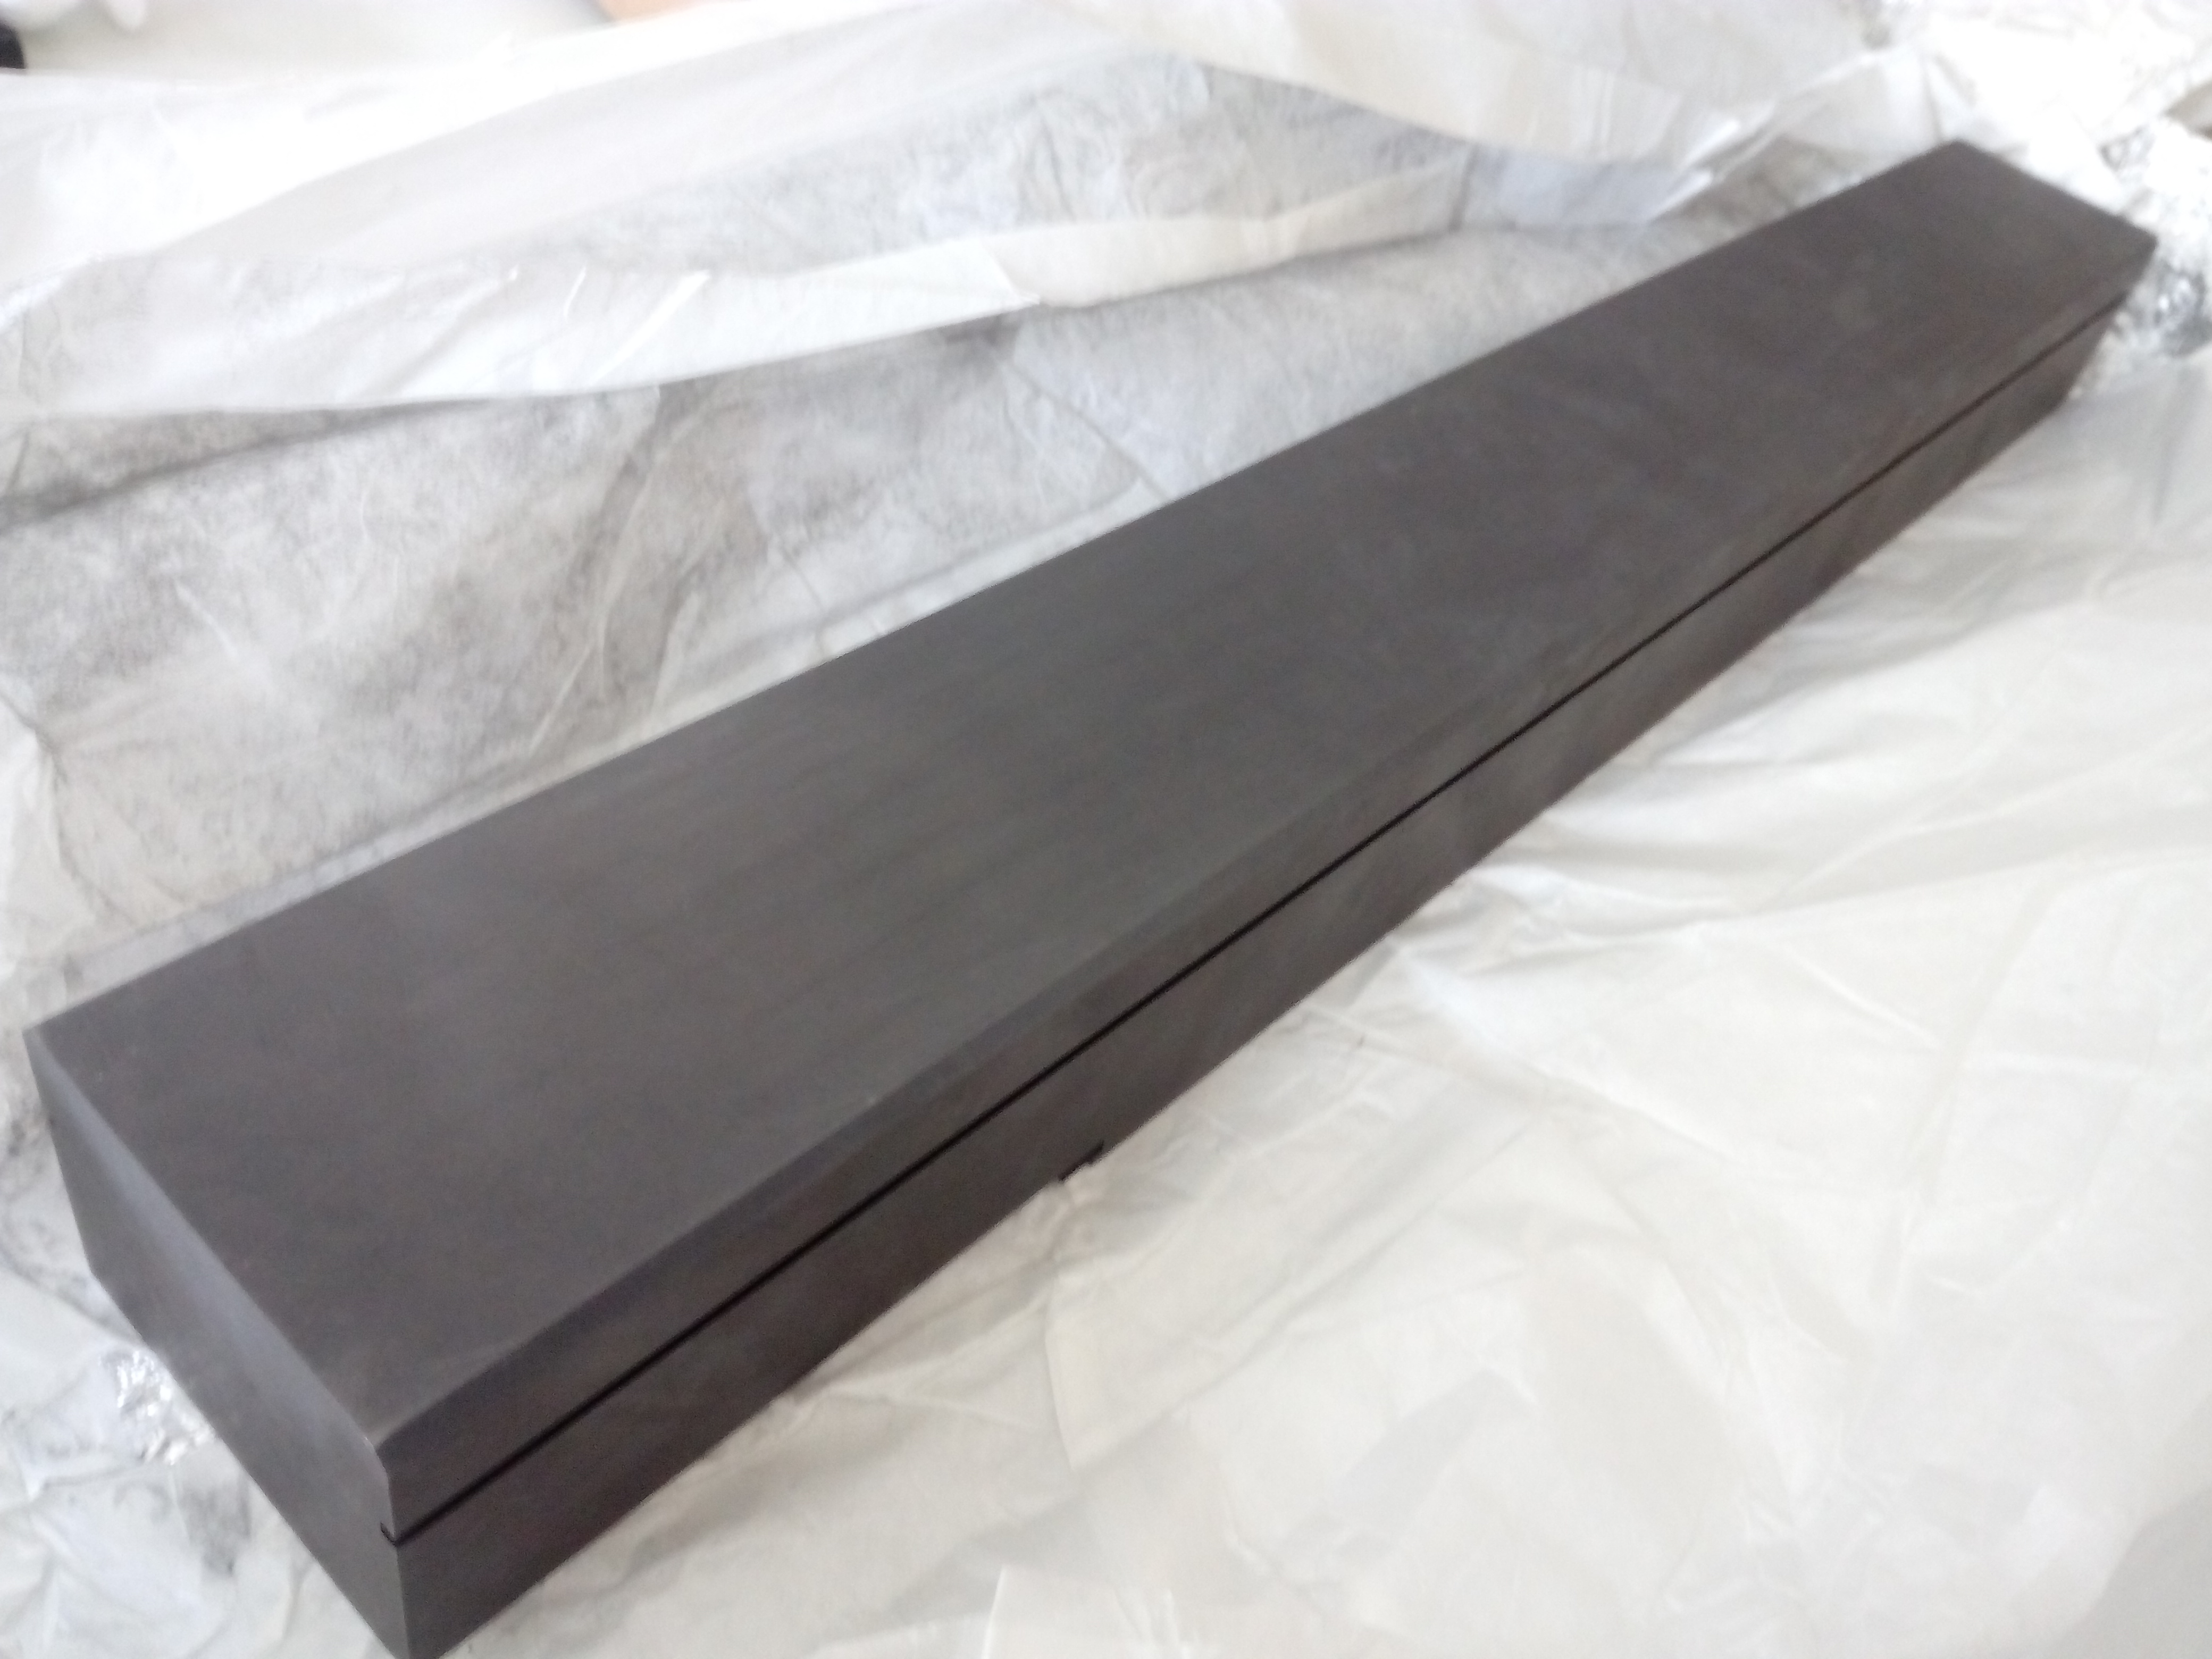
TDIS PRR meeting
Inspection Plan – Proto/HiRadMat Sub-assemblies
System/Component |  | Dimensional inspection | Chemical composition | Material properties analysis |  | NDT |  |  |  |  | Remarks
 |  |  |  | Mechanical properties | Thermal properties | Ultrasound inspection | SEM analysis | X-ray inspection | Vacuum tests | Pressure test
RF-screen |  | x | x | x |  | x |  |  |  |  | Dimensional report to be prepared by CERN
Jaw | Graphite blocks | x | x | x | x | x |  |  | x |  | Vacuum tests to be done at CERN after vacuum firing treatment
Manufacture and Inspection Plan
Procedures, specifications and drawings

Slide 11
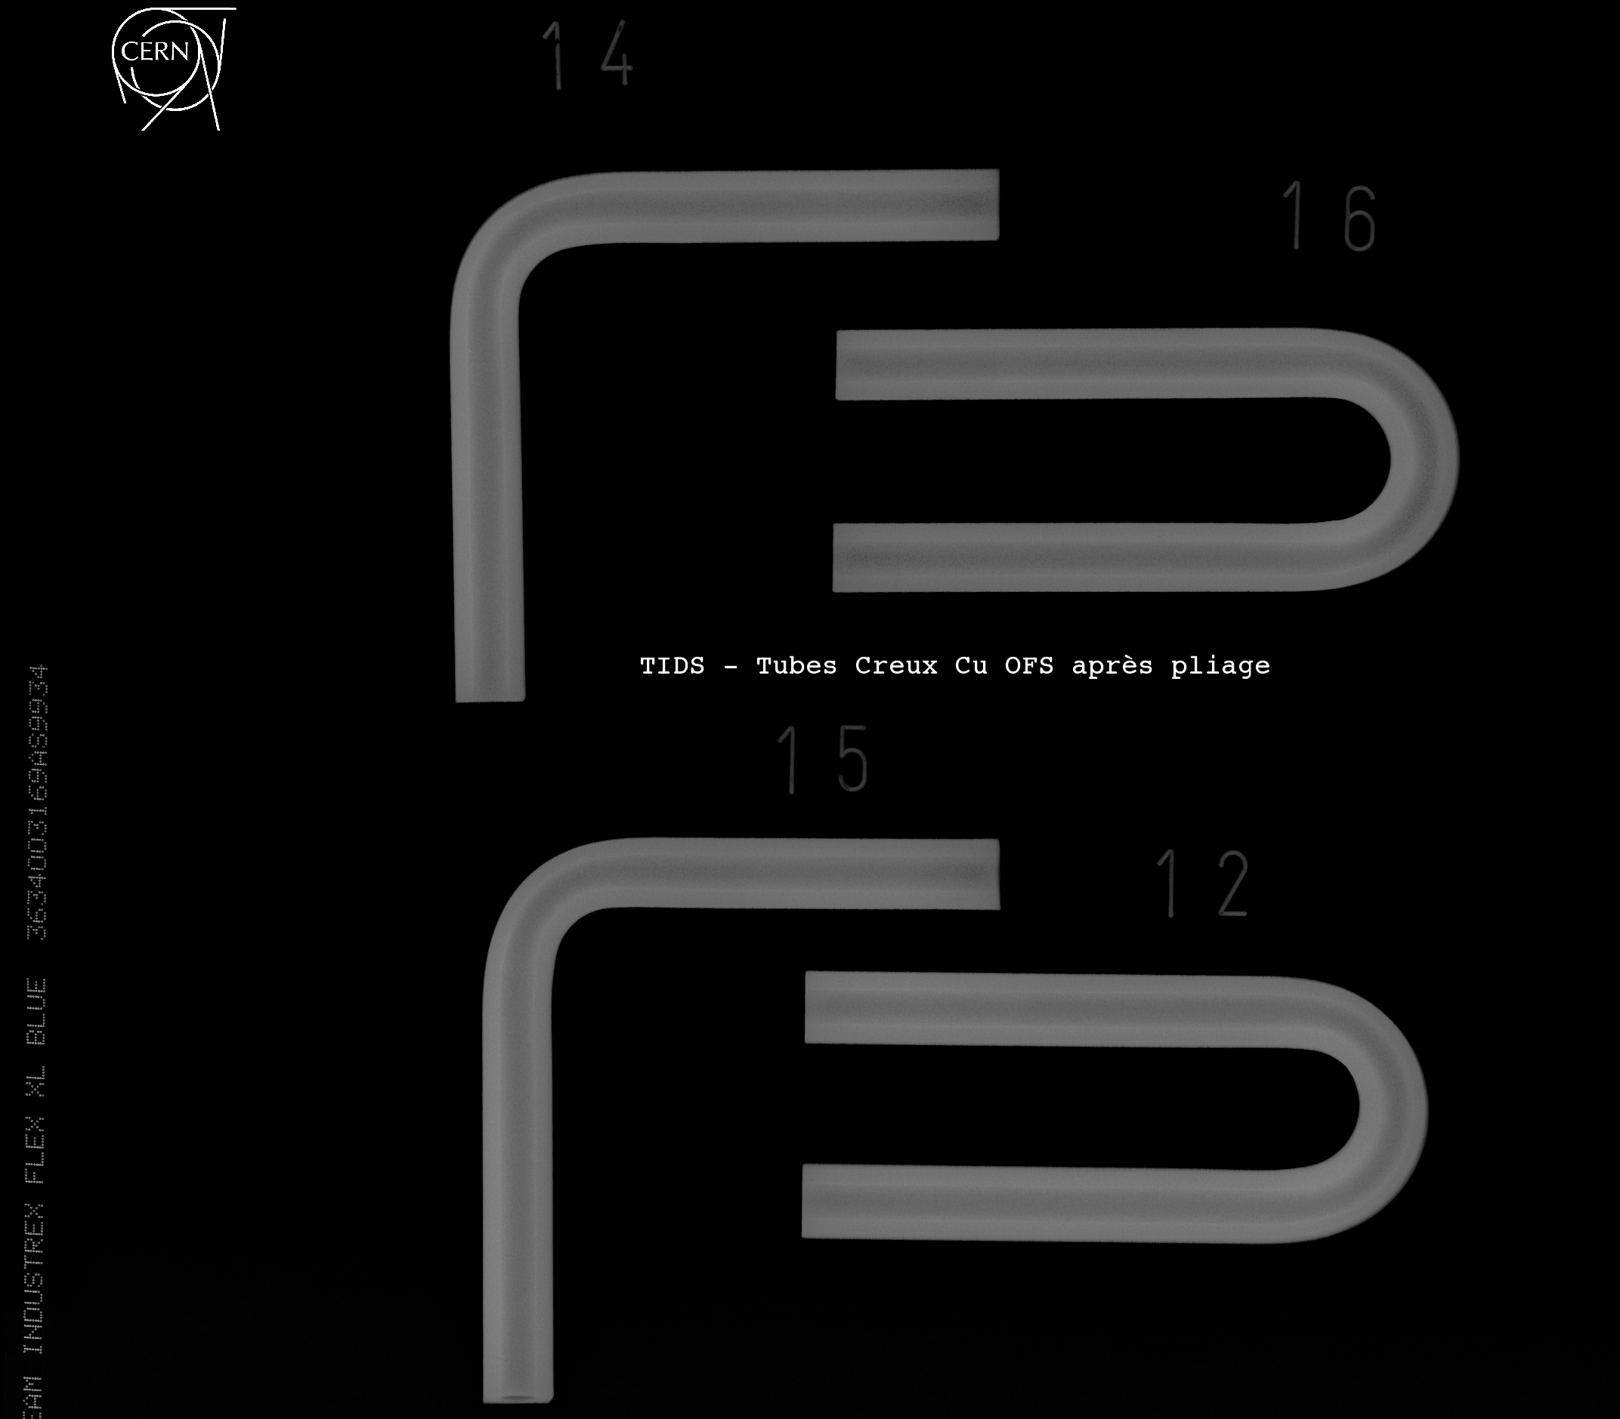
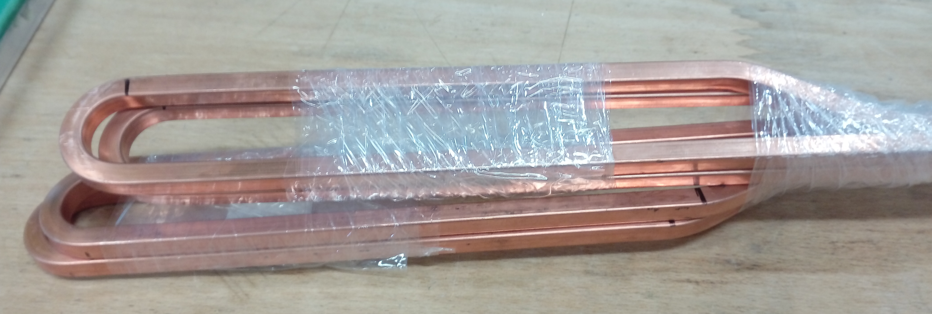
TDIS PRR meeting
Inspection Plan – Proto Sub-assemblies
System/Component |  | Dimensional inspection | Chemical composition | Material properties analysis |  | NDT |  |  |  |  | Remarks
 |  |  |  | Mechanical properties | Thermal properties | Ultrasound inspection | SEM analysis | X-ray inspection | Vacuum tests | Pressure test
Jaw | Cooling pipes | x | x | x |  | x |  | x |  | x | Radiographies of the radius areas after bending
Samples produced to verify the feasibility of the geometry
EDMS 1808269
Manufacture and Inspection Plan
Procedures, specifications and drawings

Slide 12
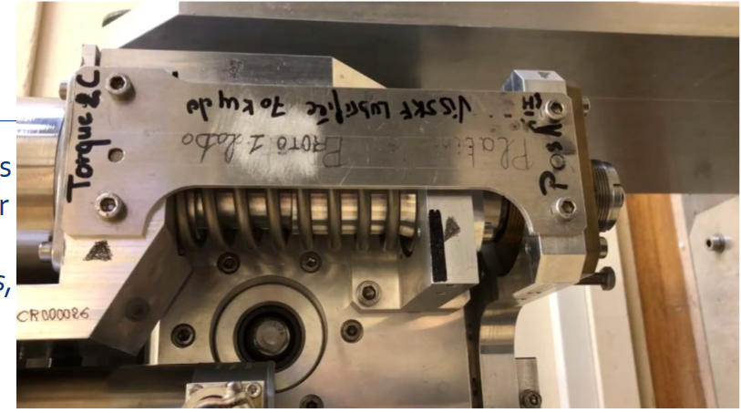
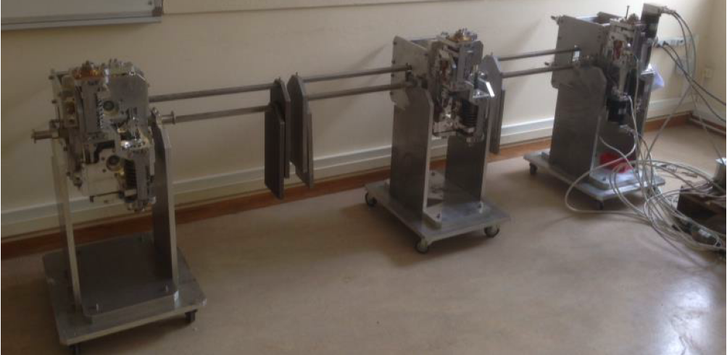
TDIS PRR meeting
Inspection Plan – Proto/HiRadMat Sub-assemblies
System/Component |  | Dimensional inspection | Chemical composition | Material properties analysis |  | NDT |  |  |  |  | Remarks
 |  |  |  | Mechanical properties | Thermal properties | Ultrasound inspection | SEM analysis | X-ray inspection | Vacuum tests | Pressure test
Mechanical table | Roller screws | x | x | x |  |  | x |  |  |  | SEM analysis before/after cycling test
Endurance test of one mechanical table foreseen to validate design. Roller screws supplier already validated for collimators
Manufacture and Inspection Plan
Procedures, specifications and drawings

Slide 13
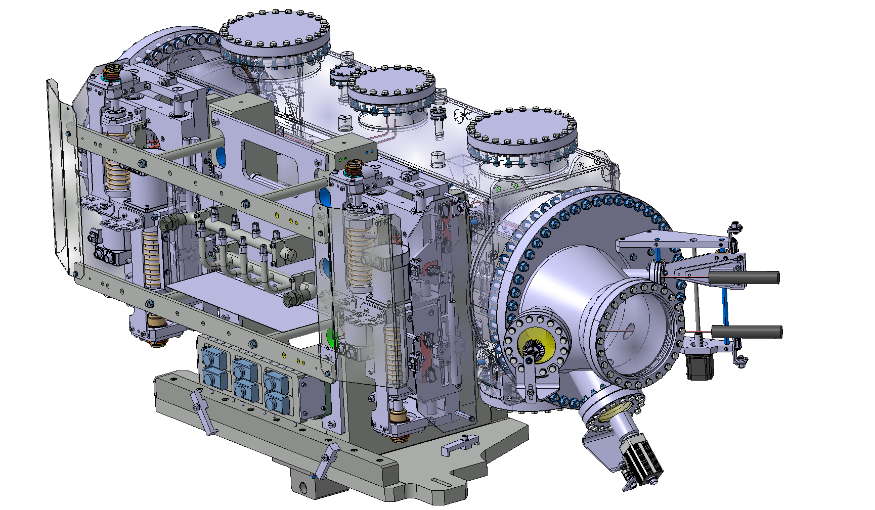
TDIS PRR meeting
Manufacture and Inspection Plan – HRMT schedule
HRMT45
Beam Time
6th – 10th August
Manufacture and Inspection Plan
Procedures, specifications and drawings

Slide 14
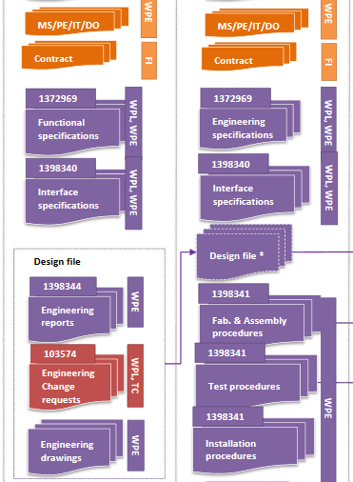
TDIS PRR meeting
Procedures for the development phase
HL-LHC baseline documentation vs
systems life-cycle (EDMS 1361462)
Documents available in EDMS for the TDIS WP14 (status: in work)
Documents to be created (2Q 2018)
Manufacture and Inspection Plan
Procedures, specifications and drawings

Slide 15
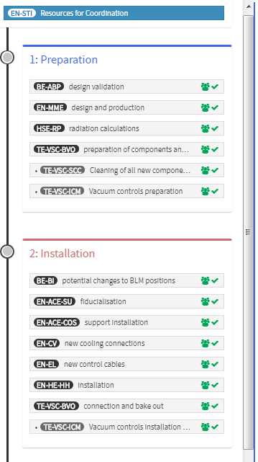
TDIS PRR meeting
Procedures
Foreseen activities for TDIS considered by LS2 coordination team in their app PLAN (code 10015).
All tasks confirmed
Manufacture and Inspection Plan
Procedures, specifications and drawings

Slide 16
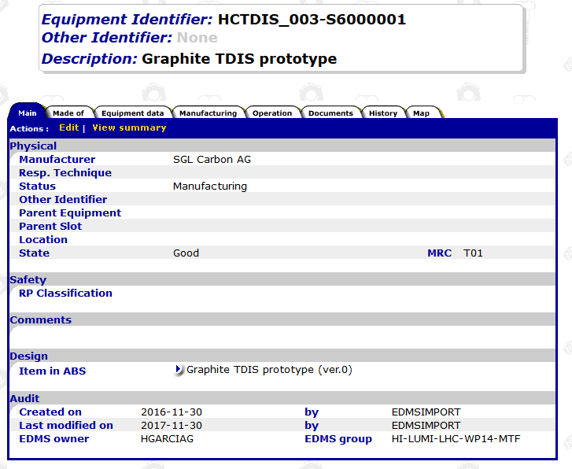
TDIS PRR meeting
TDIS Beam Absorber for Injection Segmented | Absorber Module | Motorization | Electrical motor
 |  |  | Roller screw
 |  |  | Linear bearing
 |  |  | Sliding table
 |  |  | Mechanical table frame
 |  |  | Shaft
 |  | Module support | Bracket support
 |  |  | Cooling circuit assembly support
 |  |  | Base plate
 |  |  | Electrical junction box
 |  |  | Protection cover
 |  |  | Keys
 |  | Jaw | Absorber block
 |  |  | Clamp
 |  |  | Back-stiffener
 |  |  | Cooling pipe
 |  |  | Compression spring
 |  |  | Pipes support plate
 |  |  | Springs support plate
 |  |  | Support plate
 |  | Vacuum system | Ion pump
 |  |  | NEG pump
 |  |  | VGRB gage
 |  |  | VGPB gage
 |  | Impedance Hardware | RF screen
 |  |  | RF ferrite tile
 |  |  | Transversal RF finger
 |  |  | Longitudinal RF finger
 |  | Instrumentation | LVDT
 |  |  | PT100 probe
 |  |  | Flow meter
 |  |  | Temperature sensor (cooling)
 |  | Vacuum chamber | Vessel
 |  |  | Flange
 |  |  | Bellow
 | Transition |  | Transition
 | Support assembly |  | Girder
 |  |  | Jacks
 | Sector valve assembly |  | Sector valve
Procedures
Full TDIS structure to be created in MTF application. Items available for some components already.
Manufacture and Inspection Plan
Procedures, specifications and drawings

Slide 17
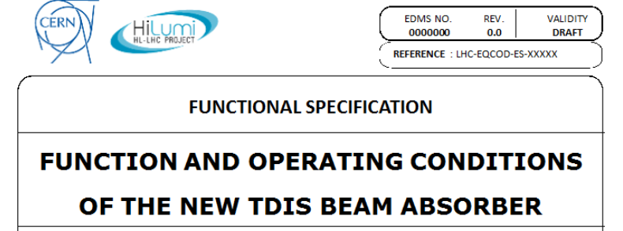
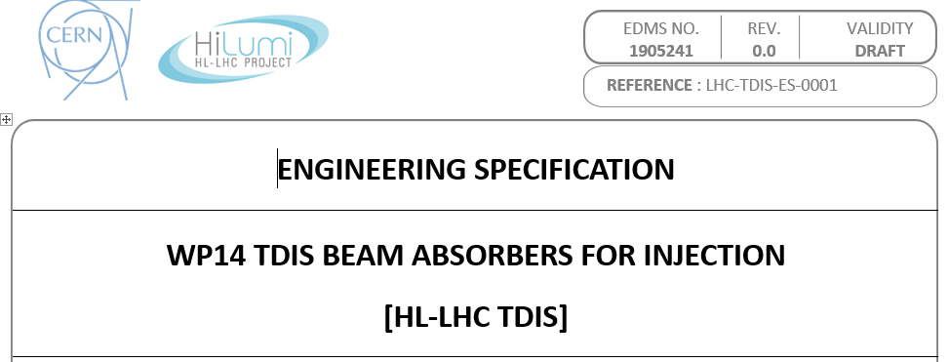
TDIS PRR meeting
Specifications
EDMS 1865250
EDMS 1905241
Excel list with all requirements included in functional specification and the corresponding studies/tests intended to verify that they are fulfilled
Manufacture and Inspection Plan
Procedures, specifications and drawings

Slide 18
# | Page | Chapter | Requirement description | Value | Relevant calculation/study/ mechanism available | Documentation | Result analysis (OK/NOK) | Remarks | Relevant verification testing | Report | Result verification (OK/NOK)
Jaw movement range in operation and setting precision
1 | 5 | 3.1 | Minimum gap (anti-collision) | 1.0 mm | Anti-collision switch / Mechanical stoppers | Drawing mechanical table LHCTDIS_0011 | OK |  | TDIS prototype validation test program | To be created
2 |  |  | Maximum gap | 110.0 mm | Mechanical stoppers integrated in mechanical tables |  | OK
3 |  |  | Maximum individual jaw position | ±55.0 mm |  |  | OK
4 |  |  | Minimum individual jaw position across axis | ±5.0 mm |  |  | OK
5 |  |  | Surface flatness | ±0.10 mm | Tolerance calculation | Tolerance Analysis Jaw block flatness (EDMS 1906421) | OK
6 |  |  | Single jaw position precision | ±0.05 mm | Precision given by roller screw thread pitch and motor step | Motor and roller screw technical specifications | OK
7 |  |  | Single jaw setting reproducibility | ±0.01 mm | Given by design | Measurements from collimators mechanical tables | OK
8 |  |  | Minimum step size | 0.01 mm | Given by motor step | Motor technical specifications | OK
9 |  |  | Maximum angle at each module | ±2 mrad | Linking bar between mechanical tables constraints max. angle | Design verified Report to be prepared | OK
10 |  |  | Maximum retraction between modules | 20 mm | Limited by software | Software program | OK
TDIS Performance vs MKI failure cases
11 | 6 | 3.2 | Charging failure - no damage | 288x2.0e11 BCMS (inj.) protons on TDIS | Fluka simulation + FEA thermomechanical simulations IP8 Large impact parameter study | FEA calculations reports (EDMS 1851379) | OK | Most critical component: TZM back-stiffener and cooling pipes | HiRadMat HRMT45 to reproduce the worst-scenario conditions | To be created
Manufacture and Inspection Plan
Procedures, specifications and drawings

Slide 19
TDIS PRR meeting
Drawings
Manufacture and Inspection Plan
Procedures, specifications and drawings

Slide 20
Thanks for your attention
Content Input from from Antonio Perillo Marcone, Chiara Braco, Luca Gentini, Hector Garcia Gavela

